Slide 1
CSE 121 – Lesson 13
Miya Natsuhara
Autumn 2023
Music: 121 23au Lecture Tunes 🌦️
TAs:
Trey Sebastian
Annie
Jasmine
Christian
Lucas
Logan
Jacob
Christina
Colton
Janvi
Arkita
Vidhi
Ritesh
Hibbah
Julia
Sahej
Anju
Jonus
Lydia
Luke
Andras
Archit
Ayesha
Vinay
Maria
Shreya
Andy
Nicolas
Shayna
Hannah
Aishah
Kriti
Minh
Vivian
Nicole
Simon
Jessie
Lydia
Yijia
sli.do #cse121

Slide 2
Announcements, Reminders
C3 will be released later today
Due Tuesday, Nov 21
Quiz 2 tomorrow in Quiz Sections!
Conditionals, while Loops, User Input (Scanner)
Next week:
Tuesday: section cancelled
Wednesday: lecture optional (Lead TA Nic will be teaching!)
Thursday, Friday: University holidays (campus is closed)
IPL: reduced staffing Mon, Tues, Wed (maybe partial day); closed Thurs-Sun
Final Exam: Wednesday, December 13 12:30pm-2:20pm

Slide 3
Formative Feedback: Closing the Loop
The Good…
Resubmission Opportunities
Pre-Class Work
In-Class Demos & Slido Questions
Quiz Sections
IPL

Slide 4
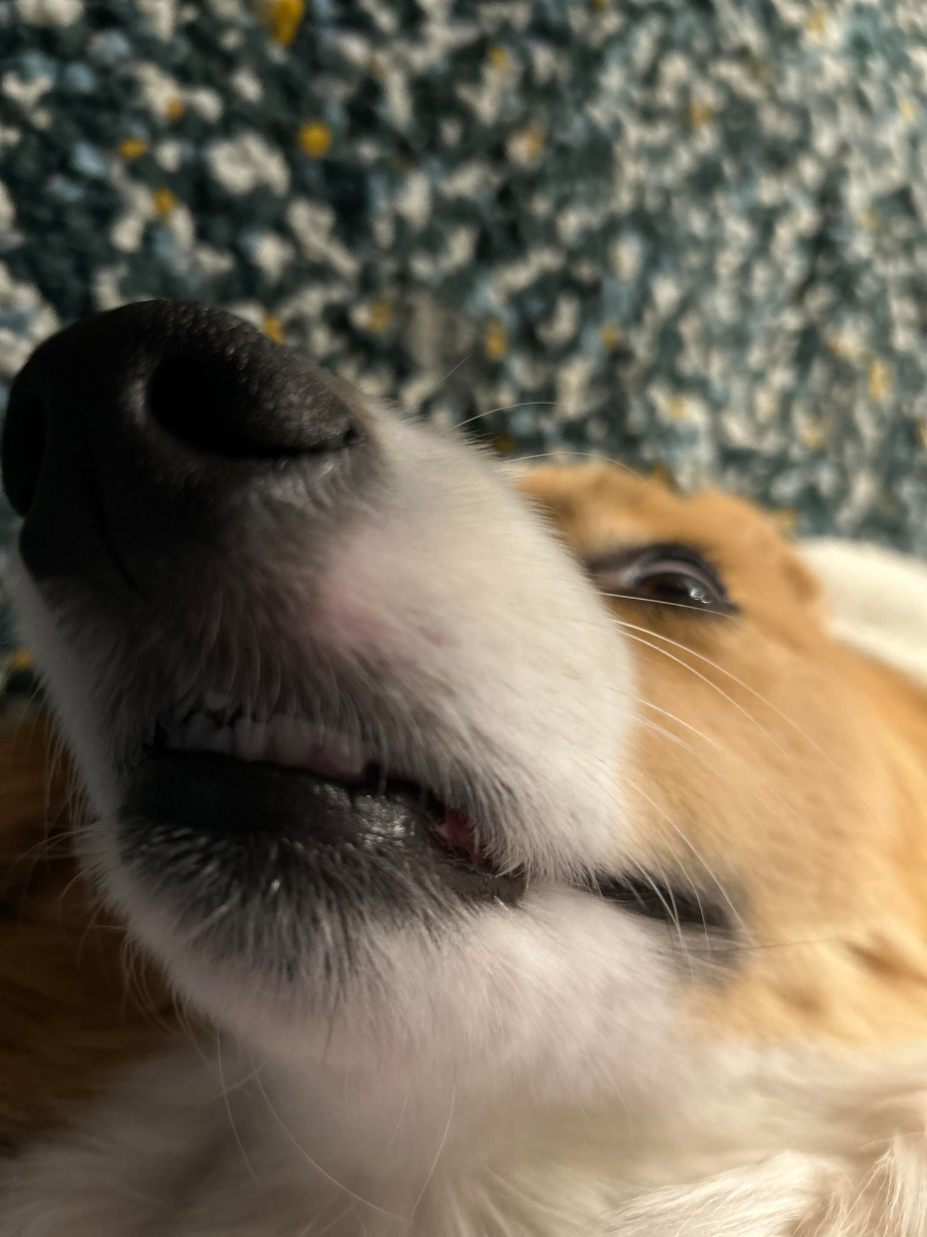
Formative Feedback: Closing the Loop
Suggestions…
More practice problems for Quizzes
Vocabulary List
Post requests in the pinned Ed post!
Approximations of how long an assignment should take…
Tell us why in the (other) pinned Ed post!

Slide 5
Formative Feedback: Closing the Loop
Reminders…
Practice Problems & Resources tab
Reading technical specifications is a skill!
For those curious…this was one of my technical specification at Microsoft…

Slide 6
(PCM) Arrays
Elements (must all be the same type)
Indices (starting at 0)
Must decide size when created
arr.length to get arr's length
Arrays.toString(arr) to get a nice String version

Slide 7
(PCM) Array Traversal Pattern
for (int i = 0; i < arr.length; i++) {
// do something with arr[i]
}

Slide 8
How can we get the last element of an array arr?
arr[arr.length()]
arr[length()]
arr[arr.length]
arr[arr.length() -1]
arr[arr.length - 1]

Slide 9
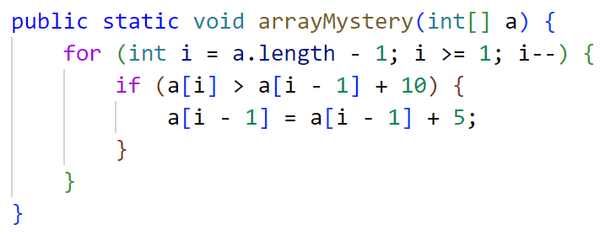
What would the array a store at the end of this arrayMystery method if {-20, 20, 26, 32, 50, 3} was passed in?
{-20, 20, 26, 32, 50, 3}
{-15, 25, 31, 37, 55, 8}
{-15, 25, 31, 37, 50, 3}
{-15, 20, 26, 37, 50, 3}

