Slide 1
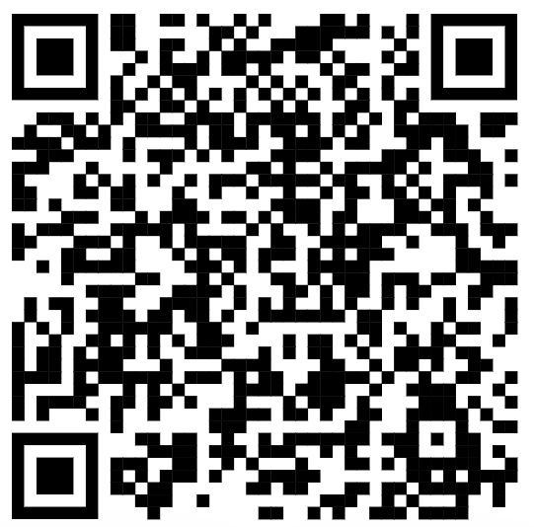
CSE 121 – Lesson 12
Miya Natsuhara
Autumn 2023
Music: 121 23au Lecture Tunes 🌦️
TAs:
Trey Sebastian
Annie
Jasmine
Christian
Lucas
Logan
Jacob
Christina
Colton
Janvi
Arkita
Vidhi
Ritesh
Hibbah
Julia
Sahej
Anju
Jonus
Lydia
Luke
Andras
Archit
Ayesha
Vinay
Maria
Shreya
Andy
Nicolas
Shayna
Hannah
Aishah
Kriti
Minh
Vivian
Nicole
Simon
Jessie
Lydia
Yijia
sli.do #cse121

Slide 2
Announcements, Reminders
University holiday on Friday (11/10) – Campus is closed!
No class session
No IPL
No Miya office hours
Programming Assignment 2 deadline extended
Now due Tuesday, Nov 14
Quiz 0 grades posted
See announcement for details
Quiz 1 will be graded once make ups have been completed (for students who were sick on Quiz 1 day)

Slide 3
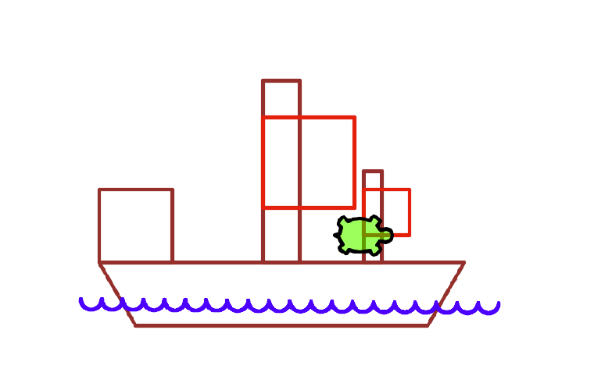
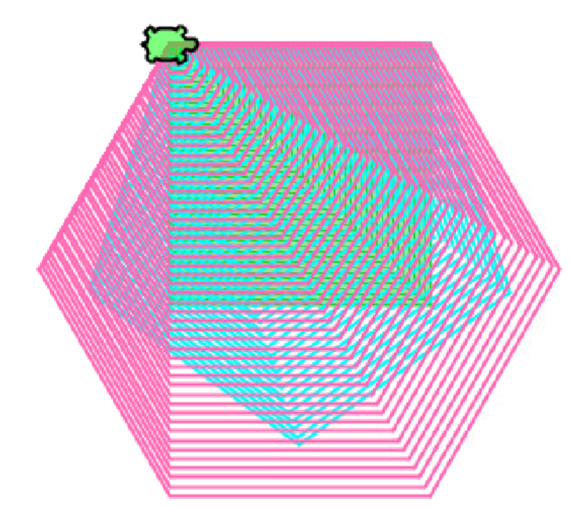
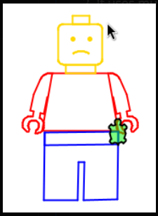
C2 Art!

Slide 4
Edge Cases! (And Testing)
When writing a method, especially one that takes input of some kind (e.g., parameters, user input) it's good to think carefully about the assumptions you can make (or cannot make) about this input.
Edge case: A scenario that is uncommon but possible, especially at the "edge" of an input's valid range.
❔Are we sure that all possible months are handled?
❔Are we sure that all possible days are handled?
❔ Are we sure that all possible combinations of months and days are handled?

Slide 5
Prioritizing Patients
Consider the specification where we determine a "priority score" for a patient.
The specification asks you to use a formula that takes into consideration:
The patient's age
The patient's zip code
Whether the hospital is in-network for the patient's insurance
The patient's pain level
The patient's temperature

Slide 6
Prioritizing Patients
Take a second to reflect – what does it mean to assign people "priority" in terms of healthcare?
When assigning somebody a priority score, what factors go into it?
Do the factors that we think are relevant reflect other social factors inadvertently?
For P2, we chose age, zip code, in-network, pain, temperature – can we think of any way these might introduce bias?

Slide 7
Prioritizing Patients
Research and reports from 2019 indicated algorithms for patient prioritization and allocation of care systematically privileged white patients over black ones (algorithm being used in the care of ~70 million patients)
Did not consider race, but made a key assumption: those with the greatest care needs will benefit most from the program (and should have priority).
Used health costs as a proxy for "care needs"
People with lower incomes tend to have lower health costs because they don't have insurance, time off work to get medical care, etc.
Socioeconomics compound with historical disenfranchisement of Black Americans, with correlate with lower on average economic bracket.

Slide 8
Prioritizing Patients
So racial bias can exist algorithmically.
How? Aren't computers supposed to be unbiased and neutral?
What is the impact of that in healthcare?
Study (Obermeyer et al 2019) finds that, with this health care costs serving as a proxy, resulted in:
An estimate that the algorithmic racial bias reduced the number of patients who were black to be flagged needing extra care by more than half
American Association for Advancement of Science (AAAS) indicates that black patients were assigned same risk/prioritization level, but were substantially sicker than white patients and were not given the appropriate level of care as a result.

Slide 9
Prioritizing Patients
What's the takeaway?
Computer Science is not neutral, and the work we can do can easily reify already-existing social biases, whether we intend to or not.
We need to be actively mindful of the assumptions we make in our implementations.
In P2 specifically, is using zip code as a proxy for priority potentially unethical?
Who is included?
Who is excluded?
CS does not exist in a vacuum – be mindful, reflect, and more than anything…continue to "debug" socio-technical issues!

