Slide 1
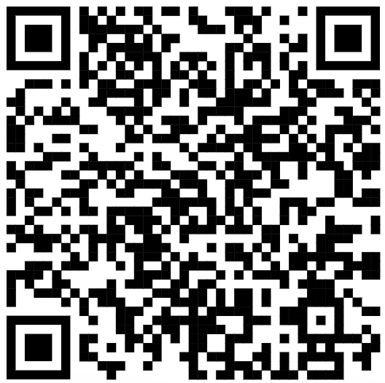
CSE 121 – Lesson 11
Miya Natsuhara
Autumn 2023
Music: 121 23au Lecture Tunes 🌦️
TAs:
Trey Sebastian
Annie
Jasmine
Christian
Lucas
Logan
Jacob
Christina
Colton
Janvi
Arkita
Vidhi
Ritesh
Hibbah
Julia
Sahej
Anju
Jonus
Lydia
Luke
Andras
Archit
Ayesha
Vinay
Maria
Shreya
Andy
Nicolas
Shayna
Hannah
Aishah
Kriti
Minh
Vivian
Nicole
Simon
Jessie
Lydia
Yijia
sli.do #cse121

Slide 2
Announcements, Reminders
Quiz 1 was yesterday
I am close to being able to release Quiz 0 and Quiz 1 grades…likely within the next few days.
Next Friday (11/10) is a University Holiday…so no class! 😴
Programming Assignment 2 will be released later tonight
Due Thursday, Nov 9

Slide 3
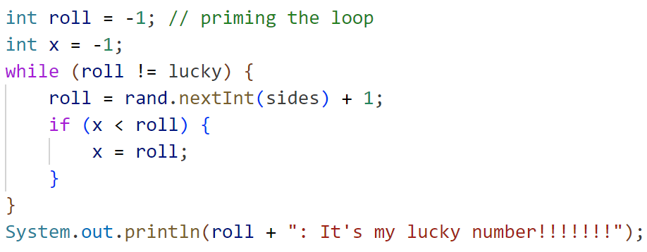
How would you describe what the variable x calculates?
The largest value rolled
The smallest value rolled
The last value rolled
The first value rolled
The sum of all values rolled
Error
-1

Slide 4
(PCM) Scanner
An object that we can use to read in input
In the java.util package
Methods | Description
nextInt() | Reads the next token from the user as an int and returns it.
nextDouble() | Reads the next token from the user as an double and returns it.
next() | Reads the next token from the user as an String and returns it.
nextLine() | Reads an entire line from the user as an String and returns it.

Slide 5
(PCM) Tokens
A unit of user input, as read by the Scanner
Tokens are separated by whitespace (spaces, tabs, new lines)
23 John Smith
42.0 "Hello world" $2.50 " 19

Slide 6
Fencepost Pattern
Some task where one piece is repeated n times, and another piece is repeated n-1 times and they alternate
g-u-m-b-a-l-l

