Slide 1
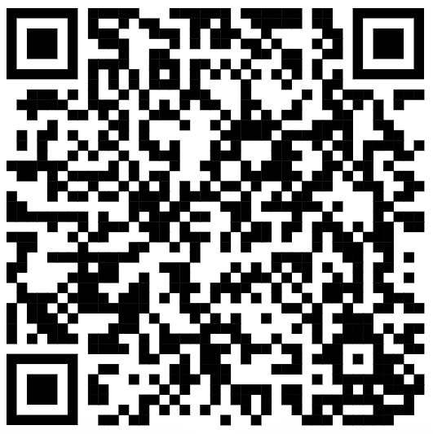
CSE 121 – Lesson 10
Miya Natsuhara
Autumn 2023
Music: 121 23au Lecture Tunes 🌦️
TAs:
Trey Sebastian
Annie
Jasmine
Christian
Lucas
Logan
Jacob
Christina
Colton
Janvi
Arkita
Vidhi
Ritesh
Hibbah
Julia
Sahej
Anju
Jonus
Lydia
Luke
Andras
Archit
Ayesha
Vinay
Maria
Shreya
Andy
Nicolas
Shayna
Hannah
Aishah
Kriti
Minh
Vivian
Nicole
Simon
Jessie
Lydia
Yijia
sli.do #cse121

Slide 2
Announcements, Reminders
Quiz 1 tomorrow (Nov 2) in your registered quiz section
Nested for loops, Random, Math, Methods, Parameters, Returns
Beak week coming up! (No homework assignment released today)

Slide 3
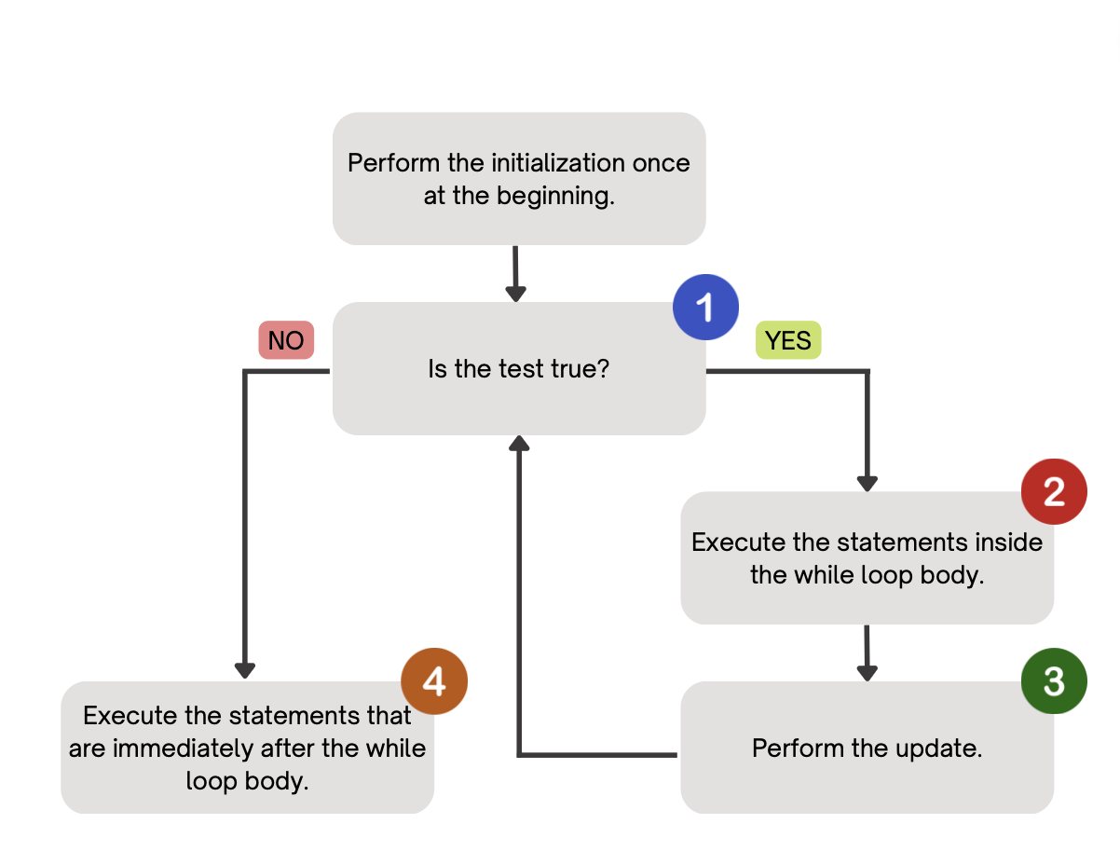
(PCM) While Loops
Repeatedly executes its body as long as its logical test is true.

Slide 4
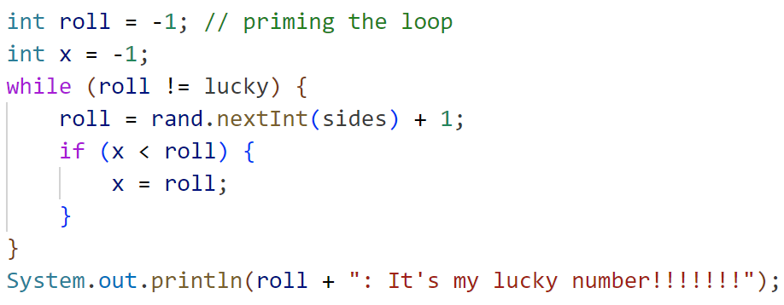
How would you describe what the variable x calculates?
The largest value rolled
The smallest value rolled
The last value rolled
The first value rolled
The sum of all values rolled
Error
-1

