Slide 1
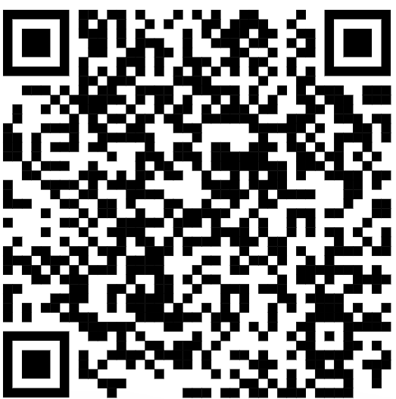
Welcome to CSE 121!
Miya Natsuhara
Autumn 2023
Music: 121 23au Lecture Tunes 🌦️
TAs:
Trey Sebastian
Annie
Jasmine
Christian
Lucas
Logan
Jacob
Christina
Colton
Janvi
Arkita
Vidhi
Ritesh
Hibbah
Julia
Sahej
Anju
Jonus
Lydia
Luke
Andras
Archit
Ayesha
Vinay
Maria
Shreya
Andy
Nicolas
Shayna
Hannah
Aishah
Kriti
Minh
Vivian
Nicole
Simon
Jessie
Lydia
Yijia
sli.do #cse121

Slide 2
Agenda
About me
About this course
Learning objectives
Other similar courses
Course components
Our learning model
Tools and resources
Course Website
Ed
Assessment and grading
Collaboration

Slide 3
Agenda
About me
About this course
Learning objectives
Other similar courses
Course components
Our learning model
Tools and resources
Course Website
Ed
Assessment and grading
Collaboration

Slide 4
Hi, I’m Miya! (she/her)
Assistant Teaching Professor in the Allen School
UW CSE alum
BS in CSE
BA in Math
Minor in ASL
MS in CSE
Former Software Engineer at Microsoft
Dog mom

Slide 5
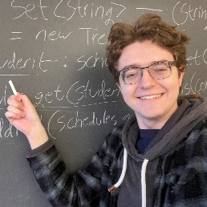
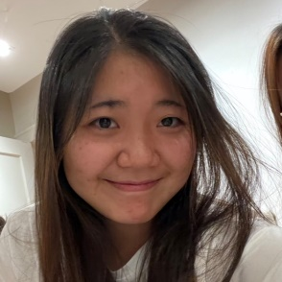
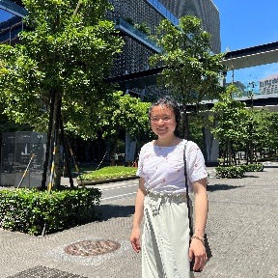
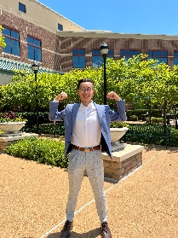
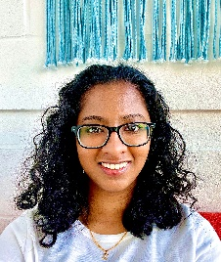
Meet your 40 TAs!

Slide 6
Agenda
About me
About this course
Learning objectives
Other similar courses
Course components
Our learning model
Tools and resources
Course Website
Ed
Assessment and grading
Collaboration

Slide 7
Learning Objectives
or, “What will I learn in this class?”
Computational Thinking
Code Comprehension
Code Writing
Communication
Testing
Debugging
Ethics / Impact

Slide 8
Other Similar Courses
Course | Good choice if…
CSE 121 | You’ve never programmed before AND You are, or want to be, in a major such as CS, CE, ECE, Info, etc. that requires Java programming
CSE 122 | You’ve done some programming (roughly one course worth) in any programming language AND You are, or want to be, in a major such as CS, CE, ECE, Info, etc. that requires Java programming
CSE 123 | You’ve taken CSE 122 AND You are, or want to be, in a major such as CS, CE, ECE, Info, etc. that requires Java programming
CSE 160 | You’ve never programmed before AND You’re interested in data science and analysis OR You’d rather learn Python than Java* OR You are, or want to be, in a major such as Physics, Bio, Stat, etc. where analyzing data through programming is useful
Other courses of interest: CSE 154, CSE 163
See Guided Self-Placement and Introductory Courses for more info

Slide 9
Course Components
Meetings
LECTURES
(x20)
SECTIONS
(x18)
We’re here!
Introduce concepts, practice ideas, discuss applications.
Pre-class materials to prepare for class each day. Due before class.
Held in person
More practice, reviews, applications
TA advice, how to be an effective student
Preparation for quizzes / exams
Assessments
PROGRAMMING ASSIGNMENTS
(x4)
CREATIVE PROJECTS
(x4)
QUIZZES
(x3)
EXAM
(x1)
Structured assignments
Programming in Java
Applying & implementing course concepts
More open-ended
assignments
Explore new ideas and applications
Taken in quiz section
45 minutes on computer
Culminating exam
Date/Time TBA

Slide 10
Agenda
About me
About this course
Learning objectives
Other similar courses
Course components
Our learning model
Tools and resources
Course Website
Ed
Assessment and grading
Collaboration
10

Slide 12
How Learning Works
Learning requires active participation in the process. It’s not as simple as sitting
and listening to someone talk at you.
Requires deliberate practice in learning by doing
Benefits from collaborative learning
Hybrid classroom model
Asks you to do some preparation before class in the form of readings and practice problems.
Should take ~30 minutes a day
Class will start with brief recap, then pick up
where the reading and practice problems leave off.
Attendance isn’t graded, but showing up and trying
is the first step in succeeding in the class!
Pre-class materials are ungraded, but
It’s okay if you find them challenging! That means
you are learning!

Slide 13
Metacognition
Metacognition: asking questions about your solution process.
Examples:
While debugging: explain to yourself why you’re making this change to your
program.
Before running your program: make an explicit prediction of what you expect to see.
When coding: be aware when you’re not making progress, so you can take a break
or try a different strategy.
When designing:
Explain the tradeoffs with using a different data structure or algorithm.
If one or more requirements change, how would the solution change as a result?
Reflect on how you ruled out alternative ideas along the way to a solution.
When studying: what is the relationship of this topic to other ideas in the course?

Slide 14
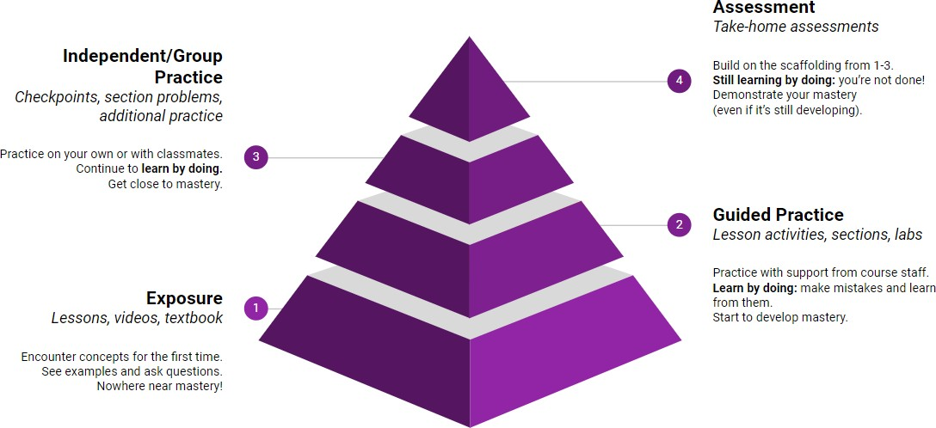
Learning in CSE 121 (or anywhere)

Slide 15
Course Culture and Support
Currently 773 students enrolled!
Wide range of backgrounds, interests, and goals
Everyone is new to programming
Support and help each other!
Form study groups
If you have a question, others almost certainly do too

Slide 16
Course Culture and Support: Getting Help
Discussion Board
Feel free to make a public or private post on Ed
We encourage you to answer other peoples’ questions! A great way to learn
Introductory Programming Lab (Office Hours)
TAs can help you face to face in office hours, and look at your code
You can go to the IPL with any course questions, not just assignments
Section
Work through related problems, get to know your TA who is here to support you
Email
We prefer that all content and logistic questions go on the Ed discussion board (even if you
make them private). 773 of you >>> 41 of us!
For serious personal circumstances, you can email Miya directly. It never hurts to email me, but if it’s a common logistic question, I may politely ask you to post on the discussion board.

Slide 17
Course Culture and Support
Policies designed with flexibility in mind
Resubmissions, lecture recordings, asynchronous discussion board
But, life and the world still happen around us…
Please reach out ASAP if you’re struggling or have circumstances that require extra support

Slide 18
The World Around CSE 121
Our goal is to give you a great CSE 121 experience
But CSE 121 does not exist in a vacuum – there’s a lot going on in the world
right now that can impact your education
We’ve designed course policies for maximum flexibility: ability to
resubmit assignments and retake quizzes
But we cannot cover every individual situation
Please reach out if you need accommodations of any kind to deal with these unfamiliar situations

Slide 19
Agenda
About me
About this course
Learning objectives
Other similar courses
Course components
Our learning model
Tools and resources
Course Website
Ed
Assessment and grading
Collaboration

Slide 20
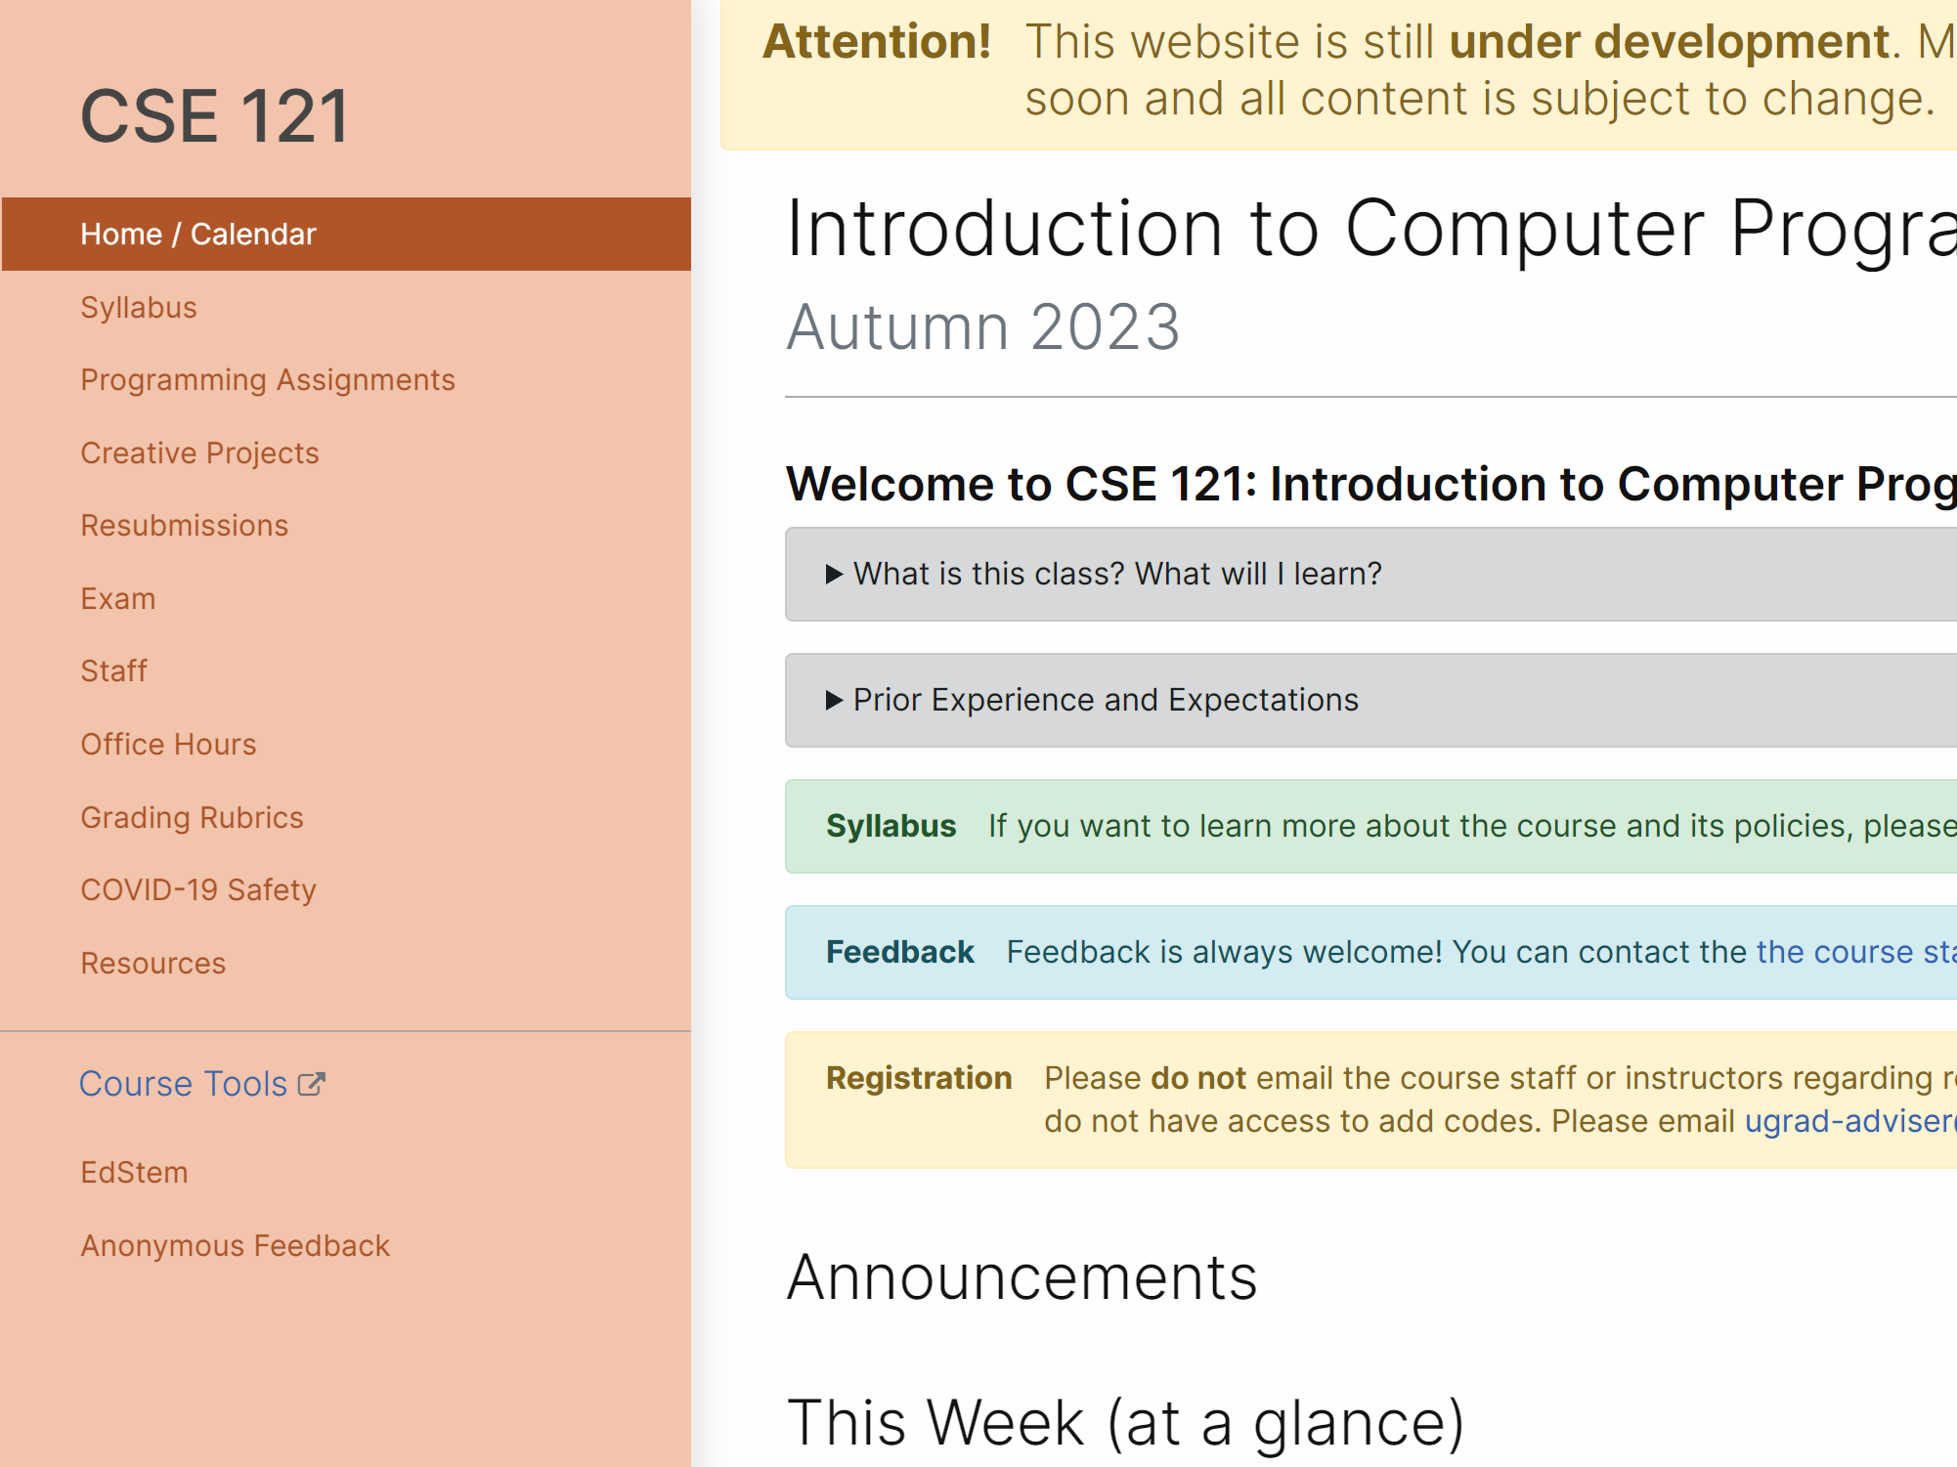
Course Website
cs.uw.edu/121
Primary source of course information (not Canvas)
Calendar will contain links to (almost) all resources

Slide 21
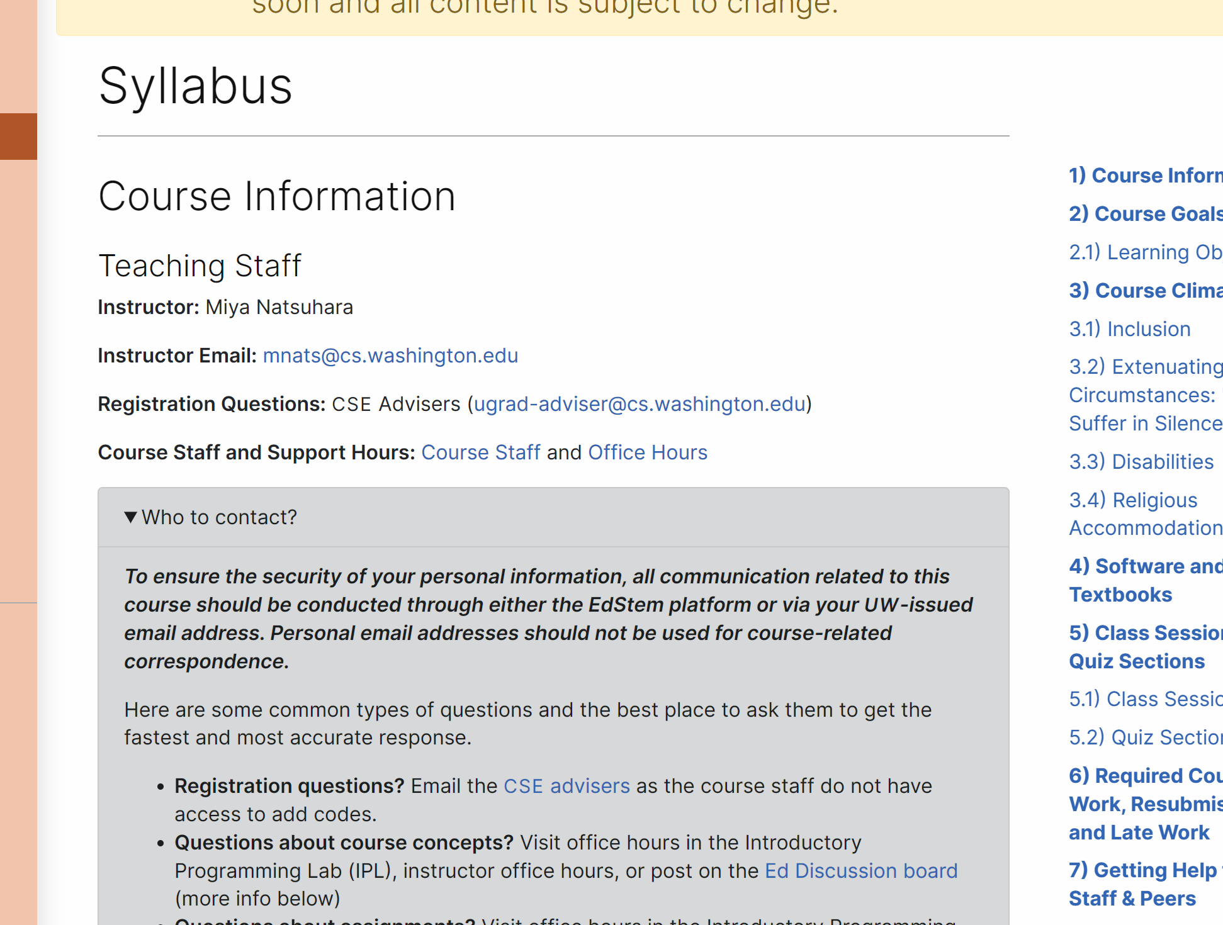
Course Website
Please review the syllabus ASAP.

Slide 22
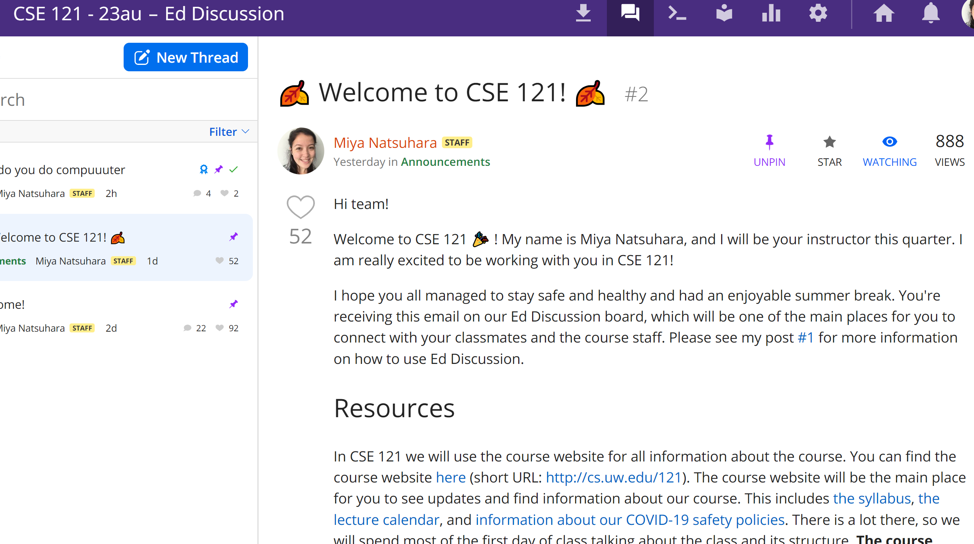
Ed
Our online learning platform
Lessons, sections, quizzes all here
Intro and walkthrough in Section 0
22

Slide 23
Other Course Tools
Canvas
My Digital Hand
Queueing in office hours
Gradebook
Lecture recordings
Visual Studio Code
Sli.do
Develop offline
Debugger Tool
In-class activities (ungraded)
No account needed

Slide 24
Agenda
About me
About this course
Learning objectives
Other similar courses
Course components
Our learning model
Tools and resources
Course Website
Ed
Assessment and grading
Collaboration

Slide 25
Assessment and Grading
Our goal in the course is for you to gain proficiency of the concepts and skills we teach
We assess your proficiency by asking you to apply the concepts and skills on tasks or problems
By necessity, we are assessing your work as a proxy for your proficiency
25

Slide 26
Resubmission
Learning takes time, and doesn’t always happen on the first try!
Each week, one previous Programming Assignment or Creative Project can be resubmitted
Must be accompanied by write up explaining changes.
Grade on resubmission replaces original grade.
An assignment is only eligible for resubmission within the 3 resubmission cycles following its grades being released.
Your lowest 2 quiz problem grades will be dropped from your gradebook (not considered when calculating course grades)
See syllabus for more details
26

Slide 27
Grading
Grades should reflect your proficiency in the course objectives
All assignments will be graded
E (Excellent),
S (Satisfactory),
or N (Not yet)
Under certain circumstances, a grade of U (Unassessable) may be assigned
Final grades will be assigned based on the amount of work at each level
See the syllabus for more details
27

Slide 28
Agenda
About me
About this course
Learning objectives
Other similar courses
Course components
Our learning model
Tools and resources
Course Website
Ed
Assessment and grading
Collaboration

Slide 29
Collaboration Policy
Learning is hard, but it’s easier when you learn from each other
You are encouraged to form study groups, work together on practice and review, and discuss your ideas and approaches at a high level
In general, share ideas and work together, but don’t copy work. Never send someone else
your code or solution write up.
If you discuss your ideas with others, you must cite them
All work you submit for grading must be predominantly and substantially your own
There is a dedicated page explaining the policy around use of generative AI tools
Withdrawal policy
See the syllabus for more details

Slide 30
Help Us Improve!
CSE 121 is super new!
We worked hard to build a course we think will be effective and supportive and help you succeed
We probably didn’t get it all right
We appreciate your patience and understanding if we need to make adjustments during the quarter
Please give us lots of feedback!
Post on Ed and/or use the Anonymous Feedback Tool

Slide 31
“Homework” for Next Time
First assignment will be released Friday, but there are some things to do in the meantime.
TODO this week
Fill out the introductory survey
Post an introduction video on your section’s Ed thread! 😊
Go meet your TA and classmates in Thursday’s quiz section
⭐Complete the pre-class material for Friday (see calendar)
Check over syllabus details

