Slide 1
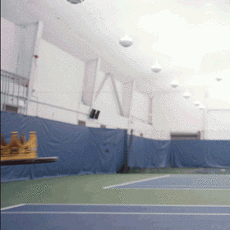
You Made It!

Slide 2
Announcements
P3 due tonight
R7 due Sunday
Can use to extend P3
Final exam next Wednesday, 12:30-2:20
Read exam policies
One note page, no more than 8.5” x 11”
Reference sheet provided
Assigned seats
Grade guarantee calculator posted later today

Slide 3
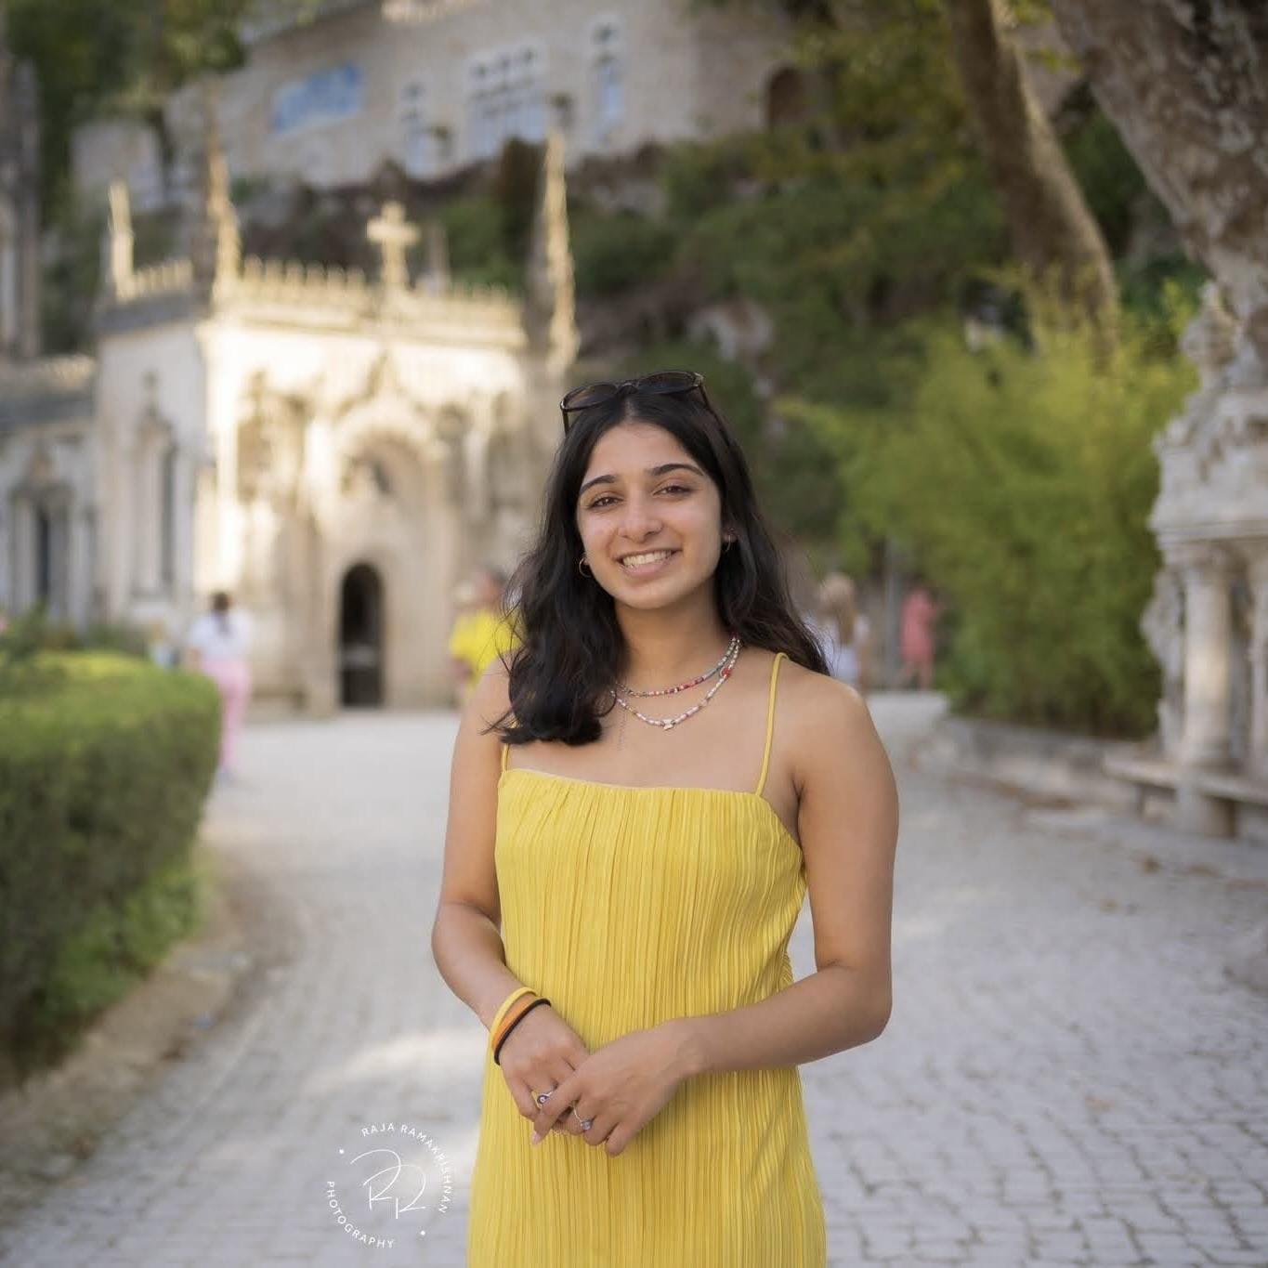
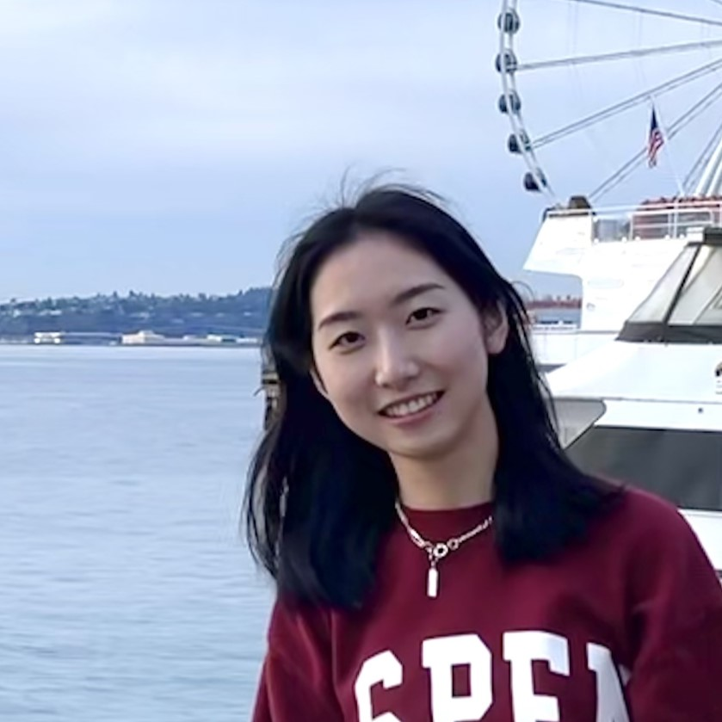
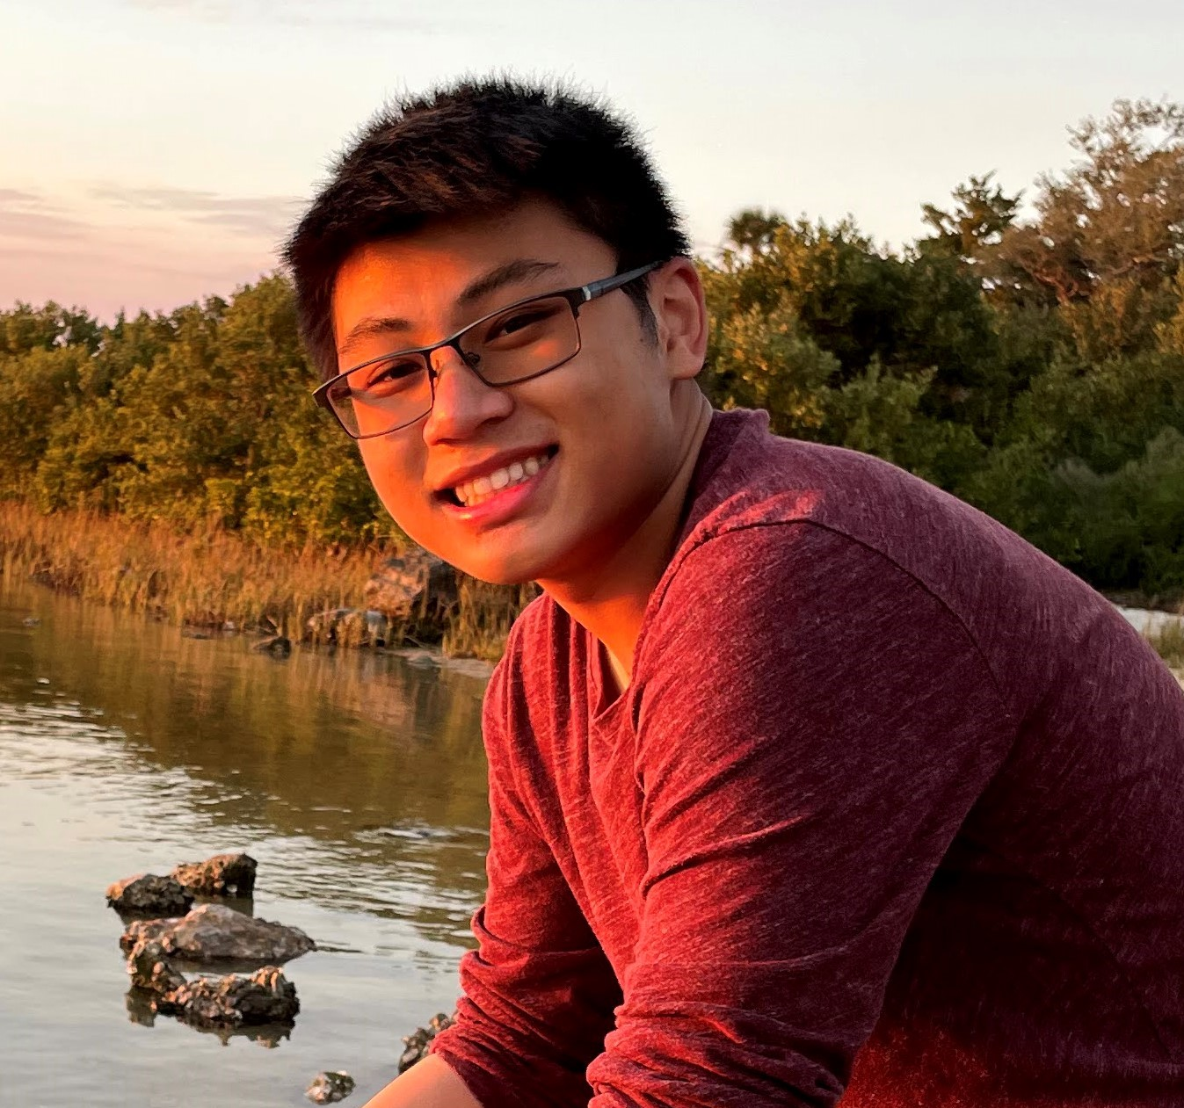
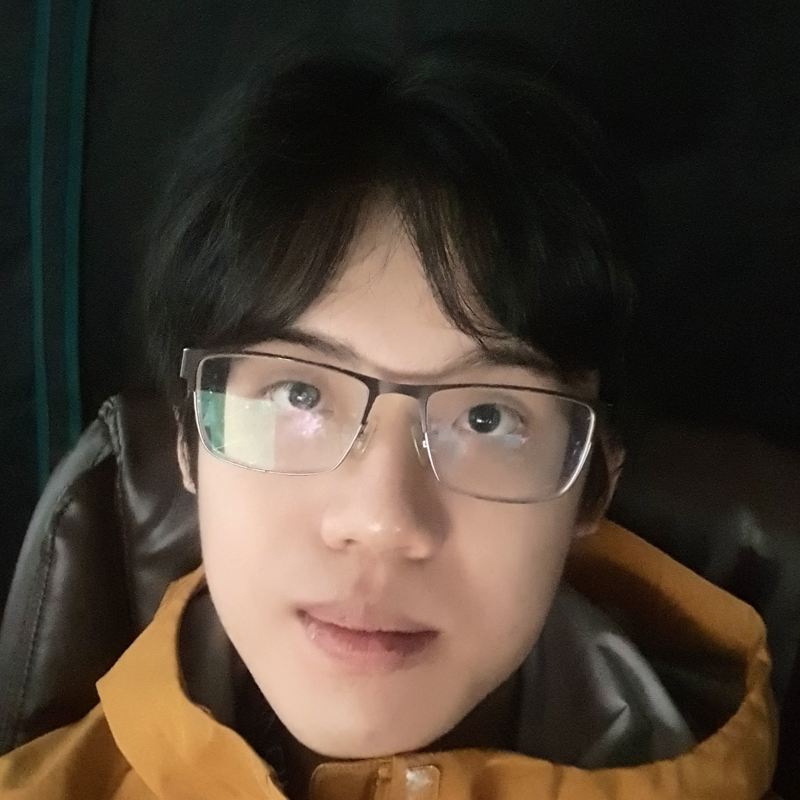
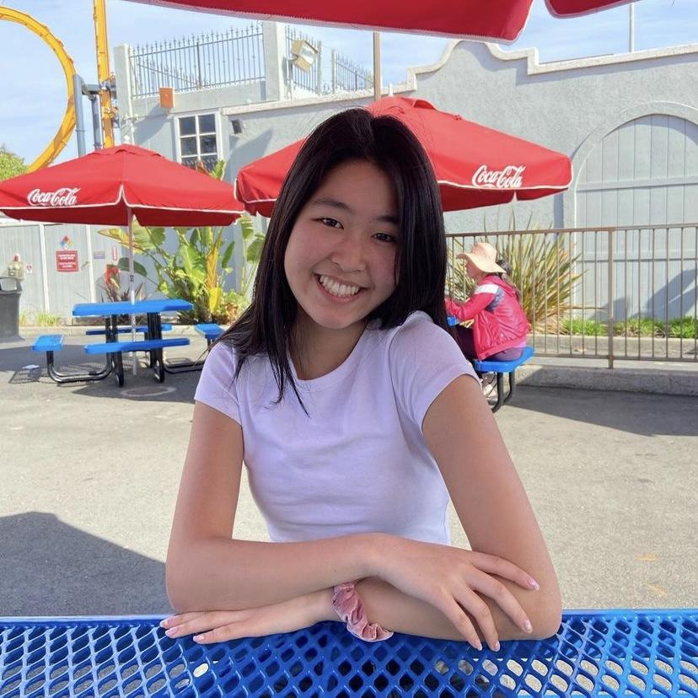
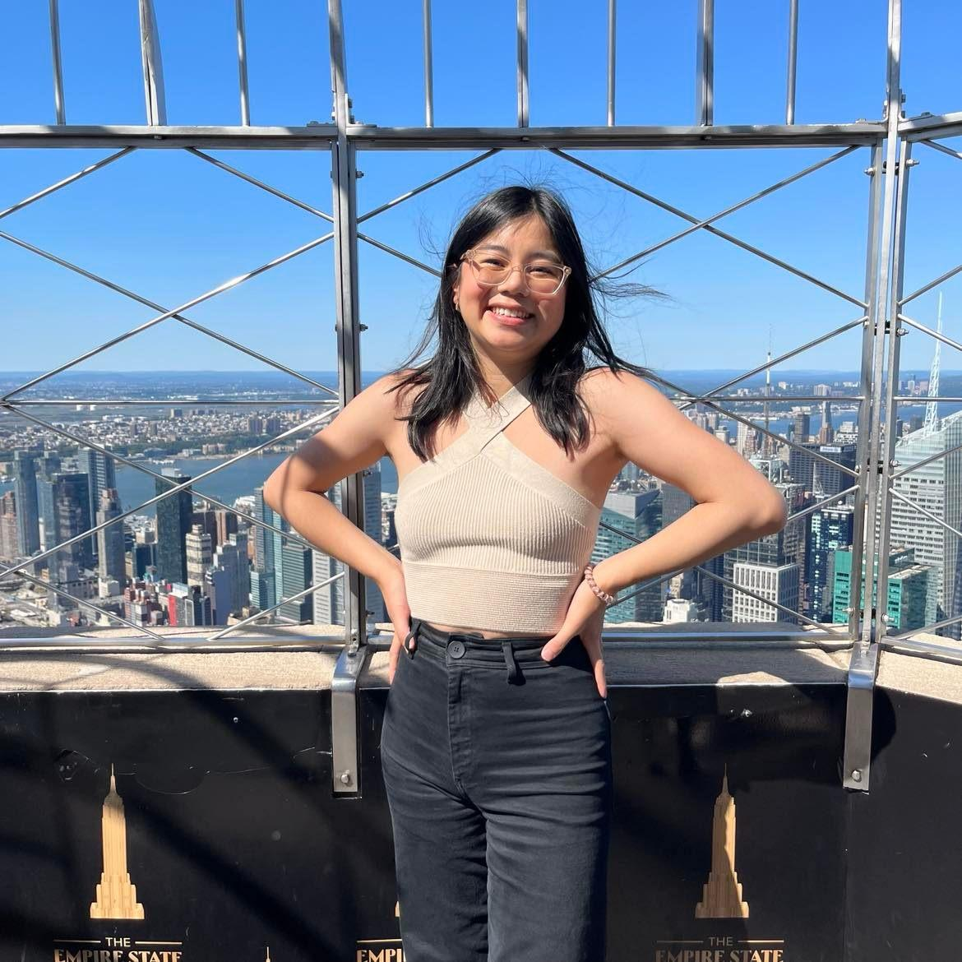
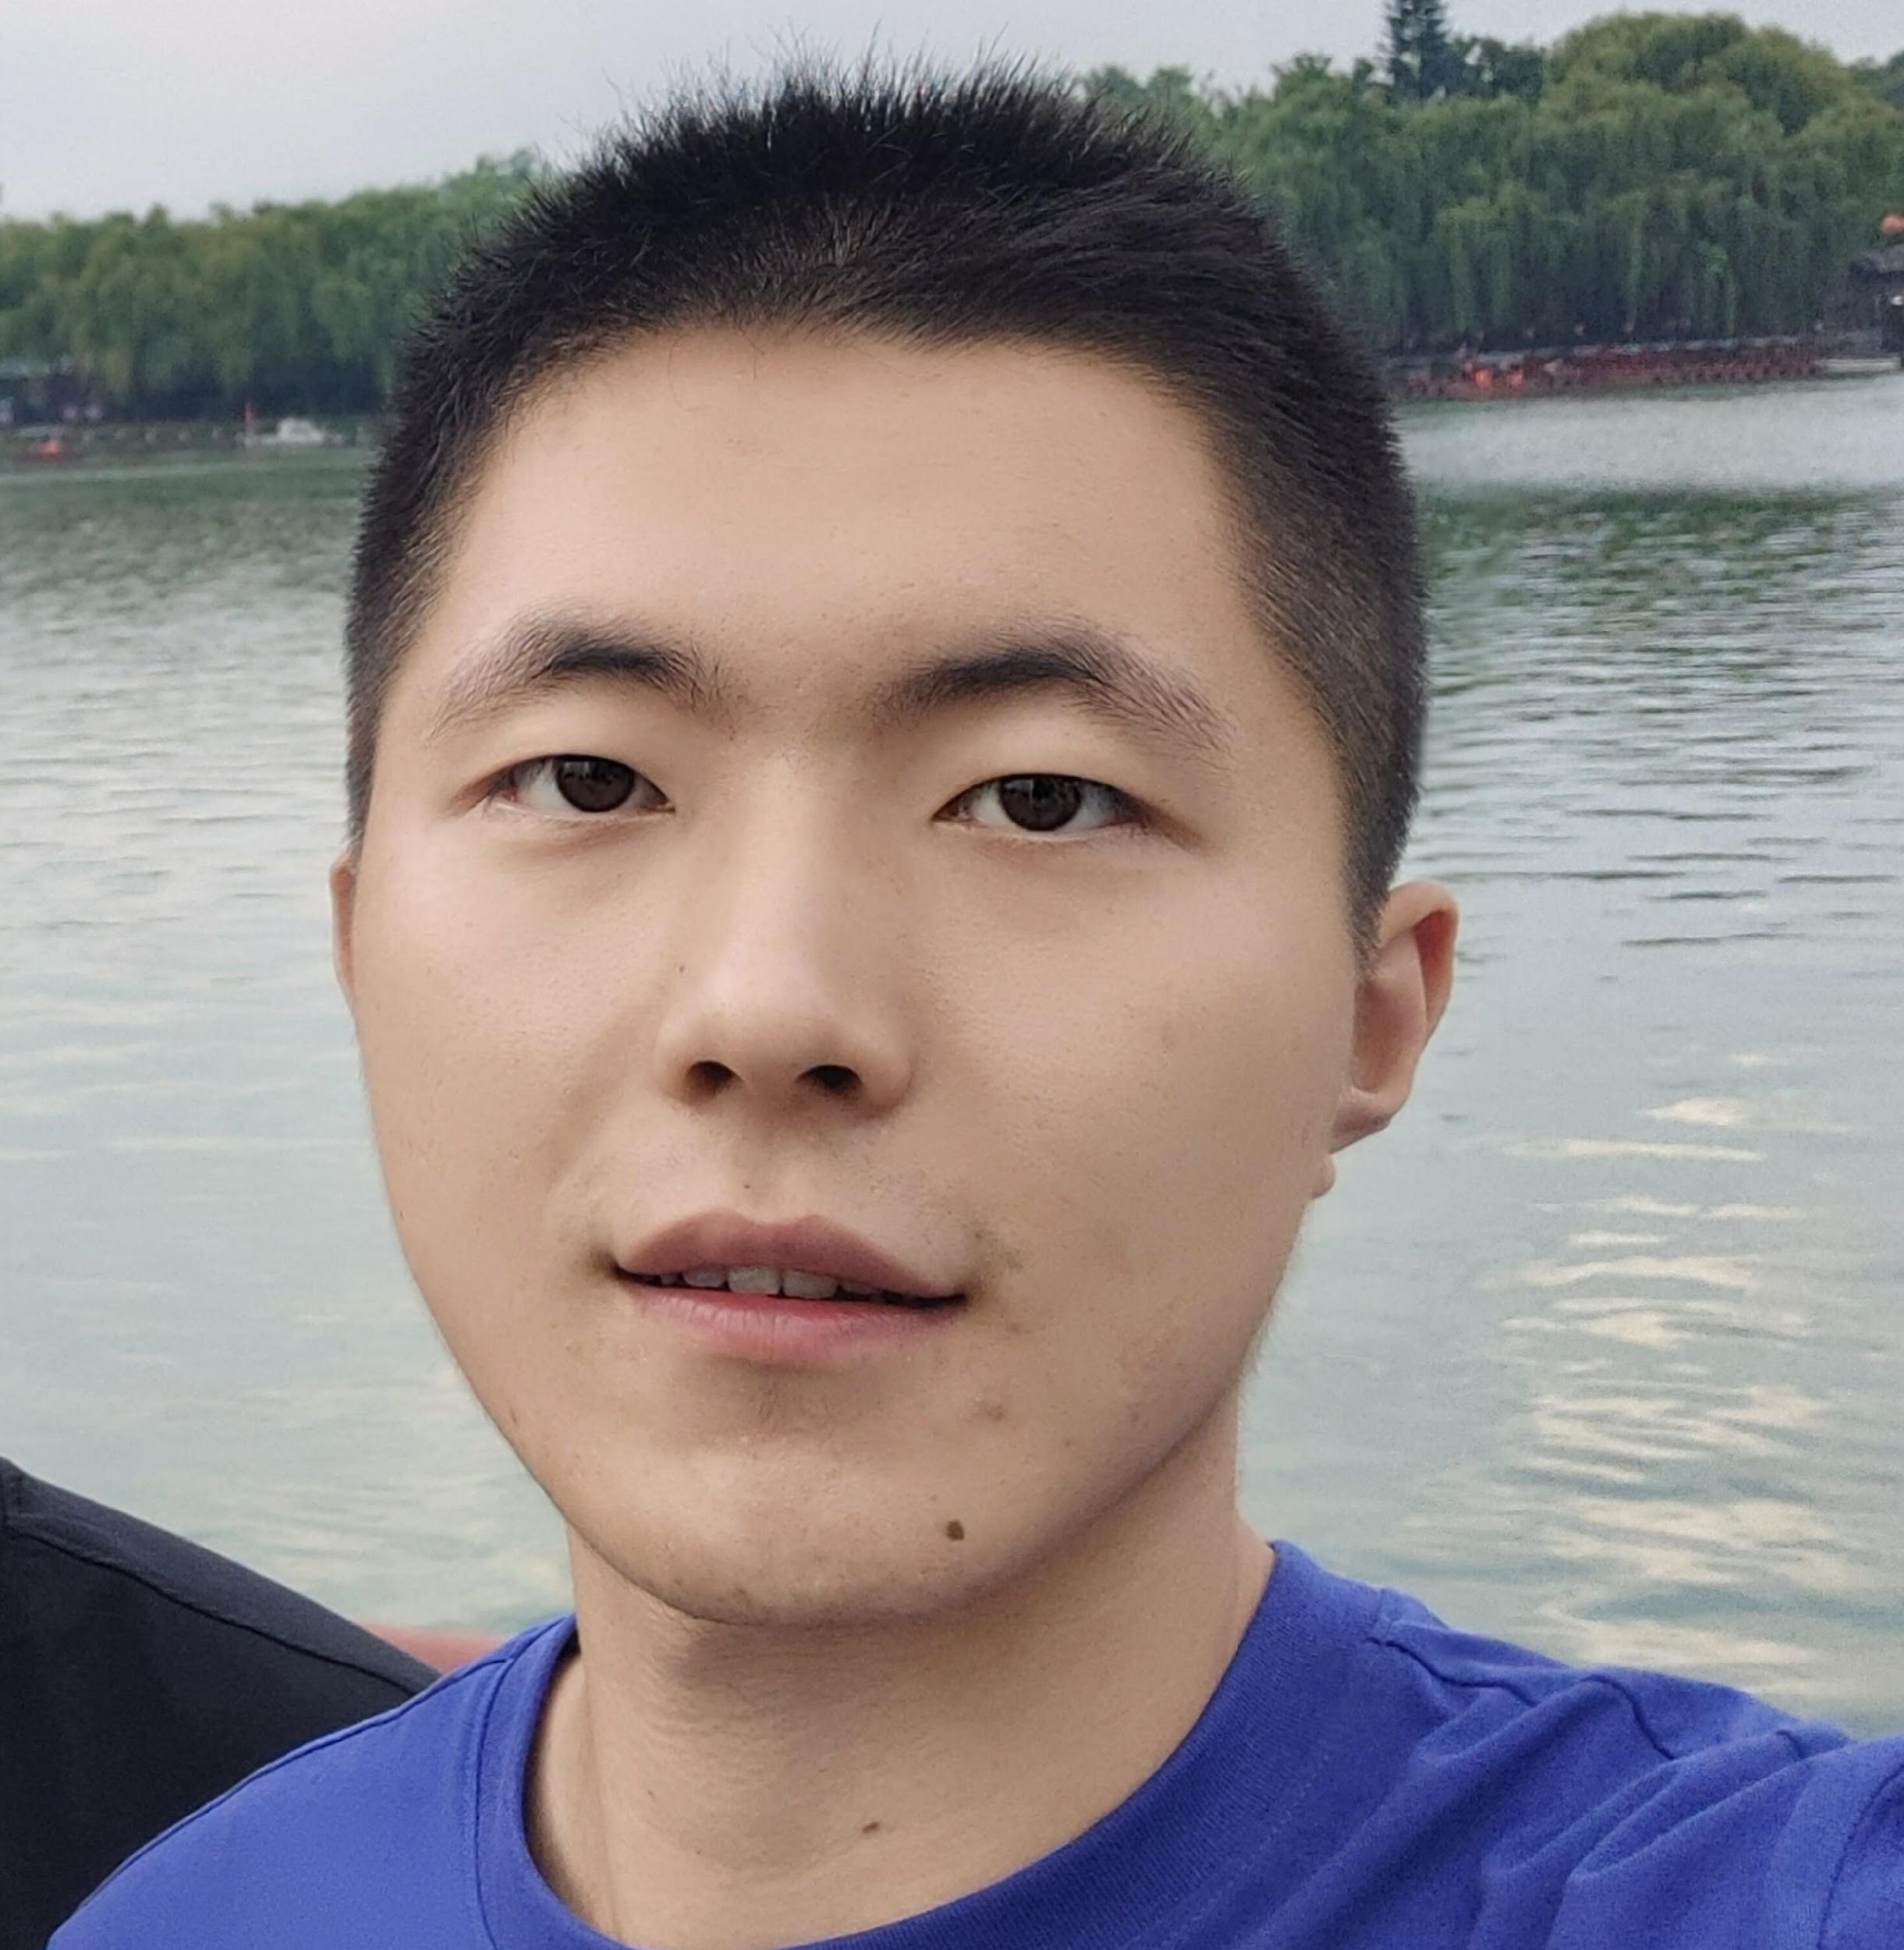
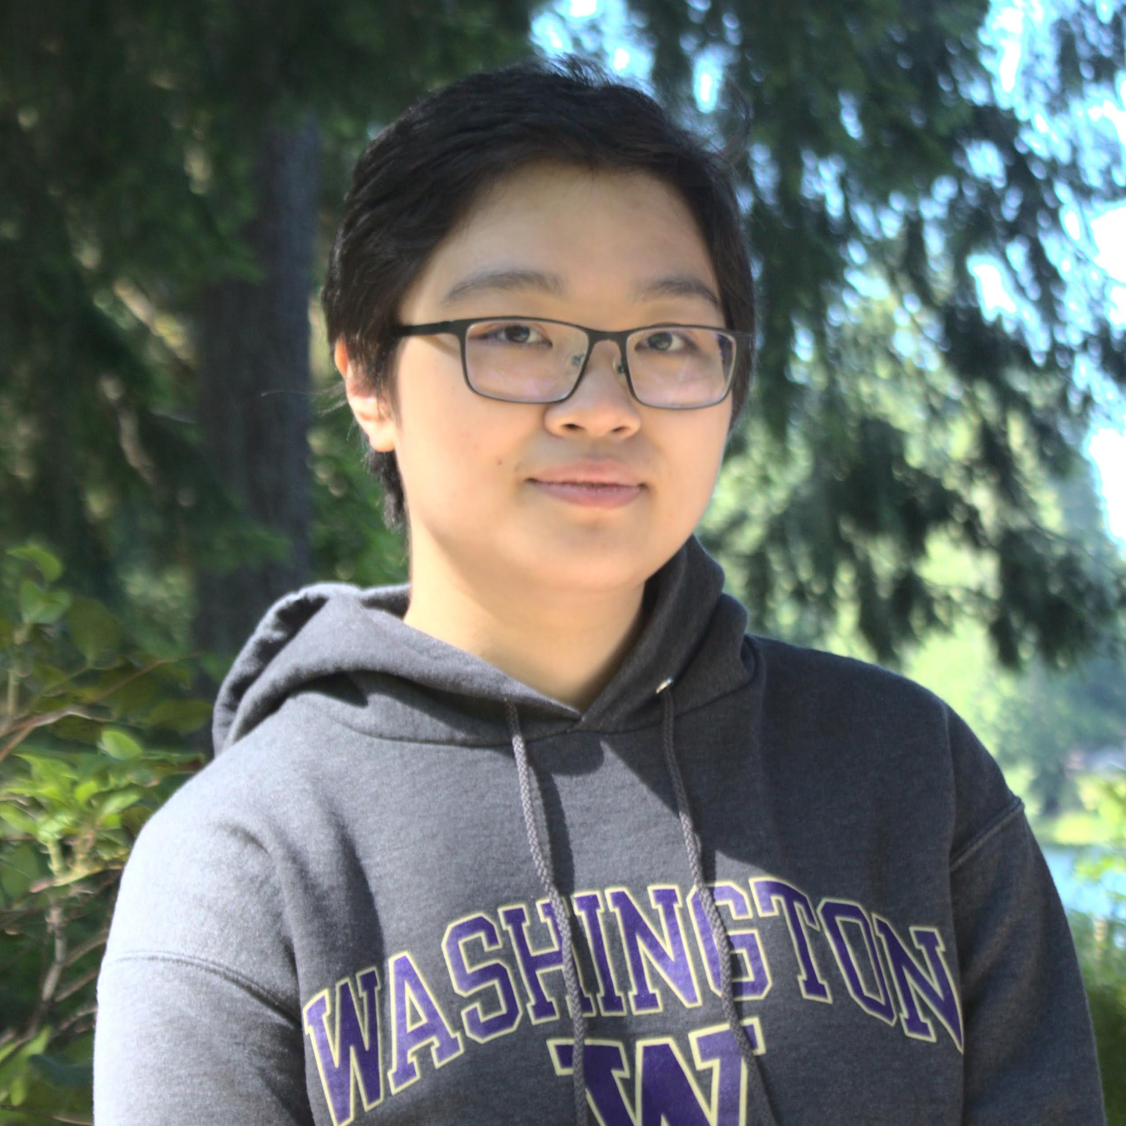
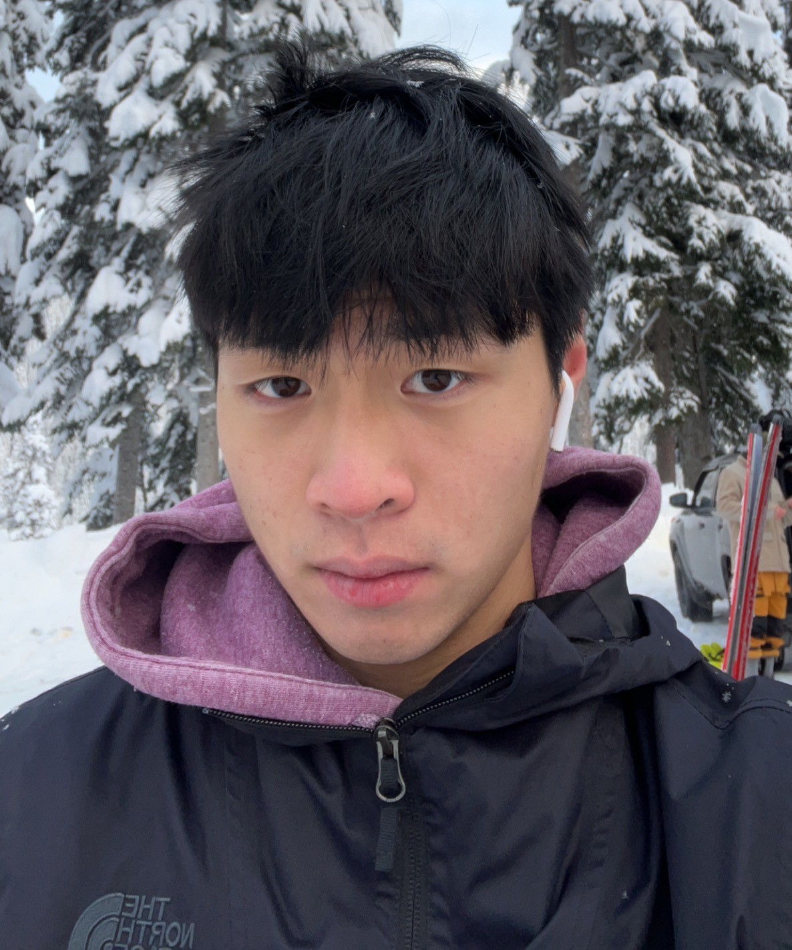
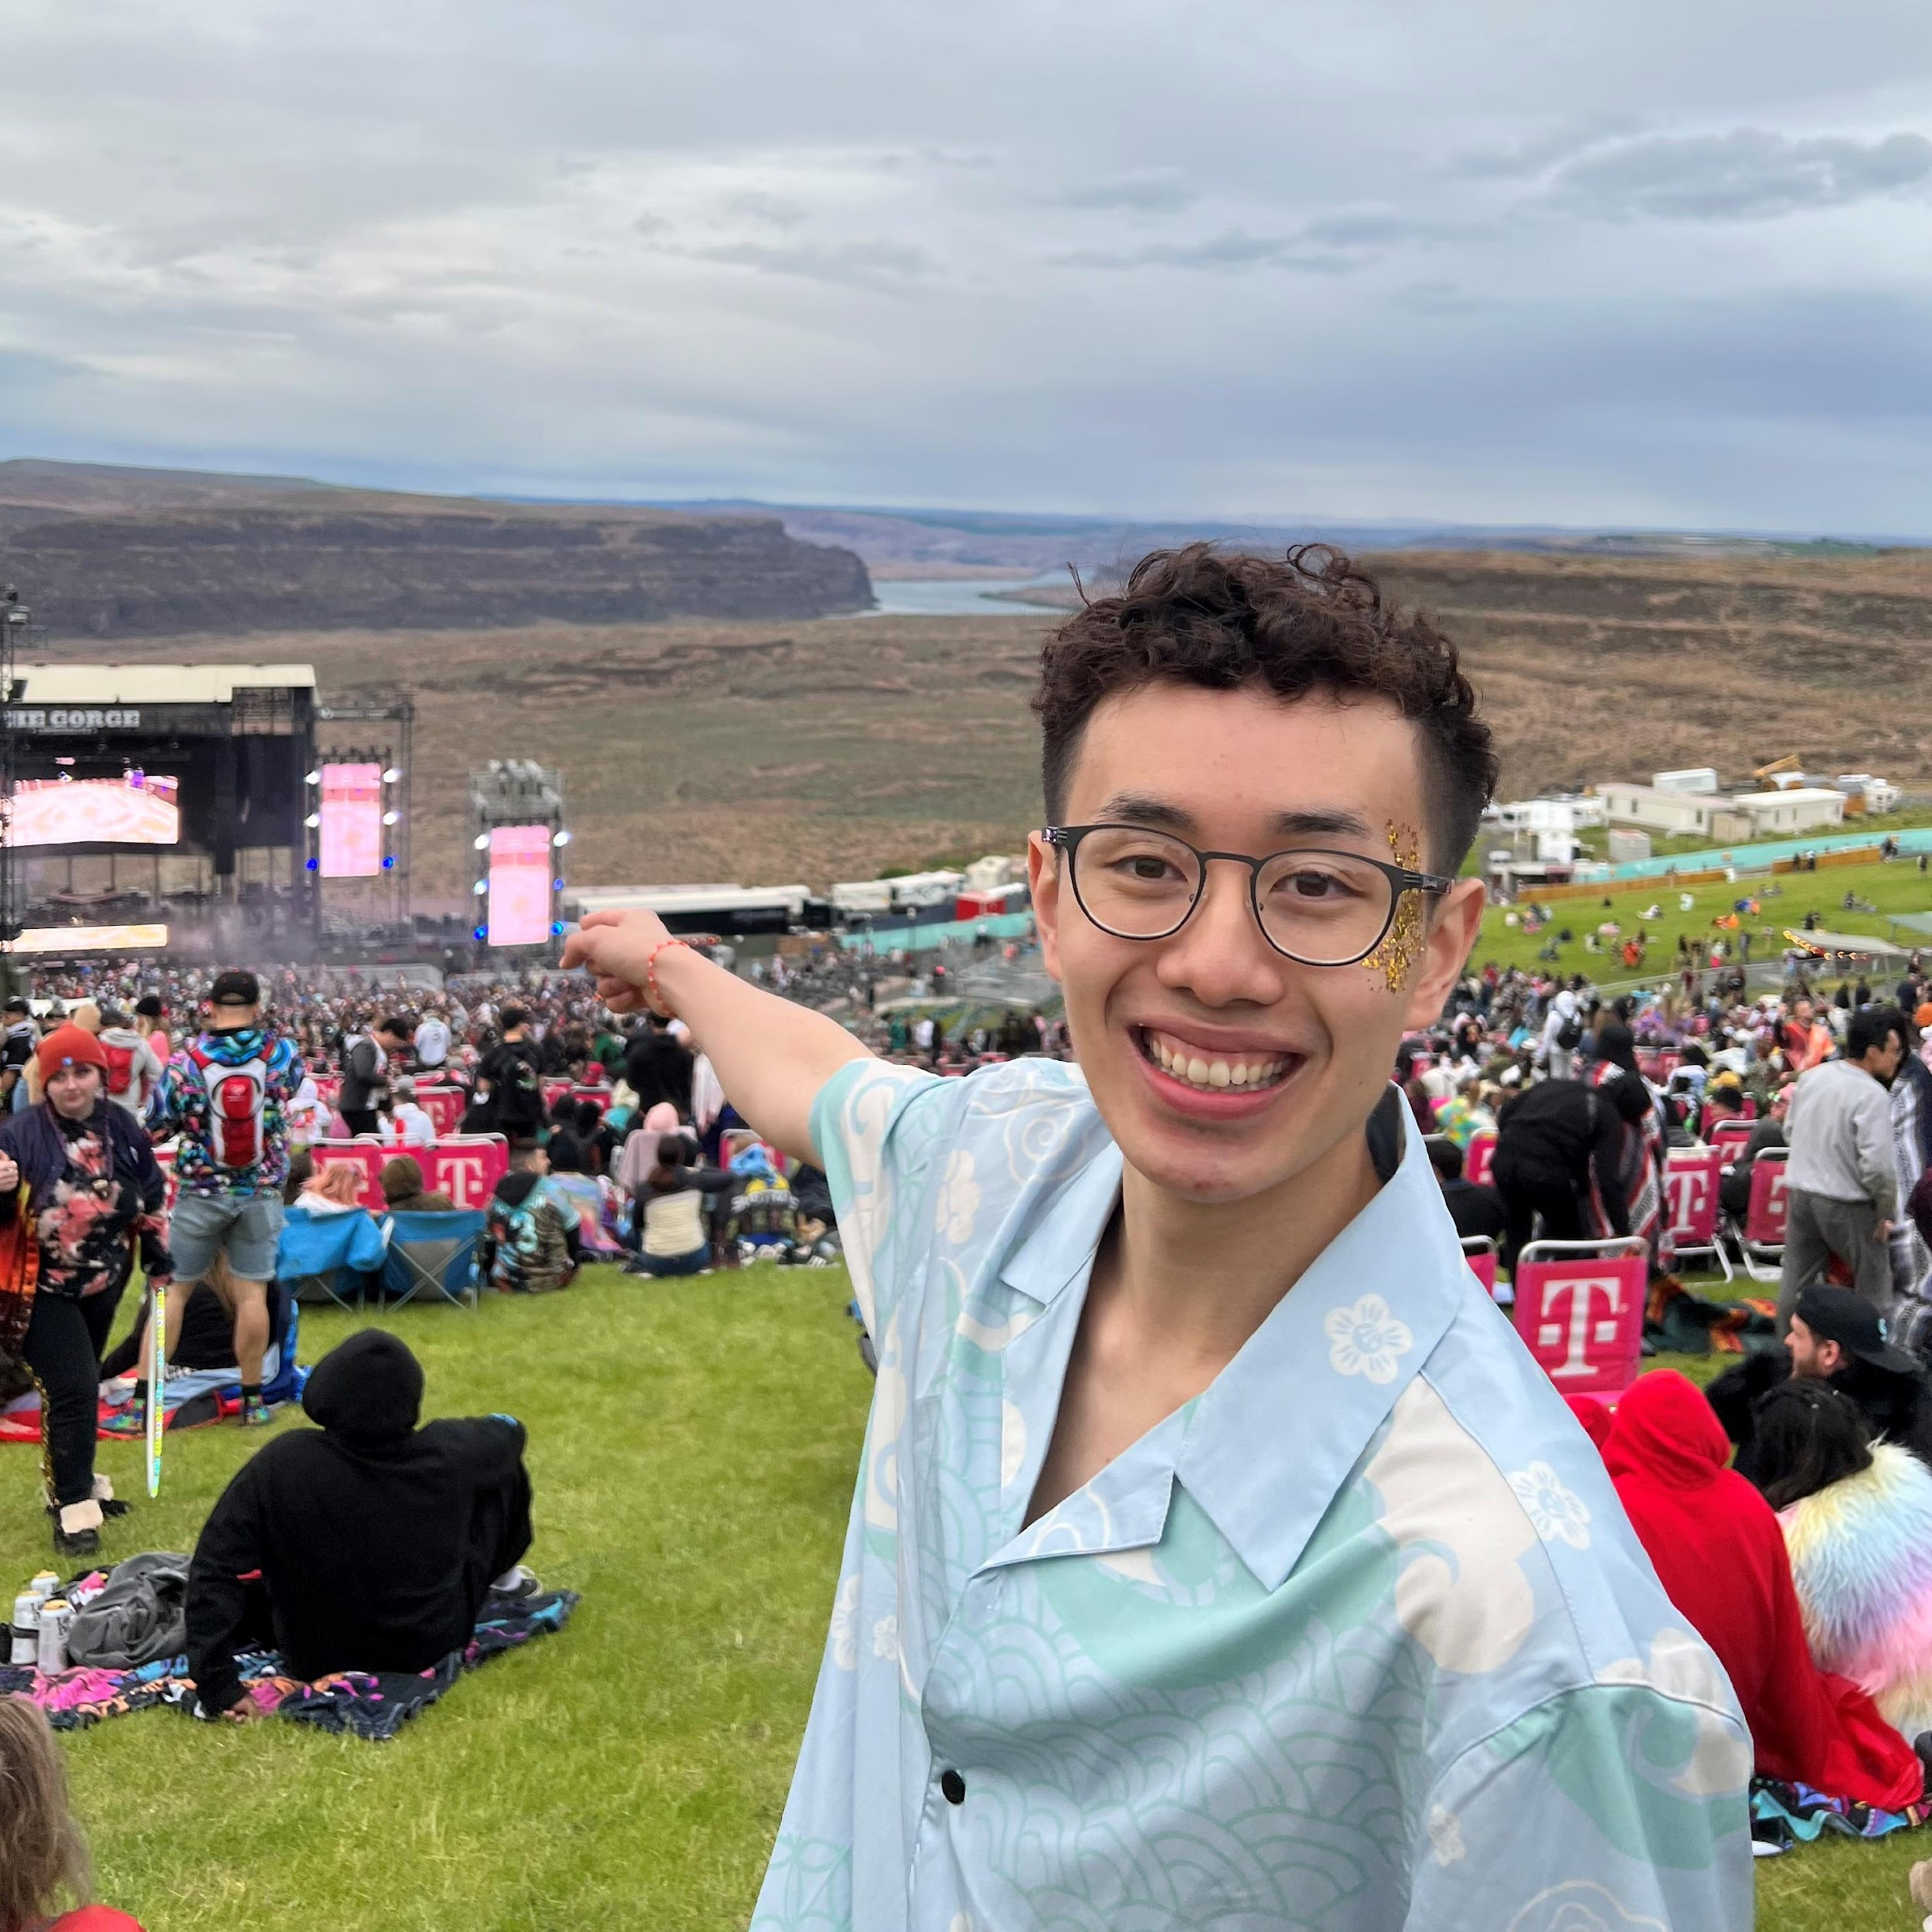
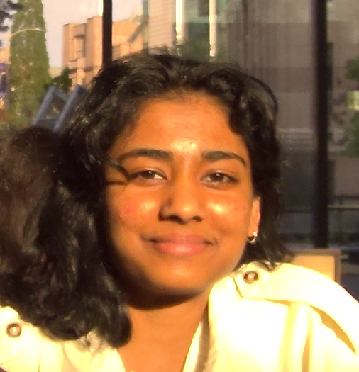
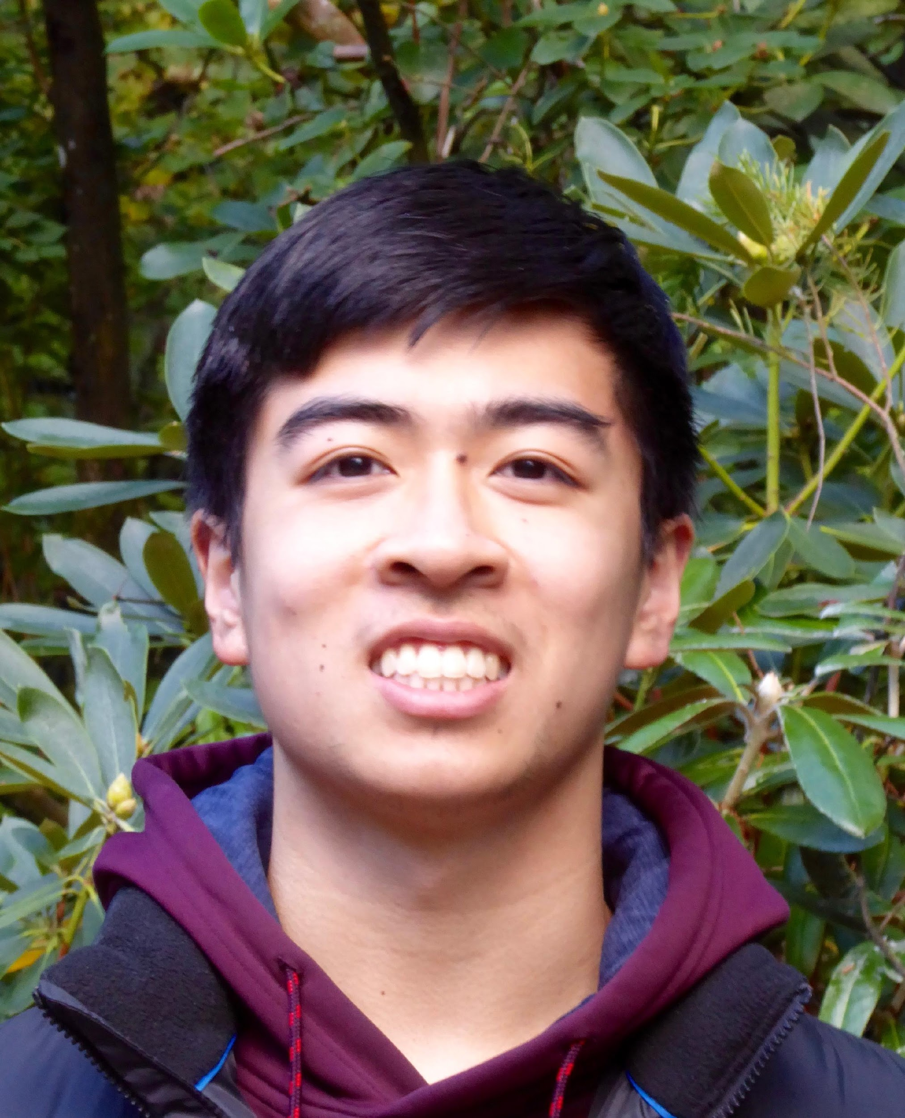
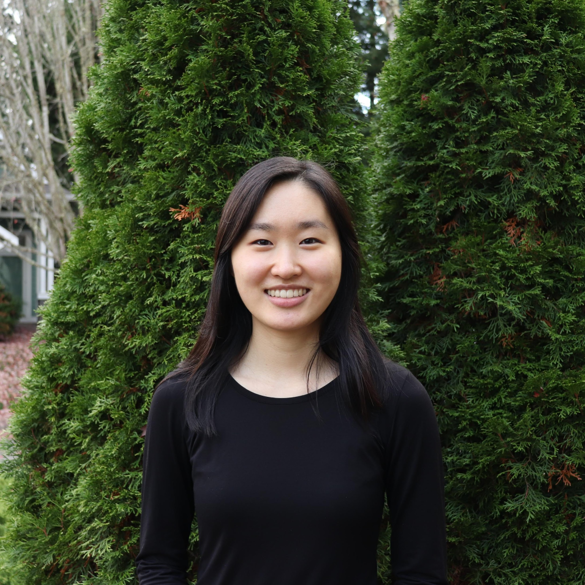
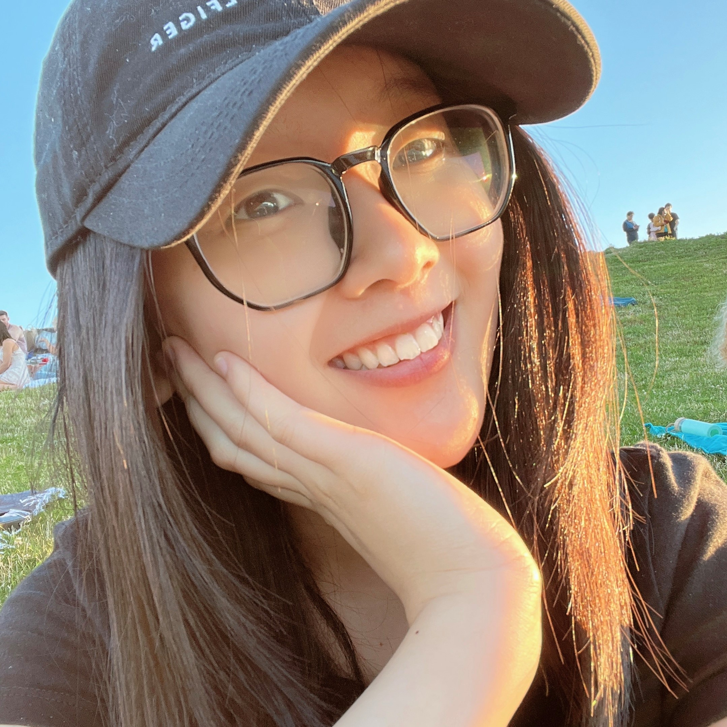
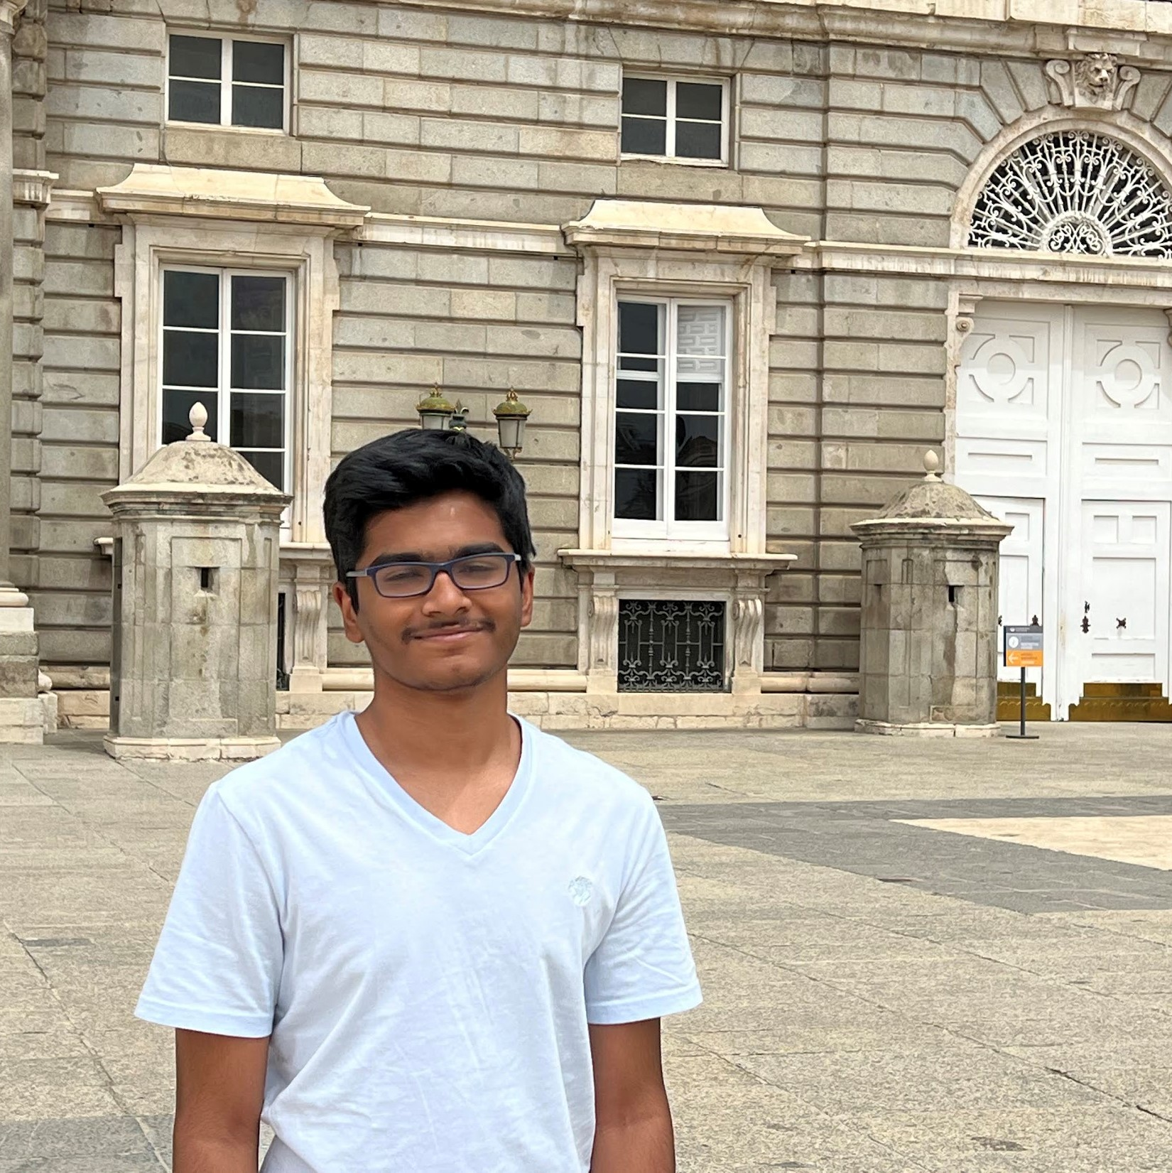
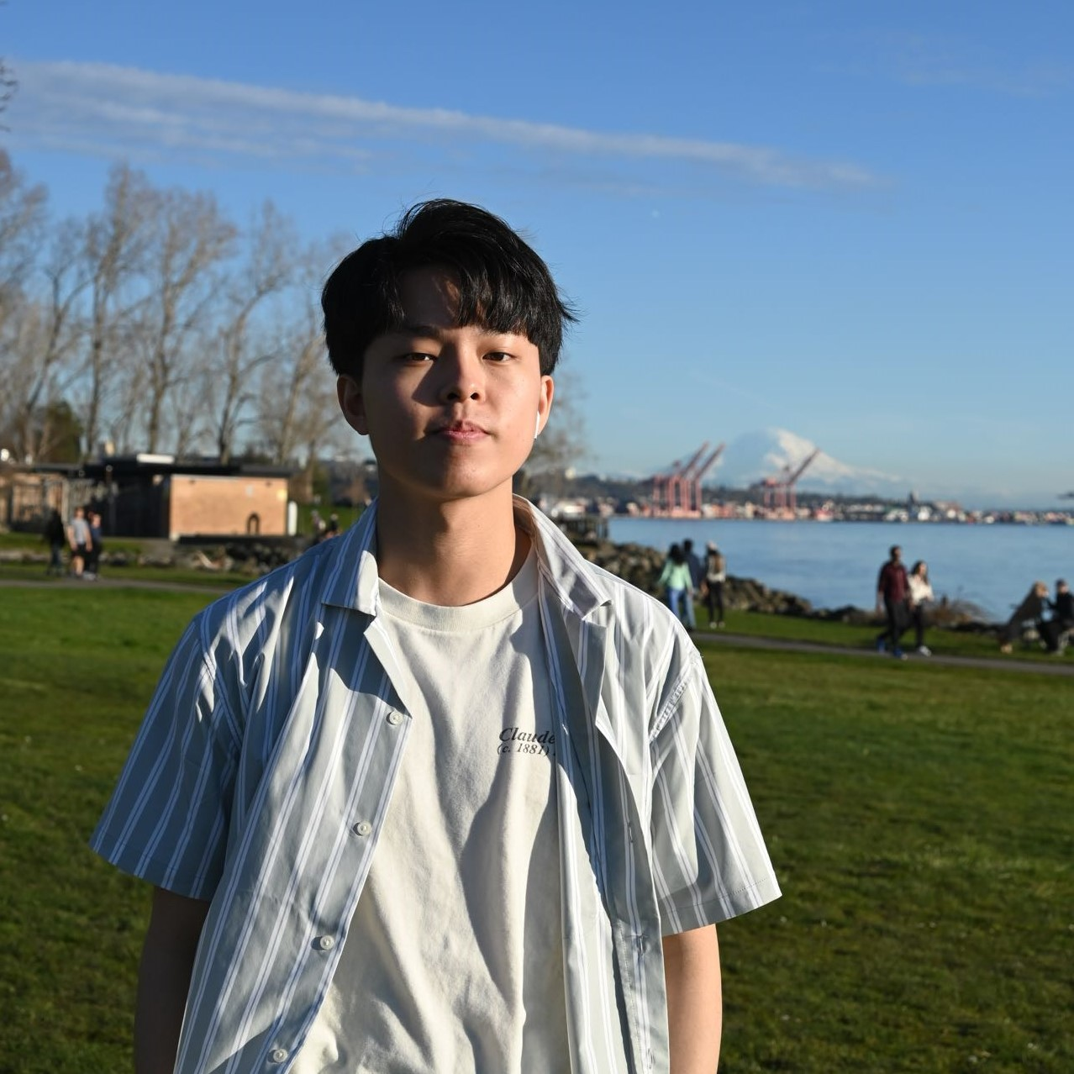
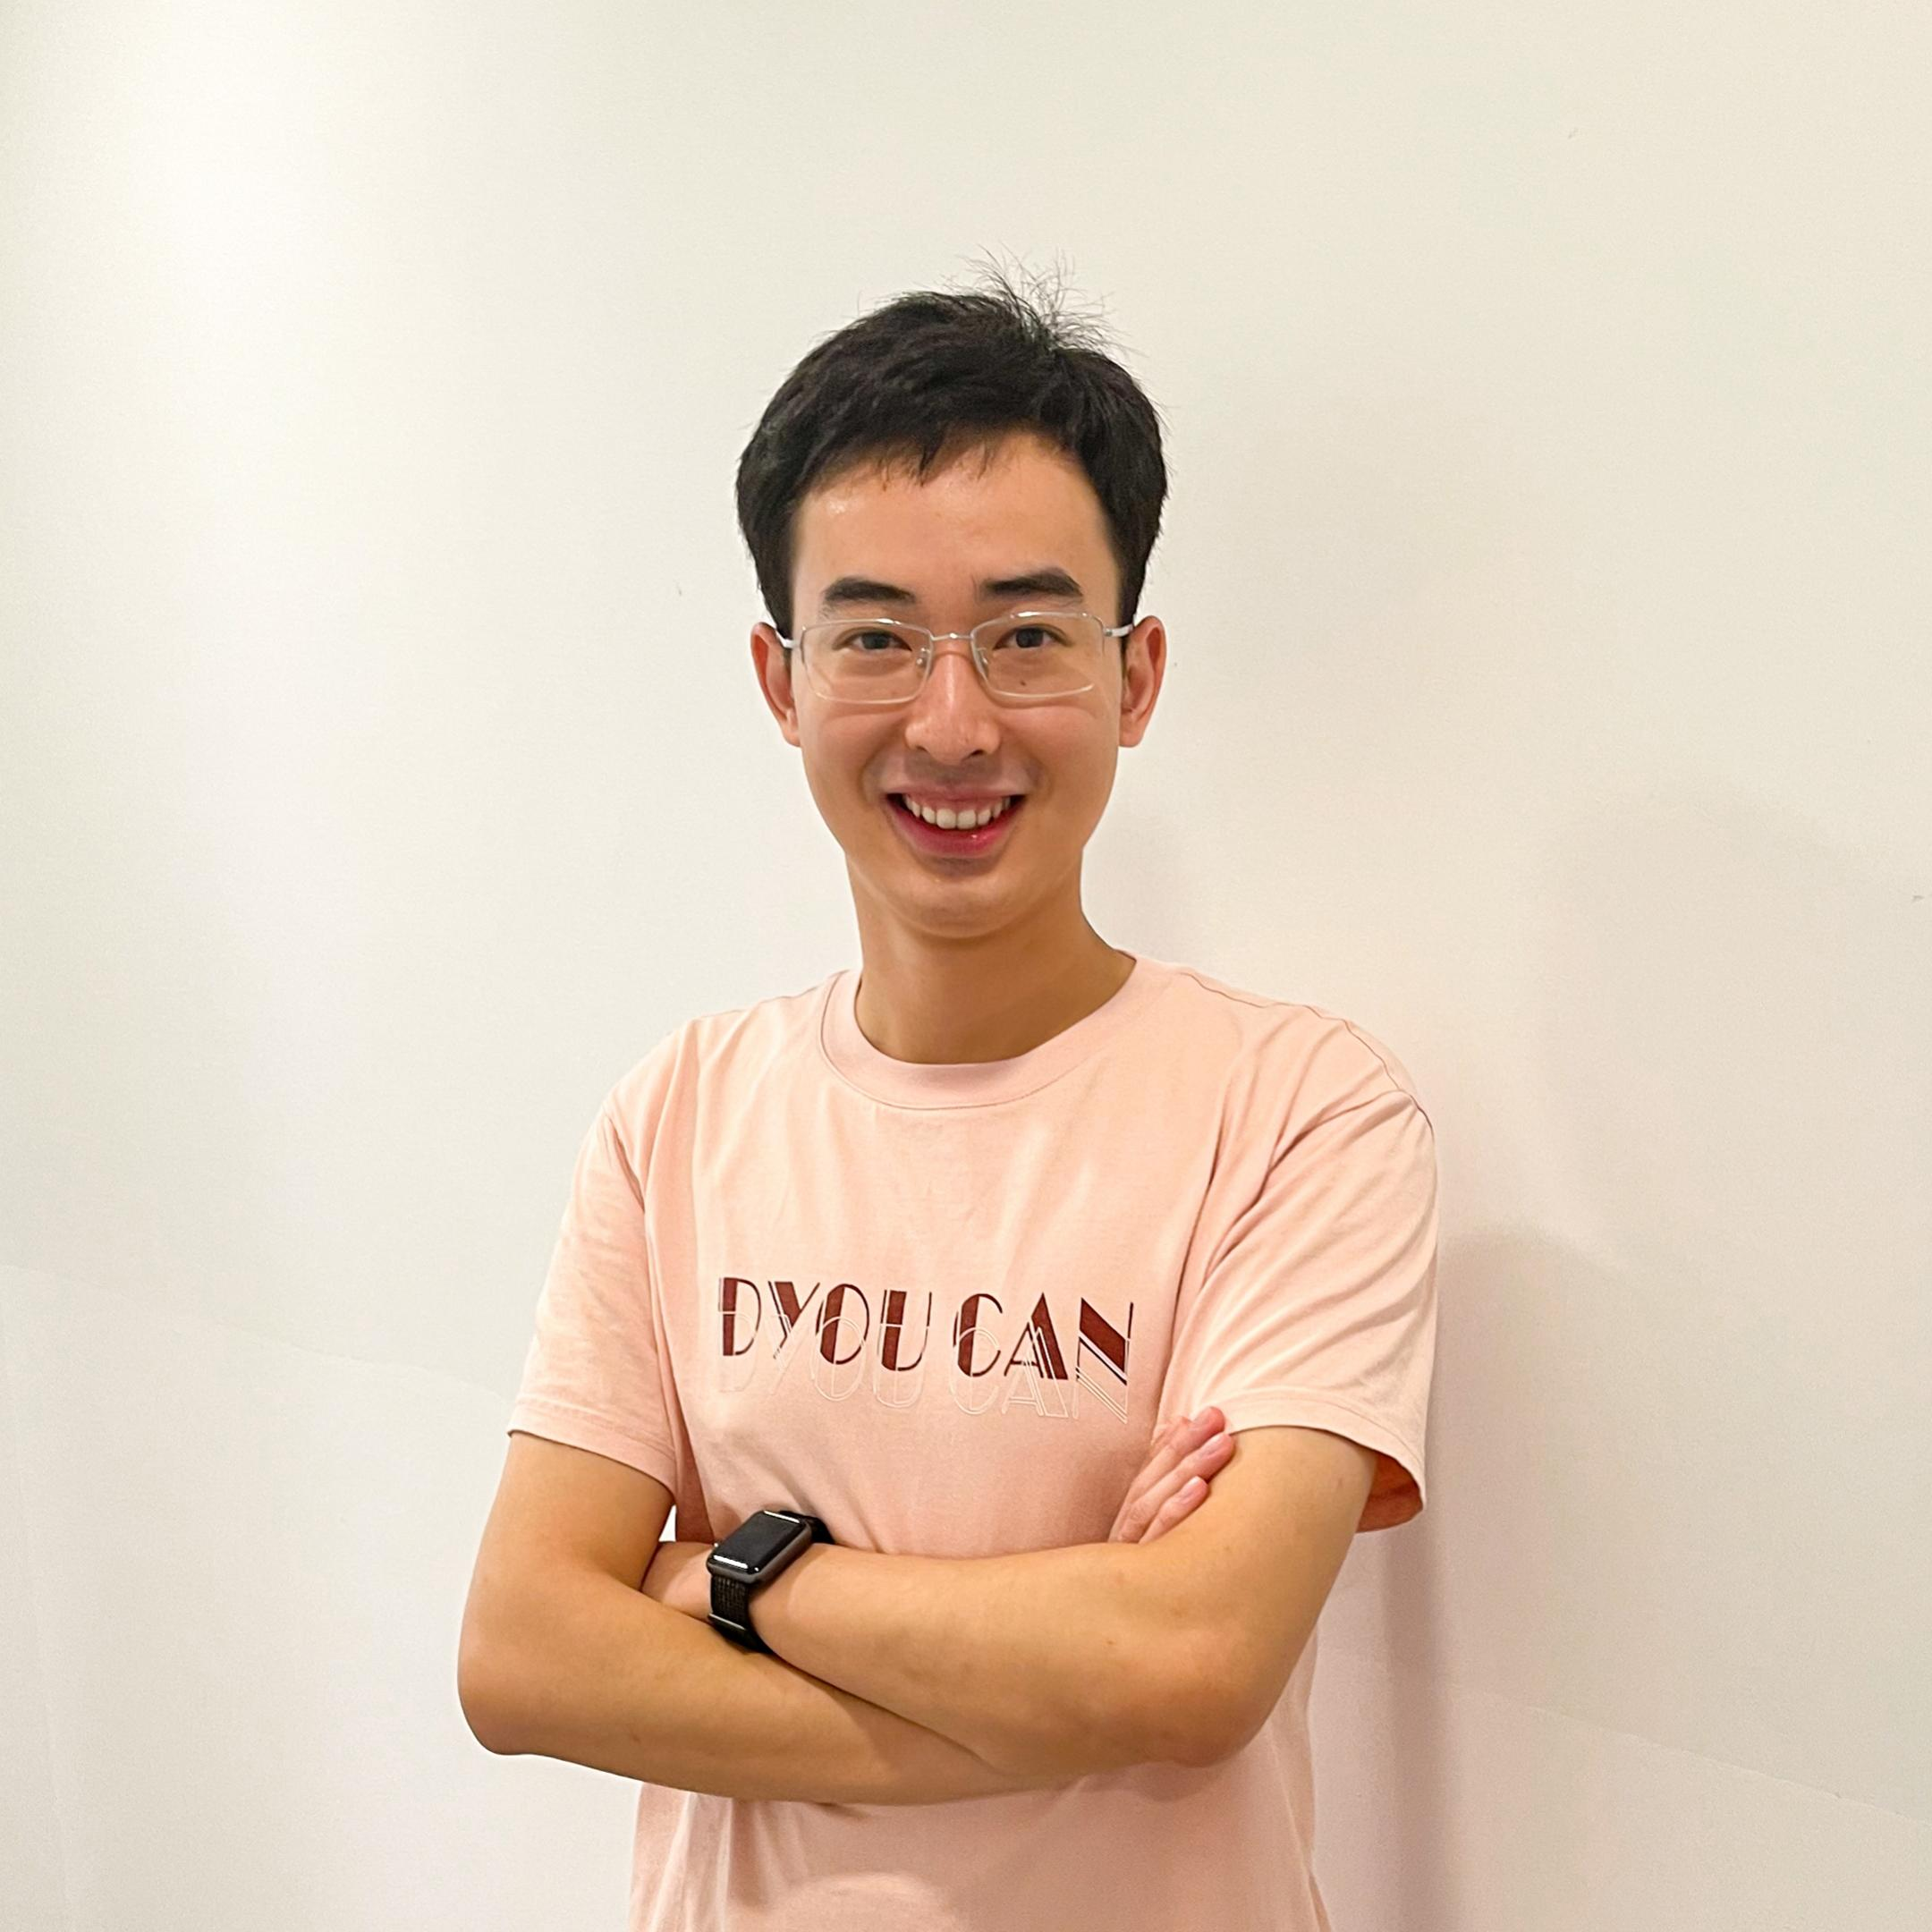
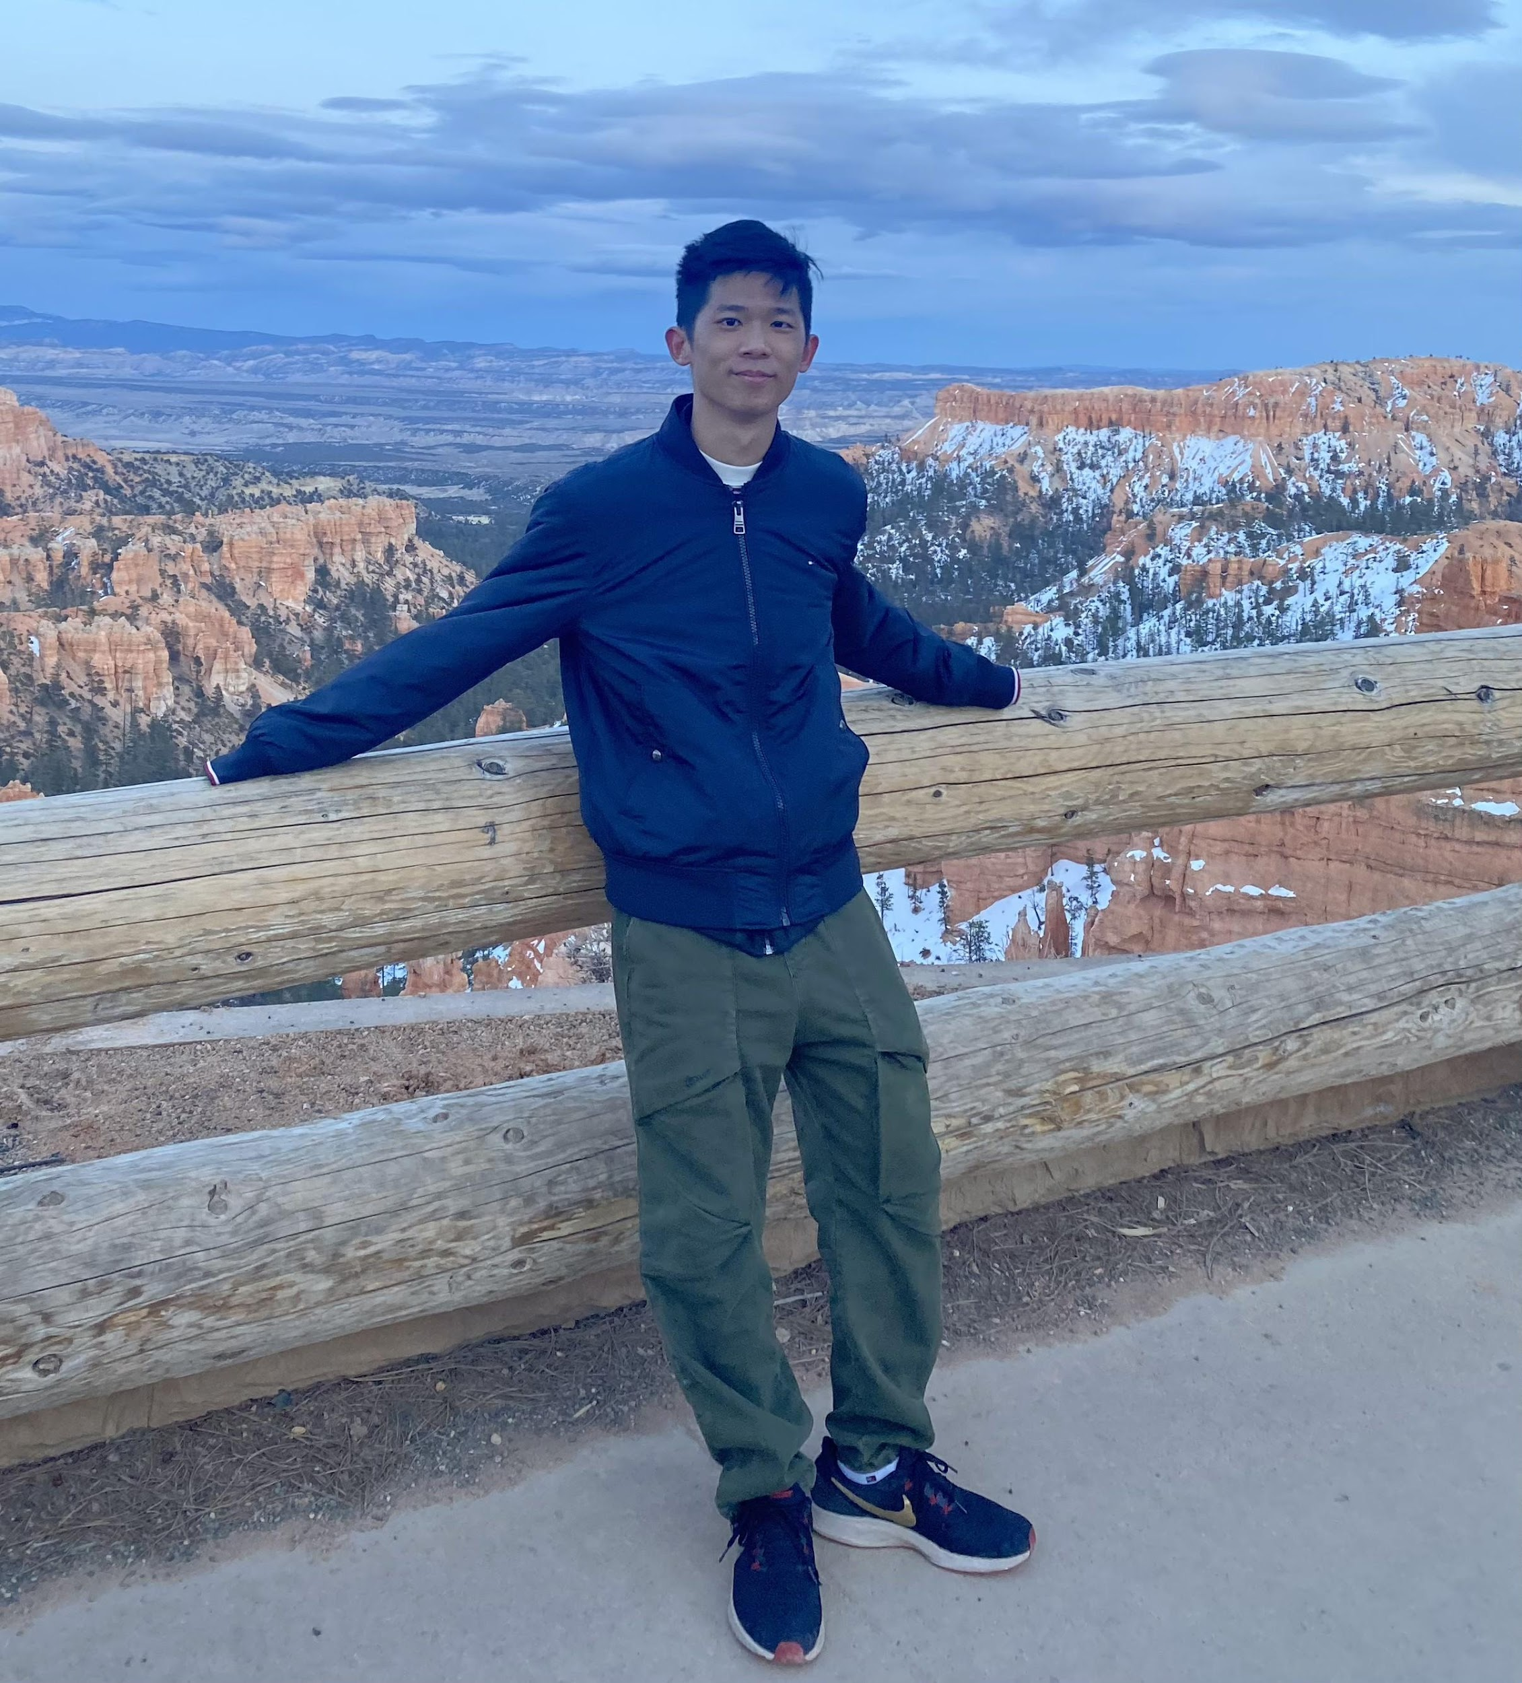
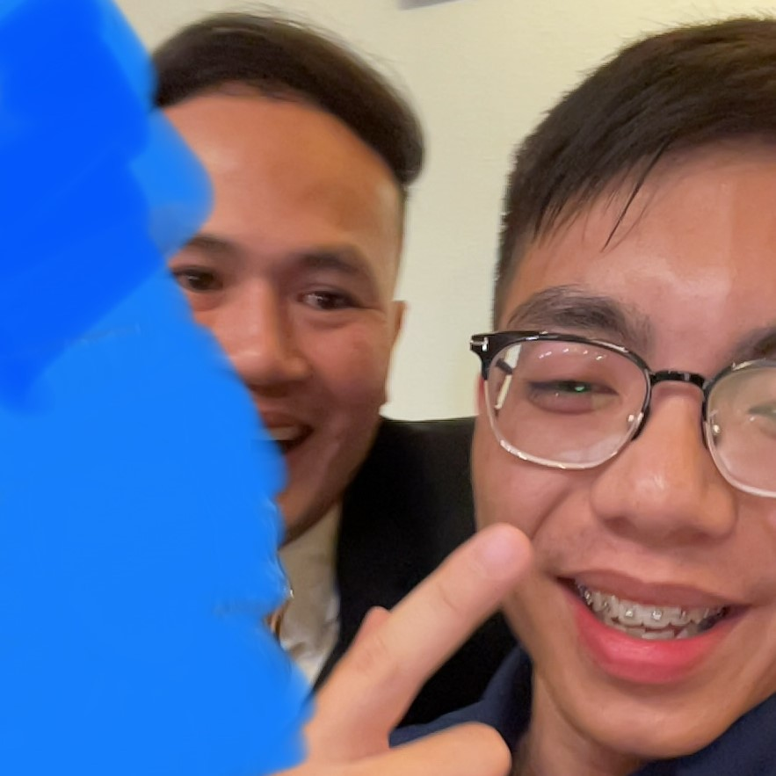
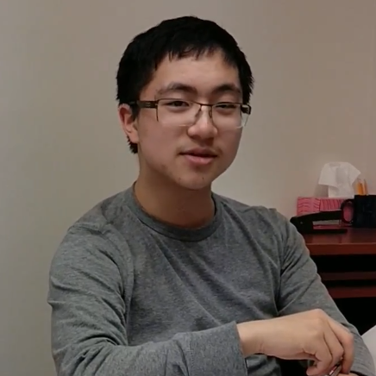
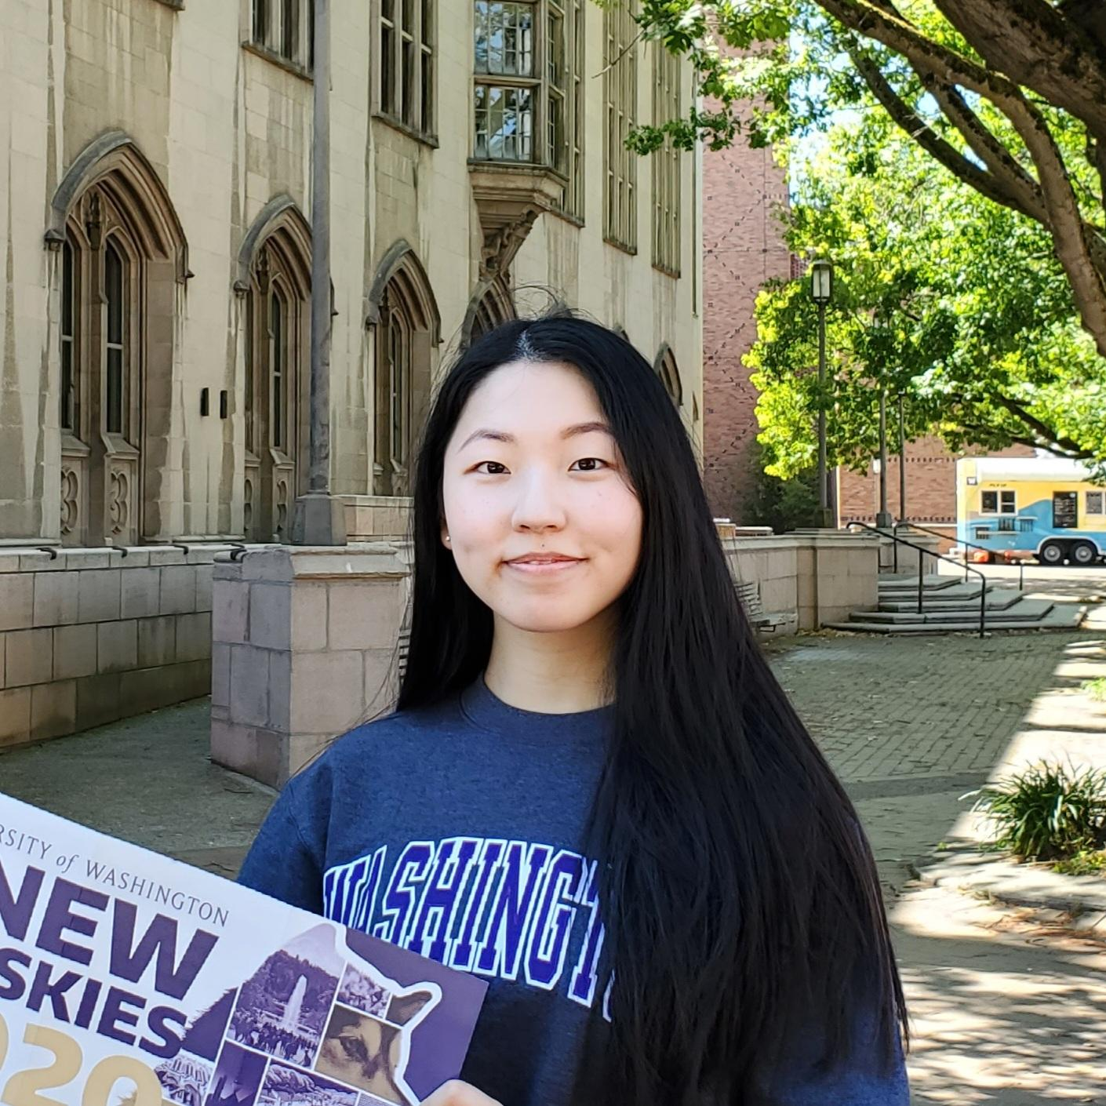
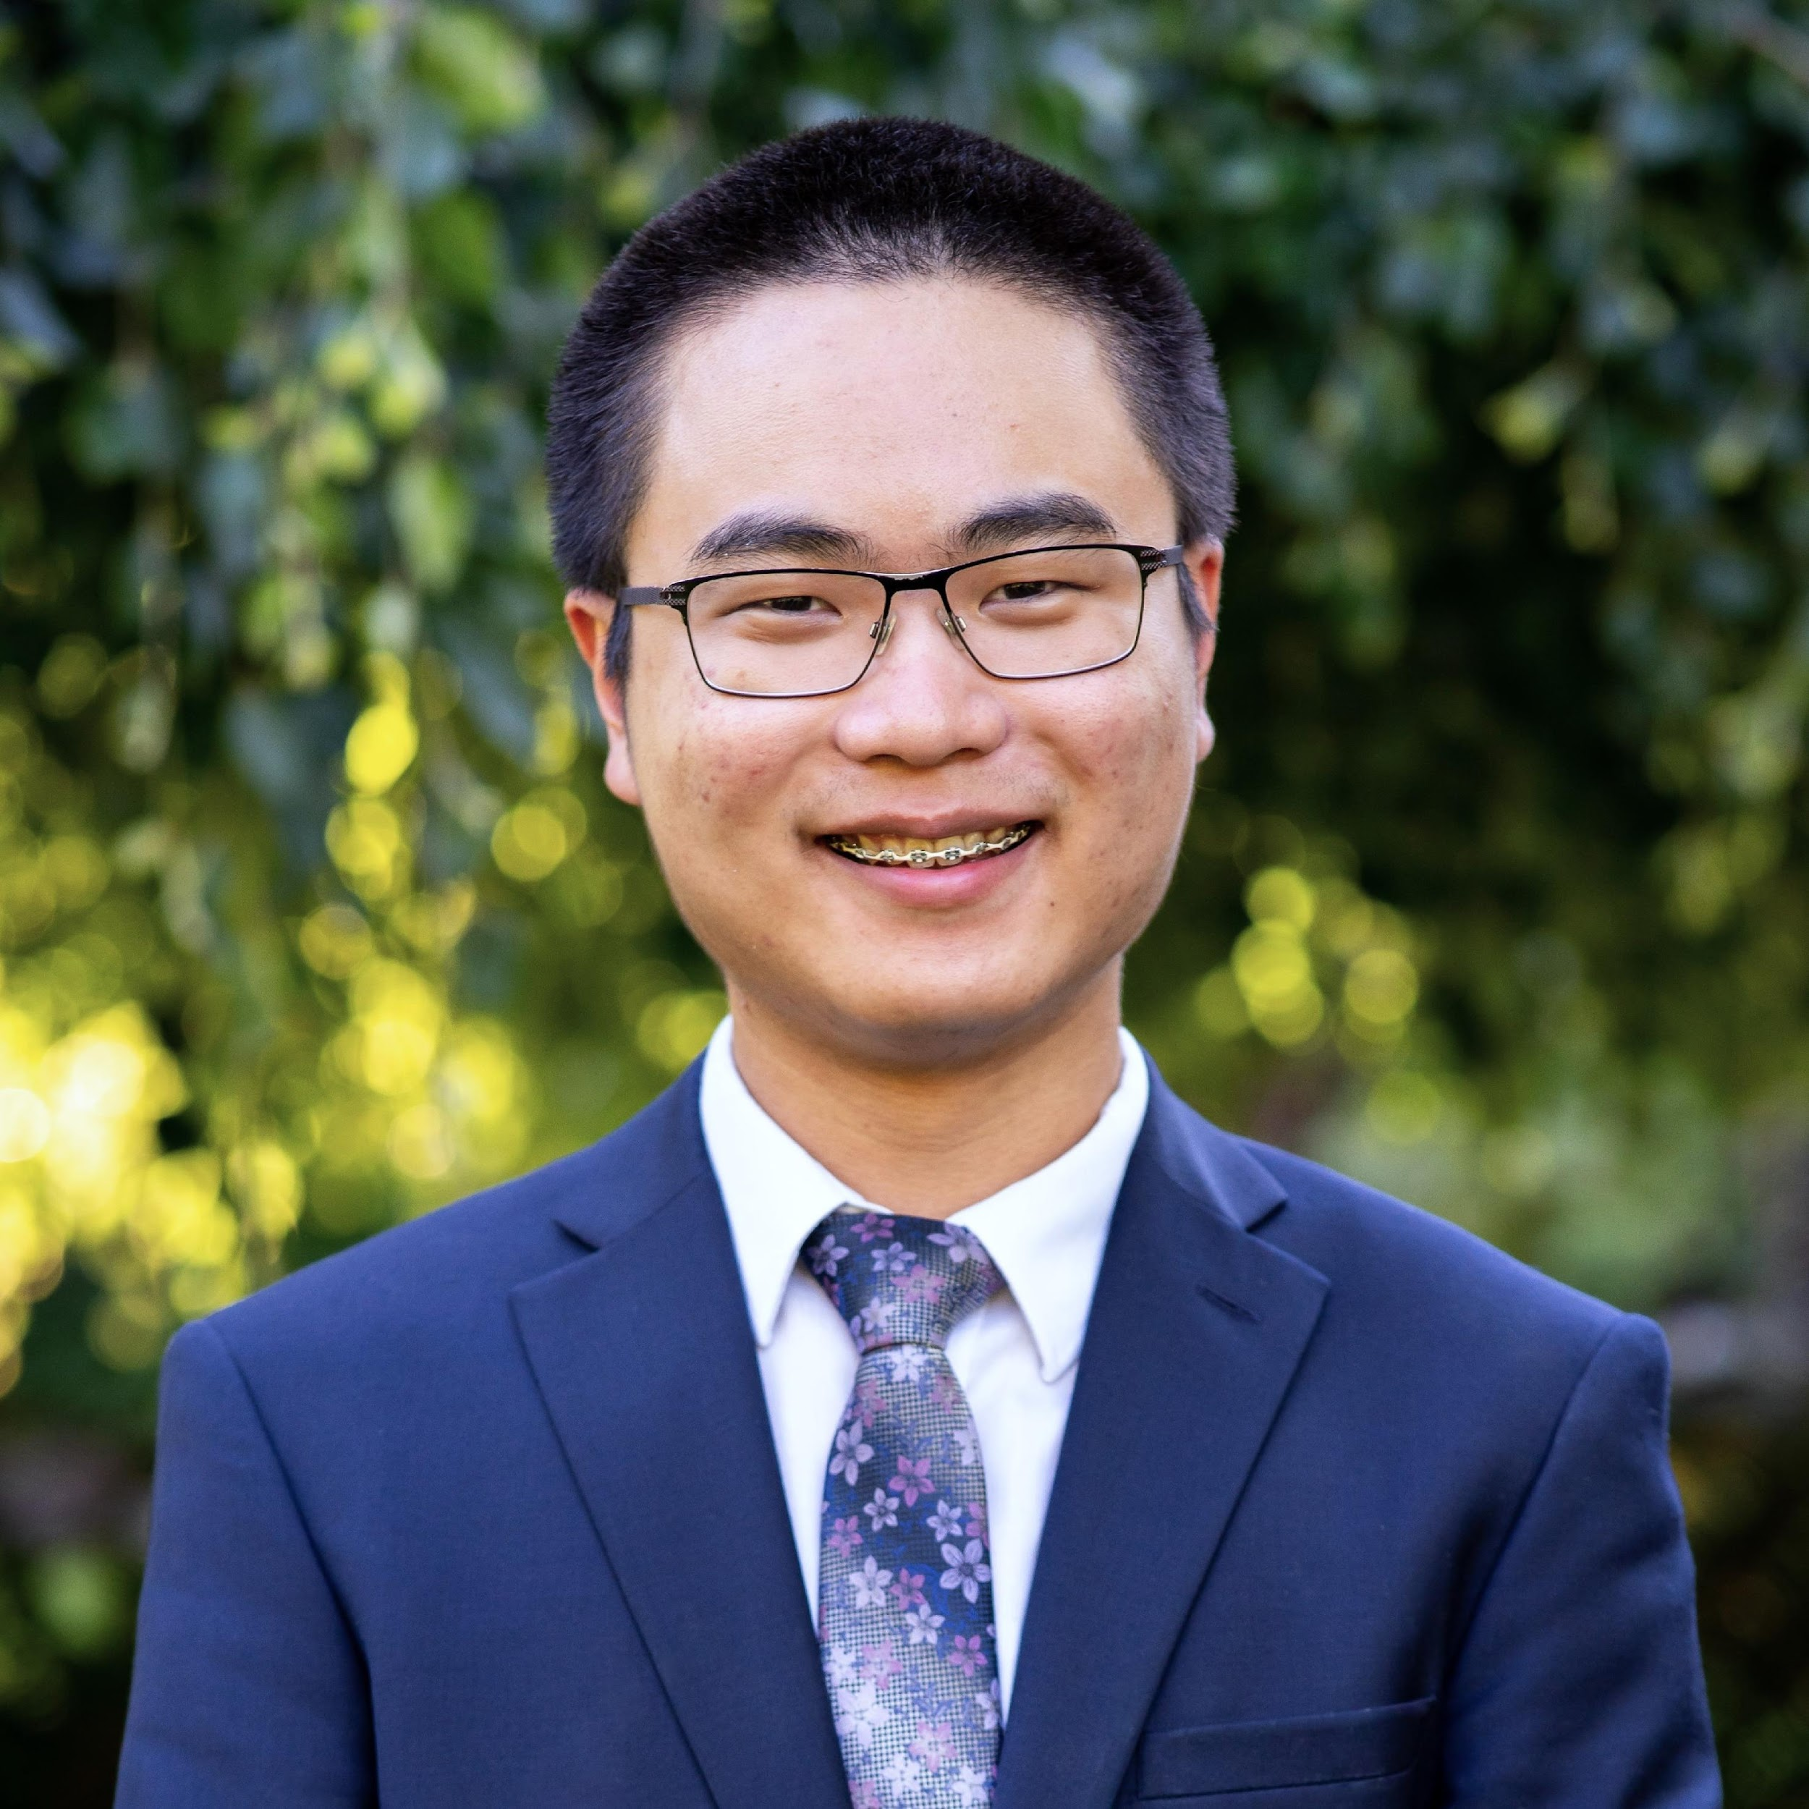
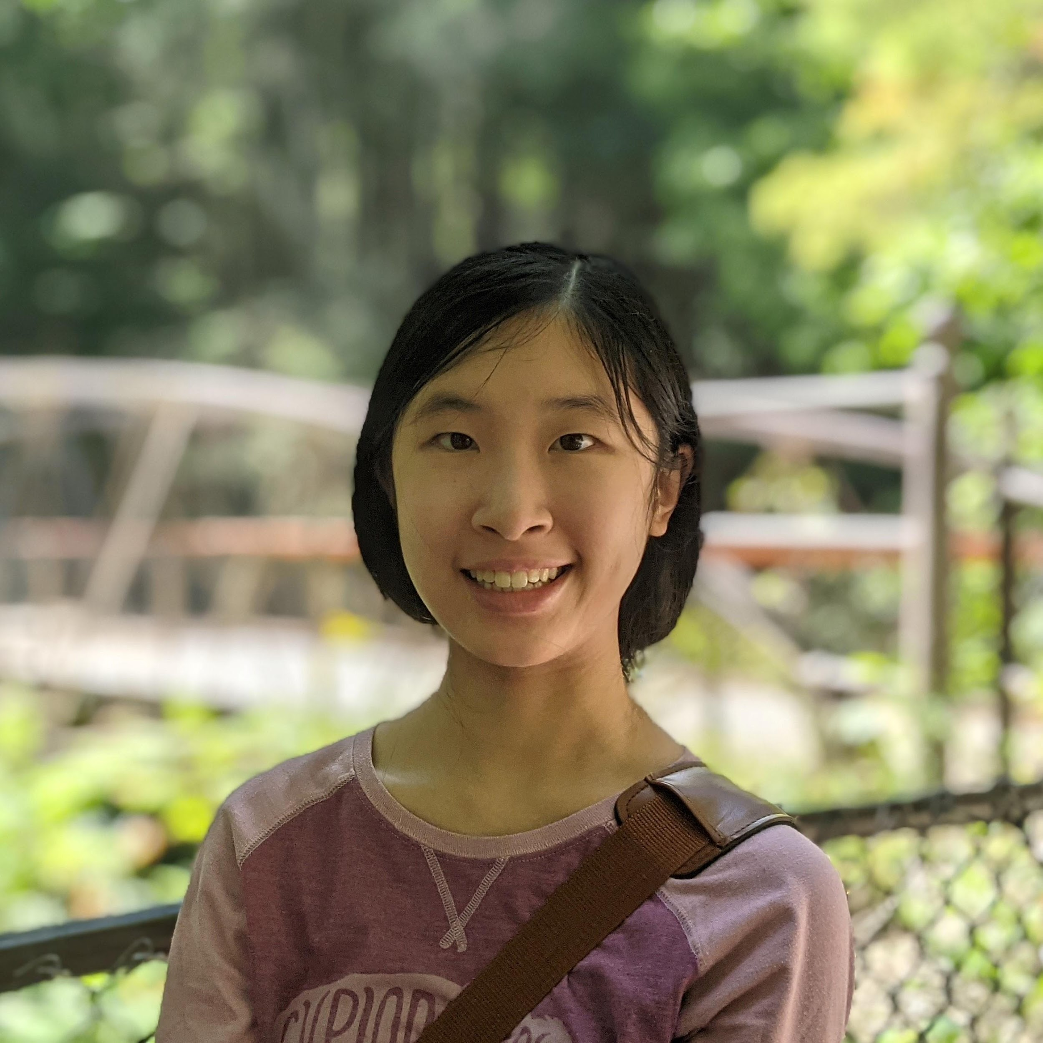
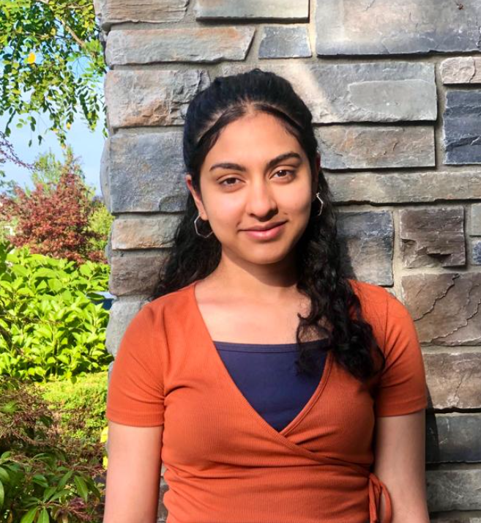
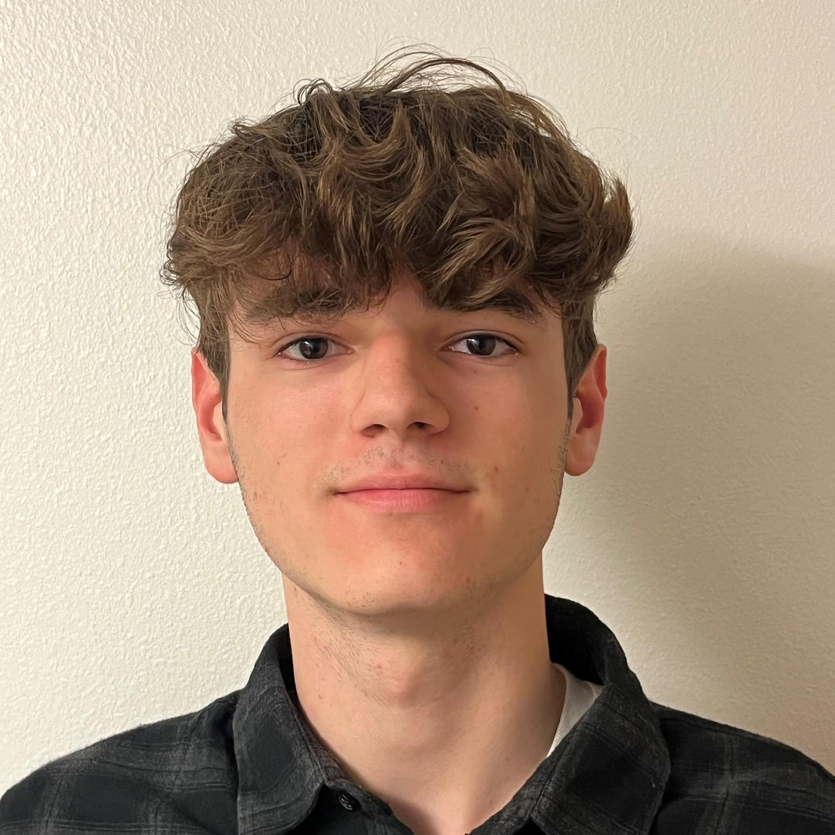
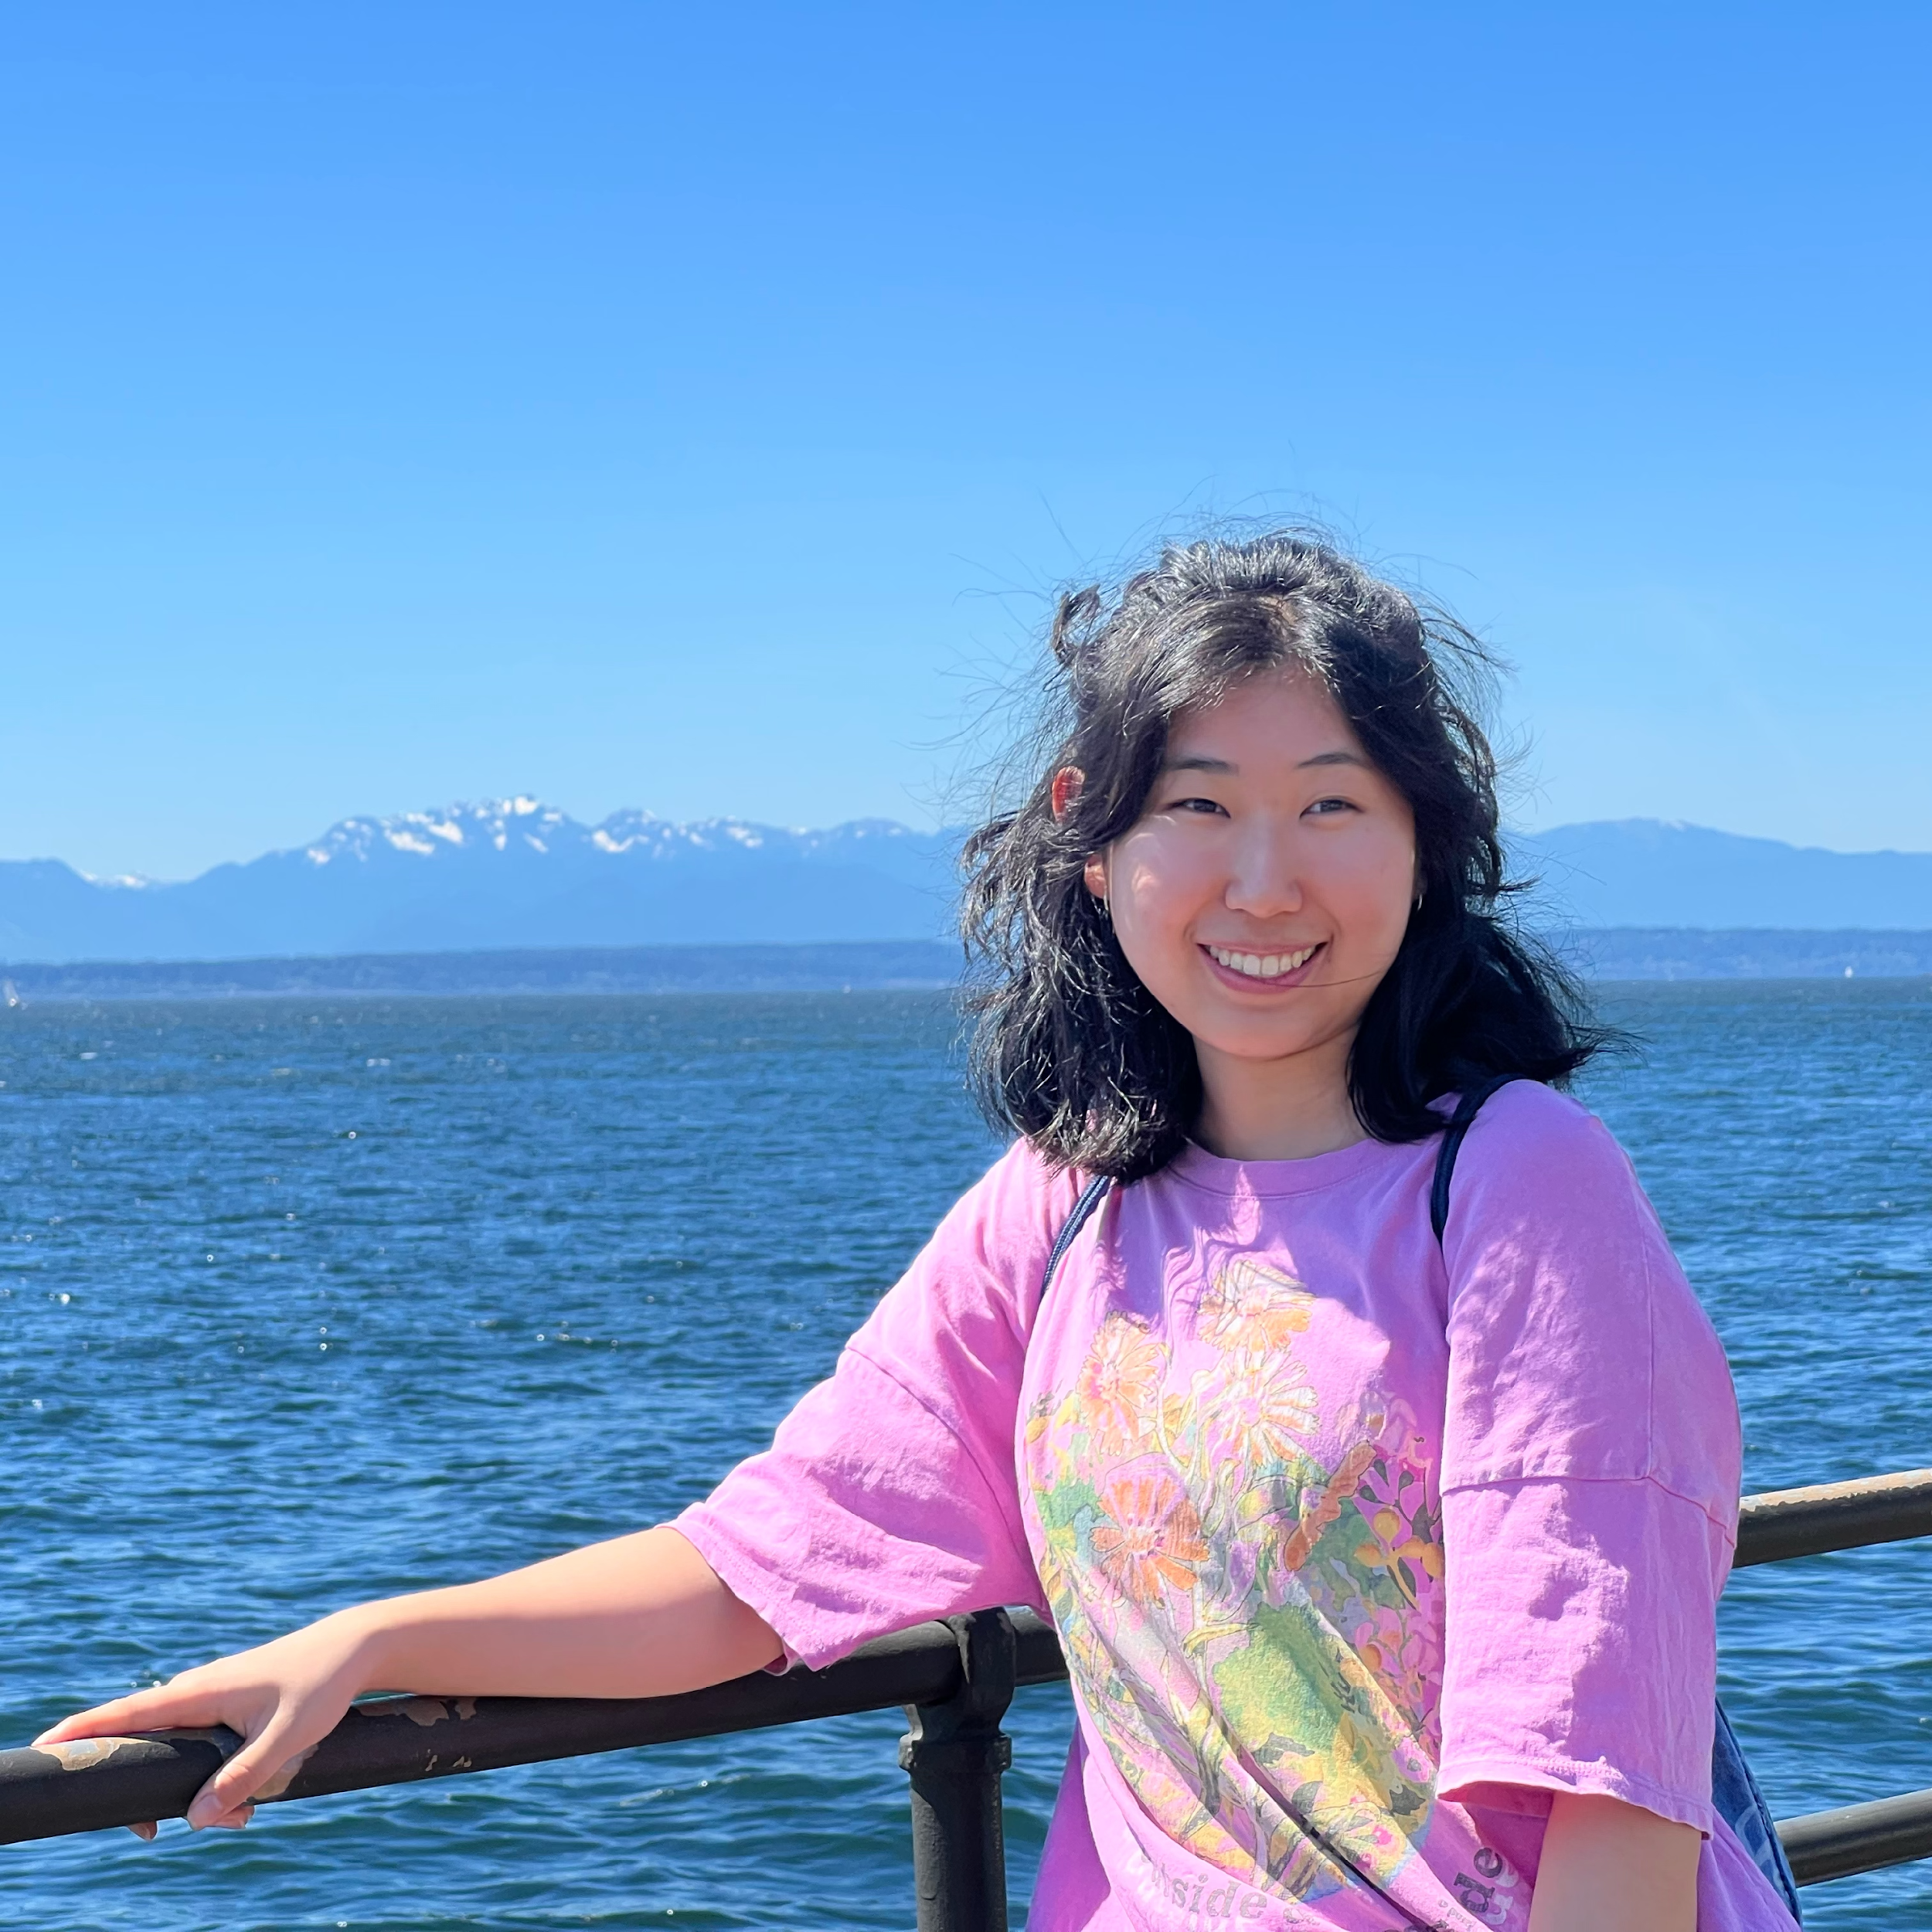
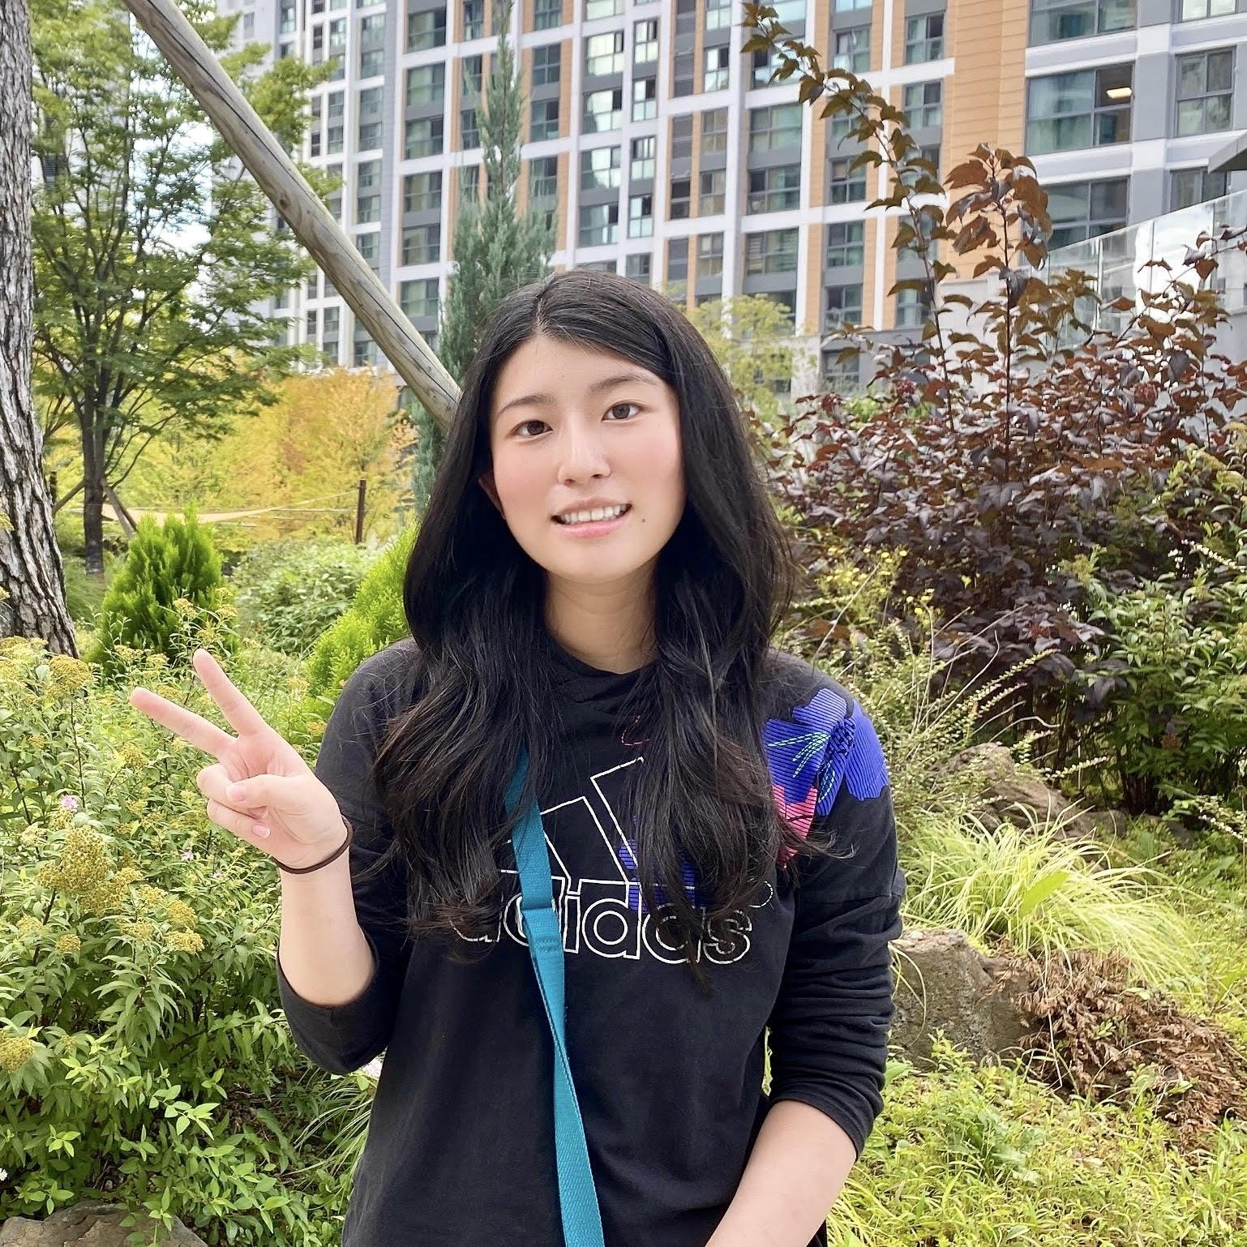
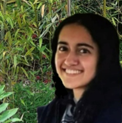
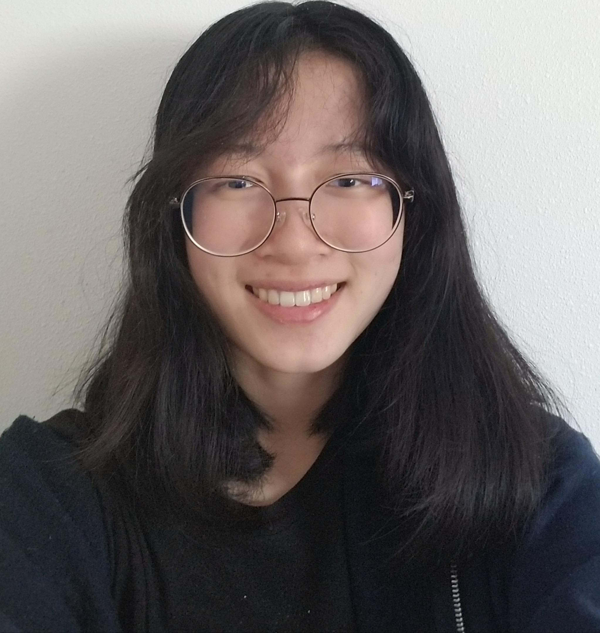
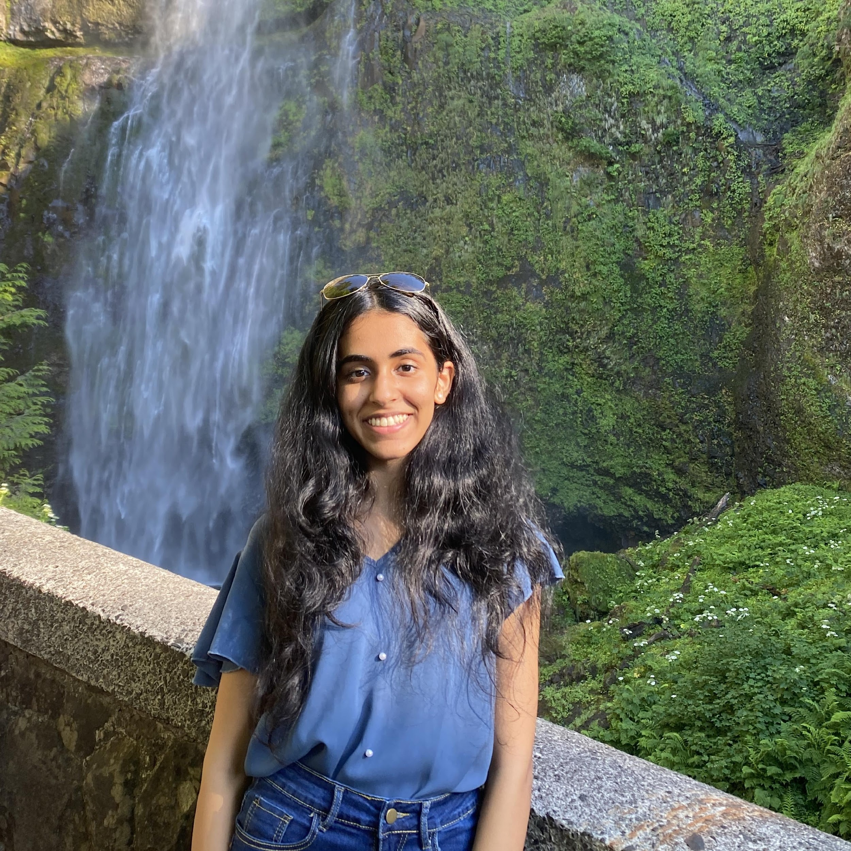
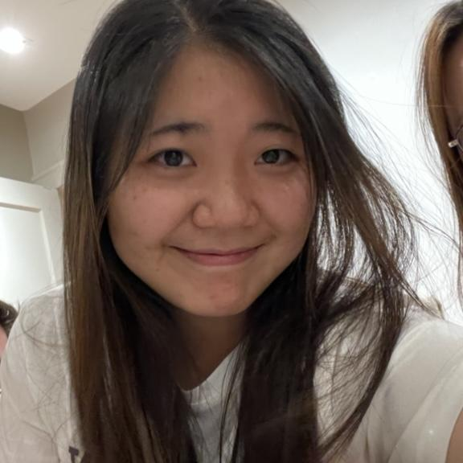
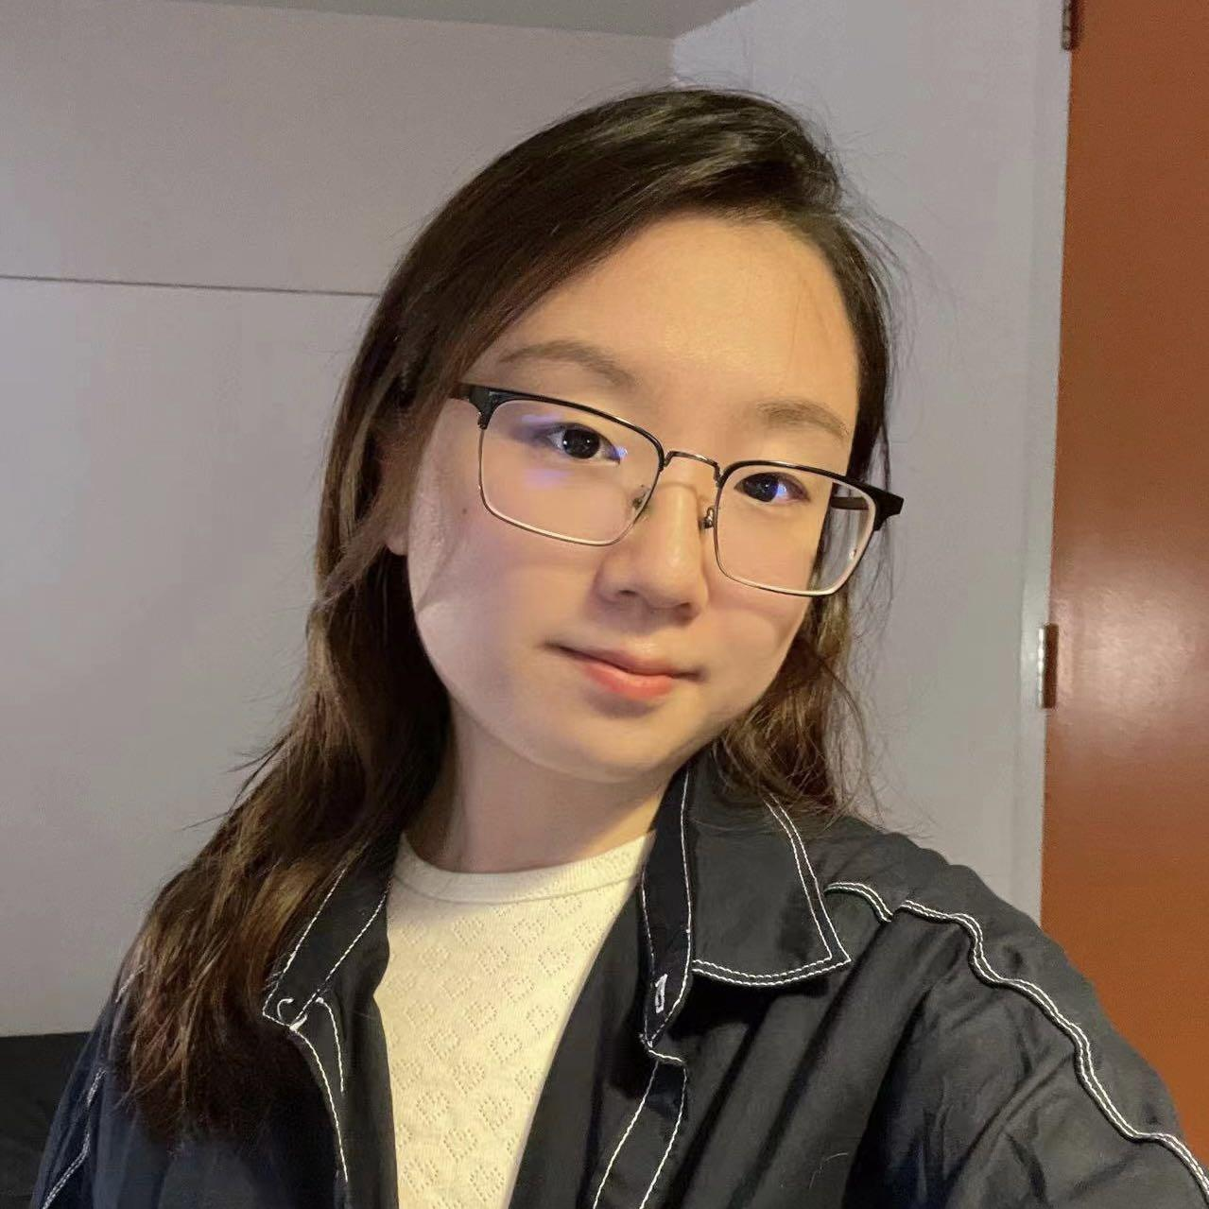
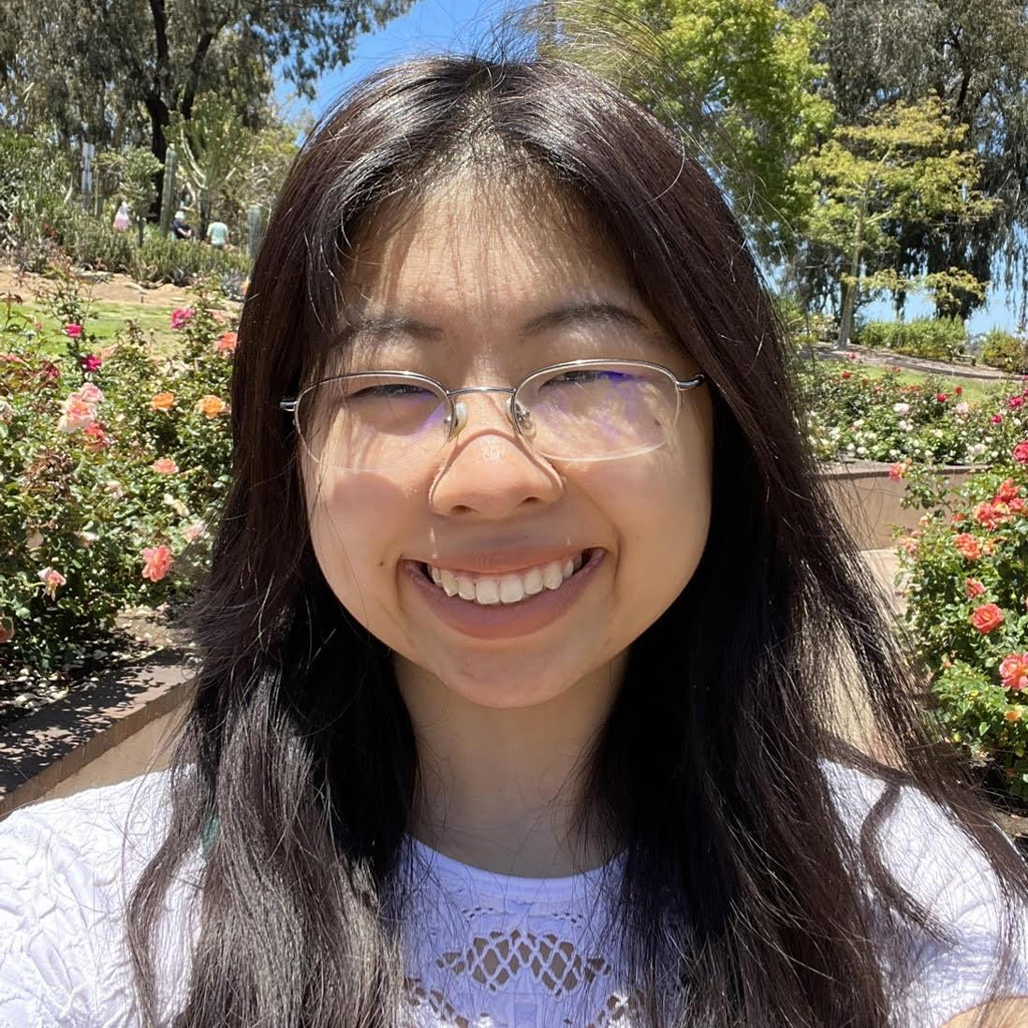
Thank your TAs!
Wrap-Up – Autumn 2022
Notes:
Elba

Slide 4
Learning Objectives
or, “What did I learn in this class?”
Computational Thinking Create an algorithm to solve a given problem and express that algorithm in a structured way (e.g. pseudocode)
Comprehension Trace and predict the behavior of programs and systems
Code Writing Write functionally correct Java programs that meet a provided specification using control structures, primitive data types, and basic data abstractions
Communication Clearly and effectively describe the behavior of a given code snippet
Debugging Identify errors in a method’s behavior & implement fixes for identified errors
Decomposition Solve problems by breaking them into subproblems and recombining the solutions using techniques such as methods
Ethics/Impact Describe ethical and sociotechnical issues related to software and technology and explain how their choices as programmers can impact those issues

Slide 5
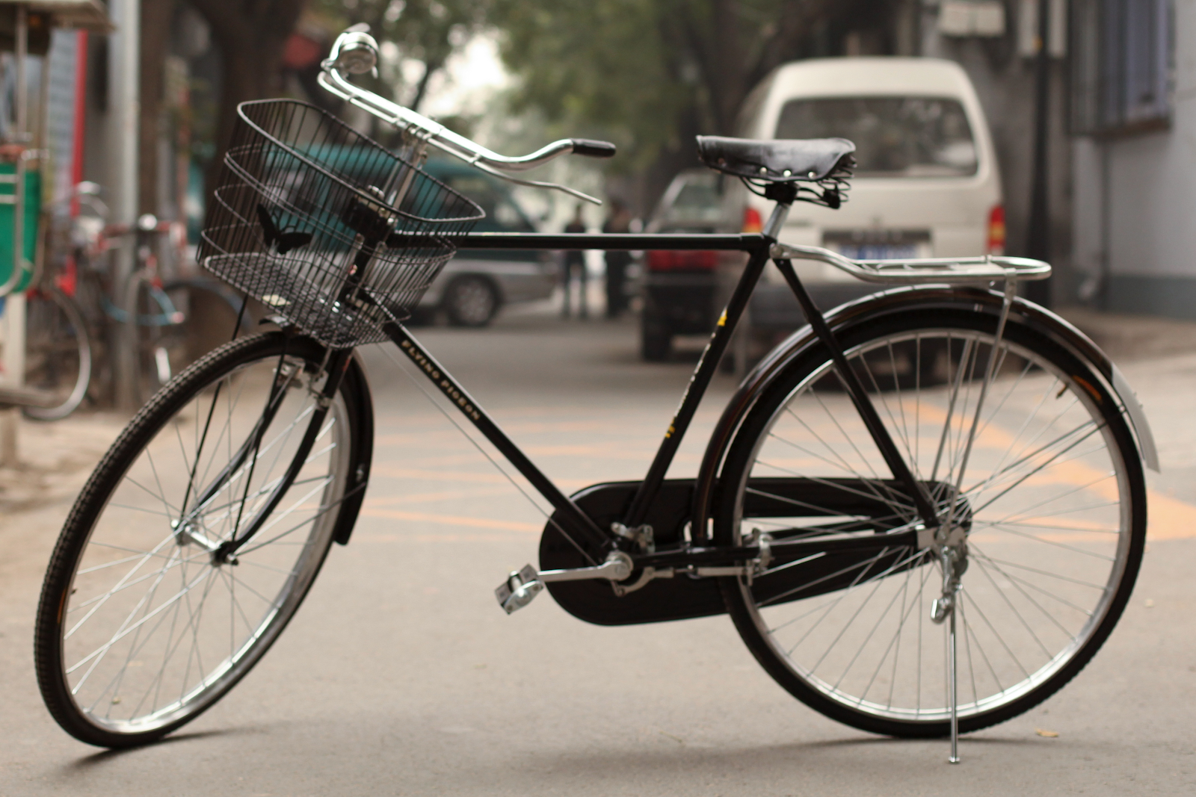

Slide 6
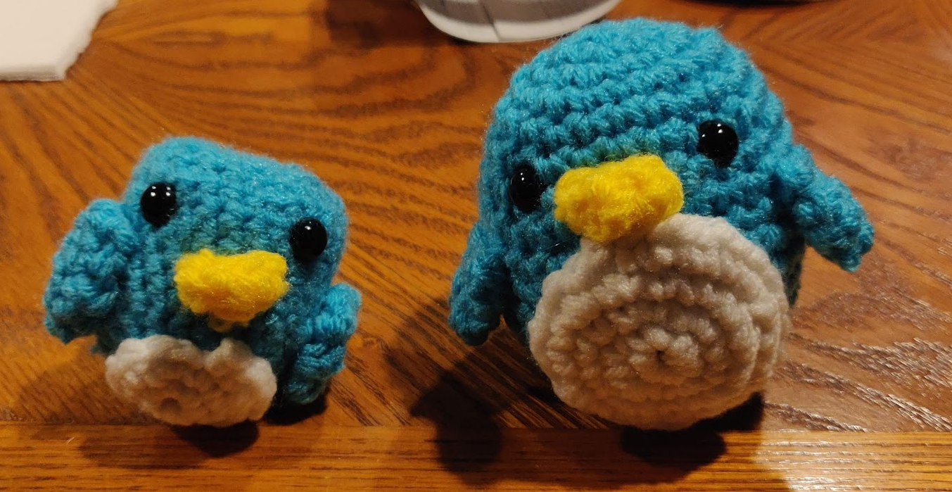
Digression: My New Hobby
Amigurumi: Japanese art of creating crocheted or knitted stuffed toys

Slide 7
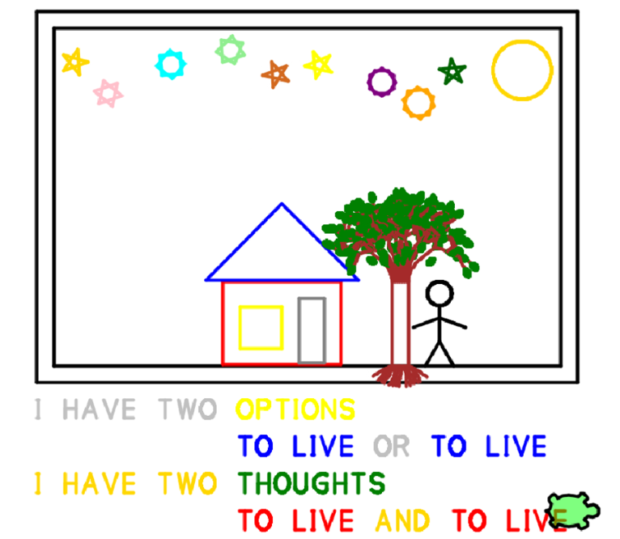
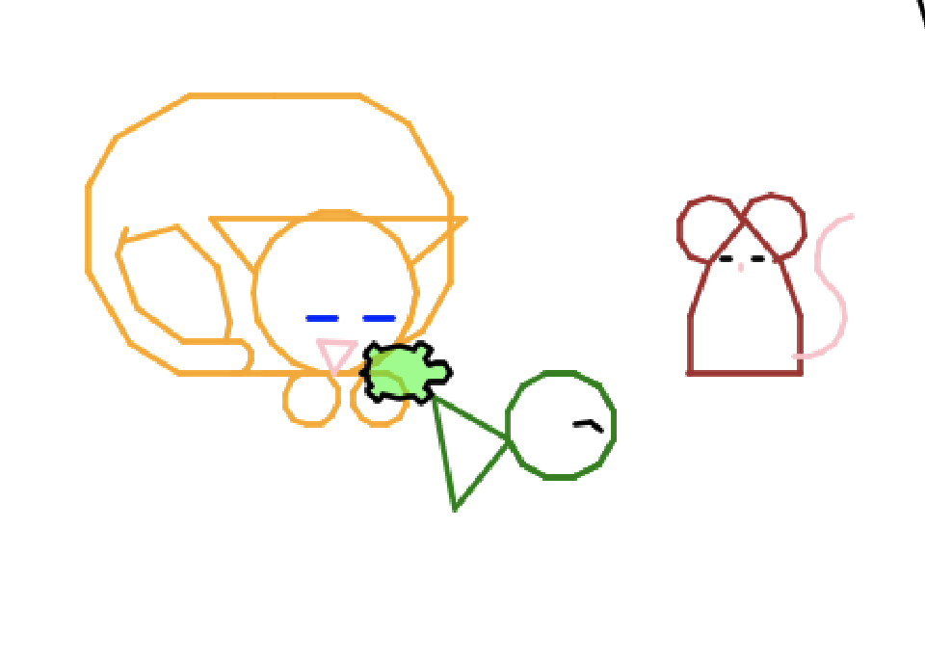
You made some pretty cool crafts yourself!

Slide 8
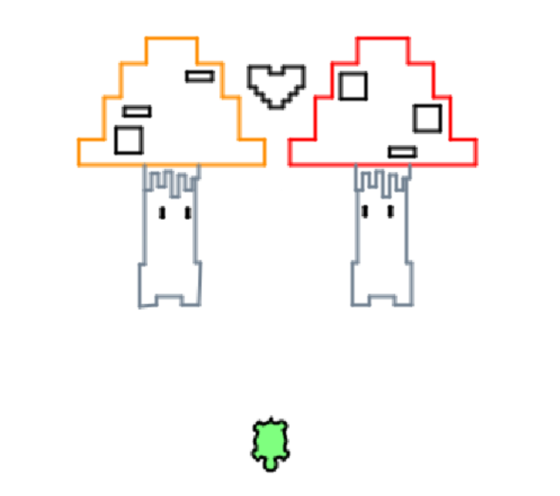
You made some pretty cool crafts yourself!

Slide 9
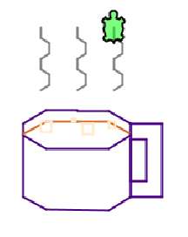
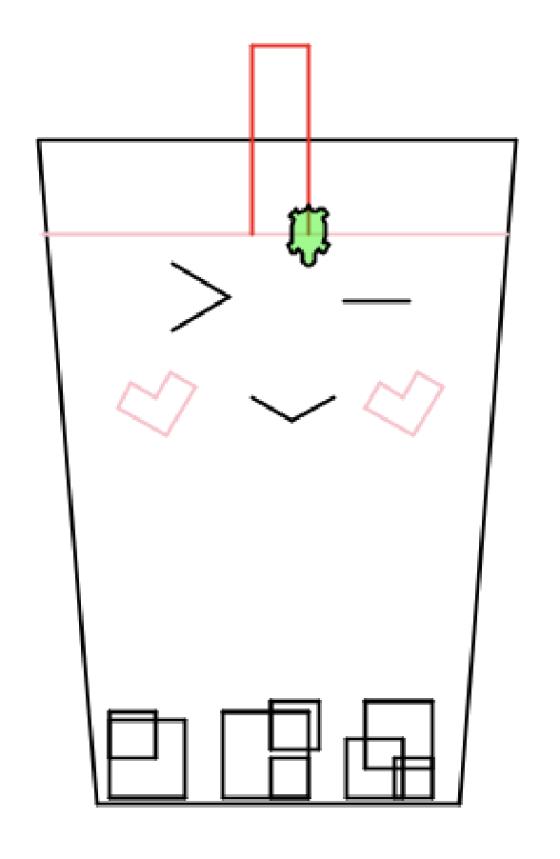
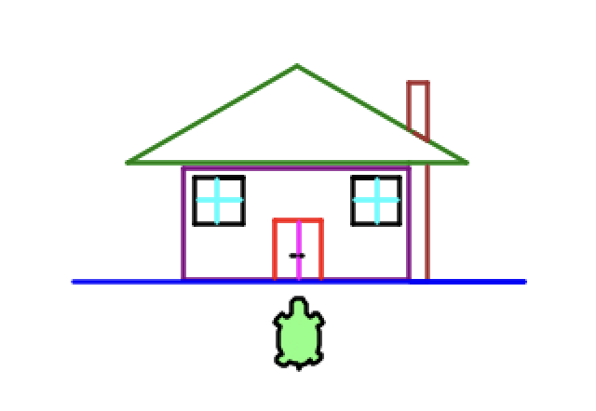
You made some pretty cool crafts yourself!

Slide 10
Applications of CS
or “What can I do with what I learned?”
Detect and prevent toxicity online
Digitize basketball players
Help DHH people identify sounds
Figure out how to best distribute relief funds
Recognize disinformation online
Make movies
Improve digital collaboration
Fix Olympic badminton
And so much more!

Slide 11
Future Courses
or “What can I do next?”
Course | Overview
CSE 122 | Introduction to Computer Programming II
CSE 123 | Introduction to Computer Programming III
Non-majors
Course | Overview
CSE 154 | Intro. to web programming (several languages)
CSE 163 | Intermediate programming, data analysis (Python)
CSE 180 | Introduction to data science (Python)
CSE 373 | Data structures and algorithms (non-majors)
CSE 374 | Low-level programming and tools (C/C++)
CSE 416 | Intro. to Machine Learning
Majors
Course | Overview
CSE 311 | Mathematical foundations
CSE 351 | Low-level computer organization/abstraction
CSE 331 | Software design/implementation
CSE 341 | Programming languages (!)
CSE 340 | Interaction programming
See: https://www.cs.washington.edu/academics/ugrad/current-students and https://www.cs.washington.edu/academics/ugrad/nonmajor-options/nonmajor-courses

Slide 12
Frequently Asked Questions
How can I get better at programming?
Practice!
How can I learn to X?
Search online, read books, look at examples
What should I work on next?
Anything you can think of! (Here are some ideas)
Beware: it’s hard to tell what’s easy and what’s hard.
Should I learn another language? Which one?
That depends–what do you want to do?
What’s the best programming language?
😠 (take CSE 341)

Slide 13
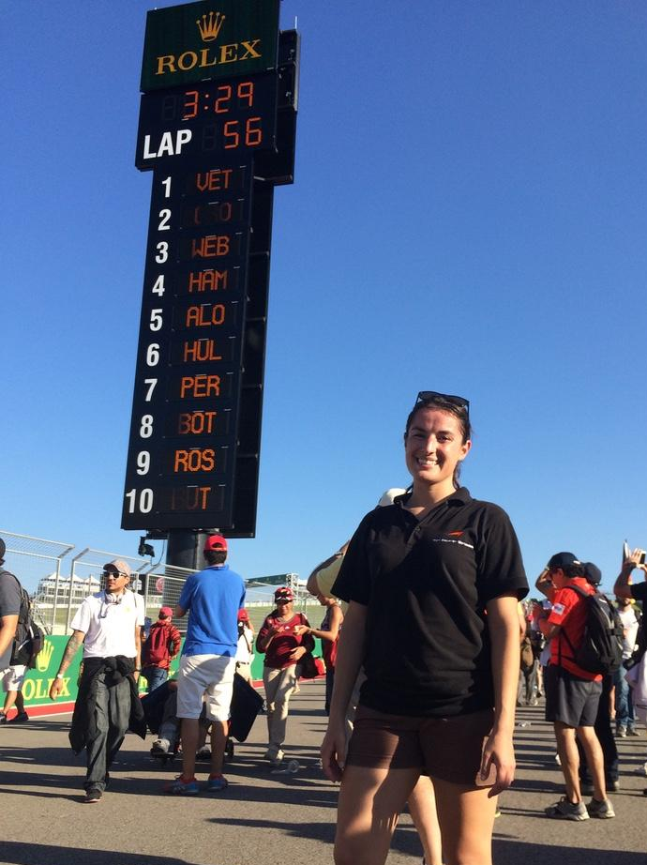
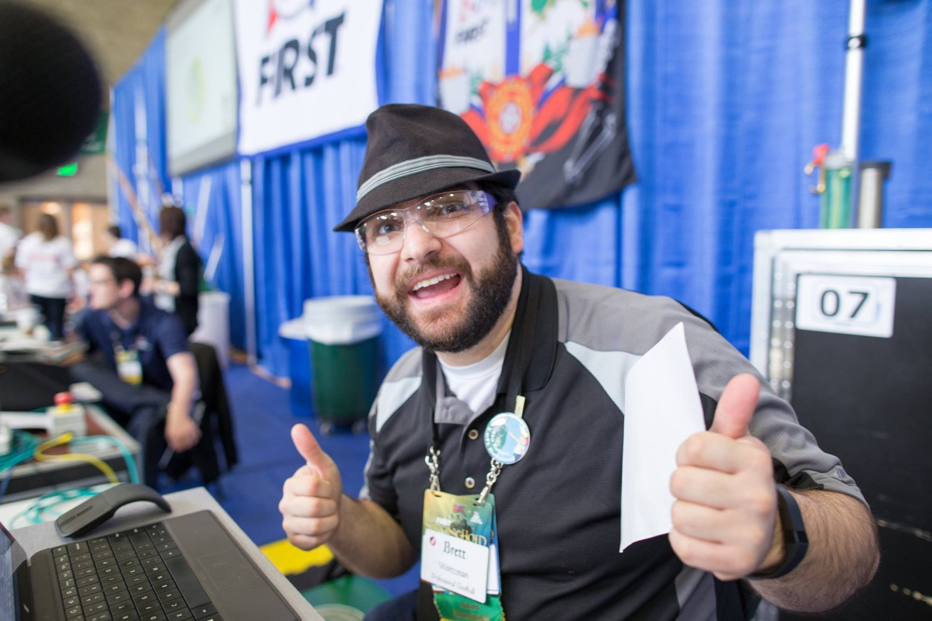
Thank you!!!
Ask Us (Almost) Anything!

