Slide 1
Welcome to CSE 121!
Brett Wortzman/Elba Garza
Autumn 2022

Slide 2
Agenda
About us
About this course
Learning objectives
Other similar courses
Course components
Our learning model
Tools and resources
Course Website
Ed
Hello, World!
Assessment and grading
Collaboration
Notes:
Brett

Slide 3
Agenda
About us
About this course
Learning objectives
Other similar courses
Course components
Our learning model
Tools and resources
Course Website
Ed
Hello, World!
Assessment and grading
Collaboration
Notes:
:32
Brett

Slide 4
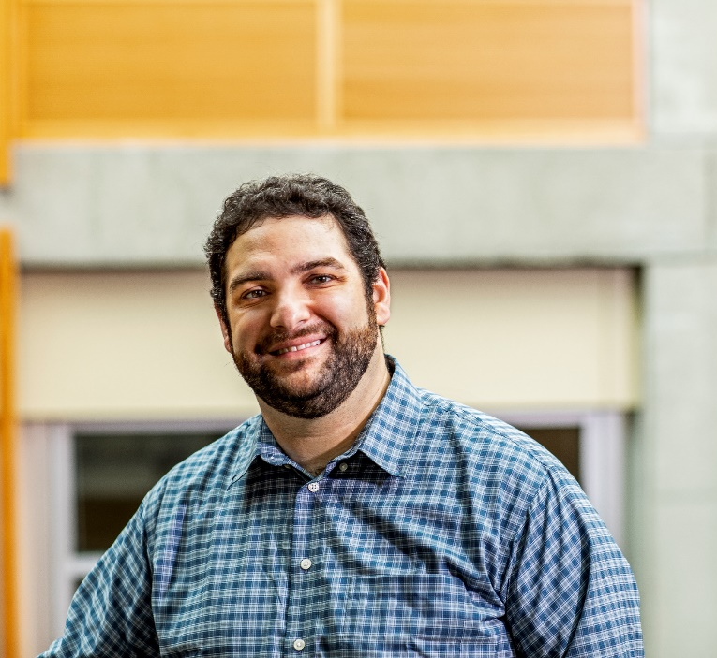
Hi, I’m Brett! (he/him)
Associate Teaching Professor
Frequent intro CS instructor
Lead designer/developer of new 12X curriculum
Also interested in CS education/pedagogy
Previously:
trained CS teachers
developed CS curriculum
taught high school CS
worked as a software engineer
Notes:
Brett

Slide 5
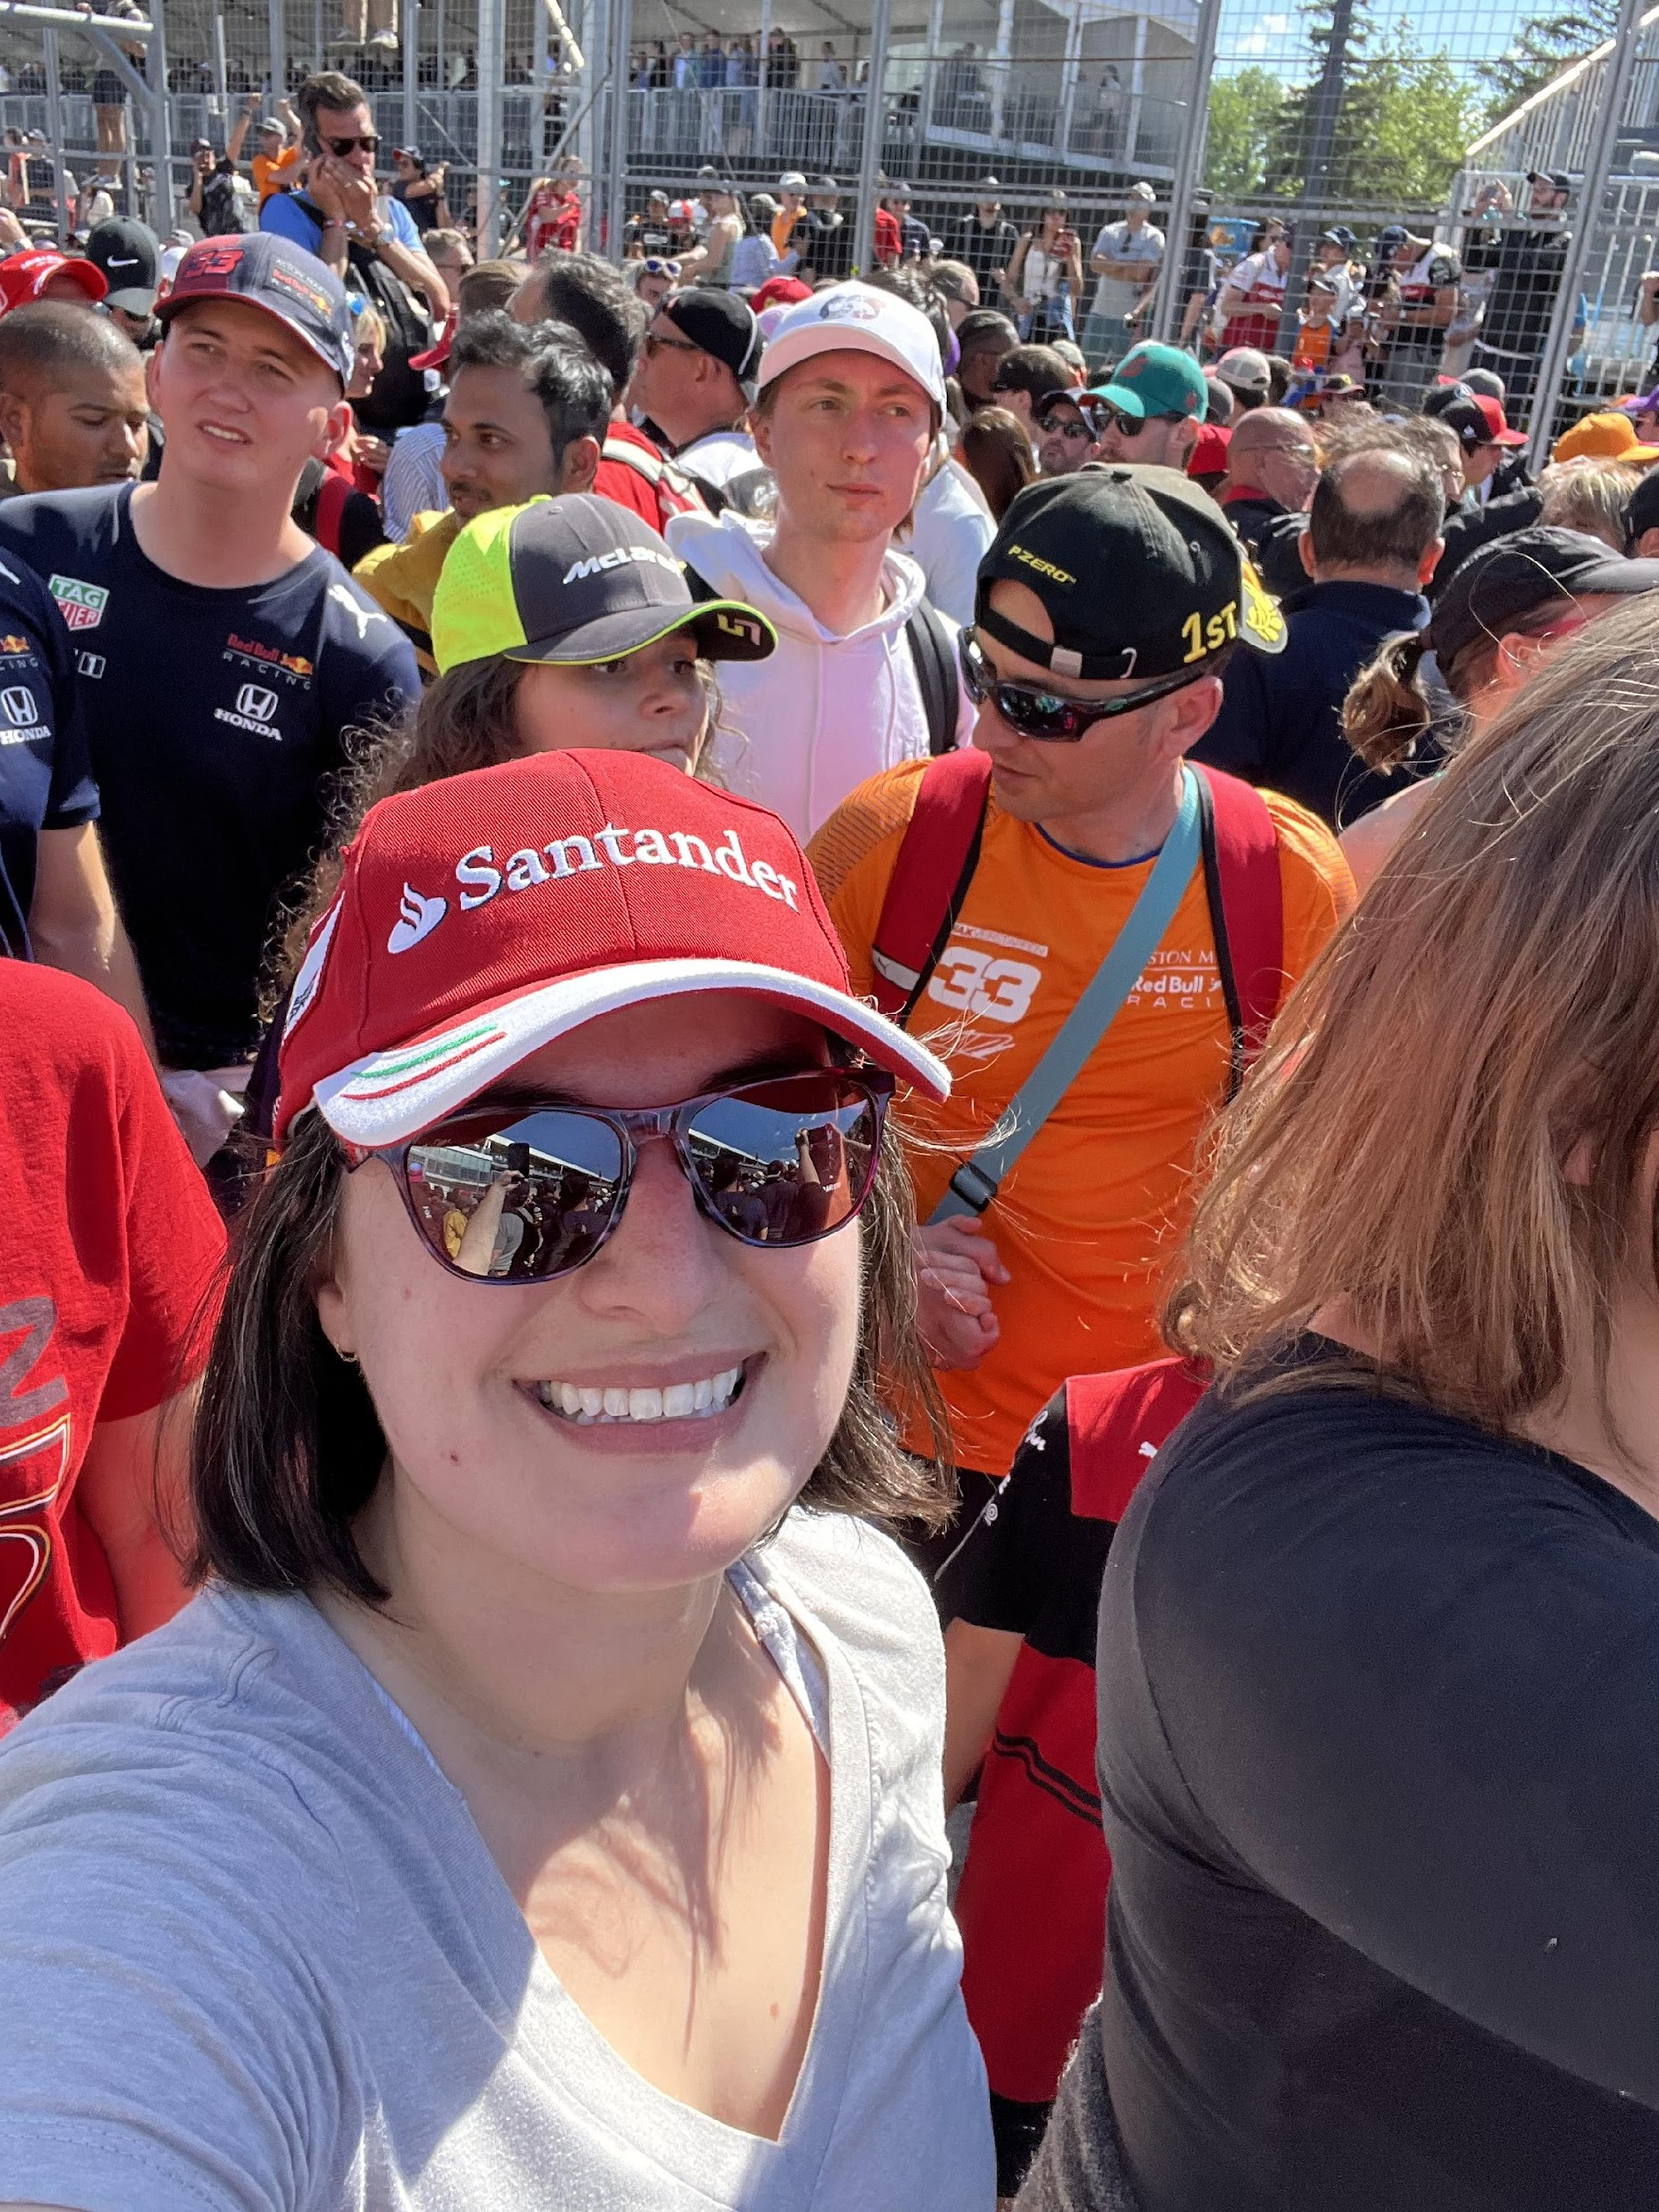
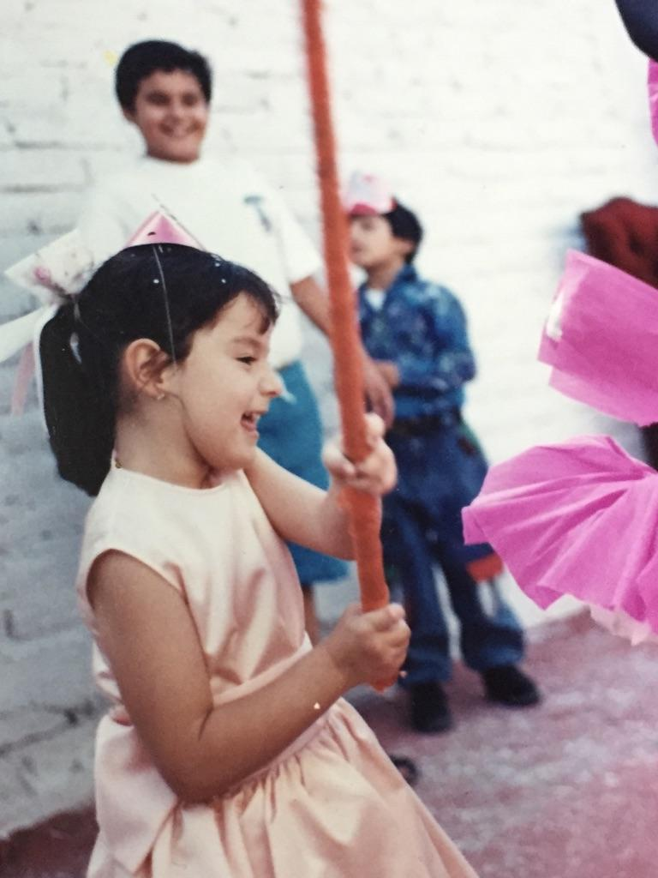
Hi, I’m Elba! (she/her)
Newly minted Assistant Teaching Professor
PhD in CS (Computer Architecture)
Previously:
taught CSCE 121... at a different university!
TA’d multiple CS courses
Notes:
Elba

Slide 6
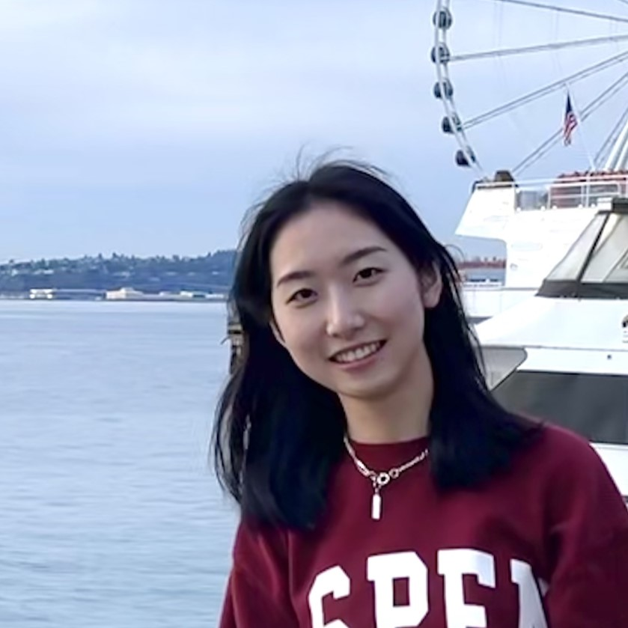
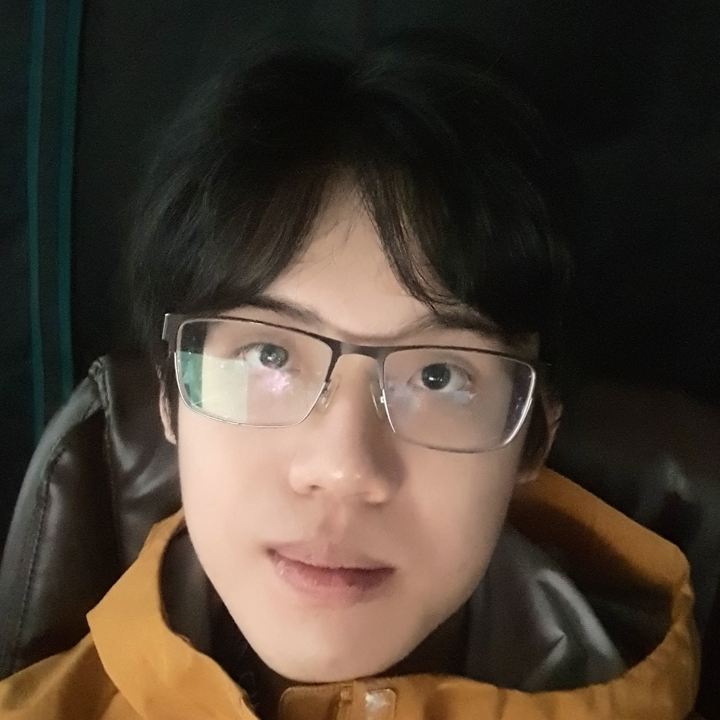
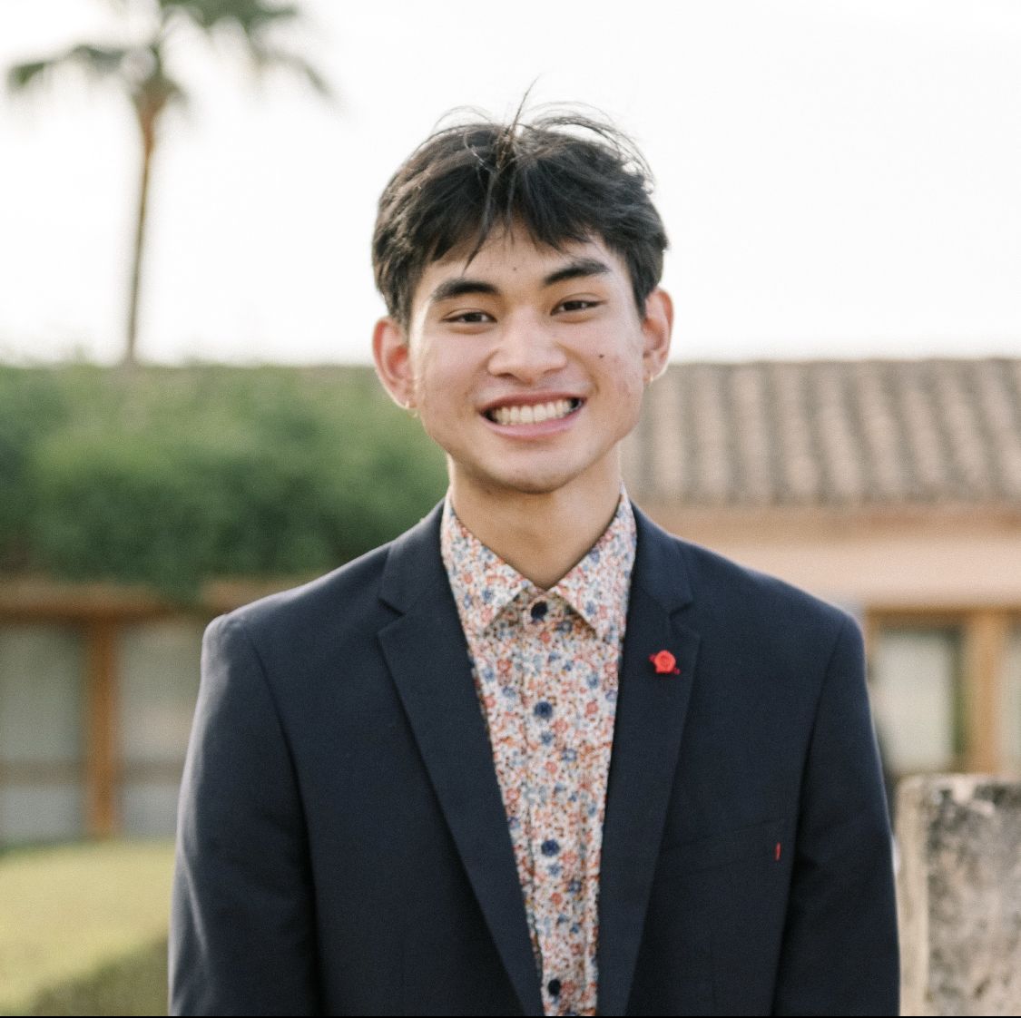
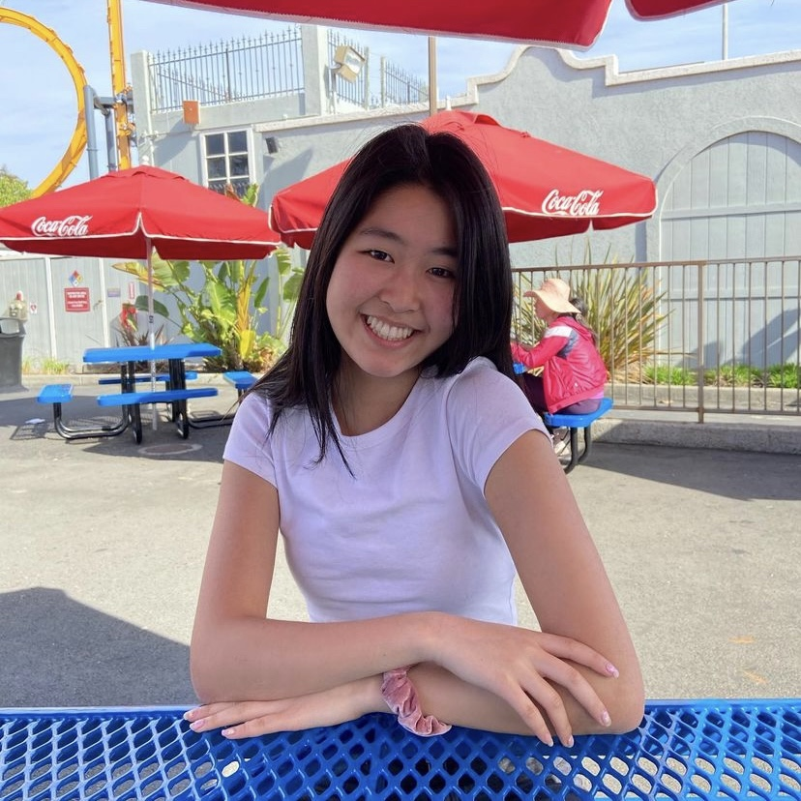
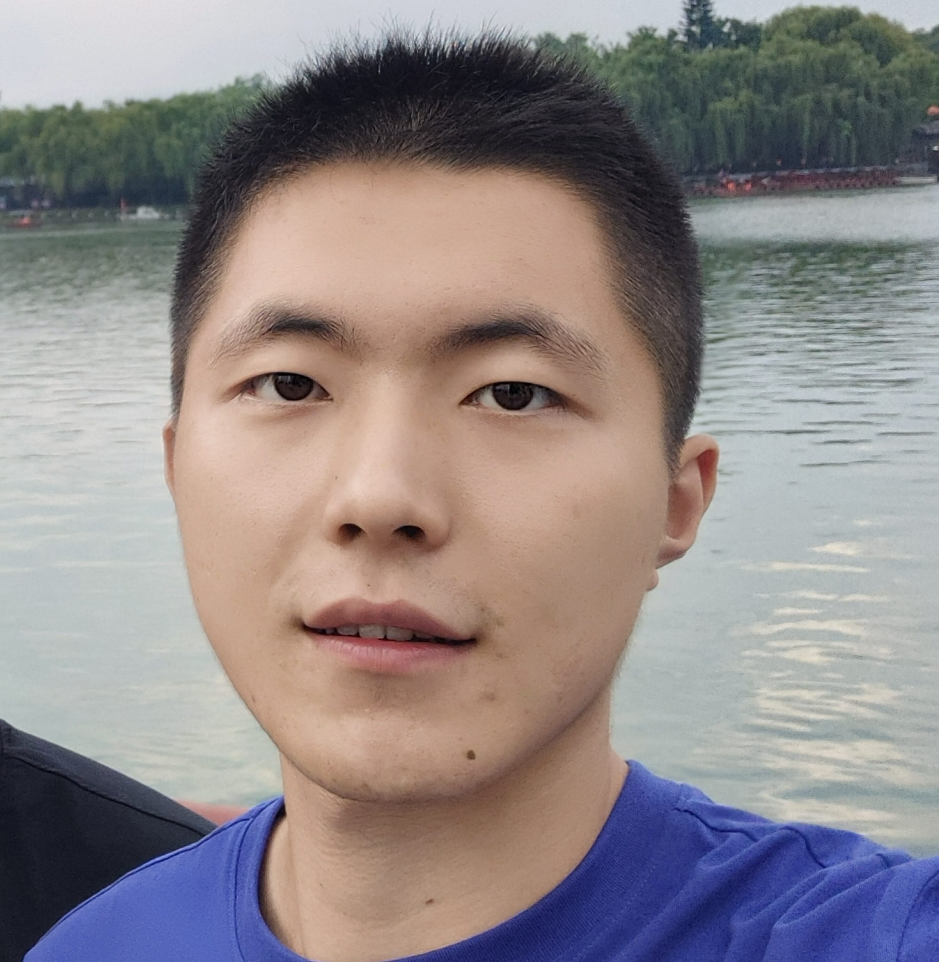
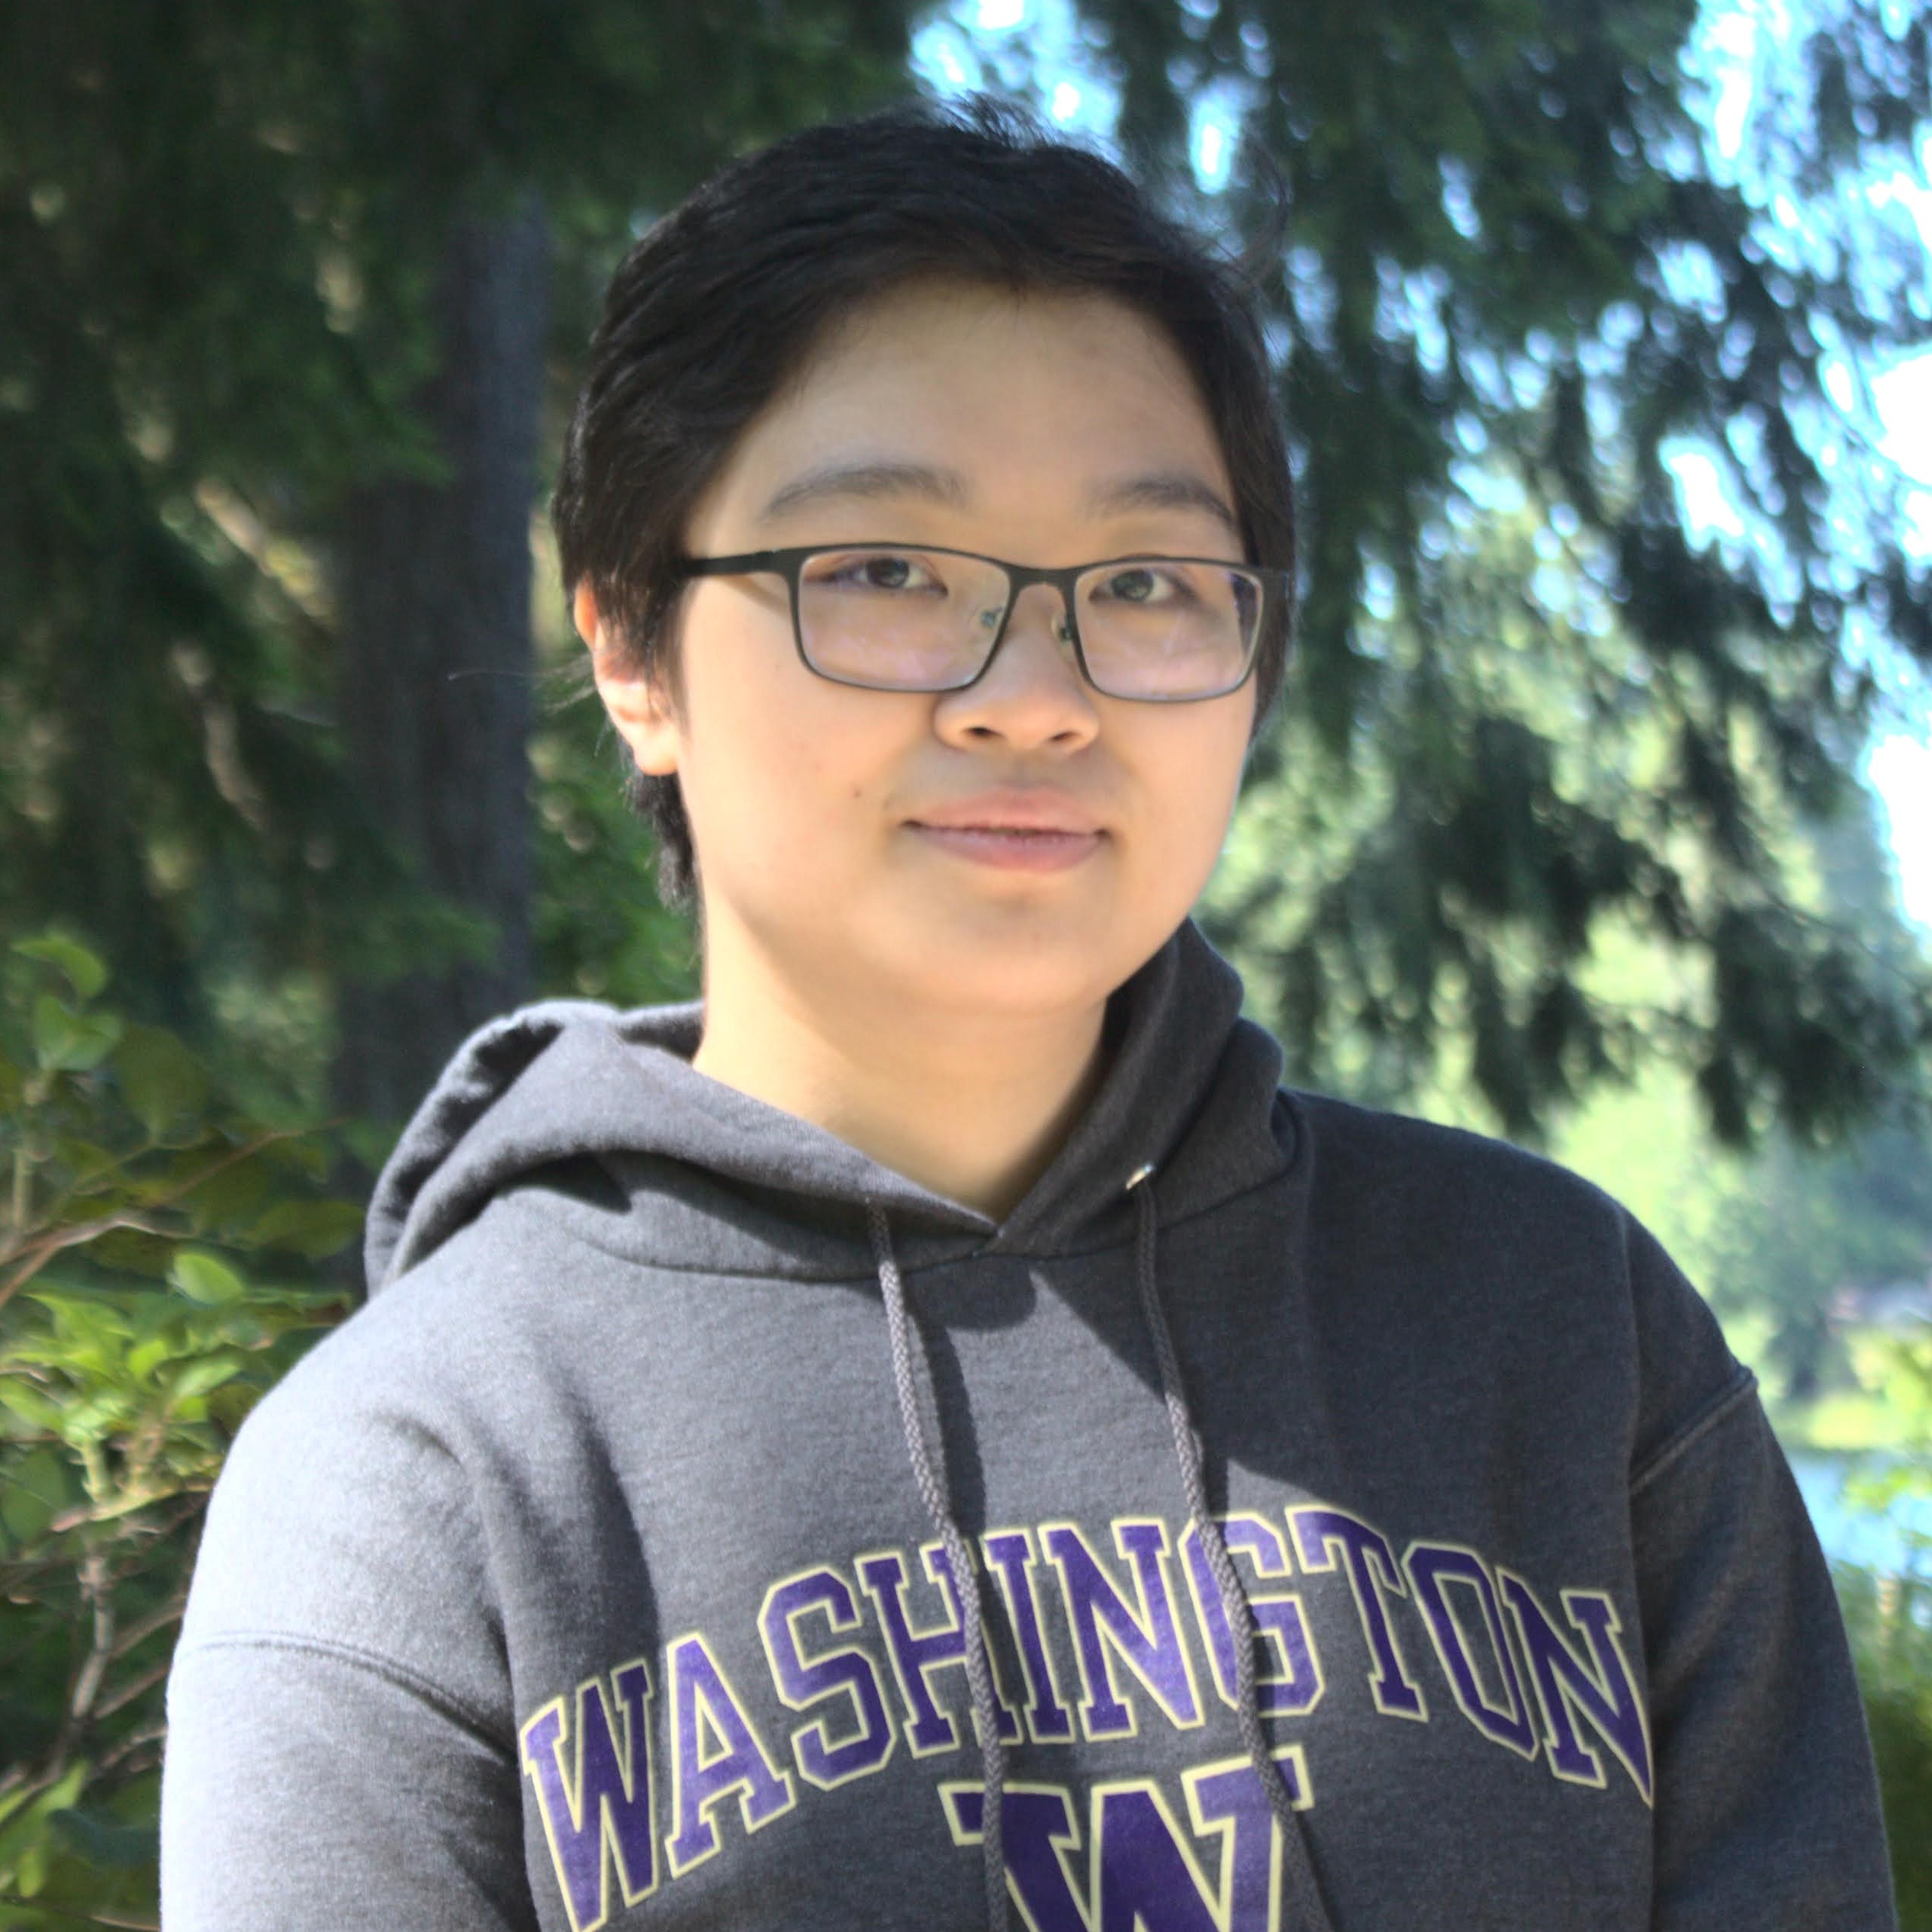
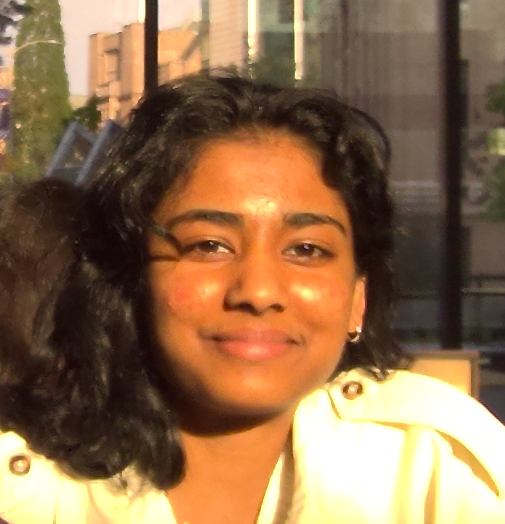
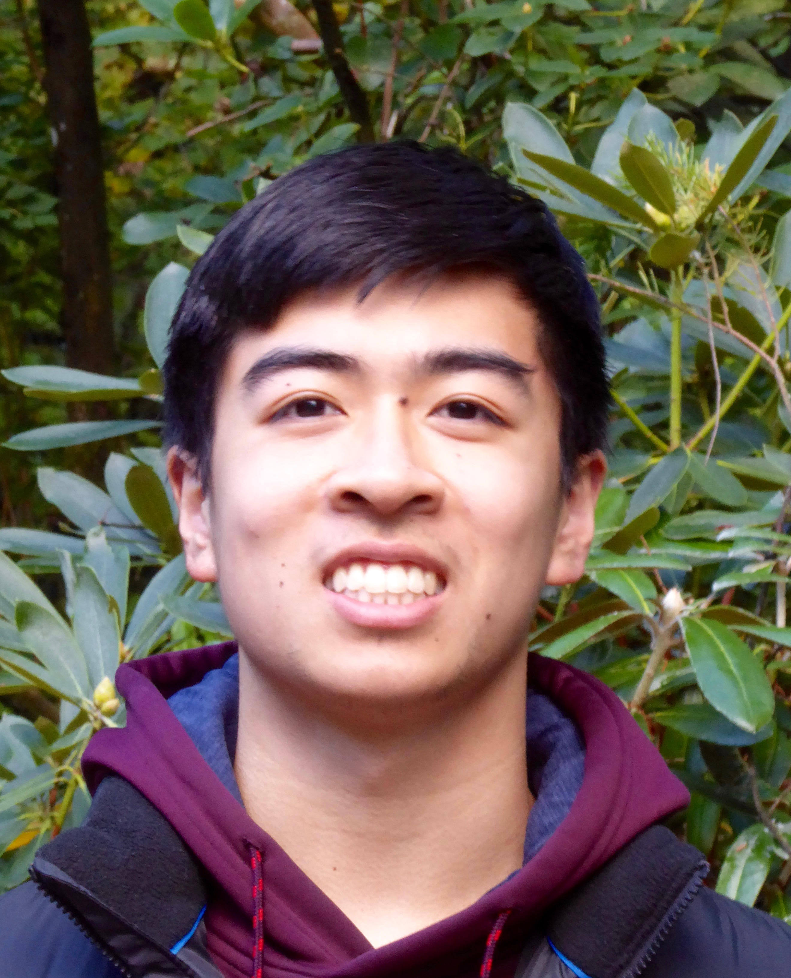
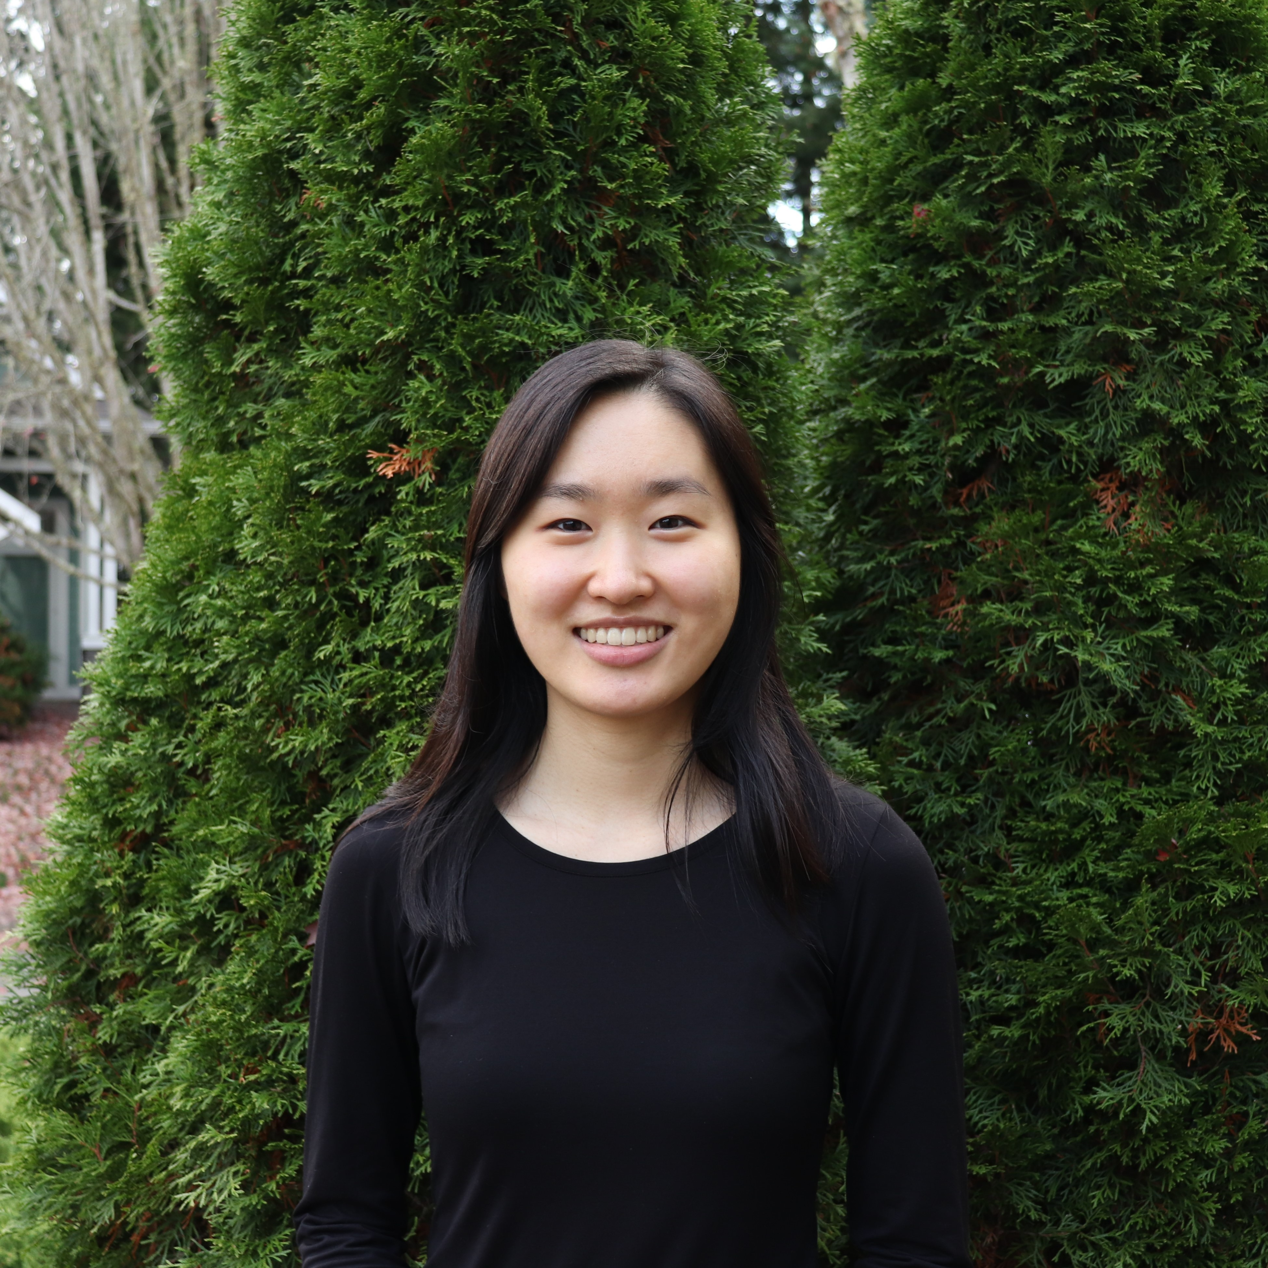
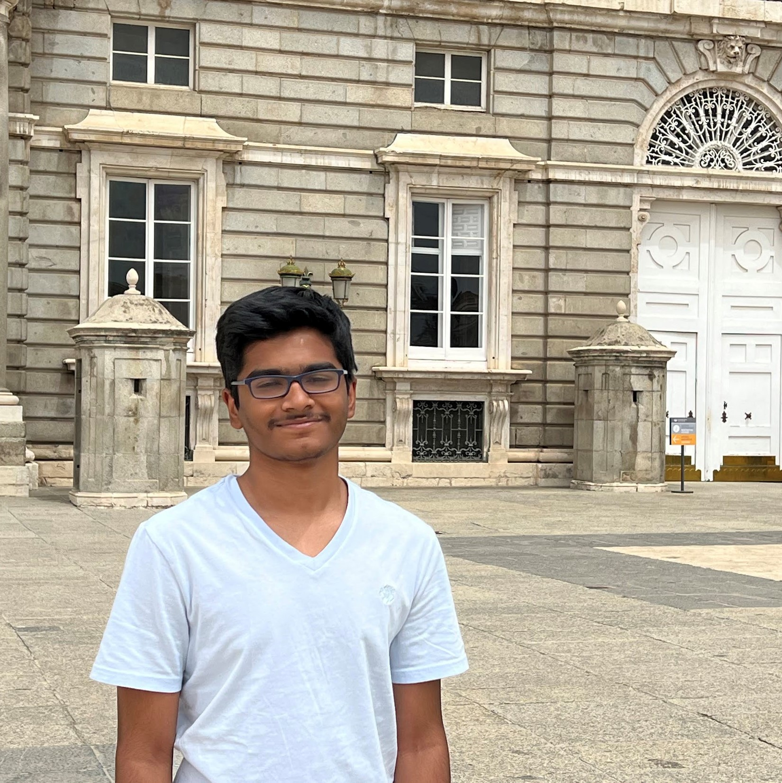
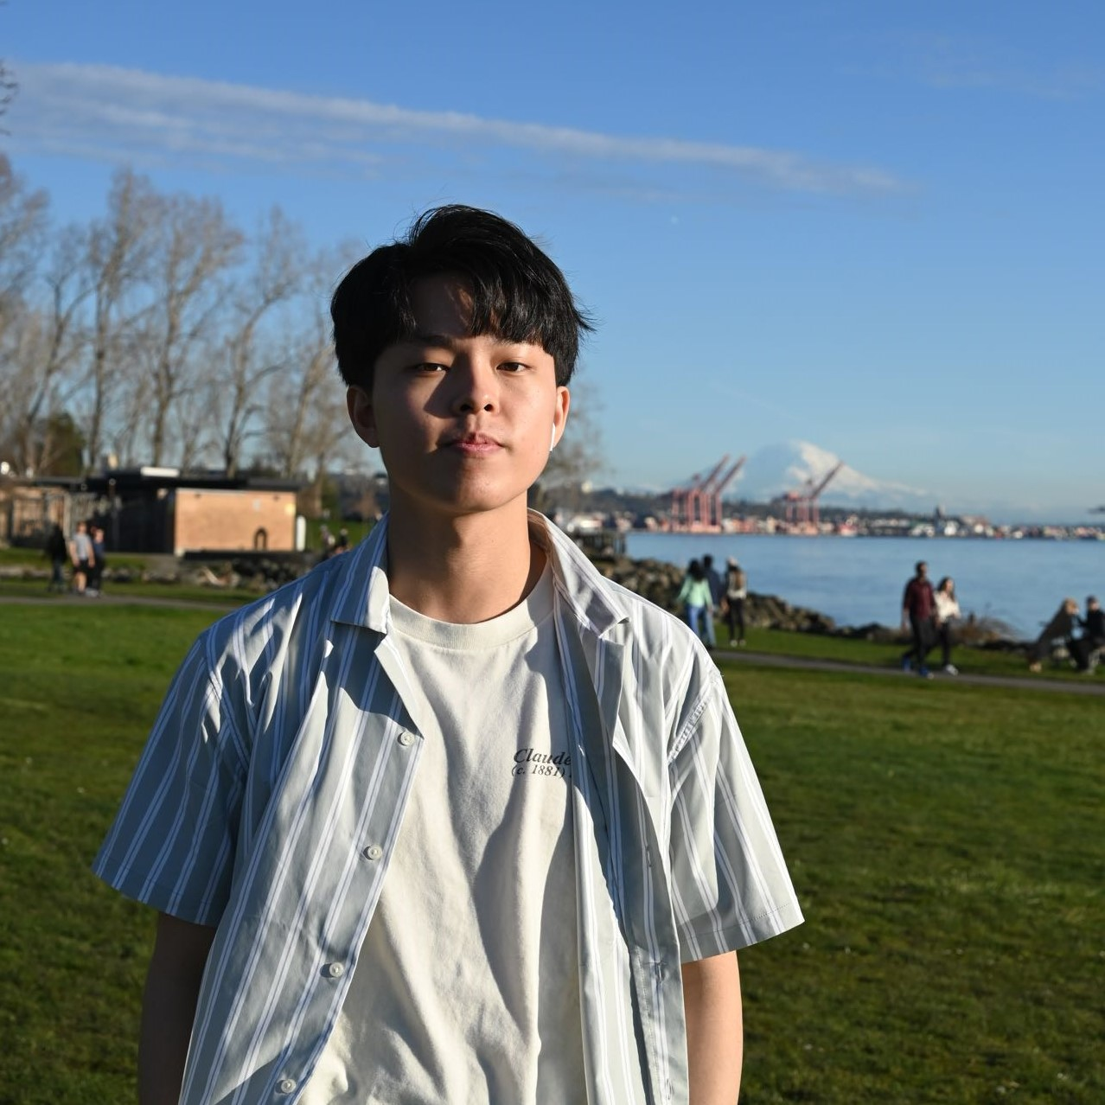
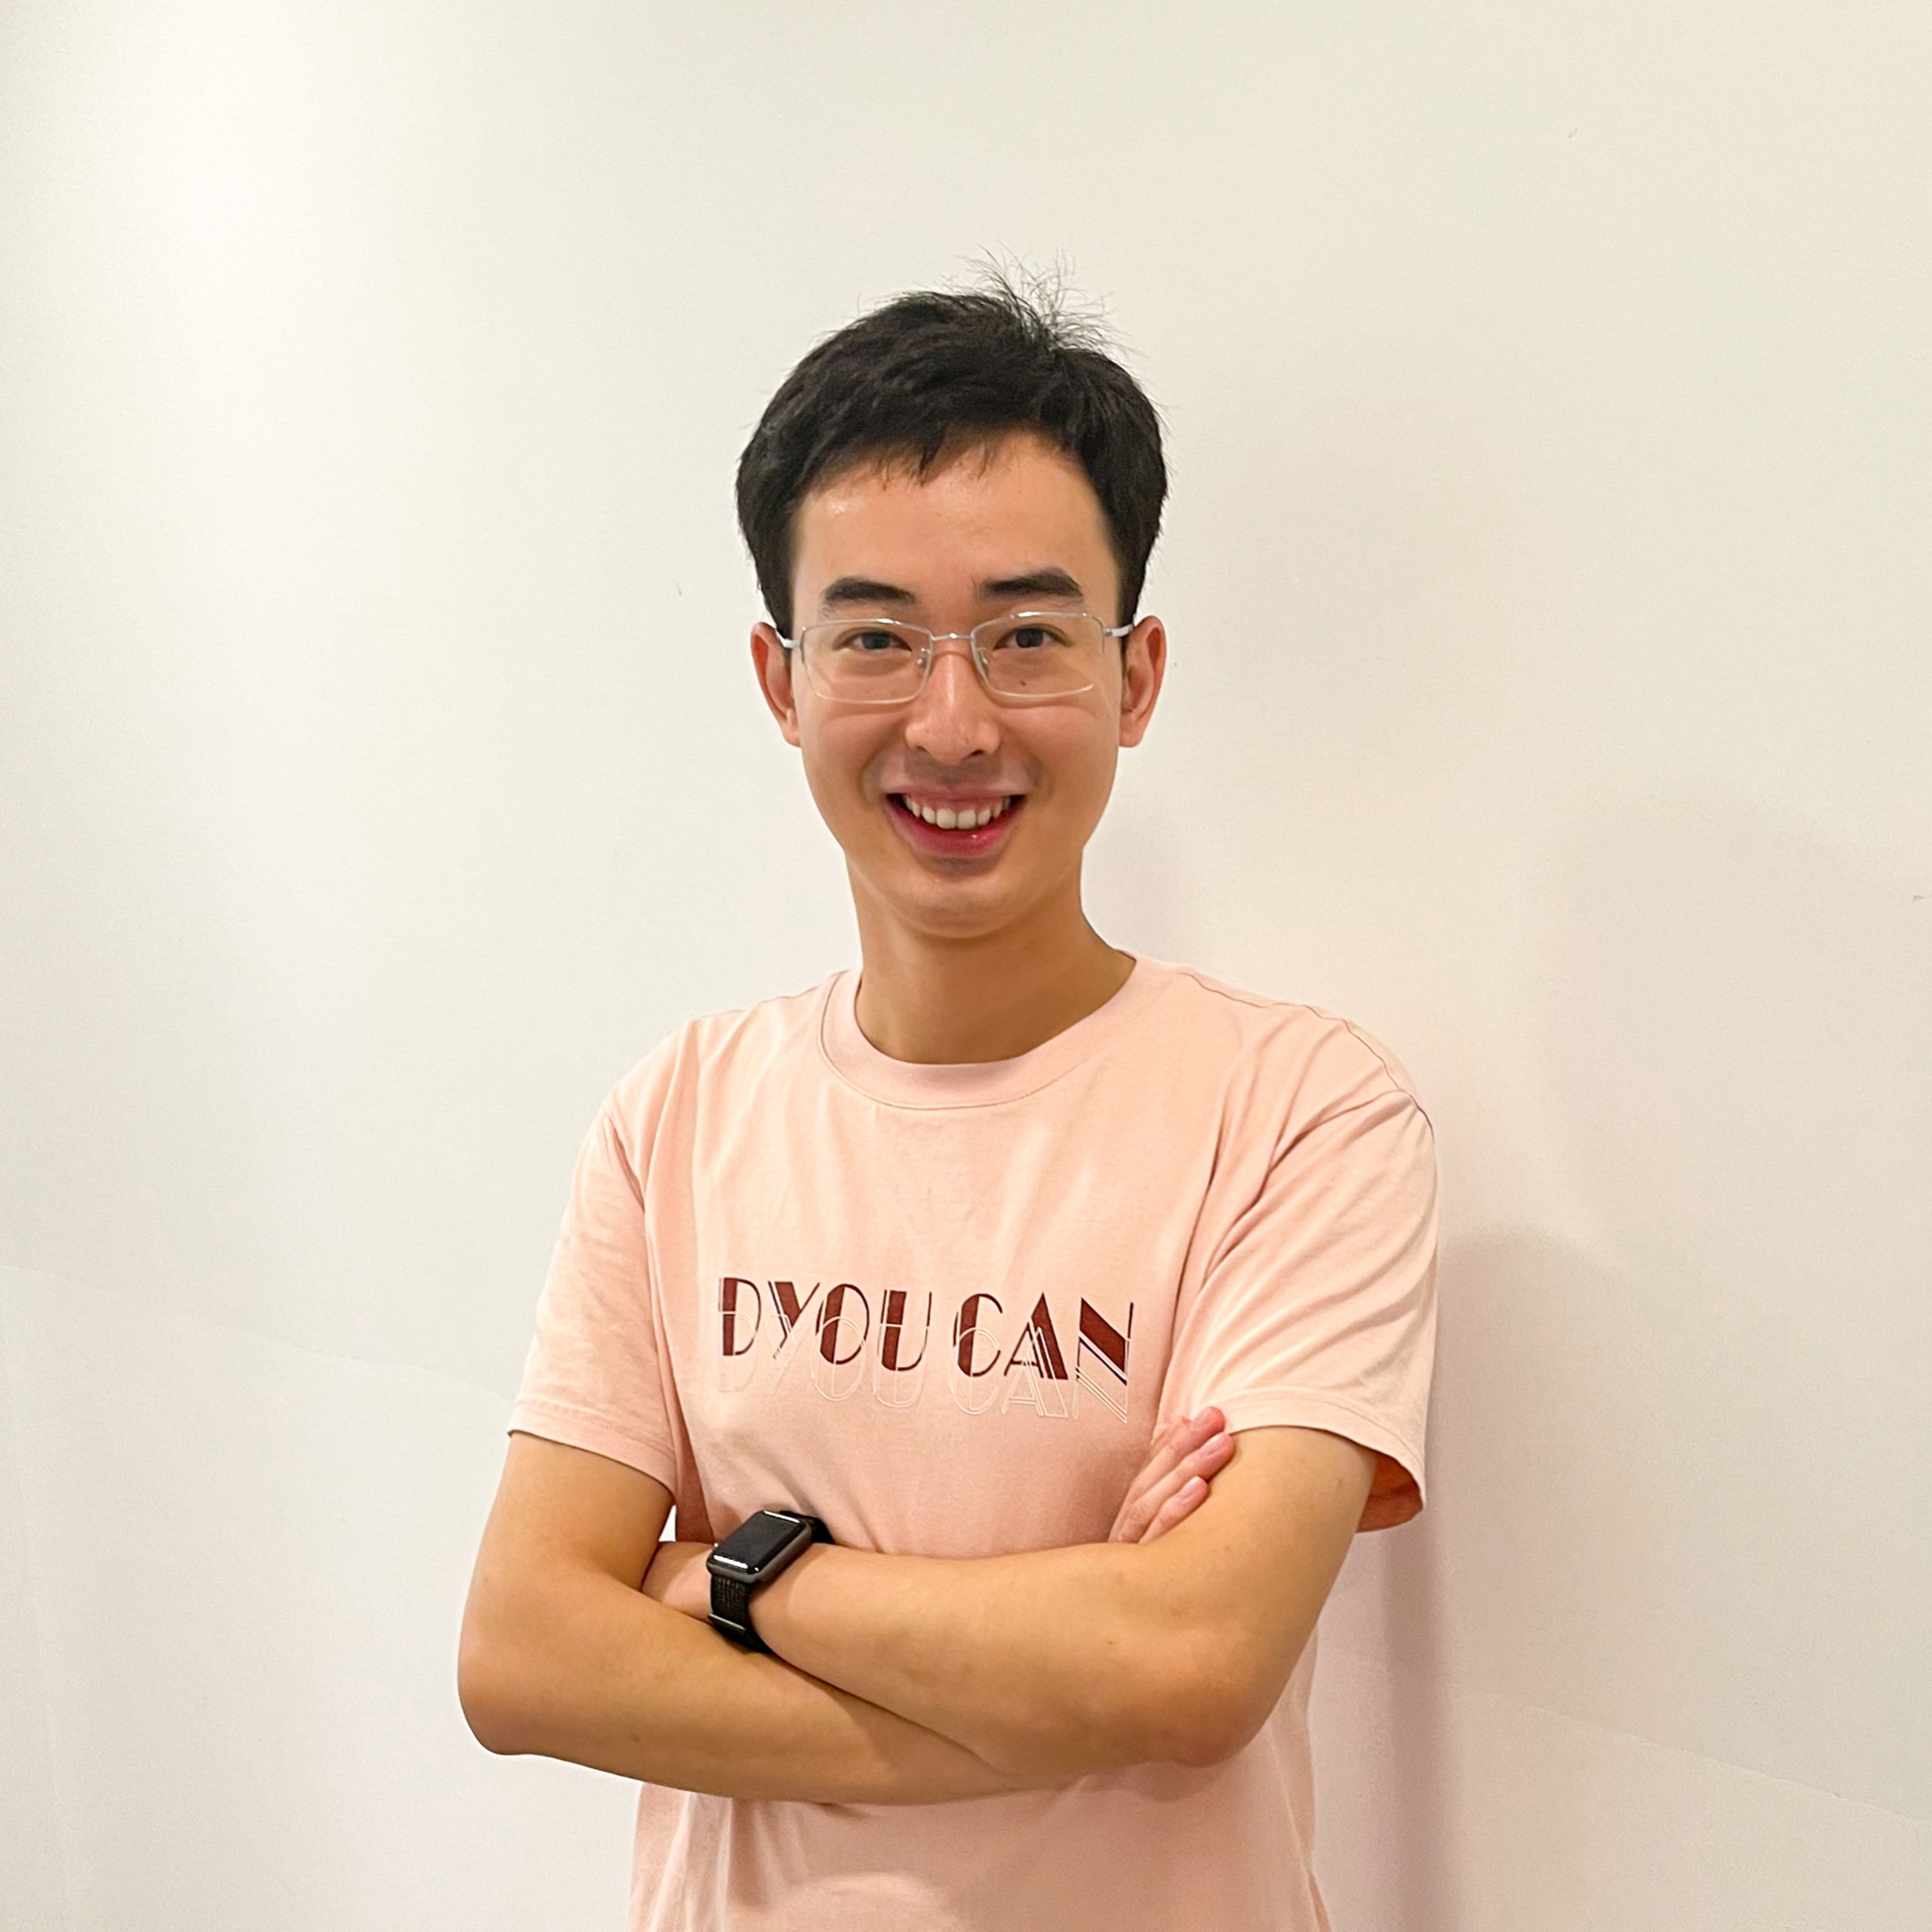
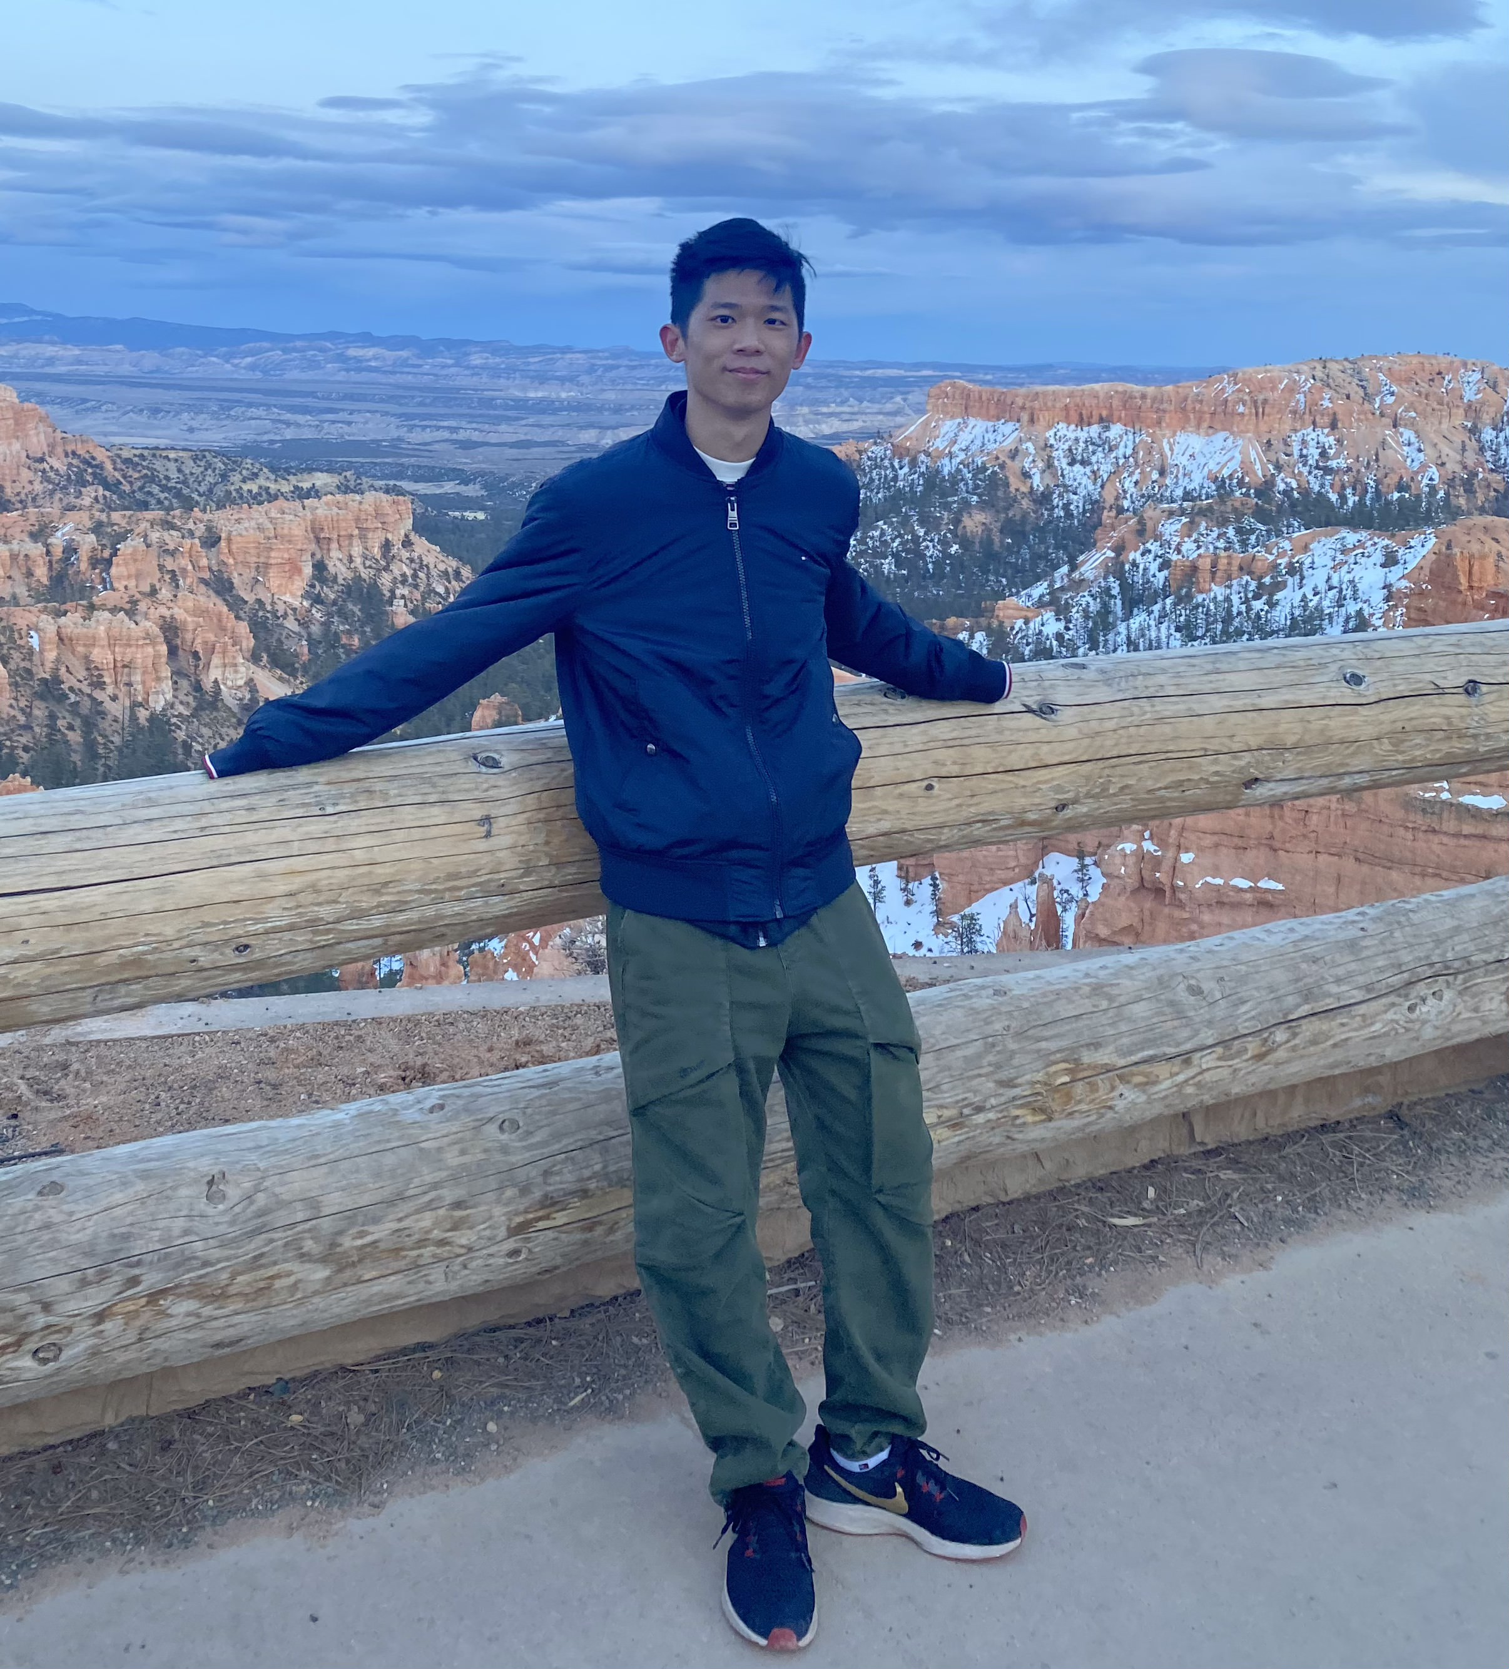
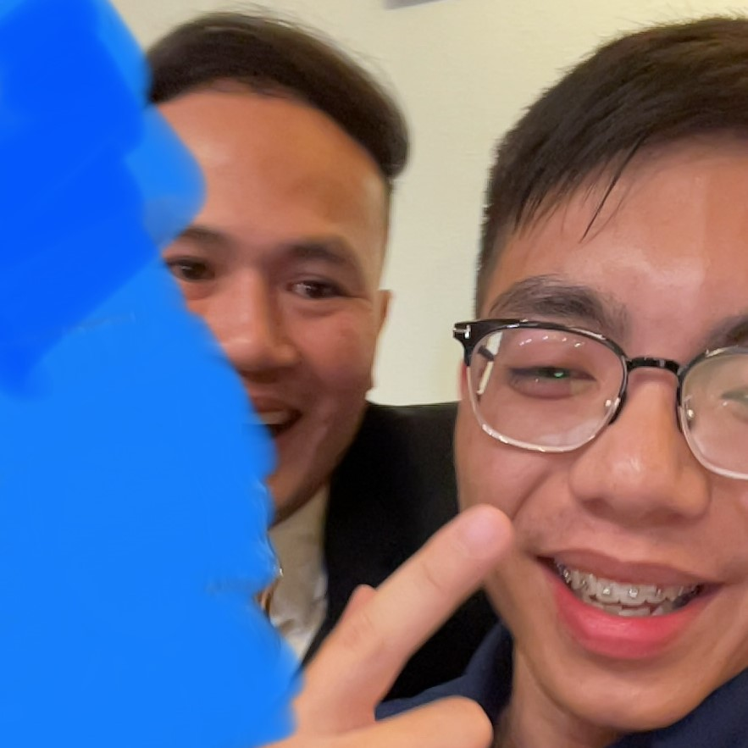
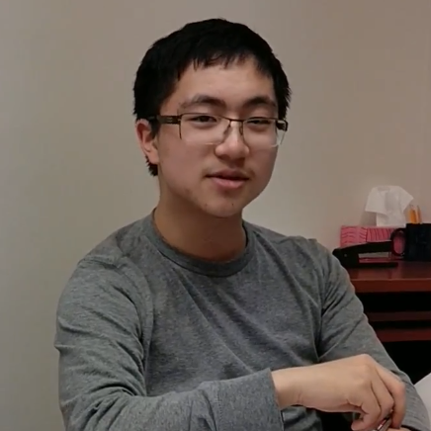
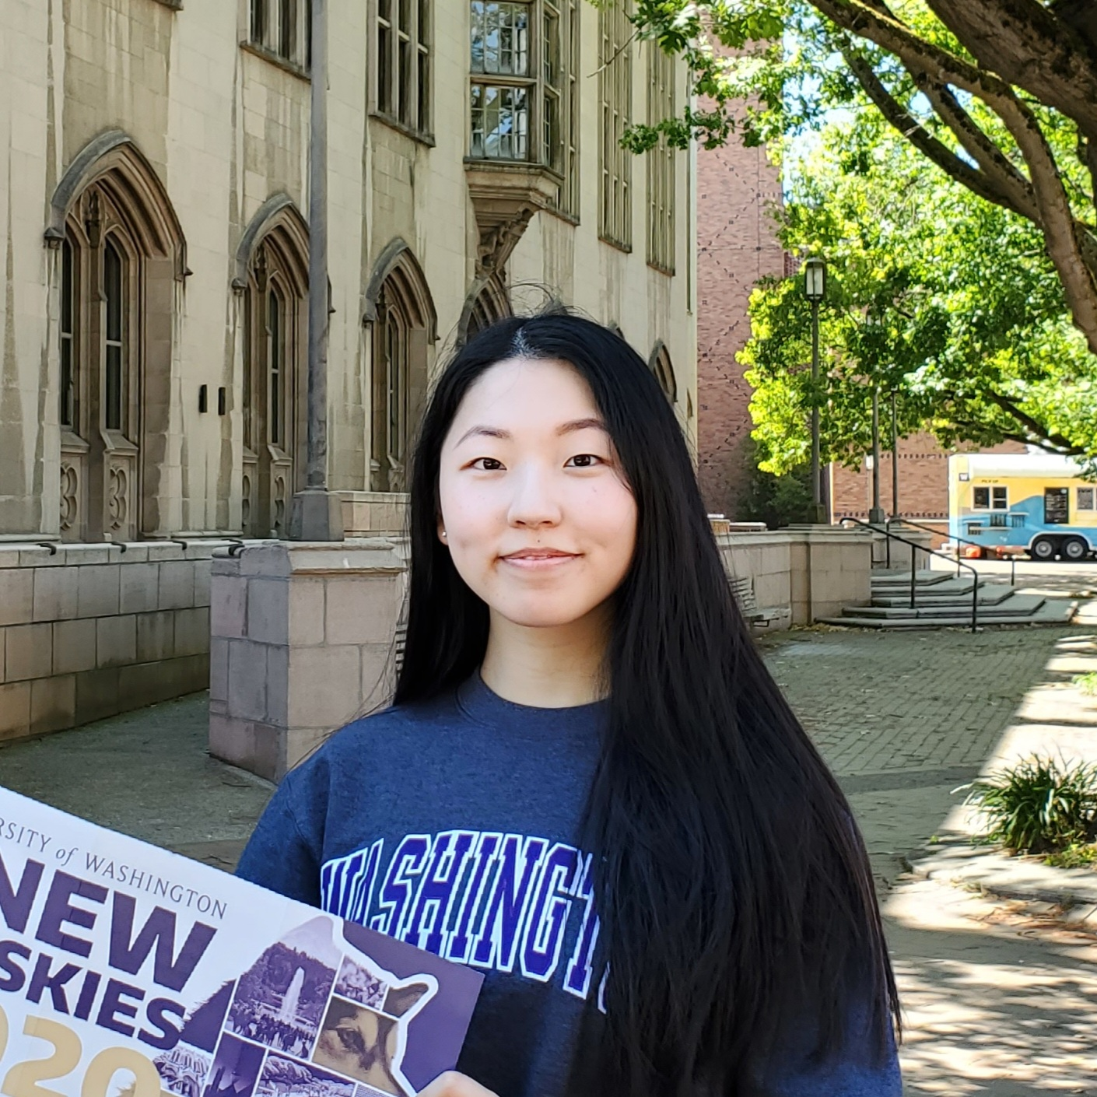
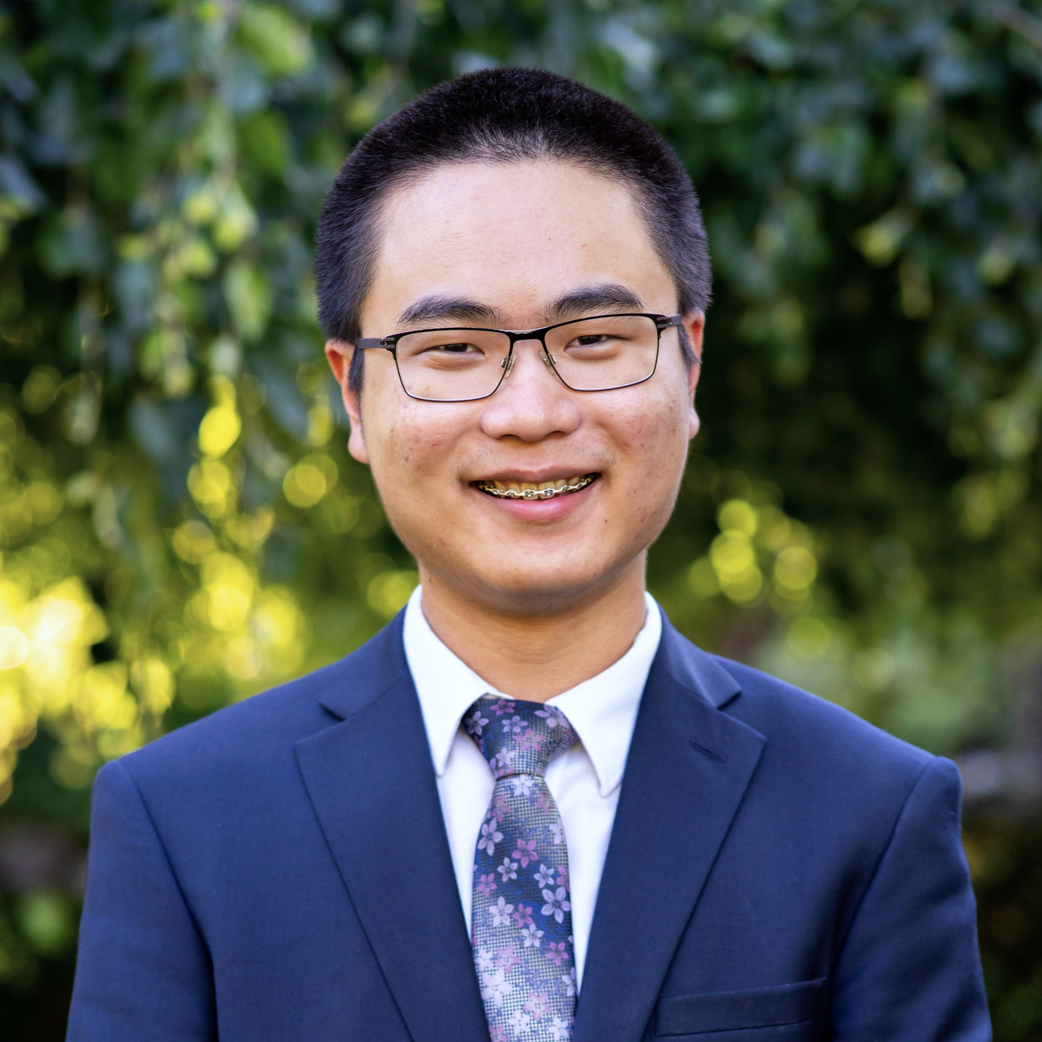
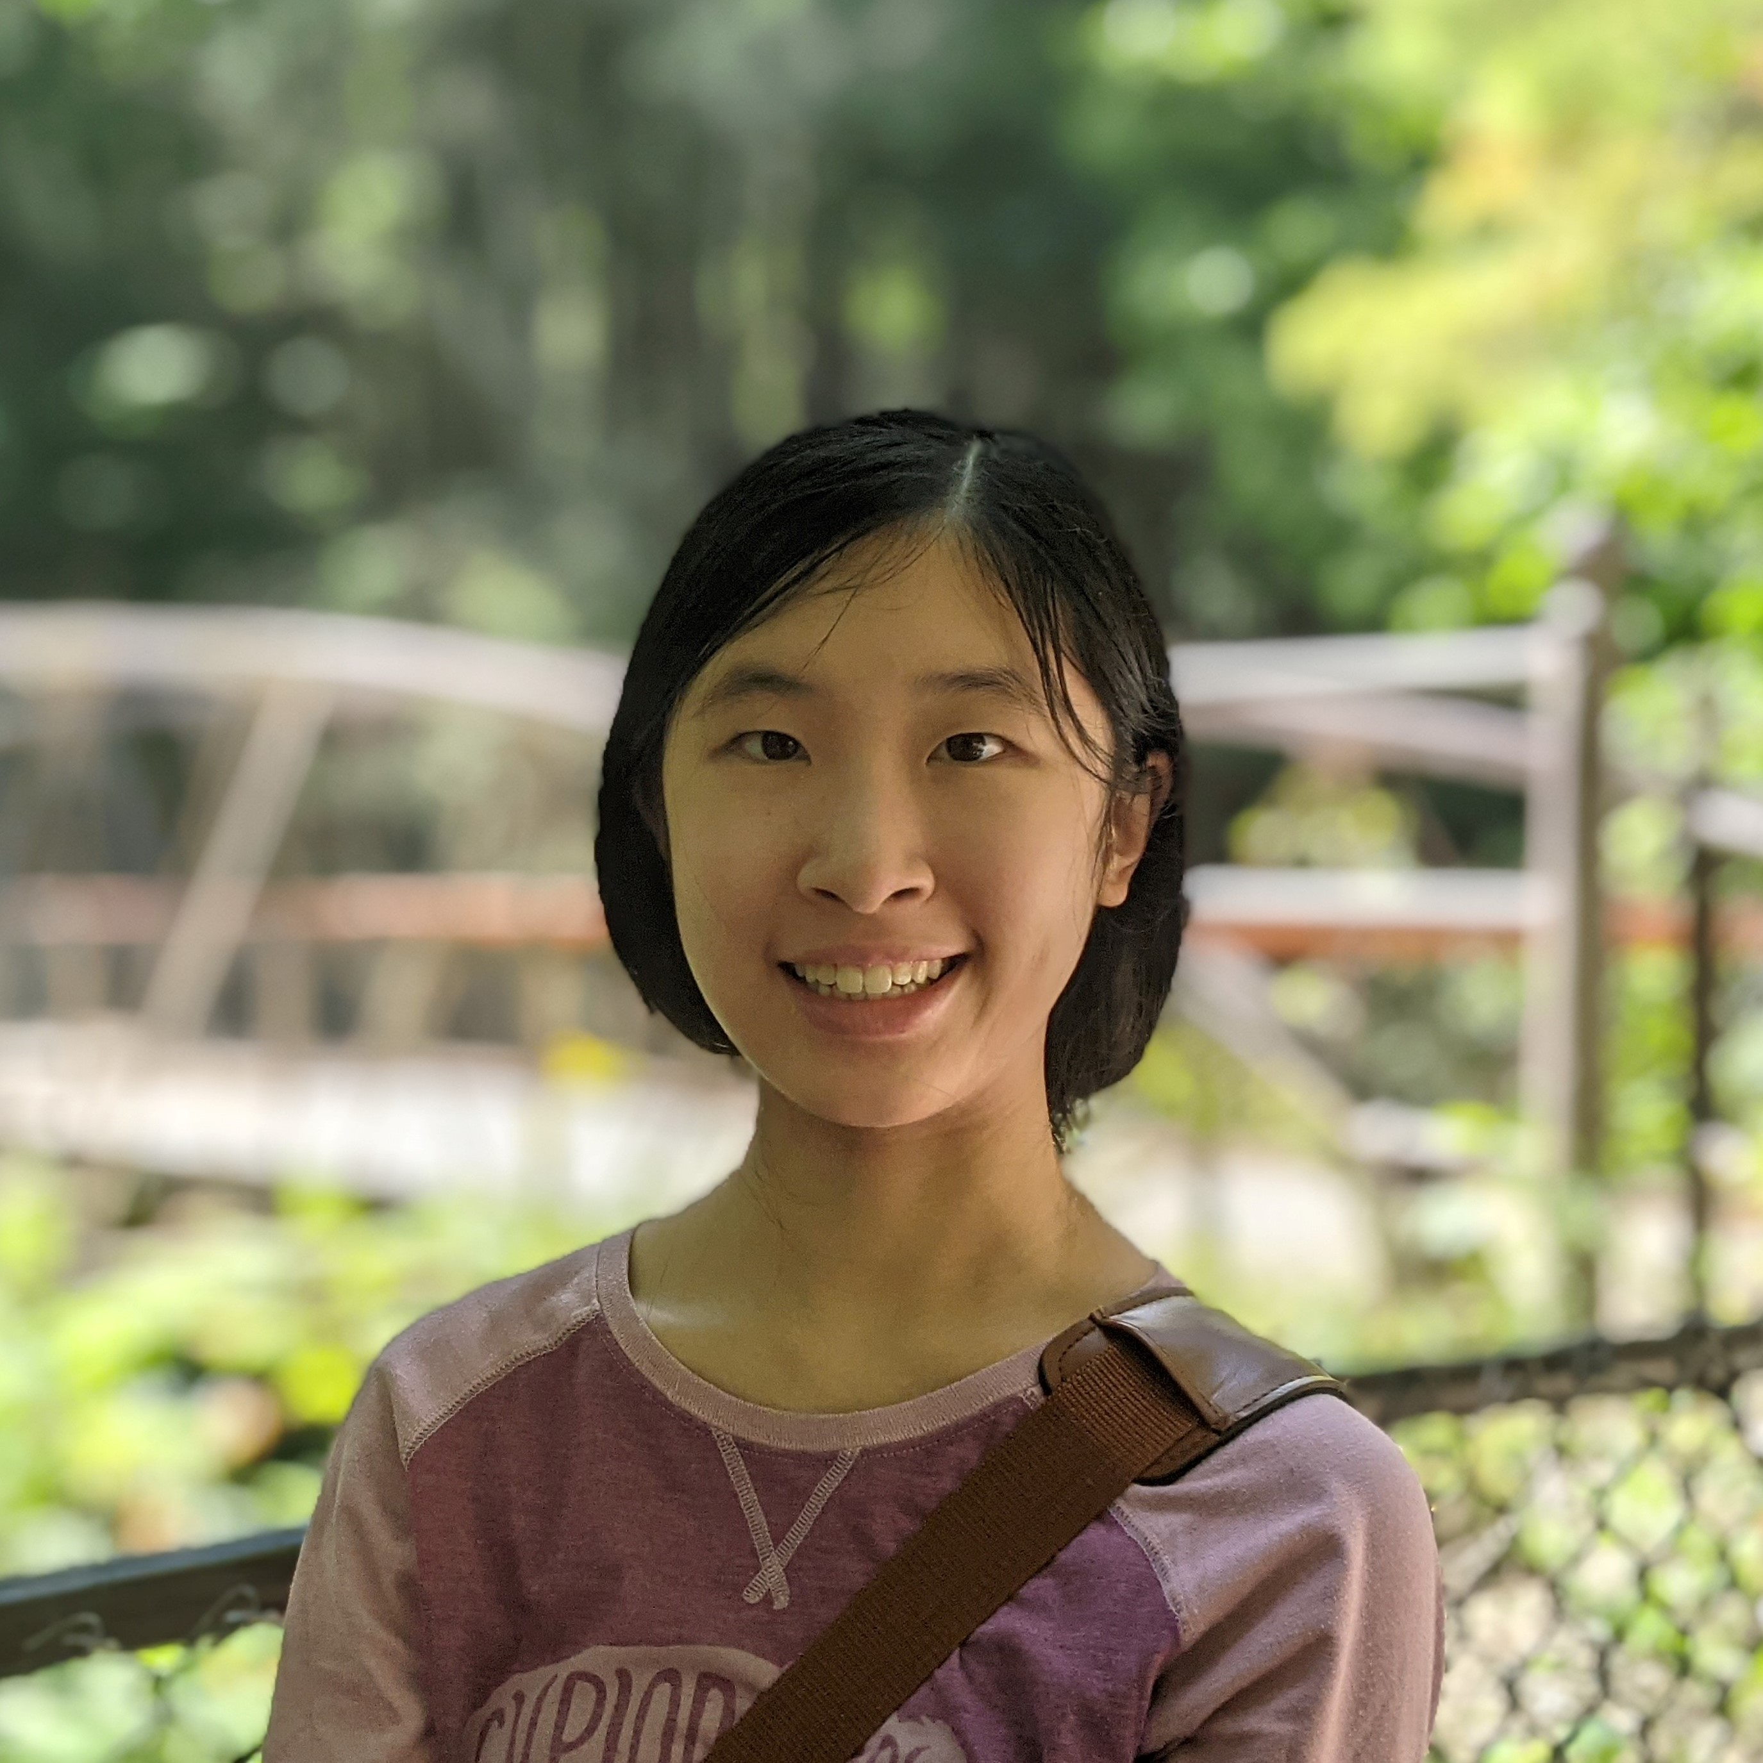
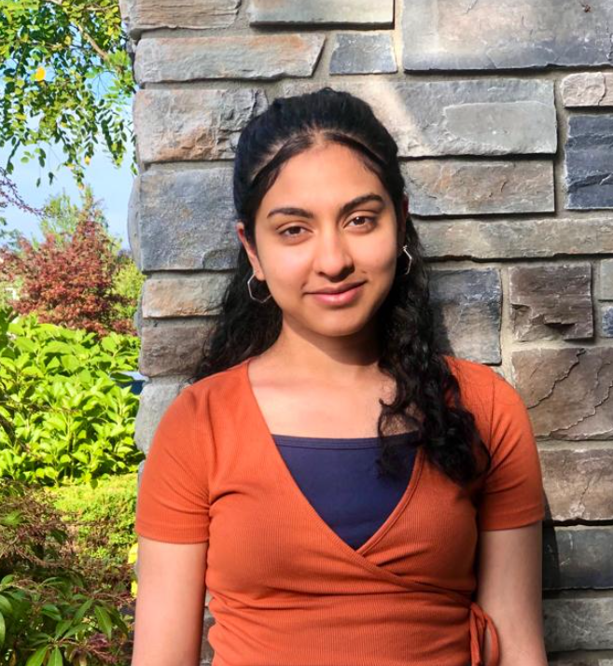
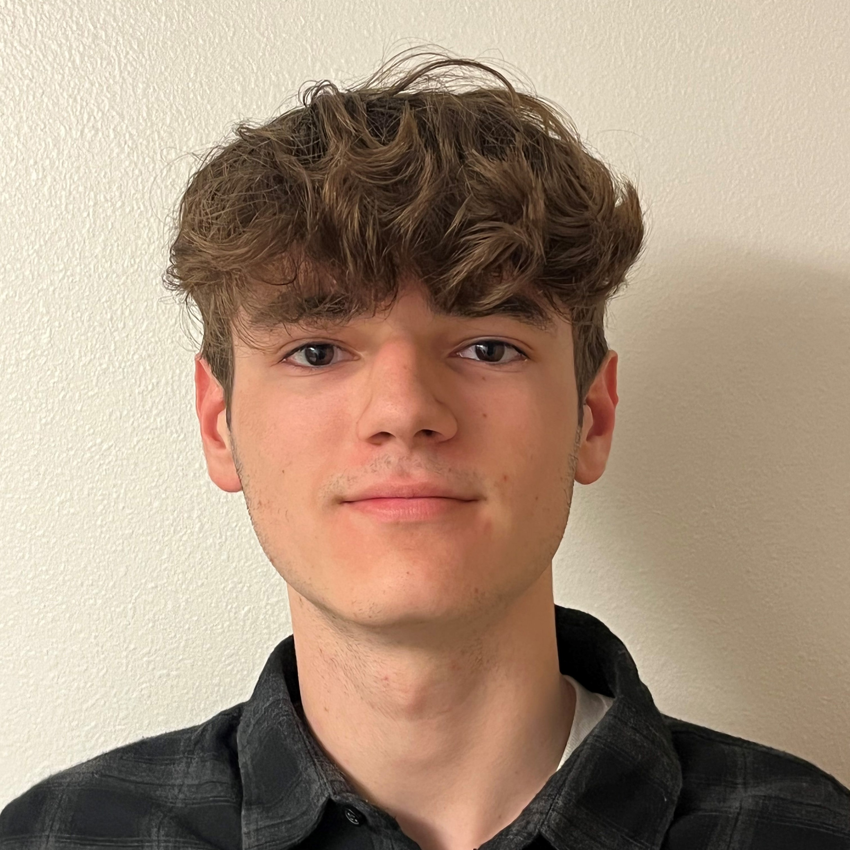
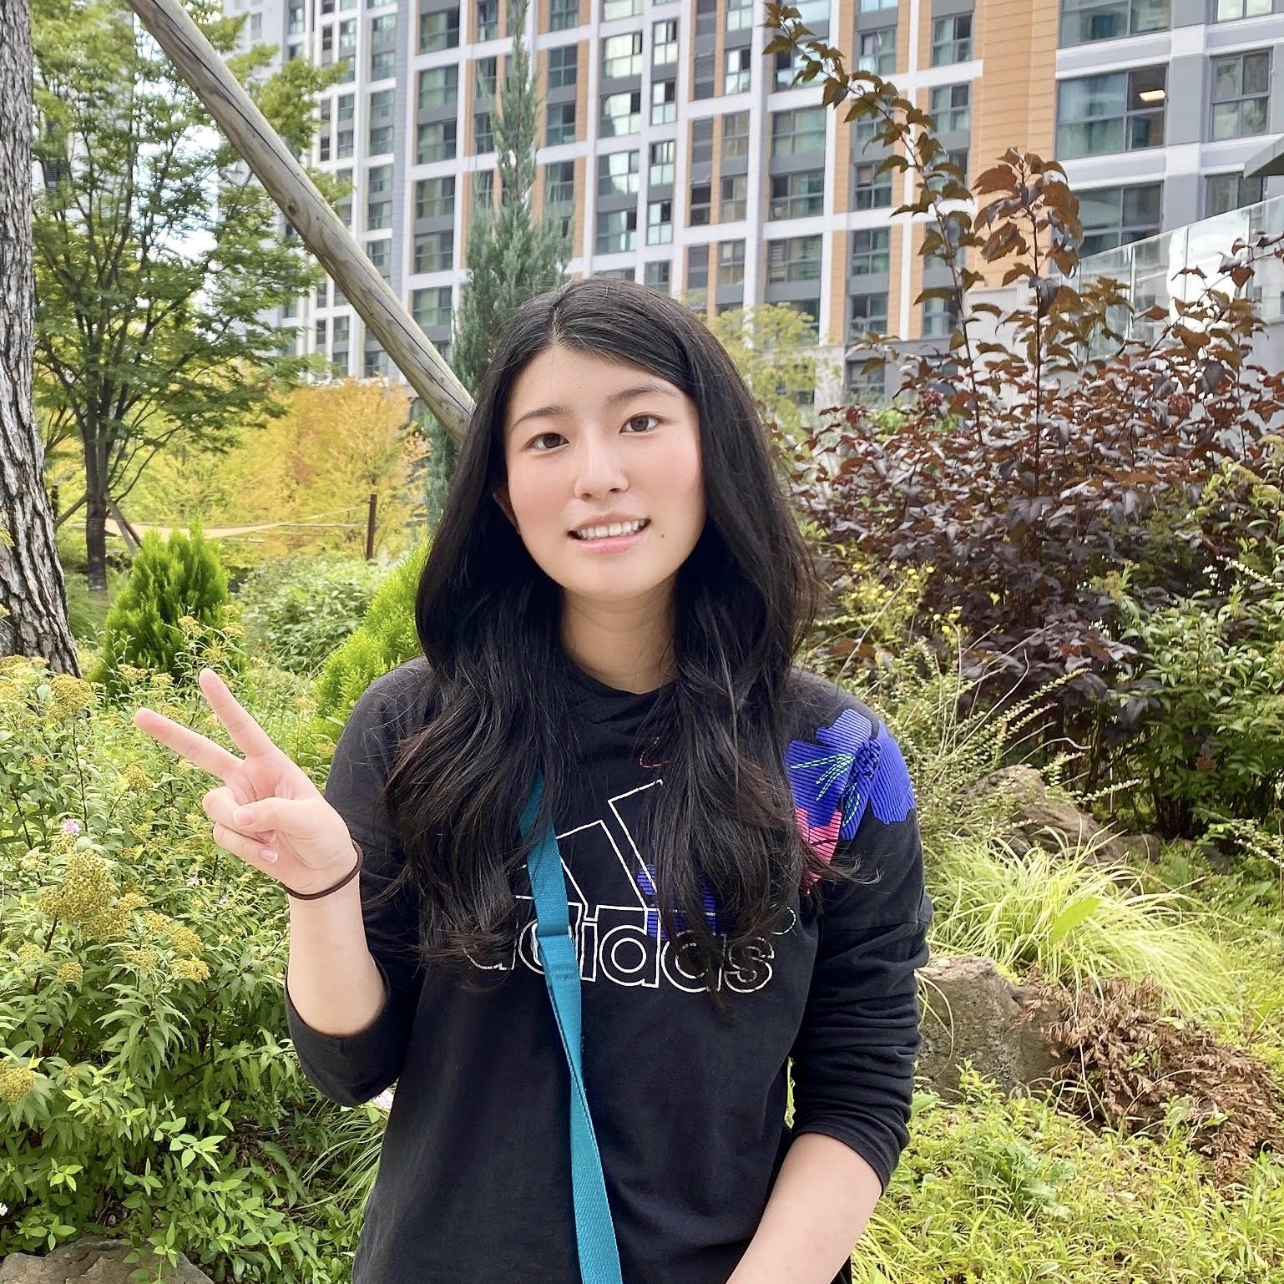
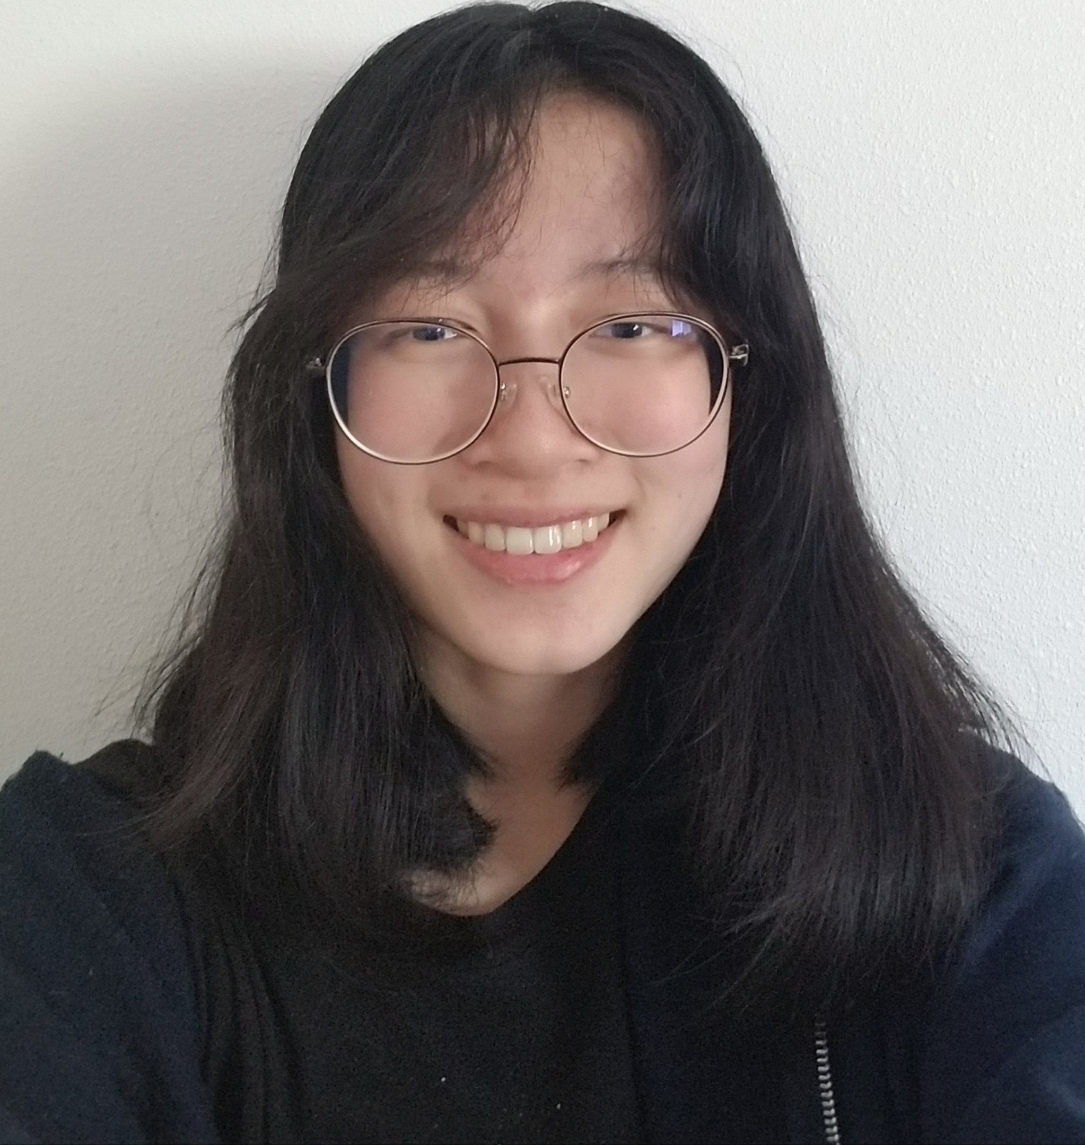
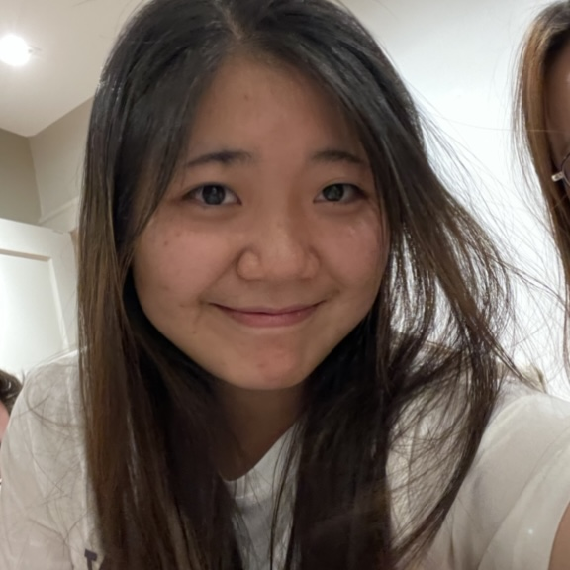
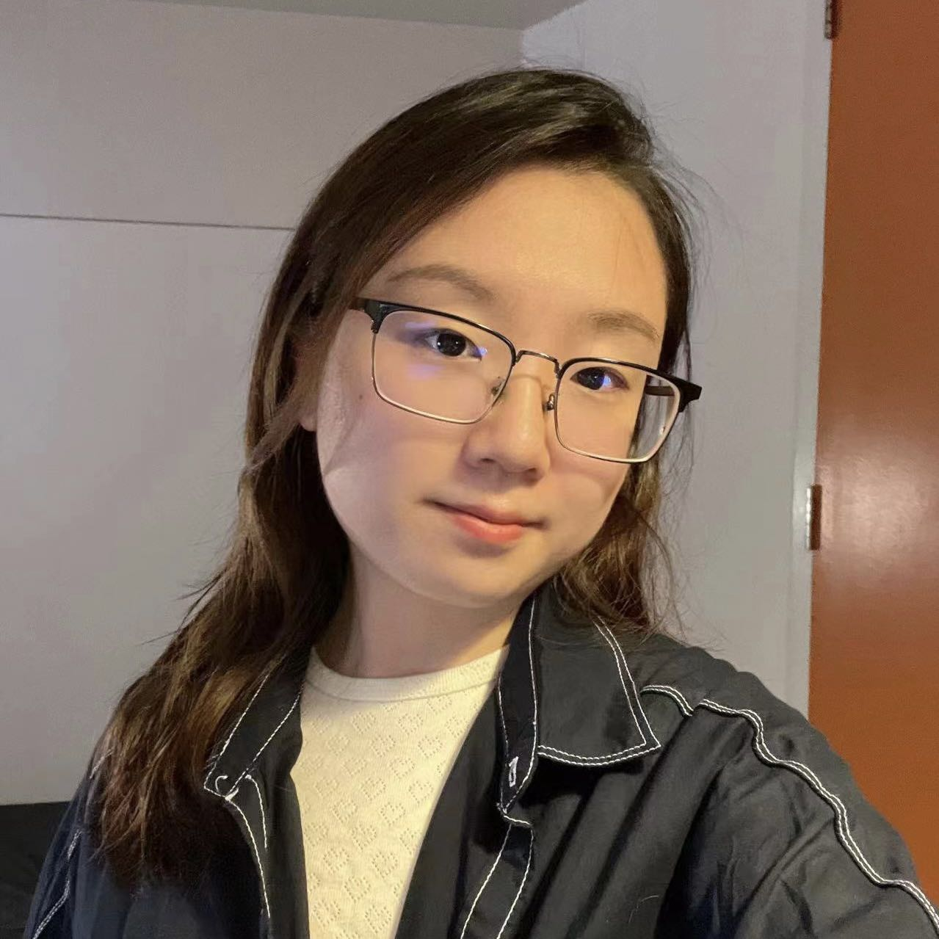
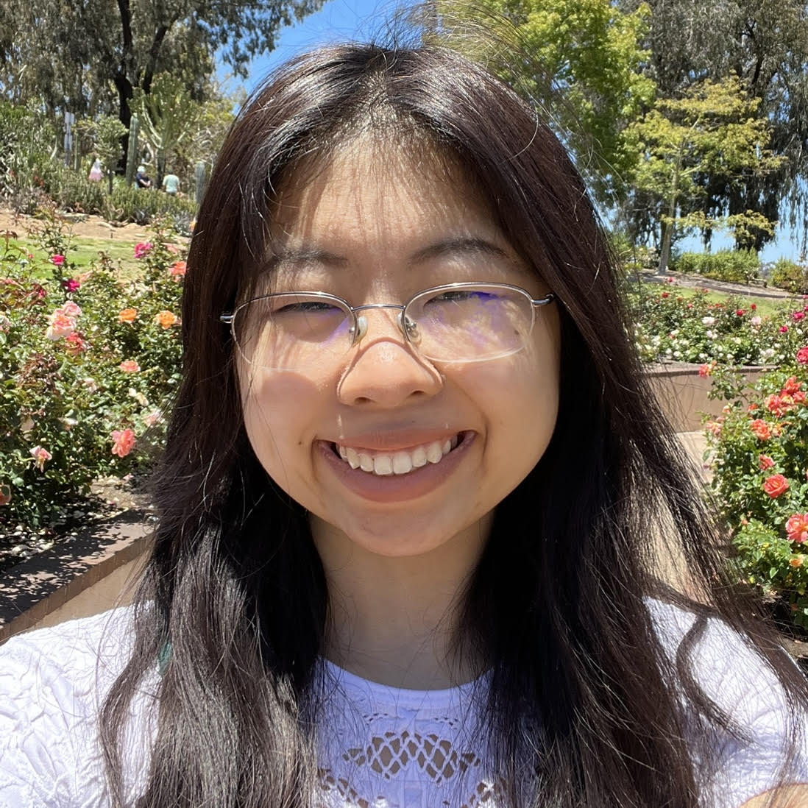
Meet (most of) your 42 TAs!
Lesson 0 - Autumn 2022
Notes:
Elba

Slide 7
Agenda
About us
About this course
Learning objectives
Other similar courses
Course components
Our learning model
Tools and resources
Course Website
Ed
Hello, World!
Assessment and grading
Collaboration
Notes:
:37
Brett

Slide 8
Learning Objectives
or, “What will I learn in this class?”
Seven themes:
Computational Thinking
Code Comprehension
Code Writing
Communication
Testing
Debugging
Ethics/Impact
Notes:
Brett

Slide 9
Other Similar Courses
Course | Good choice if…
CSE 121 | You’ve never programmed before AND You are, or want to be, in a major such as CS, CE, ECE, Info, etc. that requires Java programming
CSE 122 | You’ve done some programming (roughly one course worth) in any programming language AND You are, or want to be, in a major such as CS, CE, ECE, Info, etc. that requires Java programming
CSE 143 | You took CSE 142 at UW, at a community college, or through UW in the High School
CSE 160 | You’ve never programmed before AND You’re interested in data science and analysis OR You’d rather learn Python than Java* OR You are, or want to be, in a major such as Physics, Bio, Stat, etc. where analyzing data through programming is useful
Other courses of interest: CSE 154, CSE 123 (23wi), CSE 163 (23wi) See Guided Self-Placement and Introductory Courses for more info
Notes:
Brett

Slide 10
Help Us Improve!
CSE 121 is brand new!
We worked hard to build a course we think will be effective and supportive and help you succeed
We probably didn’t get it all right
We appreciate your patience and understanding if we need to make adjustments during the quarter
Please give us lots of feedback!
Post on Ed and/or use the Anonymous Feedback Tool
Notes:
Brett

Slide 11
Course Components
Lessons (aka Lectures)
Sections
WF, 11:30 or 2:30
Held live in KNE; recordings released after
First introductions to course concepts
Mix of presentation of content and practice activities/problems
Pre-work for most sessions
TuTh, various times
Led by TAs
Held live in person; not recorded
Materials will be released online afterwards
Additional review, discussion, and practice
Mostly practice problems
Attendance is not taken, but you are responsible for all material (including announcements).
Notes:
Elba

Slide 12
Agenda
About us
About this course
Learning objectives
Other similar courses
Course components
Our learning model
Tools and resources
Course Website
Ed
Hello, World!
Assessment and grading
Collaboration
Notes:
:45
Elba

Slide 13
Notes:
Elba

Slide 14
Digression: My Pandemic Hobby
Amigurumi: Japanese art of creating crocheted or knitted stuffed toys
Notes:
Brett

Slide 15
Digression: My Pandemic Hobby
Amigurumi: Japanese art of creating crocheted or knitted stuffed toys
Notes:
Brett

Slide 16
Digression: My Pandemic Hobby
Amigurumi: Japanese art of creating crocheted or knitted stuffed toys
Notes:
Brett

Slide 17
Course Culture and Support
Currently 841 students enrolled!
Wide range of backgrounds, interests, and goals
Everyone is new to programming
Support and help each other!
Form study groups
If you have a question, others almost certainly do too
Lots of ways to get support from us
Message board, IPL, section
Notes:
Brett

Slide 18
Course Culture and Support
Policies designed with flexibility in mind
Resubmissions/Retakes, lecture recordings
But life and the world still happen…
Please reach out ASAP if you’re struggling or have circumstances that require extra support
Notes:
Brett

Slide 19
Agenda
About us
About this course
Learning objectives
Other similar courses
Course components
Our learning model
Tools and resources
Course Website
Ed
Hello, World!
Assessment and grading
Collaboration
Notes:
:55
Elba

Slide 20
Course Website
cs.uw.edu/121
Primary source of course information (not Canvas)
Calendar will contain links to (almost) all resources
Notes:
Elba

Slide 21
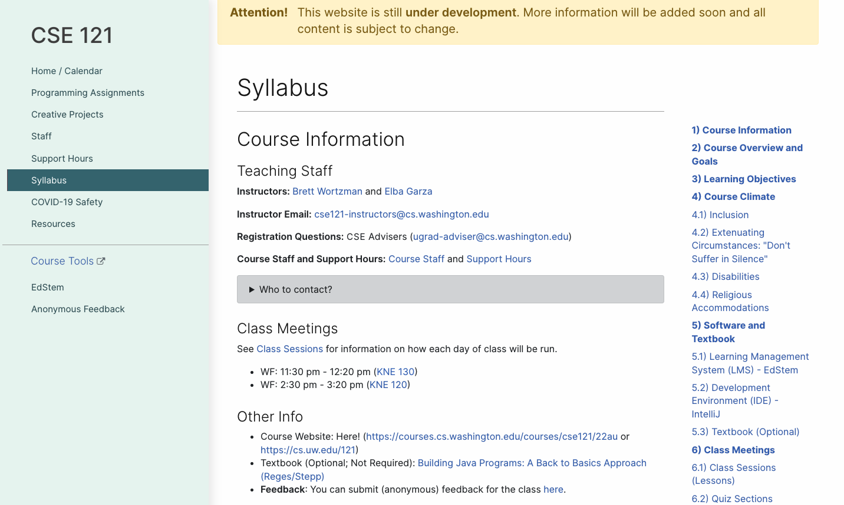
Course Website
Please review the syllabus ASAP.
Notes:
Elba

Slide 22
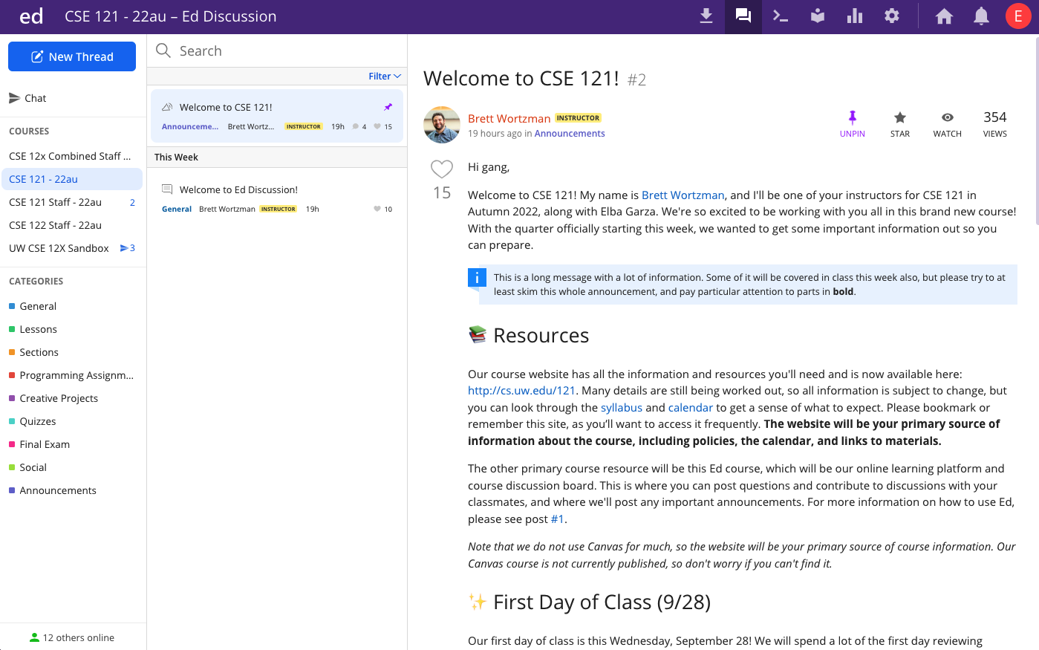
Ed
Our online learning platform
Lessons, sections, assignments posted
Linked from calendar
Submit graded work
Receive/View feedback
Message board
Including announcements
Notes:
Elba
Mention other tools coming soon: IntelliJ, MyDigitalHand, TBD polling tool (sli.do?)

Slide 23
💻: 👋🌎 Hello, World!
Notes:
:05
Elba

Slide 24
Agenda
About us
About this course
Learning objectives
Other similar courses
Course components
Our learning model
Tools and resources
Course Website
Ed
Hello, World!
Assessment and grading
Collaboration
Notes:
Here on down comes Friday.

Slide 25
Assignments and Grading
Our goal in the course is for you to gain proficiency the concepts and skills we teach
We assess your proficiency by asking you to apply the concepts and skills on tasks or problems
By necessity, we are assessing your work as a proxy for your proficiency

Slide 26
Assignments
Your learning in this course will be assessed in four ways:
Programming Assignments (~biweekly, 4 total)
Structured programming assignments to assess your proficiency of programming concepts
Creative Projects (~biweekly, 4 total)
Smaller, more open-ended assignments to give you space to explore
Quizzes (4 total, in section)
Series of problems covering all material up to that point
Final Exam (Wednesday, December 14)
Final, culminating assessment of all your skills and knowledge

Slide 27
Resubmission/Retakes
Learning takes time, and doesn’t always happen on the first try
One previous Programming Assignment or Creative Project can be resubmitted each week
Must be accompanied by a write-up describing changes
Grade on resubmission will replace original grade
Each assignment should only be resubmitted once
Each Quiz can be retaken once
Retakes scheduled at certain times– details forthcoming
See the syllabus for more details

Slide 28
Grading
Grades should reflect your proficiency in the course objectives
All assignments will be graded E (Excellent), S (Satisfactory), or N (Not yet)
Under certain circumstances, a grade of U (Unassessable) may be assigned
In some cases, not all grades will be given
Final grades will be assigned based on the amount of work at each level
See the syllabus for more details

Slide 29
Agenda
About us
About this course
Learning objectives
Other similar courses
Course components
Our learning model
Tools and resources
Course Website
Ed
Hello, World!
Assessment and grading
Collaboration

Slide 30
Collaboration Policy
Learning is hard, but it’s easier when you learn from each other
You are encouraged to form study groups; work together on pre-class work, practice and review; and discuss your ideas and approaches
All work you submit for grading must be predominantly and substantially your own
Work that violates policy may be withdrawn within 72 hours
See the syllabus for more details

