Slide 1
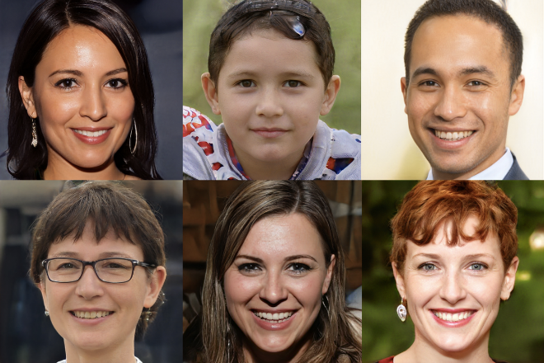
Digital “Reality” CSE 120 Winter 2020
Some Inspiration: INFO 270 Calling Bullshit: Data Reasoning in a Digital World
https://callingbullshit.org
Instructor: Teaching Assistants:
Sam Wolfson Yae Kubota Eunia Lee Erika Wolfe
ThisPersonDoesNotExist.com uses AI to generate endless fake faces
“The ability of AI to generate fake visuals is not yet mainstream knowledge, but a new website — ThisPersonDoesNotExist.com — offers a quick and persuasive education.
“The site is the creation of Philip Wang, a software engineer at Uber, and uses research released last year by chip designer Nvidia to create an endless stream of fake portraits. The algorithm behind it is trained on a huge dataset of real images, then uses a type of neural network known as a generative adversarial network (or GAN) to fabricate new examples.”
https://www.theverge.com/tldr/2019/2/15/18226005/ ai-generated-fake-people-portraits-thispersondoesnotexist- stylegan
Notes:
Very relevant to this lecture!
Take data from photos that people have posted online and generate images of people that don’t exist.

Slide 2
Administrivia
Assignments
Project Planning feedback released
Final Project Update due next Tuesday (March 3) in section
Innovation Exploration presentations continue tomorrow

Slide 3
Digital Information
All digital information is stored in binary
Online text is just ASCII or Unicode data
In most cases, it is very easy to manipulate!
Can change data in your RAM or stored on your hard drive
Example: add a new word to the English language
Printed dictionary: Get noticed by publishers, come to agreement over new definition, wait for next edition
Online: Edit your website HTML, share it. Or add to repository like urbandictionary.com or knowyourmeme.com
Notes:
Reminder: all digital info stored in binary, everything just 0s and 1s, just depends on how we interpret it.
Stored in memory or on a hard drive – can easily be overwritten or changed!
Adding a new word: pre-Internet, need to somehow get the change published (send mail to publisher, wait for next edition) lots of checks and balances and centralized authority
Now, just post it on your website (and hope someone visits it…) or post on other website

Slide 4
Digital Information
Anyone can publish anything they want online!
Freedom of speech was a central tenet of the creation of the Internet
The Bullshit Asymmetry Principle: “The amount of energy needed to refute bullshit is an order of magnitude bigger than to produce it.”
– Alberto Brandolini
Ultimately, dealing with online information boils down to a matter of trust
Notes:
Nobody really checking what you post online, at least not closely – to massive of a scale.
This is part of the idea of the Internet – freedom! No control by a central authority.
However…this means lots of nonsense ends up on the internet (so much so that there’s actually a principle about it)
Hard to know who to trust… in this lecture we’ll learn about how to try and analyze, think critically, etc.

Slide 5
Why This Matters
“[T]he United States government should teach the public to tell when they are being manipulated. Via schools and nongovernmental organizations and public service campaigns, Americans should be taught the basic skills necessary to be savvy media consumers, from how to fact-check news articles to how pictures can lie.”
– Mark Galotti, (Dec. 2016) NY Times.
Notes:
Opinion, but getting at the idea that this really is an important part of being a digital citizen

Slide 6
Outline
Exposure to Information
Spread of Information
Digital Media Manipulation
Notes:
Exposure: how do you interact
Spread: how it moves from person to person, and your role
Manipulation: how information is changed, who gets to do it

Slide 7
A Question For You!
Where do you get your news (and opinions on the news) from?

Slide 8
The Internet Forms Our Opinions
Having an enormous amount of information available to us creates a poverty of attention
Compounded by the massive new problem of fake news
How should we allocate our attention now that we have so many options to choose from?
Not only do we have the ability to choose what to read and pay attention to, but we also have the ability to choose what we believe in
Notes:
Not hyperbole to say that the internet forms our opinion.
So much information around you, hard to pay attention to it all “poverty of attention”
So how to choose from the multitude of options?
Whatever your beliefs, you can find information that confirm these beliefs

Slide 9
Example: Climate Change
Notes:
Can look for a news story that corroborates your opinion either way!
These stories from within a week of one another!
Possibly misleading – sea ice vs minimum sea ice, 35-year record vs total record, etc.

Slide 10
Example: Conspiracy Theories
Unfounded, deeply held alternative explanations for how things are
Not just for the crazies!
Aided by abundance of information and false memories
Now an almost automatic response to current events:
2016 Pizzagate: Hillary Clinton’s leaked emails linked her to an alleged child sex ring at the restaurant Comet Ping Pong
2017 Las Vegas shooting: questioning the shooter’s identity and motive
2018 Stoneman Douglas High School (Parkland, FL) shooting: staged by “crisis actors”
Notes:
Tons of intelligent, well-education people who still believe these things!
False memories: the Mandela Effect
Given the abundance of information, lots of theories emerge
https://en.wikipedia.org/wiki/False_memory
https://www.newstatesman.com/science-tech/internet/2016/12/movie-doesn-t-exist-and-redditors-who-think-it-does

Slide 11
Example: Conspiracy Theories
Easy to find corroborating or persuasive data/information for almost any position
A lot of data is misrepresented
Sometimes misinformation is purposely spread to support an agenda
Sometimes unintentionally spread: “Parkland Conspiracies Overwhelm the Internet’s Broken Trending Tools”
https://www.wired.com/story/youtube-facebook-trending-tools-parkland-conspiracy/
Notes:
So much data means that it’s really easy to find data that seems corroborating (even if it’s not!)
Sometimes sloppy analytical work.
Sometimes purposeful selection to get data to “lie”.
Sometimes just a bad game of telephone.
YouTube’s algorithms are just designed to get you to click on things – no sense of whether they’re truthful or not.
How to fix this?

Slide 12
Content Moderation
Content moderators monitor and apply site rules and guidelines (“community standards”)
AI algorithms aren’t good enough yet
These rules and guidelines are often “fuzzy” and nuanced to apply
This exposes people to the worst of the Internet ☹
The Trauma Floor: “The job also changed the way he saw the world. After he saw so many videos saying that 9/11 was not a terrorist attack, he came to believe them. Conspiracy videos about the Las Vegas massacre were also very persuasive, he says, and he now believes that multiple shooters were responsible for the attack.”
https://www.theverge.com/2019/2/25/18229714/cognizant-facebook-content-moderator-interviews-trauma-working-conditions-arizona
Notes:
https://www.theverge.com/2019/2/25/18229714/cognizant-facebook-content-moderator-interviews-trauma-working-conditions-Arizona
Hiring people to manually go through and monitor platforms like Facebook and enforce content policies
Hate speech in particular can be difficult to discern
Might even depend on the English dialect – remember ML bias
Being in an environment where you’re bombarded with this stuff can convince you of it

Slide 13
Filter Bubbles
Eli Pariser warns that technology tends towards exposure to information that confirms preexisting beliefs
https://www.ted.com/talks/eli_pariser_beware_online_filter_bubbles
People (myself included) tend to look to people who they think have the right answers
Often people who act and look like me or share similar opinions
This is a bias (natural filter bubble)
Notes:
With social media, can choose what kind of information you see
Easy to choose information that confirms your pre-existing beliefs
Curate your own environment that agrees with you – your “filter bubble”
Who to trust? – bias towards people that we choose to believe (you probably believe me because I’m the instructor)

Slide 14
Polarization and Technology
Pablo Barberá argues that technology has the opposite effect
“How Social Media Reduces Mass Political Polarization. Evidence from Germany, Spain, and the U.S.”
http://smapp.nyu.edu/papers/SocialMediaReduces.pdf
“Weak social ties tend to be more ideologically heterogeneous than strong social ties.”
“Citizens are now exposed not only to their close friends’ opinions, but also to political content shared by their co-workers, childhood friends, distant relatives, and other people with whom they form weak ties.”
Notes:
However… “weak social ties” from social media more heterogeneous, varied, with different opinions
Exposure to more opinions should theoretically give you a better perspective

Slide 15
Polarization and Technology
Diana Mutz: “Cross-cutting Social Networks: Testing Democratic Theory in Practice”
http://repository.upenn.edu/cgi/viewcontent.cgi?article=1124&context=asc_papers
“Exposure to conflicting political viewpoints is widely assumed to benefit the citizens of a democratic polity.”
“... Utilizing a laboratory experiment manipulating exposure to dissonant and consonant political views, I further substantiate the causal role of cross-cutting exposure in fostering political tolerance.”
Notes:
Conflicting viewpoints widely assumed to benefit citizens…cross-cutting exposure fostering political tolerance.

Slide 16
Facebook Friends
More recently, there’s an interesting fad of unfriending people on social media sites like Facebook
This past presidential election, in particular, has made many people post their personal political beliefs on Facebook, which has ruined many a friendship
This results in a tighter filter bubble
Notes:
However, increased amount of removing people on facebook with diff beliefs

Slide 17
Discussion
Social Media: Humanizing or Polarizing?
Notes:
What do you think? Recognizing that everyone’s experience is different.
Brings us closer together? Or polarizes us?
5min?

Slide 18
Outline
Exposure to Information
Spread of Information
Digital Media Manipulation

Slide 19
Virality
What generates $$ on the Internet?
Advertising, clicks/views, sponsorships
Notes:
Video: - 2:50
Nothing is actually free – need to pay for computers, electricity, ...

Slide 20
Virality
What generates $$ on the Internet?
Advertising, clicks/views, sponsorships
Not the truth:
https://www.youtube.com/watch?v=rE3j_RHkqJc&t=12
Notes:
Video: - 2:50

Slide 21
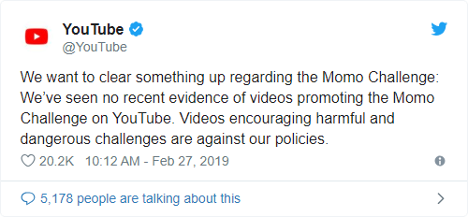
Example: Momo Challenge
Images of a demonic chicken lady spread with a warning of a dangerous “suicide” game that targets children on social media
https://www.vox.com/2019/3/3/18248783/momo-challenge-hoax-explained
Hoax fueled by media reports and parents’ fears about their children’s online activity
Original photo is of a sculpture called “Mother Bird” made by a Japanese artist
Twitter → schools → police → Kim Kardashian → TV reports
Notes:
This disturbing image spread around on the Internet, interspersed into videos intended for children, encouraging self harm and targeted to children.
However, it was a hoax and there’s no evidence that this was actually being done anywhere.
But it was picked up by TV reports – TV news was supposed to be better-researched
Was spread because it plays to the emotions of parents
Why was Kim Kardashian involved?

Slide 22
Social Media “Influencers”
Definition?
“A Social Media Influencer is a user on social media who has established credibility in a specific industry. A social media influencer has access to a large audience and can persuade others by virtue of their authenticity and reach.” – https://www.pixlee.com/definitions/definition-social-media-influencer
Notes:
How do you define an influencer? Social media, lots of followers, advertising
One definition…
but, what is pixlee.com? (turns out PR company)
Is this the right definition? I liked it, but of course this plays to my biases

Slide 23
Social Media “Influencers”
What do they do?
Using https://influencermarketinghub.com/top-25-instagram-influencers/ just as an example
Notes:
All topics that seem generally like something that we’d like to have.

Slide 24
Social Media “Influencers”
Would you rather take advice from…
a beauty blogger OR a make-up artist
a food blogger OR a food critic
a fashionista OR a movie star
a fitness guru OR a professional athlete
Why do we trust influencers?
More relatable, can see whole process
“Children report viewing influencers to be more trustworthy than traditional celebrities, possibly because of increased feelings of familiarity.” https://www.marketwatch.com/story/how-social-media-influencers-are-making-your-kids-fat-2019-03-05
Notes:
Influencers are more relatable than traditional celebrities

Slide 25
Social Media “Influencers”
… but who is more qualified?
Social media influencers are often just a form of testimonial advertising
Celebrities → “endorsement”, Ordinary citizens → “testimonial”
Anecdotal evidence is not definitive proof
Influencers are often PAID to advertise certain products!

Slide 26
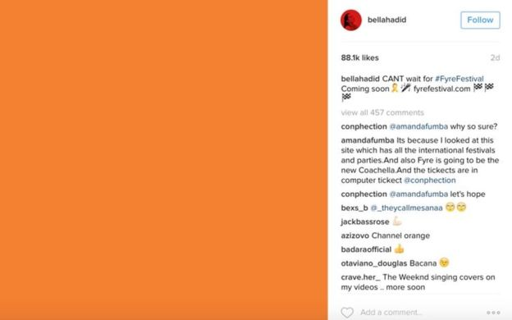
Example: Fyre Festival
Failed “luxury music festival” founded by Billy McFarland and Ja Rule
Gained traction because of influencer sponsored posts:
Expectations Reality
vs
Images from: https://www.bbc.com/news/46945662

Slide 27
Sponsored Content
These are a common source of revenue and platforms are encouraged to get you to click on them
Often look just like other items (e.g. Google search results, Facebook newsfeed)
Targeted advertising!
Open up your favorite social media platform and look at the first 10 items – count how many of them are sponsored content
Look for a little “Sponsored” tag – these were not always required!

Slide 28
Discussion
Social Media Sharing: What content do you share? Where is your line to NOT share?

Slide 29
Outline
Exposure to Information
Spread of Information
Digital Media Manipulation
Notes:
How to manipulate?

Slide 30
Image Editing
Photo editing is no longer just for the art professionals!
Built-in editing tools in apps like Snapchat, Instagram, Messenger, FaceTune
The user interfaces encourage image editing
e.g. suggested edits by Google Assistant in Google Photos
Audience photo editing
<audience responses>
Notes:
Much easier to edit photos now! It’s fun! I like to do it! But the dark side is that this can also be used to intentionally manipulate and mislead

Slide 31
Social Media Curation
What are some uses for social media?
Stay connected with those who are physically far
Meet others with shared interests regardless of location
Broadcast notable events and thoughts
Project a certain image or persona
Notes:
Social media less “personal”

Slide 32
Social Media Curation
What are some uses for social media?
Stay connected with those who are physically far
Meet others with shared interests regardless of location
Broadcast notable events and thoughts
Project a certain image or persona
Selfie scene of the character Bethany in “Jumanji 2.”
Notes:
Spends 4 minutes taking IG photo

Slide 33
Social Media Curation
What are some uses for social media?
Stay connected with those who are physically far
Meet others with shared interests regardless of location
Broadcast notable events and thoughts
Project a certain image or persona
Effects:
No statistically significant link between social media usage and depression
Arms races between online personas
Fear of missing out (FOMO)
Not spending as much time connecting in real life
Notes:
Concerns about social media, FOMO, I’ve definitely felt it.

Slide 34
Image Generation
Billions of images already exist on the internet – we can easily train algorithms to generate more from scratch
Let’s play a game!
http://whichfaceisreal.com/
Notes:
Sometimes can’t even tell what’s realy anymore

Slide 35
Audio Generation
We can synthesize audio/speech
Siri, Alexa, Cortana, GPS voices
With enough audio training data, can train a neural net to produce new audio that approximates someone’s voice
Learning Lip Sync from Audio (UW!)
Graft synthetic mouth shapes onto existing video to match audio

Slide 36
Video Generation
Videos are collections of sequential images
Faking motion and lighting is a lot harder for videos
DeepFake
An open source machine-learning-powered human image synthesis technique
Most common usage is to superimpose one person’s face onto another person’s body in a video
Still pretty easy to tell apart from authentic video

Slide 37
Video Generation
Videos are collections of sequential images
Faking motion and lighting is a lot harder for videos
Deep Video Portraits
Create photorealistic re-animations of portrait videos on top of a source actor

Slide 38
Discussion
What will we use to verify the truth once video can be easily faked?

Slide 39
What Can Be Done?
It’s not all doom and gloom
Synthesized versions can still be detected
Detection tools will continue to improve
Laws and policies will eventually catch up
Be aware of where you are getting your information from and what you choose to share
Fact-checking is exhausting, but important
Make sure your trusted sources are trustworthy

