Slide 1
Data Visualization
CSE 120, Winter 2020
Erika Wolfe
Lasers etch a 'perfect' solar energy absorber
"In a paper in Light: Science & Applications, the lab of Chunley Guo, professor of optics also affiliated with the Department of Physics and Astronomy and the Material Sciences Program, describes using powerful femto-second laser pulses to etch metal surfaces with nanoscale structures that selectively absorb light only at the solar wavelengths, but not elsewhere...
"This surface not only enhances the energy absorption from sunlight, but also reduces heat dissipation at other wavelengths, in effect, 'making a perfect metallic solar absorber for the first time,' Guo says. 'We also demonstrate solar energy harnessing with a thermal electric generator device.'"
From University of Rochester
Thanks to Jeff Heer (CSE 442) and Hunter Schafer (CSE 163) for material​
Notes:
Creativity project due tonight!

Slide 2
What is data visualization?
"… finding the artificial memory that best supports our natural means of perception" [Bertin 1967]
"The use of computer-generated, interactive, visual representations of data to amplify cognition" [Card, Mackinlay, & Schneiderman 1999]

Slide 3
Set A
X | Y
10 | 8.04
8 | 6.95
13 | 7.58
9 | 8.81
11 | 8.33
14 | 9.96
6 | 7.24
4 | 4.26
12 | 10.84
7 | 4.82
5 | 5.68
Set B
X | Y
10 | 9.14
8 | 8.14
13 | 8.74
9 | 8.77
11 | 9.26
14 | 8.1
6 | 6.13
4 | 3.1
12 | 9.11
7 | 7.26
5 | 4.74
Set C
X | Y
10 | 7.46
8 | 6.77
13 | 12.74
9 | 7.11
11 | 7.81
14 | 8.84
6 | 6.08
4 | 5.39
12 | 8.15
7 | 6.42
5 | 5.73
Set D
X | Y
8 | 6.58
8 | 5.76
8 | 7.71
8 | 8.84
8 | 8.47
8 | 7.04
8 | 5.25
19 | 12.5
8 | 5.56
8 | 7.91
8 | 6.89
Mean X: 9.0, Standard dev X: 3.317
Mean Y: 7.5, Standard dev Y: 2.03
Linear Regression:
Y = 3 + 0.5X
[Anscombe 1973]

Slide 4
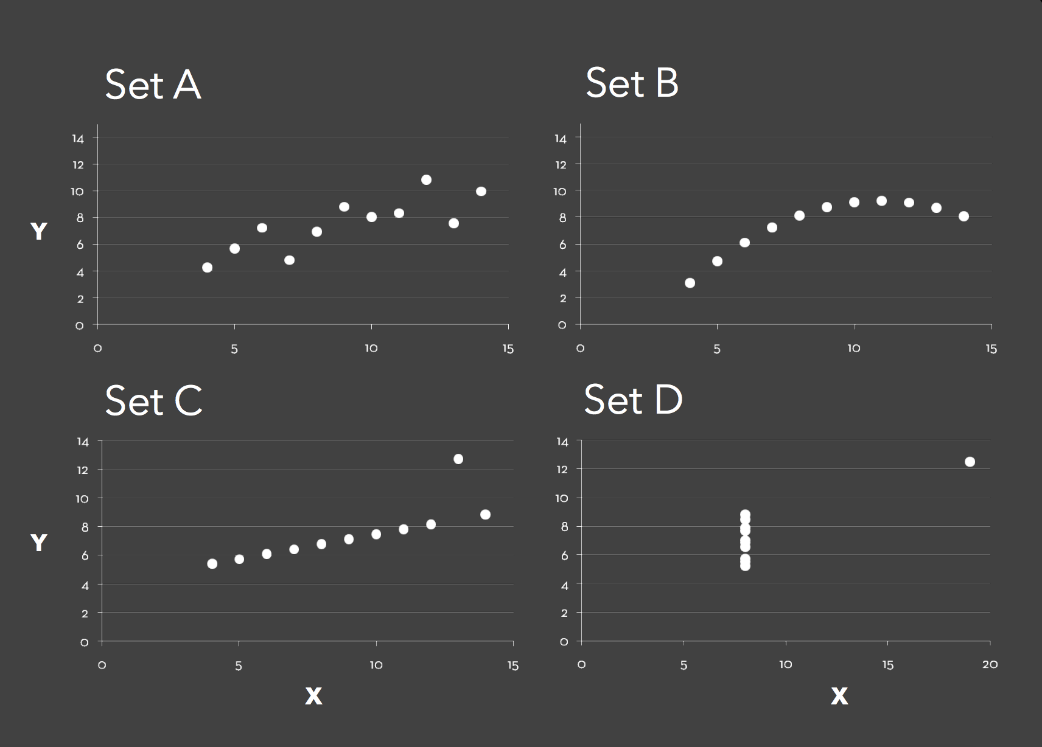

Slide 5
Why make data visualizations?
Find patterns
Answer questions and spur new ones
Support memory
Make a decision
Present an argument
Engage & inspire your audience

Slide 6
Why study data visualizations?
The world is creating TONS of data
> 90% of data in the world was created in the last two years(!!!!)
2.5 quintillion (2,500,000,000,000,000,000) bytes of data are created every day
Relevant for every discipline
Become informed consumers
They're super cool & fun to make!

Slide 7
Data Types
Nominal
Labels or categories
Fruits: apples, oranges, kiwi, ...
Ordinal
Ordered
Apples: US Utility, US No 1, US Fancy, US Extra Fancy
Quantitative
Quantity, amount, or range
Length, temperature, location (lat/long), dates

Slide 8
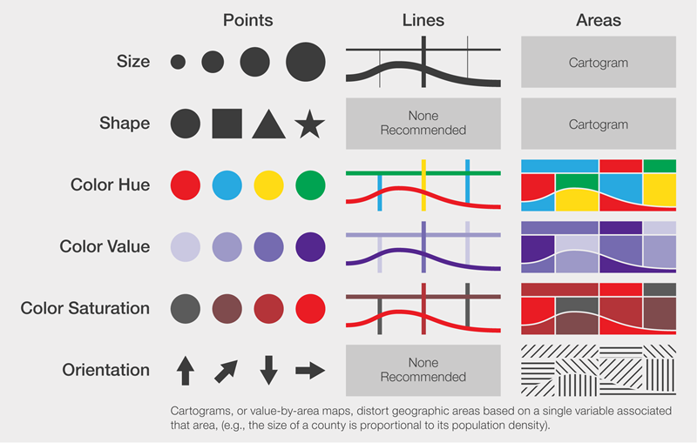
Visual Encodings

Slide 9
Intuition
Discuss with your neighbors – How much is A compared to B?
A
B
A
B
A
B
A = 25% B
A = 33% B
A = 60% B

Slide 10
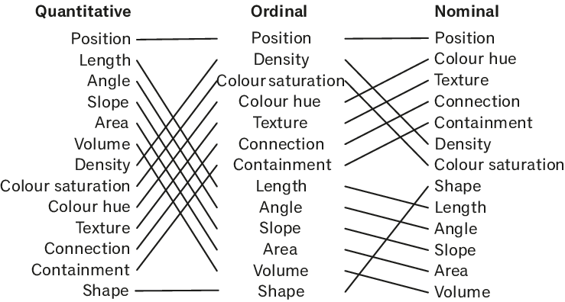
Mackinlay's ranking
Remember!
Quantitative = amount
Ordinal = ordered
Nominal = label
Conjectured effectiveness of encodings by data type.
[Mackinlay 1986]

Slide 11
Design criteria
Tell the whole truth & nothing but the truth
Consider the impact of your visualization
Use encodings that people decode better
Better = faster and/or more accurately
Think about accessibility!
Encode the most important information using the most effective encodings

Slide 12
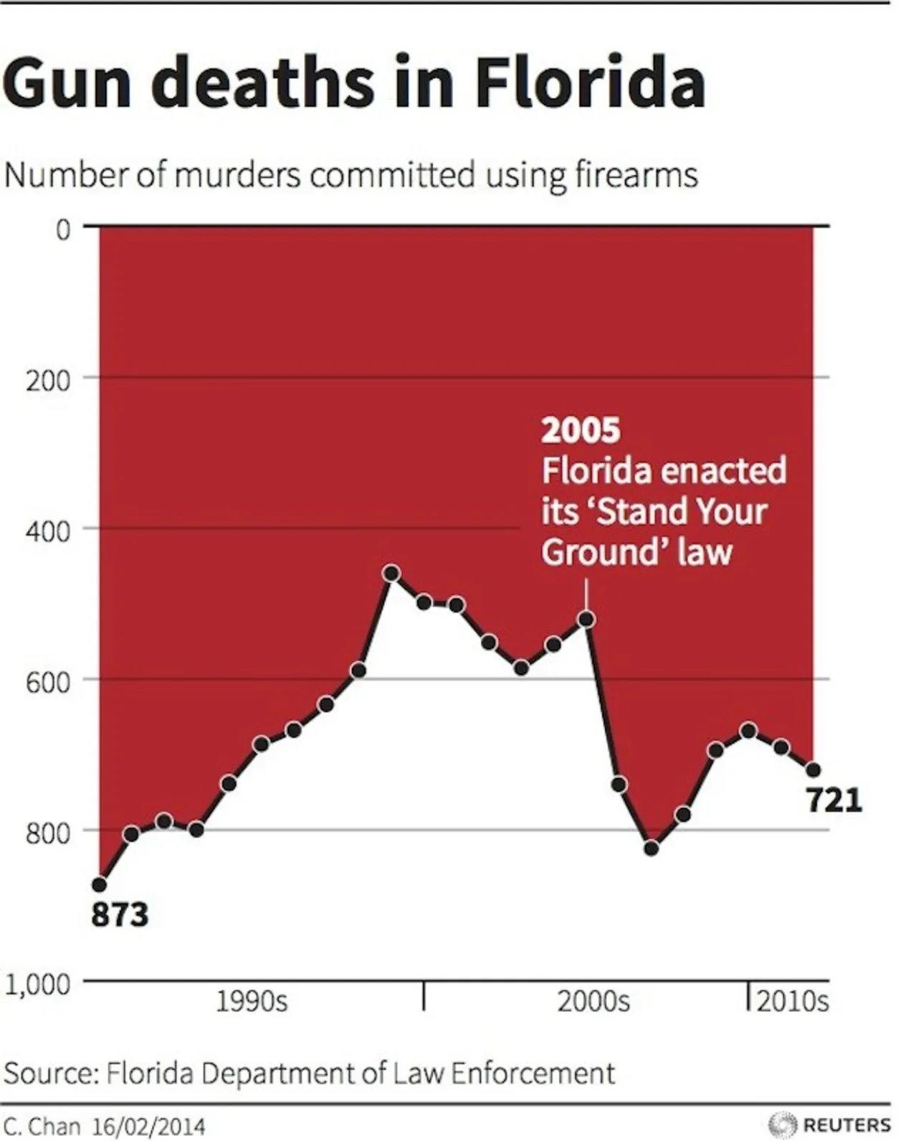
Misleading Visualization Practices
After 2005, did gun deaths in Florida increase or decrease?
Notes:
Going against common practice of starting an axis at 0 on the bottom

Slide 13
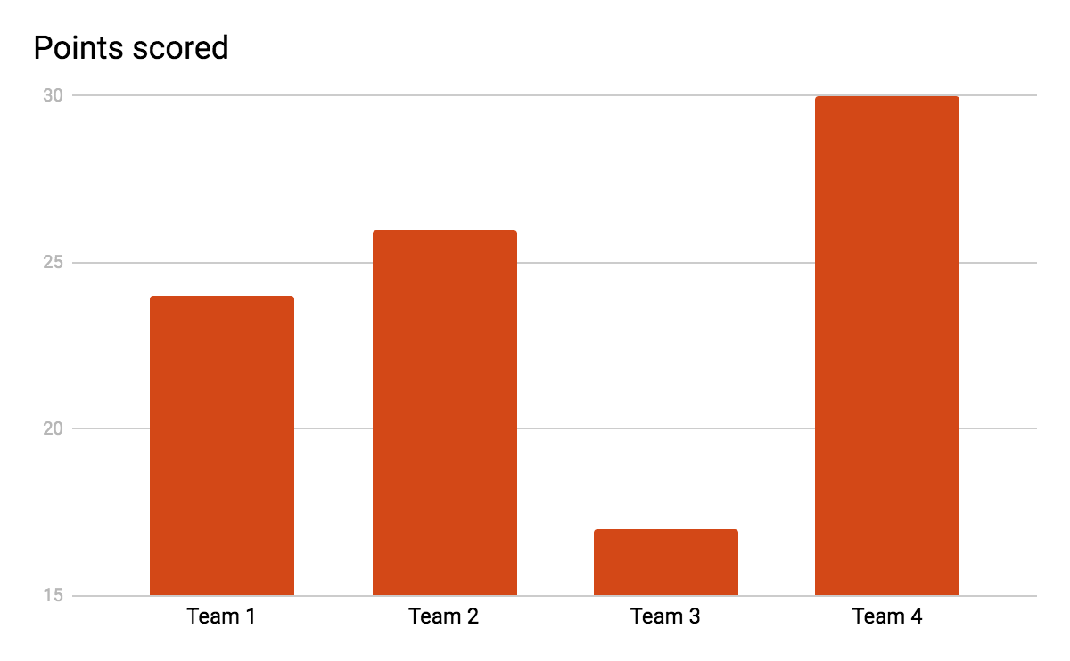
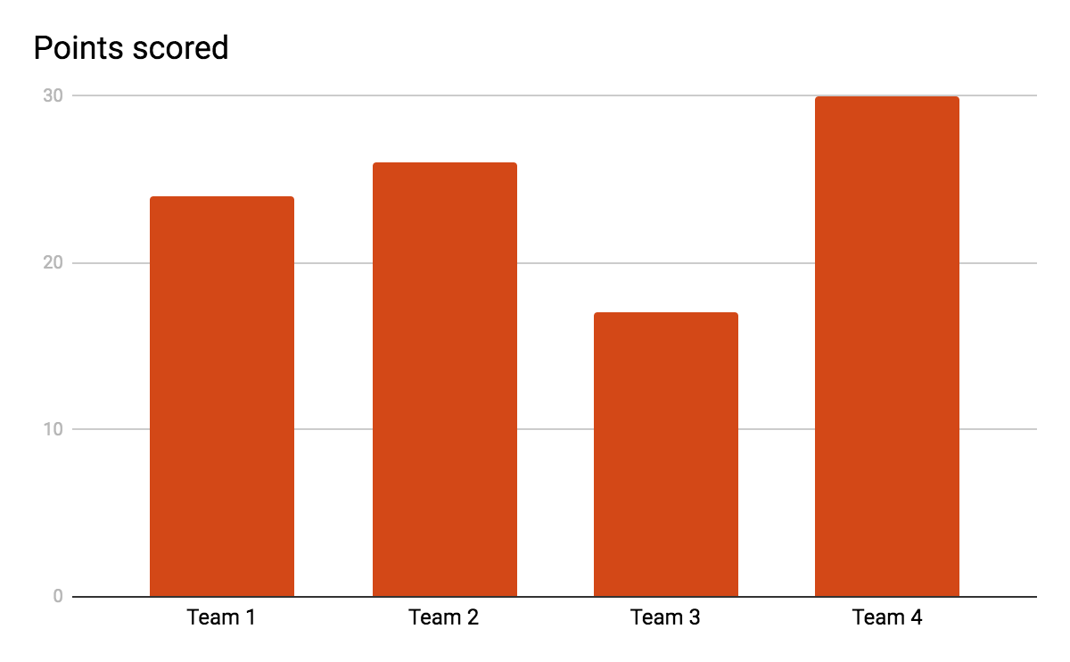
Misleading Visualization Practices
This is the same data!
Team 2 got 26 points – how many points did Team 3 get?
Notes:
Team 2 got 26 points. How many points did team 3 get?

Slide 14
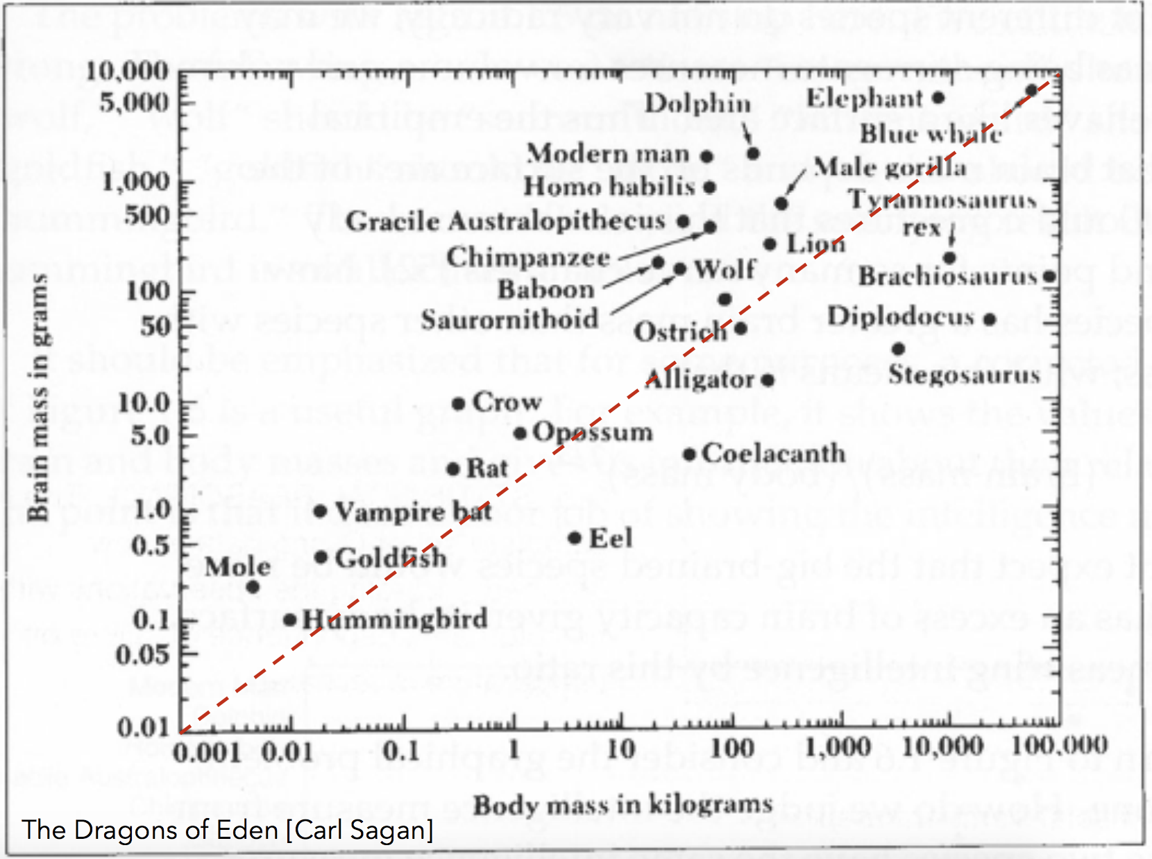
Misleading Visualization Practices
Which two animals have the highest brain mass to body mass ratio?
Notes:
Not trying to answer the question – how is brain mass correllated with body mass?
What are the top 3 animals with the largest brain mass to body mass ratio?

Slide 15
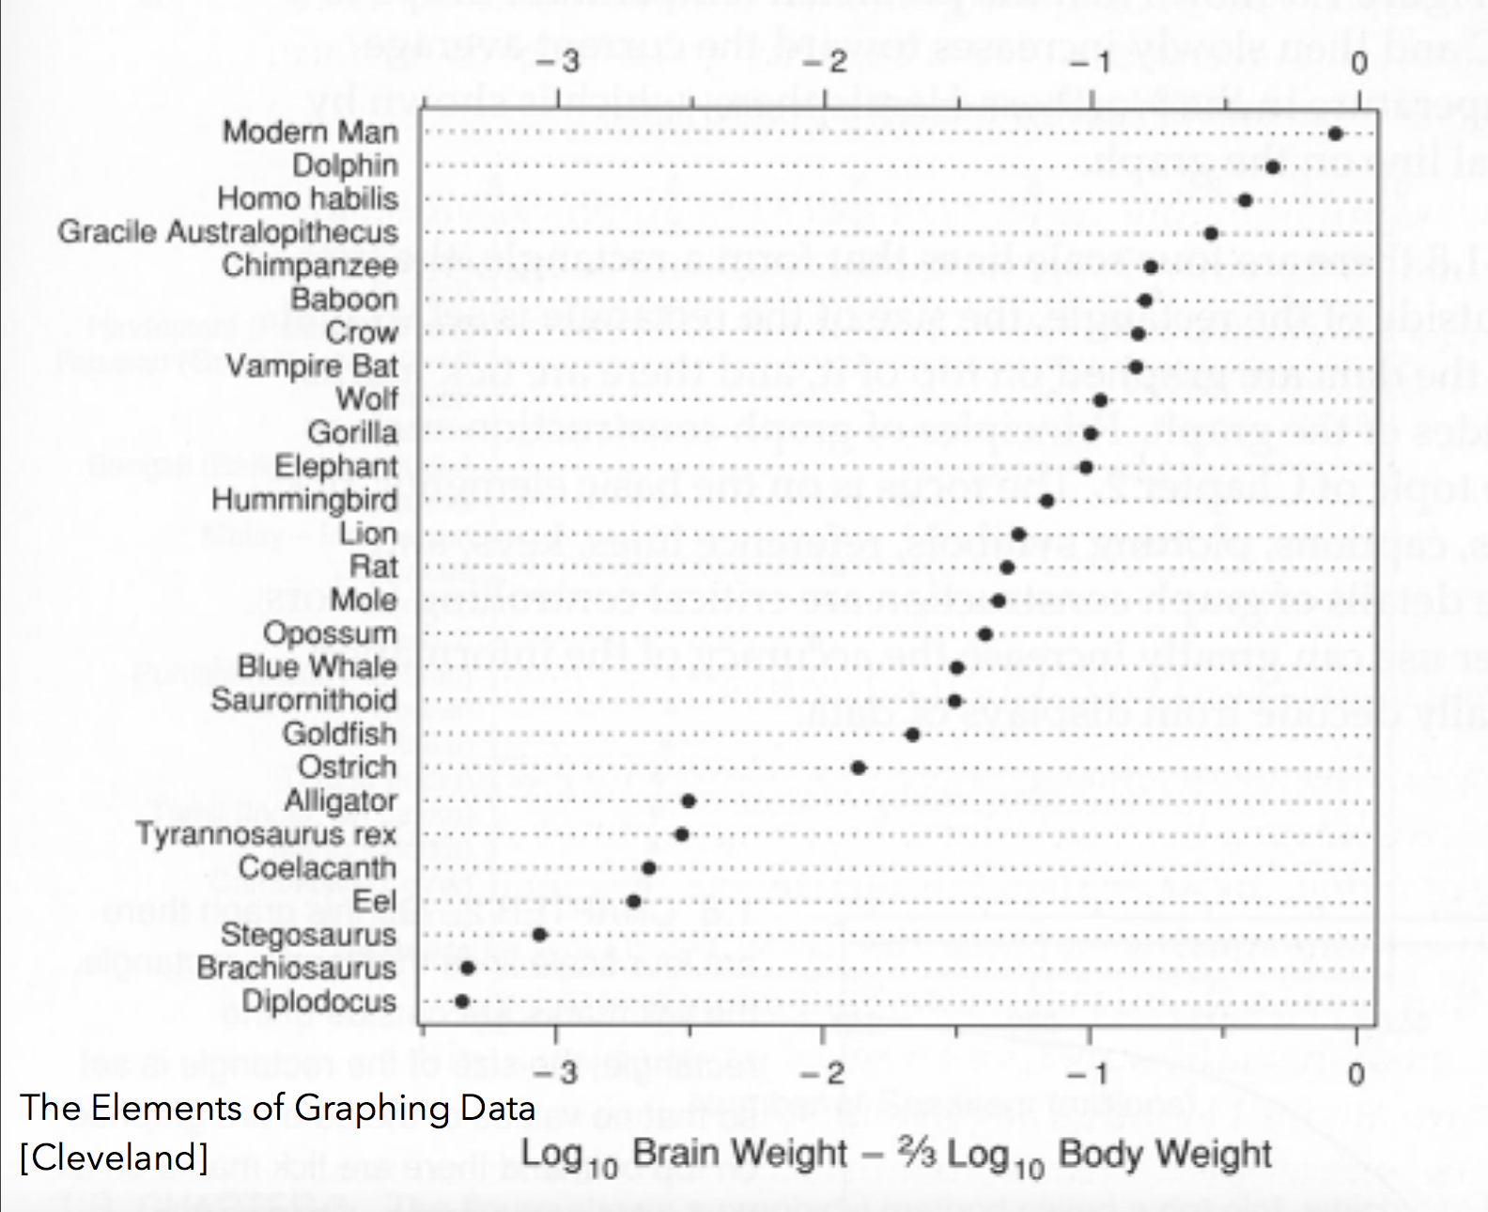
Misleading Visualization Practices
This is the same data!
Notes:
By changing our scale calculation we can better answer this question!

Slide 16
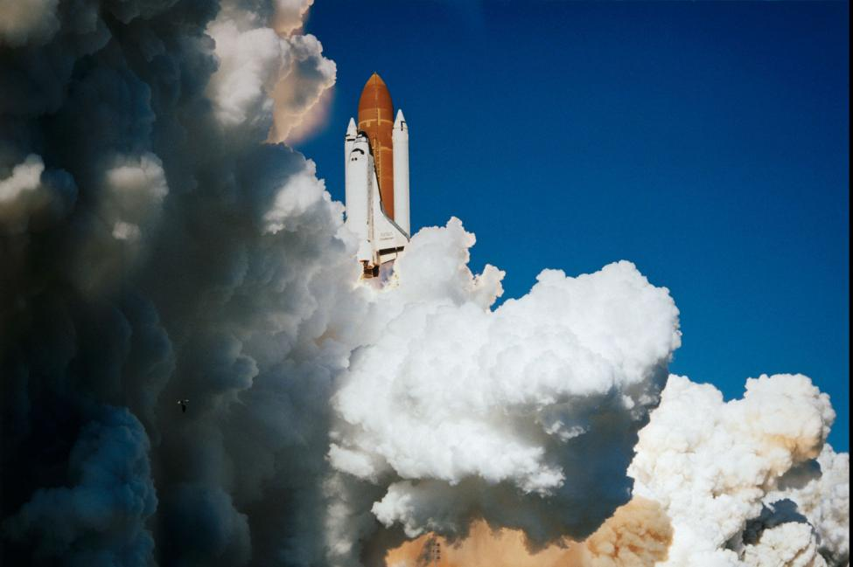
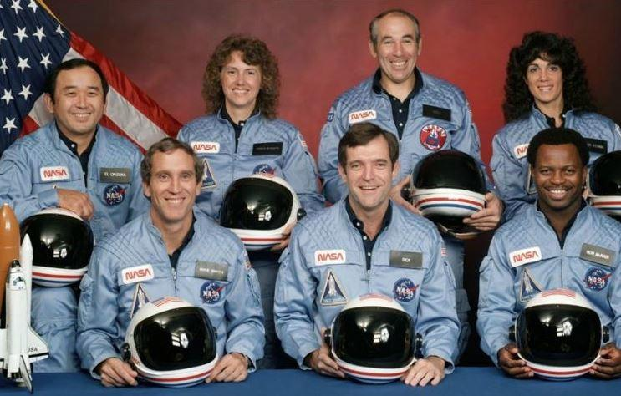
Challenger Explosion
Launched January 28, 1986
Broke apart 73 seconds after launching
Caused by cold temperatures affecting the O-rings which held together the rockets

Slide 17
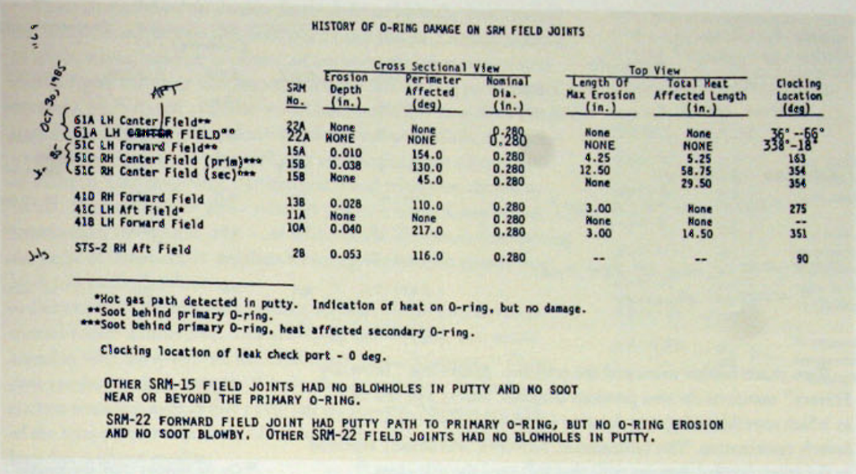
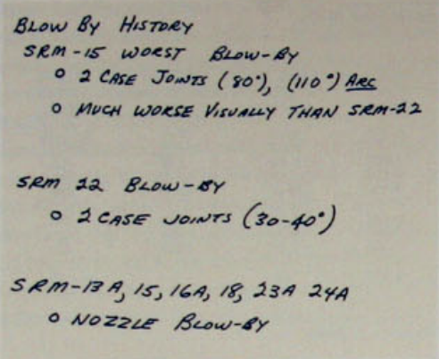
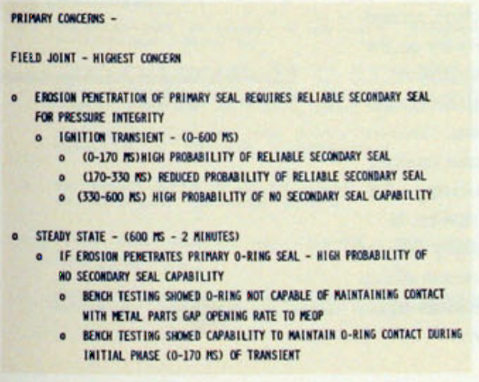
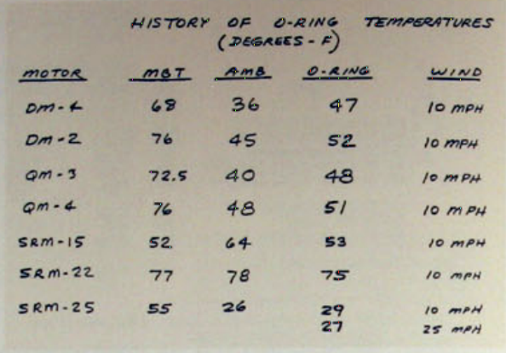
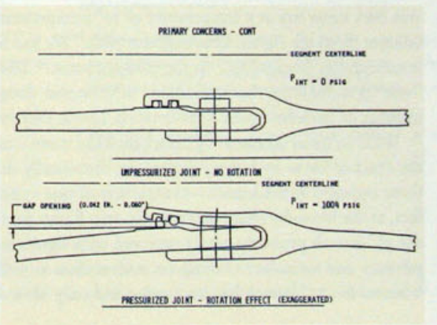
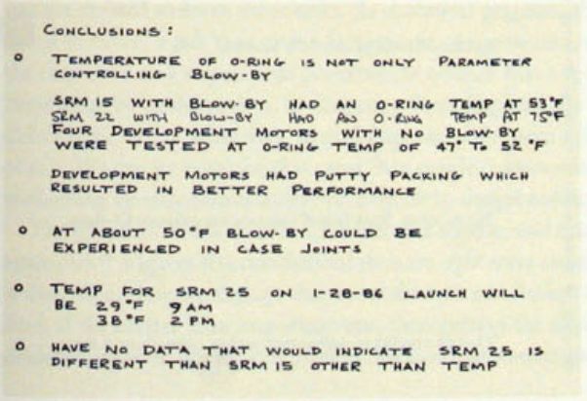
Pre-launch visualizations
Notes:
Lots of text and raw numbers
Extraneous information (physical reason why the O-rings malfunction in cold temps)
No visualization drawing a clear correlation between the O-ring malfunctions & cold temperature

Slide 18
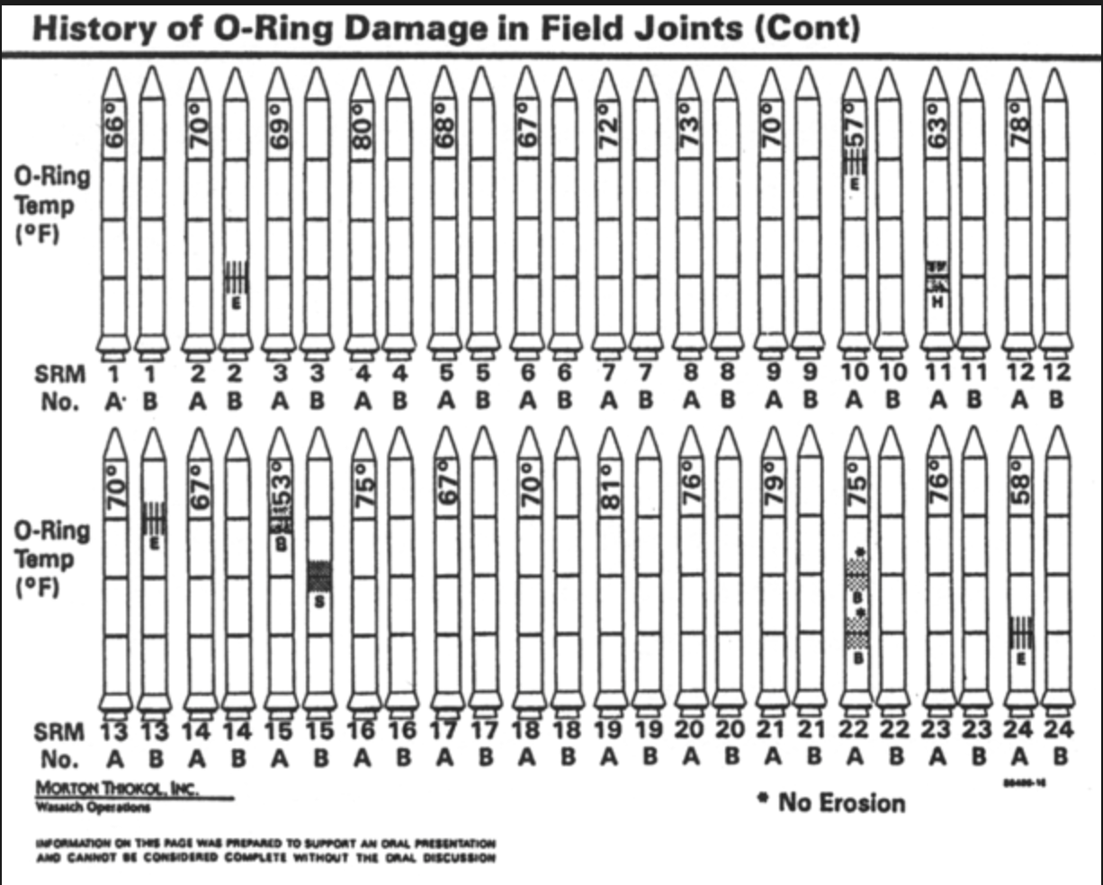
Post-launch visualizations
[Rogers Commission Report, 1986]
Notes:
Disappearing legend
Visual clutter – rockets and typography
No clear cause & effect
Ordering by time instead of temperature

Slide 19
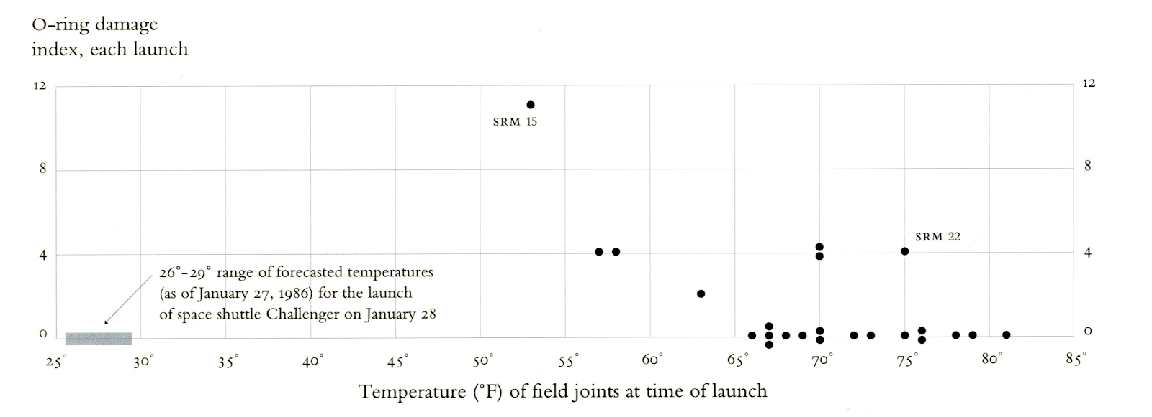
Redesign
[Tufte, 1997]

Slide 20
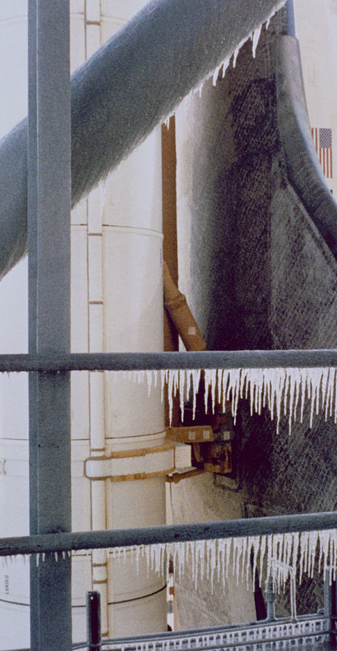
Reflections on Challenger
Remember the context when viewing redesigns
The original authors do not know the outcome
Other factors beyond data visualization!
Scientists did raise concern about the temperature
Internal & external pressure? Groupthink?

Slide 21
This was cool. What now?
Check out some of Erika's favorite visualizations
Wind map of the US
Bus bunching vis
Visual intro to machine learning
Build your own visualizations!
D3 for the web
Python + seaborn for other applications
Read about accessibility and data vis
Consume content from the data vis community
Twitter & Medium!
Think carefully about visualizations you see in the wild

Slide 22
References
https://www.forbes.com/sites/bernardmarr/2018/05/21/how-much-data-do-we-create-every-day-the-mind-blowing-stats-everyone-should-read/#26a89fdd60ba
https://gistbok.ucgis.org/bok-topics/symbolization-and-visual-variables
https://www.google.com/search?q=visual+and+statistical+thinking&oq=visual+and+statisti&aqs=chrome.0.0j69i57j0l6.2137j1j1&sourceid=chrome&ie=UTF-8

