Slide 1
Lightbot and Functions CSE 120 Winter 2020
Instructor: Teaching Assistants:
Sam Wolfson Yae Kubota Eunia Lee Erika Wolfe
The 10 Neatest Things We've Seen at CES So Far
“The big spectacle of CES hasn't fully spread its wings just yet—Tuesday will be bananas—but we're feeling the early rumblings of what's to come. On Sunday night here in Vegas, the assembled tech press got to take a peek at some of the gadgets and apps launching this week.”
https://www.wired.com/story/ces-2020-photo-gallery-day-1/

Slide 2
Administrivia
Checkoffs
Done in pairs, multiple attempts to complete
Generally due by the end of the following section; later checkoffs are longer (calendar was incorrect – now fixed)
Can get checked off by any staff member in section or OH
Homework submission
Individual work
Submit via Canvas Assignments page
Make sure you look at Canvas rubrics
Lightbot Functions assignment due Monday (1/13)
Notes:
Questions about website, Piazza, etc?
Quick overview of calendar: slides will be posted, as assignments are released they will become clickable.
Checkoff: If you are checked off, you’ll get full credit.
Homework: course web → click “assignments” → show rubric for “Lightbot Functions”
Everything has a rubric
This particular worksheet you were passed out in lab yesterday

Slide 3
Aside: Reading Presentations
In Thursday sections this quarter, we’ll ask you to form small groups (2-4) and create presentations based on the readings that you did for this week.
You will be given about 15 minutes to prepare, and 3 minutes to present.
A small amount of outside research during the preparation period is encouraged but not required.
Presentation mediums will vary from week to week.

Slide 4
Why?
Think critically about complex technical issues
Contribute to a discussion in a way that you find interesting & relevant
Practice your presentation skills
Notes:
Your presentations should be based on something from the readings that interests you, for example:
Explaining a tricky topic form the readings in a novel way (e.g., why computers use binary and not something else)
Relating a topic from the readings to something that you’ve experienced or studied in another course (e.g., the effects of exponential growth in other fields)
Persuading your audience of an opinion that you have based on what you read (and explaining why you hold it)
Or something else entirely!

Slide 5
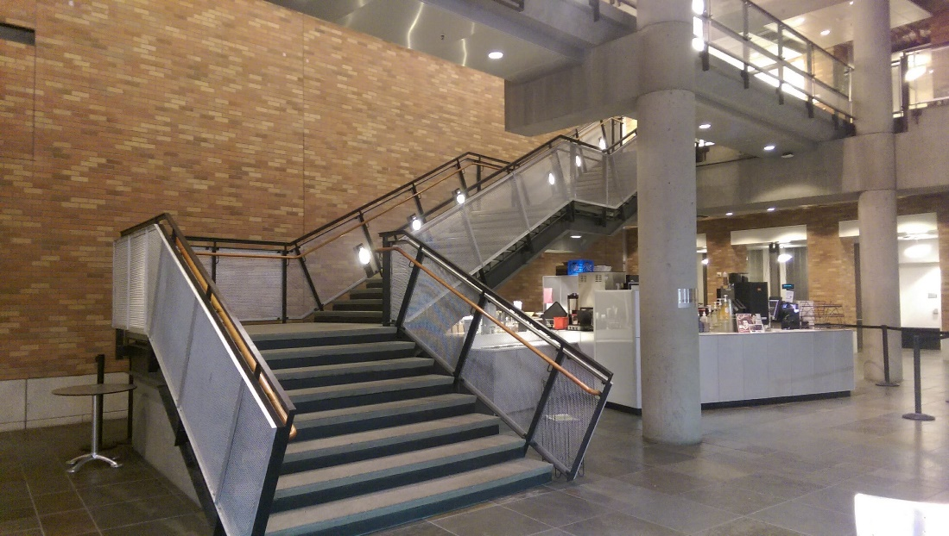
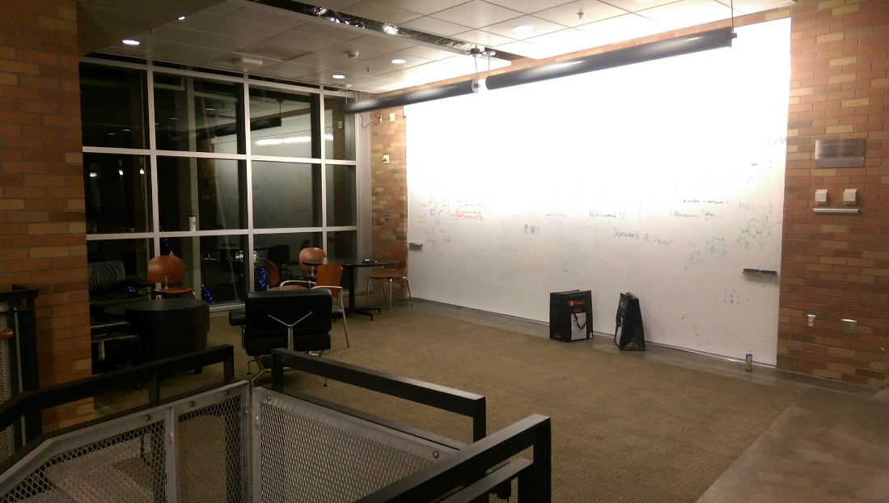
TA Office Hours
CSE breakouts
Up the stairs in the CSE Atrium (next to the café)
At the top of that first flight, the open area with the whiteboard wall is the 2nd floor breakout!
Other breakout spaces are directly above on the following floors (just up the stairs)
Notes:
TAs also talked about this in section, so can go quickly.
Very large open space in the middle of the CSE building call the Atrium. Take the spiral stairs up and there’s the breakout.
My office hours are in my office, CSE 218, which is also on the 2nd floor of the CSE building.

Slide 6
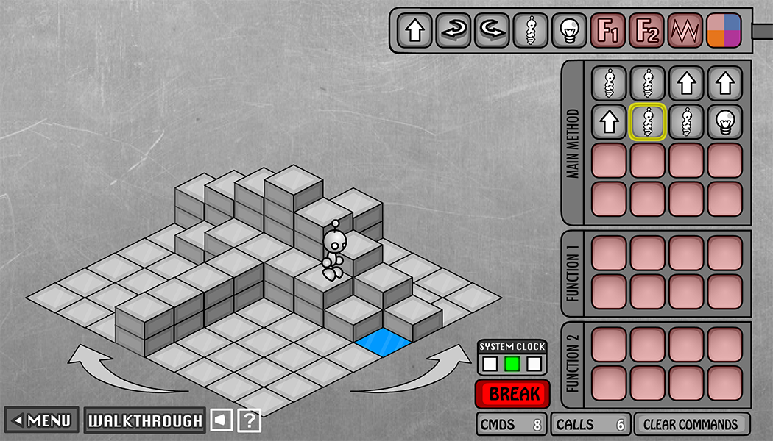
As Experienced Lightbot Players…
What are you doing in Lightbot?
Commanding a robot through a world of blocks and switches
Notes:
Now that you’ve played around with Lightbot…
Ask: what are you doing? How would you describe it?
You’re programming!

Slide 7
As Experienced Lightbot Players…
What are you doing in Lightbot?
Commanding a robot through a world of blocks and switches
Programming is commanding an agent
In this case, the agent is a robot
The agent is usually a computer, but could be a person or other device
Notes:
Programming: commanding something to do what you want it to do.
Usually a computer, or a real-life robot, etc.

Slide 8
As Experienced Lightbot Players…
What are you doing in Lightbot?
Commanding a robot through a world of blocks and switches
Programming is commanding an agent
In this case, the agent is a robot
The agent is usually a computer, but could be a person or other device
Direct an agent to a goal by giving it instructions
The agent follows the instructions flawlessly and mindlessly
The trick is to find the right instructions to match your intent
Notes:
In Lightbot, the goal was turn on blue lights.
The agent is perfect in its execution but might not achieve its goals
If it doesn’t, that’s because you didn’t give it the correct instructions
So how do you ensure that your instructions are correct?
Let’s think about what you’ll need to consider, the first of which is the order of instructions.

Slide 9
Order of Instructions
Instructions are given in order (i.e. in a sequence)
The 1st instruction is completed, then the 2nd, then the 3rd, …
You issue the instructions and the agent follows them
When the agent is following your instructions, this is called executing the program, or running the program
Notes:
How does the agent handle its instructions?
Annotate: starting from upper left to end of row; then next row
Annotate: “start”, “sequence of instructions”
Agent can only execute one instruction at a time
The order of the instructions matters!

Slide 10
Order of Events
The instructions are programmed ahead of time, and then executed later
The programmer cannot intervene until the program has finished executing or is terminated prematurely
The instructions must be correct for the agent to achieve its goal
Notes:
When you write a program, you need to plan ahead.
Write it all out before running it
You might not know what will happens until you run it
Typically not possible to intervene midway through the program
However, you might be able to stop the program prematurely.
Annotate: terminated prematurely → break

Slide 11
Point of View
Programming requires you to take the agent’s point of view
Because it is a sequence of instructions, you must account for everything that happened before (i.e. trace the program)
There is usually an indication of where you are currently in the program (sometimes called a program counter)
Notes:
Need to pretend that you are the agent (can use your hand to figure out direction and place where the agent is right now)
Tracing is a handy way to do this
Need a way to indicate what is happening right now (program counter)
Annotate: in Lightbot, the program counter is the yellow box. It tells you which instruction is currently being executed

Slide 12
Limited Instructions
The number and type of instructions is always limited
The agent can only do certain pre-defined actions
The agent can only execute one instruction at a time
Must learn how to specify complex tasks using just these simple actions
Notes:
Lightbot is simple, but you can do some complex things with it!
Robot only understands a few instructions
but they can be combined to do more.
Annotate: chess knight movement (1 move is two forward, turn right, one forward)
Draw out the chess movement on the board
How would you specify this in lightbot?
Built a complex task out of smaller instructions.

Slide 13
Limited Instructions
Limited instructions is a reality of all computing
A computer’s hardware/circuitry can only execute a small number of instructions – usually about 100
Many are just different versions of the same idea
Amazing Fact:
In theory, a computer with just SIX instruction types could compute all known computations!
Notes:
Unfortunately, this limitation applies to computers in general.
Instructions are decided when the hardware is built, and that’s all you get
Luckily, you don’t actually need that many instructions to do computation!
This is all well and good, but can you imagine having a computer that only accepts 6 (or even 100) instructions?

Slide 14
Limited Instructions in Programming
Programming would be excruciatingly tedious if you could only use the basic instructions
The early days of programming (c. 1950’s) were tedious and error-prone
No one would be a programmer no matter how much it paid!
The amazing applications we see today would not exist
Notes:
Imagine using Lightbot on a 1000*1000 board – would take forever!
Programming used to be like this
Luckily, we came up with something better – any ideas?
Muscle/neuron firing analogy for standing up – imagine if you had to tell every individual muscle what it was supposed to do, just for you to stand up!

Slide 15
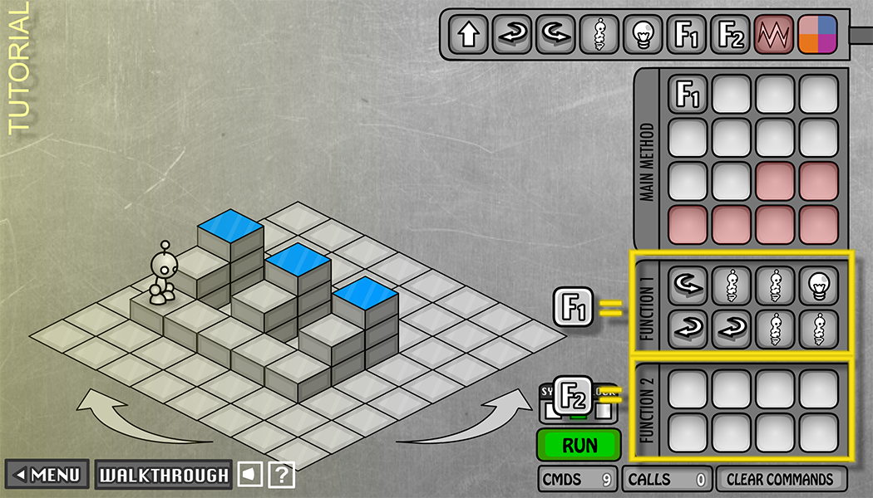
Solution: Functions!
Functions allow us to create new, more complex subtasks for our agents
Below, F1 is a function to “process a riser”
We can call a function by name (F1) to execute its instructions
Notes:
Instead of specifying every task every time, we can write it down once, then just say “do that thing that I already wrote down” in the future
A “subtask” specifies a sequence of instructions to execute
In this case, we’re going to describe F1 as “process a riser” – robot jumps to the top, lights the square, turns around, goes back down
Multiple ways to accomplish the same task – as long as it works (detail removal)
Annotate: riser in Lightbot, F1 = “process a riser”

Slide 16
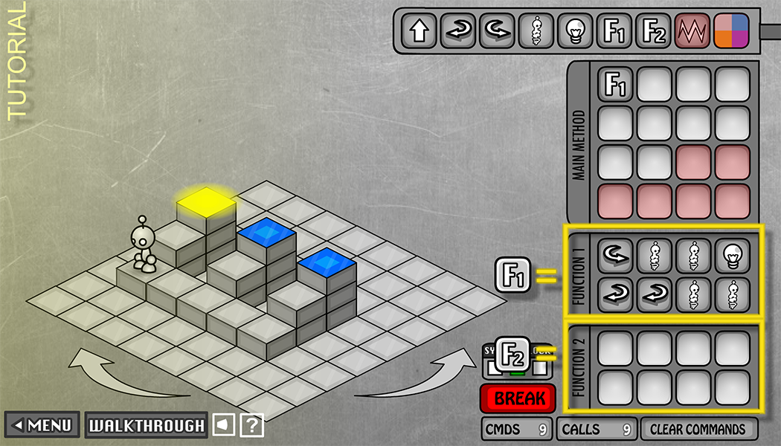
Choosing Functions
The goal is to break down a complex problem into smaller/simpler ones
Look for common patterns
“Process a riser” looks like a useful sub-problem because there are three of them
Notes:
Programming is figuring out how to break down a large, complex task into smaller, simpler subtasks.
Annotate:
ASK: Point 1 is? Detail removal
ASK: Point 2 is? Generalization
Abstraction!
Break down “process a riser”: turn to face riser; jump twice to go up; light; turn 180, go down riser

Slide 17
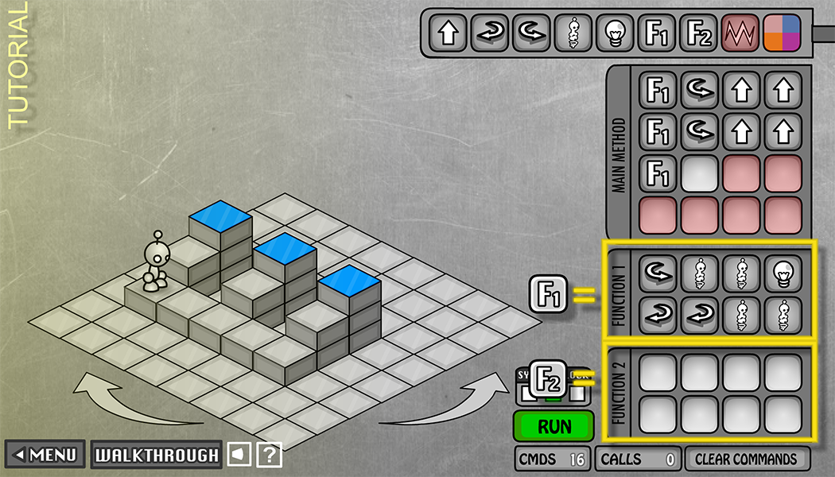
Choosing Functions
One possible solution is shown below:
17 commands, 29 calls
Notes:
Now I’ve added some instructions to the main method that move the robot across the bottom, and call “process a riser.”
This is the solution we just came up with – let’s analyze it. How good is it?
Annotate:
9 commands in main method (call F1, and move to next riser, call F1, …)
8 commands in F1
17 commands: # of visible blocks (size of program)
29 calls: # of instructions executed (# of blocks that the program counter touches), speed of program
Could we abstract/generalize this more?

Slide 18
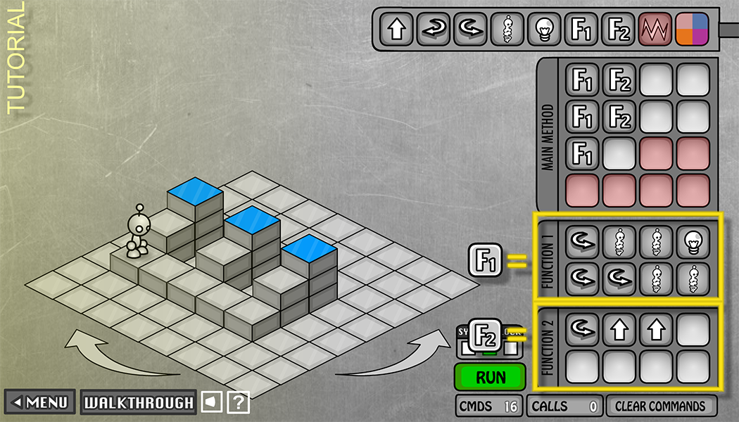
Choosing Functions
Modified solution is shown below:
Now F2 is a function to “move to next riser”
16 commands, 31 calls
Notes:
Annotate: moved the turn, jump, jump into F2
Naming the function is important – gives it context within the particular problem
5 conceptual steps rather than 26 bare instructions

Slide 19
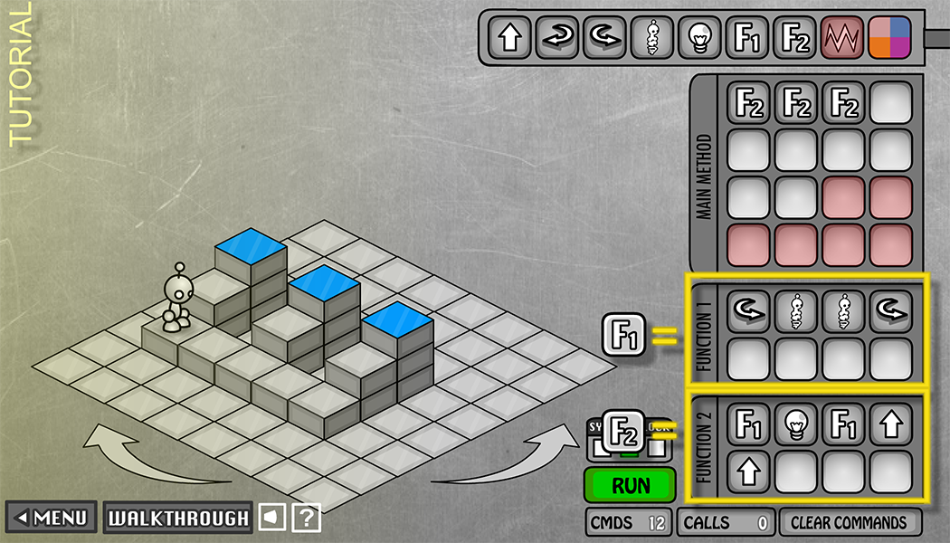
Choosing Functions
Yet another solution shown below:
12 commands, 35 calls
Notes:
Individually: try to convince yourself that this program solves the problem
With your neighbor: come up with descriptive names for F1 and F2
Annotate: trace through F2 and F1, show how F2 accomplishes processing a single riser by using F1
3 repeated conceptual steps
Annotate:
F1 is “traverse steps”
F2 is “process riser and move to next”
Equally valid, just different.

Slide 20
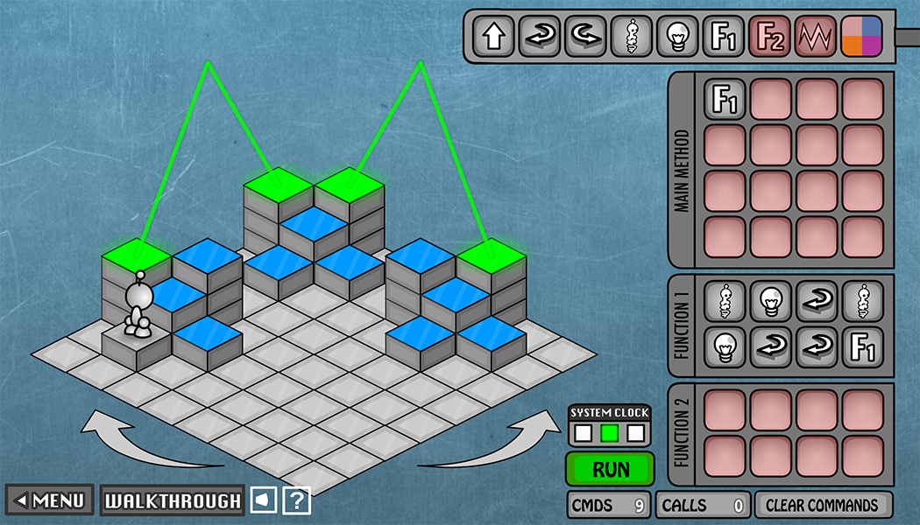
Recursion
Special case where a function calls itself
“Conceptual unit” might apply again, immediately
Notes:
This is a solution to this puzzle.
Start by executing F1
What is the last instruction in F1?
Annotate: last instruction in F1 is a call to F1! Goes back to the beginning of the function
Solves a complex problem by breaking down into a smaller unit
Annotate: trace through the program

Slide 21
Check-in Question
Which of the following statements is TRUE?
Think for a minute, then talk with your neighbors!
An agent can learn new instructions
It is the agent’s fault if the goal is not achieved
All ways to decompose a problem into functions are equally good
None of the above
We’re lost…
Notes:
A: No, fixed vocabulary (however, can create new functions and tasks that build on limited vocab, e.g., moving knight in Chess)
B: No, the agent just follows the instructions that you give it
C: No, different metrics:
Execution time
Program size
Does it work?
How easy is it to understand? (will appreciate this more later)
D: [CORRECT] None of the above ☺

Slide 22
Functions Summary
Functions are a foundational idea of computer science
Abstraction in action!
Functional abstraction helps us solve problems:
Reduce complexity: identify and solve a coherent activity or action (sub-problem) that can be reused
Associate these sub-problems with intuitive names
Solve the whole problem by composing functions
There is no “correct” way to abstract!
Notes:
Abstraction in action!!
complexity: instead of specifying everything each time you want to perform an action, write a function – then, in the future, you no longer need to care about the implementation details

Slide 23
Looking Forward
1st reading check due tomorrow (1/9 before 3:30 pm)
Discussion on the reading in section tomorrow
Continue to explore the concept of programming in the realm of Lightbot
Lightbot (checkoff) due tomorrow on 1/9
Symbolic Lightbot (checkoff) due by end of 1/10
Lightbot Functions (submitted) due end of 1/13
Create functions using handwritten symbols
F.turnaround() R,R.

