Slide 1
Course Wrap-Up CSE 120 Winter 2018
Instructor: Teaching Assistants:
Justin Hsia Anupam Gupta, Cheng Ni, Eugene Oh, Sam Wolfson, Sophie Tian, Teagan Horkan
The Grim Conclusions of the Largest-Ever Study of Fake News
“The massive new study analyzes every major contested news story in English across the span of Twitter’s existence—some 126,000 stories, tweeted by 3 million users, over more than 10 years—and finds that the truth simply cannot compete with hoax and rumor.
“This finding should dispirit every user who turns to social media to find or distribute accurate information. It suggests that no matter how adroitly people plan to use Twitter—no matter how meticulously they curate their feed or follow reliable sources—they can still get snookered by a falsehood in the heat of the moment.
“In short, social media seems to systematically amplify falsehood at the expense of the truth, and no one—neither experts nor politicians nor tech companies—knows how to reverse that trend. It is a dangerous moment for any system of government premised on a common public reality.
https://www.theatlantic.com/technology/archive/2018/03/largest-study- ever-fake-news-mit-twitter/555104/
Notes:
Published in Science 3/9/2018 from MIT researchers.
Why does falsehood do so well? The MIT team settled on two hypotheses. First, fake news seems to be more “novel” than real news. Second, fake news evoked much more emotion than the average tweet.

Slide 2
Administrivia
Assignments:
Project Code, README, and Video due tonight (3/9)
Final Exam – Tuesday 3/13, 3 pm in MGH 241
Scheduled slot is 2:30-4:20, but exam will be 60 minutes
Nearly identical to midterm – big ideas & programming
10% of course grade
TWO sheets of notes (letter, double-sided, hand-written)
Review Session: Sun 3/11, 5-7 pm in SAV 264
Course Evaluation: https://uw.iasystem.org/survey/188768

Slide 3
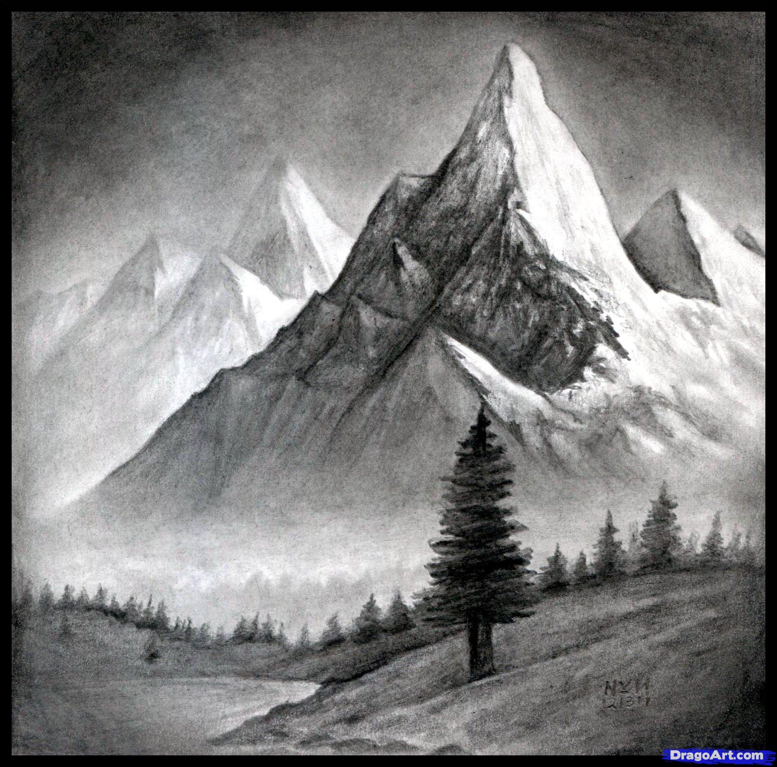
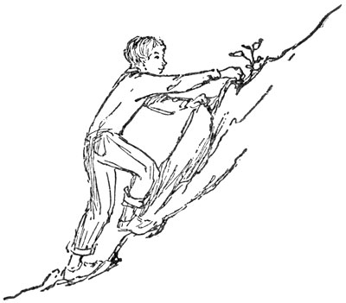
Outline
What We’ve Learned
Lecture 1 Revisited
Your Future Beyond CSE120
Source: DragoArt.com
Source: Project Gutenberg

Slide 4
Computational Thinking
It’s all about problem solving
How to attack your problem in a way that a computer can help
Most important idea: abstraction!
Detail removal and generalization help us decompose complex problems
Use bits to represent everything (i.e. digitization)
Reuse and combine building blocks (algorithms) in ways that hopefully scale well

Slide 5
Building Blocks of Algorithms
Sequencing
The application/execution of each step of an algorithm in the order given
Iteration
Repeat part of algorithm a specified number of times
Selection
Use of conditional to select which instruction to execute next
Functional Abstraction
Break larger problem into smaller, reusable parts
fill(255);
rectMode(CORNERS);
rect(-r, -r, 0, r);
ellipse(0, -r/2, r, r);
if(mousePressed) {
fill(0,0,255);
}
for(int i=20; i<400; i=i+60) {
line(i,40,i+60,80);
}

Slide 6
Programming
Learned our first programming language
Processing (Java syntax)
Iterative design cycle:
The value of a precise specification
Design, prototype, implement, and evaluate
Testing and debugging
Coding style and documentation
Proper commenting and formatting are essential for maintenance and collaboration

Slide 7
Some Big Ideas
Computers can only do a small number of things
Execute exactly what you tell it to
Computing has physical and theoretical limits
The Internet is a physical realm
Data is constantly generated, stored, and analyzed
And can be copied and distributed
Machines can “think” and “learn”?
AI & the importance of probability and training sets

Slide 8
Social Context and Impact
History of computing:
Rise of the Internet and access to information
Current boom in CS and computing education
Impacts of computing:
Algorithms can have unintended consequences
Privacy and security (or lack thereof)
Social media influences the way we think and act
Automation and the future of labor
Design matters!
Must keep in mind users and user interface

Slide 9
Outline
What We’ve Learned
Lecture 1 Revisited
Your Future Beyond CSE120

Slide 10
Why Study Computer Science?
Massive impact on our lives and society as a whole
Increasingly useful for all fields of study and areas of employment
Creative Writing – word editing, spell check, need to outcompete robots soon!
Massage Therapist – massage robots soon?
Dancing – stage lighting, motion capture to study technique
Ren Faire Actor – analyze data on ticket sales, popular booths

Slide 11
Computing in Your Future
Computing and its data are inescapable
You generate “digital footprints” all the time
Computing is a regular part of every job
Use computers and computational tools
Generate and process data
Dealing with IT people
Understanding the computation portion of projects
Our goal is to help you make sense of the “Digital Age” that we now all live in

Slide 12
About Programming
programming $≠$ computational thinking
Computational thinking is knowing how to break down and solve a problem in a way that a computer can do it
Programming is the tool you use to execute your solution
We use programming in this course as a way of teaching computational thinking
Can be learned, just like any other skill
It’s not black magic; there’s no such thing as a “coding gene”
Yes, at first it may be challenging and mind-bending – just like learning your first non-native language
My hope is that you will think differently after this course
Notes:
Terrible stereotypes of programmers – it’s just another profession nowadays

Slide 13
Big Ideas of Computing
Exposure to a broad range of topics in computer science
Not going to dive into the details
These are the motivations & the applications for programming (the tool)
Focus on what to be aware of to navigate the digital world
Goal: become “literate” in computing
As new innovations arise, can you read about it, understand its consequences, and form your own opinion?
This course will ask you to read, discuss, and write about computing

Slide 14
Outline
What We’ve Learned
Lecture 1 Revisited
Your Future Beyond CSE120

Slide 15
Giving Back to CSE120
Enjoyed the class? Lots of ways to help out!
Feedback: course eval, CS in Your Future, talk to me in OH or via email
Examples: Permission to show your work to future classes?
Recommendations: CSE120 next offered in either Wi19 or Sp19 – tell your friends!

Slide 16
More CS at UW
CSE 142 + CSE 143: Computer Programming I/II
Needed for declaring CSE major
CSE 160: Data Programming
Recommended to take 142 first, can’t take after 143
CSE 154: Web Programming
Must have taken 142, 143, or 160
CSE/STAT/INFO 180: Intro to Data Science
More forthcoming (http://escience.washington.edu/education/undergraduate/)

Slide 17
Social Implications Courses
Informatics
INFO 101: Social Networking Technologies
INFO 102: Gender and Information Technology
INFO 200: Intellectual Foundations of Informatics
Human Centered Design & Engineering
HCDE 210: Explorations in Human Centered Design

Slide 18
No More CS at UW or Break
You are now somewhat programming-literate
Can automate tasks to make your life easier
More aware of possibilities of computing
Easier to interact with IT/CS staff at work
Figure out what will be most useful to you
Some languages specific to type of work (e.g. R, MATLAB, Ruby on Rails, SQL)
Learn on your own via the Internet:

Slide 19
Making the Most of College
Seek out experiences that lead to new experiences (i.e. that pay dividends)
Build skills, interests, relationships
Meet new people, join interesting clubs, go on adventures
Don’t go it alone – find a friend group for classes
Take advantage of educational opportunities
Research: https://www.washington.edu/undergradresearch/students/find/
Student Groups: ACM, Animation Research Labs, Husky Robotics, WOOF3D, etc.
Classes: non-major courses, P.E., languages, anything of interest
Take care of yourself!

Slide 20
Making the Most of Our Future
Computing is resurfacing our world
Now almost everyone has access to everything, always
New technology affects privacy, jobs, safety, beliefs, etc.
You now know the most important parts of how it all works!
Can bring computing to new fields/jobs/areas
Keep these considerations in mind as you use and/or build things

Slide 21
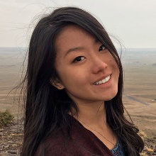
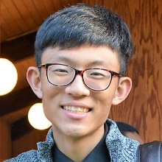
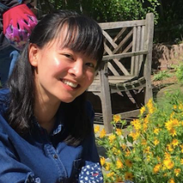
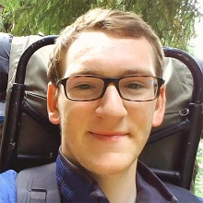
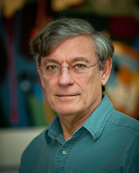
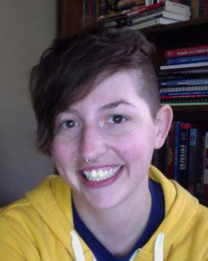
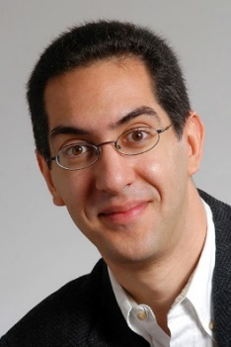
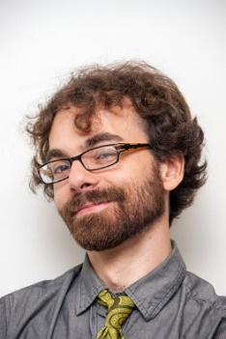
Thanks for a great quarter!
Huge thanks to your awesome TAs!
Thanks to course content creators:
Best of luck in the future!
Anupam
Cheng
Eugene
Sam
Sophie
Teagan
Larry
Synder
Susan
Evans
Dan
Garcia
Josh
Hug

Slide 22
Ask Me Anything (AMA)

