Slide 1
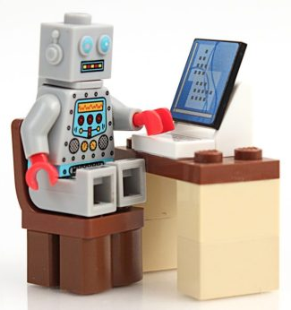
Social Implications of Computing CSE 120 Winter 2018
Instructor: Teaching Assistants:
Justin Hsia Anupam Gupta, Cheng Ni, Eugene Oh, Sam Wolfson, Sophie Tian, Teagan Horkan
AI is coming after highly skilled jobs, and it’s meeting resistance
“When automated technologies first emerged, there was a gap between the laborers they replaced and the decision-makers who implemented them. But as AI has matured, it has begun to climb the corporate ranks. Now… startups are offering AI services that can replace entire professions with lower prices and more precise results.
“Those with the most power to adopt automation are also those with the most to lose by adopting it… This is indicative of a larger problem with automation. Processes that save time on menial tasks will be successful; those that position themselves as robo versions of professionals with the power to make decisions will likely not.”
https://venturebeat.com/2018/03/04/ai-is-coming-after- highly-skilled-jobs-and-its-meeting-resistance/

Slide 2
Administrivia
Assignments:
CS in Your Future done in section tomorrow (3/8)
Project Code, README, and Video due Friday (3/9)
Final Exam – Tuesday 3/13, 3 pm in MGH 241
Scheduled slot is 2:30-4:20, but exam will be 60 minutes
Nearly identical to midterm – big ideas & programming
10% of course grade
TWO sheets of notes (letter, double-sided, hand-written)
Course Evaluation: https://uw.iasystem.org/survey/188768

Slide 3
Societal Impact of Computers
Computers have completely resurfaced society as we know it
How does this affect the way we think, act, and work?
Ellen introduces kids to the technology of yesterday
https://www.youtube.com/watch?v=3CMS9xnBRkc
Notes:
Video: 0:17 – 2:19

Slide 4
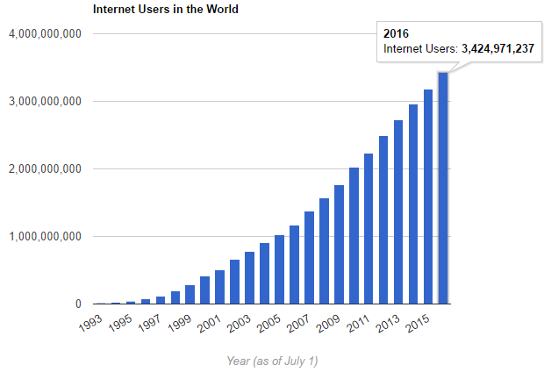
Internet Users
Image from http://www.internetlivestats.com/
Accessed May 30, 2017
Notes:
Current world population in 2018 is ~ 7.6 billion – nearly half the world is on the Internet!

Slide 5
Internet Users
Graph of "Internet users per 100 inhabitants 1997 to 2014" based on data from “Individuals using the Internet 2005 to 2014” (XLS)
https://commons.wikimedia.org/wiki/File:Internet_users_per_100_inhabitants_ITU.svg

Slide 6
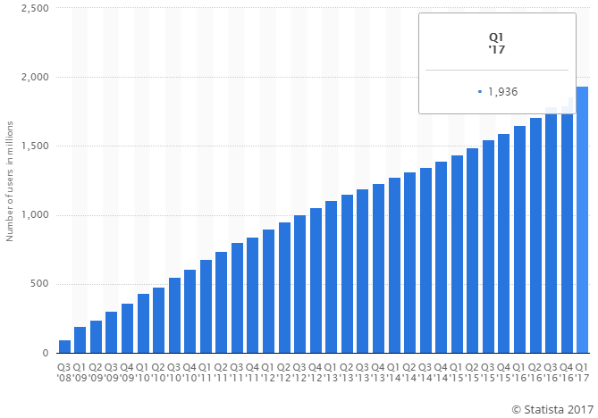
Facebook Users
Monthly active Facebook users worldwide (in millions)
https://www.statista.com/statistics/264810/number-of-monthly-active-facebook-users-worldwide/
Accessed May 30, 2017
Notes:
Over half of those supposedly on the internet are using Facebook monthly!

Slide 7
Outline
How We Think: Politics and Media
How We Act: Social Movements
How We Work: Job Implications

Slide 8
Audience News Consumption
Where do you get your news (and opinions on the news) from?
Twitter
Facebook
USA Today (media website)
Snapchat
Youtube
Reddit

Slide 9
The Internet Forms Our Opinions
Having an enormous amount of information available to us creates a poverty of attention
Compounded by the massive new problem of fake news
How should we allocate our attention now that we have so many options to choose from?
Not only do we have the ability to choose what to read and pay attention to, but we also have the ability to choose what we believe in
Notes:
Whatever your beliefs, you can find information that confirm these beliefs

Slide 10
Abundance of Info: Climate Change

Slide 11
Filter Bubbles (Eli Pariser)
Eli Pariser warns that technology tends towards exposure to information that confirms preexisting beliefs
https://www.ted.com/talks/eli_pariser_beware_online_filter_bubbles
People (myself included) tend to look to people who they think have the right answers
Often people who act and look like me or share similar opinions
This is a bias (natural filter bubble)

Slide 12
Polarization and Technology
Pablo Barberá argues that technology has the opposite effect
“How Social Media Reduces Mass Political Polarization. Evidence from Germany, Spain, and the U.S.”
http://smapp.nyu.edu/papers/SocialMediaReduces.pdf
“Citizens are now exposed not only to their close friends’ opinions, but also to political content shared by their co-workers, childhood friends, distant relatives, and other people with whom they form weak ties.”
“Weak social ties tend to be more ideologically heterogeneous than strong social ties.”

Slide 13
Polarization and Technology
Diana Mutz: “Cross-cutting Social Networks: Testing Democratic Theory in Practice”
http://repository.upenn.edu/cgi/viewcontent.cgi?article=1124&context=asc_papers
“Exposure to conflicting political viewpoints is widely assumed to benefit the citizens of a democratic polity.”
“...Utilizing a laboratory experiment manipulating exposure to dissonant and consonant political views, I further substantiate the causal role of cross-cutting exposure in fostering political tolerance.”

Slide 14
The Politics of Facebook Friends
There’s an interesting fad of unfriending people on social media sites like Facebook
This past presidential election, in particular, has made many people post their personal political beliefs on Facebook
Friendships have been ruined as a result!
This results in a tighter filter bubble

Slide 15
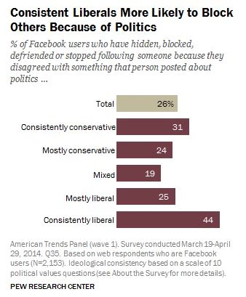
The Politics of Facebook Friends
Entire academic studies have been made on this topic
Andrea Peterson explains:
“ ... our online interactions about politics don't necessarily represent an entirely new pattern of interactions – but rather an extension of existing dynamics into the digital realm.”

Slide 16
Peer Instruction Question
Do you find that social media relationships have made you more politically aware and/or changed your own beliefs?
Vote at http://PollEv.com/justinh
Yes, social media has opened my mind to a variety of different opinions
No, I ignore or don’t see dissenting opinions on social media
No, I tend to dismiss dissenting opinions on social media as bogus
I don’t use social media enough for it to affect my opinions

Slide 17
Outline
How We Think: Politics and Media
How We Act: Social Movements
How We Work: Job Implications

Slide 18
Individual Empowerment
Individuals are empowered by their ability to access information and communicate
The Internet provides unprecedented access to both data and opinions
In China, Virtual Private Networks (VPNs) are a popular way for citizens to access news that is otherwise censored
Governments often try to control information to help control public opinion
e.g. multiple Taiwanese textbook rewrites: https://newbloommag.net/2015/07/06/taiwans-textbook-controversy/

Slide 19
Group Empowerment
Groups are empowered by the ability to coordinate and attract assistance
Can attempt to bring people to a cause (e.g. create a Facebook protest event)
Information transmission creates collective identity (i.e. it’s not just me that’s mad; my friends are mad, too)

Slide 20
Small Change (Malcolm Gladwell)
http://www.newyorker.com/magazine/2010/10/04/small-change-malcolm-gladwell
“The world, we are told, is in the midst of a revolution. The new tools of social media have reinvented social activism.”
“Activism that challenges the status quo, that attacks deeply rooted problems” is physically dangerous
Research from the 60’s suggests that people who engage in such activism usually have very strong social ties with the movement

Slide 21
Small Change (Malcolm Gladwell)
http://www.newyorker.com/magazine/2010/10/04/small-change-malcolm-gladwell
“The platforms of social media are built around weak ties. Twitter is a way of following (or being followed by) people you may never have met. Facebook is a tool for efficiently managing your acquaintances, for keeping up with the people you would not otherwise be able to stay in touch with.”
“Social networks are effective at increasing participation – by lessening the level of motivation that participation requires.”

Slide 22
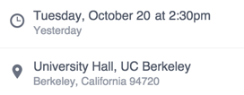
Example: Alexander Coward Protest
In Fall 2015, UC Berkeley Mathematics Lecturer Alexander Coward publicly announced his contract was not being renewed after the 2015-2016 academic year
Announcement came with harsh critique of math dept.
Feverish discussion of story on Facebook, Reddit, school newspaper, etc.
A protest event was created on Facebook, timed to coincide with an administrative review of Coward’s case

Slide 23
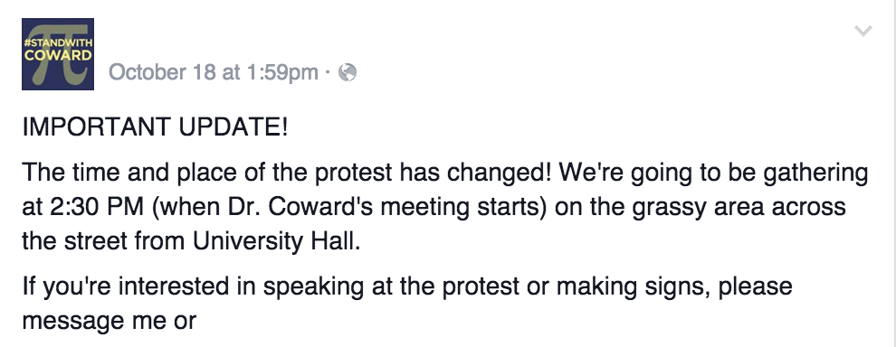
Example: Alexander Coward Protest

Slide 24
Example: Alexander Coward Protest
Slacktivism: Actions performed via the Internet in support of a political or social cause but regarded as requiring little time or involvement
e.g. signing an online petition, joining a campaign group on a social media website
Photo from Reddit: “What 3.9K facebook attendees looks like”

Slide 25
Facebook “Support” Photos
Facebook has had a variety of “support” photos in recent years
Lots of controversy about why certain events receive more attention than others
e.g. Paris bombings (Nov. 13, 2015) vs. Lebanese bombing day earlier
“Our research shows that if people are able to declare support for a charity publicly in social media, it can actually make them less likely to donate to the cause later on.”
http://web.missouri.edu/~segerti/capstone/Slacktivism.pdf

Slide 26
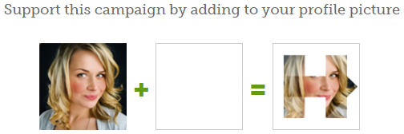
Hillary Clinton Presidential Campaign
Could create “Personal Hillary Logo” for profile
https://twibbon.com/support/h-92
Does this mean you are more likely to go out and vote?
https://www.forbes.com/sites/omribenshahar/2016/11/17/the-non-voters-who-decided-the-election-trump-won-because-of-lower-democratic-turnout/
Filter bubble: bias in media and social media realms led many to predict/assume a victory for Hillary

Slide 27
The Good and the Bad of Social Media
Despite usefulness as an organizing tool, social media might not necessarily lead to successful high-risk political actions
Gladwell: “Weak ties seldom lead to high-risk activism.”
Tufekci: “Digital tools make it much easier to build up movements quickly… before the Internet, the tedious work of organizing that was required to circumvent censorship or to organize a protest also helped build infrastructure for decision making and strategies for sustaining momentum.”
https://www.nytimes.com/2014/03/20/opinion/after-the-protests.html

Slide 28
The Good and the Bad of Social Media
However, social media can change society more subtly through establishing new social norms
Tufekci: “Those ‘likes’ on Facebook, derided as slacktivism or clicktivism, can have long-term consequences by defining which sentiments are ‘normal’ or ‘obvious’ — perhaps among the most important levers of change.”
https://www.nytimes.com/2014/03/20/opinion/after-the-protests.html
Notes:
Things that have been “common sense” in the US among various large groups of people:
Women should not vote
Women should not work outside the home
https://www.brocku.ca/MeadProject/NYT/NYT_1910_02_20.html
The white race is superior
https://en.wikipedia.org/wiki/Yellow_Peril
People of various races should be physically segregated
People of different races should not get married
Homosexuality is a mental disorder

Slide 29
Outline
How We Think: Politics and Media
How We Act: Social Movements
How We Work: Job Implications

Slide 30
Peer Instruction Question
What was your primary motivation to take CSE120?
Vote at http://PollEv.com/justinh
People told me it was cool
I thought it seemed interesting
Potentially interested in a CS career
Potentially interested in a career for which programming might be useful, but not necessarily CS
Other

Slide 31
Rapid CS Job Growth
Source: http://cs.stanford.edu/people/eroberts/CSCapacity/CSCapacity-HistoryToday.html

Slide 32
Rapid CS Student Population Growth
CSE142 (here at UW) has seen a 2-fold enrollment increase since 2008
This is actually significantly slower than most other major American universities

Slide 33
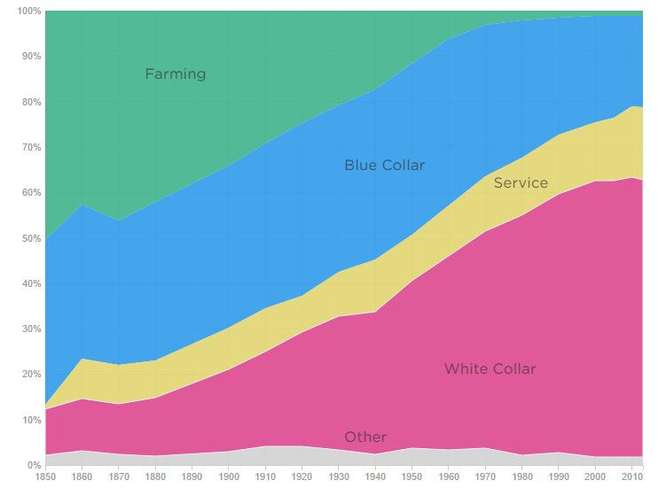
How is the Labor Pool Changing?
Composition of U.S. Job Market over the Last 150+ Years
http://www.visualcapitalist.com/visualizing-jobs-lost-automation/

Slide 34
How is the Labor Pool Changing?
http://www.washingtonpost.com/wp-srv/special/business/unemployment-where-are-the-jobs/

Slide 35
How is the Labor Pool Changing?
Estimated 3.5 million truck drivers in the US today
http://www.npr.org/sections/money/2015/02/05/382664837/map-the-most-common-job-in-every-state

Slide 36
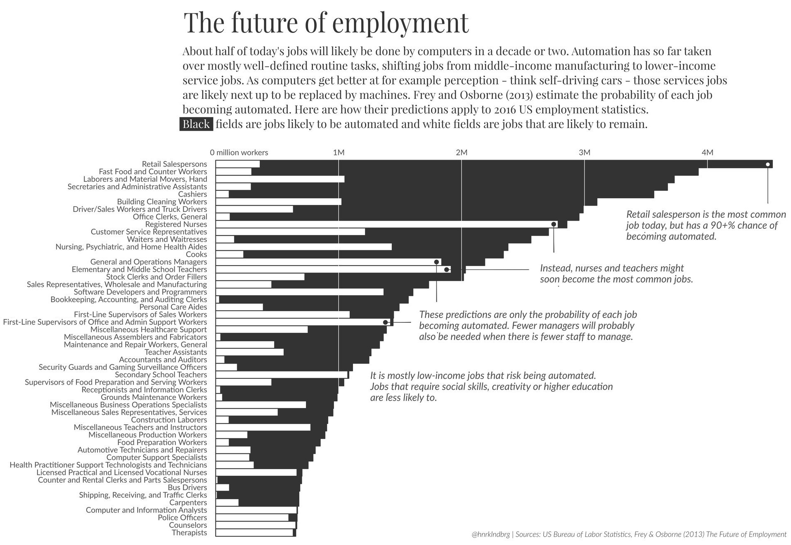
Visualizing the Jobs Lost to Automation
http://www.visualcapitalist.com/visualizing-jobs-lost-automation/

Slide 37
Humans Need Not Apply
More thoughts on your reading this week?
https://www.youtube.com/watch?v=7Pq-S557XQU

Slide 38
Labor and Output
Each worker generates ~4 times as much output as they did in 1947
Productivity and total employment historically tracked each other in the US
Number of total jobs has stagnated since 2000 (140-150 million)

Slide 39
Education and Wages
“Why Workers Are Losing the War Against Machines”
http://www.theatlantic.com/business/archive/2011/10/why-workers-are-losing-the-war-against-machines/247278/
Notes:
Certain industries are suffering much more, and a college degree is now becoming necessary for ALL jobs. What does this mean for us? And how about those soaring tuition rates? Student loans and debt? Debt forgiveness programs?

Slide 40
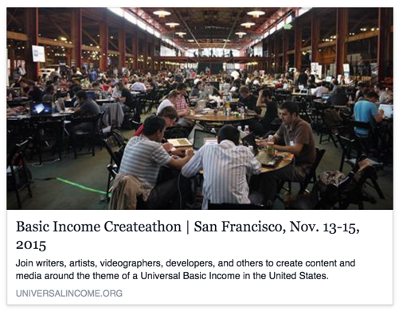
What is the Future of Labor?
Some opinions of experts:
http://www.pewinternet.org/2014/08/06/future-of-jobs/
No need to panic; new jobs will arise
We’ll move to more artisanal, small-scale modes of productions
We’ll need to reconfigure society to provide a decent standard of living for the less educated (e.g. guaranteed basic income)

Slide 41
The Paradox of Leisure
What does it mean when you have a world when you don’t have to work?
https://www.theatlantic.com/magazine/archive/2015/07/world-without-work/395294/

Slide 42
Discussion Question
Compared to our ancient small-group hunter-gatherer ancestors, are people’s lives better with all of today’s social and technological innovations?

Slide 43
Summary
Computing affects the way we form opinions
How we decide to use the Internet shapes our opinions
Pariser: People will use the Internet to reinforce their preexisting beliefs (filter bubble)
Tufecki: Social networks help establish what’s “normal”
Computing affects social movements
Useful as a tool for coordinating actions and attracting support
Gladwell: Does not lead to direct action that challenges the status quo
Gladwell/Tufecki: Can prevent movements from properly organizing
Computing affects jobs
Millions of jobs (domestic and abroad) may be automated away soon

