Slide 1
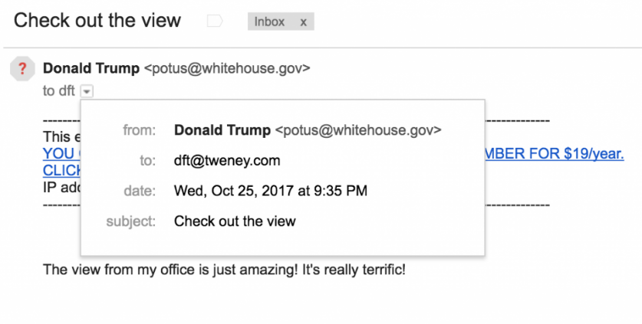
Digital Distribution CSE 120 Winter 2018
Instructor: Teaching Assistants:
Justin Hsia Anupam Gupta, Cheng Ni, Eugene Oh, Sam Wolfson, Sophie Tian, Teagan Horkan
How to Fake an Email From Almost Anyone in Under 5 Minutes
“I spend a lot of time explaining how easy it is to create fraudulent emails using an email address that doesn’t belong to you. A faked “from” address is, in fact, how the majority of email attacks happen. And email attacks (aka phishing) are how the vast majority of cyberattacks begin. So the ease of faking emails from people is a major vulnerability.
“Here’s a message I sent to myself using President Trump’s address. Note that Gmail is a suspicious of the source — that’s why it put a little red question mark next to the address.”
https://hackernoon.com/how-to-fake-an-email- from-almost-anyone-in-under- 5-minutes-12169dd44a92
Notes:
SMTP – Simple Mail Transfer Protocol defined in 1982, updated in 2008. No facility to authenticate users.

Slide 2
Administrivia
Assignments:
Creativity Planning (1/30)
Reading Check 4 due before lab (2/1)
Creativity Assignment (2/2)
“Big Idea” this week: Privacy
Midterm in class on Monday (2/5)
1 sheet of notes (2-sided, letter, handwritten)
Fill-in-the-blank(s), short answer questions
Questions will cover lectures, worksheets, assignments, and readings
Midterm Review packet on Exams page of website

Slide 3
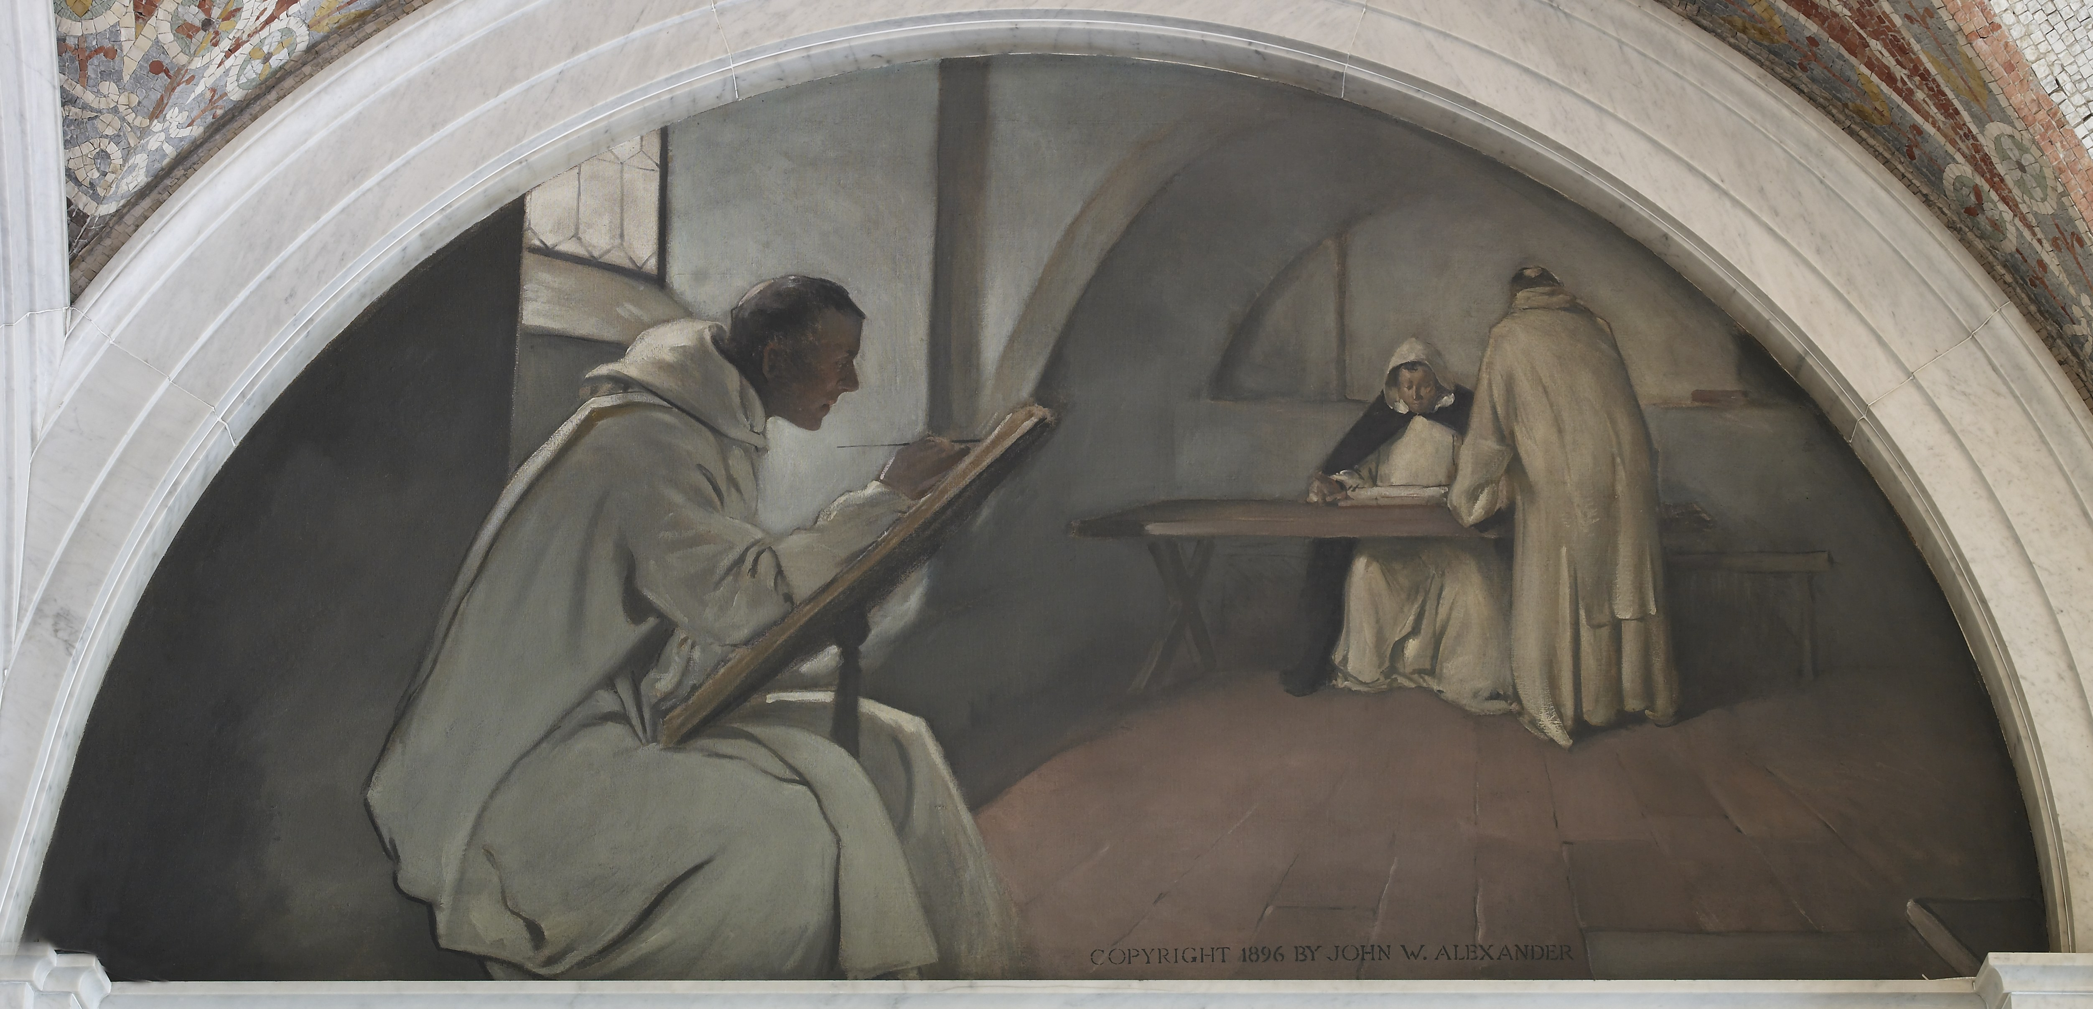
Biggest Impact of Digitization?
Digital information can be copied instantaneously and without loss
Analog copying: almost always with loss
Biological copying: mutations and recombination

Slide 4
Copying is Easy
myCopy = myData;
File: right-click $→$ Copy
Lossless, instantaneous copying leads to a wealth of societal issues:
Privacy issues
Theft of private data
Interception of transmitted data
Persistence of digital data
Usage of digital works
Copyright
Legal, cultural, and economic impacts

Slide 5
Discussion Prompts
Do you think the following are “right”? Legal? How have the rules changed in the digital vs. physical realm?
Theft: Taking something from someone else without permission
Distributing a song that you purchased to your friends
Your friend sends you a photo; without asking, you send that photo to another friend
Using an image you found on the Internet on your website (or as your profile picture)
Using an artist’s song without permission in an audio remix or online dance performance video

Slide 6
Outline
Copyright
Sharing and open-source
Creative Commons

Slide 7
Intellectual Property (IP)
Intellectual property is something produced by one’s intellect
e.g. artwork, books, photos, music, poetry, performances, software
Distribution, copying, and sale of a work is the right of the creator
It is illegal to copy someone else’s creation for anything “other than personal use”
You are the creator of all that you create
Unless otherwise specified by a contract (e.g. at work)

Slide 8
Copyright: A Primer
http://www.youtube.com/watch?v=Uiq42O6rhW4

Slide 9
Copyright Terminology Review
Copyright: legal right granting creator of an original work exclusive rights over use and distribution
Set by laws of a country
Public domain: exclusive IP rights expired, forfeited, or inapplicable
Fair Use: right to use copyrighted material without permission in specific circumstances
e.g. commentary, search engines, criticism, parody, news, scholarship
Judged based on (1) purpose/character of use, (2) nature of the work, (3) amount used, and (4) effect on work’s value

Slide 10
Copyright Notes
Applies to wide variety of works: articles, artwork, books, choreography, photos, podcasts, screenplays, software, songs
Does not apply to ideas, facts/data, or logos
Copyright is automatically applied, even without the copyright symbol ©!
Once it is “captured in a fixed format”
Copyright has a limited duration
Usually tied to life of creator
Attribution is not a substitution for permission

Slide 11
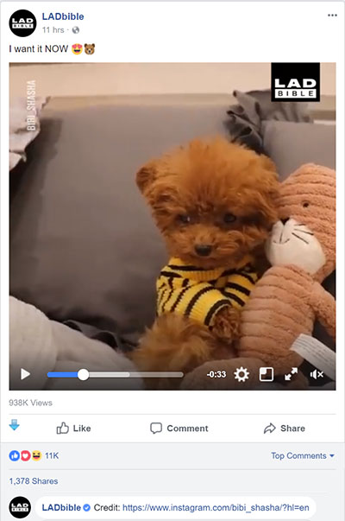
Copyright Violations
Why would people violate copyright?
Inadvertent – copying is too easy!
Inadvertent – unknown copyright status of material or misunderstanding of fair use
Financial – don’t want to pay
Financial – making money through clicks, views, and advertising

Slide 12
Copyright Violations
Most people who have posted on the Internet have probably violated copyright laws at one point
Illegal sharing of music and videos
Napster, Kazaa, DC++, Bittorrent
Illegal sharing of games
ISO images of games (to be played on emulators)
“Cracked” versions of games
Illegal usage of photos and works
Misrepresentation, plagiarism

Slide 13
Digital Rights Management (DRM)
Technologies that are used to restrict usage of proprietary hardware and copyrighted works
Not universally accepted or used; can be inconvenient
Software: Product (serial) keys
Internal algorithm checks validity of entered key
“Cracked” keys can fool the validity check
Audio: non-standard CDs or restricted usage of downloaded music
Only playable with certain devices or applications
Games: Persistent online authentication

Slide 14
Digital Millennium Copyright Act (DMCA)
Anti-circumvention provisions
Illegal to attempt to circumvent DRM (even if copyright isn’t breached)
Often viewed as anti-tinkering
Proven to be rather toothless – circumvention still happens
Safe harbor provisions
Protect “providers of online services” (e.g. ISPs, Youtube, Facebook) from being sued for copyright infringements of its users
DMCA Takedown Notice: copyright holders can request sites to remove or block access to material that violates their copyright
Notes:
Passed in 1998
ISPs can’t be sued for illegal activity of users.
Youtube & Facebook can’t be sued for

Slide 15
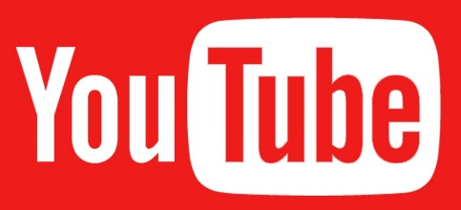
Most Effective Piracy Solution?
Online Streaming!
Make it so convenient to stream content (video, music, games) that pirating seems unnecessary

Slide 16
Copyright and Laws
Owners must “defend” their copyrights
RIAA and MPAA are at war with users
Stop Online Piracy Act (SOPA) – 2011, never voted on
Would have allowed court orders to bar access to websites with copyright infringement to advertising networks, payment facilities, and Internet service providers
Service blackout in 2012 by Wikipedia, Google, and others in protest
As of 2016, only 4 members of Congress (all in the House) have CS degrees
Notes:
RIAA – Recording Industry Association of America
MPAA – Motion Picture Association of America

Slide 17
Outline
Copyright
Sharing and open-source
Creative Commons

Slide 18
Copyright and Software
Copyright applies to software source code
Software is often distributed in executable form so that the source code is not viewable
Proprietary software has IP rights restrictions – copyright of source code or patent rights
Rapid growth – developers wanted to share ideas and build more complex software
Option 1: grant permission on a case-by-case basis
Option 2: put software in the public domain
Notes:
Public domain works can be freely used for derivative works without permission.
Works derived from public domain works can be copyrighted.
Richard Stallman burned by Symbolics on Lisp interpreter in early 1980s.

Slide 19
Copyleft
Form of licensing that offers people the right to freely distribute copies and modified versions of a work with the stipulation that the same rights be preserved in derivative works down the line
http://www.youtube.com/watch?v=u2k07BbPkDk
Notes:
First described in GNU Manifesto in 1985.

Slide 20
Open-Source Licenses
GNU General Public License (v2, v3)
Apache License
MIT License
BSD License
Public Domain
These licenses differ in:
Attribution requirements
Commercial use restrictions
Derivative work restrictions

Slide 21
Why Open Source?
Pros:
Cheaper – free to install on all machines
Crowd-sourced fixes and improvements
Can persist beyond company that created it
You can personally contribute and become part of the community
Cons:
Can be more difficult to use and support
More potential security flaws

Slide 22
Open-Source Software
 | Proprietary | Open-Source
Operating Systems | Windows, Mac OS | Linux, Android *
Web Browsers | IE/Edge, Safari | Chrome *, Firefox
Email Client | Outlook | Thunderbird
Music Player | Windows Media Player, iTunes | VLC
Audio Editing | Cubase, Logic Pro | Audacity
Image Editing | Photoshop | GIMP
Text Editor | Word, Notepad, Sublime Text | Notepad++, VS Code
* includes some proprietary software for accessing Google services

Slide 23
Outline
Copyright and protection
Sharing and open-source
Creative Commons

Slide 24
Open Source for Non-Software?
Copyright ≈ all rights reserved
What if you don’t want/need all rights?
Use can use a Creative Commons license
Maintained by Creative Commons non-profit organization, founded in 2001
Specify what uses you want to allow without needing permission
Notes:
The idea of “open source” doesn’t really apply to other types of works.

Slide 25
Layers of Creative Commons Licenses
Legal layer
Sustain lawsuits
Human-readable
Understandable for ‘everybody’
Machine-readable
Understandable for search engines

Slide 26
Creative Commons Symbols
Attribution (BY)
Must give creator credit in derived/distributed works
Noncommercial (NC)
Derived/distributed work can’t be sold
No Derivative Work (ND)
Must use AS IS
Share Alike (SA)
Derivative works may be distributed under the same license as this one

Slide 27
Types of Creative Commons Licenses

Slide 28
CC vs. Open Source
Creative Commons Licenses are not recommended for program code
Use open-source licenses instead
CC does not account for:
Patents
License compatibility
Binary vs. source code case distinction

Slide 29
Summary
Copyright is intended to protect the rights to intellectual property by the owner
Often protected by Digital Rights Management software
Legal protections and implementations are still a “work in progress”
Open-source licenses for software allow you to freely distribute your source code for use by others who agree to follow the same licensing rules
For works that you would like to share, you can waive some of your rights using Creative Commons licenses

