Slide 1
Functions in Processing CSE 120 Winter 2018
Instructor: Teaching Assistants:
Justin Hsia Anupam Gupta, Cheng Ni, Eugene Oh, Sam Wolfson, Sophie Tian, Teagan Horkan
Satellites Are Reshaping How Traders Track Earthly Commodities
“Companies… are using satellites to try to shed light on tightly held secrets in the commodity trading world, from coal mine productivity to crude oil storage. While doubts remain around the accuracy and consistency of the data, there could come a day when traders can track supply and demand of raw materials, the operations of producers and consumers and even the output of entire economies in near-real time.
“Firms… then use artificial intelligence to scan millions of those images and translate them into useful data.”
https://www.bloomberg.com/news/articles/ 2017-12-16/satellites-are-reshaping-how- traders-track-earthly-commodities

Slide 2
Administrivia
Assignments:
Lego Family due tonight (1/17)
Website Setup due before lab tomorrow (1/18)
Reading Check 2 due tomorrow (1/18)
Editing your portfolio from home
Download and install Cyberduck & VS Code
Re-do Steps 3 & 4 from the website setup
Make sure to take advantage of office hours and Piazza!

Slide 3
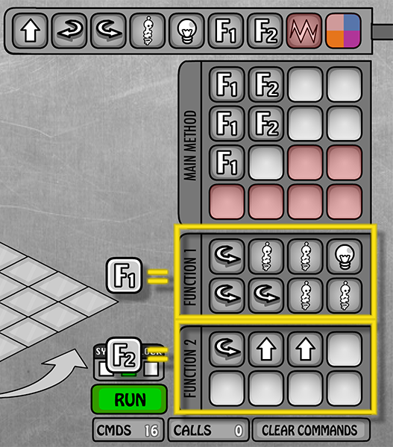
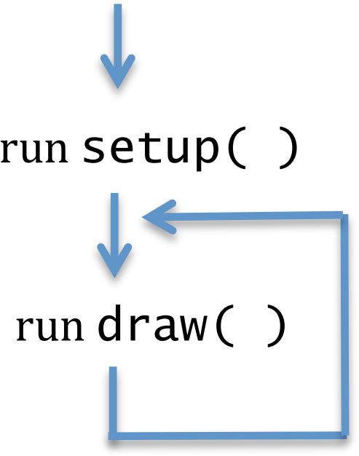
Functions (So Far)
Used for abstraction
Detail Removal: subtasks with intuitive names
Generalization: don’t repeat code
Lightbot:
Processing:
line(), rect(), …
min(), max()

Slide 4
Program Execution with Functions
Functions “break” the normal sequential execution model
When function is called, begin execution of function code
When end of function is reached, jump back to where function was called from
Analogy: Song lyrics with a repeated chorus
Example: Survivor – Eye of the Tiger
Verse 1, Verse 2, Chorus, Verse 3, CHORUS, Verse 4, CHORUS, Outro
Parameterized Example: Old MacDonald
Chorus(cow,moo), Chorus(pig,oink), Chorus(duck,quack), Chorus (sheep,baa)

Slide 5
Donatello as a Function [DEMO]
Notes:
What’s wrong with this code? What happens if we call donatello() twice?

Slide 6
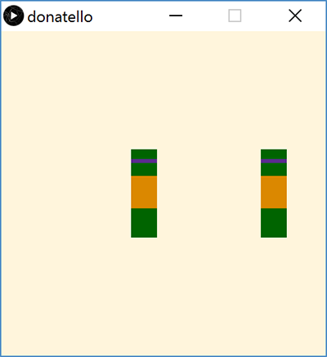
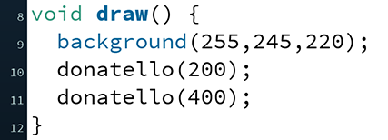
Donatello Function Parameterized
Can now call donatello() function with different x_pos

Slide 7
Return Type
What the function sends back to whoever called it
Can be any of the datatypes: int, float, color, etc.
If not returning anything, then we use void
return type

Slide 8
Function Name
Does not matter to computer, but does to humans
Should describe what the function does
Subject to same naming constraints as variables
No two functions (or variables) can have the same name
function name

Slide 9
Parameters
Required part of every function definition
Must be surrounded by parentheses
If no parameters, parentheses are left empty
Datatype and name for every parameter must be specified
Separate parameters with commas
parameters

Slide 10
Function Body
body

Slide 11
Lightbot Functions
Lightbot functions had a different syntax, but similar parts:
F.turn_around() Right, Right.
function name
parameters
body
F.turn_around() Right, Right.

Slide 12
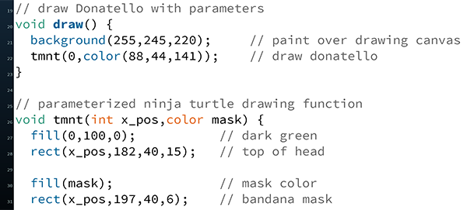
Parameters vs. Arguments [DEMO]
Implicit parameter/variable initialization with argument values
arguments
parameters

Slide 13
Parameters vs. Arguments
When you define a function, you specify the parameters
Parameters are internal variables/boxes for functions
Use parameters for values that you want to be different on different calls to this function
When you call a function, you pass arguments
The order of the arguments must match the order of the parameters
We define a function once, but can call it as many times as we want (and in different ways)!

Slide 14
Parameters Analogy
Executing a program is like walking down a hallway
Calling a function is like stepping into a room
Step back into the hallway after you are done with the task in that room
Parameters are boxes (our variable analogy) bolted to floor of room – can use while you’re there, but can’t leave room with them
Arguments are the values you place in boxes when you enter the room

Slide 15
Solving Problems
Understand the problem
What is the problem description?
What is specified and what is unspecified?
What has been given to you (e.g. starter code)?
Break the task down into less complex subtasks
Example: Make a function that draws a row of five mice with their ears touching/overlapping. The mice should all be the same color except for the middle one, which should be red.

Slide 16
Parameter Example

Slide 17
Parameter Example

Slide 18
Looking Forward
Portfolio
Don’t forget to add Taijitu, Logo Design, and Lego Family!
Animal Functions
Start in lab on Thursday, due Monday (1/22)
Design your own animal (like the mouse shown here)
Example from CSE120 Sp17 student

