Slide 1
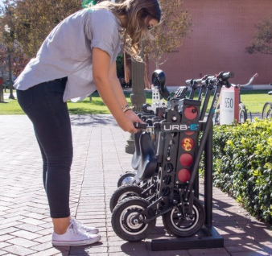
Binary Numbers CSE 120 Winter 2018
Instructor: Teaching Assistants:
Justin Hsia Anupam Gupta, Cheng Ni, Eugene Oh, Sam Wolfson, Sophie Tian, Teagan Horkan
URB-E’s launching a scooter sharing network at college campuses and hotels
“URB-E, the startup that creates foldable electric scooters, is launching a transportation system designed to promote scooter sharing on colleges campuses and other large residential developments.
“Because these properties purchase the system upfront from URB-E they can decide on their own pricing structure, so a hotel could provide free access to guests while a college campus or apartment complex could customize their own pricing structure.”
https://techcrunch.com/2018/01/10/urb-es-launching-a- scooter-sharing-network-on-college-campuses-and-hotels/

Slide 2
Administrivia
No lecture or OH on Monday (MLK Jr. Holiday)
Assignments:
Logo Design due today (1/12)
Lego Family due Wednesday (1/17)
Make sure you read the specifications carefully!
Course website Events calendar [demo]
Course website software [demo]

Slide 3
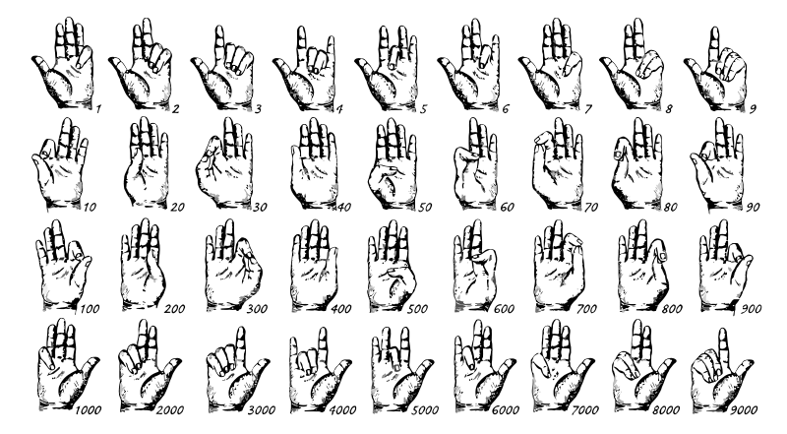
Discussion: Counting
How high can you count using just your two hands?
Discuss with your neighbor(s)
Other ways to count or keep score?
Example: Ultimate Frisbee scorekeeping

Slide 4
Lecture Outline
Decimal, Binary, and Hexadecimal
Base Conversion
Binary Encoding

Slide 5
Decimal Numbering System
Ten symbols: 0, 1, 2, 3, 4, 5, 6, 7, 8, 9
Represent larger numbers as a sequence of digits
Each digit is one of the available symbols
Example: 7061 in decimal (base 10)
7061₁₀ = (7 $×$ 10³) + (0 $×$ 10²) + (6 $×$ 10¹) + (1 $×$ 10⁰)
Notes:
Ones digit, Tens digit, Hundreds digit, etc.

Slide 6
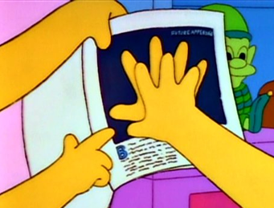
Octal Numbering System
Eight symbols: 0, 1, 2, 3, 4, 5, 6, 7
Notice that we no longer use 8 or 9
Base comparison:
Base 10: 0, 1, 2, 3, 4, 5, 6, 7, 8, 9, 10, 11, 12…
Base 8: 0, 1, 2, 3, 4, 5, 6, 7, 10, 11, 12, 13, 14…
Example: What is 7061₈ in base 10?
7061₈ = (7 $×$ 8³) + (0 $×$ 8²) + (6 $×$ 8¹) + (1 $×$ 8⁰) = 3633₁₀

Slide 7
Practice Question
What is 34₈ in base 10?
No voting for this question

Slide 8
Binary and Hexadecimal
Binary is base 2
Symbols: 0, 1
Convention: 2₁₀ = 10₂ = 0b10
Example: What is 0b110 in base 10?
0b110 = 110₂ = (1 $×$ 2²) + (1 $×$ 2¹) + (0 $×$ 2⁰) = 6₁₀
Hexadecimal (hex, for short) is base 16
Symbols? 0, 1, 2, 3, 4, 5, 6, 7, 8, 9, …?
Convention: 16₁₀ = 10₁₆ = 0x10
Example: What is 0xA5 in base 10?
0xA5 = A5₁₆ = (10 $×$ 16¹) + (5 $×$ 16⁰) = 165₁₀
9, A, B, C, D, E, F

Slide 9
Peer Instruction Question
Which of the following orderings is correct?
0xC < 0b1010 < 11
0xC < 11 < 0b1010
11 < 0b1010 < 0xC
0b1010 < 11 < 0xC
0b1010 < 0xC < 11
Think on your own for a minute, then discuss with your neighbor(s)
Vote at http://PollEv.com/justinh

Slide 10
Lecture Outline
Decimal, Binary, and Hexadecimal
Base Conversion
Binary Encoding

Slide 11
Converting to Base 10
Can convert from any base to base 10
0b110 = 110₂ = (1 $×$ 2²) + (1 $×$ 2¹) + (0 $×$ 2⁰) = 6₁₀
0xA5 = A5₁₆ = (10 $×$ 16¹) + (5 $×$ 16⁰) = 165₁₀
We learned to think in base 10, so this is fairly natural for us
Challenge: Convert into other bases (e.g. 2, 16)

Slide 12
Challenge Question
Convert 13₁₀ into binary
Hints:
2³ = 8
2² = 4
2¹ = 2
2⁰ = 1
Think on your own for a minute, then discuss with your neighbor(s)
No voting for this question

Slide 13
Converting from Decimal to Binary
Given a decimal number N:
List increasing powers of 2 from right to left until $≥$ N
Then from left to right, ask is that (power of 2) $≤$ N?
If YES, put a 1 below and subtract that power from N
If NO, put a 0 below and keep going
Example: 13 to binary
2⁴=16 | 2³=8 | 2²=4 | 2¹=2 | 2⁰=1

Slide 14
Converting from Decimal to Base B
Given a decimal number N:
List increasing powers of B from right to left until $≥$ N
Then from left to right, ask is that (power of B) $≤$ N?
If YES, put how many of that power go into N and subtract from N
If NO, put a 0 below and keep going
Example: 165 to hex
16²=256 | 16¹=16 | 16⁰=1

Slide 15
Converting Binary $↔$ Hexadecimal
Hex $→$ Binary
Substitute hex digits, then drop any leading zeros
Example: 0x2D to binary
0x2 is 0b0010, 0xD is 0b1101
Drop two leading zeros, answer is 0b101101
Binary $→$ Hex
Pad with leading zeros until multiple of 4, then substitute each group of 4
Example: 0b101101
Pad to 0b 0010 1101
Substitute to get 0x2D
Base 10 | Base 2 | Base 16
0 | 0000 | 0
1 | 0001 | 1
2 | 0010 | 2
3 | 0011 | 3
4 | 0100 | 4
5 | 0101 | 5
6 | 0110 | 6
7 | 0111 | 7
8 | 1000 | 8
9 | 1001 | 9
10 | 1010 | A
11 | 1011 | B
12 | 1100 | C
13 | 1101 | D
14 | 1110 | E
15 | 1111 | F

Slide 16
Binary $→$ Hex Practice
Convert 0b100110110101101
How many digits?
Pad:
Substitute:
Base 10 | Base 2 | Base 16
0 | 0000 | 0
1 | 0001 | 1
2 | 0010 | 2
3 | 0011 | 3
4 | 0100 | 4
5 | 0101 | 5
6 | 0110 | 6
7 | 0111 | 7
8 | 1000 | 8
9 | 1001 | 9
10 | 1010 | A
11 | 1011 | B
12 | 1100 | C
13 | 1101 | D
14 | 1110 | E
15 | 1111 | F

Slide 17
Base Comparison
Why does all of this matter?
Humans think about numbers in base 10, but computers “think” about numbers in base 2
Binary encoding is what allows computers to do all of the amazing things that they do!
Base 10 | Base 2 | Base 16
0 | 0000 | 0
1 | 0001 | 1
2 | 0010 | 2
3 | 0011 | 3
4 | 0100 | 4
5 | 0101 | 5
6 | 0110 | 6
7 | 0111 | 7
8 | 1000 | 8
9 | 1001 | 9
10 | 1010 | A
11 | 1011 | B
12 | 1100 | C
13 | 1101 | D
14 | 1110 | E
15 | 1111 | F

Slide 18
Aside: Why Base 2?
Electronic implementation
Easy to store with bi-stable elements
Reliably transmitted on noisy and inaccurate wires
Other bases possible, but not yet viable:
DNA data storage (base 4: A, C, G, T) is a hot topic
Quantum computing
0
1
0
3.3V
2.8V
0.5V
0.0V
Notes:
adenine (A), cytosine (C), guanine (G), or thymine (T)

Slide 19
Lecture Outline
Decimal, Binary, and Hexadecimal
Base Conversion
Binary Encoding

Slide 20
Numerical Encoding
AMAZING FACT: You can represent anything countable using numbers!
Need to agree on an encoding
Kind of like learning a new language
Examples:
Decimal Integers: 0$→$0b0, 1$→$0b1, 2$→$0b10, etc.
English Letters: CSE$→$0x435345, yay$→$0x796179
Emoticons: 😃 0x0, 😞 0x1, 😎 0x2, 😇 0x3, 😈 0x4, 🙋 0x5
Notes:
Base 2 is too hard for humans to read, so we use base 16 as a convenient way to hold what is effectively binary data in our brains.

Slide 21
Binary Encoding
With N binary digits, how many “things” can you represent?
Need N binary digits to represent $n$ things, where 2^{N} $≥n$
Example: 5 binary digits for alphabet because 2⁵ = 32 > 26
A binary digit is known as a bit
A group of 4 bits (1 hex digit) is called a nibble
A group of 8 bits (2 hex digits) is called a byte
1 bit $→$ 2 things, 1 nibble $→$ 16 things, 1 byte $→$ 256 things

Slide 22
So What’s It Mean?
A sequence of bits can have many meanings!
Consider the hex sequence 0x4E6F21
Common interpretations include:
The decimal number 5140257
The characters “No!”
The background color of this slide
The real number 7.203034 $×$ 10⁻³⁹
It is up to the program/programmer to decide how to interpret the sequence of bits

Slide 23
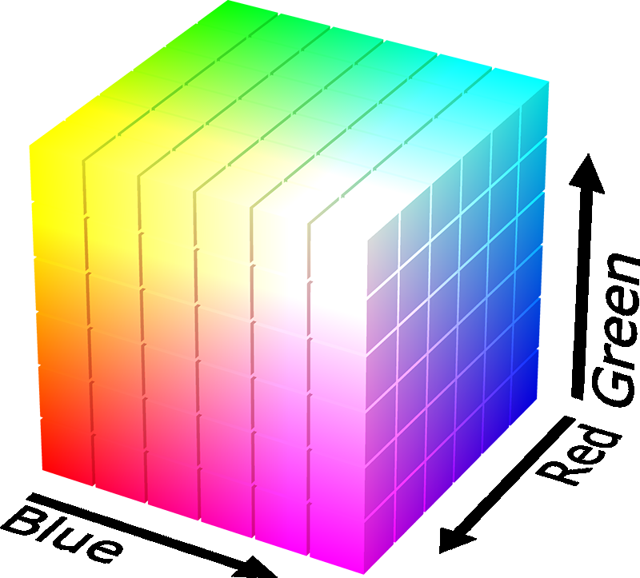
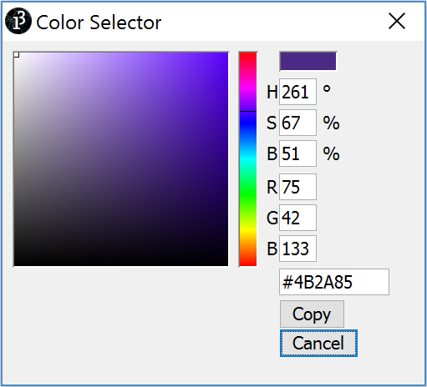
Binary Encoding – Colors
RGB – Red, Green, Blue
Additive color model (light): byte (8 bits) for each color
Commonly seen in hex (in HTML, photo editing, etc.)
Examples: Purple$→$0x4B2A85, Gold$→$0xBAA47B, Orange$→$0xE2661A, Turqoise$→$0x33997E

Slide 24
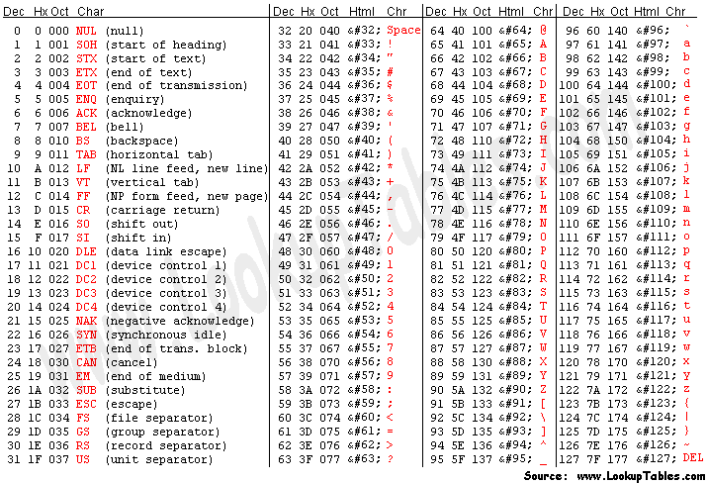
Binary Encoding – Characters/Text
ASCII Encoding (www.asciitable.com)
American Standard Code for Information Interchange

Slide 25
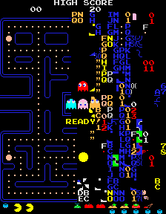
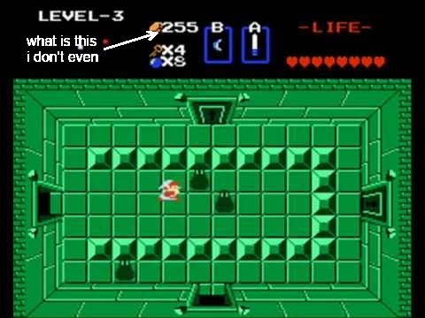
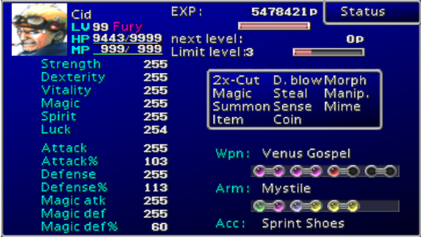
Binary Encoding – Video Games
As programs run, in-game data is stored somewhere
In many old games, stats would go to a maximum of 255
Pacman “kill screen”
http://www.numberphile.com/videos/255.html

Slide 26
Binary Encoding – Files and Programs
At the lowest level, all digital data is stored as bits!
Layers of abstraction keep everything comprehensible
Data/files are groups of bits interpreted by program
Program is actually groups of bits being interpreted by your CPU
Computer Memory Demo
Can try to open files using a text editor
From vim: %!xxd

Slide 27
Summary
Humans think about numbers in decimal; computers think about numbers in binary
Base conversion to go between them
Hexadecimal is more human-readable than binary
All information on a computer is binary
Binary encoding can represent anything!
Computer/program needs to know how to interpret the bits

Slide 28
Summary

