Slide 1

Processing and Drawing
CSE 120 Winter 2018
Instructor: Teaching Assistants:
Justin Hsia Anupam Gupta, Cheng Ni, Eugene Oh,
Sam Wolfson, Sophie Tian, Teagan Horkan
The World Health Organization Identifies Gaming Disorder as a Mental Health Condition
“The WHO’s impending beta draft… classifies gaming disorder as a pattern of behavior with ‘impaired control over gaming,’ in terms of its frequency, intensity, duration, and the capacity to quit. The disorder… is characterized by giving increased priority to gaming over other daily activities.
“The WHO’s decision highlights a schism among psychologists: some think the new designation is a welcome one, but others don’t see enough evidence to justify it.
“As our video game experience expands with virtual reality (VR) and augmented reality (AR), the argument gets even murkier.”
https://futurism.com/world-health-organization-identifies-gaming-
disorder-mental-health-condition/

Slide 2
Administrivia
Assignments:
  Lightbot Functions [hw] due today before 11:59 pm (1/8)
  Taijitu [lab] due before lab on Thursday (1/11)
First “big ideas” lecture this week: Binary
  Reading due before lab on Thursday (1/11)
  Brief discussion in lab on Thursday

Slide 3
Processing
Our programming language for this course
  Text-based language that is good for visuals and interaction
  Try to focus on ideas and techniques, not the specific commands
  No language is perfect – Processing has its fair share of quirks and deficiencies ☹
It is both a programming environment (where you type) and a programming language
  You are writing Java code, but they have made a lot of things easier

Slide 4
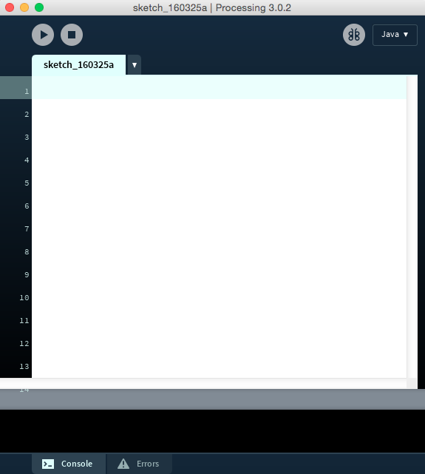
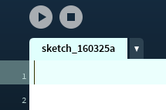
What You See

Slide 5
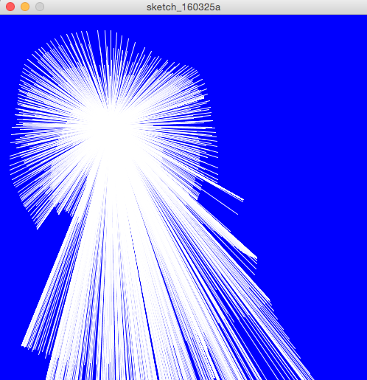
Interactive Line Drawing

Slide 6
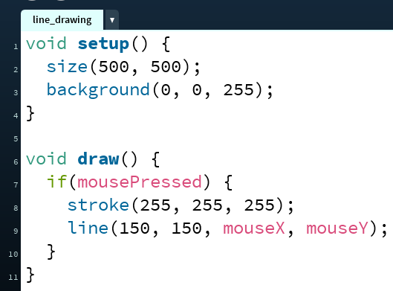
Line Drawing Code
semi-colon indicates end
of statement
case-sensitive
mouseX ≠ mousex
Other helpful environment features:
Parentheses matching
Error messages
There is color coding

Slide 7
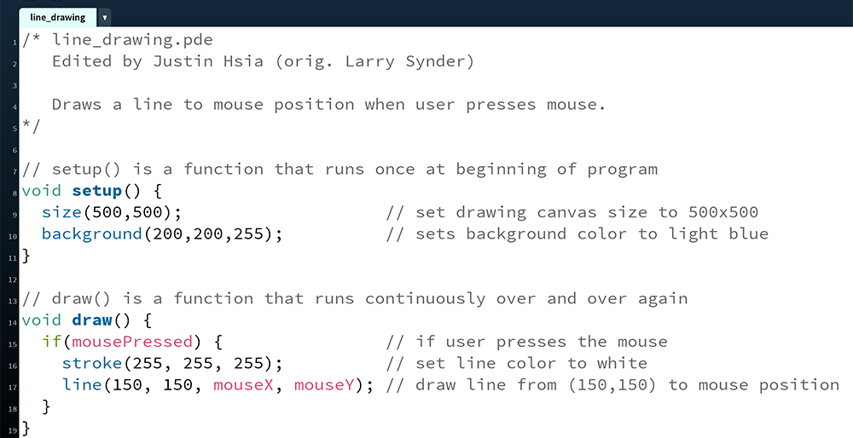
Comments Are Critical!!!

Slide 8
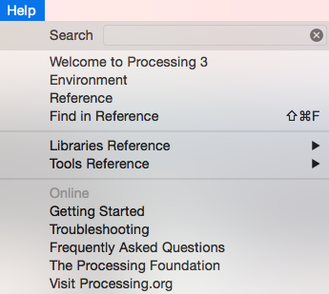
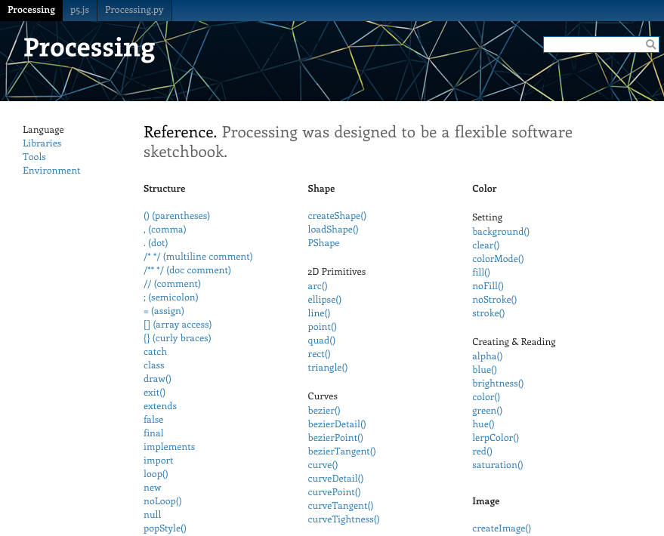
The Processing Reference

Slide 9

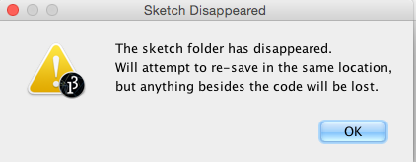
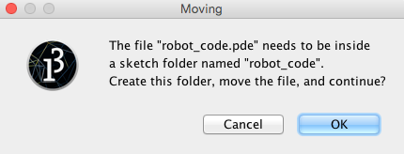
Aside: Processing Files
Processing files have extension .pde
  File names cannot contain dashes (-)
To run a Processing file, it must be in a folder of the same name
  If it’s not, then Processing will create the folder for you

Slide 10
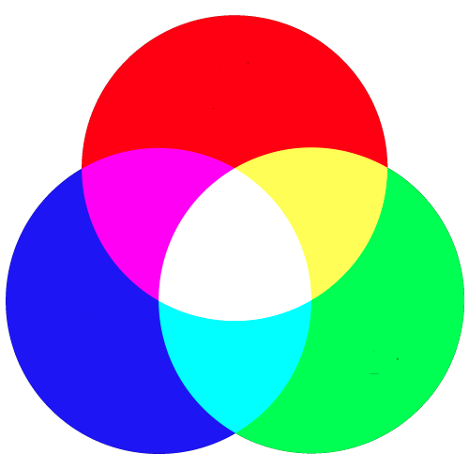
Understanding Color
In electronic systems, color specified
using the RGB color model
  Red, Green, Blue
Each pixel on your screen is made up
of 3 tiny lights, one red, one green, one blue
  Specify the intensity of each light using an integer between 0 and 255
    0 is completely off
    255 is highest intensity

Slide 11
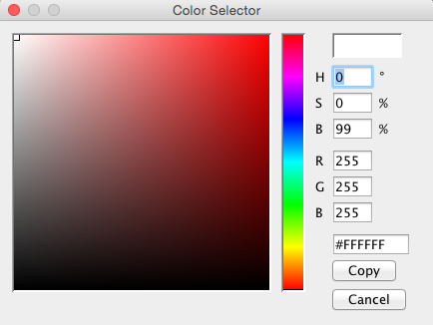
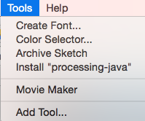
Processing’s Color Selector

Slide 12
Guess the Color
color( R, G, B);
color(255, 0, 0);
color( 0, 255, 0);
color( 0, 0, 255);
color( 0, 0, 0);
color(255, 255, 255);
color(255, 255, 0);
color(255, 0, 255);
color( 0, 255, 255);

Slide 13
Guess the Color
color( R, G, B);
color(255, 0, 0); // red
color( 0, 255, 0); // green
color( 0, 0, 255); // blue
color( 0, 0, 0); // black
color(255, 255, 255); // white
color(255, 255, 0); // yellow
color(255, 0, 255); // magenta
color( 0, 255, 255); // cyan

Slide 14
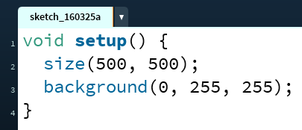
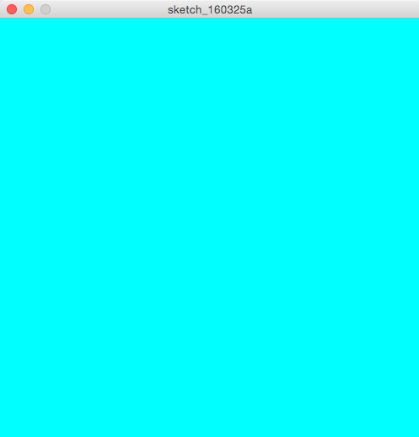
Color Functions
background(R, G, B);
  Covers the entire drawing canvas with the specified color
  Will draw over anything that was previously drawn

Slide 15
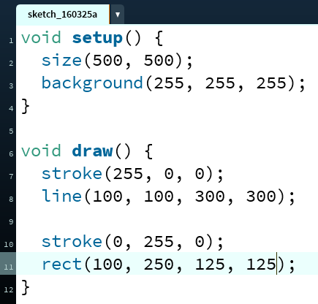
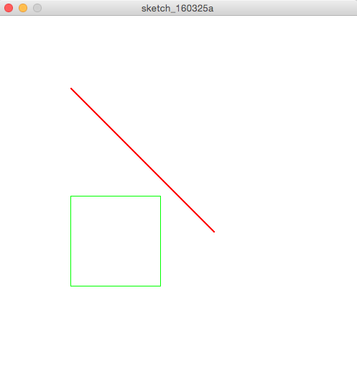
Color Functions
stroke(R, G, B);
  Sets the color of the stroke of a line or line around a shape
  Can change line size using strokeWeight(#);

Slide 16
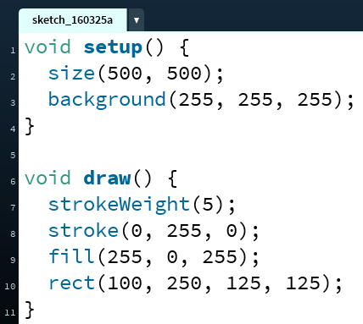
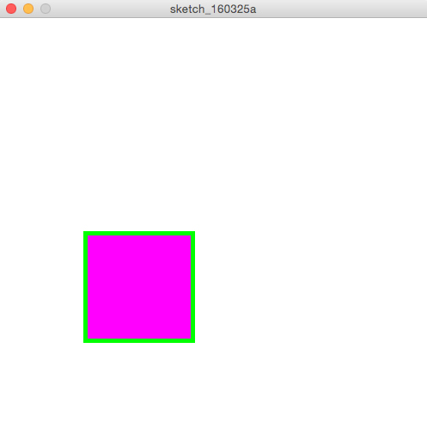
Color Functions
fill(R, G, B);
  Sets the inside color of a shape (note: you cannot fill a line)

Slide 17
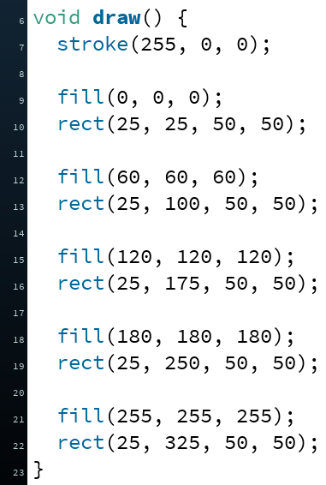
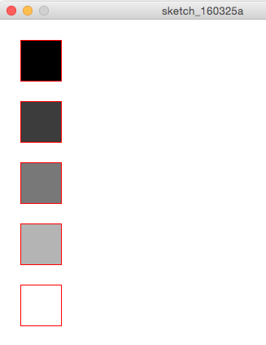
Color: “Grays"
When the values for RGB are all the same, then the color will be white, black, or some shade of gray

Slide 18
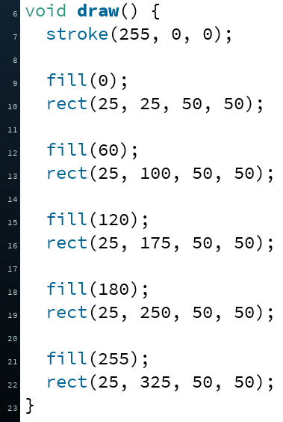
Color: “Grays"
When the values for RGB are all the same, then the color will be white, black, or some shade of gray
  For brevity, can specify just a single number instead

Slide 19
The Color “State” of Your Program
Recall that programs are executed sequentially (i.e. instruction-by-instruction)
stroke() and fill() apply to all subsequent drawing statements
  Until a later call overrides
Hidden color “state” that knows the current values of stroke(), strokeWeight(), and fill()
  In complex programs, can be difficult to keep track of
  Early rule of thumb: always explicitly set colors before each drawing element

Slide 20
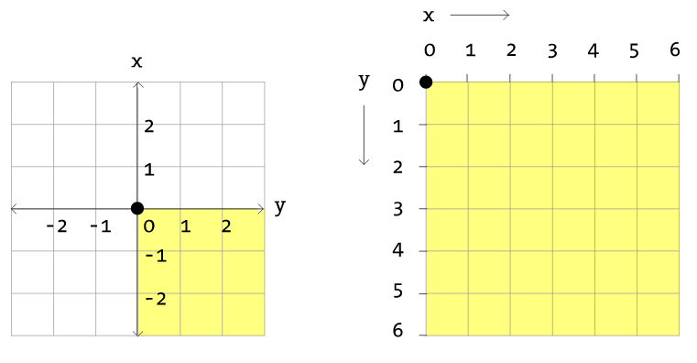
Coordinate System
y
x

Slide 21
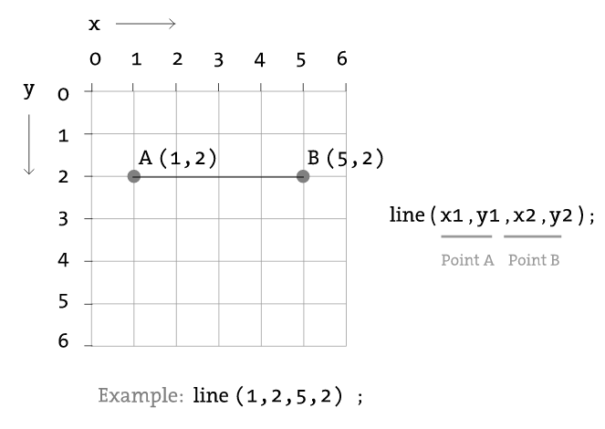
Drawing: Line

Slide 22
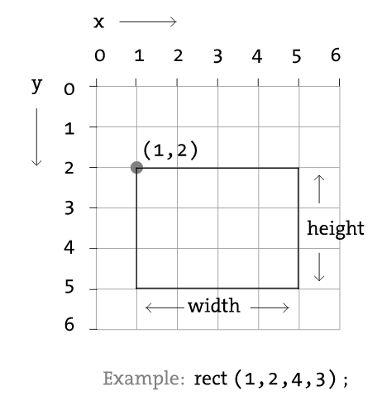
Drawing: Rectangle
Default mode is CORNER
Notes:
In CORNER: rect( x, y, width, height );

Slide 23
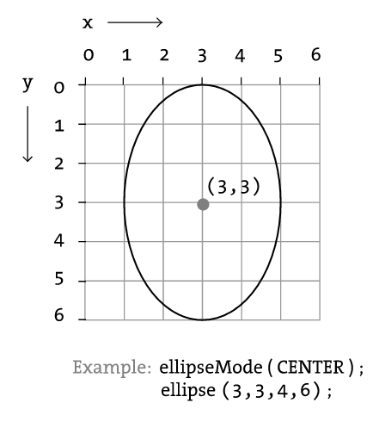
Drawing: Ellipse/Circle
Default mode is CENTER
Notes:
In CENTER: ellipse( x, y, width, height );

Slide 24




Peer Instruction Question
Which of the following drawings corresponds to the Processing code below?
  Vote at http://PollEv.com/justinh
strokeWeight(10);
stroke(75, 47, 131); // UW purple
fill(183, 165, 122); // UW gold
ellipse(100, 100, 100, 200);
  A. B. C. D.

Slide 25

Activity: Taijitu
How do you build a complex drawing out of these simple shapes?

