Slide 1
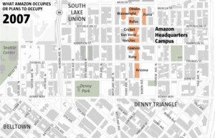
Computer Science Principles CSE 120 Winter 2018
Instructor: Teaching Assistants:
Justin Hsia Anupam Gupta, Cheng Ni, Eugene Oh, Sam Wolfson, Sophie Tian, Teagan Horkan
Ten years ago, Amazon changed Seattle, announcing its move to South Lake Union “[Dec. 21, 2017] marks 10 years since Amazon committed to building an 11-building campus in South Lake Union. But before the company locked up that space, Amazon's landlord went to the city seeking a deal, sparking debates about the impact of development that have grown louder a decade on.”
https://www.seattletimes.com/business/amazon/ ten-years-ago-amazon-changed-seattle-announcing- its-move-to-south-lake-union/

Slide 2
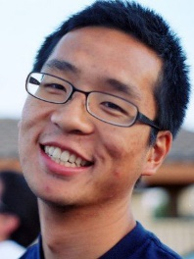
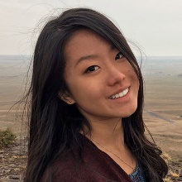
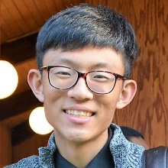
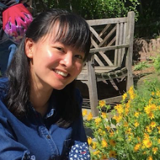
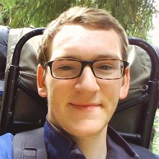
Who: Course Staff
Your Instructor: just call me Justin
From California (UC Berkeley and the Bay Area)
I like: teaching, the outdoors, board games, and ultimate
Excited to be teaching CSP again at UW!
6 TAs:
Available during lab, in office hours, and on Piazza
An invaluable source of information and assistance
Get to know us
We are here to help you succeed and improve your experience
Anupam
Cheng
Eugene
Sam
Sophie
Teagan

Slide 3
Who: You!
61 students registered
Undergrads from many different majors (or pre-majors)
This class is intended for students without significant previous experience with computing/programming
Get to know each other and help each other out!
Learning is much more fun with friends
Working well with others is a valuable life skill
Diversity of perspectives expands your horizons
Submit Pre-Course Survey so we can find out more
Notes:
How many of you are freshman? Sophomores? Juniors? Seniors?
If you have taken APCS, or a previous text-based programming course, this is not the right class for you—consider enrolling in CSE142 instead.

Slide 4
Why Study Computer Science?
Massive impact on our lives and society as a whole
Increasingly useful for all fields of study and areas of employment
Creative Writing – word editing, spell check, need to outcompete robots soon!
Massage Therapist – massage robots soon?
Dancing – stage lighting, motion capture to study technique
Ren Faire Actor – analyze data on ticket sales, popular booths

Slide 5
Computing in Your Future
Computing and its data are inescapable
You generate “digital footprints” all the time
Computing is a regular part of every job
Use computers and computational tools
Generate and process data
Dealing with IT and software people
Understanding the computational portion of projects
Our goal is to help you make sense of the “Digital Age” that we now all live in

Slide 6
Computing and Society
Raise your hand if:
You know someone who works from home
You have “stalked” someone online
You communicate mostly using images instead of words
You have taken extra trips outside to catch that Pokémon
You get the majority of your news from social media
The majority of the media you own (e.g. music, movies, books, art, games) is digital
You know someone who’s had their identity or credit card number stolen online
You’ve seen a parent quiet a child by giving them a digital device

Slide 7
What This Course IS
This course is split into two major themes:
Computational Thinking
How can you use computers to solve problems
Using programming as a tool
Computational Principles
The “big ideas of computing” that we think everyone should know
e.g. bits can represent anything and everything, what a computer can and can’t compute, how do websites and the Internet work, social implications of computing

Slide 8
What This Course Is NOT
Preparation for CSE142: Computer Programming I
This is not just a programming course
Introduce you to the concepts, but not expect you to master them
But great if you feel motivated to continue afterward!
Trivial
Supposed to be material you haven’t seen before
A technical class that asks you to read and write and be creative
Boring or back-breaking
Assignments intended to be fun, interesting, and reasonable

Slide 9
About Programming
programming $≠$ computational thinking
Computational thinking is knowing how to break down and solve a problem in a way that a computer can do it
Programming is the tool you use to execute your solution
We use programming in this course as a way of teaching computational thinking
Can be learned, just like any other skill
It’s not black magic; there’s no such thing as a “coding gene”
Yes, at first it may be challenging and mind-bending – just like learning your first non-native language
My hope is that you will think differently after this course

Slide 10
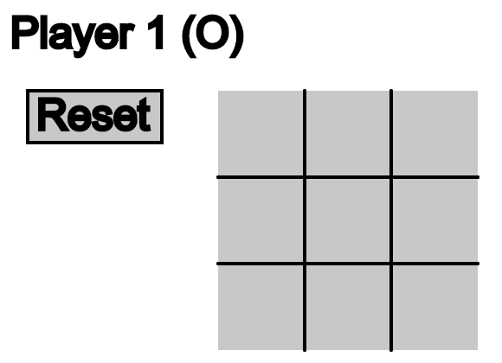
Programming in CSE120
Use a language called Processing
Text-based language that is good for visuals and interaction
We will use Java syntax
At the end of the day, the language you use doesn’t matter as long as you develop computational thinking skills

Slide 11
Big Ideas of Computing
Exposure to a broad range of topics in computer science
Not going to dive into the details
These are the motivations & the applications for programming (the tool)
Focus on what to be aware of to navigate the digital world
Goal: become “literate” in computing
As new innovations arise, can you read about it, understand its consequences, and form your own opinion?
This course will ask you to read, discuss, and write about computing innovations

Slide 12
Lecture Outline
Course Introduction
Course Policies
http://courses.cs.washington.edu/courses/cse120/18wi/syllabus/#policies
Abstraction

Slide 13
Communication
Website: http://cs.uw.edu/120
Calendar, schedule, policies, labs, links, assignments, etc.
Grade book and assignment submissions via Canvas
Discussion: http://piazza.com/washington/winter2018/cse120
Ask and answer questions – staff will monitor and contribute
ALL questions on course material should go here
Office Hours: spread throughout the week
Can also email to make individual appointments
Anonymous feedback form

Slide 14
Weekly Schedule
Lectures are Mon, Wed, Fri (3 hr)
Friday lectures will generally be reserved for “Big Ideas”
Weekly reading is due before lab on Thursday
All readings online, complete “reading check” to prep
Labs on Tue, Thu (3 hr)
Worksheets and work time with help from TAs
10-15 minutes at start of Thu lab will be spent discussing the weekly reading
Can be a demanding schedule, but should be fun!
Monday | Tuesday | Wednesday | Thursday | Friday
Lecture | Lab | Lecture | Lab (Reading) | Lecture
Notes:
Pull up course calendar.

Slide 15
Course Components and Grading
Programming Assignments (40%)
Includes a website portfolio of your work
Final Project (20%)
Of your own choosing!
Written Assignments (15%)
Includes reading checks, field trip report, mini research report
Exams: Midterm (10%) and Final (10%)
Double-check your understanding of concepts
EPA: Effort, Participation, and Altruism (5%)
Encourage class-wide learning

Slide 16
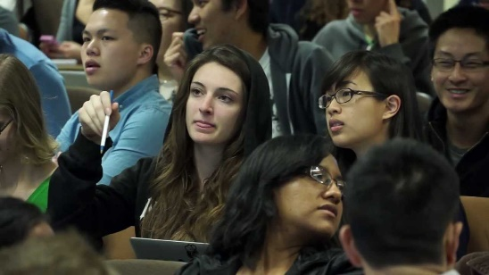
Peer Instruction
Increase real-time learning in lecture, test your understanding, increase student interactions
Lots of research supports its effectiveness
Multiple choice question at end of lecture “segment”
1 minute to decide on your own
2 minutes in pairs to reach consensus
Learn through discussion
Vote using
Use website (https://www.polleverywhere.com) or app
Linked to your UWNetID

Slide 17
Some topics that we will touch on
Which of the following seems the most interesting to you? (vote at http://PollEv.com/justinh)
How do I program simple game mechanics?
How does a computer work?
How has the Internet changed the way we interact with each other?
What is copyright and how does it apply to digital works
What is artificial intelligence?
What will I do if/when my job gets taken over by robots (i.e. automated)?

Slide 18
Hooked on Gadgets
Gadgets reduce focus and learning
Bursts of info (e.g. emails, IMs, etc.) are addictive
Heavy multitaskers have more trouble focusing and shutting out irrelevant information
http://www.npr.org/2016/04/17/474525392/attention-students-put-your-laptops-away
This applies to all aspects of life, not just lecture
NO audio allowed (mute phones & computers)
Non-disruptive use okay
Stick to side and back seats
Stop/move if asked by fellow student
Notes:
NPR segment: play until 2:28

Slide 19
To-Do List
Explore website thoroughly: http://cs.uw.edu/120
Read through the full course policies!!!
Check that you are registered on Piazza, Canvas, and Poll Everywhere
Pre-Course (Introduction) Survey due tomorrow (1/4)
More assignments will be introduced in lab tomorrow

Slide 20
Lecture Outline
Course Introduction
Course Policies
Abstraction

Slide 21
Complexity and Abstraction
Programming is straightforward, as long as your programs are small
Complexity is our enemy
Abstraction is the key to conquering complexity
Abstraction allows us to build general-purpose artifacts
Detail Removal: Hide unnecessary details from users and designers
Generalization: Avoid unnecessary repetitive work
Learning to reason using the most appropriate abstraction is a key goal of computational thinking

Slide 22
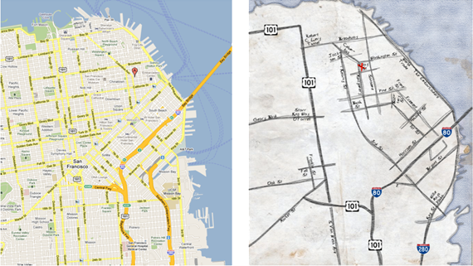
Abstraction: Detail Removal
“The act or process of leaving out of consideration one or more properties of a complex object so as to attend to others.”
Henri Matisse “Naked Blue IV”
Maps for directions

Slide 23
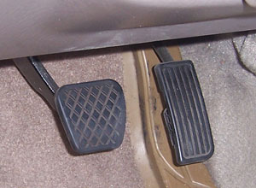
Abstraction: Detail Removal
Detail removal example:
Modern user interface: Right pedal is “accelerate”, left is “decelerate”
Even as underlying technology has changed, this abstraction has not!
Computer controlled fuel injection
Anti-lock brakes (ABS)

Slide 24
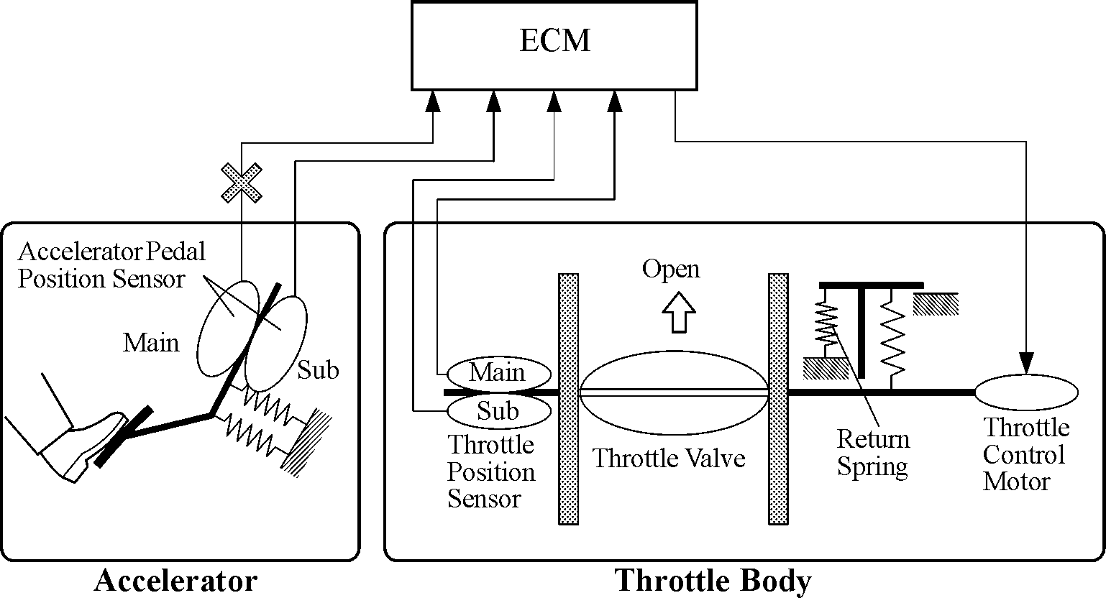
Abstraction: Detail Removal
Detail removal example:
Hide unnecessary details from other designers
e.g. Engine Control Module (ECM) designer doesn’t care about the return spring inside the Throttle!

Slide 25
Abstraction: Detail Removal
Detail removal example:
Hide unnecessary details from other designers
e.g. Engine Control Module (ECM) designer doesn’t care about the return spring inside the Throttle!
Nice to be able to think of a system as a hierarchy of well defined “chunks” with precise functionality
In CS, we say that we have a separation of concerns
Engine Control Module
Accelerator
Throttle

Slide 26
Abstraction: Generalization
“The process of formulating general concepts by abstracting common properties of instances.”
Extensible shower rods
Adjustable hats and belts
Single recipe for <fruit> cheesecake
Feeding animals on a farm
To feed <animal>, put <animal> food in <animal> dish

Slide 27
Audience Responses
Other examples of detail removal:
Operating a camera – just push a button
Sciences – abstracted structures/diagrams
Simple name for complex phenomena
Other examples of generalization:
Apply formula repeatedly (Excel)

Slide 28
Summary
Abstraction is one of the most important challenges in computer science
How do you identify the right abstraction you need (block to build) to solve your problem?
Think about computers:
How many of you actually know how a computer works?
How many of you can use a computer?
Thanks to abstraction!!!

