Slide 1
Digital Distribution CSE 120 Spring 2017
Instructor: Teaching Assistants:
Justin Hsia Anupam Gupta, Braydon Hall, Eugene Oh, Savanna Yee
China is creating a massive “Orwellian” DNA database
In the name of safeguarding its 1.4 billion people, China has been collecting biometric information from millions of people whom it deems potential threats as part of national DNA database.
China’s Ministry of Public Security has amassed information for more than 40 million people. In the US, the FBI’s national DNA index has 12.7 million offender profiles.
“Mass DNA collection by the powerful Chinese police absent effective privacy protections or an independent judicial system is a perfect storm for abuses,” said Sophie Richardson, China director at Human Rights Watch (HRW).
https://qz.com/984400/china-is-creating-a-massive-orwellian-dna-database-to-construct-harmonic-society/

Slide 2
Administrivia
Assignments:
Project Update in lab (5/25)
Innovation Comments (5/26)
Project (6/2)
Wednesday: Computing in the Developing World
Friday: Big Data
No Reading Check this week!

Slide 3
Peer Instruction Question
What is the biggest impact of digitization?
Vote at http://PollEv.com/justinh
People need to learn about binary in schools
Computers can now process data
Information can be copied without loss
There is no impact; it’s a technicality
Other: __________

Slide 4
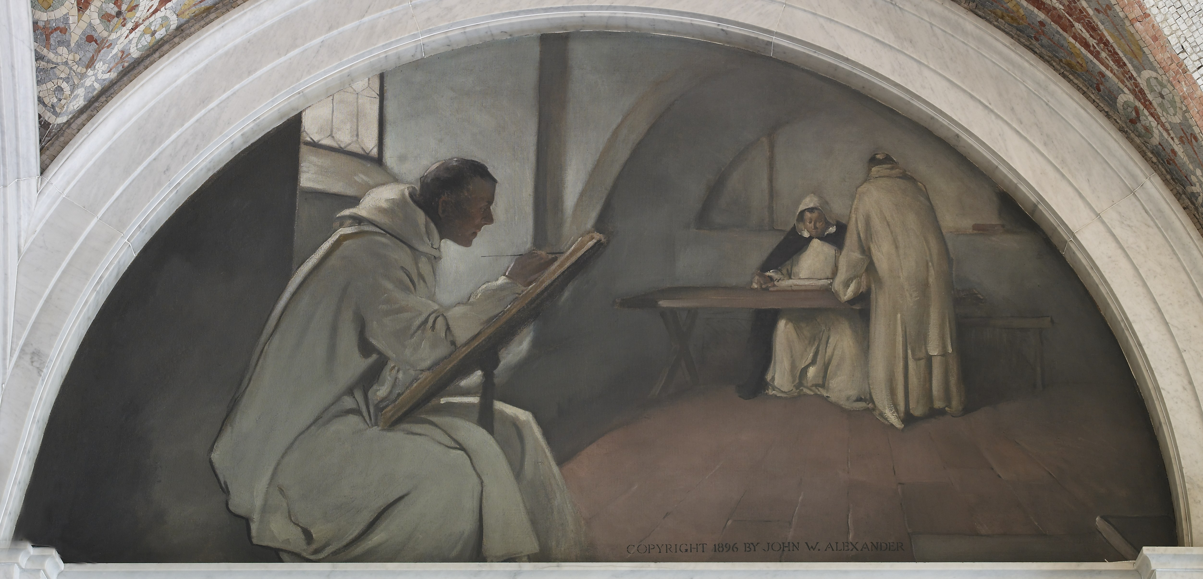
Biggest Impact of Digitization?
Digital information can be copied instantaneously and without loss
Analog copying: almost always with loss
Biological copying: mutations and recombination

Slide 5
Copying is Easy
myCopy = myData;
File: right-click $→$ Copy
Lossless, instantaneous copying leads to a wealth of societal problems:
Privacy issues
Theft of private data
Interception of transmitted data
Persistence of digital data
Usage of digital works
Copyright
Legal, cultural, and economic impacts

Slide 6
Outline
Copyright and protection
Sharing and open-source
Creative Commons

Slide 7
Digital Millennium Copyright Act (DMCA)
Russel Rains – lawyer, professor at St. Edwards University in Austin, TX
http://www.youtube.com/watch?v=bFLSe1qQUP8

Slide 8
Intellectual Property (IP)
Intellectual property is something produced by one’s intellect
e.g. artwork, books, photos, music, poetry, performances, software
Distribution, copying, and sale of a work is the right of the creator
It is illegal to copy someone else’s creation for anything “other than personal use”
You are the creator of all that you create
Unless otherwise specified by a contract (e.g. at work)

Slide 9
Copyright: A Primer
http://www.youtube.com/watch?v=Uiq42O6rhW4

Slide 10
Copyright Terminology Review
Copyright: legal right granting creator of an original work exclusive rights over use and distribution
Set by laws of a country
Public domain: exclusive IP rights expired, forfeited, or inapplicable
Fair Use: right to use copyrighted material without permission in specific circumstances
e.g. commentary, search engines, criticism, parody, news, scholarship
Judged based on (1) purpose/character of use, (2) nature of the work, (3) amount used, and (4) effect on work’s value

Slide 11
Copyright Violations
Most people who have posted on the Internet have probably violated copyright laws
Illegal sharing of music and videos
Napster, Kazaa, DC++, Bittorrent
Illegal sharing of games
ISO images of games (to be played on emulators)
Illegal usage of photos and works
Posting without attribution, misrepresentation, plagiarism

Slide 12
Copyright and Laws
Owners must “defend” their copyrights
RIAA and MPAA are at war with users
As of 2016, only 4 members of Congress (all in the House) have CS degrees
Stop Online Piracy Act (SOPA) – 2011
Would have allowed court orders to bar access to websites with copyright infringement to advertising networks, payment facilities, and Internet service providers
Service blackout in 2012 by Wikipedia, Google, and others in protest
Protect Intellectual Property Act (PIPA) – 2011
Notes:
RIAA – Recording Industry Association of America
MPAA – Motion Picture Association of America

Slide 13
Digital Rights Management (DRM)
Technologies that are used to restrict usage of proprietary hardware and copyrighted works
Not universally accepted or used; can be inconvenient
Software: Product (serial) keys
Internal algorithm checks validity of entered key
“Cracked” keys can fool the validity check
Audio: non-standard CDs or restricted usage of downloaded music
Only playable with certain devices or applications
Games: Persistent online authentication

Slide 14
Outline
Copyright and protection
Sharing and open-source
Creative Commons

Slide 15
Copyleft
Offering people the right to freely distribute copies and modified versions of a work with the stipulation that the same rights be preserved in derivative works down the line
http://www.youtube.com/watch?v=u2k07BbPkDk

Slide 16
Open-Source Licenses
GNU General Public License (v2, v3)
Apache License
MIT License
BSD License
Public Domain
These licenses differ in:
Attribution requirements
Commercial use restrictions
Derivative work restrictions

Slide 17
Why Open Source?
Pros:
Cheaper – free to install on all machines
Crowd-sourced fixes and improvements
Can persist beyond company that created it
You can personally contribute and become part of the community
Cons:
Can be more difficult to use and support
More potential security flaws

Slide 18
Open-Source Software
 | Proprietary | Open-Source
Operating Systems | Windows, Mac OS | Linux, Android *
Web Browsers | IE/Edge, Safari, | Chrome *, Firefox
Email Client | Outlook | Thunderbird
Music Player | Windows Media Player, iTunes | VLC
Audio Editing | Cubase, Logic Pro | Audacity
Image Editing | Photoshop | GIMP
Text Editor | Word, Notepad, Sublime Text | Notepad++, Brackets
* includes some proprietary software for accessing Google services

Slide 19
Outline
Copyright and protection
Sharing and open-source
Creative Commons

Slide 20
Creative Commons

Slide 21
Layers of Creative Commons Licenses
Legal layer
Sustain lawsuits
Human-readable
Understandable for ‘everybody’
Machine-readable
Understandable for search engines

Slide 22
Creative Commons Symbols
Attribution (BY)
Must give creator credit in derived/distributed works
Noncommercial (NC)
Derived/distributed work can’t be sold
No Derivative Work (ND)
Must use AS IS
Share Alike (SA)
Derivative works may be distributed under the same license as this one

Slide 23
Types of Creative Commons Licenses

Slide 24
CC vs. Open Source
Creative Commons Licenses are not recommended for program code
Use open-source licenses instead
CC does not account for:
Patents
License compatibility
Binary vs. source code case distinction

Slide 25
Social Implications
http://www.youtube.com/watch?v=Zi8cik98YmE

