Slide 1
Artificial Intelligence CSE 120 Spring 2017
Slide credits: Pieter Abbeel, Dan Klein, Stuart Russell, Pat Virtue & http://csillustrated.berkeley.edu
Instructor: Teaching Assistants:
Justin Hsia Anupam Gupta, Braydon Hall, Eugene Oh, Savanna Yee
Candy Grab Game
Grab a pack of “game pieces” (at least 10 per pair of students)
Play the following game
10 pieces on the table
Take turns taking either 1 or 2 pieces
Player that takes the last piece(s) wins ☺
How do humans learn to play this game?
How would a computer learn to play this game?
int takeTurn(int numPiecesAvailable)

Slide 2
Administrivia
Assignments:
Tic-Tac-Toe due tonight (5/19)
Project Proposal due Saturday (5/20)
Innovation Exploration post due Sunday (5/21)
Project:
Dream big! It’s okay to scale back later
You might be surprised at what you can accomplish
Feel free to brainstorm with a staff member
Make it something that you’re excited about

Slide 3
Outline
What is AI?
AI History
AI winter and the resurgence
AI Today
Applications and how they work
AI Tomorrow
Ethics and the singularity

Slide 4
Artificial Intelligence
Why learn about AI?
Funding to private AI companies globally
(in millions of $)
2012 2013 2014 2015 2016
https://www.cbinsights.com/blog/artificial-intelligence-startup-funding/

Slide 5
Candy Grab Game
int takeTurn(int numPiecesAvailable) {
return ?;
}

Slide 6
Candy Grab Game
Agent 001 – always choose 1
int takeTurn(int numPiecesAvailable) {
return 1;
}

Slide 7
Candy Grab Game
Agent 002 – always choose 2
int takeTurn(int numPiecesAvailable) {
return 2;
}

Slide 8
Candy Grab Game
Agent 007 – whatever you think is best
int takeTurn(int numPiecesAvailable) {
return ?;
}

Slide 9
Candy Grab Game
Agent 007 – whatever you think is best
int takeTurn(int numPiecesAvailable) {
if(numPiecesAvailable%3 == 2) {
return 2;
} else {
return 1;
}
}

Slide 10
Candy Grab Game
Agent 007 – whatever you think is best
int takeTurn(int numPiecesAvailable) {
return ?;
}
What if we had:
boolean willIWin(int numPiecesAvailable, boolean isMyTurn, int action)

Slide 11
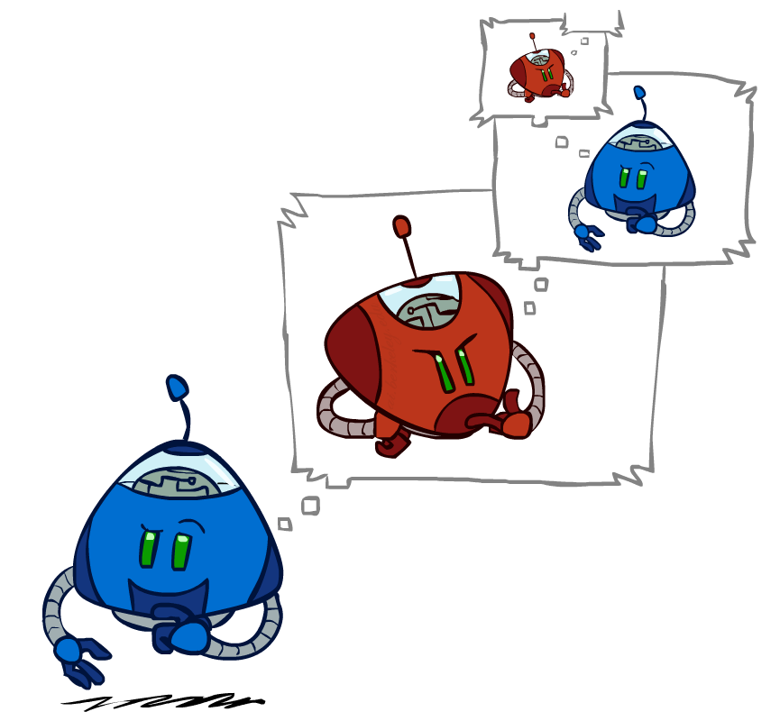
Candy Grab Game
Agent 007 – whatever you think is best
int takeTurn(int numPiecesAvailable) {
return ?;
}

Slide 12
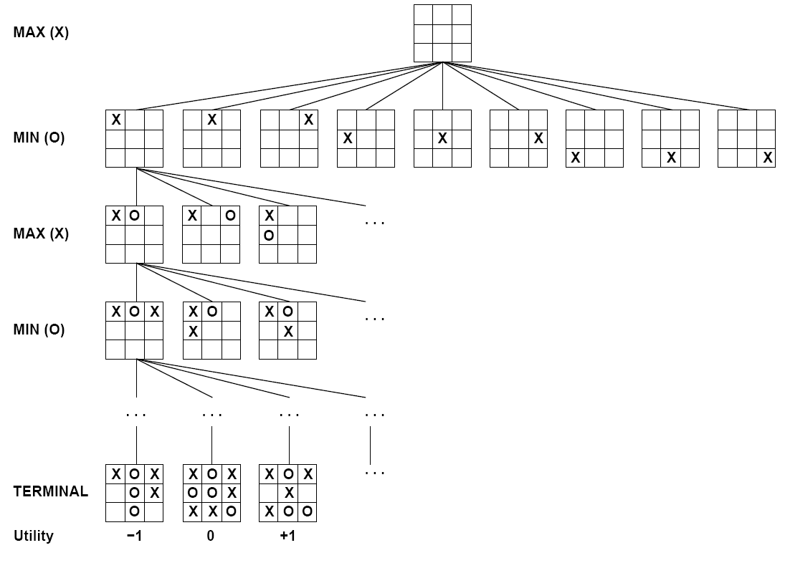
How: Search & Planning
I take an action… then what? … then what?

Slide 13
Candy Grab Game (Min-Max)
Agent 007 – whatever you think is best
int takeTurn(int numPiecesAvailable)

Slide 14
Candy Grab Game (Statistical)
Agent 007 – whatever you think is best
int takeTurn(int numPiecesAvailable)
Pieces Available | Take 1 | Take 2
2 | 0% | 100%
3 | 2% | 1%
4 | 75% | 2%
5 | 4% | 68%
6 | 5% | 6%

Slide 15
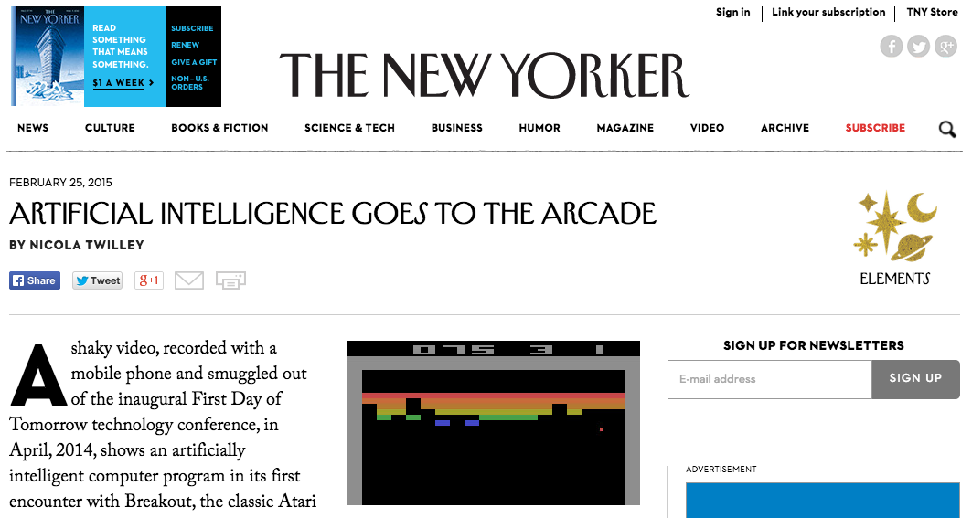
AI Games in the News
https://www.youtube.com/watch?v=EfGD2qveGdQ
https://www.youtube.com/watch?v=cjpEIotvwFY
Notes:
Video 1: 0:00 – 2:32

Slide 16
So What is AI?

Slide 17
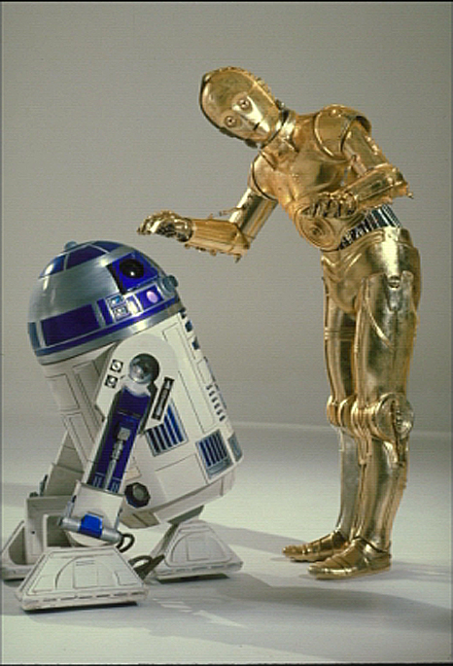
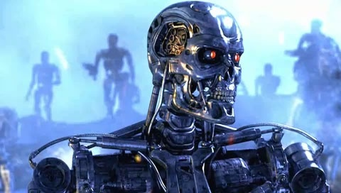
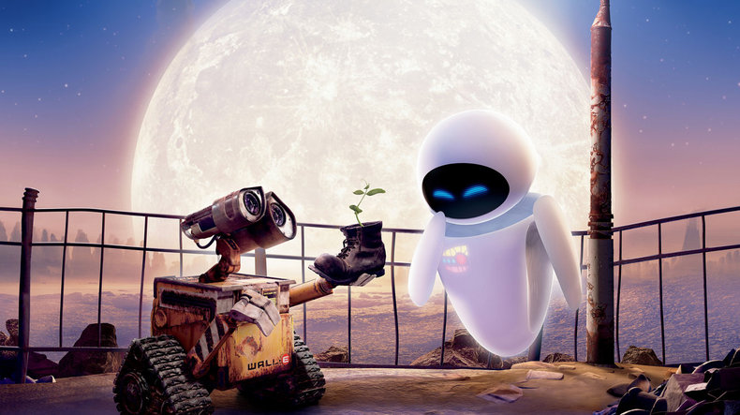
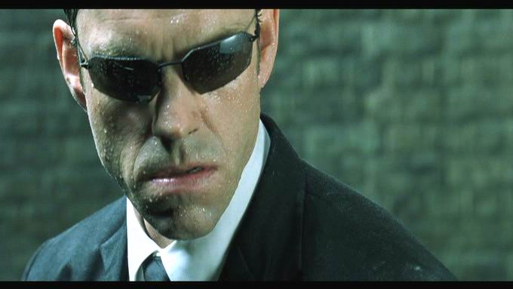
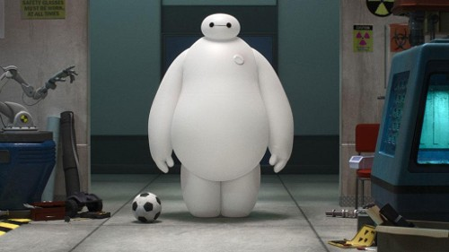
Sci-Fi AI?
Notes:
Who are these? C3PO, what does he do? Essentially google translate, (but with anxiety!)
Little guy? R2D2 – what does he do, yeah, not so sure
Things got darker: machines come back from the future – to kill us!
90’s : software is scary
Basic fear about what technology might do ?
What if we can’t even tell technology apart from ourselves?
OR maybe it’ll look really different and snarky

Slide 18
So What is AI?
The science of making machines that:
Think like people
Act like people
Notes:
Try to mimic humans!
Think like people is hard – cognitive science
More practical to make robots that act like people

Slide 19
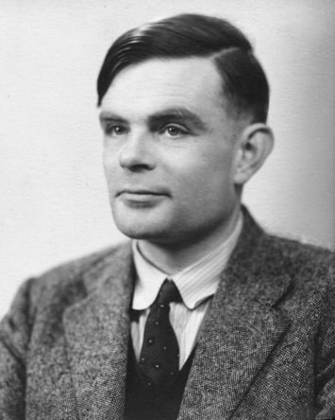
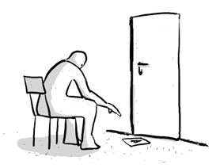
Turing Test for Intelligence
In 1950, Turing defined a test of whether a machine could “think”:
“A human judge engages in a natural language conversation with one human and one machine, each of which tries to appear human. If judge can’t tell, machine passes the Turing test.”
http://en.wikipedia.org/wiki/Turing_test
Notes:
Not always best to mimic humans – typos, slow at mental math, etc.

Slide 20
So What is AI?
The science of making machines that:
Think like people
Think rationally
Act like people
Act rationally
Notes:
What it decides and does is rational – it makes sense.

Slide 21
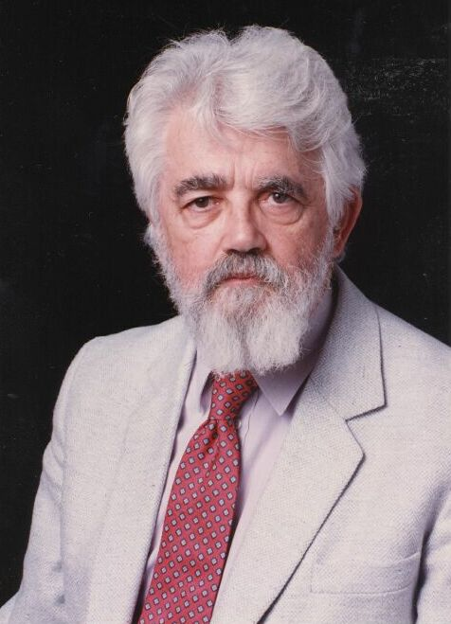
AI Definition by John McCarthy
“Getting a computer to do things which, when done by people, are said to involve intelligence”
Finesses the idea of whether a computer has consciousness, whether they have rights, etc.

Slide 22
Outline
What is AI?
AI History
AI winter and the resurgence
AI Today
Applications and how they work
AI Tomorrow
Ethics and the singularity

Slide 23
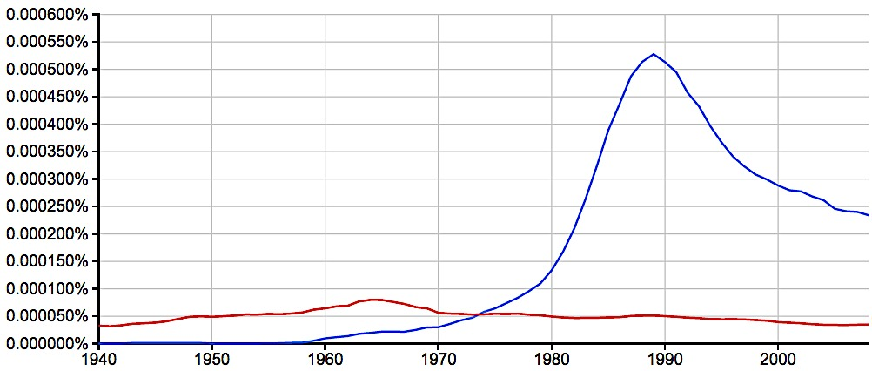
A Brief History of AI
AI
Excitement!
1950-1970
Knowledge Based
Systems
1970-1990
artificial intelligence
formal logic
Google Books Ngram Viewer: https://books.google.com/ngrams
Notes:
Percentage of times these exact pairs of words appeared compared to all pairs of words in the literature.
Formal logic – mathematical way of formulating reason and how people think
AI excitement followed the rise of early computers – if we can now get a computer to compute things, we can surely quickly get it to “intelligent machines.”
Knowledge Based Systems – taking all of the knowledge we have about the world and encoding that to create new rules based on inference.

Slide 24
Logic
A formal representation of our knowledge of the world
Use knowledge base and perception to infer new knowledge
http://www.rabittooth.com/gallery/spock_in_2012_by_rabittooth.jpg

Slide 25
isDog(animal)
$barks \& fur \& fourLegs⇔dog$
boolean isDog(animal A) {
if(!barks(A)) {
return false;
}
if(!hasFur(A)) {
return false;
}
if(!hasFourLegs(A)) {
return false;
}
return true;
}
What’s the problem?
Dog
Barks
Has Fur
Has four legs

Slide 26
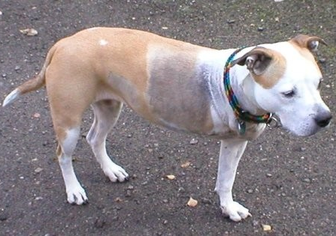
isDog(animal)
$barks \& fur \& fourLegs⇔dog$
What’s the problem?
Dog
Barks
Has Fur
Has four legs
Sheila
Notes:
How to fix?
Better sensors (DNA test)
Too specific – maybe only require a certain amount?
Use probabilities instead of boolean (statistical approach).

Slide 27
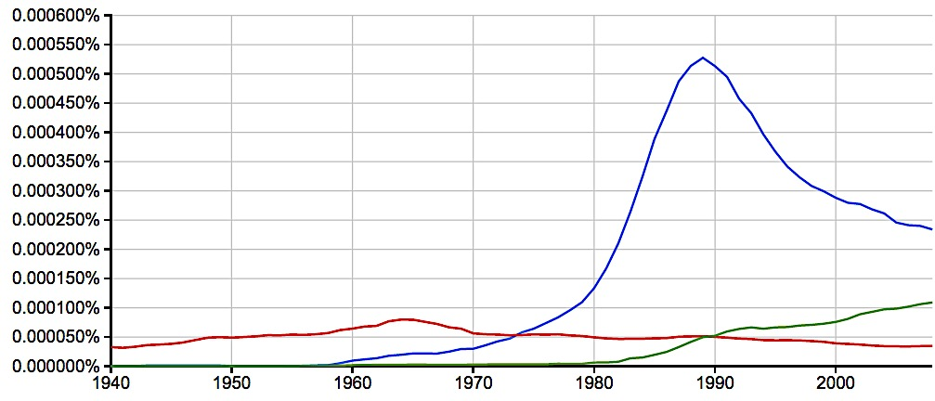
A Brief History of AI
AI
Excitement!
1950-1970
Knowledge Based
Systems
1970-1990
Statistical Approaches
1990-?
artificial intelligence
machine learning
formal logic
2008
Google Books Ngram Viewer: https://books.google.com/ngrams

Slide 28
Outline
What is AI?
AI History
AI winter and the resurgence
AI Today
Applications and how they work
AI Tomorrow
Ethics and the singularity

Slide 29
“Intelligent” Applications
Discuss in pairs/groups:
List at least four existing applications that seem intelligent
Audience responses:
Alexa, Siri – learn preferences, speech recognition
Google Maps – routing, path following, real-time updates
Google Translate – language detection, grammar, syntax
Pandora – learn musical preferences, suggestions

Slide 30
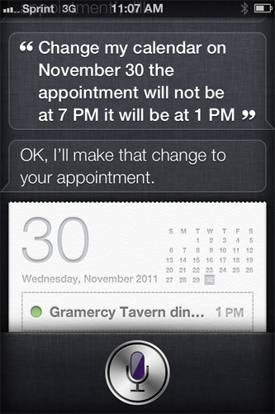
Applications: Natural Language
Speech technologies (e.g. Siri)
Automatic speech recognition (ASR)
Text-to-speech synthesis (TTS)
Dialog systems
Language processing technologies
Google translation
Web search
Spam filter

Slide 31
How: Probability
Notation:
$$P\left(limb \right| artificial, audio)$$
“Probability of ‘limb’ given ‘artificial’ and audio”
Example: speech recognition of “artificial …”
Find most probable next word given “artificial” and the audio for the second word
Which second word gives the highest probability?
$$P\left(limb \right| artificial, audio)$$
$$P\left(intelligence\right| artificial, audio)$$
$$P\left(flavoring \right| artificial, audio)$$
Break down problem
n-gram probability * audio probability
$P\left(limb \right| artificial)$ * $P\left(limb \right| audio)$
$P\left(intelligence\right| artificial)$ * $P\left(intelligence\right| audio)$
$P\left(flavoring \right| artificial)$ * $P\left(flavoring \right| audio)$

Slide 32
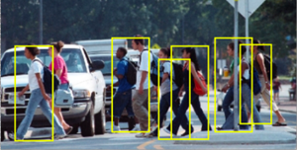
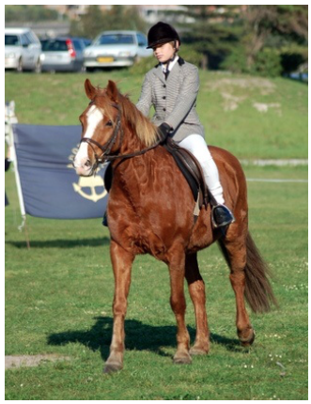
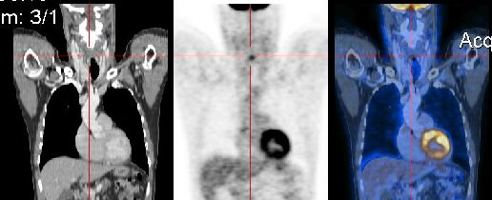
Applications: Vision (Perception)
Tasks related to understanding images/camera input
Pedestrian Detection
Segmentation
Alignment/Registration
Long, Shelhamer, Darrell. arXiv preprint arXiv:1411.4038 (2014).
https://en.wikipedia.org/wiki/Medical_image_computing#/media/File:CT-PET.jpg

Slide 33
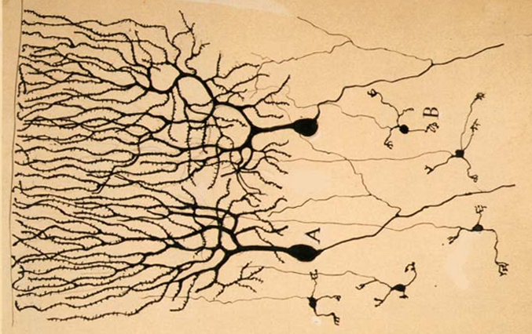
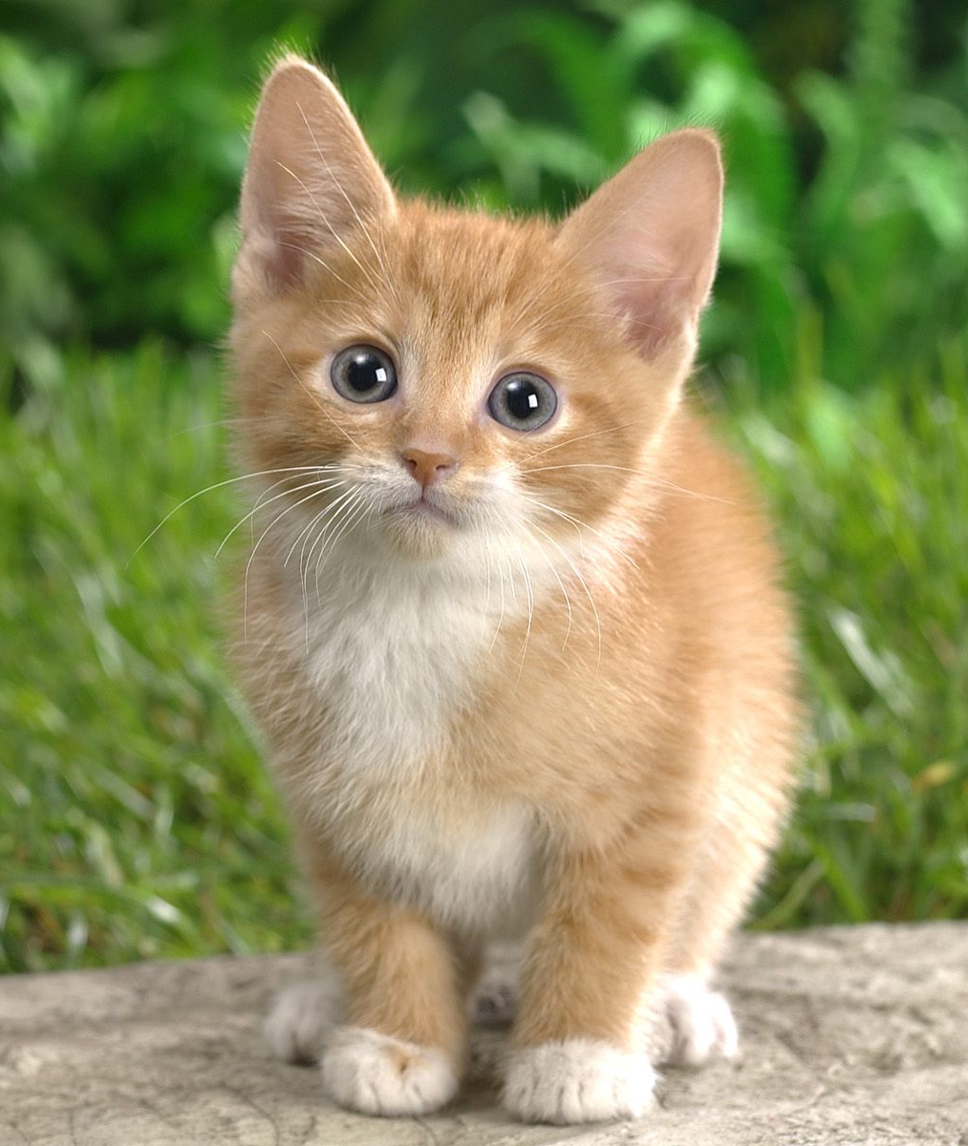
How: Neural Networks
Input Signal
Output
Signal
DOG
CAT
TREE
CAR
SKY
Image: https://en.wikipedia.org/wiki/Neuron
Notes:
Functions are connected to other functions using weights (sliders)

Slide 34
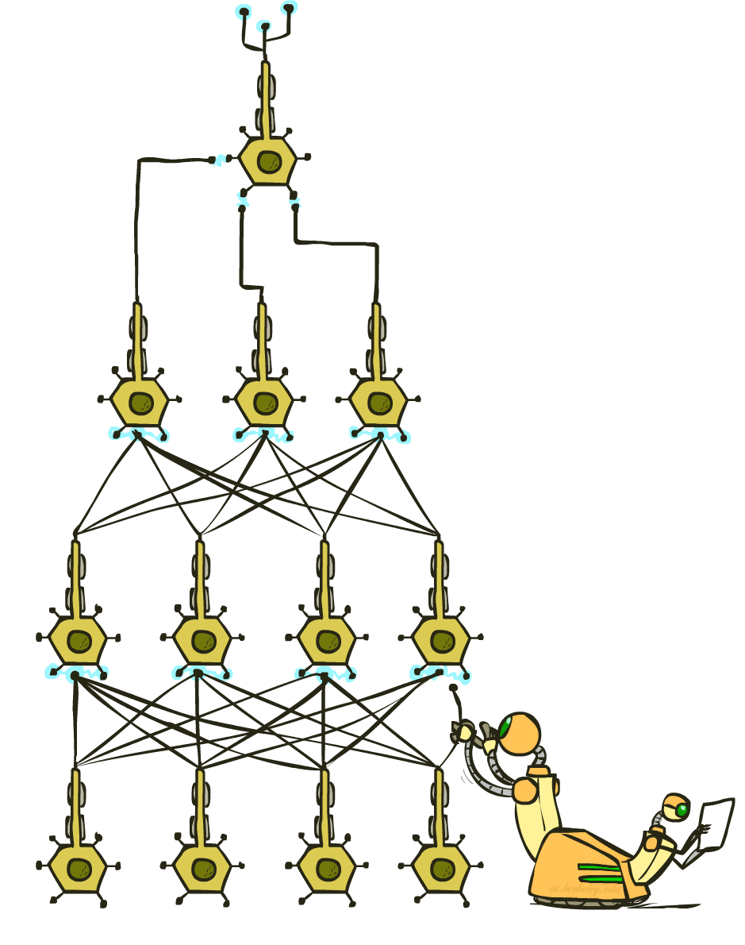
How: Neural Networks
Input Signal
Output
Signal
DOG
CAT
TREE
CAR
SKY
Image: https://en.wikipedia.org/wiki/Neuron

Slide 35
Applications: Games

Slide 36
How: Search & Planning
I take an action… then what? … then what?

Slide 37
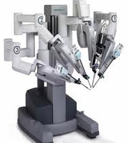
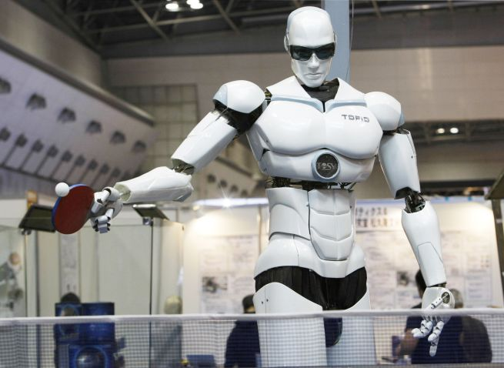
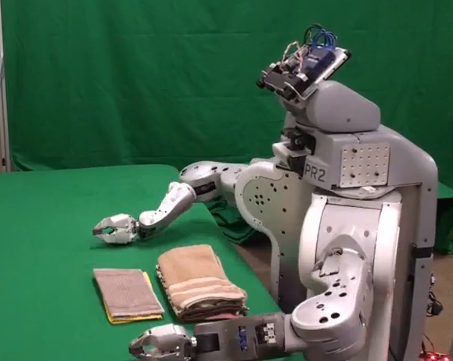
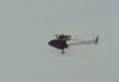
Applications: Robotics
For many, the coolest and scariest part of AI
Combines fields of AI/CS
Speech recognition
Synthetic voice
Machine vision
Planning
HCI
Surgical robots
Autonomous helicopter
TOPIO, the ping-pong playing robot
Towel-folding!

Slide 38
Applications: Robotics
Video: Bipedal Robot – Boston Dynamics
https://www.youtube.com/watch?v=rVlhMGQgDkY
Video: Robot Preschool – UC Berkeley
http://www.bloomberg.com/features/2015-preschool-for-robots/

Slide 39
Applications: Driving
Image: https://www.google.com/selfdrivingcar/how/

Slide 40
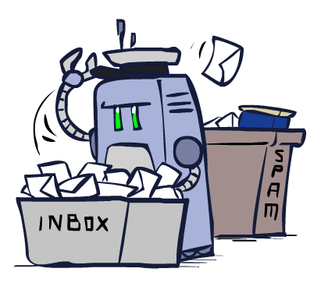
Applications: Much, Much More
Scheduling, e.g. airline routing, military
Route planning, e.g. Google maps
Medical diagnosis
Web search engines
Spam classifiers
Automated help desks
Fraud detection
Product recommendations
… Lots more!

Slide 41
Outline
What is AI?
AI History
AI winter and the resurgence
AI Today
Applications and how they work
AI Tomorrow
Ethics and the singularity

Slide 42
What’s In a Training Set?
Just like humans, machines can only learn what they are taught (or can read about on their own)
Biased training set = biased behavior
https://techcrunch.com/2016/12/10/5-unexpected-sources-of-bias-in-artificial-intelligence/
Examples:
In March 2016, Microsoft released AI Twitter bot Tay
http://www.complex.com/life/2016/03/microsoft-racist-ai
Software used to predict future criminals is biased against African Americans
https://www.propublica.org/article/machine-bias-risk-assessments-in-criminal-sentencing

Slide 43
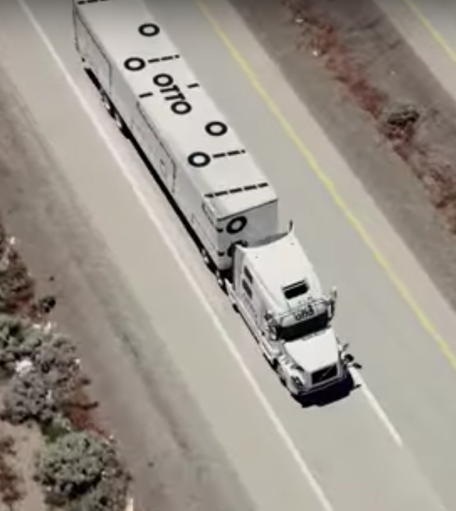
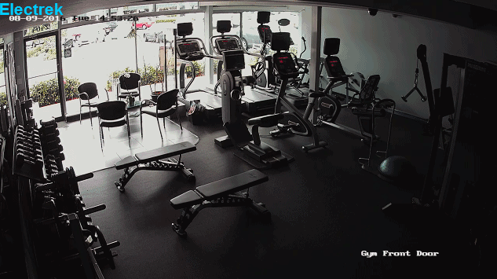
AI: What Should We Worry About?
AI Ethics: Immediate concerns
Jobs
Liability
Weapons
Images:
http://ot.to/
https://electrek.co/2016/09/25/tesla-model-s-crashes-into-gym-driver-claims-autonomous-acceleration-tesla-says-drivers-fault/
http://futureoflife.org/2016/09/20/podcast-what-is-nuclear-risk/

Slide 44
AI: Superintelligence
Singularity
Weak AI
Strong AI
Narrow AI
Limited number of applications
Artificial General Intelligence
Recursive self-improvement
Beyond human control

