Slide 1
Recursion I CSE 120 Spring 2017
Instructor: Teaching Assistants:
Justin Hsia Anupam Gupta, Braydon Hall, Eugene Oh, Savanna Yee
The Abusive ‘Pranks’ of YouTube Family Vloggers
DaddyOFive is a fairly popular YouTube channel – it boasts around 750,000 subscribers. [It] would often put up “typical” family videos, but their most popular videos are loosely executed pranks. What the family calls “pranking,” though, can look an awful lot like abuse.
Estimates of DaddyOFive’s income range from $200,000 to $350,000 annually. Though many young YouTube stars essentially work as child entertainers, the conditions of and income from their labor are not regulated. Most rely entirely on the generosity of their parents, who receive automated payments from ad revenue.
http://nymag.com/selectall/2017/04/daddyofive-youtube- abuse-controversy-explained.html

Slide 2
Administrivia
Assignments:
Controlling Elli due tonight (5/1)
Mid-Quarter Survey due Wednesday (5/3)
Living Computers Museum Report (5/14)
Midterm grades released on Gradescope
Average: 21.81/30, Std Dev: 5.31
Regrade requests via Gradescope due Wednesday (5/3)
Make sure to submit separate requests for each subproblem
Make sure you understand your mistakes

Slide 3
Growth vs. Fixed Mindset
Students can be thought of as having either a “growth” mindset or a “fixed” mindset (based on research by Carol Dweck)
“In a fixed mindset students believe their basic abilities, their intelligence, their talents, are just fixed traits. They have a certain amount and that's that, and then their goal becomes to look smart all the time and never look dumb.”
“In a growth mindset students understand that their talents and abilities can be developed through effort, good teaching and persistence. They don't necessarily think everyone's the same or anyone can be Einstein, but they believe everyone can get smarter if they work at it.”

Slide 4
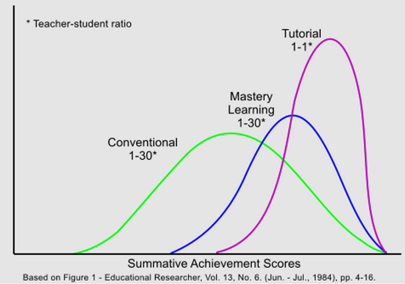
Bloom’s Two Sigma Problem
1984 Educational Researcher paper
http://web.mit.edu/5.95/readings/bloom-two-sigma.pdf
Core observation: An “average” student learning in a 1 on 1 format achieves results similar to the top 2% of a lecture based class (two standard deviations above the mean).
Very strongly implies that the “fixed” mindset is wrong!

Slide 5
Outline
Processing: translate() and rotate()
Recursion
Solving Problems Using Recursion
Variable Scope Revisited

Slide 6
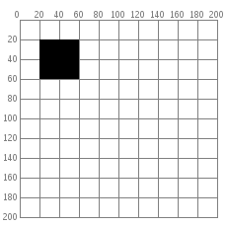
Manipulating the Coordinate Grid
We have always used the default coordinate grid:
(0,0) is the upper left corner
Increasing x-position moves towards the right
Increasing y-position moves towards the bottom
rect(20,20,40,40);

Slide 7
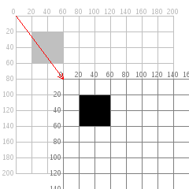
Manipulating the Coordinate Grid
translate(xShift,yShift) moves the origin
(0,0) now refers to the pixel (xShift,yShift) on the drawing canvas
Can use negative coordinates
translate(60,80);
rect(20,20,40,40);

Slide 8
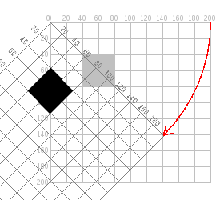
Manipulating the Coordinate Grid
rotate(angle) rotates the grid clockwise around the origin
Increasing x-position now moves at angle from horizontal
Increasing y-position now moves at angle from vertical
rotate(radians(45));
rect(40,40,40,40);

Slide 9
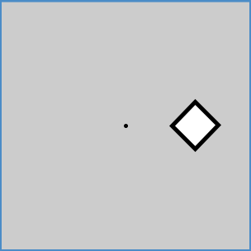
Peer Instruction Question
Which combination of commands, when followed by rect(20,20,20,20) produces the picture shown below?
Vote at http://PollEv.com/justinh
rotate(radians(45)); translate(width/2,height/2);
translate(width/2,height/2); rotate(radians(45));
rotate(radians(-45)); translate(width/2,height/2);
translate(width/2,height/2); rotate(radians(-45));
We’re lost…

Slide 10
Outline
Processing: translate() and rotate()
Recursion
Solving Problems Using Recursion
Variable Scope Revisited

Slide 11
Recursion
Recursion is an algorithmic technique where a function, in order to accomplish a task, calls itself with some part of the task
A function is recursive if the body of the function calls the function itself
We’ve seen this before!
Lightbot recursion
add(x,y) function from “Beauty in Computer Science”
Algorithm for Selection Sort

Slide 12
Building Blocks of Algorithms
Sequencing
The application/execution of each step of an algorithm in the order given
Iteration
Repeat part of algorithm a specified number of times
Selection
Use of conditional to select which instruction to execute next
Recursion
Algorithm calls itself to help solve the problem on smaller parts
fill(255);
rectMode(CORNERS);
rect(-r, -r, 0, r);
ellipse(0, -r/2, r, r);
if(mousePressed) {
fill(0,0,255);
}
for(int i=20; i<400; i=i+60) {
line(i,40,i+60,80);
}

Slide 13
Why Recurse?
In its most boring form, recursion is simply an alternative to iteration/looping
Anything you can do with iteration, you can do with recursion (an vice versa)
However, it is a profoundly powerful way of thinking!
Tremendously useful when the problem is self-similar
No more powerful than iteration, but often leads to more concise and “better” code

Slide 14
Examples of Recursion

Slide 15
Examples of Recursion

Slide 16
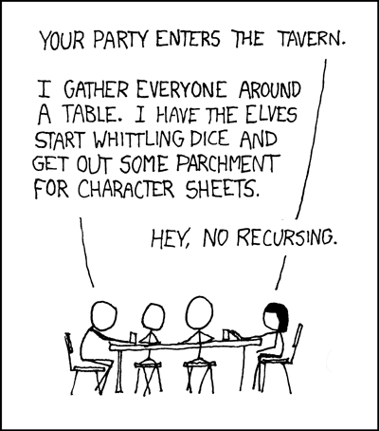
Examples of Recursion
https://xkcd.com/244/

Slide 17
Peer Instruction Question
What will happen when we try to run the following code in Processing?
Vote at: http://PollEv.com/justinh
It prints out 3, 2, 1, 0
It runs forever
Error occurs before execution
Error occurs during execution
We’re lost…
void draw() {
countdown(3);
noLoop();
}
void countdown(int n) {
println(n);
countdown(n-1);
}

Slide 18
Fixing the Countdown
Without using loops, how would you modify countdown() to stop at 0?
A conditional is needed to stop the infinite loop!
void countdown(int n) {
println(n);
countdown(n-1);
}
void countdown(int n) {
if(n<0) {
// do nothing
} else {
println(n);
countdown(n-1);
}
}

Slide 19
Outline
Processing: translate() and rotate()
Recursion
Solving Problems Using Recursion
Variable Scope Revisited

Slide 20
Recursive Solutions
Base case(s)
When the problem is simple enough to be solved directly
Needed to prevent infinite recursion
Recursive case(s)
Function calls itself one or more times on “smaller” problems
Divide the problem into one or more simpler/smaller parts
Invoke the function (recursively) on each part
Combine the solutions of the parts into a solution for the problem
Depending on the problem, any of these may be trivial or complex

Slide 21
Add
Divide: y is reduced by 1
Invoke: call to add(x+1,y-1)
Combine: none
Base: y==0 (nothing left to add)
int add(int x, int y) {
if(y==0) {
return x;
} else {
return add(x+1,y-1);
}
}

Slide 22
Add (alternate)
Divide: y is reduced by 1
Invoke: call to add(x,y-1)
Combine: add 1 to result
Base: y==0 (nothing left to add)
int add(int x, int y) {
if(y==0) {
return x;
} else {
return 1 + add(x,y-1);
}
}

Slide 23
Selection Sort
Algorithm:
Find smallest number in an array and move that to the front
Repeat this entire procedure, but for the rest of the array
Divide: array “size” reduced by 1
Invoke: call selection sort on smaller array
Combine: smallest number in front of sorted array
Base: array of size 1
To selection sort this: | 7 | 3 | 1 | 8 | 4
Move 1 to the front: | 1 | 3 | 7 | 8 | 4
Then selection sort this: | 1 | 3 | 7 | 8 | 4

Slide 24
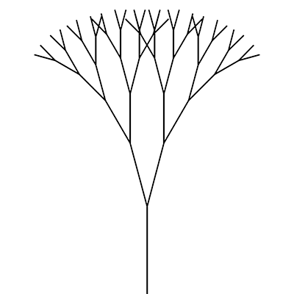
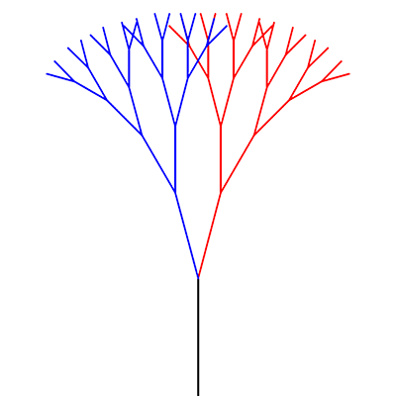
Drawing a Recursive Tree
Divide: draw smaller tree (fewer levels, shorter branches)
Invoke: draw tree as “right branch” and “left branch”
Combine: draw branch rotated from end of “trunk”
Base: “leaf branches” at end

Slide 25
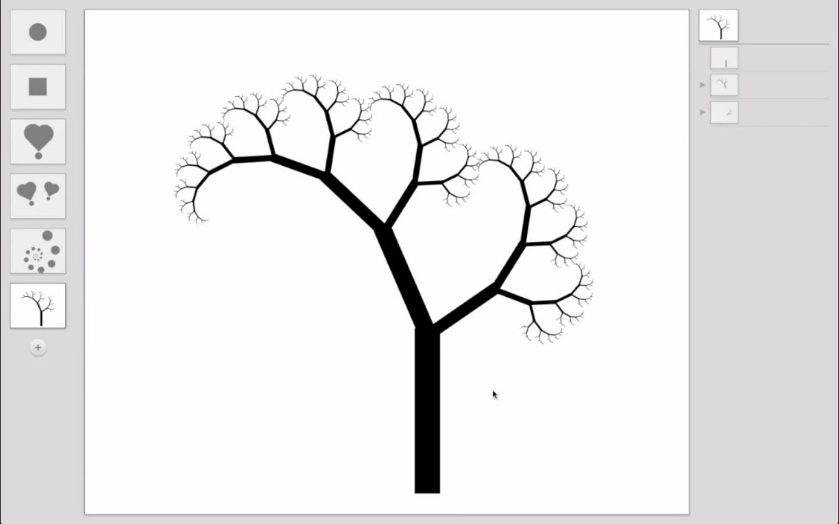
Recursive Drawing (video)
“Recursive Drawing is an exploration of user interface ideas towards the development of a spatially-oriented programming environment.”
Create drawings without any lines of code!
Created by Toby Schachman
http://recursivedrawing.com

Slide 26
Summary
A recursive function calls itself to solve a problem
Always have a base case and recursive case
Recursion adds no “power” to programming
Anything that can be done with iteration can be done with recursion and vice versa
But it makes some things much easier and more elegant
Particularly problems with “self-similarity”

