Slide 1
Computers CSE 120 Spring 2017
Instructor: Teaching Assistants:
Justin Hsia Anupam Gupta, Braydon Hall, Eugene Oh, Savanna Yee
Steve Jobs’ custom Apple I and other historic machines are on display at Seattle museum
In the earliest days of those early days, Steves Wozniak and Jobs made their first device together: the Apple I. Few of these were sold, and fewer still survive — but the Living Computers museum in Seattle managed to get three. And one of them was Jobs’ personal machine.
That’s the mission of the museum, though: the Apple I, along with dozens of other ancient computers… are deliberately there to be touched and, if not truly understood, at least experienced.
https://techcrunch.com/2017/04/17/steve-jobs-custom-apple-i-and- other-historic-machines-are-on-display-at-seattle-museum/

Slide 2
Administrivia
Assignments:
Creativity Assignment (4/24)
Reading Check 5 (4/27)
Midterm in class on Wednesday (4/26)
Bring 1 sheet of notes (2-sided, letter, handwritten)
Fill-in-the-blank(s), short answer questions, multiple choice
Questions 1-7 on readings and big ideas (drop 2 lowest scores) [10 pt]
Questions 8-10 on computational thinking (code: reading, writing, and debugging) [20 pt]
Time is not your friend
Short answers should be short
Skip questions and come back later

Slide 3
Living Computers Museum Report
Due Sunday, May 14
You have weeks 5-7 to complete
Required to visit the Living Computers Museum in SODO
2245 1st Avenue South, Seattle, WA 98134
Your admission has been paid for! (transportation is not)
Lots of hands-on exhibits involving old computers and modern gadgets and other big ideas from CSE120
We encourage you to visit in groups!
Worksheet to complete after visit
Involves some photos, a little bit of research, and some written responses

Slide 4
Outline
Student Work Showcase
Computer Components
Computer Instructions
Instruction Execution

Slide 5
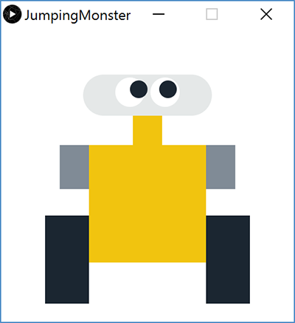
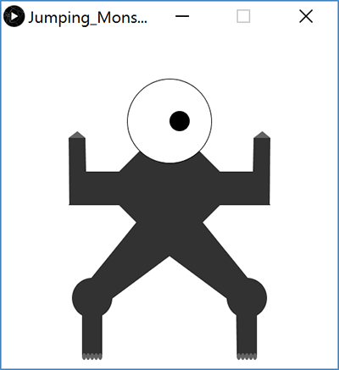
Jumping Monster
Aliakesi Zhuranko
Jack Cummings

Slide 6
Outline
Student Work Showcase
Computer Components
Computer Instructions
Instruction Execution

Slide 7
Computers are Complex
http://xkcd.com/676/
Notes:
This comic illustrates how complex computer systems are, and all the things that have to happen for a program to execute
By the end of this course, you’ll understand, mm, almost half of that, but it’s the good bits

Slide 8
Audience Responses
What are different computer components you’ve heard of?
Hard drive
RAM (memory)
CPU (processor)
Monitor
Graphics Card
Motherboard
Keyboard
Mouse
Speakers
Etc…

Slide 9
Five Components of a Computer
Control
Datapath
Memory
Input
Output
Computer
Processor
Memory
Devices
Control
Input
Datapath
Output

Slide 10
Input
Devices that send information to the computer
Examples we’ve seen:
Mouse
Keyboard
Ethernet cable/wireless card
Other examples:
Microphone
External sensors
Disk (read)

Slide 11
Output
Devices that the computer sends information to
Examples we’ve seen:
Monitor/graphics card
Ethernet cable/wireless card
Other examples:
Speakers
Printers
Disk (write)

Slide 12
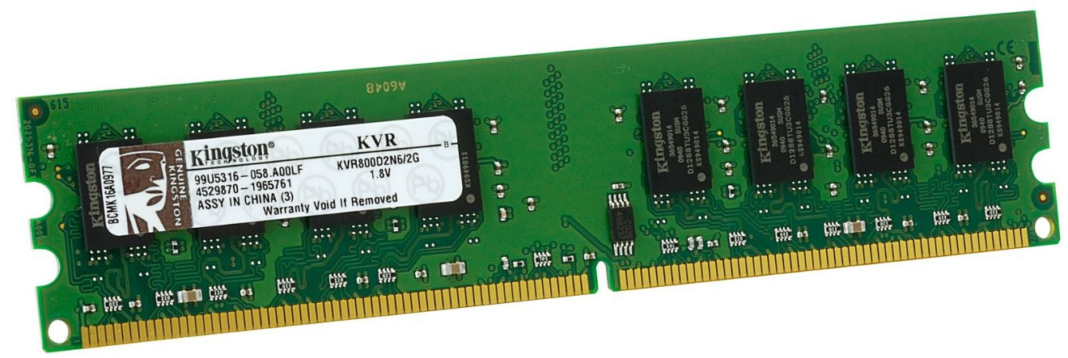
Memory
Place for temporary data storage
Typically random access memory (RAM)
Data is lost when the computer loses power!
Permanent storage goes to disk
Needed by programs as they run
Running out of available memory is typically what causes your computer to slow down

Slide 13
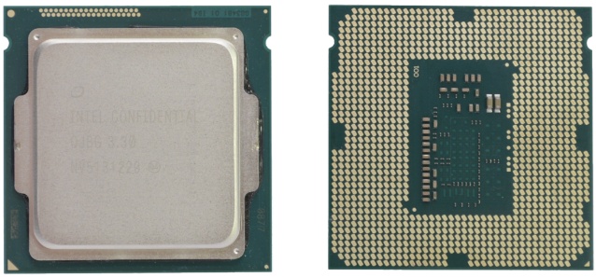
Central Processing Unit (CPU)
The “brain” of the computer – the circuitry that carries out the instructions
Datapath – all of the hardware components needed to handle all possible instructions
Control – the routing (decision-making) that determines correct instruction execution
Confusingly, modern CPUs contain multiple processors that can each run multiple processes simultaneously
More on this in a later lecture

Slide 14
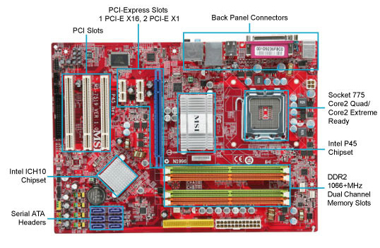
Computer Internals: Physical View
USB, etc.
Bus connections
CPU
(empty slot)
I/O
controller
Memory
Storage connections
Notes:
CPU
Looks funny because of heat sink

Slide 15
The Operating System
Everything mentioned up to this point was hardware
The piece of software that ties everything together and coordinates between hardware and software is the operating system (OS)
It’s a program, just like everything else, but more important
The OS has special privileges
The OS is heavily responsible for the security of your computer (programs and data)

Slide 16
Outline
Student Work Showcase
Computer Components
Computer Instructions
Instruction Execution

Slide 17
What Does an Instruction Look Like?
Just like all other data on a computer, instructions are also just binary data!
Example: 0x4801FE tells my computer to add one number to another
Similar to x = x + y;
An executable (program) contains the binary encoding of all of its instructions and data
Plus some other information
Hex view demo [see Panopto]
Notes:
vim: %!xxd

Slide 18
Limited Instructions
The number and type of instructions is always limited
The agent can only do certain pre-defined actions
In a computer, this is determined by the Instruction Set Architecture (ISA)
The CPU and other hardware is designed to execute only these instructions

Slide 19
Types of Instructions
Perform arithmetic operation in the CPU
c = a + b; z = x * y; i = h && g;
Control flow: what instruction to execute next
Normally whatever instruction comes next in sequence
Jump to function calls
Possibly jump on conditional branches
Possibly jump for loops
Transfer data between the CPU and memory
Load data from memory into CPU
Store CPU data into memory

Slide 20
How Can We Get Away With This?
Most computation handled by CPU, but it can only hold a small amount of information at a time
For reasons of cost and speed
As needed, transfer data between CPU and Memory
As an added trick, treat all Input and Output “like memory”
CPU
Memory
Interconnection Bus
Disks
Net
USB
Etc.

Slide 21
Memory
We can think of memory as a single, massive array
Every memory entry is the same size (1 byte)
Every memory entry has an index (memory address) and a value (data)
If our computer instructions need to use data that is stored in memory, it can reference it by using the correct memory address
00•••0
FF•••F
Address (hex):
Value (hex):
A7 | 00 | 32 | 00 | 00 | FA | • • • | CE | 26 | F4 | DE | AD | 96
Memory

Slide 22
Where are the Instructions?
When a program is running, the instructions for that program are stored in memory
Faster to read instructions from memory than from executable file on disk
The CPU reads instructions for execution in the exact same way that it reads data from memory
Take advantage of existing hardware

Slide 23
Generating Instructions
Must learn how to specify complex tasks using just these simple actions
In reality, this is often done automatically for us:
Higher-Level Language Program (e.g. Processing)
temp = v[k];
v[k] = v[k+1];
v[k+1] = temp;
Compiler
lw $t0, 0($2)
lw $t1, 4($2)
sw $t1, 0($2)
sw $t0, 4($2)
Assembly Language Program (e.g. x86-64, MIPS)
Assembler
Machine Language Program (executable)
0000 1001 1100 0110 1010 1111 0101 1000
1010 1111 0101 1000 0000 1001 1100 0110
1100 0110 1010 1111 0101 1000 0000 1001
0101 1000 0000 1001 1100 0110 1010 1111

Slide 24
Outline
Student Work Showcase
Computer Components
Computer Instructions
Instruction Execution

Slide 25
Instruction Execution
The agent follows the instructions flawlessly and mindlessly
A computer will follow the instructions given by a program and should produce identical results if given identical inputs
The CPU knows where to find the next instruction using the program counter (PC)
PC contains the address of the next instruction in memory
PC gets updated after each instruction is executed, sometimes jumping around based on the program’s control flow

Slide 26
Fetch-Execute Cycle
The most basic operation of a computer is to continually perform the following cycle:
Fetch the next instruction (read from memory)
Execute the instruction based on its purpose and specified data
Furthermore, the Execution portion can be broken down into the following rough steps:
Instruction decode
Data fetch
Instruction computation
Store result
Machine: 0x4801FE
Assembly: add %rdi, %rsi

Slide 27
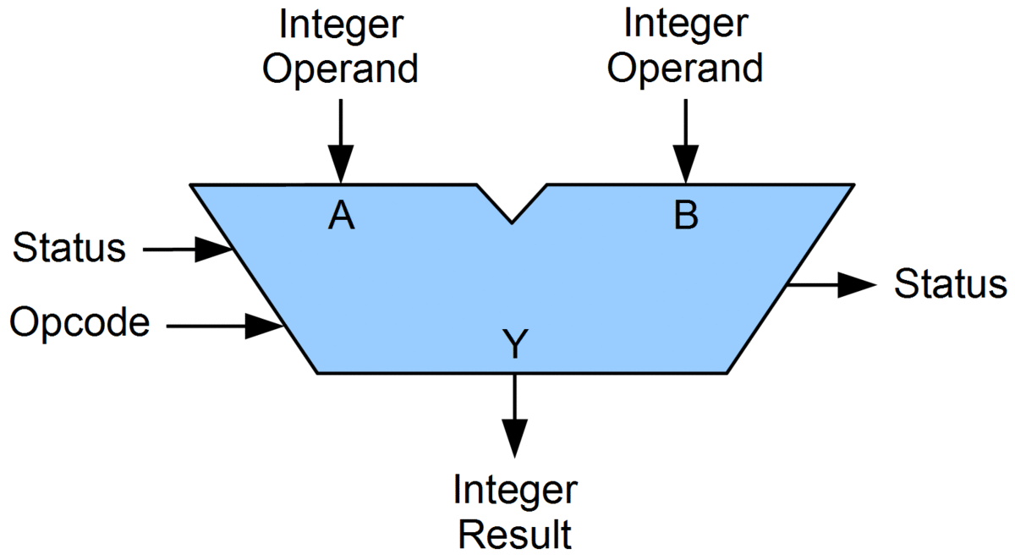
Arithmetic and Logic Unit (ALU)
A special logic block that is part of the CPU and performs the arithmetic operations
Performs the operations needed to cover all the instructions that the CPU can understand
Typically limited to two operands, which restricts the overall instruction set

Slide 28
Computer Components Revisited

Slide 29
Clock Rate
The rate at which your CPU can perform a Fetch-Execute cycle
Must make sure that clock speed is slow enough to accommodate the slowest instruction
Clock rate is usually given in Hertz (Hz = second⁻¹)
Example: 2 GHz = $2×{10}^{9} s^{−1}$ $↔$ one instruction every $5×{10}^{−10} s$ = $500 ps$
Clock rate is not a good indicator of speed
CPU must often wait for data from memory or I/O devices

Slide 30
Example: Running a Processing Program
The Processing environment compiles your code into machine language
Your Processing code gets converted into machine code (just 0’s and 1’s)
When you run the program, memory is allocated for the program’s instructions, variables, and data
Starting from the beginning (setup(), in this case), the computer will perform the Fetch-Execute cycle
Keeps going unless end of program is reached or an error is encountered before then

