Slide 1
Nested Loops & Arrays CSE 120 Spring 2017
Instructor: Teaching Assistants:
Justin Hsia Anupam Gupta, Braydon Hall, Eugene Oh, Savanna Yee
Yes, There’s Such Thing as a Professional Drone Racing Pilot
What do you get when you combine four powerful electric motors and a light carbon-fiber frame? You get instant speed. Drone Racing League's Racer 3 can get from zero to 80 mph in under a second.
These are the racing drones featured in The Drone Racing League. The races take place in huge physical spaces, like stadiums and abandoned shopping malls.
http://www.thedrive.com/aerial/9079/yes-theres-such-thing-as-professional-drone-racing-pilot

Slide 2
Administrivia
Assignments:
Creativity Planning due Tuesday (4/18)
Find a partner, come up with two proposed programs
Portfolio Update 1 due Tuesday (4/18)
Binary Practice (4/21)
Creativity Assignment (4/24)
Midterm in class on Wednesday, 4/26
1 sheet of notes (2-sided, letter, handwritten)
Fill-in-the-blank(s), short answer questions, maybe simple drawing

Slide 3
Outline
Student Work Showcase
For-Loop Review
Nested Loops
Arrays
Arrays and Loops

Slide 4
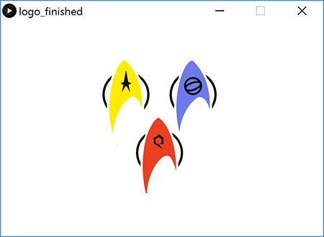
Custom Logo
Cadey Kwon

Slide 5
Lego Family
Sarah Liu

Slide 6
Outline
Student Work Showcase
For-Loop Review
Nested Loops
Arrays
Arrays and Loops

Slide 7
For-Loop Review
Loops control a sequence of repetitions
Do the same thing (or similar things) over and over again
Examples: What is changing?

Slide 8
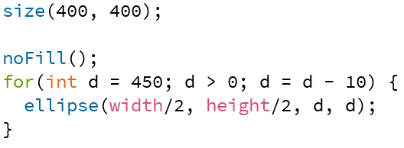
Example: Circle Loop

Slide 9
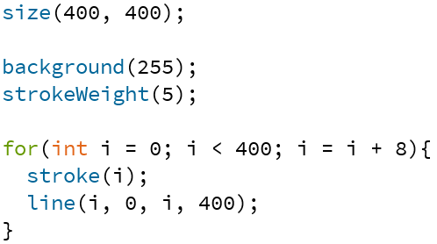
Example: Line Gradient

Slide 10
Example: Looping with User Interaction?
Draw lines from left side of screen to the horizontal position of the mouse

Slide 11
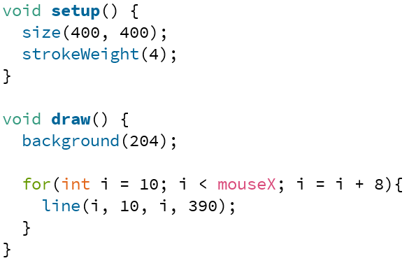
Example: Draw Lines to mouseX

Slide 12
Outline
Student Work Showcase
For-Loop Review
Nested Loops
Arrays
Arrays and Loops

Slide 13
Nested Loops
Generally a for-loop has a single loop variable that changes with each iteration
What if you need/want more things to change?
Can nest loops – i.e. put a loop inside of another loop

Slide 14
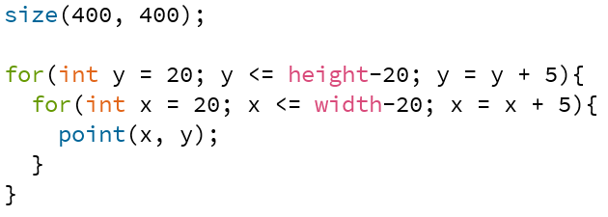
Example: Dot Grid

Slide 15
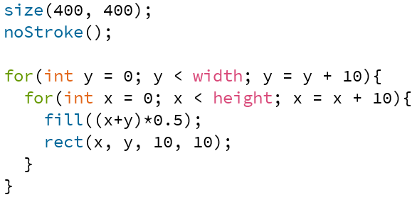
Example: 2D Gradient

Slide 16
Outline
Student Work Showcase
For-Loop Review
Nested Loops
Arrays
Arrays and Loops

Slide 17
Arrays
“Structures” that store many values of the same datatype
Help us group related data
Arrays store large amounts of data that you can access using a single variable name
Accessing arrays with loops is very convenient

Slide 18
Arrays
“Structures” that store many values of the same datatype
Element: a single value in the array
Index: a number that specifies the location of a particular element of the array
Start from 0
Length: total number of elements in the array
Example:
Index: | 0 | 1 | 2 | 3 | 4
Value: | 12 | 49 | -2 | 5 | 17
length of 5
“element 0”
“element 4”

Slide 19
Arrays in Processing
Declaration: type[] name
e.g. int[] is array of integers, color[] is array of colors
Creation: new type[num]
e.g. int[] intArr = new int[5];
Default value for all elements is “zero-equivalent” (0, 0.0, false, black)
Remember that actual indices are from 0 to num-1
Initialization: {elem0, elem1, …, elemN};
e.g. int[] intArr = {12, 49, -2, 5, 17};

Slide 20
Arrays in Processing
Use element: name[index]
In expression, uses value of that index of the array
In assignment, modifies value of that index of the array
Get length: name.length
Example:
int[] intArr = {12, 49, -2, 5, 17};
println(intArr[0]); // prints 12 to console
intArr[2] = intArr.length; // changes -2 to 5
Index: | 0 | 1 | 2 | 3 | 4
Value: | 12 | 49 | -2 | 5 | 17

Slide 21
Example: Lots of Plusses

Slide 22
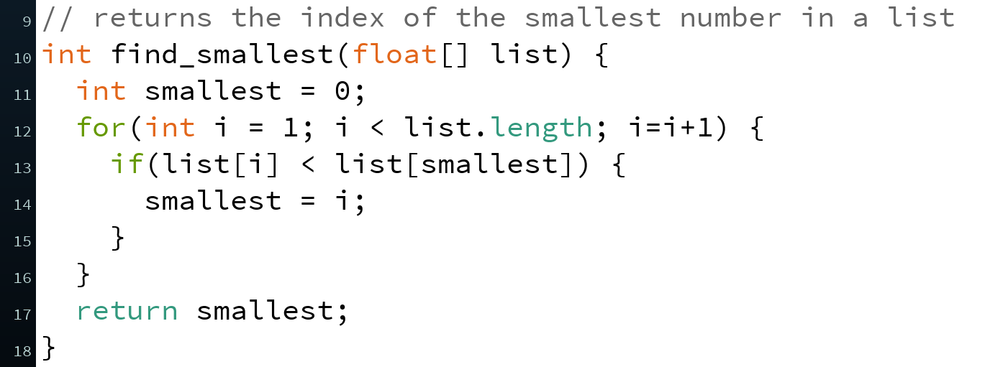
Example: Index of Smallest Number
Algorithm:
Keep track of the index of the smallest number seen so far
Start with index 0
Check each element 1-by-1; if number is smaller, then update the smallest index

