Slide 1
Expressions & Control Flow CSE 120 Spring 2017
Instructor: Teaching Assistants:
Justin Hsia Anupam Gupta, Braydon Hall, Eugene Oh, Savanna Yee
Uber said to use “sophisticated” software to defraud drivers, passengers
Uber has devised a "clever and sophisticated" scheme in which it manipulates navigation data used to determine "upfront" rider fare prices while secretly short-changing the driver, according to a proposed class-action lawsuit against the ride-hailing app.
When a rider uses Uber's app to hail a ride, the fare the app immediately shows to the passenger is based on a slower and longer route compared to the one displayed to the driver. The software displays a quicker, shorter route for the driver. But the rider pays the higher fee, and the driver's commission is paid from the cheaper, faster route, according to the lawsuit.
https://arstechnica.com/tech-policy/2017/04/uber-said-to-use- sophisticated-software-to-defraud-drivers-passengers/

Slide 2
Administrivia
Assignments:
Events due Tuesday (4/11)
Animal Functions due Wednesday (4/12)
Make sure to ask for help before deadlines
All assignments (except Reading Checks) due at 11:59pm
If posting code, make the post private; see Piazza Usage Guidelines
Check rubrics – incomplete assignments submitted on time still eligible for partial credit
“Big Ideas” this week: Algorithms

Slide 3
Outline
Expressions & Operators
Conditionals
if-statement
Loops
while-loop
for-loop

Slide 4
Expressions
“An expression is a combination of one or more values, constants, variables, operators, and functions that the programming language interprets and computes to produce another value.”
https://en.wikipedia.org/wiki/Expression_(computer_science)
Expressions are evaluated and resulting value is used
Assignment: x = x + 1;
Assignment: x_pos = min(x_pos + 3, 460);
Argument: ellipse(50+x, 50+y, 50, 50);
Argument: mouse(rowX+4*sp,rowY,rowC);

Slide 5
Operators
Built-in “functions” in Processing that use special symbols:
Multiplicative: * / %
Additive: + -
Relational: < > <= >=
Equality: == !=
Logical: && || !
Operators can only be used with certain data types and return certain data types
Multiplicative/Additive: give numbers, get number
Relational: give numbers, get Boolean
Logical: give Boolean, get Boolean
Equality: give same type, get Boolean

Slide 6
Operators
Built-in “functions” in Processing that use special symbols:
Multiplicative: * / %
Additive: + -
Relational: < > <= >=
Equality: == !=
Logical: && || !
In expressions, use parentheses for evaluation ordering and readability
e.g. x + (y * z) is the same as x + y * z, but easier to read

Slide 7
Modulus Operator: %
x % y is read as “x mod y” and returns the remainder after y divides x
For short, we say “mod” instead of modulus
Practice:
0 % 3 is ____
1 % 3 is ____
2 % 3 is ____
3 % 3 is ____
4 % 3 is ____
5 % 3 is ____
6 % 3 is ____

Slide 8
Modulus Operator: %
x % y is read as “x mod y” and returns the remainder after y divides x
For short, we say “mod” instead of modulus
Example Uses:
Parity: Number n is even if n%2 == 0
Leap Year: Year year is a leap year if year%4 == 0
Chinese Zodiac: year1 and year2 are the same animal if year1%12 == year2%12

Slide 9
Modulus Example in Processing
Use mod to “wrap around”
Replace min/max function to “connect” edges of drawing canvas
x_pos = min(x_pos + 3, 460);
x_pos = (x_pos + 3) % 460;

Slide 10
Control Flow
The order in which instructions are executed
We typically say that a program is executed in sequence from top to bottom, but that’s not always the case:
Function calls and return calls
Conditional/branching statements
Loops
Curly braces {} are used to group statements
Help parse control flow
Remember to use indentation!

Slide 11
Outline
Expressions & Operators
Conditionals
if-statement
Loops
while-loop
for-loop

Slide 12
If-Statements
Sometimes you don’t want to execute every instruction
Situationally-dependent
Conditionals give the programmer the ability to make decisions
The next instruction executed depends on a specified condition
The condition must evaluate to a boolean (i.e. true or false)
Sometimes referred to as “branching”
This generally lines up well with natural language intuition

Slide 13
If-Statements
Start
Basic form:
if(condition) {
// “then”
// statements
}
Example conditions:
Variable: if( done == true )
Variable: if( done )
Expression: if( x_pos > 460 )
Expression: if( x_pos > 100 && y_pos > 100 )
Condition?
False
True
“Then”
Statements
End

Slide 14
If-Statements
Start
With else clause:
if(condition) {
// “then”
// statements
} else {
// “otherwise”
// statements
}
Condition?
False
True
“Then”
Statements
“Otherwise”
Statements
End

Slide 15
If-Statements
Start
With else if clause:
if(cond1) {
// “then”
// statements
} else if(cond2) {
// “otherwise if”
// statements
}
Cond1?
False
Cond2?
False
True
True
“Then”
Statements
“Otherwise if”
Statements
End

Slide 16
If-Statements
Notice that conditionals always go from Start to End
Choose one of many branches
A conditional must have a single if, as many else if as desired, and at most one else
Can nest and combine in interesting ways:
if(cond1) {
if(cond2) {
// statement1
} else {
// statement2
}
}
if(cond1 && cond2) {
// statement1
} else if(cond1) { // statement2
}

Slide 17
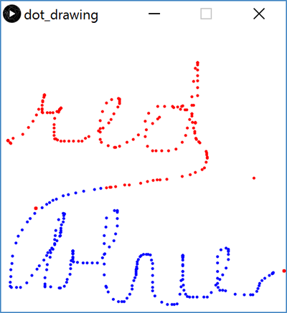
Processing Demo: Drawing Dots

Slide 18
Outline
Expressions & Operators
Conditionals
if-statement
Loops
while-loop
for-loop

Slide 19
Looping
Sometimes we want to do the same (or similar) things over and over again
Looping saves us time from writing out all of the instructions
Loops control a sequence of repetitions

Slide 20
While-Loop
Start
Basic form:
while(condition) {
// loop
// body
}
Repeat loop body until condition is false
Must make sure to update conditional variable(s) in loop body, otherwise you cause an infinite loop
draw() is basically a while(true) loop
Condition?
True
Loop Body
False
End

Slide 21
While-Loop
Start
More general form:
// init cond var(s)
while(condition) {
// loop body
// update var(s)
}
This occurs so commonly that we create a separate syntax for it!
Initialize Var(s)
Update Var(s)
Condition?
True
Loop Body
False
End

Slide 22
For-Loop
Start
for(init; cond; update){
// loop body
}
First runs init expression(s)
Then checks cond
If true, runs loop body followed by update statement(s)
Initialize Var(s)
Update Var(s)
Condition?
True
Loop Body
False
End

Slide 23
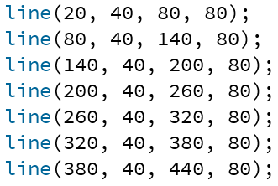
For-Loop Example
Without loop:
With loop:

Slide 24
Understanding the For-Loop
Choice of variable name(s) is not critical
Represent the value(s) that vary between different executions of the loop body
Think of as temporary variable(s)
Variable scope: variable i only exists within this loop
initialization

Slide 25
Understanding the For-Loop
Condition evaluated before the loop body and must evaluate to true or false
Reminder: > greater than < less than >= greater than or equal to >= less than or equal to == equal to != not equal to
condition

Slide 26
Understanding the For-Loop
Update is an assignment that is executed after the loop body
Loop body is enclosed by curly braces {} and should be indented for readability
update
loop body

Slide 27
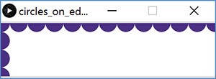
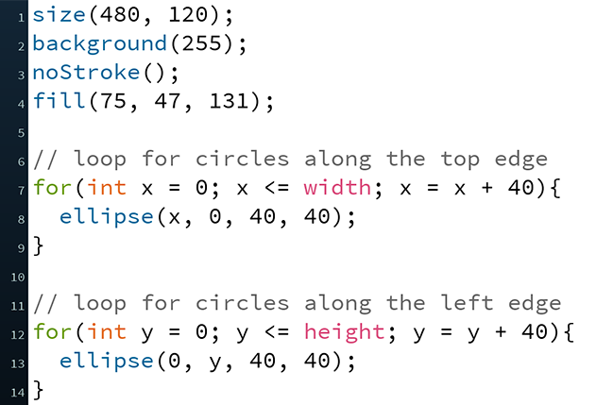
Processing Demo: Circles on Canvas Edge

