Slide 1
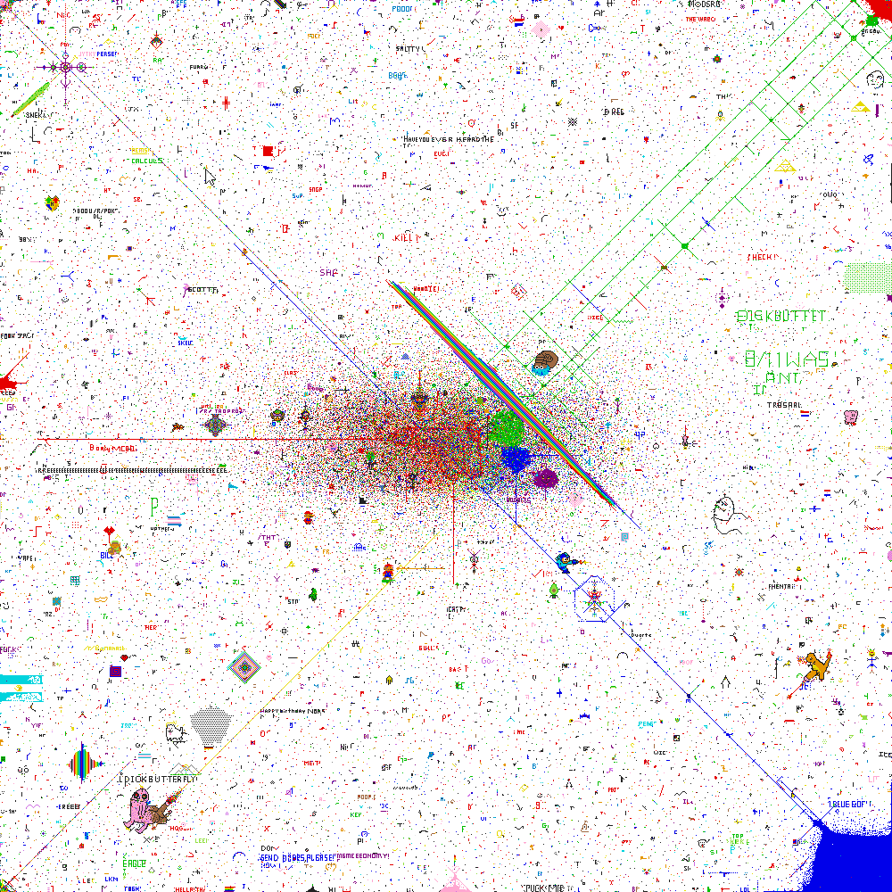
Functions in Processing CSE 120 Spring 2017
Instructor: Teaching Assistants:
Justin Hsia Anupam Gupta, Braydon Hall, Eugene Oh, Savanna Yee
When Pixels Collide
For April Fool's Day, Reddit launched a little experiment. It gave its users, who are all anonymous, a blank canvas called Place.
The rules were simple. Each user could choose one pixel from 16 colors to place anywhere on the canvas. They could place as many pixels of as many colors as they wanted, but they had to wait a few minutes between placing each one.
Over the following 72 hours, what emerged was nothing short of miraculous.
http://sudoscript.com/reddit-place/

Slide 2
Administrivia
Assignments:
Custom Logo due today (4/7)
Lego Family due Sunday (4/9)
Make sure to take advantage of office hours and Piazza!

Slide 3
Drawing a Square with Functions
[See Demo on Panopto]

Slide 4
Donatello as a Function
Notes:
What’s wrong with this code? What happens if we call donatello() twice?

Slide 5
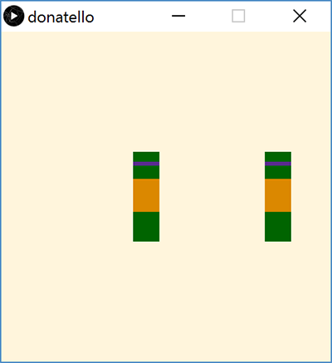
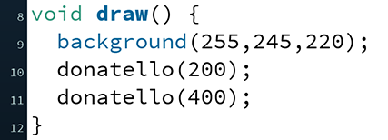
Donatello Function Parameterized
Can now call donatello() function with different x_pos

Slide 6
Return Type
What the function sends back to whoever called it
Can be any of the datatypes: int, float, color, etc.
If not returning anything, then we use void
return type

Slide 7
Function Name
Does not matter to computer, but does to humans
Should describe what the function does
Must start with a letter, but can contain numbers and underscores
Why not hyphen?
No two functions (or variables) can have the same name
function name

Slide 8
Parameters
Required part of every function definition
Must be surrounded by parentheses
If no parameters, parentheses are left empty
Datatype and name for every parameter must be specified
Separate parameters with commas
parameters

Slide 9
Function Body
body

Slide 10
Lightbot Functions
Lightbot functions had a different syntax, but similar parts:
F.turn_around() Right, Right.
function name
parameters
body
F.turn_around() Right, Right.

Slide 11
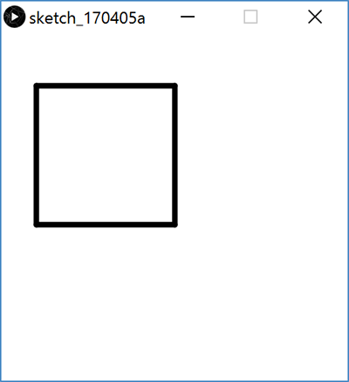
Parameters vs. Arguments
arguments
parameters

Slide 12
Parameters vs. Arguments
When you define a function, you specify the parameters
Use parameters for values that you want to be different on different calls to this function
When you call a function, you pass arguments
The order of the arguments must match the order of the parameters
We define a function once, but can call it as many times as we want!

Slide 13
Variable Scope
When an argument is passed to a function, what does the function actually get?
Internal variables (i.e. parameters) get a copy of the argument value
Internal variables only exist within the function they are declared
The variables “cease to exist” when the function finishes
“Scope” of a variable is the part(s) of code where that variable name binding is valid (i.e. where it exists)

Slide 14
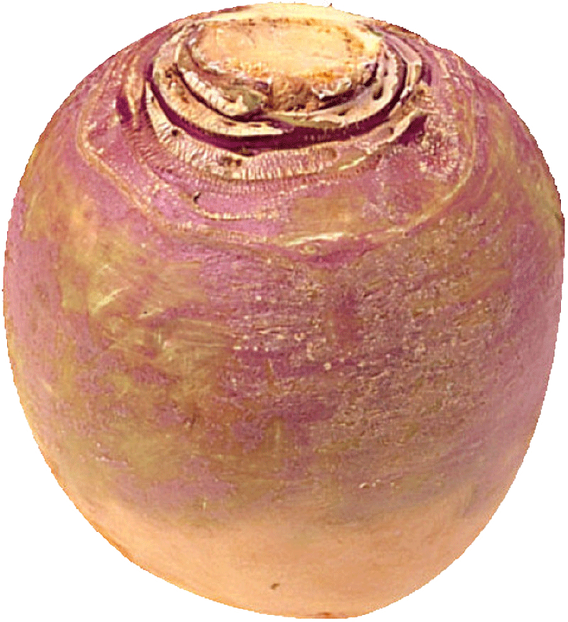
Question
If you’re dreaming and someone in your dream hands you a turnip, do you wake up with a turnip in your bed?
Yes
No
I will report back on Monday
Variable scope demo in Processing: [see Panopto]
Notes:
Demo: addOne(int val) function that adds one. Call from draw(), use noLoop(). Print onto drawing canvas using text().

Slide 15
Parameter Example

Slide 16
Parameter Example

Slide 17
Solving Problems
Understand the problem
What is the problem description?
What is specified and what is unspecified?
What has been given to you (e.g. starter code)?
Break the task down into less complex subtasks
Example: Make a function that draws a row of five mice with their ears touching/overlapping. The mice should all be the same color except for the middle one, which should be red.

Slide 18
Looking Forward
Lego Family
Design an abstracted family
Create functions for drawing each family member, including variables for position/movement
Have family members start at corners, then move into place
Events
Introduce user interactions! Due Tuesday (4/11)
Animal Functions
Start in lab on Tuesday, due Wednesday (4/12)
Design your own animal (like the mouse shown here)

