Slide 1
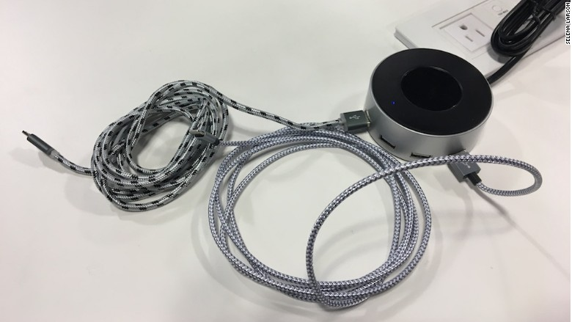
Variables & Datatypes CSE 120 Spring 2017
Instructor: Teaching Assistants:
Justin Hsia Anupam Gupta, Braydon Hall, Eugene Oh, Savanna Yee
Please stop charging your phone in public ports
"Just by plugging your phone into a [compromised] power strip or charger, your device is now infected, and that compromises all your data," Drew Paik of security firm Authentic8 explained.
Public charging stations and wi-fi access points are found in places like airports, planes, conference centers and parks, so people can always have access to their phones and data. But connecting your phone to an unknown port has its risks.
The cord you use to charge your phone is also used to send data from your phone to other devices. If a port is compromised, there's no limit to what information a hacker could take, Paik explained.
http://money.cnn.com/2017/02/15/technology/public-ports-charging-bad-stop/

Slide 2
Administrivia
Assignments:
Taijitu due today (4/5)
Reading Check 2 due tomorrow (4/6)
Custom Logo due Friday (4/7)
Assignment rubrics on Canvas
No “big ideas” lecture this week
More time on programming

Slide 3
Lab: Custom Logo

Slide 4
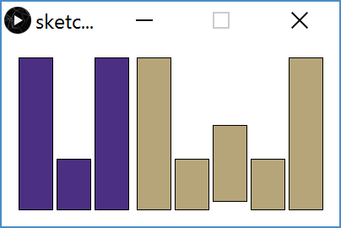
Lab: Custom Logo

Slide 5
Drawing a Square
[See Demo on Panopto]

Slide 6
Variables
Piece of your program that holds the value of something
Every variable must be given a name and a datatype
The values of these variables can change (i.e. vary) during the execution of your program
Warning: Not like a variable in Algebra (i.e. an unknown)
Assignment: give a variable a specific value
e.g. x = 12;
Read: use the current value of a variable
e.g. y = x + 1;

Slide 7
Datatypes
int: integers
float: decimal/real numbers
color: a triple of numbers representing RGB
boolean: true or false
Many more exist and can be found in the Processing Reference:

Slide 8
Declarations
We declare a variable by telling Processing the variable’s datatype, followed by the variable’s name:
You can also give a variable a starting value (initialization) in the same line as the declaration:

Slide 9
Drawing a Square with Variables
[See Demo on Panopto]

Slide 10
Variable Rules & Guidelines
Variables are case-sensitive
e.g. leftside is not the same as leftSide
Variable names are meaningless to computers, but meaningful to humans
Choosing informative names improves readability and reduces confusion
In this class, most of our variables will be declared and initialized at the very top of our programs

Slide 11
Variable Manipulation
Executed sequentially, just like other statements
For variable assignments, compute right-hand side first, then store result in variable
Example: int x = 4; x = x + 1;
Read the current value of x (4) for the right-hand side
Add 1 to the current value of x
Store the result (5) back into x

Slide 12
Variable Practice
int x = 1; int y = 2; int z = 3; x = x + 1; y = y - 1; z = z + 2;
int x = 7; int y = 2; int z = 0; x = x + 3; y = y – 2; z = x + y;
int x = -1; int y = 0; int z = 5; x = x + z; y = y – x; z = x + z;
x | y | z
x | y | z
x | y | z

Slide 13
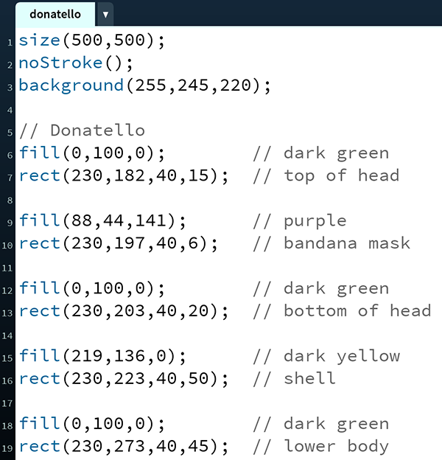
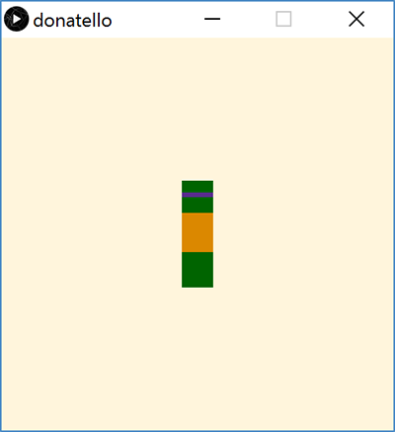
TMNT: Donatello

Slide 14
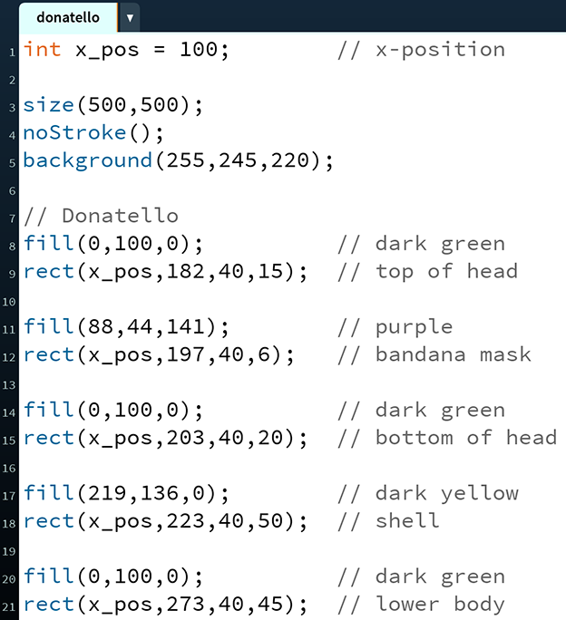
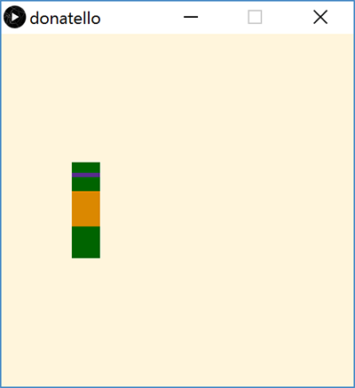
Donatello with a Variable

Slide 15
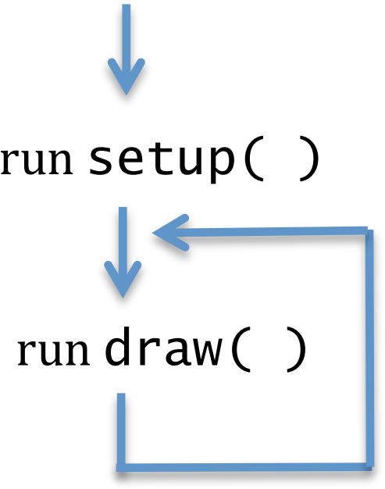
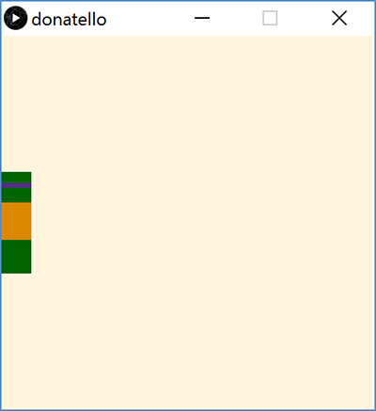
Donatello with Motion
Notes:
In setup(), set x_pos = 0;
In draw(), change x_pos: x_pos = x_pos + 1;

Slide 16
Stopping Motion
Stop Donatello from running off the right side of the screen:
x_pos = min(x_pos + 1, 460);
Stop Donatello from running off the left side of the screen:
x_pos = max(x_pos - 1, 0);

Slide 17
Falling Into Place
Introduce variables for each body segment:
Update each variable at different speeds:

Slide 18
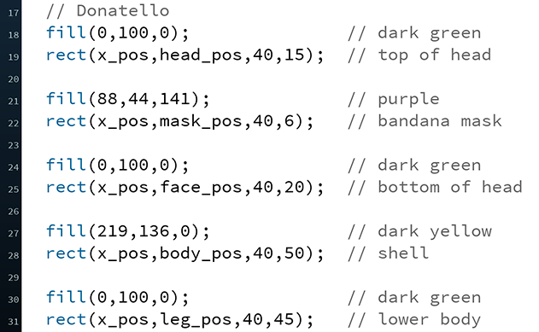
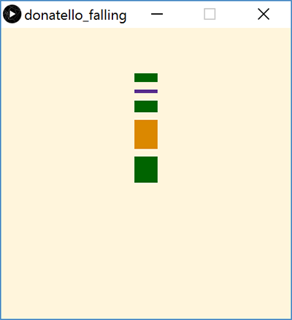
Falling Into Place
Update y-positions of drawing based on new variables:

Slide 19
Summary
Variables are named quantities that can vary during the execution of a program
Datatypes specific different forms of data
e.g. int, float, color, Boolean
Variable declarations specify a variable datatype and name to the program
Generally occurs at top of program
min() and max() functions can be used to limit or stop change in a variable value

