Slide 1
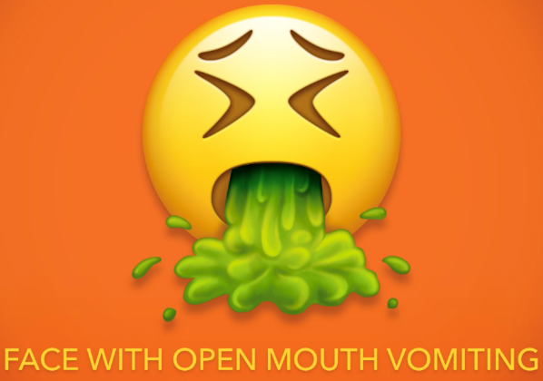
Processing Introduction CSE 120 Spring 2017
Instructor: Teaching Assistants:
Justin Hsia Anupam Gupta, Braydon Hall, Eugene Oh, Savanna Yee
69 New Emojis Announced, Including Breastfeeding Woman, Woman with Headscarf, and Steak
The newest emoji update may be the most inclusive yet, featuring a woman wearing a head covering, a breastfeeding woman, and also both steak and broccoli. These are just a few of the 69 individual symbols with varying skin tone and gender offered in shadowy technology organization the Unicode Consortium's 10th update, which includes Emoji 5.0.
There will also be dinosaurs, dumplings, cussing, and hedgehogs. Oh, and this barfing emoji:
https://creators.vice.com/en_us/article/69-new-emojis- breastfeeding-woman-headscarf-steak

Slide 2
Administrivia
Assignments:
Lightbot Functions due today (4/3)
Building a Robot due tomorrow (4/4)
Taijitu due Wednesday (4/5)
No “big ideas” lecture this week
More time on programming

Slide 3
Processing
Our programming language for this course
Text-based language that is good for visuals and interaction
Try to focus on ideas and techniques, not the specific commands
No language is perfect – Processing has its fair share of quirks and deficiencies ☹
It is both a programming environment (where you type) and a programming language
You are writing Java code, but they have made a lot of things easier

Slide 4
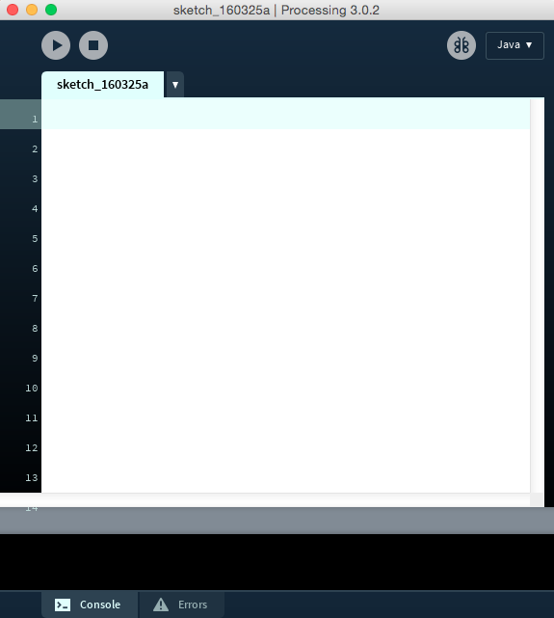
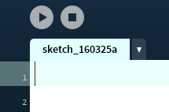
What You See

Slide 5
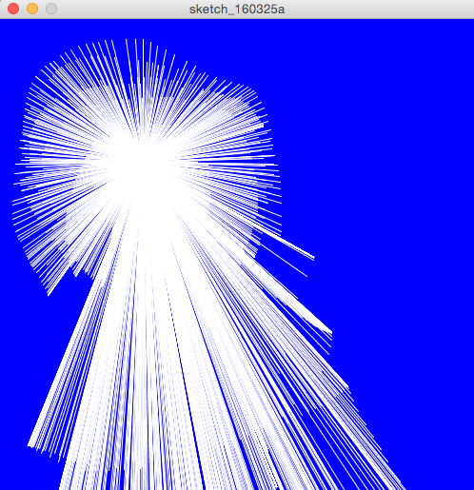
Interactive Line Drawing

Slide 6
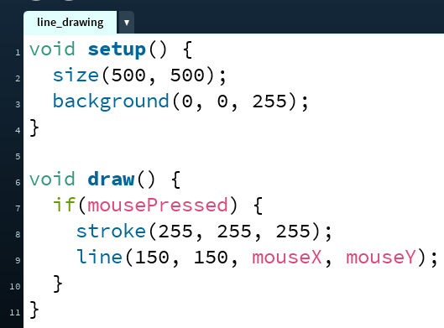
Line Drawing Code
semi-colon indicates end
of statement
case-sensitive
mouseX ≠ mousex
Other helpful environment features:
Parentheses matching
Error messages
There is color coding

Slide 7
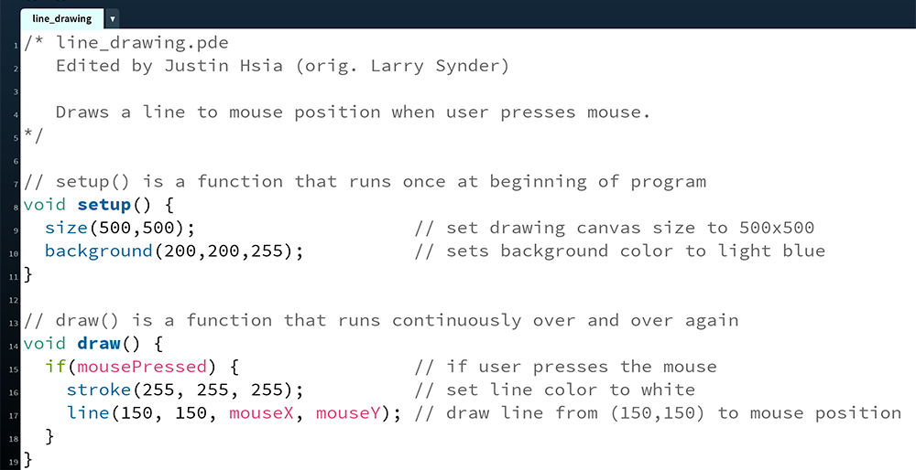
Comments Are Critical!!!

Slide 8
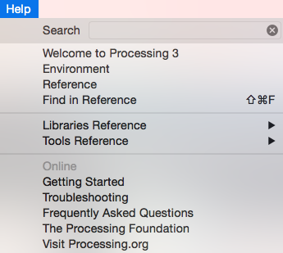
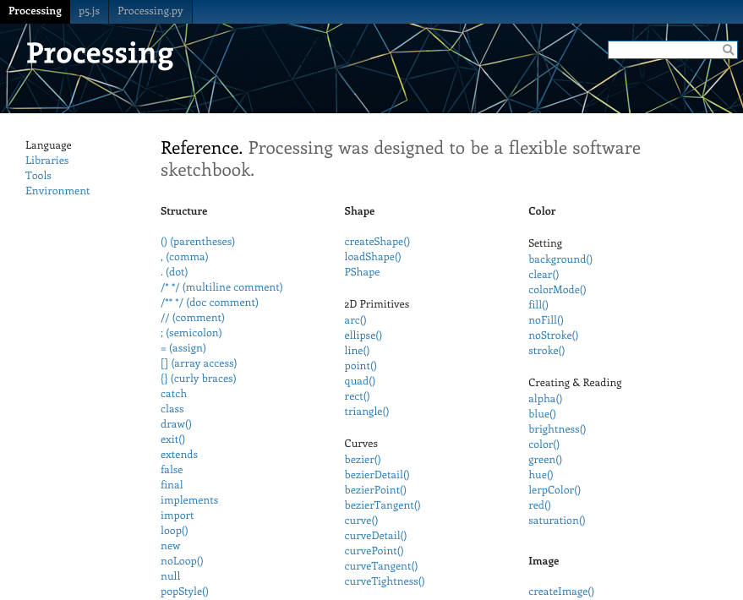
The Processing Reference

Slide 9
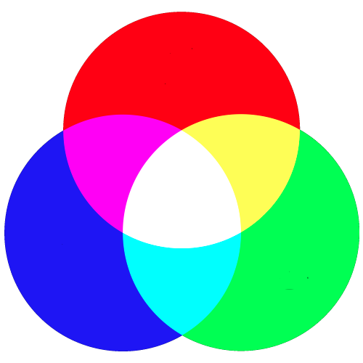
Understanding Color
In electronic systems, color specified using the RGB color model
Red, Green, Blue
Each pixel on your screen is made up of 3 tiny lights, one red, one green, one blue
Specify the intensity of each light using an integer between 0 and 255
0 is completely off
255 is highest intensity

Slide 10
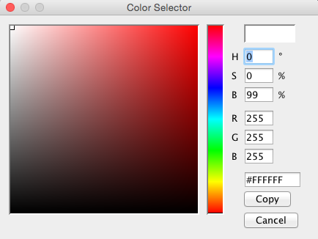
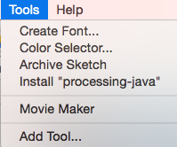
Processing’s Color Selector

Slide 11
Guess the Color
color( R, G, B);
color(255, 0, 0);
color( 0, 255, 0);
color( 0, 0, 255);
color( 0, 0, 0);
color(255, 255, 255);
color(255, 255, 0);
color(255, 0, 255);
color( 0, 255, 255);

Slide 12
Guess the Color
color( R, G, B);
color(255, 0, 0); // R fully on
color( 0, 255, 0); // G fully on
color( 0, 0, 255); // B fully on
color( 0, 0, 0); // all off
color(255, 255, 255); // all fully on
color(255, 255, 0); // R,G fully on
color(255, 0, 255); // R,B fully on
color( 0, 255, 255); // G,B fully on

Slide 13
Guess the Color
color( R, G, B);
color(255, 0, 0); // red
color( 0, 255, 0); // green
color( 0, 0, 255); // blue
color( 0, 0, 0); // black
color(255, 255, 255); // white
color(255, 255, 0); // yellow
color(255, 0, 255); // magenta
color( 0, 255, 255); // cyan

Slide 14
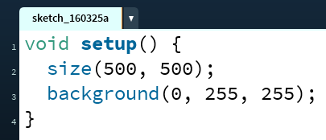
Color Functions
background(R, G, B);
Sets the background color of the drawing canvas

Slide 15
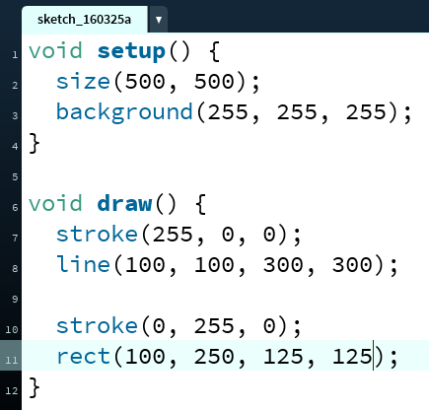
Color Functions
stroke(R, G, B);
Sets the color of the stroke of a line or line around a shape
Can change line size using strokeWeight(#);

Slide 16
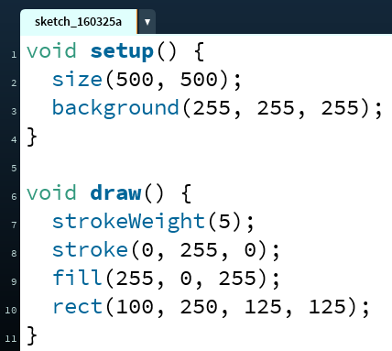
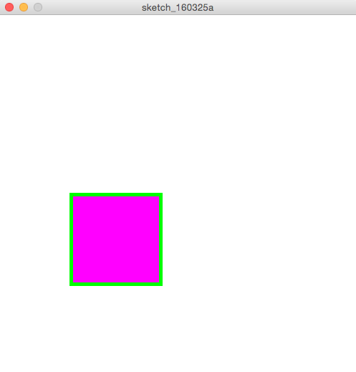
Color Functions
fill(R, G, B);
Sets the inside color of a shape (note: you cannot fill a line)

Slide 17
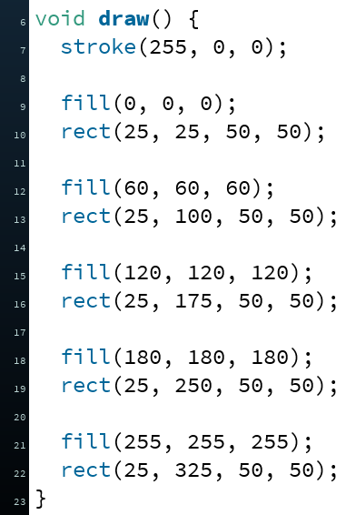
Color: “Grays"
When the values for RGB are all the same, then the color will be white, black, or some shade of gray

Slide 18
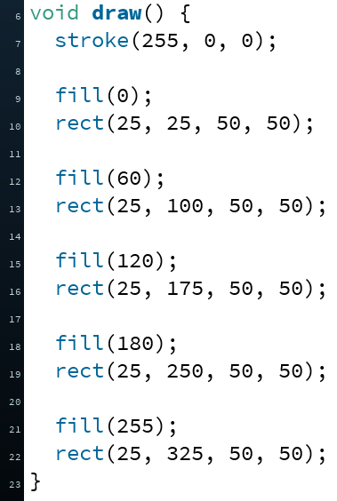
Color: “Grays"
When the values for RGB are all the same, then the color will be white, black, or some shade of gray
For brevity, can specify just a single number instead

Slide 19
The Color “State” of Your Program
Recall that programs are executed sequentially (i.e. instruction-by-instruction)
background(), stroke(), and fill() apply to all subsequent drawing statements
Until a later call overrides
Hidden color “state” that knows the current values of background(), stroke(), and fill()
In complex programs, can be difficult to keep track of
Early rule of thumb: always explicitly set colors before each drawing element

Slide 20
Assignment: Coloring a Robot

Slide 21
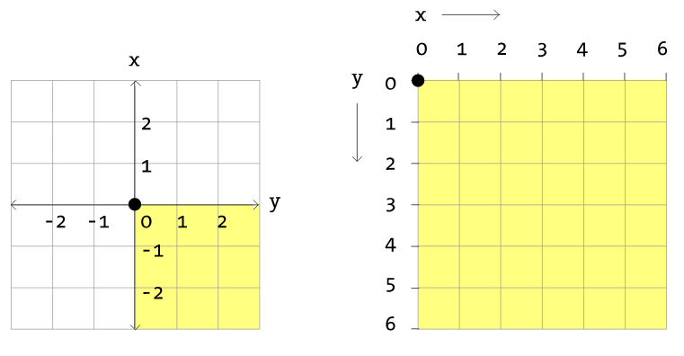
Coordinate System

Slide 22
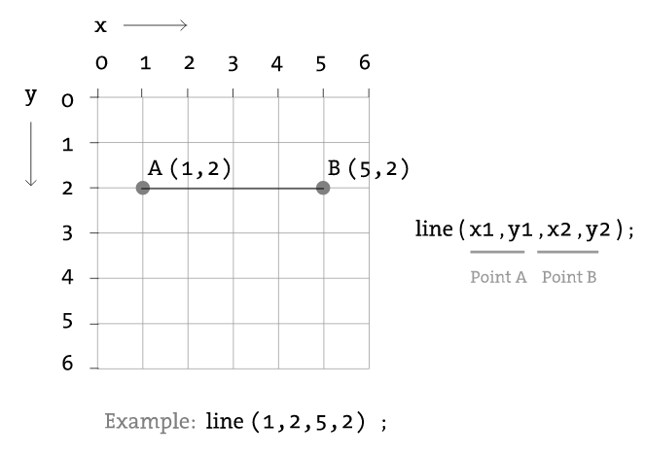
Drawing: Line

Slide 23
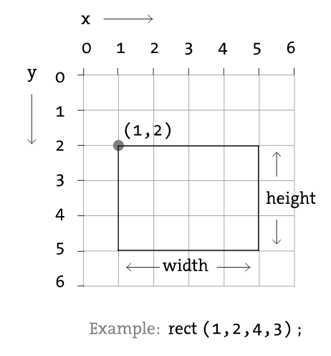
Drawing: Rectangle
Default mode is CORNER
Notes:
In CORNER: rect( x, y, width, height );

Slide 24
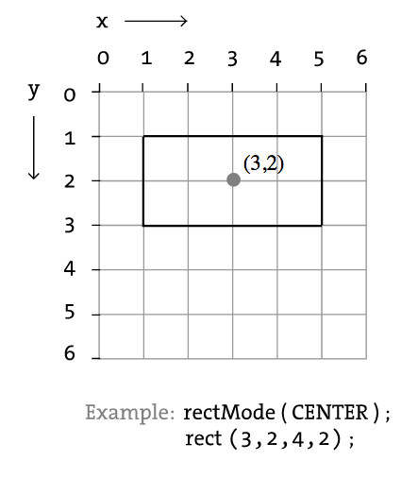
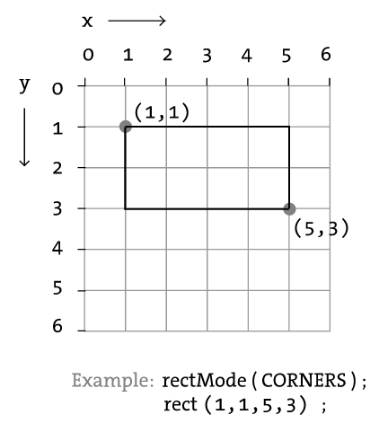
Drawing: Additional Rect Modes
CENTER
CORNERS
Notes:
In CENTER: rect( x, y, width, height );
In CORNERS: rect( x1, y1, x2, y2 );

Slide 25
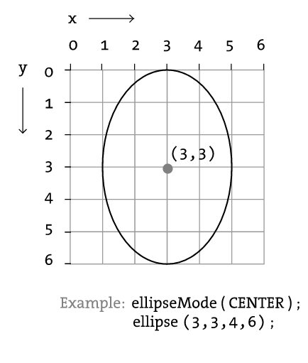
Drawing: Ellipse/Circle
Default mode is CENTER
Notes:
In CENTER: ellipse( x, y, width, height );

Slide 26
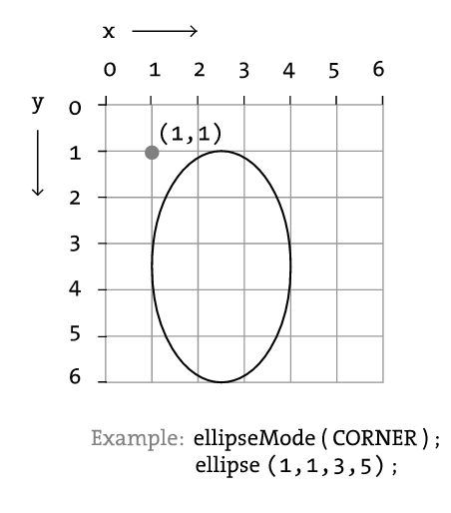
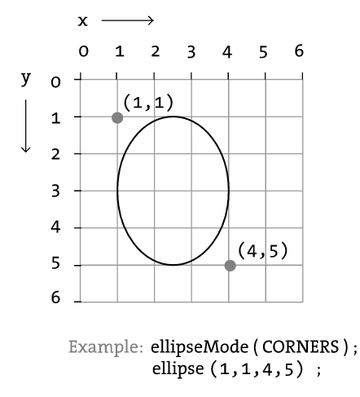
Drawing: Additional Ellipse Modes
CORNER
CORNERS
Notes:
In CORNER: ellipse( x, y, width, height );
In CORNERS: ellipse( x1, y1, x2, y2 );

Slide 27
Peer Instruction Question
Which of the following drawings corresponds to the Processing code below?
Vote at http://PollEv.com/justinh
strokeWeight(10);
stroke(75, 47, 131); // UW purple
fill(183, 165, 122); // UW gold
ellipse(100, 100, 100, 200); // CENTER mode
A. B. C. D.

Slide 28
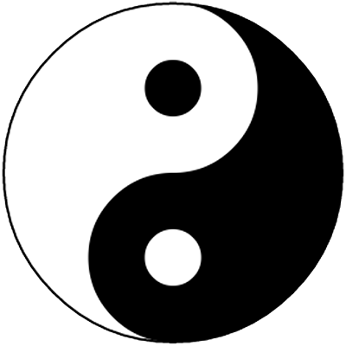
Lab: Taijitu
How do you build a complex drawing out of these simple shapes?

Slide 29
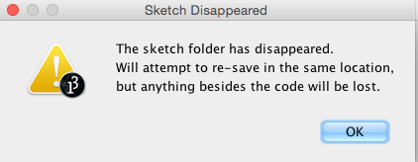
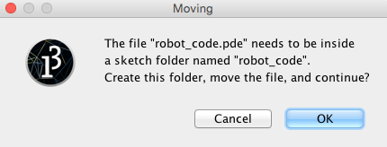
Aside: Processing Files
Processing files have extension .pde
File names cannot contain dashes (-)
To run a Processing file, it must be in a folder of the same name
If it’s not, then Processing will create the folder for you

