Slide 1
Lightbot and Functions CSE 120 Winter 2017
Instructor: Teaching Assistants:
Justin Hsia Anupam Gupta, Braydon Hall, Eugene Oh, Savanna Yee
As Congress Repeals Internet Privacy Rules, Putting Your Options In Perspective
Passed by the Federal Communications Commission in October, the rules never went into effect. If they had, it would have given consumers more control over how ISPs use the data they collect. Most notably, the rules would have required explicit consent from consumers if sensitive data – like financial or health information, or browsing history – were to be shared or sold.
These rules wouldn't have applied to the likes of Google or Facebook – massive data collectors and digital advertisers. But consumer groups argue… you could abandon those companies in favor of other websites, if you disagree with their policies; switching Internet providers is not so easy.
http://www.npr.org/sections/alltechconsidered/2017/03/28/521813464/as-congress-repeals-internet-privacy-rules-putting-your-options-in-perspective

Slide 2
Administrivia
Check-in
How is Exploring Lightbot going? (due tonight)
How is your portfolio setup going? (due Friday)
Sorry that we are not teaching you HTML/CSS
Any questions on course navigation?
Reading Check 1 is on Canvas and due in the 24 hours preceding your Thursday lab
20 minutes, short answer
Personal Values assignment due Sunday (4/2)

Slide 3
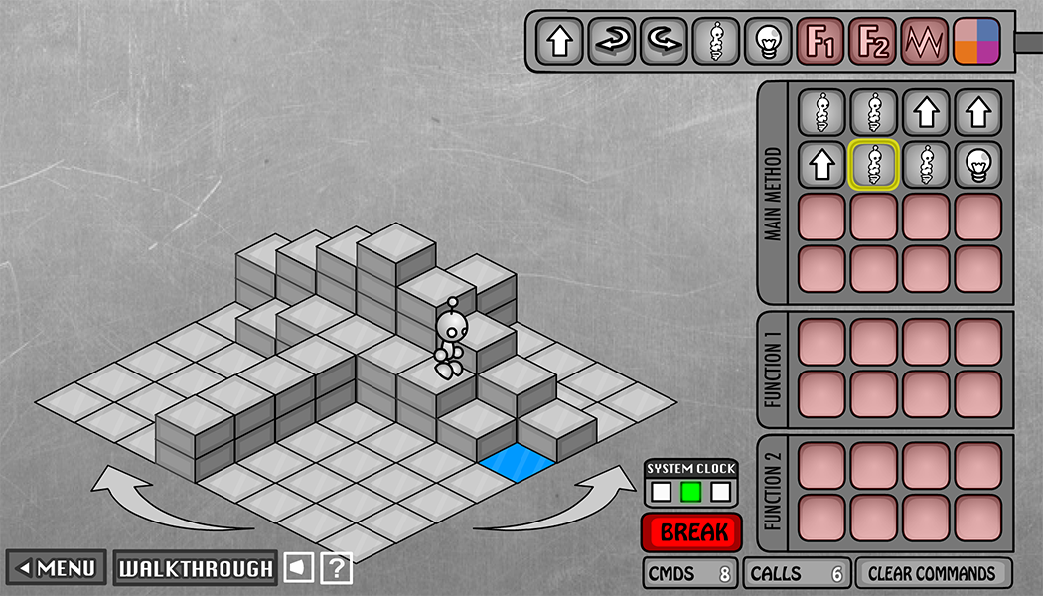
As Experienced Lightbot Players…
What are you doing in Lightbot?
Commanding a robot through a world of blocks and switches

Slide 4
As Experienced Lightbot Players…
What are you doing in Lightbot?
Commanding a robot through a world of blocks and switches
Programming is commanding an agent
In this case, the agent is a robot
The agent is usually a computer, but could be a person or other device

Slide 5
As Experienced Lightbot Players…
What are you doing in Lightbot?
Commanding a robot through a world of blocks and switches
Programming is commanding an agent
In this case, the agent is a robot
The agent is usually a computer, but could be a person or other device
Direct an agent to a goal by giving it instructions
The agent follows the instructions flawlessly and mindlessly
The trick is to find the right instructions to match your intent

Slide 6
Order of Instructions
Instructions are given in order (i.e. in a sequence)
The 1st instruction is completed, then the 2nd, then the 3rd, …
You issue the instructions and the agent follows them
When the agent is following your instructions, this is called executing the program, or running the program

Slide 7
Order of Events
The instructions are programmed ahead of time, and then executed later
The programmer cannot intervene until the program has finished executing or is terminated prematurely
The instructions must be correct in order for the agent to achieve its goal

Slide 8
Point of View
Programming requires you to take the agent’s point of view
Because it is a sequence of instructions, you must account for everything that happened before (i.e. trace the program)
There is usually an indication of where you are currently in the program (sometimes called a program counter)

Slide 9
Limited Instructions
The number and type of instructions is always limited
The agent can only do certain pre-defined actions
The agent can only execute one instruction at a time
Must learn how to specify complex tasks using just these simple actions

Slide 10
Limited Instructions
Limited instructions is a reality of all computing
A computer’s hardware/circuitry can only execute a small number of instructions – usually about 100
Many are just different versions of the same idea
Amazing Fact:
In theory, a computer with just SIX instruction types could compute all known computations!

Slide 11
Back in Reality
Programming would be amazingly tedious if you could only use the basic instructions
No one would be a programmer no matter how much it paid!
The amazing applications we see today would not exist
The early days of programming were like this
Tedious and error-prone
Notes:
Muscle/neuron firing analogy for standing up

Slide 12
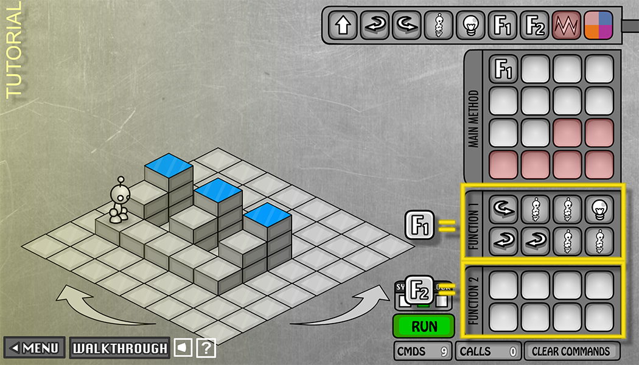
Solution: Functions!
Functions allow us to create new, more complex instructions for our agents
Below, F1 is a function to “process a riser”
We can call a function by name (F1) to execute its instructions

Slide 13
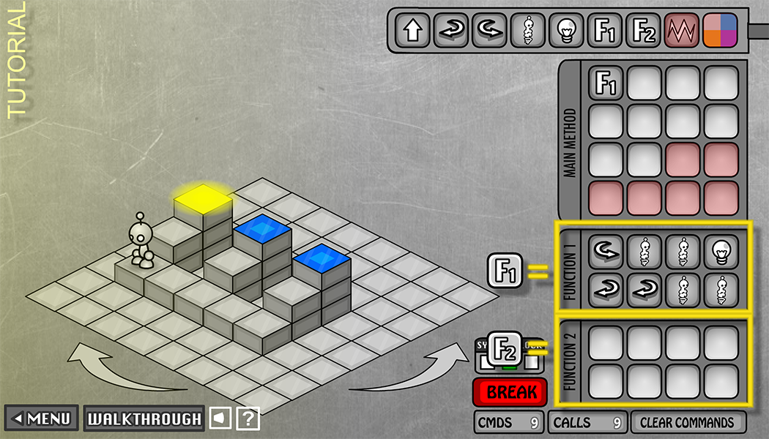
Choosing Functions
The goal is to break down a complex problem into smaller/simpler ones
Look for common patterns
“Process a riser” looks like a useful sub-problem because there are three of them [DEMO]
Notes:
Point 1: Abstraction
Point 2: Generalization

Slide 14
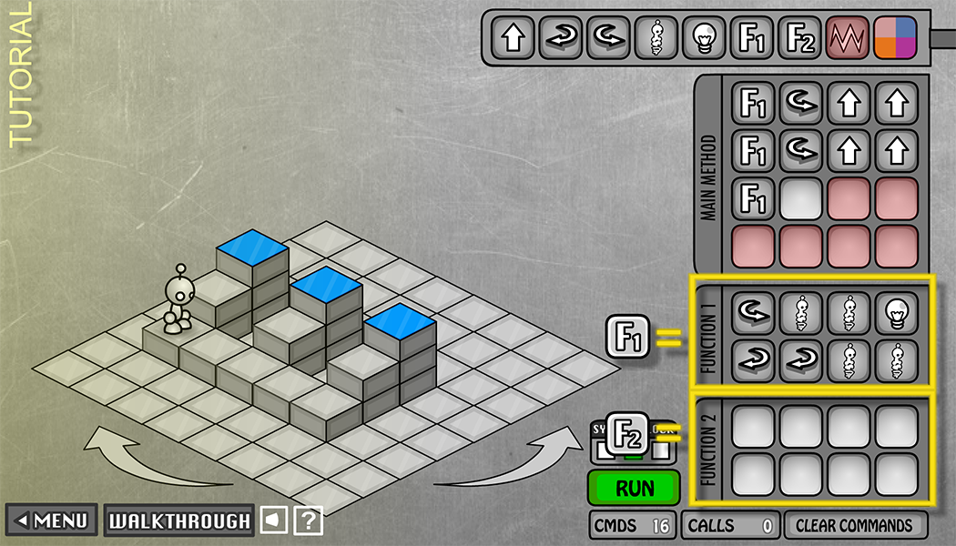
Choosing Functions
One possible solution is shown below:
17 commands, 29 calls

Slide 15
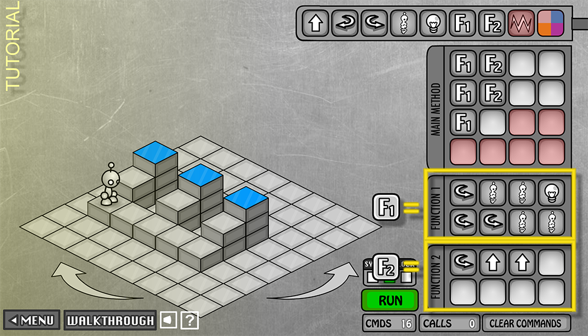
Choosing Functions
Modified solution is shown below:
Now F2 is a function to “move to next riser”
16 commands, 31 calls
Notes:
5 conceptual steps rather than 26 bare instructions

Slide 16
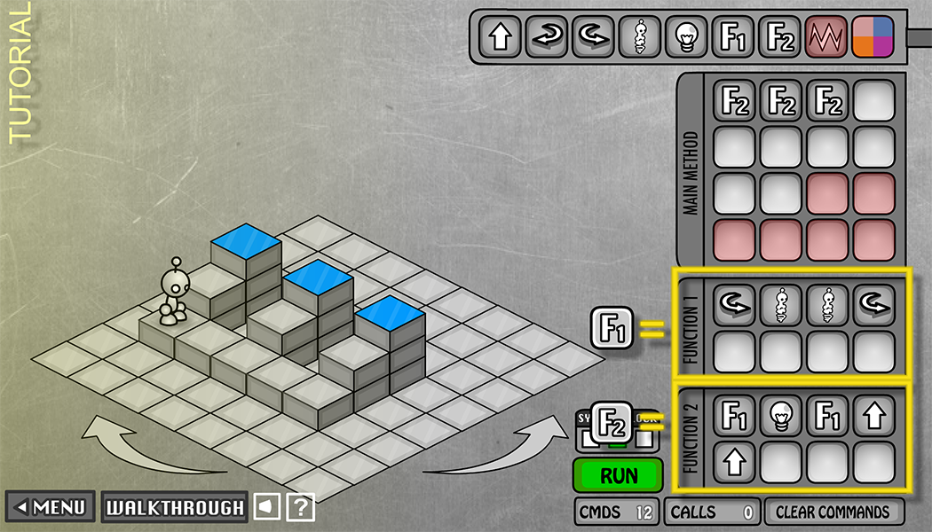
Choosing Functions
Yet another solution shown below:
F1 is “traverse steps”, F2 is “process riser and move to next”
12 commands, 35 calls
Notes:
3 repeated conceptual steps

Slide 17
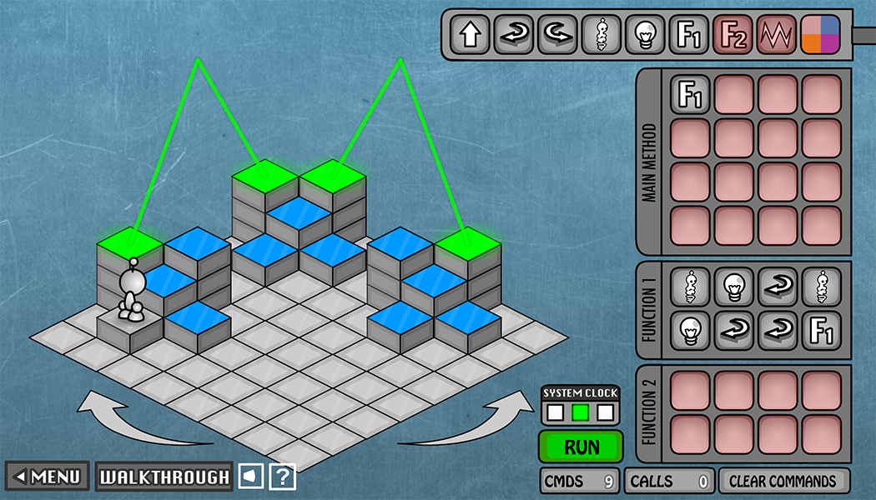
Recursion
Special case where a function calls itself
“Conceptual unit” might apply again, immediately
More about this later in the course

Slide 18
Peer Instruction Question
Which of the following statements is TRUE?
Vote at http://PollEv.com/justinh
An agent can learn new instructions
It is the agent’s fault if the goal is not achieved
All ways to decompose a problem into functions are equally good
None of the above
We’re lost…

Slide 19
Functions Summary
Functions may seem “obvious” to you, but they are a foundational idea of computer science
Abstraction in action!
Functional abstraction helps us solve problems:
Reduce complexity: identify and solve a coherent activity or action (sub-problem) that can be reused
Associate these sub-problems with intuitive names
Solve the whole problem by composing functions
There is no “correct” way to abstract!

Slide 20
Looking Forward
Continue to explore the concept of programming in the realm of Lightbot
Now symbolically – not restricted by computer or clicking
Symbolic Lightbot
Start in lab tomorrow, due Friday (3/31)
Use handwritten symbols for instructions
Lightbot Functions
Create functions using handwritten symbols
F.turnaround() R,R.

