Slide 1
Algorithmic Aspects of Parallel Query Processing
Paris Koutris – U. of Wisconsin
Semih Salihoglu – U. of Waterloo
Dan Suciu – U. of Washington

Slide 2
Motivation
Most modern data analytics tools process data on a cluster:
  Spark, Dremel, Redshift, Myria, Hive, Impala, Scope, Flink, etc
Reason: use sufficiently many nodes to avoid having to spill intermediate results to disk
Consequence: data is processed on clusters with x10-x1000 nodes
This tutorial: basic data processing
algorithms on a large cluster

Slide 3

Tutorial based on this survey
https://tinyurl.com/y99w99b4
Free until June 18
(create account)

Slide 4
Outline
Models of parallel computation (Dan)
Two-way joins (Paris)
Multi-way joins (Paris+Semih)
Sorting & Matrix multiplication (Paris+Semih)
Conclusion (Dan)

Slide 5
Models
Abstract model to analyze algorithms
Massively Parallel Communication (MPC)
(simplified BSP model [Valiant ’90])
  Cluster of nodes (=servers, =processors)
  Computation = several rounds
  Each round = processing + communication
Shared-nothing architecture

Slide 6
Massively Parallel Communication Model (MPC)
Input (size=IN)
Input data = size IN
O(IN/p)
O(IN/p)
Server 1
. . . .
Server p
Number of servers = p
Notes:
Say: in algorithms, L = maximum load. In lower bounds, L = average load

Slide 7
Massively Parallel Communication Model (MPC)
Input (size=IN)
Input data = size IN
O(IN/p)
O(IN/p)
Server 1
. . . .
Server p
Number of servers = p
One round = Compute & communicate
Notes:
Say: in algorithms, L = maximum load. In lower bounds, L = average load

Slide 8
Massively Parallel Communication Model (MPC)
Input (size=IN)
Input data = size IN
O(IN/p)
O(IN/p)
Server 1
. . . .
Server p
Number of servers = p
≤L
≤L
Round 1
One round = Compute & communicate
Server 1
. . . .
Server p
Notes:
Say: in algorithms, L = maximum load. In lower bounds, L = average load

Slide 9
Massively Parallel Communication Model (MPC)
Input (size=IN)
Input data = size IN
O(IN/p)
O(IN/p)
Server 1
. . . .
Server p
Number of servers = p
≤L
≤L
Round 1
One round = Compute & communicate
Server 1
. . . .
Server p
≤L
≤L
Round 2
Server 1
. . . .
Server p
Notes:
Say: in algorithms, L = maximum load. In lower bounds, L = average load

Slide 10
Massively Parallel Communication Model (MPC)
Input (size=IN)
Input data = size IN
O(IN/p)
O(IN/p)
Server 1
. . . .
Server p
Number of servers = p
≤L
≤L
Round 1
One round = Compute & communicate
Server 1
. . . .
Server p
≤L
≤L
Round 2
Server 1
. . . .
Server p
≤L
≤L
Round 3
. . . .
. . . .
Notes:
Say: in algorithms, L = maximum load. In lower bounds, L = average load

Slide 11
Massively Parallel Communication Model (MPC)
Input (size=IN)
Input data = size IN
O(IN/p)
O(IN/p)
Server 1
. . . .
Server p
Number of servers = p
≤L
≤L
Round 1
One round = Compute & communicate
Server 1
. . . .
Server p
≤L
≤L
Round 2
Algorithm = Several rounds
Server 1
. . . .
Server p
≤L
≤L
Round 3
. . . .
. . . .
Notes:
Say: in algorithms, L = maximum load. In lower bounds, L = average load

Slide 12
Massively Parallel Communication Model (MPC)
Input (size=IN)
Input data = size IN
O(IN/p)
O(IN/p)
Server 1
. . . .
Server p
Number of servers = p
≤L
≤L
Round 1
One round = Compute & communicate
Server 1
. . . .
Server p
≤L
≤L
Round 2
Algorithm = Several rounds
Server 1
. . . .
Server p
Max communication load / round / server = L
≤L
≤L
Round 3
. . . .
. . . .
Notes:
Say: in algorithms, L = maximum load. In lower bounds, L = average load

Slide 13
Massively Parallel Communication Model (MPC)
Input (size=IN)
Input data = size IN
O(IN/p)
O(IN/p)
Server 1
. . . .
Server p
Number of servers = p
≤L
≤L
Round 1
One round = Compute & communicate
Server 1
. . . .
Server p
≤L
≤L
Round 2
Algorithm = Several rounds
Server 1
. . . .
Server p
Max communication load / round / server = L
≤L
≤L
Round 3
. . . .
. . . .
Cost: | Ideal | Practical ε∈(0,1) | Naïve 1 | Naïve 2
Load L | L = IN/p | L = IN/p^{1-ε} | L = IN | L = IN/p
Rounds r | 1 | O(1) | 1 | p
Notes:
Say: in algorithms, L = maximum load. In lower bounds, L = average load

Slide 14
Massively Parallel Communication Model (MPC)
Input (size=IN)
Input data = size IN
O(IN/p)
O(IN/p)
Server 1
. . . .
Server p
Number of servers = p
≤L
≤L
Round 1
One round = Compute & communicate
Server 1
. . . .
Server p
≤L
≤L
Round 2
Algorithm = Several rounds
Server 1
. . . .
Server p
Max communication load / round / server = L
≤L
≤L
Round 3
. . . .
. . . .
Cost: | Ideal | Practical ε∈(0,1) | Naïve 1 | Naïve 2
Load L | L = IN/p | L = IN/p^{1-ε} | L = IN | L = IN/p
Rounds r | 1 | O(1) | 1 | p
Notes:
Say: in algorithms, L = maximum load. In lower bounds, L = average load

Slide 15
Massively Parallel Communication Model (MPC)
Input (size=IN)
Input data = size IN
O(IN/p)
O(IN/p)
Server 1
. . . .
Server p
Number of servers = p
≤L
≤L
Round 1
One round = Compute & communicate
Server 1
. . . .
Server p
≤L
≤L
Round 2
Algorithm = Several rounds
Server 1
. . . .
Server p
Max communication load / round / server = L
≤L
≤L
Round 3
. . . .
. . . .
Cost: | Ideal | Practical ε∈(0,1) | Naïve 1 | Naïve 2
Load L | L = IN/p | L = IN/p^{1-ε} | L = IN | L = IN/p
Rounds r | 1 | O(1) | 1 | p
Notes:
Say: in algorithms, L = maximum load. In lower bounds, L = average load

Slide 16
Massively Parallel Communication Model (MPC)
Input (size=IN)
Input data = size IN
O(IN/p)
O(IN/p)
Server 1
. . . .
Server p
Number of servers = p
≤L
≤L
Round 1
One round = Compute & communicate
Server 1
. . . .
Server p
≤L
≤L
Round 2
Algorithm = Several rounds
Server 1
. . . .
Server p
Max communication load / round / server = L
≤L
≤L
Round 3
. . . .
. . . .
Cost: | Ideal | Practical ε∈(0,1) | Naïve 1 | Naïve 2
Load L | L = IN/p | L = IN/p^{1-ε} | L = IN | L = IN/p
Rounds r | 1 | O(1) | 1 | p
Notes:
Say: in algorithms, L = maximum load. In lower bounds, L = average load

Slide 17
Massively Parallel Communication Model (MPC)
Input (size=IN)
Input data = size IN
O(IN/p)
O(IN/p)
Server 1
. . . .
Server p
Number of servers = p
≤L
≤L
Round 1
One round = Compute & communicate
Server 1
. . . .
Server p
≤L
≤L
Round 2
Algorithm = Several rounds
Server 1
. . . .
Server p
Max communication load / round / server = L
≤L
≤L
Round 3
. . . .
. . . .
Cost: | Ideal | Practical ε∈(0,1) | Naïve 1 | Naïve 2
Load L | L = IN/p | L = IN/p^{1-ε} | L = IN | L = IN/p
Rounds r | 1 | O(1) | 1 | p
Notes:
Say: in algorithms, L = maximum load. In lower bounds, L = average load

Slide 18
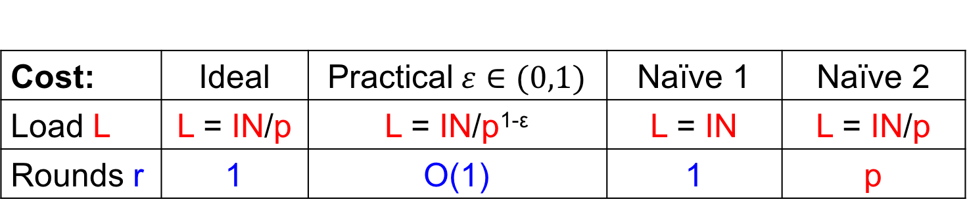
Massively Parallel Communication Model (MPC)
Input (size=IN)
Input data = size IN
O(IN/p)
O(IN/p)
Server 1
. . . .
Server p
Number of servers = p
≤L
≤L
Round 1
One round = Compute & communicate
Server 1
. . . .
Server p
≤L
≤L
Round 2
Algorithm = Several rounds
Server 1
. . . .
Server p
Max communication load / round / server = L
≤L
≤L
Round 3
. . . .
. . . .
Cost: | Ideal | Practical$ε∈(0,1)$ | Naïve 1 | Naïve 2
Load L | L = IN/p | L = IN/p^{1-ε} | L = IN | L = IN/p
Rounds r | 1 | O(1) | 1 | p
Notes:
Say: in algorithms, L = maximum load. In lower bounds, L = average load

Slide 19
Discussion: Traditional Models
Circuits ≈ oblivious MPC
  Circuit-size = p×r, Depth = r, Fan-in = L
PRAM: shared-memory, p processors
  Brent’s theorem: T_{p} = O(Circuit-size/p + Depth)
BSP [Valiant ’90]: shared-nothing
  detailed communication cost
  MPC removes those details

Slide 20
Summary of the Model
MPC
  shared nothing
  All-to-all communication
Two cost parameters:
  L (load) = max communication at each server
  r (number of rounds)

Slide 21
Outline
Models of parallel computation (Dan)
Two-way joins (Paris)
Multi-way joins (Paris+Semih)
Sorting & Matrix multiplication (Paris+Semih)
Conclusion (Dan)

Slide 22
2-way Joins
SELECT *
FROM R , S
WHERE R.y = S.y ;
Join(x,y,z) = R(x,y) ⋈ S(y,z)
We will see 2 types of techniques for a parallel join:
hash-based join
sort-based join

Slide 23
Parallel Hash Join
R
x | y
a | b
a | c
b | c
S
y | z
b | d
b | e
c | e
Join(x,y,z) = R(x,y) ⋈ S(y,z)
IN = |R| + |S|
p servers
Choose a hash function h that maps values from the domain to
one of the p servers
Round #1 communication: each server
  sends record R(x,y) to server h(y)
  sends record S(y,z) to server h(y)
Round #1 computation: each server
  computes the join R(x,y) ⋈ S(y,z) of the local instances
Notes:
say that the load is IN/p

Slide 24

A Simple Analysis w/o Skew
How far away is the maximum load L from
the expected load IN/p ?
Suppose that every value of y appears at most once in the database (no skew). Then:
In other words, for large enough input, with high probability we have load:
$$L = O(IN/p)$$

Slide 25
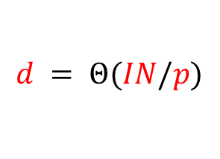
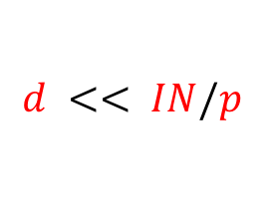

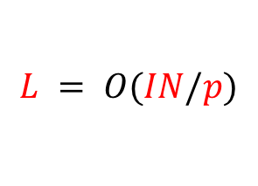
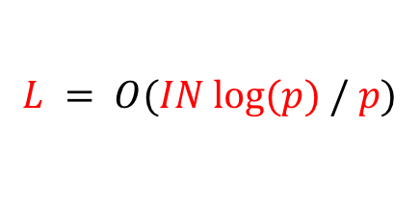
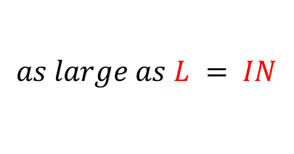
A Simple Analysis with Skew
Suppose now that every value of y appears exactly d times in the database. Then:
The exponent has now an additional factor d
$$d << IN/p$$
$$d = Θ(IN/p)$$
$$d >> IN/p$$
$$L = O(IN/p)$$
$$L = O(IN log⁡(p) / p)$$
$$as large as L = IN$$

Slide 26
The Effect of Skew
IN = 100 billion tuples
at most 30% over the expected load IN/p with probability 95%
p = 1,000
d = 10,000
As the number p of
servers grows, it is
more likely that we
observe the effects
of skew!
d
(in million)
p = 100
d = 4,000,000
p

Slide 27
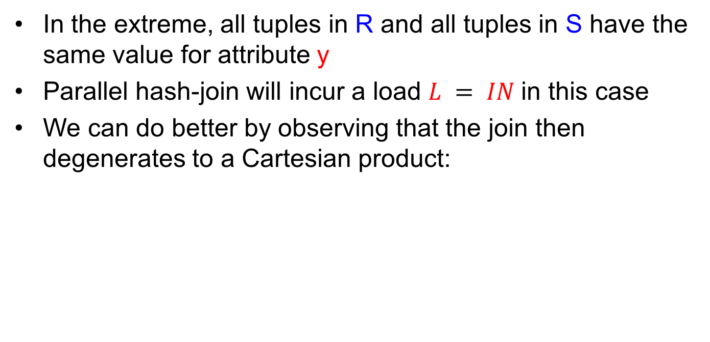
Skew in the Extreme
In the extreme, all tuples in R and all tuples in S have the same value for attribute y
Parallel hash-join will incur a load $L = IN$in this case
We can do better by observing that the join then degenerates to a Cartesian product:
SELECT *
FROM R , S ;
Product(x,z) = R(x) ⋈ S(z)

Slide 28
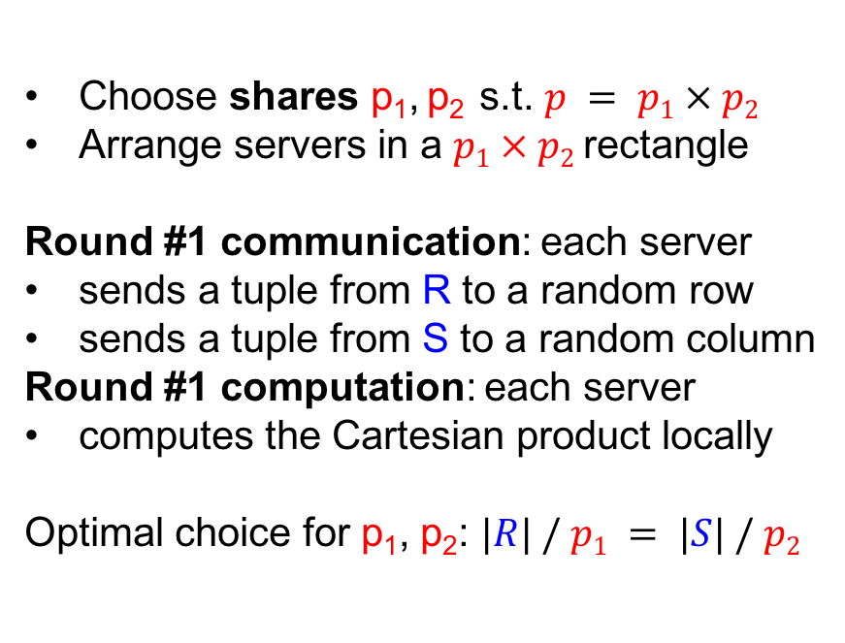
Cartesian Product
S(z) →
 | 1 | 2 |  |  |  |  |  | p₂
1
2
p₁
Product(x,z) = R(x) ⋈ S(z)
Choose shares p₁, p₂ s.t. $p = p1 × p2$
Arrange servers in a $p1 × p2$rectangle
Round #1 communication: each server
sends a tuple from R to a random row
sends a tuple from S to a random column
Round #1 computation: each server
computes the Cartesian product locally
Optimal choice for p₁, p₂: $|R| / p1 = |S| / p2$
R(x) →
OUT = |R| * |S|
The above 1-round algorithm is optimal for the load
When |R| << |S|, the algorithm broadcasts R and partitions only S

Slide 29
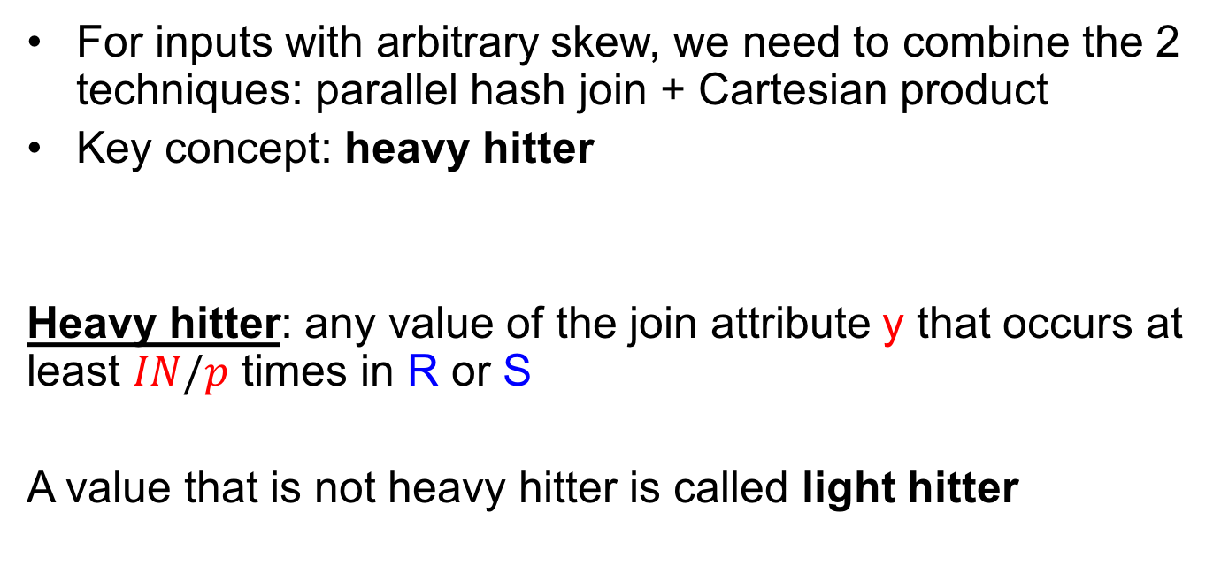
Parallel Join for Arbitrary Skew
For inputs with arbitrary skew, we need to combine the 2 techniques: parallel hash join + Cartesian product
Key concept: heavy hitter
Heavy hitter: any value of the join attribute y that occurs at least $IN/p$ times in R or S
A value that is not heavy hitter is called light hitter

Slide 30
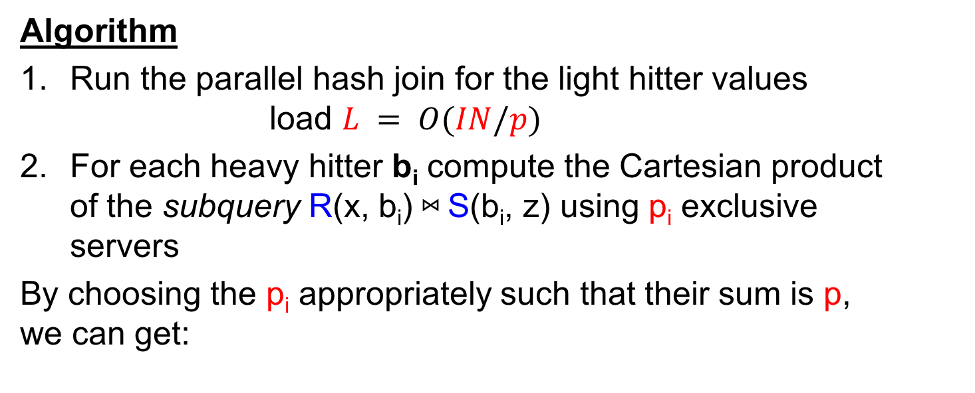
Parallel Join for Arbitrary Skew
Algorithm
Run the parallel hash join for the light hitter values load $L = O(IN/p)$
For each heavy hitter b_{i} compute the Cartesian product of the subquery R(x, b_{i}) ⋈ S(b_{i}, z) using p_{i} exclusive servers
By choosing the p_{i} appropriately such that their sum is p, we can get:

Slide 31
Parallel Sort Join
Algorithm [Hu et al. ‘17]
Union the two relations R,S
Parallel sort the result using the value of the join attribute as sort key
We distinguish two cases for a value of y:
  if all tuples with value b are in the same server, the join can be computed locally
  for values that cross multiple servers, we apply the Cartesian product algorithm
Notes:
TODO: Add a picture for parallel sort join.
Split the cost

Slide 32
2-way Joins in Practice
Parallel Hash Join [SparkSQL, Hive, Myria, Impala, …]
  most commonly used join algorithm
Broadcast Join [Hive, Impala, SparkSQL]
  if one relation is much smaller than the other relation, broadcast it to every server
Parallel Sort Join [SparkSQL]
Note: the choice of the local join algorithm is independent
of the parallel algorithm!

Slide 33
Outline
Models of parallel computation (Dan)
Two-way joins (Paris)
Multi-way joins (Paris+Semih)
Sorting & Matrix multiplication (Paris+Semih)
Conclusion (Dan)

Slide 34
From 2-way to Multiway Joins
The triangle query
Δ(x,y,z) = R(x,y) ⋈ S(y,z) ⋈ T(z,x)
|R| = |S| = |T| = N tuples
IN = 3 N
Algorithm introduced by [Afrati and Ullman ’10]
  Named later Shares Algorithm
  For MapReduce
Analyzed/optimized [Beame et al. ’13,’14]
  HyperCube Algorithm
  For the MPC model
The triangle query can be computed in one round!
Notes:
say that typically needs 2 rounds through 2 binary joins

Slide 35
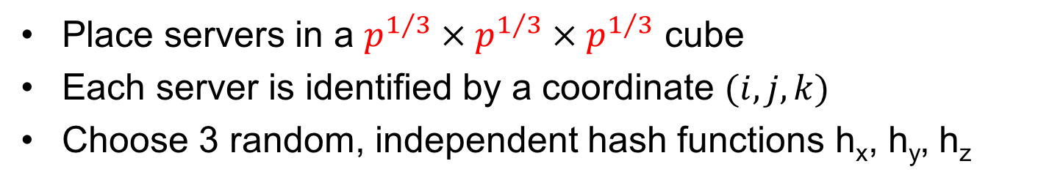
Triangles in One Round
Δ(x,y,z) = R(x,y) ⋈ S(y,z) ⋈ T(z,x)
Place servers in a $p^{1/3} × p^{1/3} × p^{1/3}$ cube
Each server is identified by a coordinate $(i,j,k)$
Choose 3 random, independent hash functions h_{x}, h_{y}, h_{z}
z
    R(a,b)->(h_{x}(a),h_{y}(b),*)
    S(b,c)->(*,h_{y}(b),h_{z}(c))
    Δ(a,b,c)@
    (h_{x}(a),h_{y}(b),h_{z}(c))
x
y
    T(c,a)->(h_{x}(a),*,h_{z}(c))

Slide 36
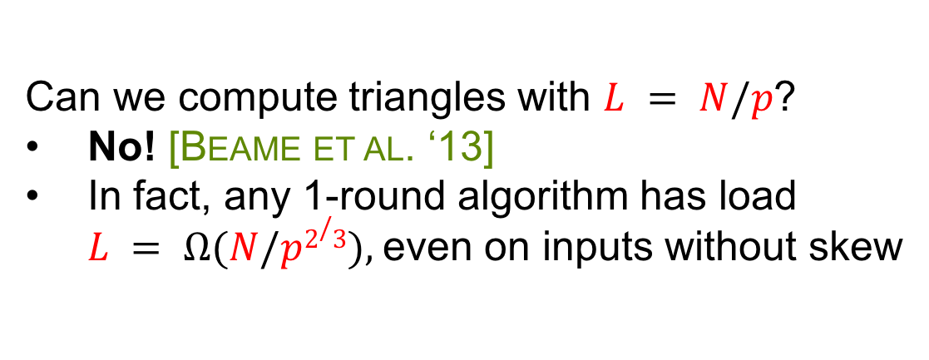
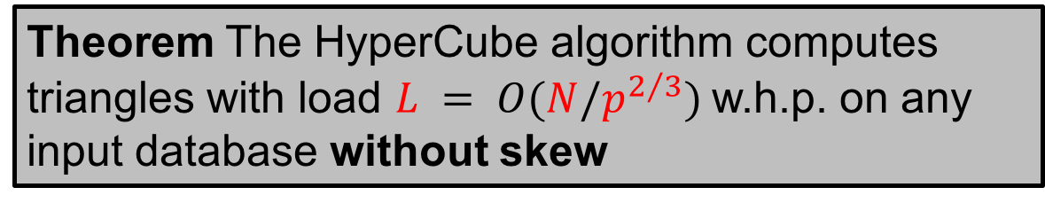
Analysis for Triangles
Δ(x,y,z) = R(x,y) ⋈ S(y,z) ⋈ T(z,x)
|R| = |S| = |T| = N tuples
Theorem The HyperCube algorithm computes triangles with load $L = O(N/p^{2/3})$w.h.p. on any input database without skew
Can we compute triangles with $L = N/p$?
No! [Beame et al. ‘13]
In fact, any 1-round algorithm has load
$L = Ω(N/p2/3),$even on inputs without skew

Slide 37
Multiway Joins
Q(x₁, x₂, …, x_{k} ) = S₁(x₁) ⋈ S₂(x₂) ⋈ … ⋈ S_{l} (x_{l})
shares
HyperCube Algorithm
organize the p servers in a p₁ × p₂ × … × p_{k} hypercube
choose k independent hash functions
Round #1 communication: send S_{j}(x_{j1}, x_{j2}, …) to all servers whose coordinates agree with h_{j1}(x_{j1}), h_{j2}(x_{j2}), …
Round #1 computation: compute Q locally on every server
How do we choose the shares so that we minimize L?
Notes:
Latexit:
\mathbf{
{\color{blue}Q}(x_1, \ldots, x_k) =
{\color{blue}S_1}(\bar x_1) \wedge
{\color{blue}S_2}(\bar x_2) \wedge \cdots \wedge
{\color{blue}S_\ell}(\bar x_\ell)
}
-----------------------------------------
\mathbf{
{\color{red}L} \stackrel{\mathrm{def}}{=} \max_j \frac{{\color{red}m}}{\prod_{i: x_i \in \text{Vars}({\color{blue}S_j})} {\color{red}p}_i}
}

Slide 38
Choosing the Shares
Q(x₁, x₂, …, x_{k} ) = S₁(x₁) ⋈ S₂(x₂) ⋈ … ⋈ S_{l} (x_{l})
the shares must satisfy
#tuples a server receives from S_{j} =
To optimize load, we minimize
Notes:
say about max/sum.

Slide 39

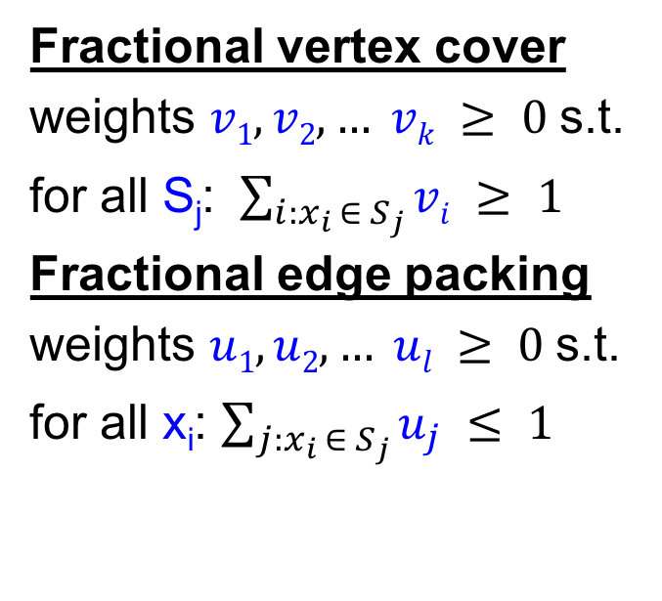
Refresher: Covers & Packings
Q(x₁, x₂, …, x_{k} ) = S₁(x₁) ⋈ S₂(x₂) ⋈ … ⋈ S_{l} (x_{l})
½
Fractional vertex cover
weights $v1, v2, … vk ≥ 0$s.t.
for all S_{j}: $\sum_{i:x_{i} ∈ S_{j}}{vi} ≥ 1$
Fractional edge packing
weights $u1, u2, … ul ≥ 0$s.t.
for all x_{i}: $\sum_{j:x_{i} ∈ S_{j}}{u_{j}} ≤ 1$
½
½
½
½
½
$$minv Σi vi =maxu Σj uj =τ∗$$
Notes:
other packings/covers, e.g. 1,0,0

Slide 40
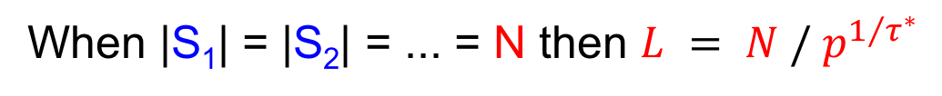
Optimal Load
Q(x₁, x₂, …, x_{k} ) = S₁(x₁) ⋈ S₂(x₂) ⋈ … ⋈ S_{l} (x_{l})
[Beame’14]
Theorem The HyperCube algorithm computes a join query in one round with load
The load achieved is optimal
When |S₁| = |S₂| = ... = N then $L = N / p^{1/{τ^{∗}}}$
* The load analysis works only for data without skew

Slide 41
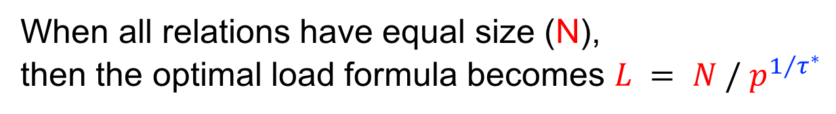
Example - Equal Size
When all relations have equal size (N),
then the optimal load formula becomes $L = N / p^{1/{τ^{∗}}}$
R(x,y) ⋈ S(y,z)
R(x,y) ⋈ S(y,z) ⋈ T(z,x)
τ* = 1
1
0
½
½
τ* = 3/2
½
L = N / p
L = N / p^{3/2}

Slide 42
Example - Unequal Size
Δ(x,y,z) = R(x,y) ⋈ S(y,z) ⋈ T(z,x)
Edge packing u_{R}, u_{S}, u_{T} | Maximum load L | Max when | HyperCube Shares
1/2, 1/2, 1/2 | (|R| |S| |T|)^{1/3} / p^{2/3}
1, 0, 0 | |R| / p
0, 1, 0 | |S| / p
0, 0, 1 | |T| / p
0, 0, 0 | 0
L = max of these values
Notes:
& \mathbf{{\color{red}L}({\color{blue}u})=} \\
&
\mathbf{
\left(
\frac{
{{\color{red}m_R}}^{\color{blue}u_R} \cdot
{{\color{red}m_S}}^{\color{blue}u_S} \cdot
{{\color{red}m_T}}^{\color{blue}u_T}
}
{\color{red}p}
\right)^{
\frac{1}{{\color{blue}u_R}+{\color{blue}u_S}+{\color{blue}u_T}
}
}
}
=================================
\mathbf{
\frac{{\color{red}m}_R}{\color{red}p}
\geq
\sqrt{\frac{{\color{red}m}_S{\color{red}m}_T}
{\color{red}p}}
}
==================================
\mathbf{
{\color{red}p}^{\color{blue}e_x} \cdot {\color{red}p}^{\color{blue}e_y} \cdot {\color{red}p}^{\color{blue}e_z}
}

Slide 43
Example - Unequal Size
Δ(x,y,z) = R(x,y) ⋈ S(y,z) ⋈ T(z,x)
Edge packing u_{R}, u_{S}, u_{T} | Maximum load L | Max when | HyperCube Shares
1/2, 1/2, 1/2 | (|R| |S| |T|)^{1/3} / p^{2/3} | |R| ≈ |S| ≈ |T| | p_{x}, p_{y}, p_{z} > 1
1, 0, 0 | |R| / p
0, 1, 0 | |S| / p
0, 0, 1 | |T| / p
0, 0, 0 | 0
L = max of these values
Notes:
& \mathbf{{\color{red}L}({\color{blue}u})=} \\
&
\mathbf{
\left(
\frac{
{{\color{red}m_R}}^{\color{blue}u_R} \cdot
{{\color{red}m_S}}^{\color{blue}u_S} \cdot
{{\color{red}m_T}}^{\color{blue}u_T}
}
{\color{red}p}
\right)^{
\frac{1}{{\color{blue}u_R}+{\color{blue}u_S}+{\color{blue}u_T}
}
}
}
=================================
\mathbf{
\frac{{\color{red}m}_R}{\color{red}p}
\geq
\sqrt{\frac{{\color{red}m}_S{\color{red}m}_T}
{\color{red}p}}
}
==================================
\mathbf{
{\color{red}p}^{\color{blue}e_x} \cdot {\color{red}p}^{\color{blue}e_y} \cdot {\color{red}p}^{\color{blue}e_z}
}

Slide 44
Example - Unequal Size
Δ(x,y,z) = R(x,y) ⋈ S(y,z) ⋈ T(z,x)
Edge packing u_{R}, u_{S}, u_{T} | Maximum load L | Max when | HyperCube Shares
1/2, 1/2, 1/2 | (|R| |S| |T|)^{1/3} / p^{2/3} | |R| ≈ |S| ≈ |T| | p_{x}, p_{y}, p_{z} > 1
1, 0, 0 | |R| / p |  | p_{z} = 1
0, 1, 0 | |S| / p
0, 0, 1 | |T| / p
0, 0, 0 | 0
L = max of these values
Notes:
& \mathbf{{\color{red}L}({\color{blue}u})=} \\
&
\mathbf{
\left(
\frac{
{{\color{red}m_R}}^{\color{blue}u_R} \cdot
{{\color{red}m_S}}^{\color{blue}u_S} \cdot
{{\color{red}m_T}}^{\color{blue}u_T}
}
{\color{red}p}
\right)^{
\frac{1}{{\color{blue}u_R}+{\color{blue}u_S}+{\color{blue}u_T}
}
}
}
=================================
\mathbf{
\frac{{\color{red}m}_R}{\color{red}p}
\geq
\sqrt{\frac{{\color{red}m}_S{\color{red}m}_T}
{\color{red}p}}
}
==================================
\mathbf{
{\color{red}p}^{\color{blue}e_x} \cdot {\color{red}p}^{\color{blue}e_y} \cdot {\color{red}p}^{\color{blue}e_z}
}

Slide 45
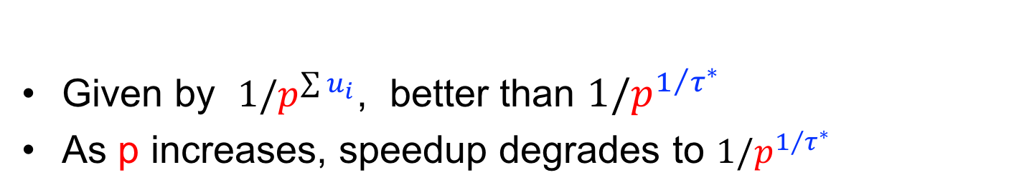
HyperCube Speedup
Given by $1/p^{\sum{u_{i}}}$, better than ${1/p}^{1/{τ^{∗}}}$
As p increases, speedup degrades to ${1/p}^{1/{τ^{∗}}}$
speedup
p
Notes:
\mathbf{
{\color{red}L}({\color{blue}u})\stackrel{\mathrm{def}}{=}
\left(
\frac{
{\color{red}m_1}^{\color{blue}u_1}\cdot
{\color{red}m_2}^{\color{blue}u_2}\cdots
{\color{red}m_\ell}^{\color{blue}u_\ell}
}
{\color{red}p}
\right)^
{\frac{1}{{\color{blue}u_1} + {\color{blue}u_2} + \cdots + {\color{blue}u_\ell}}}
}
--------------------------
\mathbf{
{\color{red}L}({\color{blue}u})=
{\color{red}m}/{\color{red}p}^
{1/({\color{blue}u_1} + {\color{blue}u_2} + \cdots + {\color{blue}u_\ell})}
}
-----------------------
\mathbf{
\max_{\color{blue}u} {\color{red}L}({\color{blue}u})
=
{\color{red}m}/{\color{red}p}^{1/{\color{blue}\tau^*}}
}

Slide 46
Skew Matters
Skewed data significantly degrades the performance in distributed query processing
Skewed values must be treated specially!
State of the art in large scale distributed systems: DIY ☹

Slide 47
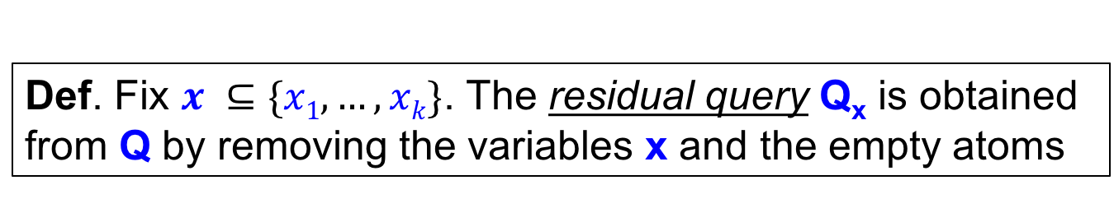
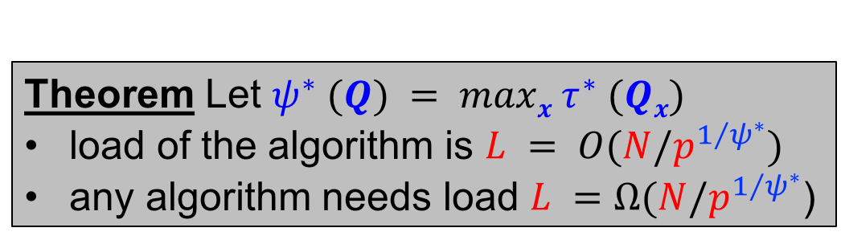
The SkewHC algorithm
Q(x₁, x₂, …, x_{k} ) = S₁(x₁) ⋈ S₂(x₂) ⋈ … ⋈ S_{l} (x_{l})
|S₁| = |S₂| = … = N
Def. A value is a heavy hitter if it occurs > N/p times
Def. Fix $x ⊆\{x1, …, xk\}$. The residual query Q_{x} is obtained
from Q by removing the variables x and the empty atoms
Algorithm: in parallel, for every combination of heavy/light,
compute the residual query for that combination
Theorem Let $ψ^{∗} (Q) = maxx τ^{∗} (Qx)$
load of the algorithm is $L = O(N/p^{1/{ψ^{∗}}})$
any algorithm needs load $L =Ω(N/p^{1/{ψ^{∗}}}$)

Slide 48
Example
Δ(x,y,z) = R(x,y) ⋈ S(y,z) ⋈ T(z,x)
Heavy hitter = a value that occurs at least N/p times
Each attribute has at most p heavy hitters
x | y | z | Residual query | τ* | L | p₁ × p₂ × p₃
light | light | light | R(x,y) ⋈ S(y,z) ⋈ T(z,x) | 3/2 | N/p^{2/3} | p^{1/3} × p^{1/3} × p^{1/3}
. . . . |  |  | . . .

Slide 49
Example
Δ(x,y,z) = R(x,y) ⋈ S(y,z) ⋈ T(z,x)
Heavy hitter = a value that occurs at least N/p times
Each attribute has at most p heavy hitters
x | y | z | Residual query | τ* | L | p₁ × p₂ × p₃
light | light | light | R(x,y) ⋈ S(y,z) ⋈ T(z,x) | 3/2 | N/p^{2/3} | p^{1/3} × p^{1/3} × p^{1/3}
light | light | heavy | R(x,y) ⋈ S(y) ⋈ T(x) | 2 | N/p^{1/2} | p^{1/2} × p^{1/2} × 1
. . . . |  |  | . . .

Slide 50
Example
Δ(x,y,z) = R(x,y) ⋈ S(y,z) ⋈ T(z,x)
Heavy hitter = a value that occurs at least N/p times
Each attribute has at most p heavy hitters
x | y | z | Residual query | τ* | L | p₁ × p₂ × p₃
light | light | light | R(x,y) ⋈ S(y,z) ⋈ T(z,x) | 3/2 | N/p^{2/3} | p^{1/3} × p^{1/3} × p^{1/3}
light | light | heavy | R(x,y) ⋈ S(y) ⋈ T(x) | 2 | N/p^{1/2} | p^{1/2} × p^{1/2} × 1
light | heavy | heavy | R(x) ⋈ T(x) | 1 | N/p | p × 1 × 1
. . . . |  |  | . . .

Slide 51
Summary
Query |  | No Skew 1 Round (𝞃*) | Skew 1 Round (ψ*)
 |  | 𝞃* = 3/2 IN/p^{2/3} | ψ* = 2 IN/p^{1/2}
 |  | 𝞃* = 1 IN/p | ψ* = 2 IN/p^{1/2}
general |  | IN/p^{1/τ*} | IN/p^{1/ψ*}
x
≤
y
z
x
y
z
≤
≤
What about multiple rounds?

Slide 52
Multiple Rounds
Queries are typically executed in multiple rounds
  SELECT cKey, month, sum(price)
  FROM Orders, Customers
  GROUP BY cKey, month
High-level Question:
  What is the computational power of rounds?
Upshot: Few results & many open questions for CQs

Slide 53
1-round vs Multi-round
Query |  | No Skew 1 Round (𝞃*) | Skew 1 Round (ψ*)
 |  | 𝞃* = 3/2 IN/p^{2/3} | ψ* = 2 IN/p^{1/2}
 |  | 𝞃* = 1 IN/p | ψ* = 2 IN/p^{1/2}
 |  | 𝞃* = 2 IN/p^{1/2} | ψ* = 2 IN/p^{1/2}
x
≤
y
z
x
y
z
≤
x
y
R(x),S(x, y),T(y)
≤
No Skew, Multi Rounds => Easy

Slide 54
1-round vs Multi-round
Query | No Skew Multi-Round | No Skew 1 Round (𝞃*) | Skew 1 Round (ψ*)
 | IN/p | 𝞃* = 3/2 IN/p^{2/3} | ψ* = 2 IN/p^{1/2}
 | IN/p | 𝞃* = 1 IN/p | ψ* = 2 IN/p^{1/2}
 | IN/p | 𝞃* = 2 IN/p^{1/2} | ψ* = 2 IN/p^{1/2}
x
𝞺* =
≤
≤
y
z
𝞺* =
x
y
z
≤
≤
x
y
R(x),S(x, y),T(y)
𝞺* = 1
≤
≤
No Skew, Multi Rounds => Easy
Skew, Multi Round
AGM bound 𝞺*
1 ≤ 𝞺*, 𝞃* ≤ ψ*
Tight for only some queries
General queries open

Slide 55
Background: AGM Bound
Given Q: R₁ ⋈ … ⋈ R_{n}, what’s the max size of |OUT|?
Assume |R_{i}| are equal. Let be a fractional edge cover:
Then: dddddddddd
x
y
𝞺* = 1
R(x)
S(x, y)
T(y)
1
0
1
𝞺* : weight of minimum fractional edge cover

Slide 56
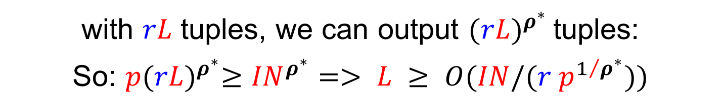

Multi-round Communication LB
Simple counting argument!
L tuples
L tuples
L tuples
…
…
Processor k
Network Card
Round 1
Round 2
…
Round r
with $rL$ tuples, we can output ${(rL)}^{ρ^{∗}}$tuples:
So: $p{(rL)}^{ρ^{∗}}≥{IN}^{ρ^{∗}}=> L ≥ O(IN/(r p^{1/{ρ^{∗}}}))$
If $r = O(1),$then $L ≥ O(IN/p^{1/{ρ^{∗}}})$

Slide 57
Extreme No Skew Multi-Round: Easy Case
Iterative binary joins at each round
Ex:
x
OUT(x, y, z)
Round 2:
y
z
R(x, y)
1 | 2
2 | 4
… | …
n | 9
S(y, z)
1 | n
2 | 7
… | …
n | 3
T(z, x)
1 | 5
2 | 6
… | …
n | 1
TMP(x, y, z)
T(z, x)
Round 1:
R(x,y)
S(y, z)
Any Q, with r = n-1 and optimal L
Intermediate relation sizes do not grow with binary joins
in the case of extreme no-skew

Slide 58
Skew Multi-Round: Hard Case (1)
Iterative binary joins if Q decomposes into semijoins
Ex 1:
R(x)
T(y)
OUT(x, y)
x
S(x, y)
y
Round 2:
𝞺* = 1
ψ* = 2
TMP(x, y)
T(y)
Round 1:
R(x)
S(x, y)
Semijoins remove potential outputs each round
without growing intermediate relations

Slide 59
Skew Multi-Round: Hard Case (2)
x
Ex 2:
  Decompose into “semijoin residual queries”
𝞺* = 3/2
y
z
  Heavy-Light + Semijoins Alg
  ?
  deg(h) < IN/p^{1/3}
  Light values
  O(p^{1/3}) many Heavy values
  (e.g. z = 3)
R^{L}(x, y)
S^{L}(y, z)
T^{L}(z, x)
R(x, y)
S(y, 3)
T(3, x)
  q(z=3):
x
y
  1 round HC on p machines
  L=O(IN/p^{2/3})
  2 round semijoin on p^{2/3} machines
  L=O(IN/p^{2/3})
r: 2, L=O(IN/p^{2/3}) => worst-case optimal

Slide 60
Limitation of HL+Semijoins
  Heavy Light+Semijoins: decomposes Q into
  ``residual semijoin queries’’ (recursively) based on degrees
  But only when arities ≤ 2 or several special cases
  Open: L=O(IN/p^{1/𝞺*}) for general queries?

Slide 61
Example Difficult Query
R₁
x₁ x₂ x₃
𝞺* = 2
ψ* = 3
S₁
S₂
S₃
R₂
y₁ y₂ y₃
  Open: L=O(IN/p^{1/2}) in O(1) rounds?

Slide 62
Scalability Limitation of L=IN/p^{1/𝞺*} (1)
𝞺* can be very high for even small-size queries
R₁
R₂
…
R₂₀
A₀
A₁
A₂₀
𝞺* = 10
HC or Heavy-Light+Semijoin give poor scalability
  2x speedup requires 1024x more processors

Slide 63
Scalability Limitation of L=IN/p^{1/𝞺*} (2)
Iterative BJ might generate a lot of intermediate data
…
Round 3
T₂(x₁, x₂, x₃, x₄)
Round 2
T₁(x₁, x₂, x₃)
R₃(x₃, x₄ )
  Problem: |T_{i}| > p|IN|
  better run 1 round & replicate IN
Round 1
R₁(x₁, x₂ )
R₂(x₂, x₃ )
Upshot: Semijoins can help if OUT is small

Slide 64
Yannakakis Algorithm For Acyclic Queries
Input: Acyclic query Q: R1 ⋈ R2 ⋈ … ⋈ Rn &
    a width-1 Generalized Hypertree Decomposition of Q
A₀
A₀A₁
λ=R₁
width = 1
R₁
R₂
A₁A₃
λ=R₃
A₀A₂
λ=R₂
A₁
A₂
R₃
R₄
R₅
A₃
A₄
A₅
A₂ subtree
A₂A₄
λ=R₄
A₂A₅
λ=R₅
Q
width-1 GHD

Slide 65
Yannakakis Algorithm For Acyclic Queries
  Upward Semijoin
  Phase
R₁
A₀ | A₁
a₀₁ | a₁₁
a₀₂ | a₁₂
a₀₃ | a₁₃
R₃
A₁ | A₃
a₁₁ | a₃₁
a₁₁ | a₃₂
R₂
A₀ | A₂
a₀₁ | a₂₁
a₀₂ | a₂₂
a₀₃ | a₂₃
⋊
R₄
A₂ | A₄
a₂₁ | a₄₁
a₂₂ | a₄₂
R₅
A₂ | A₅
a₂₁ | a₅₁
a₂₅ | a₅₅
width-1 GHD

Slide 66
Yannakakis Algorithm For Acyclic Queries
  Upward Semijoin
  Phase
R₁
A₀ | A₁
a₀₁ | a₁₁
a₀₂ | a₁₂
a₀₃ | a₁₃
R₃
A₁ | A₃
a₁₁ | a₃₁
a₁₁ | a₃₂
R₂
A₀ | A₂
a₀₁ | a₂₁
a₀₂ | a₂₂
⋊
R₄
A₂ | A₄
a₂₁ | a₄₁
a₂₂ | a₄₂
R₅
A₂ | A₅
a₂₁ | a₅₁
a₂₅ | a₅₅

Slide 67
Yannakakis Algorithm For Acyclic Queries
  Upward Semijoin
  Phase
R₁
A₀ | A₁
a₀₁ | a₁₁
a₀₂ | a₁₂
a₀₃ | a₁₃
⋊
R₃
A₁ | A₃
a₁₁ | a₃₁
a₁₁ | a₃₂
R₂
A₀ | A₂
a₀₁ | a₂₁
R₄
A₂ | A₄
a₂₁ | a₄₁
a₂₂ | a₄₂
R₅
A₂ | A₅
a₂₁ | a₅₁
a₂₅ | a₅₅

Slide 68
Yannakakis Algorithm For Acyclic Queries
  Upward Semijoin
  Phase
R₁
A₀ | A₁
a₀₁ | a₁₁
⋊
R₃
A₁ | A₃
a₁₁ | a₃₁
a₁₁ | a₃₂
R₂
A₀ | A₂
a₀₁ | a₂₁
R₄
A₂ | A₄
a₂₁ | a₄₁
a₂₂ | a₄₂
R₅
A₂ | A₅
a₂₁ | a₅₁
a₂₅ | a₅₅

Slide 69
Yannakakis Algorithm For Acyclic Queries
  Downward Semijoin
  Phase
R₁
A₀ | A₁
a₀₁ | a₁₁
⋉
R₃
A₁ | A₃
a₁₁ | a₃₁
a₁₁ | a₃₂
R₂
A₀ | A₂
a₀₁ | a₂₁
R₄
A₂ | A₄
a₂₁ | a₄₁
a₂₂ | a₄₂
R₅
A₂ | A₅
a₂₁ | a₅₁
a₂₅ | a₅₅

Slide 70
Yannakakis Algorithm For Acyclic Queries
  Downward Semijoin
  Phase
R₁
A₀ | A₁
a₀₁ | a₁₁
⋉
R₃
A₁ | A₃
a₁₁ | a₃₁
a₁₁ | a₃₂
R₂
A₀ | A₂
a₀₁ | a₂₁
R₄
A₂ | A₄
a₂₁ | a₄₁
a₂₂ | a₄₂
R₅
A₂ | A₅
a₂₁ | a₅₁
a₂₅ | a₅₅

Slide 71
Yannakakis Algorithm For Acyclic Queries
  Downward Semijoin
  Phase
R₁
A₀ | A₁
a₀₁ | a₁₁
R₃
A₁ | A₃
a₁₁ | a₃₁
a₁₁ | a₃₂
R₂
A₀ | A₂
a₀₁ | a₂₁
⋉
R₄
A₂ | A₄
a₂₁ | a₄₁
a₂₂ | a₄₂
R₅
A₂ | A₅
a₂₁ | a₅₁
a₂₅ | a₅₅

Slide 72
Yannakakis Algorithm For Acyclic Queries
  Downward Semijoin
  Phase
R₁
A₀ | A₁
a₀₁ | a₁₁
R₃
A₁ | A₃
a₁₁ | a₃₁
a₁₁ | a₃₂
R₂
A₀ | A₂
a₀₁ | a₂₁
⋉
R₄
A₂ | A₄
a₂₁ | a₄₁
R₅
A₂ | A₅
a₂₁ | a₅₁
a₂₅ | a₅₅

Slide 73
Yannakakis Algorithm For Acyclic Queries
  Join Phase
R₁
A₀ | A₁
a₀₁ | a₁₁
R₃
A₁ | A₃
a₁₁ | a₃₁
a₁₁ | a₃₂
R₂
A₀ | A₂
a₀₁ | a₂₁
⋈
R₄
A₂ | A₄
a₂₁ | a₄₁
R₅
A₂ | A₅
a₂₁ | a₅₁

Slide 74
Yannakakis Algorithm For Acyclic Queries
  Join Phase
R₁
A₀ | A₁
a₀₁ | a₁₁
R₃
A₁ | A₃
a₁₁ | a₃₁
a₁₁ | a₃₂
T₁
A₀ | A₂ | A₅
a₀₁ | a₂₁ | a₅₁
⋈
R₄
A₂ | A₄
a₂₁ | a₄₁

Slide 75
Yannakakis Algorithm For Acyclic Queries
  Join Phase
R₁
A₀ | A₁
a₀₁ | a₁₁
⋈
R₃
A₁ | A₃
a₁₁ | a₃₁
a₁₁ | a₃₂
T₂
A₀ | A₂ | A₄ | A₅
a₀₁ | a₂₁ | a₄₁ | a₅₁

Slide 76
Yannakakis Algorithm For Acyclic Queries
  Join Phase
T₃
A₀ | A₁ | A₂ | A₄ | A₅
a₀₁ | a₁₁ | a₂₁ | a₄₁ | a₅₁
⋈
R₃
A₁ | A₃
a₁₁ | a₃₁
a₁₁ | a₃₂

Slide 77
Yannakakis Algorithm For Acyclic Queries
OUT
A₀ | A₁ | A₂ | A₃ | A₄ | A₅
a₀₁ | a₁₁ | a₂₁ | a₃₁ | a₄₁ | a₅₁
a₀₁ | a₁₁ | a₂₁ | a₃₂ | a₄₁ | a₅₁
O(n) semijoins + O(n) joins
Serial Run-Time: O(IN+OUT)
because |T_{i}| ≤ OUT

Slide 78
GYM: Distributed Yannakakis on Acyclic Q
Naively distribute semijoins&joins separate rounds:
Linear scalability: 2x processors, 2x speed up
 | GYM r=O(n) | HL + Semijoins r = O(1), arity 2
OUT< p^{1-1/𝞺*}IN | L = (IN +OUT)/p | L = IN/p^{1/𝞺*}
≤
Larger p allows for larger OUT

Slide 79
GYM in O(d) Rounds
Acyclic queries have w-1 GHDs w/ different depths
Path-n
Lowest depth w-1 GHD:
d = Ɵ(n)
R₁
R₂
R_{n-1}
R_{n}
A₀
A₁
…
A_{n-1}
A_{n}
Star-n
A₀A₁
λ=R₁
A₂
A₁
R₂
R₁
R_{n}
A₃
A₀
A_{n}
R₃
…
A₀A₂
λ=R₂
A₀A₃
λ=R₃
A₀A_{n}
λ=R_{n}
R₅
…
R₄
A₄
A₅
d=1
Can optimize GYM to run in r = O(d) and same L
w/ parallel joins and semijoins

Slide 80
Ex: Vanilla GYM
  Upward Semijoin
  Phase
R₁
A₀ | A₁
⋊
R₂
A₀ | A₂
R₃
A₀ | A₃
R₄
A₀ | A₄
Round 1

Slide 81
Ex: Vanilla GYM
  Upward Semijoin
  Phase
R₁
A₀ | A₁
⋊
R₂
A₀ | A₂
R₃
A₀ | A₃
R₄
A₀ | A₄
Round 2

Slide 82
Ex: Vanilla GYM
  Upward Semijoin
  Phase
R₁
A₀ | A₁
⋊
R₂
A₀ | A₂
R₃
A₀ | A₃
R₄
A₀ | A₄
Round 3

Slide 83
Ex: Vanilla GYM
  Downward Semijoin
  Phase
R₁
A₀ | A₁
⋊
R₂
A₀ | A₂
R₃
A₀ | A₃
R₄
A₀ | A₄
Round 4

Slide 84
Ex: Vanilla GYM
  Downward Semijoin
  Phase
R₁
A₀ | A₁
⋊
R₂
A₀ | A₂
R₃
A₀ | A₃
R₄
A₀ | A₄
Round 5

Slide 85
Ex: Vanilla GYM
  Downward Semijoin
  Phase
R₁
A₀ | A₁
⋊
R₂
A₀ | A₂
R₃
A₀ | A₃
R₄
A₀ | A₄
Round 6

Slide 86
Ex: Vanilla GYM
  Join Phase
R₁
A₀ | A₁
⋈
R₂
A₀ | A₂
R₃
A₀ | A₃
R₄
A₀ | A₄
Round 7

Slide 87
Ex: Vanilla GYM
  Join Phase
T₁
A₀ | A₁ | A₂
⋈
R₃
A₀ | A₃
R₄
A₀ | A₄
Round 8

Slide 88
Ex: Vanilla GYM
  Join Phase
T₂
A₀ | A₁ | A₂ | A₃
⋈
R₄
A₀ | A₄
Round 9

Slide 89
Ex: Vanilla GYM
OUT
A₀ | A₁ | A₂ | A₃ | A₄

Slide 90
Ex: Optimized GYM
  Upward Semijoin
  Phase
R₁
A₀ | A₁
⋊
⋊
⋊
R₂
A₀ | A₂
R₃
A₀ | A₃
R₄
A₀ | A₄
Round 1

Slide 91
Ex: Optimized GYM
  Upward Semijoin
  Phase
R₁
A₀ | A₁
∩
R`₁
A₀ | A₁
R``₁
A₀ | A₁
R```₁
A₀ | A₁
Round 2

Slide 92
Ex: Optimized GYM
  Downward Semijoin
  Phase
R₁
A₀ | A₁
⋊
⋊
⋊
R₂
A₀ | A₂
R₃
A₀ | A₃
R₄
A₀ | A₄
Round 3

Slide 93
Ex: Optimized GYM
  Join Phase
R₁
A₀ | A₁
Skew-HC
⋈
R₂
A₀ | A₂
R₃
A₀ | A₃
R₄
A₀ | A₄
Round 4

Slide 94
Ex: Optimized GYM
OUT
A₀ | A₁ | A₂ | A₃ | A₄

Slide 95
Generalizing To Any Query and GHD
Any Q with width-w, depth-d GHD can run in:
r=O(d), L=O((IN^{w} + OUT)/p)
R₁
R₂
R_{n-1}
R_{n}
A₀
A₁
…
A_{n-1}
A_{n}
R_{n}
T_{k}=R₁R_{n/2}R_{n}
R_{n-1}
…
…
T_{i}=R₁R₄R₇
…
T_{j}=R_{n-6}R_{n-3}R_{n}
R₂
…
T_{k}=R_{n-2}R_{n-1}R_{n}
T₁=R₁R₂R₃
R₁
T₁=R₁R₂R₃…R_{n}
R₁
R₃
R₅
…
R_{n-2}
R_{n}
w=1,d=n
w=n/2, d=1
w=3, d=log(n)
Can tradeoff r and L by constructing GHDs
with different w and d

Slide 96
Main Takeaways
High-degree residual query decompositions + semijoins:
  L=O(IN/p^{1/𝞺*}) (for some Qs)
Yannakakis style processing improves L if OUT is small
Depth & width of decompositions allow r & L tradeoffs

Slide 97
Multi-round Multiway Joins In Practice
Most Systems: Iterative Binary Join Plans
Tributary Join [Chu et al. SIGMOD ‘15]
Subgraph Queries:
  BiGJoin [Ammar et al., VLDB ‘18]
  SEED [Lai et al., VLDB Journal, ‘17]
  TwinTwigJoin [Lai et al., VLDB ‘16]
  PSgL [Shao et al., SIGMOD ’14]

Slide 98
Outline
Models of parallel computation (Dan)
Two-way joins (Paris)
Multi-way joins (Paris+Semih)
Sorting & Matrix multiplication (Paris+Semih)
Conclusion (Dan)

Slide 99
Sorting
Sorting is a fundamental operation in data processing
  join computation (parallel merge join)
  similarity joins
  aggregation/grouping
input size: N items

Slide 100
The PSRS algorithm
Parallel Sort by Regular Sample (PSRS)
find p−1 values, called splitters
−∞ = y₀ < y₁ <···< y_{p-1} < y_{p} = +∞
each server gets assigned one of the p intervals
partition the data such that all items in the same interval are sent to the same server
each server sorts the items locally

Slide 101
The PSRS algorithm
How does PSRS find the splitters?
each server sorts its data locally, and computes the p-1 local splitters (called the regular sample) that partition uniformly the local data
each server broadcasts its regular sample
the final p splitters are computed by sorting the union of the local regular samples, and choosing every p-th item.

Slide 102
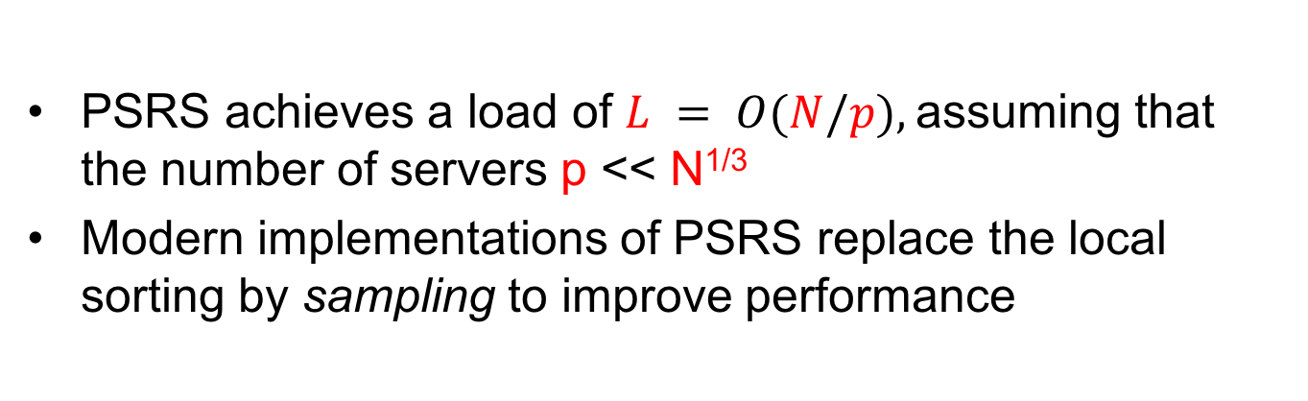
The PSRS algorithm: analysis
PSRS achieves a load of $L = O(N/p),$assuming that the number of servers p << N^{1/3}
Modern implementations of PSRS replace the local sorting by sampling to improve performance
What happens for larger values of p?

Slide 103
Cole’s Algorithm
designed for the PRAM model
works for arbitrary number of processors p
sorts in time O(N / p log(N) )
does not naturally extend to BSP or MPC, since the processors access the shared memory in patterns that are costly to convert into messages

Slide 104
Goodrich’s Algorithm
designed for BSP (hence can be adapted to MPC)
works for arbitrary number of processors p
with load L = N/p, it runs in O(log_{L}(N)) rounds
the algorithm is very complex!

Slide 105
Lower Bounds on Sorting
Theorem The minimum number of rounds needed by any MPC algorithm to sort N items is Ω(log_{L}N)
Theorem The minimum communication needed by any MPC algorithm to sort N items is Ω(N log_{L}N)
The lower bounds are independent of the number of servers p
Having more processors doesn’t improve communication or synchronization!

Slide 106
Sorting in Practice
None of the optimal parallel algorithms are used in practice
In real-world instances of sorting, parallelism is coarse-grained (p << N)
Typical method: find the splitters, partition, and then sort locally
Year | Winner | Time | p and Memory/Processor
2016 | Tencent Sort | 134s | 512 (512GB)
2015 | FuxiSort | 377s | 3134 (96GB) + 243 (128GB)
2014 | TritonSort | 1378s | 186 (244GB)
2014 | Apache Spark | 1406s | 207 (244GB)
2013 | Hadoop | 4328s | 2100 (64GB)
2011 | TritonSort | 8274s | 52 (24GB)

Slide 107
Conventional Square Matrix Multiplication
n
n
3.2 | 6.7 | … | 7.4
4.3 | 2.7 | … | 8.7
… | … | … | …
-1.1 | 0.3 | … | 1.4
5.8 | 0.1 | … | 2.2
6.1 | 3.8 | … | 1.6
… | … | … | …
0.8 | 2.5 | … | 0.4
8.8 | 0.5 | … | 1.4
1.5 | 1.0 | … | 2.5
… | … | … | …
4.4 | 3.0 | … | 5.6
n
n
=
A
B
C
Focus on Conventional Algs that do all n³ products
  i.e.: Strassen-like algs are not allowed
Reflects practice & o.w. LBs are trivial
Stateless MPC: Procs keep O(L) elements (memory)
Analyze other parameters, p, r, C=prL

Slide 108
SQL Query of Matrix Multiplication
select A.i,B.k,sum(A.v*B.v)
from A, B
where A.j = B.j
group by A.i, B.k
Aggregation Part
Join Part
j
k
k
3.2 | 6.7 | … | 7.4
4.3 | 2.7 | … | 8.7
… | … | … | …
-1.1 | 0.3 | … | 1.4
5.8 | 0.1 | … | 2.2
6.1 | 3.8 | … | 1.6
… | … | … | …
0.8 | 2.5 | … | 0.4
8.8 | 0.5 | … | 1.4
1.5 | 1.0 | … | 2.5
… | … | … | …
4.4 | 3.0 | … | 5.6
i
×
j
=
i
A
B
C
i | j | v
1 | 1 | 3.2
... | … | …
n | n | 1.4
j | k | v
1 | 1 | 5.8
... | … | …
n | n | 2.6
i | k | sum
1 | 1 | 8.8
... | … | …
n | n | 5.6

Slide 109
1-round Algorithm (1)
Need entire rows & cols: 2n ≤ L ≤ n²
k₂
k₁
A
B
Suppose L = 2tn (so each proc. can store 2t rows and cols)
Q: # rows k₁ & # cols k₂ should a processor get?
A: k₁=k₂= t can do k₁k₂n = t²n products
Ex:t=3, n=75 => 9*75 = 675 prods/proc
[McKellar & Coffman, CACM, 1969], [Afrati et. al. VLDB, 2013]

Slide 110
1-round Algorithm (2)
L = 2tn: Divide into K=n/t rectangular groups
R₁
p₁
A
…
p₂
1 R_{i} & 1 C_{j}
per processor
R_{K}
p₃
C₁
…
C_{K}
…
B
p_{K^2}
L = 2tn, C = K²L => C= O(n⁴/L)
[McKellar & Coffman, CACM, 1969], [Afrati et. al. VLDB, 2013]

Slide 111
2-round Algorithm (1)
Can do partial products & aggregate in separate rounds
prods/proc: (tn)^{3/2}
(3*75)^{3/2}=3375 vs 675
p₁
A₁₁
…
A_{1H}
p₁
A
…
…
…
p₂
A_{H1}
…
A_{HH}
p₃
r = 1
r = 2
p_{i}
B_{1H}
…
B_{1H}
B
…
…
…
…
…
p_{j}
B_{H1}
…
B_{HH}
p_{H^3}

Slide 112
Generalizing to > 2 Rounds
r = 2
A₁₁
B₁₁
A₁₂
×
B₂₁
×
…
B_{2H}
A_{H1}
×
H³
block products
…
r = 1
A₃₇
×
B₇₄
r = 1
A_{HH}
×
B_{HH}
A₅₉
×
B_{9H}
…
A₂₂
×
B₂₂
Group into H groups of H² s.t.
  G_{z}: A_{i,j} × B_{j,k} s.t. j = (i + k + z) mod H
Each r: mult. as many block products as possible
  w/ 1 proc doing 1 block product (+ partial aggregation)
[McColl & Tiskin, Algoritmica, 1999], [Pietracaprina et. al., ICS, 2012]

Slide 113
Example Groups
G₀
A₀₀ | A₀₁ | A₀₂ | A₀₃
A₁₀ | A₁₁ | A₁₂ | A₁₃
A₂₀ | A₂₁ | A₂₂ | A₂₃
A₃₀ | A₃₁ | A₃₂ | A₃₃
B₀₀ | B₀₁ | B₀₂ | B₀₃
B₁₀ | B₁₁ | B₁₂ | B₁₃
B₂₀ | B₂₁ | B₂₂ | B₂₃
B₃₀ | B₃₁ | B₃₂ | B₃₃
C₀₀ | C₀₁ | C₀₂ | C₀₃
C₁₀ | C₁₁ | C₁₂ | C₁₃
C₂₀ | C₂₁ | C₂₂ | C₂₃
C₃₀ | C₃₁ | C₃₂ | C₃₃
Each group has exactly 1 block-mult for one C_{ij} block

Slide 114
Example Groups
G₀
G₁
G₂
G₃
A₀₀ | A₀₁ | A₀₂ | A₀₃
A₁₀ | A₁₁ | A₁₂ | A₁₃
A₂₀ | A₂₁ | A₂₂ | A₂₃
A₃₀ | A₃₁ | A₃₂ | A₃₃
A₀₀ | A₀₁ | A₀₂ | A₀₃
A₁₀ | A₁₁ | A₁₂ | A₁₃
A₂₀ | A₂₁ | A₂₂ | A₂₃
A₃₀ | A₃₁ | A₃₂ | A₃₃
A₀₀ | A₀₁ | A₀₂ | A₀₃
A₁₀ | A₁₁ | A₁₂ | A₁₃
A₂₀ | A₂₁ | A₂₂ | A₂₃
A₃₀ | A₃₁ | A₃₂ | A₃₃
A₀₀ | A₀₁ | A₀₂ | A₀₃
A₁₀ | A₁₁ | A₁₂ | A₁₃
A₂₀ | A₂₁ | A₂₂ | A₂₃
A₃₀ | A₃₁ | A₃₂ | A₃₃
B₀₀ | B₀₁ | B₀₂ | B₀₃
B₁₀ | B₁₁ | B₁₂ | B₁₃
B₂₀ | B₂₁ | B₂₂ | B₂₃
B₃₀ | B₃₁ | B₃₂ | B₃₃
B₀₀ | B₀₁ | B₀₂ | B₀₃
B₁₀ | B₁₁ | B₁₂ | B₁₃
B₂₀ | B₂₁ | B₂₂ | B₂₃
B₃₀ | B₃₁ | B₃₂ | B₃₃
B₀₀ | B₀₁ | B₀₂ | B₀₃
B₁₀ | B₁₁ | B₁₂ | B₁₃
B₂₀ | B₂₁ | B₂₂ | B₂₃
B₃₀ | B₃₁ | B₃₂ | B₃₃
B₀₀ | B₀₁ | B₀₂ | B₀₃
B₁₀ | B₁₁ | B₁₂ | B₁₃
B₂₀ | B₂₁ | B₂₂ | B₂₃
B₃₀ | B₃₁ | B₃₂ | B₃₃
C₀₀ | C₀₁ | C₀₂ | C₀₃
C₁₀ | C₁₁ | C₁₂ | C₁₃
C₂₀ | C₂₁ | C₂₂ | C₂₃
C₃₀ | C₃₁ | C₃₂ | C₃₃
C₀₀ | C₀₁ | C₀₂ | C₀₃
C₁₀ | C₁₁ | C₁₂ | C₁₃
C₂₀ | C₂₁ | C₂₂ | C₂₃
C₃₀ | C₃₁ | C₃₂ | C₃₃
C₀₀ | C₀₁ | C₀₂ | C₀₃
C₁₀ | C₁₁ | C₁₂ | C₁₃
C₂₀ | C₂₁ | C₂₂ | C₂₃
C₃₀ | C₃₁ | C₃₂ | C₃₃
C₀₀ | C₀₁ | C₀₂ | C₀₃
C₁₀ | C₁₁ | C₁₂ | C₁₃
C₂₀ | C₂₁ | C₂₂ | C₂₃
C₃₀ | C₃₁ | C₃₂ | C₃₃
Each group has exactly 1 block-mult for one C_{ij} block

Slide 115
Example 1: p=H² (H=4, p=16)
G₀
A₀₀ | A₀₁ | A₀₂ | A₀₃
A₁₀ | A₁₁ | A₁₂ | A₁₃
A₂₀ | A₂₁ | A₂₂ | A₂₃
A₃₀ | A₃₁ | A₃₂ | A₃₃
p₁
Partial Sums
p₂
P₀₀ | P₀₁ | P₀₂ | P₀₃
P₁₀ | P₁₁ | P₁₂ | P₁₃
P₂₀ | P₂₁ | P₂₂ | P₂₃
P₃₀ | P₃₁ | P₃₂ | P₃₃
OUT
p₃
B₀₀ | B₀₁ | B₀₂ | B₀₃
B₁₀ | B₁₁ | B₁₂ | B₁₃
B₂₀ | B₂₁ | B₂₂ | B₂₃
B₃₀ | B₃₁ | B₃₂ | B₃₃
…
p₁₆
Round 1

Slide 116
Example 1: p=H² (H=4, p=16)
G₁
A₀₀ | A₀₁ | A₀₂ | A₀₃
A₁₀ | A₁₁ | A₁₂ | A₁₃
A₂₀ | A₂₁ | A₂₂ | A₂₃
A₃₀ | A₃₁ | A₃₂ | A₃₃
p₁
Partial Sums
p₂
P₀₀ | P₀₁ | P₀₂ | P₀₃
P₁₀ | P₁₁ | P₁₂ | P₁₃
P₂₀ | P₂₁ | P₂₂ | P₂₃
P₃₀ | P₃₁ | P₃₂ | P₃₃
B₀₀ | B₀₁ | B₀₂ | B₀₃
B₁₀ | B₁₁ | B₁₂ | B₁₃
B₂₀ | B₂₁ | B₂₂ | B₂₃
B₃₀ | B₃₁ | B₃₂ | B₃₃
OUT
p₃
…
P₀₀ | P₀₁ | P₀₂ | P₀₃
P₁₀ | P₁₁ | P₁₂ | P₁₃
P₂₀ | P₂₁ | P₂₂ | P₂₃
P₃₀ | P₃₁ | P₃₂ | P₃₃
p₁₆
Round 2

Slide 117
Example 1: p=H² (H=4, p=16)
G₂
A₀₀ | A₀₁ | A₀₂ | A₀₃
A₁₀ | A₁₁ | A₁₂ | A₁₃
A₂₀ | A₂₁ | A₂₂ | A₂₃
A₃₀ | A₃₁ | A₃₂ | A₃₃
p₁
Partial Sums
p₂
P₀₀ | P₀₁ | P₀₂ | P₀₃
P₁₀ | P₁₁ | P₁₂ | P₁₃
P₂₀ | P₂₁ | P₂₂ | P₂₃
P₃₀ | P₃₁ | P₃₂ | P₃₃
B₀₀ | B₀₁ | B₀₂ | B₀₃
B₁₀ | B₁₁ | B₁₂ | B₁₃
B₂₀ | B₂₁ | B₂₂ | B₂₃
B₃₀ | B₃₁ | B₃₂ | B₃₃
OUT
p₃
…
P₀₀ | P₀₁ | P₀₂ | P₀₃
P₁₀ | P₁₁ | P₁₂ | P₁₃
P₂₀ | P₂₁ | P₂₂ | P₂₃
P₃₀ | P₃₁ | P₃₂ | P₃₃
p₁₆
Round 3

Slide 118
Example 1: p=H² (H=4, p=16)
G₃
A₀₀ | A₀₁ | A₀₂ | A₀₃
A₁₀ | A₁₁ | A₁₂ | A₁₃
A₂₀ | A₂₁ | A₂₂ | A₂₃
A₃₀ | A₃₁ | A₃₂ | A₃₃
p₁
Final Output
p₂
C₀₀ | C₀₁ | C₀₂ | C₀₃
C₁₀ | C₁₁ | C₁₂ | C₁₃
C₂₀ | C₂₁ | C₂₂ | C₂₃
C₃₀ | C₃₁ | C₃₂ | C₃₃
B₀₀ | B₀₁ | B₀₂ | B₀₃
B₁₀ | B₁₁ | B₁₂ | B₁₃
B₂₀ | B₂₁ | B₂₂ | B₂₃
B₃₀ | B₃₁ | B₃₂ | B₃₃
OUT
p₃
…
P₀₀ | P₀₁ | P₀₂ | P₀₃
P₁₀ | P₁₁ | P₁₂ | P₁₃
P₂₀ | P₂₁ | P₂₂ | P₂₃
P₃₀ | P₃₁ | P₃₂ | P₃₃
p₁₆
Round 4

Slide 119
Example 2: p=2H² (H=4, p=32)
A₀₀ | A₀₁ | A₀₂ | A₀₃
A₁₀ | A₁₁ | A₁₂ | A₁₃
A₂₀ | A₂₁ | A₂₂ | A₂₃
A₃₀ | A₃₁ | A₃₂ | A₃₃
p₁
Partial Sums 1
P₀₀ | P₀₁ | P₀₂ | P₀₃
P₁₀ | P₁₁ | P₁₂ | P₁₃
P₂₀ | P₂₁ | P₂₂ | P₂₃
P₃₀ | P₃₁ | P₃₂ | P₃₃
…
OUT
G₀
B₀₀ | B₀₁ | B₀₂ | B₀₃
B₁₀ | B₁₁ | B₁₂ | B₁₃
B₂₀ | B₂₁ | B₂₂ | B₂₃
B₃₀ | B₃₁ | B₃₂ | B₃₃
p₁₆
A₀₀ | A₀₁ | A₀₂ | A₀₃
A₁₀ | A₁₁ | A₁₂ | A₁₃
A₂₀ | A₂₁ | A₂₂ | A₂₃
A₃₀ | A₃₁ | A₃₂ | A₃₃
p₁₇
Partial Sums 2
P’₀₀ | P’₀₁ | P’₀₂ | P’₀₃
P’₁₀ | P’₁₁ | P’₁₂ | P’₁₃
P’₂₀ | P’₂₁ | P’₂₂ | P’₂₃
P’₃₀ | P’₃₁ | P’₃₂ | P’₃₃
G₁
…
OUT
B₀₀ | B₀₁ | B₀₂ | B₀₃
B₁₀ | B₁₁ | B₁₂ | B₁₃
B₂₀ | B₂₁ | B₂₂ | B₂₃
B₃₀ | B₃₁ | B₃₂ | B₃₃
p₃₂
Round 1

Slide 120
Example 2: p=2H² (H=4, p=32)
A₀₀ | A₀₁ | A₀₂ | A₀₃
A₁₀ | A₁₁ | A₁₂ | A₁₃
A₂₀ | A₂₁ | A₂₂ | A₂₃
A₃₀ | A₃₁ | A₃₂ | A₃₃
p₁
Partial Sums 1
P₀₀ | P₀₁ | P₀₂ | P₀₃
P₁₀ | P₁₁ | P₁₂ | P₁₃
P₂₀ | P₂₁ | P₂₂ | P₂₃
P₃₀ | P₃₁ | P₃₂ | P₃₃
P₀₀ | P₀₁ | P₀₂ | P₀₃
P₁₀ | P₁₁ | P₁₂ | P₁₃
P₂₀ | P₂₁ | P₂₂ | P₂₃
P₃₀ | P₃₁ | P₃₂ | P₃₃
…
OUT
G₂
B₀₀ | B₀₁ | B₀₂ | B₀₃
B₁₀ | B₁₁ | B₁₂ | B₁₃
B₂₀ | B₂₁ | B₂₂ | B₂₃
B₃₀ | B₃₁ | B₃₂ | B₃₃
p₁₆
A₀₀ | A₀₁ | A₀₂ | A₀₃
A₁₀ | A₁₁ | A₁₂ | A₁₃
A₂₀ | A₂₁ | A₂₂ | A₂₃
A₃₀ | A₃₁ | A₃₂ | A₃₃
p₁₇
Partial Sums 2
P’₀₀ | P’₀₁ | P’₀₂ | P’₀₃
P’₁₀ | P’₁₁ | P’₁₂ | P’₁₃
P’₂₀ | P’₂₁ | P’₂₂ | P’₂₃
P’₃₀ | P’₃₁ | P’₃₂ | P’₃₃
P’₀₀ | P’₀₁ | P’₀₂ | P’₀₃
P’₁₀ | P’₁₁ | P’₁₂ | P’₁₃
P’₂₀ | P’₂₁ | P’₂₂ | P’₂₃
P’₃₀ | P’₃₁ | P’₃₂ | P’₃₃
G₃
…
OUT
B₀₀ | B₀₁ | B₀₂ | B₀₃
B₁₀ | B₁₁ | B₁₂ | B₁₃
B₂₀ | B₂₁ | B₂₂ | B₂₃
B₃₀ | B₃₁ | B₃₂ | B₃₃
p₃₂
Round 2

Slide 121
Example 2: p=2H² (H=4, p=32)
p₁
Final Output
C₀₀ | C₀₁ | C₀₂ | C₀₃
C₁₀ | C₁₁ | C₁₂ | C₁₃
C₂₀ | C₂₁ | C₂₂ | C₂₃
C₃₀ | C₃₁ | C₃₂ | C₃₃
P₀₀ | P₀₁ | P₀₂ | P₀₃
P₁₀ | P₁₁ | P₁₂ | P₁₃
P₂₀ | P₂₁ | P₂₂ | P₂₃
P₃₀ | P₃₁ | P₃₂ | P₃₃
…
OUT
p₁₆
p₁₇
P’₀₀ | P’₀₁ | P’₀₂ | P’₀₃
P’₁₀ | P’₁₁ | P’₁₂ | P’₁₃
P’₂₀ | P’₂₁ | P’₂₂ | P’₂₃
P’₃₀ | P’₃₁ | P’₃₂ | P’₃₃
…
p₃₂
Round 3

Slide 122
Cost Analysis
 | Communication | Rounds
Rectangle-Block | O(n⁴/L) | 1
Square-Block | rpL=O(n³/L^{1/2}) | O(n³/(pL^{3/2}) + log_{L}n)
Generalizes 2D and 3D algorithms.
Tight both for C and r for a given L!
Sub-linear Scalability: pL > n³/L^{1/2} => L > n²/p^{2/3} => L > IN/p^{2/3}
**Next: B/c of connection to △ query and 𝞺* of △is 3/2**

Slide 123
Round-Independent LB on C (and L) (1)
Suppose a proc. has N a_{ij}, N b_{jk} and contributes to N c_{ik} elements
Q: How many elementary multiplications can it perform?
v₁₁₁
V
i | j | k
?
i
A
C
a₁₁₁
…
c₁₁₁
j
k
…
…
A
i | j
N
B
j | k
N
C
i | k
N
B
b₁₁₁
A: AGM => 𝞺*= 3/2, so O(N^{3/2})
[Irony, Toledo, & Tiskin, JPDC, 2004], [Hong & Kung, STOC, 1981]

Slide 124
Round-Independent LB on C (and L) (2)
L elements
L elements
L elements
…
Processor k
≤ L input
elements
…
Network Card
Phase 1
Phase 2
…
Phase k
With L communication, a proc can do O(L^{3/2}) products.
n³ products must be performed.
=> C = Ω(n³/L^{1/2}) (irrespective of r)

Slide 125
Lower Bounds on Rounds
max(LB for Join, LB for GroupBy-and-Aggr)
LB for Join:
  C = r × p × L > n³/L^{1/2} => r =Ω(n³/(pL^{3/2}))
LB for GroupBy-and-Aggr: r = Ω(log_{L}n)
r = Ω(max(n³/(pL^{3/2}), log_{L}n)
[Irony, Toledo, & Tiskin, JPDC, 2004], [Goodrich, SICOMP, 1999]

Slide 126
Summary
1-round LB on C = n⁴/L
n³
multi-round LB on C = n³/L^{1/2}
requires
≥ 4 rounds
LBs met by:
Square-block multi-r &
Rectangle-block 1 round algs
requires
≥ 3 rounds
n^{2.5}
Communication (C)
requires
≥ 2 rounds
n²
n^{1/4}
n^{1/3}
n^{1/2}
2n
n²
Load (L)

Slide 127
Other Results
Non-Square MM
Sparse square and non-square MM
Strassen-like MM
Cholesky, LU, QR decompositions, eigenvalue and singular value decompositions

Slide 128
Outline
Models of parallel computation (Dan)
Two-way joins (Paris)
Multi-way joins (Paris+Semih)
Sorting & Matrix multiplication (Paris+Semih)
Conclusion (Dan)

Slide 129
Summary
Algorithms for:
Joins: 2-way, multi-way
Sorting
Matrix multiplication
Goal: minimize total runtime
Minimize communication cost
Minimize number of rounds

Slide 130
Main Takeaways
Joins:
Skew-free data
  Optimal communication related to the fractional edge packing number 𝞃*
Skewed data
  Optimal communication related to the fractional edge covering number 𝞀*
Total communication >> input data

Slide 131
Main Takeaways
Sorting and matrix multiplication
No skew
Total communication = O(IN)
When p << IN, algorithms are simple
When p ≈ IN, algorithms are complex

Slide 132
Open Questions
Sorting-based optimal multi-join algorithm
Optimal communication cost f(IN,OUT)
Lower bound for multi-rounds (w/o skew)

Slide 133
Questions?
https://tinyurl.com/y99w99b4
Free until June 18
(create account)

