Slide 1
Practical Aspects of Modern Cryptography
Autumn 2016
Tolga Acar
Josh Benaloh

Slide 2
Agenda
Hardware crypto devices
Smart cards
TPMs (v1.2 and v2.0)
Hardware Security Modules
Authentication Tokens

Slide 3
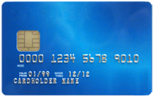
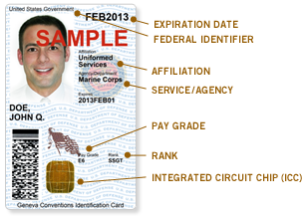
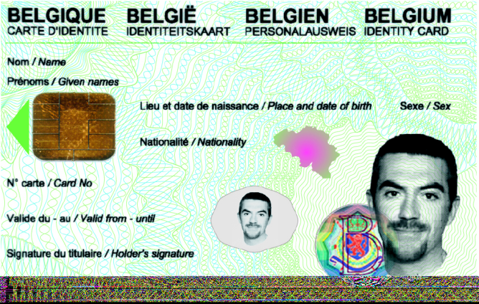

Slide 4
What is a smart card?
Long history, invented in the 1970s
Integrated Circuit Cards - ICC
Initially used for pay phone systems in France
Most successful deployment: GSM cell phones
Payments: EMV
Strong User Authentication. Some examples:
National eID programs in Asia and Europe
DoD CAC cards

Slide 5
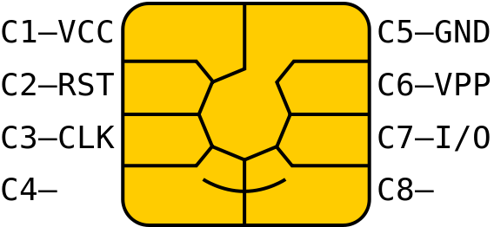
Smart Cards
ISO/IEC 7810 and 7816
Pin | Description
VCC | Power supply input
RST | Reset signal from the interface device, or In combination with an internal reset control circuit (optional)
CLK | Clock signal (optional used by the card)
GND | Ground voltage
VPP | Programming voltage input (deprecated, optional)
I/O | Serial data I/O
C4 | Aux contact. USB devices D+
C8 | Aux contact. USB devices D-

Slide 6
Smart Cards: typical
256 – 4KB RAM
8KB – 32KB ROM
1KB – 32KB EEPROM
CPU
8-bit or 16-bit CPU (8051 is common) @ 16MHz
32-bit RISC @ 25 – 32 MHz
Crypto processor: RSA, DES, 3DES, ECC, AES, SHAx
Atmel, Infineon, NXP, ST Microelectronics, and many others

Slide 7
Credit Cards with Chip
1974
1977
1979
1984
1996
2007
Chip card description
uP chip card invention
Commercial smart cards
French chip card rollout
EMV
Contactless protocol
2008
CCPS: Contactless Comm. Protocol Spec. (L1)

Slide 8
Benefits of smart cards
Provides secure storage for private keys & data
Tamper resistant
Cryptographically secure
Provides two factor authentication
Something you have – The Card
Something you know – The PIN (Also referred to as Card Holder Verification- CHV)
Programmable cards
Ex.: JavaCards, .NET Cards

Slide 9
Some Applications
Building access
User authentication (ID)
Banking and finance
Mobile communications
Pay phone cards
E-mail security
Transportation
Passports
Loyalty programs

Slide 10
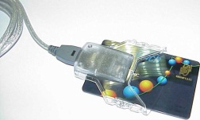
Possible eID scenarios
Work Corp
Woodgrove Bank
Government Tax Agency
Government eID Bank Smartcard …
Domain Logon
Web Banking
Name Address Submit/sign form …
eID Issuance
Email, IM, …
Abby
Smartcard + Reader / PIN pad
Michael

Slide 11
Smart Card Management System
Register/Unregister
Adding/Removing from the system
Issue
Issuance and personalization for a smart card holder
Initialization
Activating for the first use by the card holder
Deactivation/Activation
Putting the card on hold and re-activating it
Lock/Unlock
Card holder access is blocked or unblocked
Revoke
Card credentials are revoked
Retire
Card holder is disconnected from the card
Delete
Permanent removal of the card from the system
Backup/Restore
Backup copy of the credentials on the card, and restore from a backup

Slide 12
Hardware Security Modules
Physical computing device in different form factors
One or more crypto processors
Tamper-resistant
Bus snooping prevention
Side channel leakage protection
Self zeroization and destruction
No key export mode
FIPS 140 Level 3+ certification
SW Interfaces: PKCS#11, Java, CAPI, CNG, and proprietary

Slide 13
Why HSM?
Compliance requirements
FIPS 140 Level 3+
Common Criteria (EAL3+)
All crypto keys are locked inside the HSM
No cleartext keys outside the HSM
Key operations via handles, key usage restrictions
High-value keys: significant negative impact from key compromise
Object types
Asymmetric keys
Symmetric keys
Certificates
Arbitrary data
Crypto processing offload
TLS accelerators, cryptographic processing offload

Slide 14
A Few Use Cases
Certificate Authorities: PKI
CA private key is generated and stored in the HSM
Payments
PCI: Payment Card Industry data protection
PIN encryption
EMV: Card Master Keys, key derivation
TLS
Crypto processing offload: accelerator
Private keys are generated and used in the HSM

Slide 15
Net HSM, Security Worlds
Network attached HSM, sharable cryptographic resource
Multiple HSM devices sharing the same set of keys
Each device has unique HW keys
Common security world keys encrypted with device key
Encrypted keys are stored in files
Security World keys encrypt application keys
Encrypted application keys are stored in files
Access cards (smart cards) are optionally required
Required to add an HSM to a security world
Lights-out mode: no PIN, no smart card (accelerator mode)

Slide 16
TPM for Crypto
HSM
Hardware Security Module
TPM based
Crypto
Software Crypto
No Hardware
Cost:
Expensive Moderate Inexpensive
Security:
Very Secure More Secure Moderate (OS-Dependent)
Deployment:
Hard Easier Easy
Following TPM sections include content from Shon Eizenhoefer, Paul England, David Wooten

Slide 17
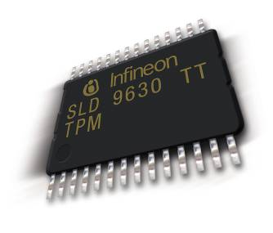
What Is A Trusted Platform Module (TPM)?
Smartcard-like module on the motherboard
Protects secrets
Performs cryptographic functions
RSA, SHA-1/256, RNG, ECC, AES, others
Performs digital signature operations
Anchors chain of trust for keys and credentials
Protects itself against attacks
Holds Platform Measurements (hashes)
Can create, store and manage keys
Provides a unique Endorsement Key (EK)
Provides a unique Storage Root Key (SRK)
TPM 1.2 spec: www.trustedcomputinggroup.org

Slide 18
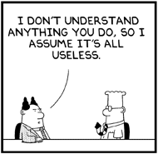
TPM v1.2 → v2.0
Algorithmic progression
SHA-1 showing sign of weakness
Shift from RSA to ECC
Mutual lack of trust across geographies
Need beyond user PCs
Server use cases
Too difficult to use (Owner → Security, Privacy, Platform)
V1.2 and v2.0 are not compatible
Notes:
http://www.iaik.tugraz.at/content/about_iaik/events/ETISS_INTRUST_2013/ETISS/slides/ETISS-INTRUST-2013-LiqunChen.pdf

Slide 19
TPM v1.2 and 2.0
 | V1.0 | V2.0
Architecture | Only one | Common and platform-specific: mandatory, optional, or banned
Cryptographic Algorithms | Required: RSA, SHA-1, MGF1, RNG, DAA, KeyGen Optional: AES, XOR Banned: 3DES | Required: SHA-1, SHA-256, RSA, ECC (BN-256, NIST P-256), HMAC, AES-128, MGF1, RNG, DAA-ECC, KeyGen, KDF
Storage Root Key | RSA-2048 with one hierarchy | Multiple keys and algorithms per hierarchy (three of them)

Slide 20
TPMv2.0 Roots of Trust
Elements that must be trusted: malice is not detectable
Measurement (RTM)
Integrity relevant information (of CPU)
Core Roots of Trust or Measurement is the first set of instructions executed by the CPU when a new trust chain is established (reset)
These instructions send identity values to RTS
Storage (RTS)
Shielded TPM memory (e.g., keys)
Reporting (RTR)
Reports on RTS contents, i.e., signature over TPM contents
PCR: Platform Configuration Registers (Quote)
Audit logs
Key properties

Slide 21
TPMv2.0 Primary Seeds
Large random value stored persistently in the TPM
Used to generate keys, seeds, and proof values
Object Value = KDF(Primary Seed, Parameters)
EPS: Endorsement Primary Seed
Generate Endorsement Keys (EK) – RTR Identity
PPS: Platform Primary Seed
Hierarchy controlled by platform firmware (not OS)
SPS: Storage Primary Seed
Hierarchies controlled by the platform owner
Generates Storage Root Keys (SRK) for OS/App use

Slide 22
TPM v2.0 Crypto Subsystem
Hash functions and HMAC
Asymmetric encryption and decryption
Asymmetric signing and signature verification
Symmetric encryption and decryption
CTR, OFB, CBC, CFB, ECB
Key generation
Key generation from the RNG
Primary Key derivation from a seed with a KDF
RNG
KDF
Hash-based (SP800-108 and SP800-56A)
HMAC as the PRF

Slide 23
TPM RNG
RNG consists of
Entropy source and collector
Collects entropy and removes bias
Collected entropy is used to update the state register
State register
Input value to the mixing function
Mixing function (e.g., a hash function)
Typically implemented as a PRNG

Slide 24
TPM RNG
RNG
DRBG
TPM2_StirRandom()
Entropy Source
Entropy
Random Bits
Random Numbers

Slide 25
TPM Key Features
Platform measurements
TPM can measure instruction sequences & store the results in Platform Configuration Registers (PCRs)
Encryption
TPM can encrypt arbitrary data using TPM keys, or keys protected by TPM keys
Sealed Storage
TPM can encrypt arbitrary data, using TPM keys or keys protected by TPM keys and under a set of PCR values
Data can only be decrypted later under the same PCR configuration
Attestation (more later)

Slide 26
Sealed Storage
Why is Sealed Storage useful?
Provides a mechanism for defending against boot-time attacks
Sealed Storage lets a TPM encrypt data to a specific set (or subset) of PCR values
Example: Full Volume Encryption (FVE)
BitLocker™ Drive Encryption on Windows

Slide 27
Booting w/ TPM measurements

Slide 28
Secure Boot with TPM
Where does the public key trust come from?
Databases
Signature Database and Revoked Signature Database
Signers or image hashes (UEFI app/driver, OS Loader)
Key Enrollment Key database
Database of signing keys to update the signature databases
Boot Sequence
Boot manager → Anti-Malware → Kernel Drivers → Initialize User Mode processes

Slide 29
Disk Layout And Key Storage
Where’s the Encryption Key?
SRK (Storage Root Key) contained in TPM
SRK encrypts FVEK (Full Volume Encryption Key) protected by TPM/PIN/USB Storage Device
FVEK stored (encrypted by SRK) on hard drive in the OS Volume
OS Volume Contains
Encrypted OS
Encrypted Page File
Encrypted Temp Files
Encrypted Data
Encrypted Hibernation File
3
OS Volume
2
FVEK
1
SRK
System
System Volume Contains:
MBR, Boot manager, Boot Utilities
(Unencrypted, small)

Slide 30
TPM Attestation
Attestation is an authentication technology
But more than “simple signing”
Attestation allows a TPM to sign data and a set (or subset) of the current PCR values
TPM attests to a certain software configuration
whatever was measured into those PCR registers is part of its digital signature
Quoting

Slide 31
TPM Attestation
Attestation | Attests to …
Endorsement Certificate | Genuine TPM, TPM specification compliance. Asymmetric key embedded in a TPM and a vouching credential
Platform Certificate | Contains a Root of Trust for Measurement, genuine TPM
Attestation Key Certificate | An asymmetric key pair protected in a genuine, but unidentified, TPM Typically relies on Endorsement and Platform Certificates
Key Attestation | Platform attestation to vouch for a TPM asymmetric key using an attestation key
Quote | Measurement to vouch for a software/firmware state, typically over a PCR using an attestation-key

Slide 32
TPM Management
User has a difficult time understanding the TPM controls
What is the difference between TPM enable and activate?
Security and privacy functions use the same controls
Need to take ownership of TPM to use the Storage Root Key but that also enables Endorsement Key operations which are privacy sensitive.
PCR sealing model is brittle
Makes it difficult to manage keys that rely on PCR values.
System updates that change a PCR measurement can be very disruptive.

Slide 33
PCR “Brittleness”
Many configuration changes leading to PCR changes are benign
But still result in keys becoming unusable, etc.
Sometimes if you plan ahead you can prevent this
E.g. seal to a future known good configuration
Sometimes we can fix this with smarter external software
E.g. extend hashes of authorized signing keys and check certificates

Slide 34
Ecosystem Issues
TPM/TCM are not interchangeable.
No BIOS level abstraction for a security token (TPM/TCM) as there is for a disk (read/write logical blocks).
Makes it hard to adopt boot code for alternative algorithms.
Trusted computing crosses national boundaries.
Neither the TPM nor the TCM has the ability to meet both local and international cryptographic requirements at the same time.
The sunset of SHA1 has demonstrated the importance of not being tied to a fixed set of algorithms.
It will be a major upset to the ecosystem (chip, system, software) to switch to a new TPM with a new software interface.
Changing the TPM algorithms is going to cause a major upheaval in the ecosystem.

Slide 35
Virtualization
Sharing a single physical platform among multiple virtual machines (VMs) with complete isolation among VMs
Benefits
Consolidation of workloads, Fault tolerance, Extensibility, Ease of Management, Better security

Slide 36
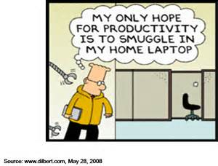
Virtualization
With increasing h/w support, performance degradation is becoming minimal
With multi-core, we can envision pervasive adoption
Solutions available for server, client, and mobile platforms
E.g., virtualized data centers (EC2, Azure)
And, Dilbert running his office VM on home computer

Slide 37
Virtual TPM
Challenge: physical TPM itself is hard to virtualize
By design, TPM resists virtualization
TPM emulation
Complete s/w emulation, TCG interface: vTPM [Berger06]
Para-virtualized TPM sharing [England08]
Hypercall interface with Hv as mediator

Slide 38
vTPM
Service VM
Guest 0
Guest 1
vTPM
vTPM
VMM
TPM

Slide 39
vTPM
Service VM
Guest
Pros
Standard TCG interface
High fidelity: full legacy support
Vendors can add VM use-cases
Migration, suspend/resume, rollback
Cons
Low resistance to physical attack
Reduced resistance to software attack
Hypervisor is more complex and exposed than TPM embedded OS
Trust model for TPM is complex
Hypervisor security model influences vTPM security
vTPM
VMM
TPM

Slide 40
Para-Virtualized TPM Sharing
Guest 0
Guest 1
VMM
TPM Access Mediation
Guest 0 state
Guest 1 state
TPM

Slide 41
Para-Virtualized TPM - Attestation
Guest 0
Guest 1
HvQuote(TCB, nonce)
PcrReset(15)
PcrExtend(15,VPCR1)
Quote((0,15), nonce)
VPCR1
VPCR1
VPCR1
VPCR0
VPCR0
TPM
Resettable PCR
…
PCR1
PCR0

