Slide 1
Practical Aspects of Modern Cryptography
Autumn 2016
Tolga Acar
Josh Benaloh

Slide 2
Application
Verifiable Elections

Slide 3
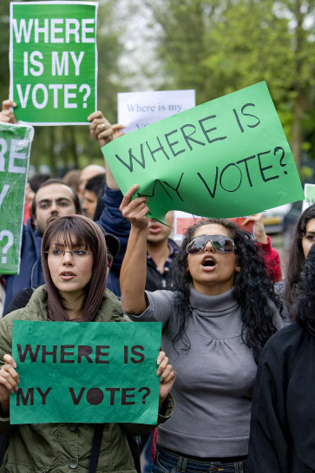

Slide 4
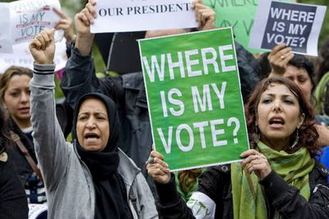
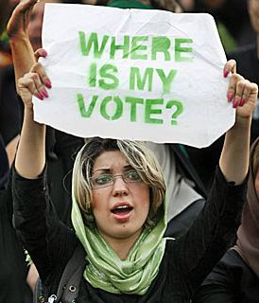
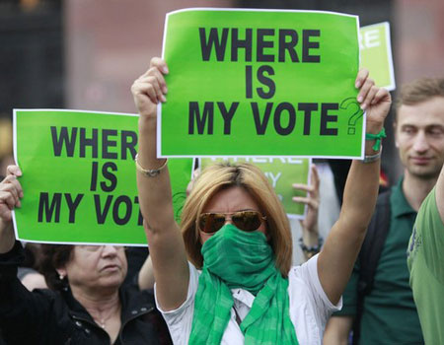
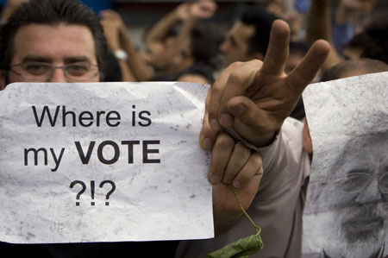

Slide 5
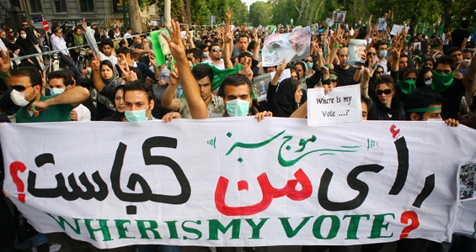
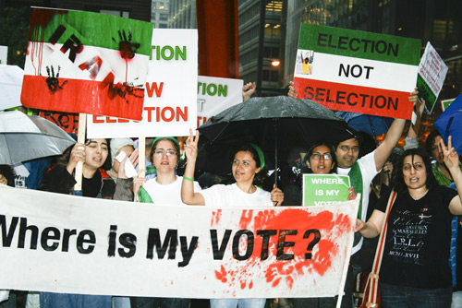

Slide 6
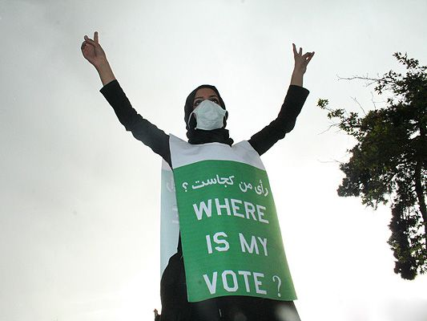
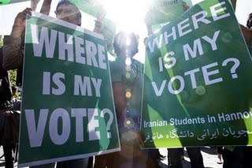

Slide 7
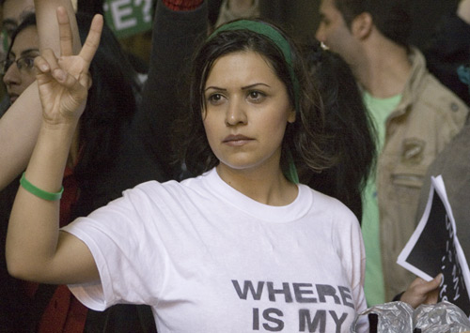
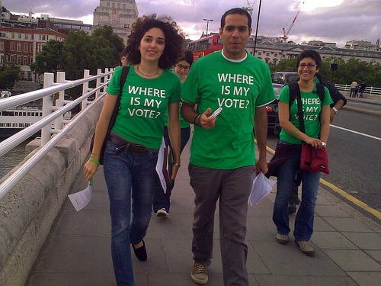

Slide 8

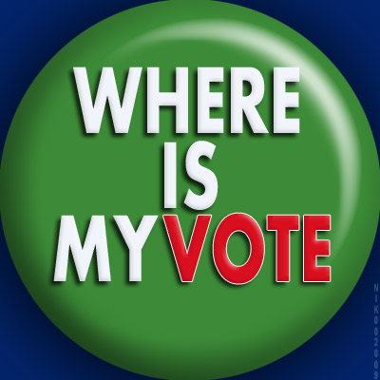

Slide 9



Slide 10
Traditional Voting Methods

Slide 11
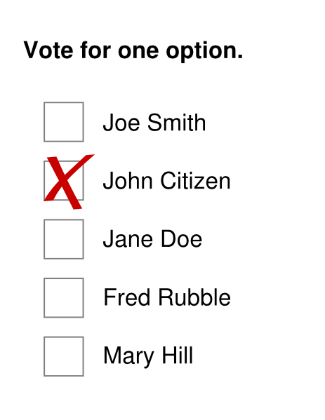
Traditional Voting Methods
Hand-Counted Paper

Slide 12
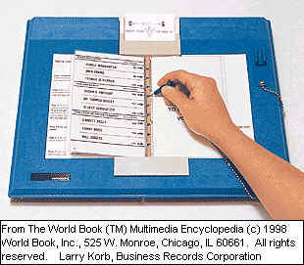
Traditional Voting Methods
Hand-Counted Paper
Punch Cards

Slide 13
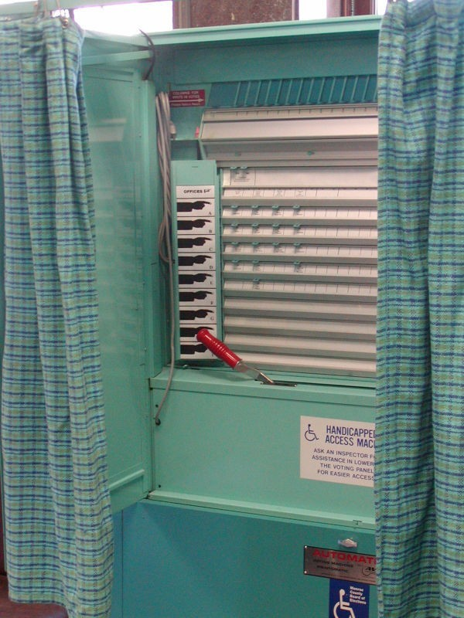
Traditional Voting Methods
Hand-Counted Paper
Punch Cards
Lever Machines

Slide 14
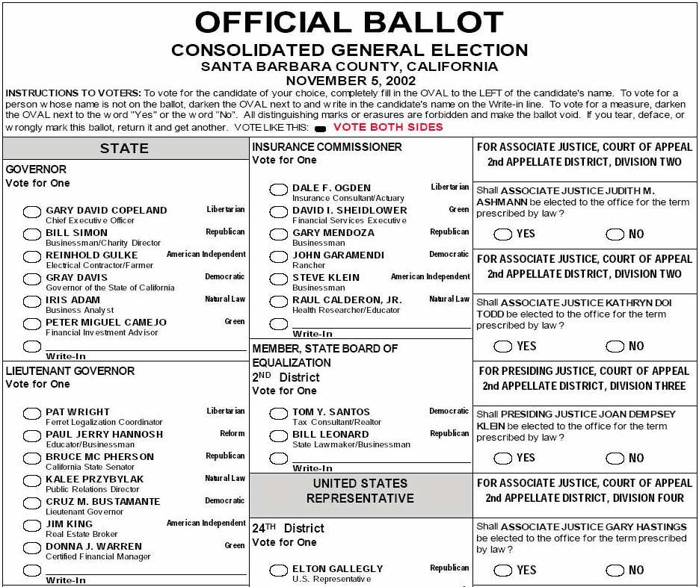
Traditional Voting Methods
Hand-Counted Paper
Punch Cards
Lever Machines
Optical Scan Ballots

Slide 15
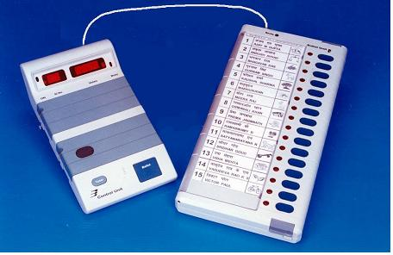
Traditional Voting Methods
Hand-Counted Paper
Punch Cards
Lever Machines
Optical Scan Ballots
Electronic Voting Machines

Slide 16
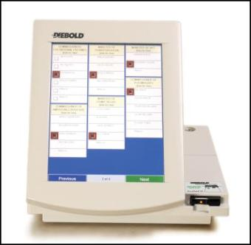
Traditional Voting Methods
Hand-Counted Paper
Punch Cards
Lever Machines
Optical Scan Ballots
Electronic Voting Machines
Touch-Screen Terminals

Slide 17
Traditional Voting Methods
Hand-Counted Paper
Punch Cards
Lever Machines
Optical Scan Ballots
Electronic Voting Machines
Touch-Screen Terminals
Various Hybrids

Slide 18
Vulnerabilities and Trust
All of these systems have substantial vulnerabilities.
All of these systems require trust in the honesty and expertise of election officials (and usually the equipment vendors as well).
Can we do better?

Slide 19
The Voter’s Perspective

Slide 20

The Voter’s Perspective

Slide 21
The Voter’s Perspective

Slide 22
The Voter’s Perspective

Slide 23

The Voter’s Perspective

Slide 24
The Voter’s Perspective

Slide 25

The Voter’s Perspective

Slide 26
The Voter’s Perspective

Slide 27

The Voter’s Perspective

Slide 28

The Voter’s Perspective

Slide 29

The Voter’s Perspective

Slide 30

The Voter’s Perspective

Slide 31

The Voter’s Perspective

Slide 32
The Voter’s Perspective

Slide 33
The Voter’s Perspective

Slide 34
The Voter’s Perspective
As a voter, you don’t really know what happens behind the curtain.
You have no choice but to trust the people working behind the curtain.
You don’t even get to choose the people who you will have to trust.

Slide 35
The Voter’s Perspective
As a voter, you don’t really know what happens behind the curtain.
You have no choice but to trust the people working behind the curtain.
You don’t even get to choose the people who you will have to trust.

Slide 36
We Can Do Better!
Elections can be run such that each and every voter can verify the correctness of the tally without having to trust anyone or anything!

Slide 37
Verifiable Election Technologies
Allow voters to track their individual (sealed) votes and ensure that they are properly counted…
… even in the presence of faulty or malicious election equipment …
… and/or careless or dishonest election personnel.

Slide 38
Voters can check that …
Their own (sealed) votes have been properly recorded.
All recorded votes have been properly counted.
This is not just checking a claim that the right steps have been taken.
This is actually a check that the counting is correct.

Slide 39
End-to-End Verifiability
E2E-verifiability is not a property of an election system …
It is a property of an individual election.

Slide 40
End-to-End Verifiability
E2E-verifiable elections can be produced by …
Paper-based or Electronic systems
Local or Remote systems
Monitored or Unmonitored systems

Slide 41
E2E is a Property
End-to-end verifiability is a property of an election.
Voters can check that their selections have been accurately recorded.
Anyone can check that all recorded votes have been accurately counted.

Slide 42
E2E-Verifiability Replaces Trust
In an E2E-verifiable election, the integrity of tallies can be verified entirely without trust.
Voters and observers can verify everything themselves. They don’t need to trust election officials, equipment, vendors, or anyone.

Slide 43
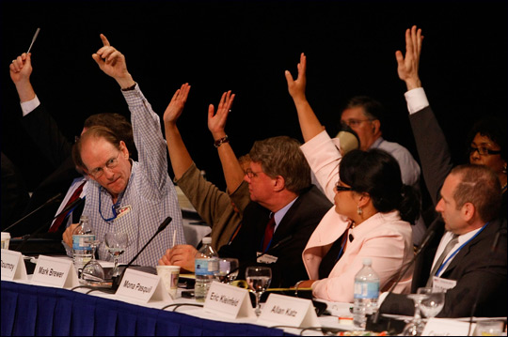
An E2E-Verifiable Election

Slide 44
An E2E-Verifiable Election
Voter Name | Vote
Alice Smith | Jefferson
Bob Williams | Adams
Carol James | Adams
David Fuentes | Jefferson
Ellen Chu | Jefferson
Totals
Jefferson | 3
Adams | 2

Slide 45
But wait …
This isn’t a secret-ballot election.
Quite true, but it’s enough to show that E2E-verifiability is possible
… and also to falsify arguments that electronic elections are inherently untrustworthy.

Slide 46
Privacy
The only ingredient missing from this transparent election is privacy – and the things which flow from privacy (e.g. protection from coercion).
Performing tasks while preserving privacy is the bailiwick of cryptography.
Cryptographic techniques can enable E2E-verifiable elections while preserving voter privacy.

Slide 47
Adding Encryption
A layer of confidentiality can be added to an otherwise openly-verifiable system using homomoprhic encryption to sum votes in encrypted form.

Slide 48
Secure Multiparty Computation
General cryptographic techniques can compute any function on private inputs.
Does not apply to elections because voters should not be able to reveal their votes – even if they want to do so.

Slide 49
Multi-Party Computation (MPC)
[a.k.a. Secure Function Evaluation (SFE)]
Techniques like zero-knowledge interactive proofs allow parties to compute any function of their respective inputs – without revealing their inputs.

Slide 50
Why are Elections so Hard?
Voters should not be able to reveal their votes to others – even if they want to.
The ability to reveal votes would enable vote-selling and coercion.
MPC allows participants to disclose inputs.

Slide 51
An E2E-Verifiable Election
Voter Name | Vote
Alice Smith | Jefferson
Bob Williams | Adams
Carol James | Adams
David Fuentes | Jefferson
Ellen Chu | Jefferson
Totals
Jefferson | 3
Adams | 2

Slide 52
An E2E-Verifiable Election
Voter Name | Vote
Alice Smith | Jefferson | X37BM6YPM
Bob Williams | Adams | 2J8CNF2KQ
Carol James | Adams | VRSF5JQWZ
David Fuentes | Jefferson | MW5B2VA7Y
Ellen Chu | Jefferson | 8VPPS2L39
Totals
Jefferson | 3
Adams | 2

Slide 53
An E2E-Verifiable Election
Voter Name | Vote
Alice Smith | Jefferson | X37BM6YPM
Bob Williams | Adams | 2J8CNF2KQ
Carol James | Adams | VRSF5JQWZ
David Fuentes | Jefferson | MW5B2VA7Y
Ellen Chu | Jefferson | 8VPPS2L39
Totals
Jefferson | 3
Adams | 2

Slide 54
An E2E-Verifiable Election
Voter Name | Vote
Alice Smith | Jefferson | X37BM6YPM
Bob Williams | Adams | 2J8CNF2KQ
Carol James | Adams | VRSF5JQWZ
David Fuentes | Jefferson | MW5B2VA7Y
Ellen Chu | Jefferson | 8VPPS2L39
Totals
Jefferson | 3
Adams | 2

Slide 55
An E2E-Verifiable Election
 |  | X37BM6YPM
 |  | 2J8CNF2KQ
 |  | VRSF5JQWZ
 |  | MW5B2VA7Y
 |  | 8VPPS2L39
Totals
Jefferson | 3
Adams | 2

Slide 56
An E2E-Verifiable Election
 |  | X37BM6YPM
 |  | 2J8CNF2KQ
 |  | VRSF5JQWZ
 |  | MW5B2VA7Y
 |  | 8VPPS2L39
Mathematical
Proof
Totals
Jefferson | 3
Adams | 2

Slide 57
Secure MPC is not Enough
Secure Multi-Party Computation allows any public function to be computed on any number of private inputs without compromising the privacy of the inputs.
But secure MPC does not prevent parties from revealing their private inputs if they so choose.

Slide 58
End-to-End Verifiable Elections
Two principle phases …
Voters publish their names and encrypted votes.
Administrators compute and publish the tally together with a cryptographic proof that the tally “matches” the set of encrypted votes.

Slide 59
Fundamental Tallying Decision
There are essentially two paradigms to choose from …
Anonymized Ballots
(Mix Networks)
Ballotless Tallying
(Homomorphic Encryption)

Slide 60
Anonymized Ballots

Slide 61
Ballotless Tallying

Slide 62
Homomorphic Tallying

Slide 63
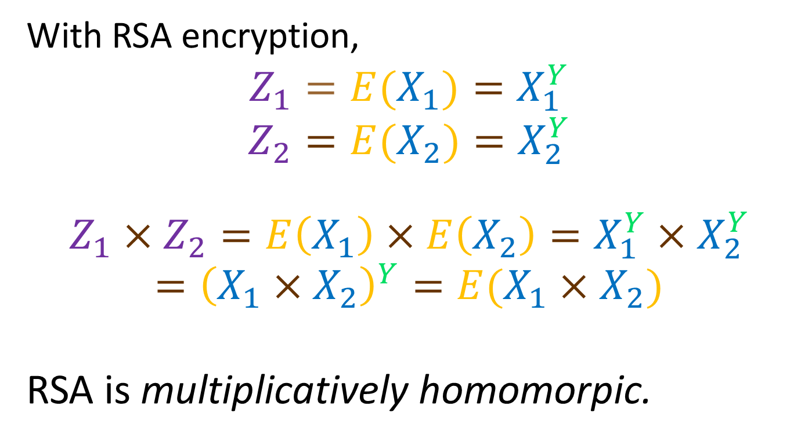
Homomorphic Encryption
With RSA encryption,
$$Z_{1}=E(X_{1})=X_{1}^{Y}$$
$$Z_{2}=E(X_{2})=X_{2}^{Y}$$
$$Z_{1}×Z_{2}=E\left(X_{1}\right)×E\left(X_{2}\right)=X_{1}^{Y}×X_{2}^{Y}$$
$$={\left(X_{1}×X_{2}\right)}^{Y}=E(X_{1}×X_{2})$$
RSA is multiplicatively homomorpic.

Slide 64
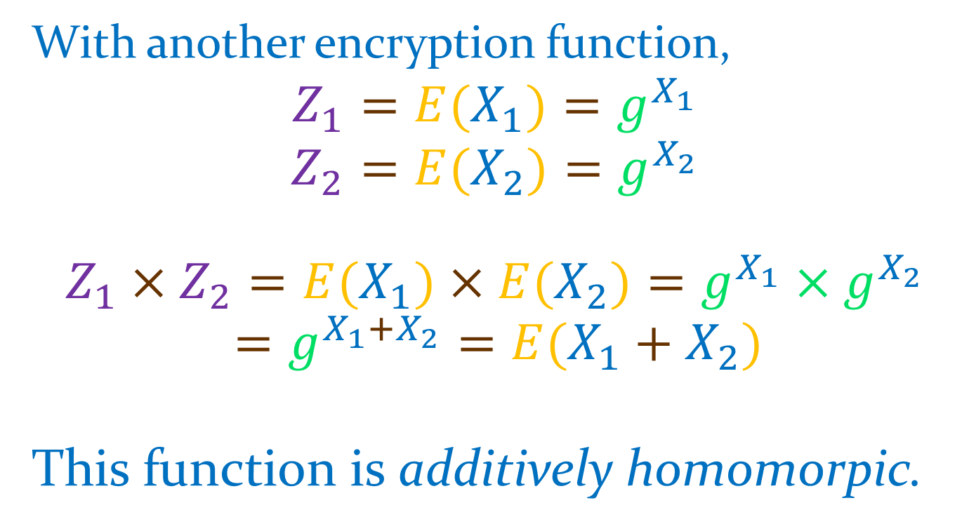
Homomorphic Encryption
With another encryption function,
$$Z_{1}=E(X_{1})=g^{X_{1}}$$
$$Z_{2}=E(X_{2})=g^{X_{2}}$$
$$Z_{1}×Z_{2}=E(X_{1})×E(X_{2})=g^{X_{1}}×g^{X_{2}}$$
$$=g^{X_{1}+X_{2}}=E(X_{1}+X_{2})$$
This function is additively homomorpic.

Slide 65
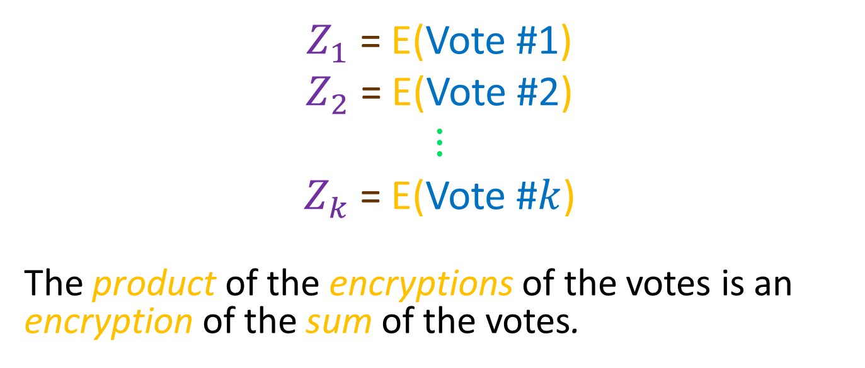
In Elections …
$Z_{1}$ = E(Vote #1)
$Z_{2}$ = E(Vote #2)
$$⋮$$
$Z_{k}$ = E(Vote #$k$)
The product of the encryptions of the votes is an encryption of the sum of the votes.

Slide 66
Homomorphic Encryption
Some Homomorphic Functions
RSA: E(m) = m^{e} mod n
ElGamal: E(m,r) = (g^{r},mh^{r}) mod p
GM: E(b,r) = r²g^{b} mod n
Benaloh: E(m,r) = r^{e}g^{m} mod n
Pallier: E(m,r) = r^{n}g^{m} mod n²

Slide 67
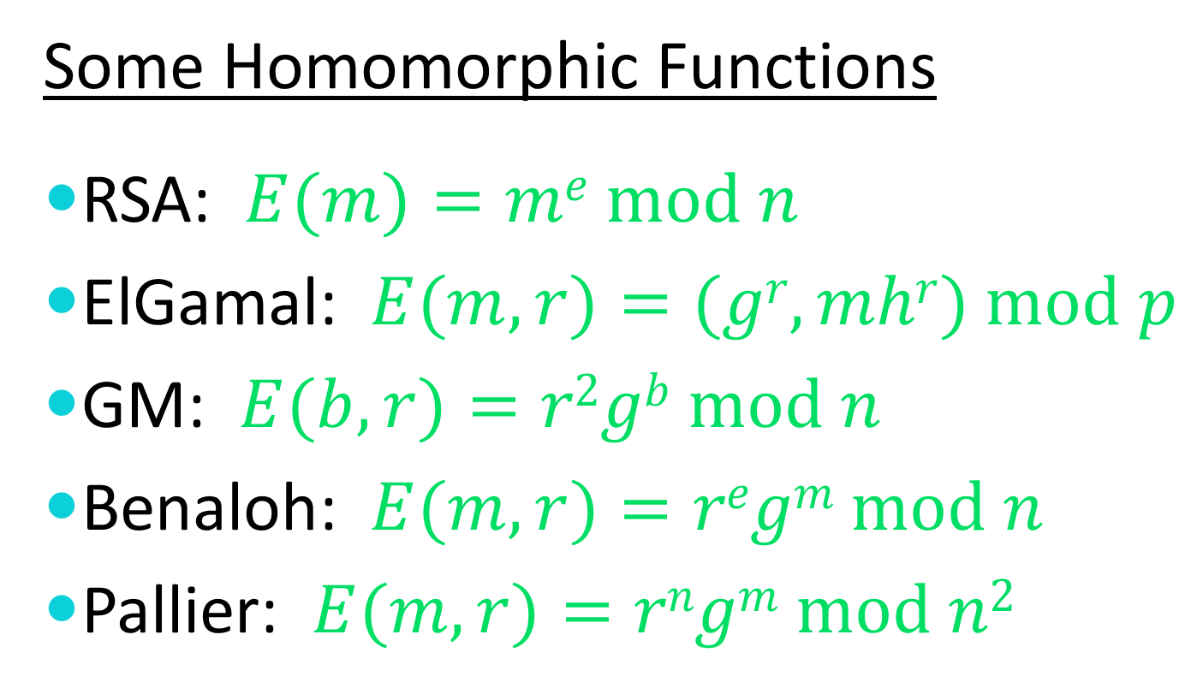
Homomorphic Encryption
Some Homomorphic Functions
RSA: $E(m)=me mod n$
ElGamal: $E(m,r)=(gr,mhr) mod p$
GM: $E(b,r)=r2gb mod n$
Benaloh: $E(m,r)=regm mod n$
Pallier: $E(m,r)=rngm mod n2$

Slide 68
Fully Homomorphic Encryption
The prior multiplicatively and additively homomorphic encryption functions are all very efficient.
There are much newer fully homomorphic encryption functions (simultaneously additive and multiplicative), but they are very inefficient.

Slide 69
Cloud Computing
The holy grail of a cloud computing service is to be able to perform (multi-party) computations on encrypted data without holding decryption keys.
This is entirely possible
– in theory
But it’s woefully inefficient in practice
– except in special cases

Slide 70

A Valid Vote
$$\left\langle 0, 1, 0, 0; 1, 0; 0, 0, 0\right\rangle$$
First Race
Second Race
Third Race
First
Option
Second
Option
Third
Option
Fourth
Option

Slide 71
Pros and Cons of Ballots
Ballots simplify write-ins.
Ballots make it harder to enforce privacy – especially in complex counting scenarios.

Slide 72
Homomorphic Encryption
We can construct a public-key encryption function E such that if
A is an encryption of a and
B is an encryption of b then
A⊗B is an encryption of a⊕b.

Slide 73
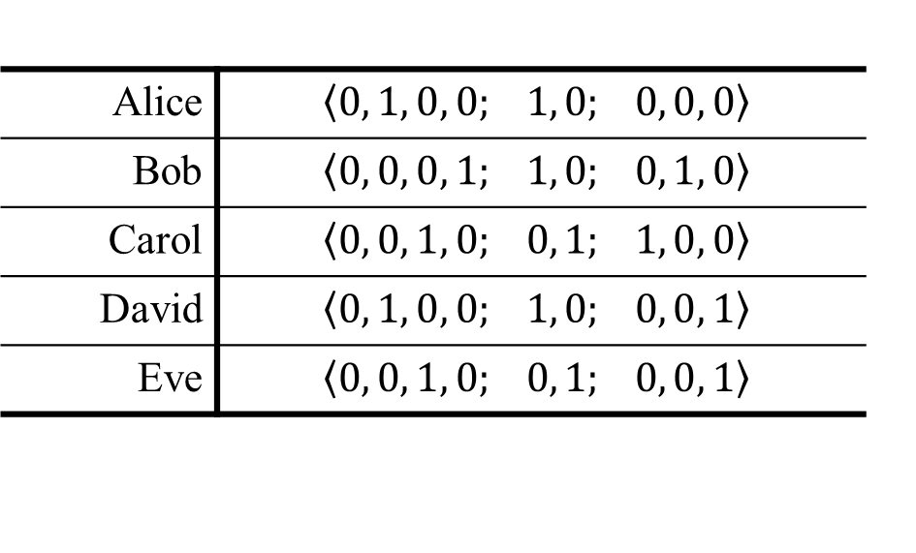
Homomorphic Elections
Alice | $$\left\langle 0, 1, 0, 0; 1, 0; 0, 0, 0\right\rangle$$
Bob | $$\left\langle 0, 0, 0, 1; 1, 0; 0, 1, 0\right\rangle$$
Carol | $$\left\langle 0, 0, 1, 0; 0, 1; 1, 0, 0\right\rangle$$
David | $$\left\langle 0, 1, 0, 0; 1, 0; 0, 0, 1\right\rangle$$
Eve | $$\left\langle 0, 0, 1, 0; 0, 1; 0, 0, 1\right\rangle$$

Slide 74
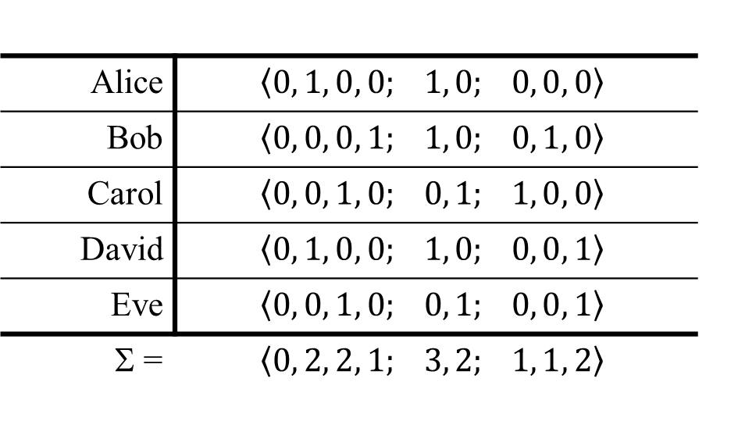
Homomorphic Elections
Alice | $$\left\langle 0, 1, 0, 0; 1, 0; 0, 0, 0\right\rangle$$
Bob | $$\left\langle 0, 0, 0, 1; 1, 0; 0, 1, 0\right\rangle$$
Carol | $$\left\langle 0, 0, 1, 0; 0, 1; 1, 0, 0\right\rangle$$
David | $$\left\langle 0, 1, 0, 0; 1, 0; 0, 0, 1\right\rangle$$
Eve | $$\left\langle 0, 0, 1, 0; 0, 1; 0, 0, 1\right\rangle$$
Σ = | $$\left\langle 0, 2, 2, 1; 3, 2; 1, 1, 2\right\rangle$$

Slide 75
Homomorphic Elections
Alice | $$\left\langle 0, 1, 0, 0; 1, 0; 0, 0, 0\right\rangle$$
Bob | $$\left\langle 0, 0, 0, 1; 1, 0; 0, 1, 0\right\rangle$$
Carol | $$\left\langle 0, 0, 1, 0; 0, 1; 1, 0, 0\right\rangle$$
David | $$\left\langle 0, 1, 0, 0; 1, 0; 0, 0, 1\right\rangle$$
Eve | $$\left\langle 0, 0, 1, 0; 0, 1; 0, 0, 1\right\rangle$$

Slide 76
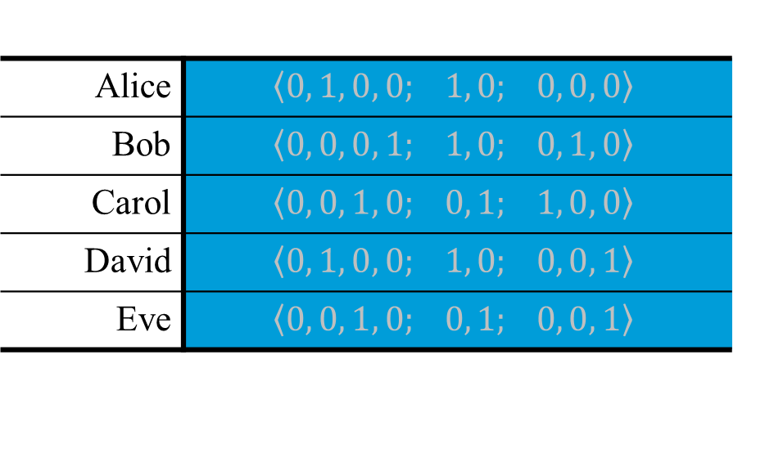
Homomorphic Elections
Alice | $$\left\langle 0, 1, 0, 0; 1, 0; 0, 0, 0\right\rangle$$
Bob | $$\left\langle 0, 0, 0, 1; 1, 0; 0, 1, 0\right\rangle$$
Carol | $$\left\langle 0, 0, 1, 0; 0, 1; 1, 0, 0\right\rangle$$
David | $$\left\langle 0, 1, 0, 0; 1, 0; 0, 0, 1\right\rangle$$
Eve | $$\left\langle 0, 0, 1, 0; 0, 1; 0, 0, 1\right\rangle$$

Slide 77
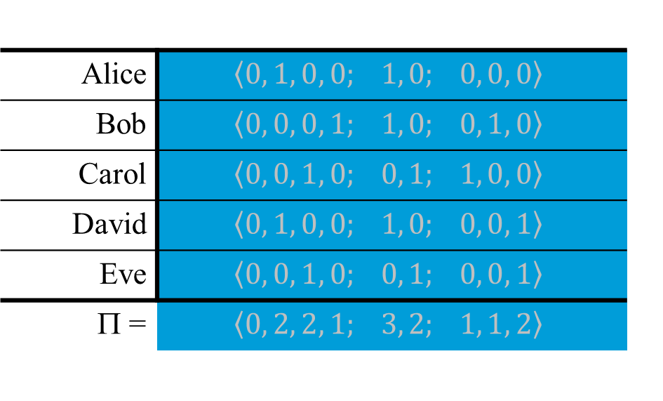
Homomorphic Elections
Alice | $$\left\langle 0, 1, 0, 0; 1, 0; 0, 0, 0\right\rangle$$
Bob | $$\left\langle 0, 0, 0, 1; 1, 0; 0, 1, 0\right\rangle$$
Carol | $$\left\langle 0, 0, 1, 0; 0, 1; 1, 0, 0\right\rangle$$
David | $$\left\langle 0, 1, 0, 0; 1, 0; 0, 0, 1\right\rangle$$
Eve | $$\left\langle 0, 0, 1, 0; 0, 1; 0, 0, 1\right\rangle$$
Π = | $$\left\langle 0, 2, 2, 1; 3, 2; 1, 1, 2\right\rangle$$

Slide 78

Homomorphic Elections
Alice | $$\left\langle 0, 1, 0, 0; 1, 0; 0, 0, 0\right\rangle$$
Bob | $$\left\langle 0, 0, 0, 1; 1, 0; 0, 1, 0\right\rangle$$
Carol | $$\left\langle 0, 0, 1, 0; 0, 1; 1, 0, 0\right\rangle$$
David | $$\left\langle 0, 1, 0, 0; 1, 0; 0, 0, 1\right\rangle$$
Eve | $$\left\langle 0, 0, 1, 0; 0, 1; 0, 0, 1\right\rangle$$
Σ = | $$\left\langle 0, 2, 2, 1; 3, 2; 1, 1, 2\right\rangle$$

Slide 79
Homomorphic Elections
Alice | $$\left\langle 0, 1, 0, 0; 1, 0; 0, 0, 0\right\rangle$$
Bob | $$\left\langle 0, 0, 0, 1; 1, 0; 0, 1, 0\right\rangle$$
Carol | $$\left\langle 0, 0, 1, 0; 0, 1; 1, 0, 0\right\rangle$$
David | $$\left\langle 0, 1, 0, 0; 1, 0; 0, 0, 1\right\rangle$$
Eve | $$\left\langle 0, 0, 1, 0; 0, 1; 0, 0, 1\right\rangle$$
Σ = | $$\left\langle 0, 2, 2, 1; 3, 2; 1, 1, 2\right\rangle$$

Slide 80
Homomorphic Elections
Alice | $$\left\langle 0, 1, 0, 0; 1, 0; 0, 0, 0\right\rangle$$
Bob | $$\left\langle 0, 0, 0, 1; 1, 0; 0, 1, 0\right\rangle$$
Carol | $$\left\langle 0, 0, 1, 0; 0, 1; 1, 0, 0\right\rangle$$
David | $$\left\langle 0, 1, 0, 0; 1, 0; 0, 0, 1\right\rangle$$
Eve | $$\left\langle 0, 0, 1, 0; 0, 1; 0, 0, 1\right\rangle$$
Σ = | $$\left\langle 0, 2, 2, 1; 3, 2; 1, 1, 2\right\rangle$$

Slide 81
Homomorphic Elections
Alice | 0
Bob | 0
Carol | 1
David | 0
Eve | 1
 | Σ =

Slide 82
Homomorphic Elections
Alice | 0
Bob | 0
Carol | 1
David | 0
Eve | 1
 | Σ =
 | 2

Slide 83
Homomorphic Elections
Alice | 0
Bob | 0
Carol | 1
David | 0
Eve | 1

Slide 84
Homomorphic Elections
Alice | 0
Bob | 0
Carol | 1
David | 0
Eve | 1

Slide 85
Homomorphic Elections
Alice | 0
Bob | 0
Carol | 1
David | 0
Eve | 1
 | ⊗=
 | 2

Slide 86
Homomorphic Elections
Alice | 0
Bob | 0
Carol | 1
David | 0
Eve | 1
 | ⊗=
 | 2

Slide 87
Homomorphic Elections
Alice | 0
Bob | 0
Carol | 1
David | 0
Eve | 1
 | ⊗=
 | 2

Slide 88
Multiple Authorities
Alice | 0
Bob | 0
Carol | 1
David | 0
Eve | 1

Slide 89
Multiple Authorities
 |  |  | X₁ | X₂ | X₃
Alice | 0 | = Σ | 3 | -5 | 2
Bob | 0 | = Σ | -4 | 5 | -1
Carol | 1 | = Σ | 2 | -3 | 2
David | 0 | = Σ | -2 | -1 | 3
Eve | 1 | = Σ | 4 | -1 | -2

Slide 90
Multiple Authorities
 |  |  | X₁ | X₂ | X₃
Alice | 0 | = Σ | 3 | -5 | 2
Bob | 0 | = Σ | -4 | 5 | -1
Carol | 1 | = Σ | 2 | -3 | 2
David | 0 | = Σ | -2 | -1 | 3
Eve | 1 | = Σ | 4 | -1 | -2
 |  |  | Σ = | Σ = | Σ =

Slide 91
Multiple Authorities
 |  |  | X₁ | X₂ | X₃
Alice | 0 | = Σ | 3 | -5 | 2
Bob | 0 | = Σ | -4 | 5 | -1
Carol | 1 | = Σ | 2 | -3 | 2
David | 0 | = Σ | -2 | -1 | 3
Eve | 1 | = Σ | 4 | -1 | -2
 |  |  | Σ = | Σ = | Σ =
 |  |  | 3 | -5 | 4

Slide 92
Multiple Authorities
 |  |  | X₁ | X₂ | X₃
Alice | 0 | = Σ | 3 | -5 | 2
Bob | 0 | = Σ | -4 | 5 | -1
Carol | 1 | = Σ | 2 | -3 | 2
David | 0 | = Σ | -2 | -1 | 3
Eve | 1 | = Σ | 4 | -1 | -2
 |  |  | Σ = | Σ = | Σ =
 |  | = Σ | 3 | -5 | 4

Slide 93
Multiple Authorities
 |  |  | X₁ | X₂ | X₃
Alice | 0 | = Σ | 3 | -5 | 2
Bob | 0 | = Σ | -4 | 5 | -1
Carol | 1 | = Σ | 2 | -3 | 2
David | 0 | = Σ | -2 | -1 | 3
Eve | 1 | = Σ | 4 | -1 | -2
 |  |  | Σ = | Σ = | Σ =
 | 2 | = Σ | 3 | -5 | 4

Slide 94
Multiple Authorities
 |  |  | X₁ | X₂ | X₃
Alice | 0 | = Σ | 3 | -5 | 2
Bob | 0 | = Σ | -4 | 5 | -1
Carol | 1 | = Σ | 2 | -3 | 2
David | 0 | = Σ | -2 | -1 | 3
Eve | 1 | = Σ | 4 | -1 | -2
 | Σ = |  | Σ = | Σ = | Σ =
 | 2 | = Σ | 3 | -5 | 4

Slide 95
Multiple Authorities
The sum of the shares of the votes constitute shares of the sum of the votes.

Slide 96
Multiple Authorities
 |  |  | X₁ | X₂ | X₃
Alice | 0 | = Σ | 3 | -5 | 2
Bob | 0 | = Σ | -4 | 5 | -1
Carol | 1 | = Σ | 2 | -3 | 2
David | 0 | = Σ | -2 | -1 | 3
Eve | 1 | = Σ | 4 | -1 | -2
 | Σ = |  | Σ = | Σ = | Σ =
 | 2 | = Σ | 3 | -5 | 4

Slide 97
Multiple Authorities
 |  |  | X₁ | X₂ | X₃
Alice | 0 |  | 3 | -5 | 2
Bob | 0 |  | -4 | 5 | -1
Carol | 1 |  | 2 | -3 | 2
David | 0 |  | -2 | -1 | 3
Eve | 1 |  | 4 | -1 | -2

Slide 98
Multiple Authorities
 |  |  | X₁ | X₂ | X₃
Alice | 0 |  | 3 | -5 | 2
Bob | 0 |  | -4 | 5 | -1
Carol | 1 |  | 2 | -3 | 2
David | 0 |  | -2 | -1 | 3
Eve | 1 |  | 4 | -1 | -2
 |  |  | ⊗ = | ⊗ = | ⊗ =

Slide 99
Multiple Authorities
 |  |  | X₁ | X₂ | X₃
Alice | 0 |  | 3 | -5 | 2
Bob | 0 |  | -4 | 5 | -1
Carol | 1 |  | 2 | -3 | 2
David | 0 |  | -2 | -1 | 3
Eve | 1 |  | 4 | -1 | -2
 |  |  | ⊗ = | ⊗ = | ⊗ =
 |  |  | 3 | -5 | 4

Slide 100
Multiple Authorities
 |  |  | X₁ | X₂ | X₃
Alice | 0 |  | 3 | -5 | 2
Bob | 0 |  | -4 | 5 | -1
Carol | 1 |  | 2 | -3 | 2
David | 0 |  | -2 | -1 | 3
Eve | 1 |  | 4 | -1 | -2
 |  |  | ⊗ = | ⊗ = | ⊗ =
 |  |  | 3 | -5 | 4

Slide 101
Multiple Authorities
 |  |  | X₁ | X₂ | X₃
Alice | 0 |  | 3 | -5 | 2
Bob | 0 |  | -4 | 5 | -1
Carol | 1 |  | 2 | -3 | 2
David | 0 |  | -2 | -1 | 3
Eve | 1 |  | 4 | -1 | -2
 |  |  | ⊗ = | ⊗ = | ⊗ =
 |  | = Σ | 3 | -5 | 4

Slide 102
Multiple Authorities
 |  |  | X₁ | X₂ | X₃
Alice | 0 |  | 3 | -5 | 2
Bob | 0 |  | -4 | 5 | -1
Carol | 1 |  | 2 | -3 | 2
David | 0 |  | -2 | -1 | 3
Eve | 1 |  | 4 | -1 | -2
 |  |  | ⊗ = | ⊗ = | ⊗ =
 | 2 | = Σ | 3 | -5 | 4

Slide 103
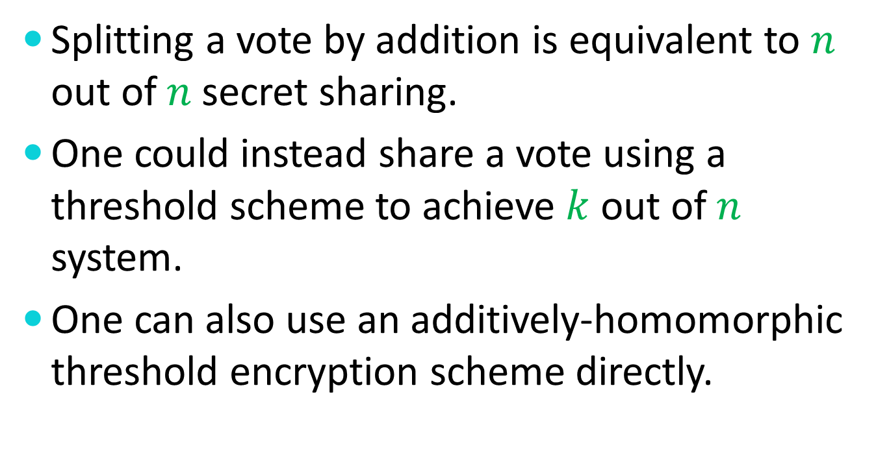
Adding Robustness
Splitting a vote by addition is equivalent to $n$ out of $n$ secret sharing.
One could instead share a vote using a threshold scheme to achieve $k$ out of $n$ system.
One can also use an additively-homomorphic threshold encryption scheme directly.

Slide 104
Mix-Based Elections

Slide 105
Mix-Based Elections
Shuffle the encrypted ballots by transforming each into a different representation of the same ballot and then permuting the full set.

Slide 106
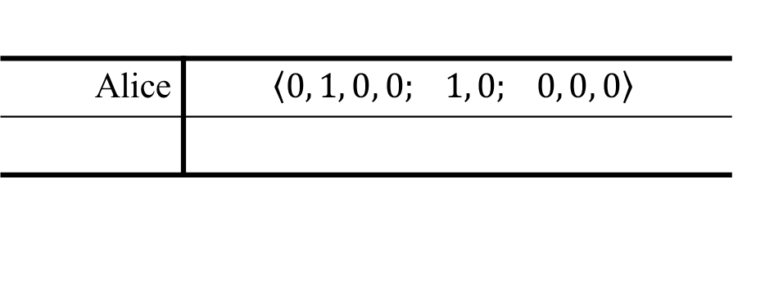
Mix-Based Elections
Alice | $$\left\langle 0, 1, 0, 0; 1, 0; 0, 0, 0\right\rangle$$

Slide 107
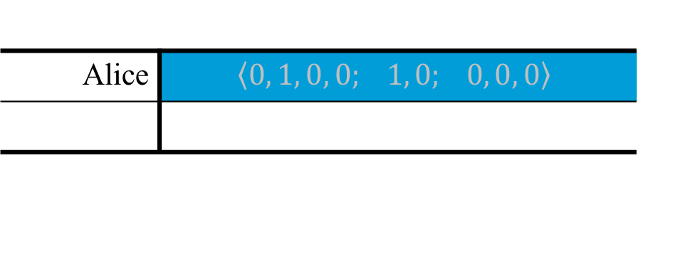
Mix-Based Elections
Alice | $$\left\langle 0, 1, 0, 0; 1, 0; 0, 0, 0\right\rangle$$

Slide 108

Mix-Based Elections
Alice | $$\left\langle 0, 1, 0, 0; 1, 0; 0, 0, 0\right\rangle$$
Null | $$\left\langle 0, 0, 0, 0; 0, 0; 0, 0, 0\right\rangle$$

Slide 109
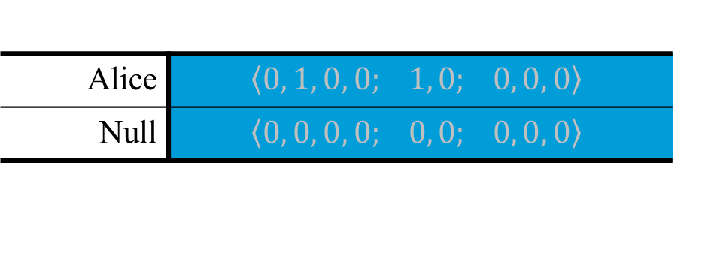
Mix-Based Elections
Alice | $$\left\langle 0, 1, 0, 0; 1, 0; 0, 0, 0\right\rangle$$
Null | $$\left\langle 0, 0, 0, 0; 0, 0; 0, 0, 0\right\rangle$$

Slide 110
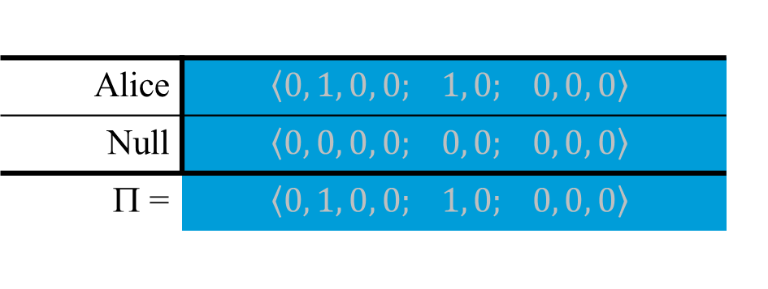
Mix-Based Elections
Alice | $$\left\langle 0, 1, 0, 0; 1, 0; 0, 0, 0\right\rangle$$
Null | $$\left\langle 0, 0, 0, 0; 0, 0; 0, 0, 0\right\rangle$$
Π = | $$\left\langle 0, 1, 0, 0; 1, 0; 0, 0, 0\right\rangle$$

Slide 111
Mix-Based Elections
Each shuffler proves that its output set is a permutation of different encryptions of its input set.
After a sufficient number of shuffles, the individual ballots can be opened.

Slide 112
Homomorphic Tallying

Slide 113
The Mix-Net Paradigm
MIX
Vote
Vote
Vote
Vote

Slide 114
The Mix-Net Paradigm
MIX
Vote
Vote
Vote
Vote

Slide 115
Multiple Mixes


MIX
❖
MIX
Vote



Vote


◎
Vote
☺

✵
Vote

Slide 116
Decryption Mix-net
  Each object is encrypted with a pre-determined set of encryption layers.
  Each mix, in pre-determined order performs a decryption to remove its associated layer.

Slide 117
Re-encryption Mix-net
  The decryption and shuffling functions are decoupled.
  Mixes can be added or removed dynamically with robustness.
  Proofs of correct mixing can be published and independently verified.

Slide 118
Recall Homomorphic Encryption
We can construct a public-key encryption function E such that if
A is an encryption of a and
B is an encryption of b then
A⊗B is an encryption of a⊕b.

Slide 119
Re-encryption (additive)
A is an encryption of a and
Z is an encryption of 0 then
A⊗Z is another encryption of a.

Slide 120
Re-encryption (multiplicative)
A is an encryption of a and
I is an encryption of 1 then
A⊗I is another encryption of a.

Slide 121
A Re-encryption Mix
MIX

Slide 122
A Re-encryption Mix
MIX

Slide 123
Re-encryption Mix-nets
MIX
MIX
Vote
Vote
Vote
Vote

Slide 124
Verifiability
Each re-encryption mix provides a mathematical proof that its output is a permutation of re-encryptions of its input.
Any observer can verify this proof.
The decryptions are also proven to be correct.
If a mix’s proof is invalid, its mixing will be bypassed.

Slide 125
Faulty Mixes
MIX
MIX
Vote
Vote
Vote
Vote

Slide 126
Some Verifiable Mixes
1993 Park, Itoh, and Kurosawa
1995 Sako and Kilian
2001 Furukawa and Sako
2001 Neff
2002 Jakobsson, Juels, and Rivest
2003 Groth

Slide 127
Re-encryption Mix Operation
Input Ballot Set
Output Ballot Set
MIX

Slide 128
Re-encryption Mix Operation
Input Ballot Set
Output Ballot Set
MIX

Slide 129
Re-encryption Mix Operation
MIX

Slide 130
Re-encryption Mix Operation
Inputs
Outputs
62951413
53124141
81828172
81828172
93308161
62951413
53124141
93308161

Slide 131
Who has the Keys?
A pre-determined set of parties independently generate and share the encryption (and decryption) keys used in the election.
A pre-determined threshold of key holders is required to decrypt.

Slide 132
Who has the Keys?
Important
If a sufficient number of key holders collude, they can compromise voter privacy.
But even if all key holders collude, they cannot compromise the integrity of the tallies.

Slide 133
Re-encryption
Each value is re-encrypted by multiplying it by an encryption of one.
This can be done without knowing the decryptions.

Slide 134
Verifying a Re-encryption
MIX
53124141
31415926
14142135
62951413
27182818
31415926
16180339
93308161
16180339
81828172
14142135
27182818

Slide 135
A Simple Verifiable Re-encryption Mix

Slide 136
Is This “Proof” Absolute?
The proof can be “defeated” if and only if every left/right decision can be predicted by the prover in advance.
If there are 100 intermediate ballot sets, the chance of this happening is 1 in 2¹⁰⁰.

Slide 137
Who Chooses?
If you choose, then you are convinced.
  But this won’t convince me.
We can each make some of the choices.
  But this can be inefficient.
We can co-operate on the choices.
  But this is cumbersome.
We can agree on a random source.
  But what source?

Slide 138
Who Chooses?
The Fiat-Shamir Heuristic
Prepare all of the ballot sets as above.
Put all of the data into a one-way hash.
Use the hash output to make the choices.
This allows a proof of equivalence to be “published” by the mix.

Slide 139
Assumptions
  A disadvantage of using Fiat-Shamir is that election integrity now requires a computational assumption – the assumption that the hash is “secure”.
  Voter privacy depends upon the quality of the encryption.

Slide 140
The Encryption
Anyone with the decryption key can read all of the votes – even before mixing.
A threshold encryption scheme is used to distribute the decryption capabilities.

Slide 141
Randomized Partial Checking
MIX

Slide 142
Choose Any Two
We have techniques to make verifiable tallying …
Computationally Efficient
Conceptually Simple
Exact

Slide 143


How Can Humans Verify Votes?
VRSF5JQWZ $=$ Adams ?

Slide 144
Believing Without Seeing

Slide 145

Believing Without Seeing
I claim that all of the cards below are red.

Slide 146
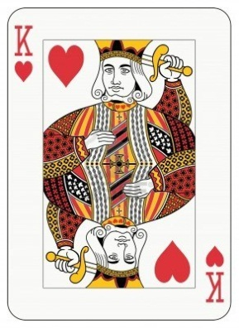
Believing Without Seeing
I claim that all of the cards below are red.

Slide 147
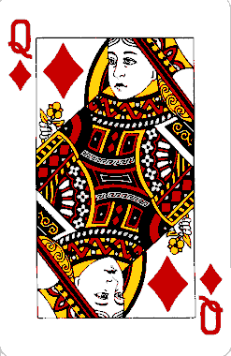
Believing Without Seeing
I claim that all of the cards below are red.

Slide 148
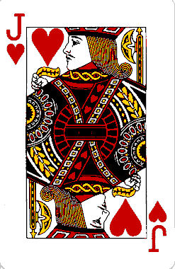
Believing Without Seeing
I claim that all of the cards below are red.

Slide 149
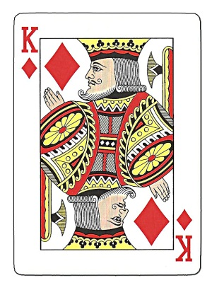
Believing Without Seeing
I claim that all of the cards below are red.

Slide 150
Believing Without Seeing
I claim that all of the cards below are red.

Slide 151
Believing Without Seeing
I claim that all of the cards below are red.
You’ve never seen this card.

Slide 152
Believing Without Seeing
I claim that all of the cards below are red.
You’ve never seen this card.
But you now have good reason to believe it’s red.

Slide 153
Non-transferable Belief
Even though you now believe that this card is red, there’s nothing that you can do to convince someone else.

Slide 154
Believing Without Seeing
I claim that all of the encryptions below are votes for Adams.
8QZ4TY2B7
GX39M6P4Y
T9VBS5ZDF
VRSF5JQWZ
J44Y0CURV

Slide 155
Believing Without Seeing
I claim that all of the encryptions below are votes for Adams.
8QZ4TY2B7
GX39M6P4Y
T9VBS5ZDF
VRSF5JQWZ
J44Y0CURV

Slide 156
Believing Without Seeing
I claim that all of the encryptions below are votes for Adams.
VRSF5JQWZ
Adams
Adams
Adams
Adams

Slide 157

Interactive Proofs

Slide 158
Interactive Proofs

Slide 159
Interactive Proofs
If I am determined to cheat you, the only way I could do this would be to guess your selection in advance.
My probability of success: 1 in 100

Slide 160
Interactive Proofs

Slide 161
Strong Interactive Proofs

Slide 162
Strong Interactive Proofs
If I am determined to cheat you, the only way I could do this would be to guess your selection in advance.
My probability of success: 1 in 1267650600228229401496703205376 ≈ 10³⁰

Slide 163
In practice …
Even if very few voters each “spoil” a single ballot, very high integrity is assured.
If 100 voters in a national election each spoil a single ballot, a malicious system would be unlikely to be able to alter even 1% of the votes without detection.

Slide 164
Voter Privacy
Confidentiality of votes is not merely a right that voters can choose to exercise.
Confidentiality is an obligation that must be imposed on all votes.

Slide 165
Asymmetric Cryptography
Devices don’t need to have secret keys!
They need to be able to encrypt, but they needn’t be able to decrypt.

Slide 166
Randomized Encryption
Ballot encryption must be “randomized”.
Identical ballots should not have identical encryptions.

Slide 167


Ballot Encryption
Random
Value
Raw
Ballot
Encrypted
Ballot
Ballot
Encryptor

Slide 168
Ballot Encryption
Random
Value
Raw
Ballot
Encrypted
Ballot
Ballot
Encryptor
Adams

Slide 169
Ballot Encryption
Random
Value
230921
967332
736118
Raw
Ballot
Encrypted
Ballot
Ballot
Encryptor
Adams

Slide 170
Ballot Encryption
Random
Value
230921
967332
736118
Raw
Ballot
Encrypted
Ballot
Ballot
Encryptor
Adams
8QZ4TY2B7

Slide 171
Ballot Encryption
Random
Value
667324
048573
586935
Raw
Ballot
Encrypted
Ballot
Ballot
Encryptor
Adams
GX39M6P4Y

Slide 172
Ballot Encryption
Random
Value
667324
048573
586935
=
Raw
Ballot
Encrypted
Ballot
Ballot
Encryptor
Adams
GX39M6P4Y

Slide 173
A Verifiable Election Record
Cast Ballots
X37BM6YPM
2J8CNF2KQ
VRSF5JQWZ
MW5B2VA7Y
8VPPS2L39
Spoiled Ballots
36PWY4MMB | Jefferson
8QZ4TY2B7 | Adams
GX39M6P4Y | Adams
Mathematical
Proof
Totals
Jefferson | 3
Adams | 2

Slide 174
The Tally Proof
There are essentially two paradigms to choose from …
Anonymized Ballots
(Mix Networks)
Ballotless Tallying
(Homomorphic Encryption)

Slide 175
Anonymized Ballots

Slide 176
Ballotless Tallying

Slide 177
Traditional Static Encryption
The only thing you do with encrypted data
VRSF5JQWZ
is decrypt it.

Slide 178
Computing on Encrypted Data
Some modern encryption methods allows useful computation on encrypted data.
VRSF5JQWZ MW5B2VA7Y

Slide 179
Homomorphic Encryption
We can construct encryption functions such that if
A is an encryption of a and
B is an encryption of b then
A × B is an encryption of a × b.

Slide 180
Homomorphic Encryption
We can also construct other encryption functions such that if
A is an encryption of a and
B is an encryption of b then
A × B is an encryption of a + b.

Slide 181
How do Humans Encrypt?
If voters encrypt their votes with devices of their own choosing, they are subject to coercion and compromise.
If voters encrypt their votes on “official” devices, how can they trust that their intentions have been properly captured?

Slide 182
The Human Encryptor
  We need to find ways to engage humans in an interactive proof process to ensure that their intentions are accurately reflected in encrypted ballots cast on their behalf.

Slide 183
MarkPledge Ballot
Alice | 367 | 248 | 792 | 141 | 390 | 863 | 427 | 015
Bob | 629 | 523 | 916 | 504 | 129 | 077 | 476 | 947
Carol | 285 | 668 | 049 | 732 | 859 | 308 | 156 | 422
David | 863 | 863 | 863 | 863 | 863 | 863 | 863 | 863
Eve | 264 | 717 | 740 | 317 | 832 | 399 | 441 | 946

Slide 184
MarkPledge Ballot
Alice | 367 | 248 | 792 | 141 | 390 | 863 | 427 | 015
Bob | 629 | 523 | 916 | 504 | 129 | 077 | 476 | 947
Carol | 285 | 668 | 049 | 732 | 859 | 308 | 156 | 422
David | 863 | 863 | 863 | 863 | 863 | 863 | 863 | 863
Eve | 264 | 717 | 740 | 317 | 832 | 399 | 441 | 946

Slide 185
MarkPledge Ballot
Alice | 367 | 248 | 792 | 141 | 390 | 863 | 427 | 015
Bob | 629 | 523 | 916 | 504 | 129 | 077 | 476 | 947
Carol | 285 | 668 | 049 | 732 | 859 | 308 | 156 | 422
David | 863 | 863 | 863 | 863 | 863 | 863 | 863 | 863
Eve | 264 | 717 | 740 | 317 | 832 | 399 | 441 | 946
Device commitment to voter: “You’re candidate’s number is 863.”

Slide 186
MarkPledge Ballot
Alice | 367 | 248 | 792 | 141 | 390 | 863 | 427 | 015
Bob | 629 | 523 | 916 | 504 | 129 | 077 | 476 | 947
Carol | 285 | 668 | 049 | 732 | 859 | 308 | 156 | 422
David | 863 | 863 | 863 | 863 | 863 | 863 | 863 | 863
Eve | 264 | 717 | 740 | 317 | 832 | 399 | 441 | 946
Device commitment to voter: “You’re candidate’s number is 863.”
Voter challenge: “Decrypt column number 5.”

Slide 187
MarkPledge Ballot
Alice | 367 | 248 | 792 | 141 | 390 | 863 | 427 | 015
Bob | 629 | 523 | 916 | 504 | 129 | 077 | 476 | 947
Carol | 285 | 668 | 049 | 732 | 859 | 308 | 156 | 422
David | 863 | 863 | 863 | 863 | 863 | 863 | 863 | 863
Eve | 264 | 717 | 740 | 317 | 832 | 399 | 441 | 946
Device commitment to voter: “You’re candidate’s number is 863.”
Voter challenge: “Decrypt column number 5.”

Slide 188
MarkPledge Ballot
Alice | 367 | 248 | 792 | 141 | 390 | 863 | 427 | 015
Bob | 629 | 523 | 916 | 504 | 129 | 077 | 476 | 947
Carol | 285 | 668 | 049 | 732 | 859 | 308 | 156 | 422
David | 863 | 863 | 863 | 863 | 863 | 863 | 863 | 863
Eve | 264 | 717 | 740 | 317 | 832 | 399 | 441 | 946

Slide 189
Prêt à Voter Ballot
Bob
Eve
Carol
Alice
David
 | 17320508

Slide 190
Prêt à Voter Ballot
Bob
Eve
Carol
Alice | X
David
 | 17320508

Slide 191
Prêt à Voter Ballot
 | X
 | 17320508

Slide 192
PunchScan Ballot
Y – Alice
X – Bob
#001
X
Y

Slide 193
PunchScan Ballot
Y – Alice
X – Bob
#001
Y
X

Slide 194
PunchScan Ballot
X – Alice
Y – Bob
#001
Y
X

Slide 195
PunchScan Ballot
X – Alice
Y – Bob
#001
Y
X

Slide 196
PunchScan Ballot
X – Alice
Y – Bob
#001
#001
Y
X

Slide 197
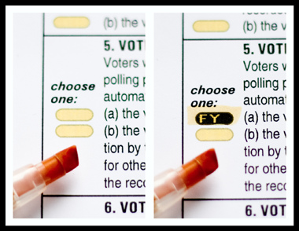
Scantegrity

Slide 198
Voter-Initiated Auditing
Voter can use “any” device to make selections (touch-screen DRE, OpScan, etc.)
After selections are made, voter receives an encrypted receipt of the ballot.

Slide 199

Voter-Initiated Auditing
Voter choice: Cast or Spoil
734922031382
Encrypted Vote

Slide 200
Voter-Initiated Auditing
Cast
734922031382
Encrypted Vote

Slide 201


Voter-Initiated Auditing
Spoil
Vote for Alice
Random # is
28637582738
734922031382

Slide 202
Voter-Initiated Auditing
When instantiated on an electronic voting device (DRE), it looks like Helios.
When instantiated on an optical scanner, you get VeriScan.

Slide 203
A Verifiable Election Record
Cast Ballots
X37BM6YPM
2J8CNF2KQ
VRSF5JQWZ
MW5B2VA7Y
8VPPS2L39
Spoiled Ballots
36PWY4MMB | Jefferson
8QZ4TY2B7 | Adams
GX39M6P4Y | Adams
Mathematical
Proof
Totals
Jefferson | 3
Adams | 2

Slide 204
A Verifiable Election Record
Cast Ballots
X37BM6YPM
2J8CNF2KQ
VRSF5JQWZ
MW5B2VA7Y
8VPPS2L39
Mathematical
Proof
Totals
Jefferson | 3
Adams | 2

Slide 205
A Verifiable Election Record
Cast Ballots
X37BM6YPM
2J8CNF2KQ
VRSF5JQWZ
MW5B2VA7Y
8VPPS2L39
Totals
Jefferson | 3
Adams | 2

Slide 206
A Verifiable Election Record
Cast Ballots | Adams | Jefferson
X37BM6YPM | 0 | 1
2J8CNF2KQ | 1 | 0
VRSF5JQWZ | 1 | 0
MW5B2VA7Y | 0 | 1
8VPPS2L39 | 0 | 1
Totals
Jefferson | 3
Adams | 2

Slide 207
A Verifiable Election Record
Cast Ballots | Adams | Jefferson
X37BM6YPM | 0 | 1
2J8CNF2KQ | 1 | 0
VRSF5JQWZ | 1 | 0
MW5B2VA7Y | 0 | 1
8VPPS2L39 | 0 | 1
Totals
Jefferson | 3
Adams | 2

Slide 208
A Verifiable Election Record
Cast Ballots | Adams | Jefferson
X37BM6YPM | 0 | 1
2J8CNF2KQ | 1 | 0
VRSF5JQWZ | 1 | 0
MW5B2VA7Y | 0 | 1
8VPPS2L39 | 0 | 1
Totals
Jefferson | 3
Adams | 2

Slide 209
A Verifiable Election Record
Cast Ballots | Adams | Jefferson
X37BM6YPM | 0 | 1
2J8CNF2KQ | 1 | 0
VRSF5JQWZ | 1 | 0
MW5B2VA7Y | 0 | 1
8VPPS2L39 | 0 | 1
×
Totals
Jefferson | 3
Adams | 2

Slide 210
A Verifiable Election Record
Cast Ballots | Adams | Jefferson
X37BM6YPM | 0 | 1
2J8CNF2KQ | 1 | 0
VRSF5JQWZ | 1 | 0
MW5B2VA7Y | 0 | 1
8VPPS2L39 | 0 | 1
×
CM97JQX4D
Totals
Jefferson | 3
Adams | 2

Slide 211
A Verifiable Election Record
Cast Ballots | Adams | Jefferson
X37BM6YPM | 0 | 1
2J8CNF2KQ | 1 | 0
VRSF5JQWZ | 1 | 0
MW5B2VA7Y | 0 | 1
8VPPS2L39 | 0 | 1
× | +
CM97JQX4D
Totals
Jefferson | 3
Adams | 2

Slide 212
A Verifiable Election Record
Cast Ballots | Adams | Jefferson
X37BM6YPM | 0 | 1
2J8CNF2KQ | 1 | 0
VRSF5JQWZ | 1 | 0
MW5B2VA7Y | 0 | 1
8VPPS2L39 | 0 | 1
× | +
CM97JQX4D | 2 | 3
Totals
Jefferson | 3
Adams | 2

Slide 213
A Verifiable Election Record
Cast Ballots | Adams | Jefferson
X37BM6YPM | 0 | 1
2J8CNF2KQ | 1 | 0
VRSF5JQWZ | 1 | 0
MW5B2VA7Y | 0 | 1
8VPPS2L39 | 0 | 1
× | +
CM97JQX4D | 2 | 3
Totals
Jefferson | 3
Adams | 2

Slide 214
A Verifiable Election Record
Cast Ballots | Adams | Jefferson
X37BM6YPM | 0 | 1
2J8CNF2KQ | 1 | 0
VRSF5JQWZ | 1 | 0
MW5B2VA7Y | 0 | 1
8VPPS2L39 | 0 | 1
× | +
CM97JQX4D | 2 | 3
Totals
Jefferson | 3
Adams | 2

Slide 215
A Verifiable Election Record
Cast Ballots | Adams | Jefferson
X37BM6YPM | 0 | 1
2J8CNF2KQ | 1 | 0
VRSF5JQWZ | 1 | 0
MW5B2VA7Y | 0 | 1
8VPPS2L39 | 0 | 1
× | +
CM97JQX4D | 2 | 3
Spoiled Ballots
36PWY4MMB | Jefferson
8QZ4TY2B7 | Adams
GX39M6P4Y | Adams
Totals
Jefferson | 3
Adams | 2

Slide 216
A Verifiable Election Record
Cast Ballots | Adams | Jefferson
X37BM6YPM | 0 | 1
2J8CNF2KQ | 1 | 0
VRSF5JQWZ | 1 | 0
MW5B2VA7Y | 0 | 1
8VPPS2L39 | 0 | 1
× | +
CM97JQX4D | 2 | 3
Spoiled Ballots
36PWY4MMB | Jefferson
8QZ4TY2B7 | Adams
GX39M6P4Y | Adams
Totals
Jefferson | 3
Adams | 2

Slide 217
An unexpected benefit …

Slide 218
Provisional Ballots
Common practice is to release preliminaries tallies that exclude provisional ballots.
Provisional ballots that are adjuciated as proper are added to the tallies.

Slide 219
Provisional Ballot Privacy
Privacy is substantially diminished for provisional ballots.
End-to-end methods can restore this privacy by initially counting all provisional ballots and then selectively removing ballots that are subsequently deemed illegitimate.

Slide 220
A Verifiable Election Record
Cast Ballots | Adams | Jefferson
X37BM6YPM | 0 | 1
2J8CNF2KQ | 1 | 0
VRSF5JQWZ | 1 | 0
MW5B2VA7Y | 0 | 1
8VPPS2L39 | 0 | 1
× | +
CM97JQX4D | 2 | 3
Spoiled Ballots
36PWY4MMB | Jefferson
8QZ4TY2B7 | Adams
GX39M6P4Y | Adams
Totals
Jefferson | 3
Adams | 2

Slide 221
A Verifiable Election Record
Cast Ballots | Adams | Jefferson
X37BM6YPM | 0 | 1
2J8CNF2KQ | 1 | 0
VRSF5JQWZ | 1 | 0
MW5B2VA7Y | 0 | 1
8VPPS2L39 | 0 | 1
× | +
CM97JQX4D | 2 | 3
Spoiled Ballots
36PWY4MMB | Jefferson
8QZ4TY2B7 | Adams
GX39M6P4Y | Adams
Totals
Jefferson | 3
Adams | 2

Slide 222
A Verifiable Election Record
Cast Ballots | Adams | Jefferson
X37BM6YPM | 0 | 1
2J8CNF2KQ | 1 | 0
VRSF5JQWZ | 1 | 0
MW5B2VA7Y | 0 | 1
8VPPS2L39 | 0 | 1
× | +
CM97JQX4D | 2 | 3
Spoiled Ballots
36PWY4MMB | Jefferson
8QZ4TY2B7 | Adams
GX39M6P4Y | Adams
Totals
Jefferson | 3
Adams | 2

Slide 223
Benefits of E2E-Verifiability
Strong public assurance of election integrity
Elimination of trust requirements
Certification relief

Slide 224
The Voter’s Perspective
Verifiable election systems can be built to look exactly like current systems …
… with one addition …

Slide 225
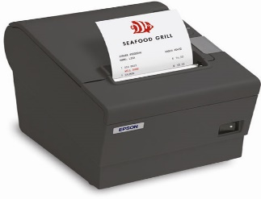
A Verifiable Receipt
Precinct 37 – Machine 4
Nov. 6, 2012 1:39PM
Vote receipt tag:
7A34ZR9K4BX
***VOTE COMFIRMED***

Slide 226
The Voter’s Perspective
Voters can …
Use receipts to check their results are properly recorded on a public web site.
Throw their receipts in the trash.
Write and use their own election verifiers.
Download applications from sources of their choice to verify the mathematical proof of the tally.
Believe verifications done by their political parties, LWV, ACLU, etc.
Accept the results without question.

Slide 227
Real-World Deployments
Helios (www.heliosvoting.org) – Adida and others
  Used to elect president of UC Louvain, Belgium.
  Used in Princeton University student government.
  Used to elect IACR Board of Directors.
Scantegrity II (www.scantegrity.org) – Chaum, Rivest, many others
  Used for 2009 & 2011 municipal elections in Takoma Park, MD.
STAR-Vote – Benaloh, Byrne, Eakin, Kortum, McBurnett, Pereira, Stark, Wallach
  Designed for use in Travis County, Texas.

Slide 228
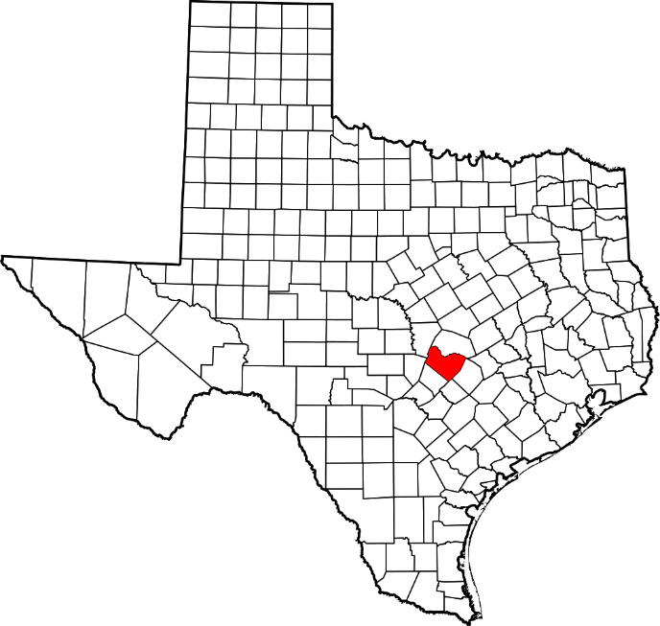
Travis County, Texas

Slide 229
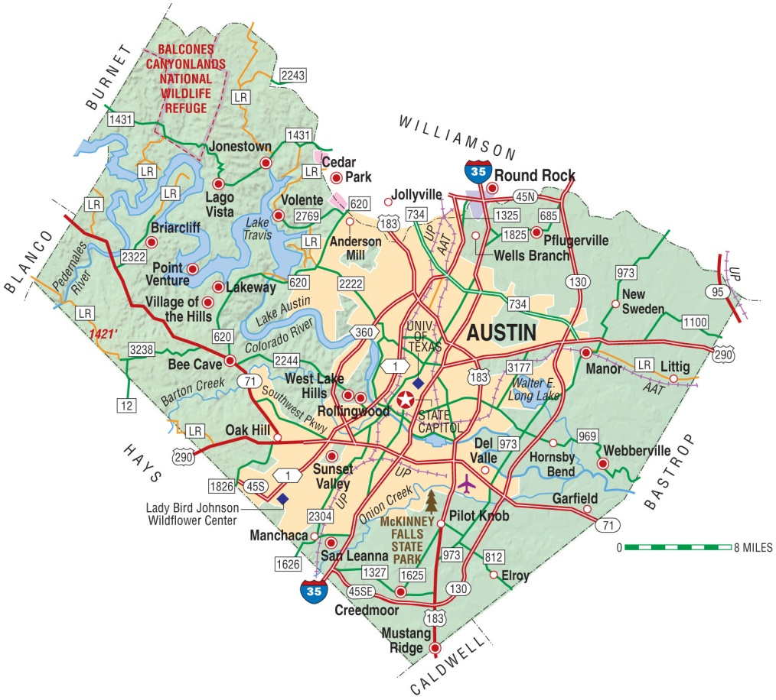
Travis County, Texas
Population (2010 Census):
1,024,266

Slide 230
Travis County Requirements
Hand-marked paper is unwieldy and ambiguous.
Many voters and activists want paper records.
Sweet spot: Electronic ballot-marking devices produce marked paper ballot summaries.

Slide 231
STAR-Vote
Electronic ballot-marking devices
Full paper-ballot records
Full verifiability
Privacy-preserving risk-limiting auditing
Tight coordination/agreement between tallies

Slide 232
Voter Sign-in

Slide 233
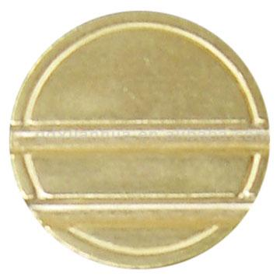
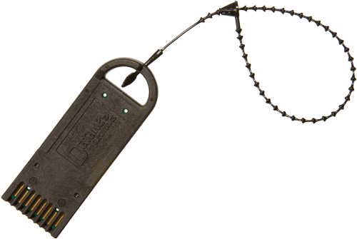
Receive Token
Enter code:
7126

Slide 234
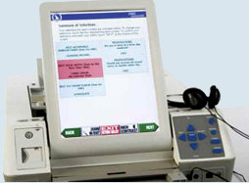
Electronic Ballot-Marking Device

Slide 235
Ballot Summary and Receipt
President: Alice
Vice-President: Bob
Treasurer: Carol
Secretary: David
_____________________
Ballot #: 32496
----------------------------------
Vote receipt tag:
7A34ZR9K4BX

Slide 236
Ballot Summary and Receipt
President: Alice
Vice-President: Bob
Treasurer: Carol
Secretary: David
_____________________
Ballot #: 32496
----------------------------------
Vote receipt tag:
7A34ZR9K4BX
Cleartext Selections →

Slide 237
Ballot Summary and Receipt
President: Alice
Vice-President: Bob
Treasurer: Carol
Secretary: David
_____________________
Ballot #: 32496
----------------------------------
Vote receipt tag:
7A34ZR9K4BX
Cleartext Selections →
Ballot ID →

Slide 238
Ballot Summary and Receipt
President: Alice
Vice-President: Bob
Treasurer: Carol
Secretary: David
_____________________
Ballot #: 32496
----------------------------------
Vote receipt tag:
7A34ZR9K4BX
Cleartext Selections →
Ballot ID →
Voter Receipt →

Slide 239
Voter Tasks
Remove voter receipt (this could also be provided to the voter on a separate slip),

Slide 240
Ballot Summary and Receipt
President: Alice
Vice-President: Bob
Treasurer: Carol
Secretary: David
_____________________
Ballot #: 32496
----------------------------------
Vote receipt tag:
7A34ZR9K4BX
Cleartext Selections →
Ballot ID →
Voter Receipt →

Slide 241

Ballot Summary and Receipt
President: Alice
Vice-President: Bob
Treasurer: Carol
Secretary: David
_____________________
Cleartext Selections →
Encrypted Selections →

Slide 242
Ballot Summary and Receipt
President: Alice
Vice-President: Bob
Treasurer: Carol
Secretary: David
_____________________
Ballot #: 32496
Cleartext Selections →
Ballot ID →

Slide 243
Voter Tasks
Remove voter receipt (this could also be provided to the voter on a separate slip),
and …

Slide 244
Voter Tasks
Two Options:
CAST or SPOIL

Slide 245
CAST Option

Slide 246
CAST Option
A voter casts a ballot by depositing it in the ballot box.
A scanner in the ballot box reads and records the Ballot ID.
A ballot is NOT considered cast until it is deposited in the ballot box.

Slide 247
SPOIL Option

Slide 248
SPOIL Option
A voter can take a completed ballot paper to a poll worker and exchange it for a new voting token.
The voter can retain the original receipt and a copy (or perhaps even original) of the spoiled paper ballot.
Any other ballots are considered unvoted.

Slide 249
Ballot Processing
Ballot-marking devices retain encrypted versions of all ballots produced.
All encrypted ballots are posted together with their corresponding receipts.
Verifiably-opened spoiled ballots are also posted.

Slide 250
Full Verification
Voters can check that their receipts are correctly posted.
Voters can check that their spoiled ballots are decrypted as expected.
Anyone can verify the accuracy of the tallies and spoiled ballot decryptions.

Slide 251
What’s Next?
Internet Voting?
Some jurisdictions are beginning to explore Internet voting.
There is a strong push towards IV from a variety of constituencies.

Slide 252
