Slide 1
Practical Aspects of Modern Cryptography
Autumn 2016
Tolga Acar
Josh Benaloh

Slide 2
Fun with Public-Key
Tonight we’ll …
Introduce some basic tools of public-key crypto
Combine the tools to create more powerful tools
Lay the ground work for substantial applications

Slide 3
Challenge-Response Protocols

Slide 4
Challenge-Response Protocols
One party often wants to convince another party that something is true …

Slide 5
Challenge-Response Protocols
One party often wants to convince another party that something is true …
… without giving everything away.

Slide 6

Proof of Knowledge
“I know the secret key $k$.”

Slide 7
PoK: Method 1

Slide 8
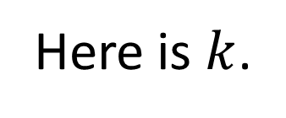
PoK: Method 1
Here is $k$.

Slide 9
PoK: Method 2

Slide 10
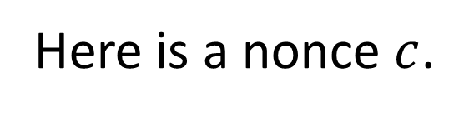
PoK: Method 2
Here is a nonce $c$.

Slide 11
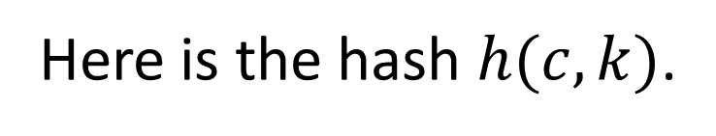
PoK: Method 2
Here is a nonce $c$.
Here is the hash $h(c,k)$.

Slide 12
Interactive Proofs and Zero Knowledge
There are non-traditional methods of convincing others that something is true without writing down a proof.
These methods can be used to convince others of the veracity of partial information about a secret.

Slide 13
Traditional Proofs

Slide 14
Traditional Proofs
I want to convince you that something is true.

Slide 15
Traditional Proofs
I want to convince you that something is true.
I write down a proof and give it to you.

Slide 16
Interactive Proofs
We engage in a dialogue at the conclusion of which you are convinced that my claim is true.

Slide 17
Graph Isomorphism

Slide 18
Graph Isomorphism
B
C
A
E
D

Slide 19
Graph Isomorphism
B
C
A
A
E
D
C
D
B
E

Slide 20
IP of Graph Isomorphism
G₁
G₂

Slide 21
IP of Graph Isomorphism
Generate, say, 100 additional graphs isomorphic to G₁ (and therefore also isomorphic to G₂).

Slide 22
IP of Graph Isomorphism
H₁
H₂
G₁
H₃
G₂
H₁₀₀

Slide 23
IP of Graph Isomorphism

Slide 24
IP of Graph Isomorphism
Accept a single bit challenge “L/R” for each of the 100 additional graphs.

Slide 25
IP of Graph Isomorphism
Accept a single bit challenge “L/R” for each of the 100 additional graphs.
Display the indicated isomorphism for each of the additional graphs.

Slide 26
IP of Graph Isomorphism
H₁
H₂
G₁
H₃
G₂
H₁₀₀

Slide 27
IP of Graph Isomorphism
L
H₁
H₂
R
G₁
H₃
R
G₂
L
H₁₀₀

Slide 28
IP of Graph Isomorphism
H₁
H₂
G₁
H₃
G₂
H₁₀₀

Slide 29
IP of Graph Isomorphism

Slide 30
IP of Graph Isomorphism
If graphs G₁ and G₂ were not isomorphic, then the “prover” would not be able to show any additional graph to be isomorphic to both G₁ and G₂.

Slide 31
IP of Graph Isomorphism
If graphs G₁ and G₂ were not isomorphic, then the “prover” would not be able to show any additional graph to be isomorphic to both G₁ and G₂.
A successful false proof would require the prover to guess all 100 challenges in advance: probability 1 in 2¹⁰⁰.

Slide 32
Fiat-Shamir Heuristic

Slide 33
Fiat-Shamir Heuristic
Instead of challenge bits being externally generated, they can be produced by applying a one-way hash function to the full set of additional graphs.

Slide 34
Fiat-Shamir Heuristic
Instead of challenge bits being externally generated, they can be produced by applying a one-way hash function to the full set of additional graphs.
This allows an interactive proof to be “published” without need for interaction.

Slide 35
IP of Graph Non-Isomorphism

Slide 36
IP of Graph Non-Isomorphism
G₁
G₂

Slide 37
IP of Graph Non-Isomorphism
A verifier can generate 100 additional graphs, each isomorphic to one of G₁ and G₂ , and present them to the prover.

Slide 38
IP of Graph Non-Isomorphism
A verifier can generate 100 additional graphs, each isomorphic to one of G₁ and G₂ , and present them to the prover.
The prover can then demonstrate that the graphs are not isomorphic by identifying which of G₁ and G₂ each additional graph is isomorphic to.

Slide 39
IP of Graph Non-Isomorphism
G₁
G₂

Slide 40
IP of Graph Non-Isomorphism
H₁
H₂
G₁
H₃
G₂
H₁₀₀

Slide 41
IP of Graph Non-Isomorphism
H₁
H₂
G₁
H₃
G₂
H₁₀₀

Slide 42
Proving Something is a Square

Slide 43

Proving Something is a Square
Suppose I want to convince you that $Y$ is a square modulo $N$.
[There exists an $X$ such that $Y = X^{2} \operatorname{mod}{N}$.]

Slide 44
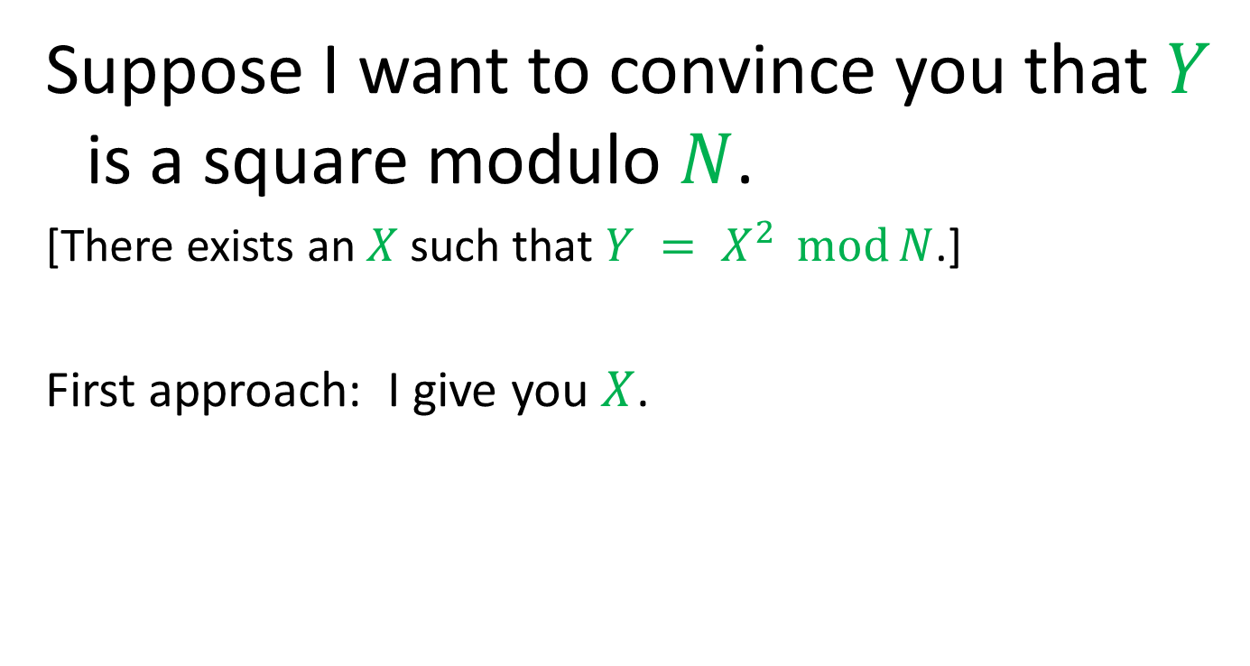
Proving Something is a Square
Suppose I want to convince you that $Y$ is a square modulo $N$.
[There exists an $X$ such that $Y = X^{2} \operatorname{mod}{N}$.]
First approach: I give you $X$.

Slide 45
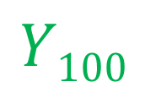
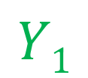
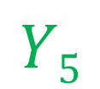

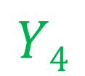
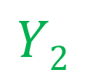
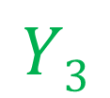
An Interactive Proof
$$Y$$
$$Y1$$
$$Y2$$
$$Y3$$
$$Y4$$
$$Y5$$
$$Y100$$

Slide 46

An Interactive Proof
$$Y$$
$$Y1$$
$$Y2$$
$$Y3$$
$$Y4$$
$$Y5$$
$$Y100$$
0
1
0
0
1
1

Slide 47
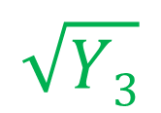
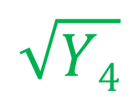
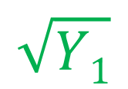
An Interactive Proof
$$Y$$
$$Y1$$
$$Y2$$
$$Y3$$
$$Y4$$
$$Y5$$
$$Y100$$
0
1
0
0
1
1
$$\sqrt{Y1}$$
$$\sqrt{Y3}$$
$$\sqrt{Y4}$$

Slide 48
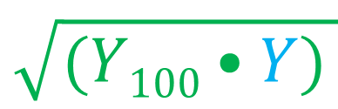
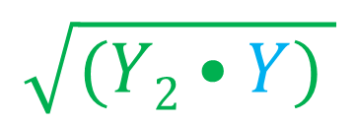
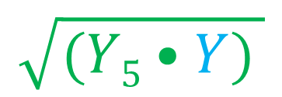
An Interactive Proof
$$Y$$
$$Y1$$
$$Y2$$
$$Y3$$
$$Y4$$
$$Y5$$
$$Y100$$
0
1
0
0
1
1
$$\sqrt{Y1}$$
$$\sqrt{Y3}$$
$$\sqrt{Y4}$$
$$\sqrt{(Y2•Y) }$$
$$\sqrt{(Y5•Y) }$$
$$\sqrt{(Y100•Y) }$$

Slide 49
An Interactive Proof

Slide 50
An Interactive Proof
In order for me to “fool” you, I would have to guess your exact challenge sequence.

Slide 51
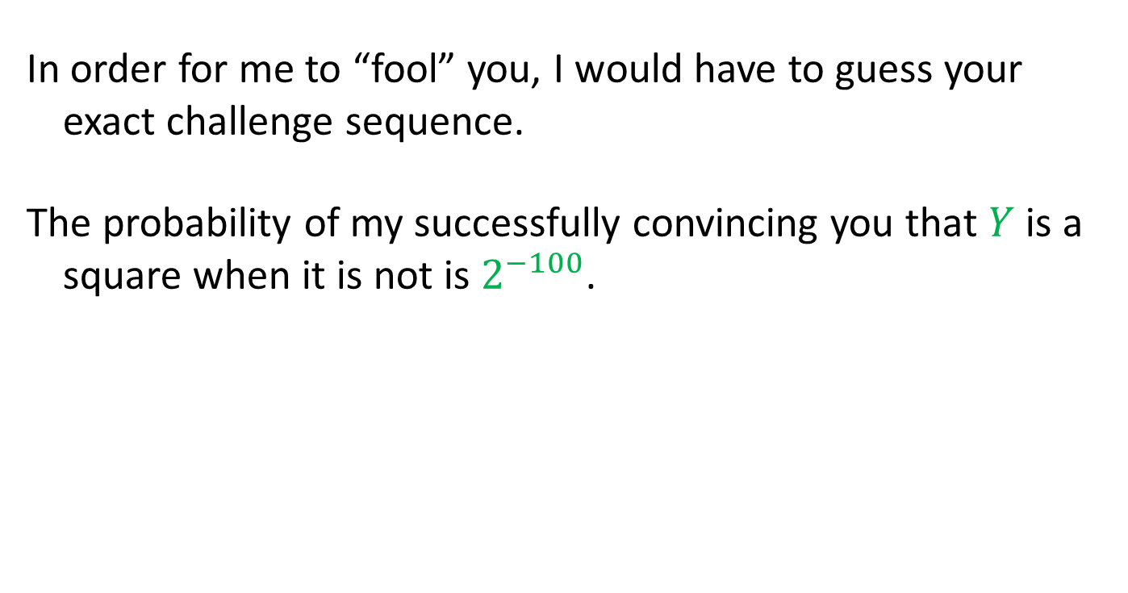
An Interactive Proof
In order for me to “fool” you, I would have to guess your exact challenge sequence.
The probability of my successfully convincing you that $Y$ is a square when it is not is $2^{−100}$.

Slide 52
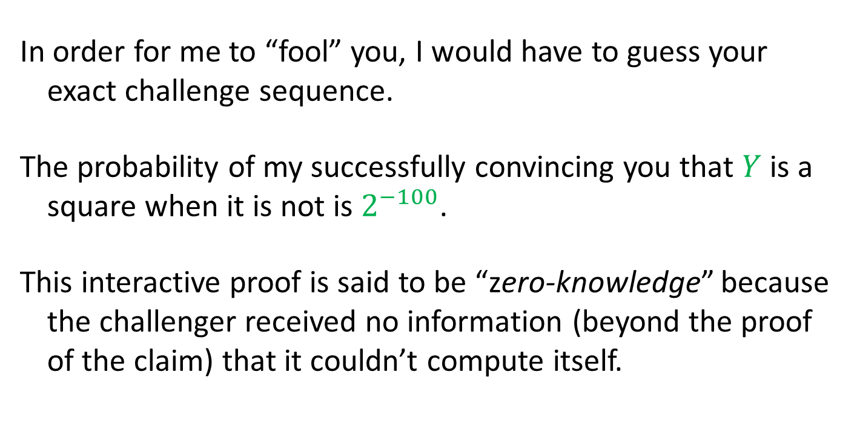
An Interactive Proof
In order for me to “fool” you, I would have to guess your exact challenge sequence.
The probability of my successfully convincing you that $Y$ is a square when it is not is $2^{−100}$.
This interactive proof is said to be “zero-knowledge” because the challenger received no information (beyond the proof of the claim) that it couldn’t compute itself.

Slide 53
Applying Fiat-Shamir
Once again, the verifier challenges can be simulated by the use of a one-way function to generate the challenge bits.

Slide 54
An Non-Interactive ZK Proof
$$Y$$
$$Y1$$
$$Y2$$
$$Y3$$
$$Y4$$
$$Y5$$
$$Y100$$

Slide 55
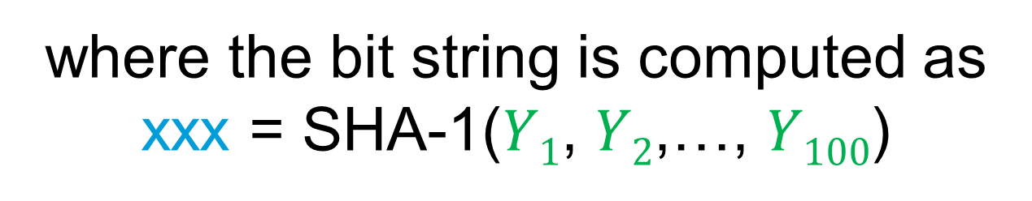
An Non-Interactive ZK Proof
$$Y$$
$$Y1$$
$$Y2$$
$$Y3$$
$$Y4$$
$$Y5$$
$$Y100$$
0
1
0
0
1
1
where the bit string is computed as
xxx = SHA-1($Y1$, $Y2$,…, $Y100$)

Slide 56
An Non-Interactive ZK Proof
$$Y$$
$$Y1$$
$$Y2$$
$$Y3$$
$$Y4$$
$$Y5$$
$$Y100$$
0
1
0
0
1
1
$$\sqrt{Y1}$$
$$\sqrt{Y3}$$
$$\sqrt{Y4}$$

Slide 57
An Non-Interactive ZK Proof
$$Y$$
$$Y1$$
$$Y2$$
$$Y3$$
$$Y4$$
$$Y5$$
$$Y100$$
0
1
0
0
1
1
$$\sqrt{Y1}$$
$$\sqrt{Y3}$$
$$\sqrt{Y4}$$
$$\sqrt{(Y2•Y) }$$
$$\sqrt{(Y5•Y) }$$
$$\sqrt{(Y100•Y) }$$

Slide 58
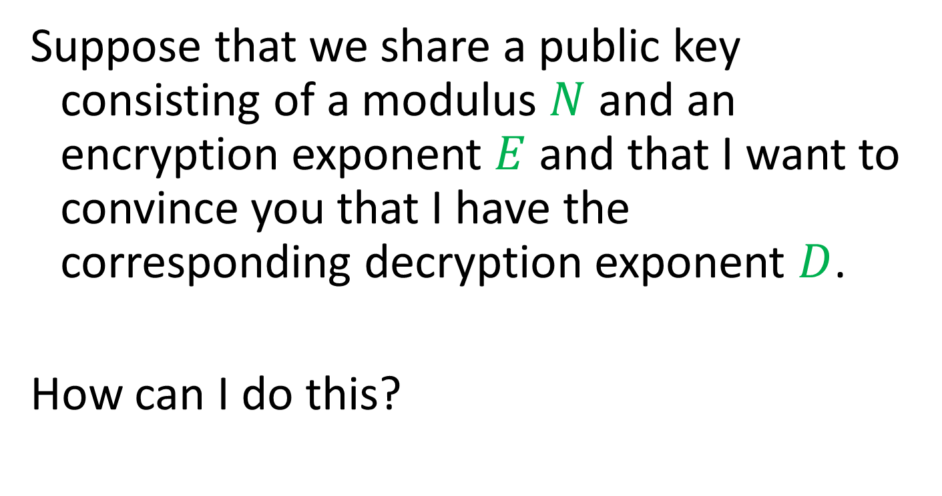
Proving Knowledge
Suppose that we share a public key consisting of a modulus $N$ and an encryption exponent $E$ and that I want to convince you that I have the corresponding decryption exponent $D$.
How can I do this?

Slide 59
Proving Knowledge

Slide 60

Proving Knowledge
I can give you my private key $D$.

Slide 61

Proving Knowledge
I can give you my private key $D$.
You can encrypt something for me and I decrypt it for you.

Slide 62
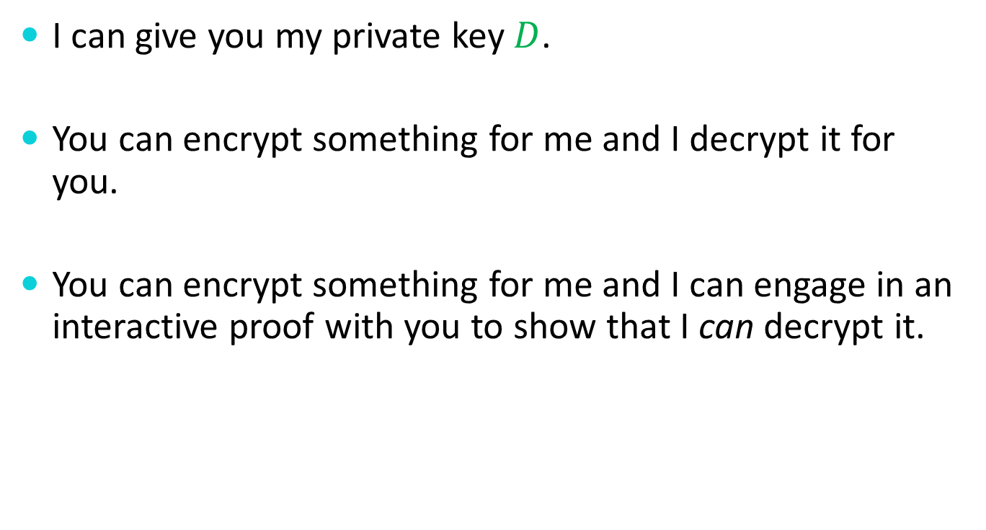
Proving Knowledge
I can give you my private key $D$.
You can encrypt something for me and I decrypt it for you.
You can encrypt something for me and I can engage in an interactive proof with you to show that I can decrypt it.

Slide 63

A Proof of Knowledge
$$Y$$

Slide 64
A Proof of Knowledge
$$Y$$
$$Y1$$
$$Y2$$
$$Y3$$
$$Y4$$
$$Y5$$
$$Y100$$

Slide 65
A Proof of Knowledge
$$Y$$
$$Y1$$
$$Y2$$
$$Y3$$
$$Y4$$
$$Y5$$
$$Y100$$
0
1
0
0
1
1

Slide 66
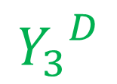
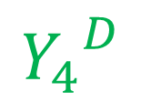
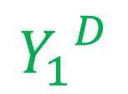
A Proof of Knowledge
$$Y$$
$$Y1$$
$$Y2$$
$$Y3$$
$$Y4$$
$$Y5$$
$$Y100$$
0
1
0
0
1
1
$${Y_{1}}^{D}$$
$${Y_{3}}^{D}$$
$${Y_{4}}^{D}$$

Slide 67
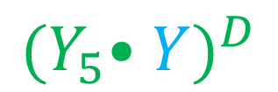
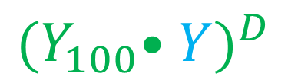
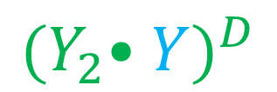
A Proof of Knowledge
$$Y$$
$$Y1$$
$$Y2$$
$$Y3$$
$$Y4$$
$$Y5$$
$$Y100$$
0
1
0
0
1
1
$${Y_{1}}^{D}$$
$${Y_{3}}^{D}$$
$${Y_{4}}^{D}$$
$${{(Y}_{2}•Y)}^{D}$$
$${{(Y}_{5}•Y)}^{D}$$
$${{(Y}_{100}•Y)}^{D}$$

Slide 68
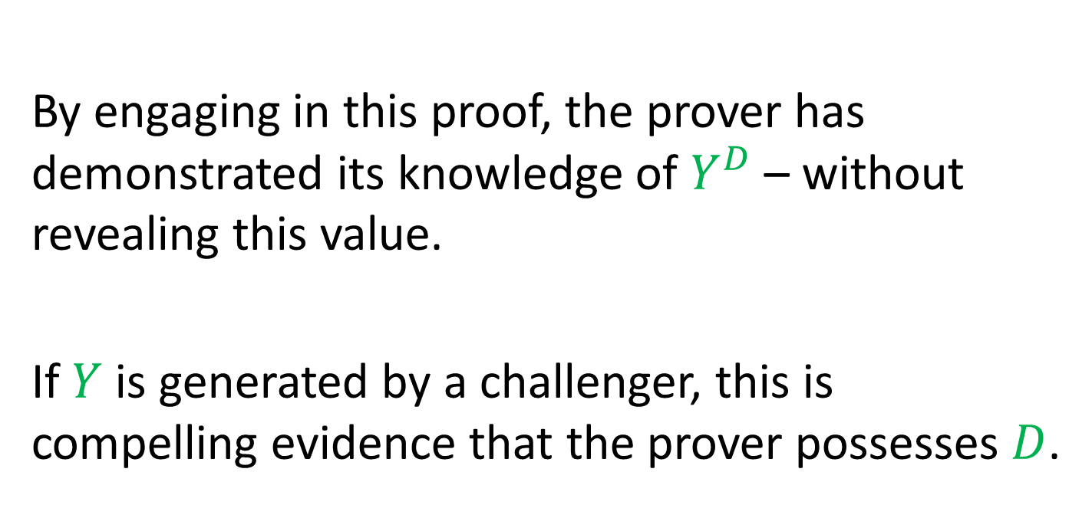
A Proof of Knowledge
By engaging in this proof, the prover has demonstrated its knowledge of $Y^{D}$ – without revealing this value.
If $Y$ is generated by a challenger, this is compelling evidence that the prover possesses $D$.

Slide 69
Facts About Interactive Proofs
Anything in PSPACE can be proven with a polynomial-time interactive proof.
Anything in NP can be proven with a zero-knowledge interactive proof.

Slide 70
Secret Sharing

Slide 71
Secret Sharing
Suppose that I have some data that I want to share amongst three people such that

Slide 72
Secret Sharing
Suppose that I have some data that I want to share amongst three people such that
any two can uniquely determine the data

Slide 73
Secret Sharing
Suppose that I have some data that I want to share amongst three people such that
any two can uniquely determine the data
but any one alone has no information whatsoever about the data.

Slide 74
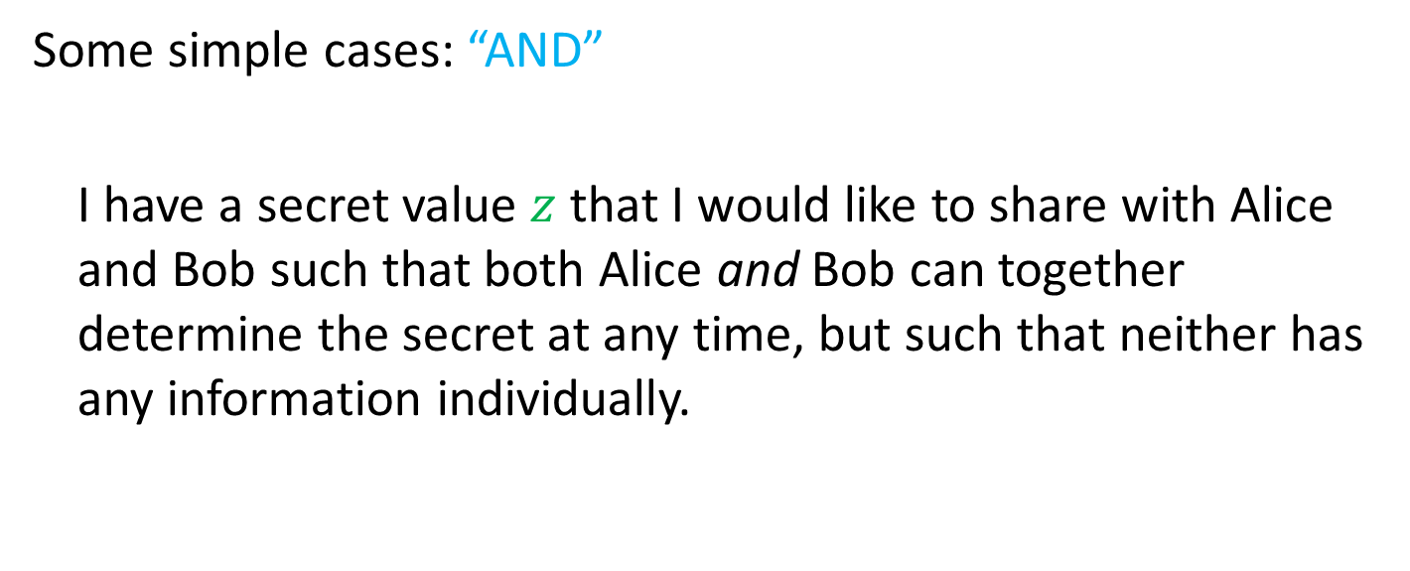
Secret Sharing
Some simple cases: “AND”
I have a secret value $z$ that I would like to share with Alice and Bob such that both Alice and Bob can together determine the secret at any time, but such that neither has any information individually.

Slide 75
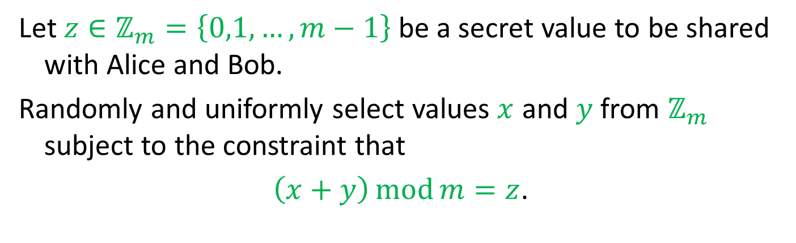
Secret Sharing – AND
Let $z∈ℤ_{m}=\left\{0,1,…,m−1\right\}$be a secret value to be shared with Alice and Bob.
Randomly and uniformly select values $x$ and $y$ from $ℤ_{m}$ subject to the constraint that
$\left(x+y\right)\operatorname{mod}{m}=z$.

Slide 76
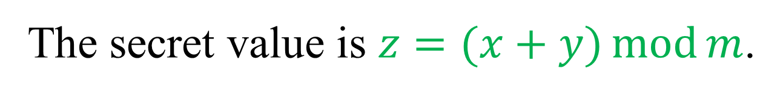
Secret Sharing – AND
The secret value is $z=(x+y)\operatorname{mod}{m}$.

Slide 77


Secret Sharing – AND
The secret value is $z=(x+y)\operatorname{mod}{m}$.
$$x$$
$$y$$

Slide 78
Secret Sharing – AND
The secret value is $z=(x+y)\operatorname{mod}{m}$.
$$x$$
$$y$$

Slide 79
Secret Sharing – AND
The secret value is $z=(x+y)\operatorname{mod}{m}$.
$$y$$

Slide 80
Secret Sharing – AND
The secret value is $z=(x+y)\operatorname{mod}{m}$.
$$y$$

Slide 81
Secret Sharing – AND
The secret value is $z=(x+y)\operatorname{mod}{m}$.

Slide 82
Secret Sharing – AND
The secret value is $z=(x+y)\operatorname{mod}{m}$.

Slide 83
Secret Sharing – AND
The secret value is $z=(x+y)\operatorname{mod}{m}$.
$$x$$

Slide 84
Secret Sharing – AND
The secret value is $z=(x+y)\operatorname{mod}{m}$.
$$x$$
$$y$$

Slide 85
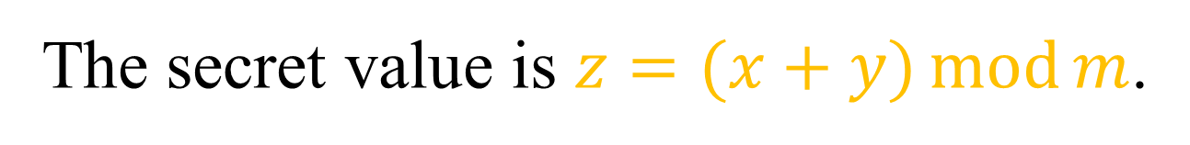
Secret Sharing – AND
The secret value is $z=(x+y)\operatorname{mod}{m}$.
$$x$$
$$y$$

Slide 86
Secret Sharing – AND
This trick easily generalizes to more than two shareholders.

Slide 87
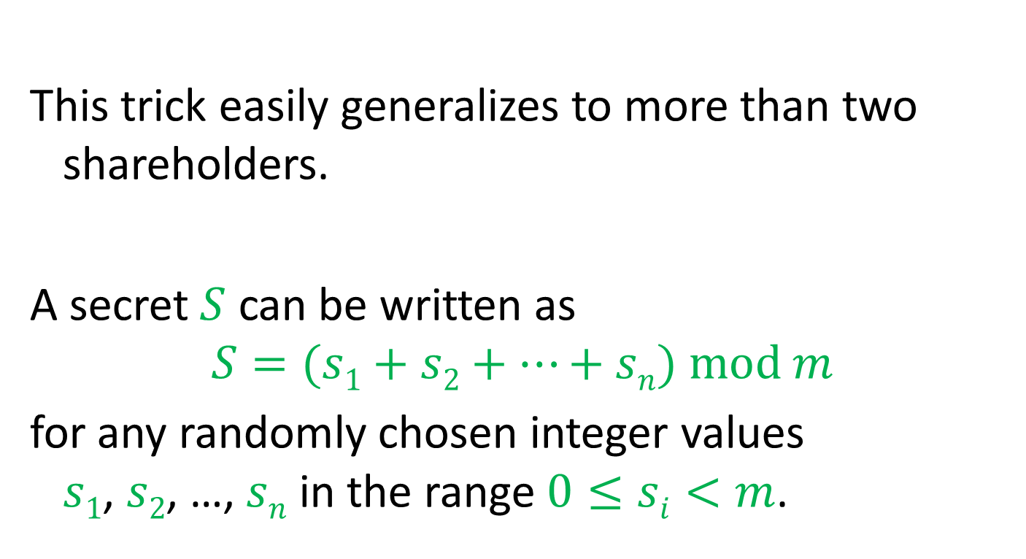
Secret Sharing – AND
This trick easily generalizes to more than two shareholders.
A secret $S$ can be written as
$$S=(s1+s2+…+sn) mod m$$
for any randomly chosen integer values $s1$, $s2$, …, $sn$ in the range $0≤si<m$.

Slide 88
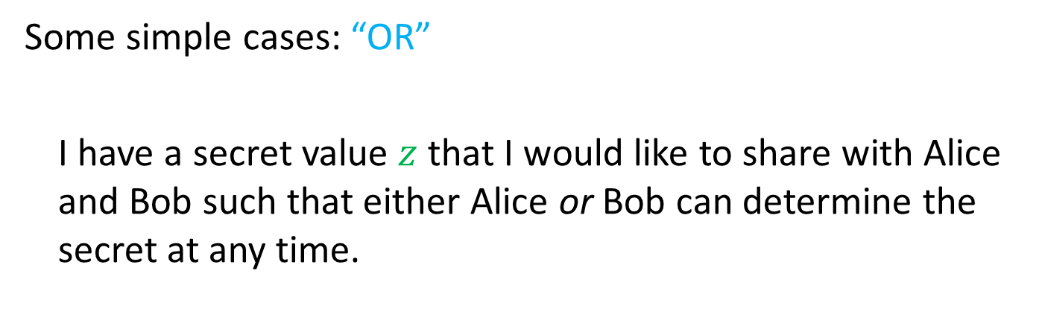
Secret Sharing
Some simple cases: “OR”
I have a secret value $z$ that I would like to share with Alice and Bob such that either Alice or Bob can determine the secret at any time.

Slide 89

Secret Sharing – OR
The secret value is $z$.

Slide 90


Secret Sharing – OR
The secret value is $z$.
$$z$$
$$z$$

Slide 91
Secret Sharing – OR
The secret value is $z$.
$$z$$
$$z$$

Slide 92
Secret Sharing – OR
The secret value is $z$.
$$z$$

Slide 93
Secret Sharing – OR
The secret value is $z$.
$$z$$

Slide 94
Secret Sharing – OR
The secret value is $z$.

Slide 95
Secret Sharing – OR
The secret value is $z$.
$$z$$

Slide 96
Secret Sharing – OR
The secret value is $z$.
$$z$$

Slide 97
Secret Sharing – OR
This case also generalizes easily to more than two shareholders.

Slide 98
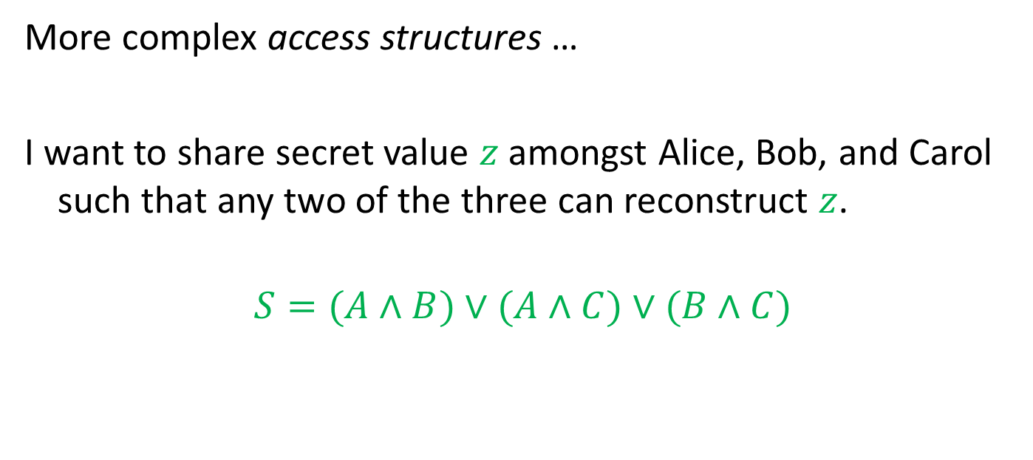
Secret Sharing
More complex access structures …
I want to share secret value $z$ amongst Alice, Bob, and Carol such that any two of the three can reconstruct $z$.
$$S=(A∧B)∨(A∧C)∨(B∧C)$$

Slide 99
Secret Sharing
OR
AND
AND
AND
A
B
A
C
B
C

Slide 100
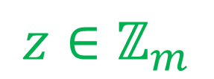
Secret Sharing
$$z∈ℤ_{m}$$
OR
AND
AND
AND
A
B
A
C
B
C

Slide 101


Secret Sharing
$$z∈ℤ_{m}$$
OR
$$z$$
$$z$$
$$z$$
AND
AND
AND
A
B
A
C
B
C

Slide 102
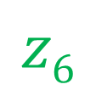
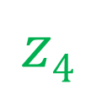
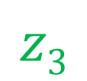
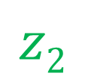
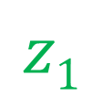
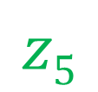
Secret Sharing
$$z∈ℤ_{m}$$
OR
$$z$$
$$z$$
$$z$$
AND
AND
AND
$$z1$$
$$z2$$
$$z3$$
$$z4$$
$$z5$$
$$z6$$
A
B
A
C
B
C

Slide 103
Threshold Schemes

Slide 104

Threshold Schemes
I want to distribute a secret datum amongst $n$ trustees such that

Slide 105
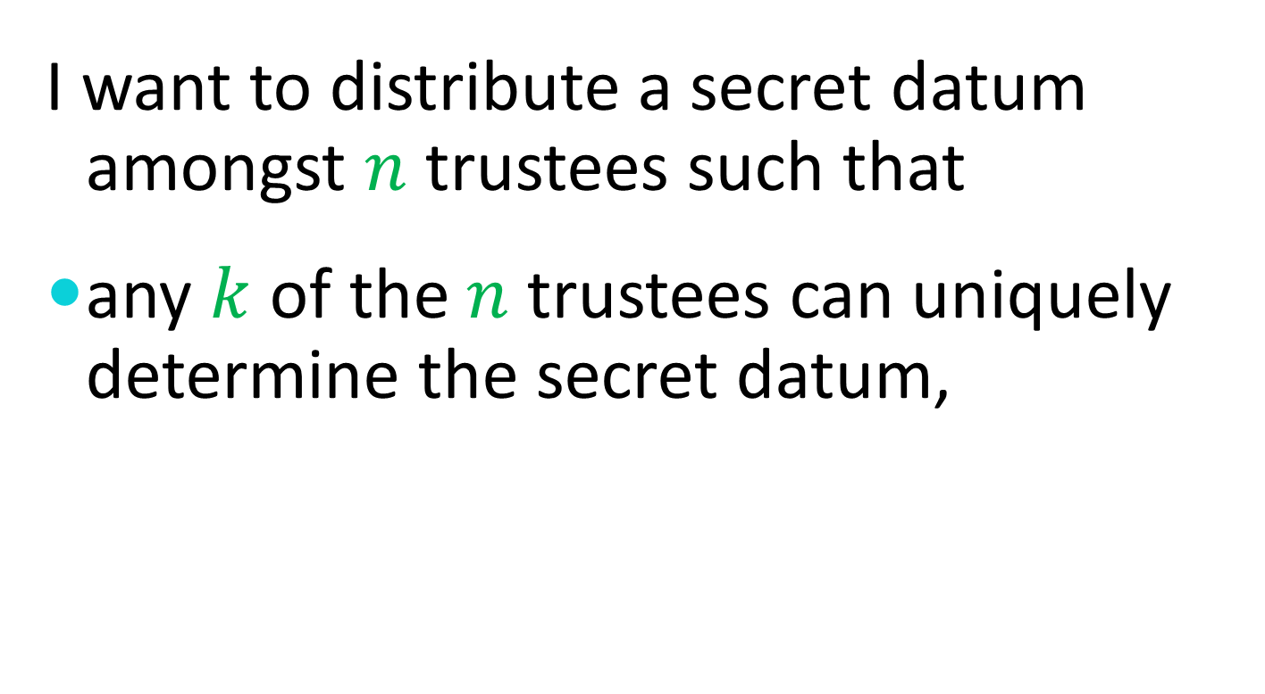
Threshold Schemes
I want to distribute a secret datum amongst $n$ trustees such that
any $k$ of the $n$ trustees can uniquely determine the secret datum,

Slide 106
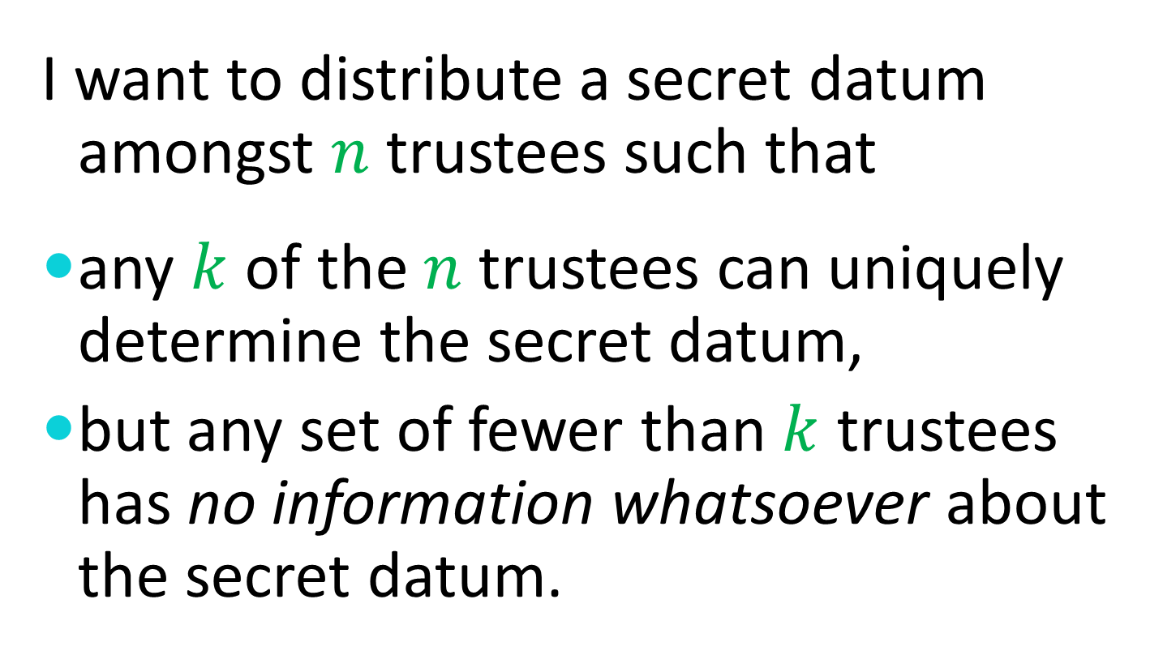
Threshold Schemes
I want to distribute a secret datum amongst $n$ trustees such that
any $k$ of the $n$ trustees can uniquely determine the secret datum,
but any set of fewer than $k$ trustees has no information whatsoever about the secret datum.

Slide 107
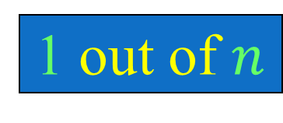

Threshold Schemes
OR
1 out of $n$
AND
$n$ out of $n$

Slide 108

Shamir’s Threshold Scheme
Any $k$ points $s_{1}$, $s_{2}$, …, $s_{k}$ in a field uniquely determine a polynomial $P$ of degree at most $k−1$ with $P\left(i\right)=s_{i}$ for $i=1, 2,…,k$.
This not only works of the reals, rationals, and other infinite fields, but also over the finite field
$$ℤ_{p}=\left\{0,1,…,p−1\right\}$$
where $p$ is a prime.

Slide 109

Shamir’s Threshold Scheme
To distribute a secret value $s∈ℤ_{p}$ amongst a set of $n$ Trustees $\left\{T_{1},T_{2},…,T_{n}\right\}$such that any $k$ can determine the secret

Slide 110

Shamir’s Threshold Scheme
To distribute a secret value $s∈ℤ_{p}$ amongst a set of $n$ Trustees $\left\{T_{1},T_{2},…,T_{n}\right\}$such that any $k$ can determine the secret
pick random coefficients $a_{1},a_{2},…,a_{k−1}∈ℤ_{p}$

Slide 111

Shamir’s Threshold Scheme
To distribute a secret value $s∈ℤ_{p}$ amongst a set of $n$ Trustees $\left\{T_{1},T_{2},…,T_{n}\right\}$such that any $k$ can determine the secret
pick random coefficients $a_{1},a_{2},…,a_{k−1}∈ℤ_{p}$
let $P\left(x\right)=a_{k−1}x^{k−1}+…+a_{2}x^{2}+a_{1}x+s$

Slide 112

Shamir’s Threshold Scheme
To distribute a secret value $s∈ℤ_{p}$ amongst a set of $n$ Trustees $\left\{T_{1},T_{2},…,T_{n}\right\}$such that any $k$ can determine the secret
pick random coefficients $a_{1},a_{2},…,a_{k−1}∈ℤ_{p}$
let $P\left(x\right)=a_{k−1}x^{k−1}+…+a_{2}x^{2}+a_{1}x+s$
give $P(i)$ to trustee $T_{i}$.

Slide 113

Shamir’s Threshold Scheme
To distribute a secret value $s∈ℤ_{p}$ amongst a set of $n$ Trustees $\left\{T_{1},T_{2},…,T_{n}\right\}$such that any $k$ can determine the secret
pick random coefficients $a_{1},a_{2},…,a_{k−1}∈ℤ_{p}$
let $P\left(x\right)=a_{k−1}x^{k−1}+…+a_{2}x^{2}+a_{1}x+s$
give $P(i)$ to trustee $T_{i}$.
The secret value is $s = P(0)$.

Slide 114

Shamir’s Threshold Scheme
The threshold 2 case:
Example: Range = $ℤ_{11}=\left\{0,1,…,10\right\}$, Secret = 9

Slide 115
Shamir’s Threshold Scheme
The threshold 2 case:
Example: Range = $ℤ_{11}=\left\{0,1,…,10\right\}$, Secret = 9

Slide 116
Shamir’s Threshold Scheme
The threshold 2 case:
Example: Range = $ℤ_{11}=\left\{0,1,…,10\right\}$, Secret = 9
(0,9)
Secret

Slide 117
Shamir’s Threshold Scheme
The threshold 2 case:
Example: Range = $ℤ_{11}=\left\{0,1,…,10\right\}$, Secret = 9
(0,9)
Secret

Slide 118
Shamir’s Threshold Scheme
The threshold 2 case:
Example: Range = $ℤ_{11}=\left\{0,1,…,10\right\}$, Secret = 9
(0,9)
Secret
(1,7)
Share 1
(2,5)
Share 2
(3,3)
Share 3

Slide 119
Shamir’s Threshold Scheme
The threshold 2 case:
Example: Range = $ℤ_{11}=\left\{0,1,…,10\right\}$, Secret = 9

Slide 120
Shamir’s Threshold Scheme
The threshold 2 case:
Example: Range = $ℤ_{11}=\left\{0,1,…,10\right\}$, Secret = 9
(1,7)
Share 1

Slide 121
Shamir’s Threshold Scheme
The threshold 2 case:
Example: Range = $ℤ_{11}=\left\{0,1,…,10\right\}$, Secret = 9
(1,7)
Share 1
(3,3)
Share 3

Slide 122
Shamir’s Threshold Scheme
The threshold 2 case:
Example: Range = $ℤ_{11}=\left\{0,1,…,10\right\}$, Secret = 9
(1,7)
Share 1
(3,3)
Share 3

Slide 123
Shamir’s Threshold Scheme
The threshold 2 case:
Example: Range = $ℤ_{11}=\left\{0,1,…,10\right\}$, Secret = 9
(0,9)
Secret
(1,7)
Share 1
(3,3)
Share 3

Slide 124

Shamir’s Threshold Scheme
The threshold 2 case:
Example: Range = $ℤ_{11}=\left\{0,1,…,10\right\}$

Slide 125
Shamir’s Threshold Scheme
The threshold 2 case:
Example: Range = $ℤ_{11}=\left\{0,1,…,10\right\}$
(1,7)
Share 1

Slide 126
Shamir’s Threshold Scheme
The threshold 2 case:
Example: Range = $ℤ_{11}=\left\{0,1,…,10\right\}$
(1,7)
Share 1
(3,4)
Share 3

Slide 127
Shamir’s Threshold Scheme
The threshold 2 case:
Example: Range = $ℤ_{11}=\left\{0,1,…,10\right\}$
(1,7)
Share 1
(3,4)
Share 3

Slide 128
Shamir’s Threshold Scheme
The threshold 2 case:
Example: Range = $ℤ_{11}=\left\{0,1,…,10\right\}$
(0,8.5)
Secret
(1,7)
Share 1
(3,4)
Share 3

Slide 129

Shamir’s Threshold Scheme
The threshold 2 case:
Example: Range = $ℤ_{11}=\left\{0,1,…,10\right\}$
In $ℤ_{11}$, $8.5$
$$≡ 17÷2$$
$$≡ 6×6$$
$$≡ 36$$
$$≡ 3$$
(0,8.5)
Secret
(1,7)
Share 1
(3,4)
Share 3

Slide 130
Shamir’s Threshold Scheme
Two methods are commonly used to interpolate a polynomial given a set of points.

Slide 131
Shamir’s Threshold Scheme
Two methods are commonly used to interpolate a polynomial given a set of points.
Lagrange interpolation

Slide 132
Shamir’s Threshold Scheme
Two methods are commonly used to interpolate a polynomial given a set of points.
Lagrange interpolation
Solving a system of linear equations

Slide 133
Lagrange Interpolation

Slide 134

Lagrange Interpolation
For each point $(i,s_{i})$, construct a polynomial $P_{i}$ with the correct value at $i$ and a value of zero at the other given points.

Slide 135

Lagrange Interpolation
For each point $(i,s_{i})$, construct a polynomial $P_{i}$ with the correct value at $i$ and a value of zero at the other given points.
$$P_{i}\left(x\right)=s_{i}×\prod_{j≠i}{(x−j)}÷\prod_{j≠i}{(i−j)}$$

Slide 136

Lagrange Interpolation
For each point $(i,s_{i})$, construct a polynomial $P_{i}$ with the correct value at $i$ and a value of zero at the other given points.
$$P_{i}\left(x\right)=s_{i}×\prod_{j≠i}{(x−j)}÷\prod_{j≠i}{(i−j)}$$
Then sum the $P_{i}\left(x\right)$ to compute $P\left(x\right)$.

Slide 137

Lagrange Interpolation
For each point $(i,s_{i})$, construct a polynomial $P_{i}$ with the correct value at $i$ and a value of zero at the other given points.
$$P_{i}\left(x\right)=s_{i}×\prod_{j≠i}{(x−j)}÷\prod_{j≠i}{(i−j)}$$
Then sum the $P_{i}\left(x\right)$ to compute $P\left(x\right)$.
$$P(x)=\sum_{i}{P_{i}\left(x\right)}$$

Slide 138
Solving a Linear System

Slide 139
Solving a Linear System
Regard the polynomial coefficients as unknowns.

Slide 140
Solving a Linear System
Regard the polynomial coefficients as unknowns.
Plug in each known point to get a linear equation in terms of the unknown coefficients.

Slide 141
Solving a Linear System
Regard the polynomial coefficients as unknowns.
Plug in each known point to get a linear equation in terms of the unknown coefficients.
Once there are as many equations as unknowns, use linear algebra to solve the system of equations.

Slide 142
Verifiable Secret Sharing
Secret sharing is very useful when the “dealer” of a secret is honest, but what bad things can happen if the dealer is potentially dishonest?
Can measures be taken to eliminate or mitigate the damages?

Slide 143

Homomorphic Encryption
Recall that with RSA, there is a multiplicative homomorphism.
$$E\left(x\right)E\left(y\right)≡E(xy)$$
Can we find an encryption function with an additive homomorphism?

Slide 144

An Additive Homomorphism
Can we find an encryption function for which the sum (or product) of two encrypted messages is the (an) encryption of the sum of the two original messages?
$$E(x)◦E(y)≡E(x+y)$$

Slide 145

An Additive Homomorphism
Recall the one-way function given by
$f(x) = gx mod m$.
For this function,
$$f(x)f(y) mod m = gxgy mod m =$$
$g^{x+y} mod m = f(x+y) mod m$.

Slide 146
Verifiable Secret Sharing

Slide 147

Verifiable Secret Sharing
Select a polynomial with secret $a_{0}$ as
$P\left(x\right)=a_{k−1}x^{k−1}+⋯+a_{2}x^{2}+a_{1}x+a_{0}$.

Slide 148

Verifiable Secret Sharing
Select a polynomial with secret $a_{0}$ as
$P\left(x\right)=a_{k−1}x^{k−1}+⋯+a_{2}x^{2}+a_{1}x+a_{0}$.
Commit to the coefficients by publishing
$g^{a_{0}}$, $g^{a_{1}}$, $g^{a_{2}}$, …, $g^{a_{k−1}}$.

Slide 149

Verifiable Secret Sharing
Select a polynomial with secret $a_{0}$ as
$P\left(x\right)=a_{k−1}x^{k−1}+⋯+a_{2}x^{2}+a_{1}x+a_{0}$.
Commit to the coefficients by publishing
$g^{a_{0}}$, $g^{a_{1}}$, $g^{a_{2}}$, …, $g^{a_{k−1}}$.
Compute a commitment to $P(i)$ from public values as
$g^{P(i)}=g^{a_{0}i^{0}}g^{a_{1}i^{1}}g^{a_{2}i^{2}}⋯g^{a_{k−1}i^{k−1}}$.

Slide 150
Verifiable Secret Sharing
An important detail
Randomness must be included to prevent small spaces of possible secrets and shares from being exhaustively searched.

Slide 151
Secret Sharing Homomorphisms
All of these secret sharing methods have an additional useful feature:
If two secrets are separately shared amongst the same set of people in the same way, then the sum of the individual shares constitute shares of the sum of the secrets.

Slide 152

Secret Sharing Homomorphisms
OR
Secret: $a$ – Shares: $a$, $a$, …, $a$
Secret: $b$ – Shares: $b$, $b$, …, $b$
Secret sum: $a+b$
Share sums: $a+b$, $a+b$, …, $a+b$

Slide 153

Secret Sharing Homomorphisms
AND
Secret: $a$ – Shares: $a1$, $a2$, …, $an$
Secret: $b$ – Shares: $b1$, $b2$, …, $bn$
Secret sum: $a+b$
Share sums: $a1+b1$, $a2+b2$, …, $an+bn$

Slide 154

Secret Sharing Homomorphisms
THRESHOLD
Secret: $P_{1}(0)$ – Shares: $P_{1}(1)$, $P_{1}(2)$, …, $P_{1}(n)$
Secret: $P_{2}(0)$ – Shares: $P_{2}(1)$, $P_{2}(2)$, …, $P_{2}(n)$
Secret sum: $P_{1}(0)+P_{2}(0)$
Share sums: $P_{1}(1)+P_{2}(1)$, $P_{1}(2)+P_{2}(2)$, …, $P_{1}(n)+P_{2}(n)$

Slide 155

Threshold Encryption
I want to encrypt a secret message $M$ for a set of $n$ recipients such that
any $k$ of the $n$ recipients can uniquely decrypt the secret message $M$,
but any set of fewer than $k$ recipients has no information whatsoever about the secret message $M$.

Slide 156



Recall Diffie-Hellman
Alice
Randomly select a large integer $a$ and send $A=g^{a} mod p$.
Compute the key $K=B^{a} mod p$.
Bob
Randomly select a large integer $b$ and send $B=g^{b} mod p$.
Compute the key $K=A^{b} mod p$.
$$B^{a} = g^{ba} = g^{ab} = A^{b}$$

Slide 157
ElGamal Encryption

Slide 158

ElGamal Encryption
Alice selects a large random private key $a$ and computes an associated public key $A=g^{a} mod p$.

Slide 159

ElGamal Encryption
Alice selects a large random private key $a$ and computes an associated public key $A=g^{a} mod p$.
To send a message $M$ to Alice, Bob selects a random value $r$ and computes the pair $(X,Y) = (A^{r}M mod p, g^{r} mod p)$.

Slide 160

ElGamal Encryption
Alice selects a large random private key $a$ and computes an associated public key $A=g^{a} mod p$.
To send a message $M$ to Alice, Bob selects a random value $r$ and computes the pair $(X,Y) = (A^{r}M mod p, g^{r} mod p)$.
To decrypt, Alice computes
$X/Y^{a} mod p = A^{r}M/g^{ra} mod p = M$.

Slide 161

ElGamal Re-Encryption
If $A=g^{a} mod p$is a public key and the pair
$$(X,Y) = (A^{r}M mod p, g^{r} mod p)$$
is an encryption of message $M$, then for any value $c$, the pair
$$(A^{c}X,g^{c}Y) = (A^{c+r}M mod p, g^{c+r} mod p)$$
is an encryption of the same message $M$, for any value $c$.

Slide 162
Group ElGamal Encryption

Slide 163

Group ElGamal Encryption
Each recipient selects a large random private key $ai$ and computes an associated public key $Ai = g^{a_{i}} mod p$.

Slide 164

Group ElGamal Encryption
Each recipient selects a large random private key $ai$ and computes an associated public key $Ai = g^{a_{i}} mod p$.
The group key is $A = \prod{A_{i}}mod p = g^{\sum{a_{i}}} mod p$.

Slide 165

Group ElGamal Encryption
Each recipient selects a large random private key $ai$ and computes an associated public key $Ai = g^{a_{i}} mod p$.
The group key is $A = \prod{A_{i}}mod p = g^{\sum{a_{i}}} mod p$.
To send a message $M$ to the group, Bob selects a random value $r$ and computes the pair $(X,Y) = (A^{r}M mod p, g^{r} mod p)$.

Slide 166

Group ElGamal Encryption
Each recipient selects a large random private key $ai$ and computes an associated public key $Ai = g^{a_{i}} mod p$.
The group key is $A = \prod{A_{i}}mod p = g^{\sum{a_{i}}} mod p$.
To send a message $M$ to the group, Bob selects a random value $r$ and computes the pair $(X,Y) = (A^{r}M mod p, g^{r} mod p)$.
To decrypt, each group member computes $Y_{i}=Y^{a_{i}} mod p$. The message $M = X/\prod{Y_{i}}mod p$.

Slide 167
Threshold Encryption (ElGamal)

Slide 168

Threshold Encryption (ElGamal)
Each recipient selects $k$ large random secret coefficients $a_{i,0}$, $a_{i,1}$, …, $a_{i,k−2}$, $a_{i,k−1}$ and forms the polynomial
$$P_{i}\left(x\right)=a_{i,k−1}x^{k−1}+a_{i,k−2}x^{k−2}+⋯+a_{i,1}x+a_{i,0}$$

Slide 169

Threshold Encryption (ElGamal)
Each recipient selects $k$ large random secret coefficients $a_{i,0}$, $a_{i,1}$, …, $a_{i,k−2}$, $a_{i,k−1}$ and forms the polynomial
$$P_{i}\left(x\right)=a_{i,k−1}x^{k−1}+a_{i,k−2}x^{k−2}+⋯+a_{i,1}x+a_{i,0}$$
Each polynomial $P_{i}(x)$is then verifiably shared with the other recipients by distributing each $g^{a_{i,j}}$.

Slide 170

Threshold Encryption (ElGamal)
Each recipient selects $k$ large random secret coefficients $a_{i,0}$, $a_{i,1}$, …, $a_{i,k−2}$, $a_{i,k−1}$ and forms the polynomial
$$P_{i}\left(x\right)=a_{i,k−1}x^{k−1}+a_{i,k−2}x^{k−2}+⋯+a_{i,1}x+a_{i,0}$$
Each polynomial $P_{i}(x)$is then verifiably shared with the other recipients by distributing each $g^{a_{i,j}}$.
The joint (threshold) public key is $\prod{g^{a_{i,0}}}$.

Slide 171

Threshold Encryption (ElGamal)
Each recipient selects $k$ large random secret coefficients $a_{i,0}$, $a_{i,1}$, …, $a_{i,k−2}$, $a_{i,k−1}$ and forms the polynomial
$$P_{i}\left(x\right)=a_{i,k−1}x^{k−1}+a_{i,k−2}x^{k−2}+⋯+a_{i,1}x+a_{i,0}$$
Each polynomial $P_{i}(x)$is then verifiably shared with the other recipients by distributing each $g^{a_{i,j}}$.
The joint (threshold) public key is $\prod{g^{a_{i,0}}}$.
Any set of $k$ recipients can form the secret key $\sum{a_{i,0}}$ to decrypt.

Slide 172
Application: Verifiable Elections

Slide 173
Application
Verifiable Elections

Slide 174


Slide 175





Slide 176



Slide 177



Slide 178



Slide 179



Slide 180



Slide 181
Traditional Voting Methods

Slide 182

Traditional Voting Methods
Hand-Counted Paper

Slide 183

Traditional Voting Methods
Hand-Counted Paper
Punch Cards

Slide 184

Traditional Voting Methods
Hand-Counted Paper
Punch Cards
Lever Machines

Slide 185

Traditional Voting Methods
Hand-Counted Paper
Punch Cards
Lever Machines
Optical Scan Ballots

Slide 186

Traditional Voting Methods
Hand-Counted Paper
Punch Cards
Lever Machines
Optical Scan Ballots
Electronic Voting Machines

Slide 187

Traditional Voting Methods
Hand-Counted Paper
Punch Cards
Lever Machines
Optical Scan Ballots
Electronic Voting Machines
Touch-Screen Terminals

Slide 188
Traditional Voting Methods
Hand-Counted Paper
Punch Cards
Lever Machines
Optical Scan Ballots
Electronic Voting Machines
Touch-Screen Terminals
Various Hybrids

Slide 189
Vulnerabilities and Trust
All of these systems have substantial vulnerabilities.
All of these systems require trust in the honesty and expertise of election officials (and usually the equipment vendors as well).
Can we do better?

Slide 190
The Voter’s Perspective

Slide 191

The Voter’s Perspective

Slide 192
The Voter’s Perspective

Slide 193
The Voter’s Perspective

Slide 194

The Voter’s Perspective

Slide 195
The Voter’s Perspective

Slide 196

The Voter’s Perspective

Slide 197
The Voter’s Perspective

Slide 198

The Voter’s Perspective

Slide 199

The Voter’s Perspective

Slide 200

The Voter’s Perspective

Slide 201

The Voter’s Perspective

Slide 202

The Voter’s Perspective

Slide 203
The Voter’s Perspective

Slide 204
The Voter’s Perspective

Slide 205
The Voter’s Perspective
As a voter, you don’t really know what happens behind the curtain.
You have no choice but to trust the people working behind the curtain.
You don’t even get to choose the people who you will have to trust.

Slide 206
The Voter’s Perspective
As a voter, you don’t really know what happens behind the curtain.
You have no choice but to trust the people working behind the curtain.
You don’t even get to choose the people who you will have to trust.

Slide 207
We Can Do Better!
Elections can be run such that each and every voter can verify the correctness of the tally without having to trust anyone or anything!

Slide 208
Verifiable Election Technologies
Allow voters to track their individual (sealed) votes and ensure that they are properly counted…
… even in the presence of faulty or malicious election equipment …
… and/or careless or dishonest election personnel.

Slide 209
Voters can check that …
Their own (sealed) votes have been properly recorded.
All recorded votes have been properly counted.
This is not just checking a claim that the right steps have been taken.
This is actually a check that the counting is correct.

Slide 210
End-to-End Verifiability
E2E-verifiability is not a property of an election system …
It is a property of an individual election.

Slide 211
End-to-End Verifiability
E2E-verifiable elections can be produced by …
Paper-based or Electronic systems
Local or Remote systems
Monitored or Unmonitored systems

Slide 212
E2E is a Property
End-to-end verifiability is a property of an election.
Voters can check that their selections have been accurately recorded.
Anyone can check that all recorded votes have been accurately counted.

Slide 213
E2E-Verifiability Replaces Trust
In an E2E-verifiable election, the integrity of tallies can be verified entirely without trust.
Voters and observers can verify everything themselves. They don’t need to trust election officials, equipment, vendors, or anyone.

Slide 214

An E2E-Verifiable Election

Slide 215
An E2E-Verifiable Election
Voter Name | Vote
Alice Smith | Jefferson
Bob Williams | Adams
Carol James | Adams
David Fuentes | Jefferson
Ellen Chu | Jefferson
Totals
Jefferson | 3
Adams | 2

Slide 216
But wait …
This isn’t a secret-ballot election.
Quite true, but it’s enough to show that voter-verifiability is possible
… and also to falsify arguments that electronic elections are inherently untrustworthy.

Slide 217
Privacy
The only ingredient missing from this transparent election is privacy – and the things which flow from privacy (e.g. protection from coercion).
Performing tasks while preserving privacy is the bailiwick of cryptography.
Cryptographic techniques can enable E2E-verifiable elections while preserving voter privacy.

Slide 218
Secure Multiparty Computation
General cryptographic techniques can compute any function on private inputs.
Does not apply to elections because voters should not be able to reveal their votes – even if they want to do so.

Slide 219
Adding Encryption
A layer of confidentiality can be added to an otherwise openly-verifiable system using homomoprhic encyption in which the product of ciphertexts constitutes an encryption of the sum of the corresponding plaintexts.

Slide 220
An E2E-Verifiable Election
Voter Name | Vote
Alice Smith | Jefferson
Bob Williams | Adams
Carol James | Adams
David Fuentes | Jefferson
Ellen Chu | Jefferson
Totals
Jefferson | 3
Adams | 2

Slide 221
An E2E-Verifiable Election
Voter Name | Vote
Alice Smith | Jefferson | X37BM6YPM
Bob Williams | Adams | 2J8CNF2KQ
Carol James | Adams | VRSF5JQWZ
David Fuentes | Jefferson | MW5B2VA7Y
Ellen Chu | Jefferson | 8VPPS2L39
Totals
Jefferson | 3
Adams | 2

Slide 222
An E2E-Verifiable Election
Voter Name | Vote
Alice Smith | Jefferson | X37BM6YPM
Bob Williams | Adams | 2J8CNF2KQ
Carol James | Adams | VRSF5JQWZ
David Fuentes | Jefferson | MW5B2VA7Y
Ellen Chu | Jefferson | 8VPPS2L39
Totals
Jefferson | 3
Adams | 2

Slide 223
An E2E-Verifiable Election
Voter Name | Vote
Alice Smith | Jefferson | X37BM6YPM
Bob Williams | Adams | 2J8CNF2KQ
Carol James | Adams | VRSF5JQWZ
David Fuentes | Jefferson | MW5B2VA7Y
Ellen Chu | Jefferson | 8VPPS2L39
Totals
Jefferson | 3
Adams | 2

Slide 224
An E2E-Verifiable Election
 |  | X37BM6YPM
 |  | 2J8CNF2KQ
 |  | VRSF5JQWZ
 |  | MW5B2VA7Y
 |  | 8VPPS2L39
Totals
Jefferson | 3
Adams | 2

Slide 225
An E2E-Verifiable Election
 |  | X37BM6YPM
 |  | 2J8CNF2KQ
 |  | VRSF5JQWZ
 |  | MW5B2VA7Y
 |  | 8VPPS2L39
Mathematical
Proof
Totals
Jefferson | 3
Adams | 2

Slide 226
Secure MPC is not Enough
Secure Multi-Party Computation allows any public function to be computed on any number of private inputs without compromising the privacy of the inputs.
But secure MPC does not prevent parties from revealing their private inputs if they so choose.

Slide 227
End-to-End Verifiable Elections
Two principle phases …
Voters publish their names and encrypted votes.
Administrators compute and publish the tally together with a cryptographic proof that the tally “matches” the set of encrypted votes.

Slide 228
Fundamental Tallying Decision
There are essentially two paradigms to choose from …
Anonymized Ballots
(Mix Networks)
Ballotless Tallying
(Homomorphic Encryption)

Slide 229
Anonymized Ballots

Slide 230
Ballotless Tallying

Slide 231
Homomorphic Tallying

Slide 232

Homomorphic Encryption
With RSA encryption,
$$Z_{1}=E(X_{1})=X_{1}^{Y}$$
$$Z_{2}=E(X_{2})=X_{2}^{Y}$$
$$Z_{1}×Z_{2}=E\left(X_{1}\right)×E\left(X_{2}\right)=X_{1}^{Y}×X_{2}^{Y}$$
$$={\left(X_{1}×X_{2}\right)}^{Y}=E(X_{1}×X_{2})$$
RSA is multiplicatively homomorpic.

Slide 233

Homomorphic Encryption
With another encryption function,
$$Z_{1}=E(X_{1})=g^{X_{1}}$$
$$Z_{2}=E(X_{2})=g^{X_{2}}$$
$$Z_{1}×Z_{2}=E(X_{1})×E(X_{2})=g^{X_{1}}×g^{X_{2}}$$
$$=g^{X_{1}+X_{2}}=E(X_{1}+X_{2})$$
This function is additively homomorpic.

Slide 234

In Elections …
$Z_{1}$ = E(Vote #1)
$Z_{2}$ = E(Vote #2)
$$⋮$$
$Z_{k}$ = E(Vote #$k$)
The product of the encryptions of the votes is an encryption of the sum of the votes.

Slide 235
Homomorphic Encryption
Some Homomorphic Functions
RSA: E(m) = m^{e} mod n
ElGamal: E(m,r) = (g^{r},mh^{r}) mod p
GM: E(b,r) = r²g^{b} mod n
Benaloh: E(m,r) = r^{e}g^{m} mod n
Pallier: E(m,r) = r^{n}g^{m} mod n²

Slide 236

A Valid Vote
$$\left\langle 0, 1, 0, 0; 1, 0; 0, 0, 0\right\rangle$$
First Race
Second Race
Third Race
First
Option
Second
Option
Third
Option
Fourth
Option

Slide 237
Pros and Cons of Ballots
Ballots simplify write-ins.
Ballots make it harder to enforce privacy – especially in complex counting scenarios.

Slide 238
Homomorphic Encryption
We can construct a public-key encryption function E such that if
A is an encryption of a and
B is an encryption of b then
A⊗B is an encryption of a⊕b.

Slide 239

Homomorphic Elections
Alice | $$\left\langle 0, 1, 0, 0; 1, 0; 0, 0, 0\right\rangle$$
Bob | $$\left\langle 0, 0, 0, 1; 1, 0; 0, 1, 0\right\rangle$$
Carol | $$\left\langle 0, 0, 1, 0; 0, 1; 1, 0, 0\right\rangle$$
David | $$\left\langle 0, 1, 0, 0; 1, 0; 0, 0, 1\right\rangle$$
Eve | $$\left\langle 0, 0, 1, 0; 0, 1; 0, 0, 1\right\rangle$$

Slide 240

Homomorphic Elections
Alice | $$\left\langle 0, 1, 0, 0; 1, 0; 0, 0, 0\right\rangle$$
Bob | $$\left\langle 0, 0, 0, 1; 1, 0; 0, 1, 0\right\rangle$$
Carol | $$\left\langle 0, 0, 1, 0; 0, 1; 1, 0, 0\right\rangle$$
David | $$\left\langle 0, 1, 0, 0; 1, 0; 0, 0, 1\right\rangle$$
Eve | $$\left\langle 0, 0, 1, 0; 0, 1; 0, 0, 1\right\rangle$$
Σ = | $$\left\langle 0, 2, 2, 1; 3, 2; 1, 1, 2\right\rangle$$

Slide 241
Homomorphic Elections
Alice | $$\left\langle 0, 1, 0, 0; 1, 0; 0, 0, 0\right\rangle$$
Bob | $$\left\langle 0, 0, 0, 1; 1, 0; 0, 1, 0\right\rangle$$
Carol | $$\left\langle 0, 0, 1, 0; 0, 1; 1, 0, 0\right\rangle$$
David | $$\left\langle 0, 1, 0, 0; 1, 0; 0, 0, 1\right\rangle$$
Eve | $$\left\langle 0, 0, 1, 0; 0, 1; 0, 0, 1\right\rangle$$

Slide 242

Homomorphic Elections
Alice | $$\left\langle 0, 1, 0, 0; 1, 0; 0, 0, 0\right\rangle$$
Bob | $$\left\langle 0, 0, 0, 1; 1, 0; 0, 1, 0\right\rangle$$
Carol | $$\left\langle 0, 0, 1, 0; 0, 1; 1, 0, 0\right\rangle$$
David | $$\left\langle 0, 1, 0, 0; 1, 0; 0, 0, 1\right\rangle$$
Eve | $$\left\langle 0, 0, 1, 0; 0, 1; 0, 0, 1\right\rangle$$

Slide 243

Homomorphic Elections
Alice | $$\left\langle 0, 1, 0, 0; 1, 0; 0, 0, 0\right\rangle$$
Bob | $$\left\langle 0, 0, 0, 1; 1, 0; 0, 1, 0\right\rangle$$
Carol | $$\left\langle 0, 0, 1, 0; 0, 1; 1, 0, 0\right\rangle$$
David | $$\left\langle 0, 1, 0, 0; 1, 0; 0, 0, 1\right\rangle$$
Eve | $$\left\langle 0, 0, 1, 0; 0, 1; 0, 0, 1\right\rangle$$
Π = | $$\left\langle 0, 2, 2, 1; 3, 2; 1, 1, 2\right\rangle$$

Slide 244

Homomorphic Elections
Alice | $$\left\langle 0, 1, 0, 0; 1, 0; 0, 0, 0\right\rangle$$
Bob | $$\left\langle 0, 0, 0, 1; 1, 0; 0, 1, 0\right\rangle$$
Carol | $$\left\langle 0, 0, 1, 0; 0, 1; 1, 0, 0\right\rangle$$
David | $$\left\langle 0, 1, 0, 0; 1, 0; 0, 0, 1\right\rangle$$
Eve | $$\left\langle 0, 0, 1, 0; 0, 1; 0, 0, 1\right\rangle$$
Σ = | $$\left\langle 0, 2, 2, 1; 3, 2; 1, 1, 2\right\rangle$$

Slide 245
Homomorphic Elections
Alice | $$\left\langle 0, 1, 0, 0; 1, 0; 0, 0, 0\right\rangle$$
Bob | $$\left\langle 0, 0, 0, 1; 1, 0; 0, 1, 0\right\rangle$$
Carol | $$\left\langle 0, 0, 1, 0; 0, 1; 1, 0, 0\right\rangle$$
David | $$\left\langle 0, 1, 0, 0; 1, 0; 0, 0, 1\right\rangle$$
Eve | $$\left\langle 0, 0, 1, 0; 0, 1; 0, 0, 1\right\rangle$$
Σ = | $$\left\langle 0, 2, 2, 1; 3, 2; 1, 1, 2\right\rangle$$

Slide 246
Homomorphic Elections
Alice | $$\left\langle 0, 1, 0, 0; 1, 0; 0, 0, 0\right\rangle$$
Bob | $$\left\langle 0, 0, 0, 1; 1, 0; 0, 1, 0\right\rangle$$
Carol | $$\left\langle 0, 0, 1, 0; 0, 1; 1, 0, 0\right\rangle$$
David | $$\left\langle 0, 1, 0, 0; 1, 0; 0, 0, 1\right\rangle$$
Eve | $$\left\langle 0, 0, 1, 0; 0, 1; 0, 0, 1\right\rangle$$
Σ = | $$\left\langle 0, 2, 2, 1; 3, 2; 1, 1, 2\right\rangle$$

Slide 247
Homomorphic Elections
Alice | 0
Bob | 0
Carol | 1
David | 0
Eve | 1
 | Σ =

Slide 248
Homomorphic Elections
Alice | 0
Bob | 0
Carol | 1
David | 0
Eve | 1
 | Σ =
 | 2

Slide 249
Homomorphic Elections
Alice | 0
Bob | 0
Carol | 1
David | 0
Eve | 1

Slide 250
Homomorphic Elections
Alice | 0
Bob | 0
Carol | 1
David | 0
Eve | 1

Slide 251
Homomorphic Elections
Alice | 0
Bob | 0
Carol | 1
David | 0
Eve | 1
 | ⊗=
 | 2

Slide 252
Homomorphic Elections
Alice | 0
Bob | 0
Carol | 1
David | 0
Eve | 1
 | ⊗=
 | 2

Slide 253
Homomorphic Elections
Alice | 0
Bob | 0
Carol | 1
David | 0
Eve | 1
 | ⊗=
 | 2

Slide 254
Multiple Authorities
Alice | 0
Bob | 0
Carol | 1
David | 0
Eve | 1

Slide 255
Multiple Authorities
 |  |  | X₁ | X₂ | X₃
Alice | 0 | = Σ | 3 | -5 | 2
Bob | 0 | = Σ | -4 | 5 | -1
Carol | 1 | = Σ | 2 | -3 | 2
David | 0 | = Σ | -2 | -1 | 3
Eve | 1 | = Σ | 4 | -1 | -2

Slide 256
Multiple Authorities
 |  |  | X₁ | X₂ | X₃
Alice | 0 | = Σ | 3 | -5 | 2
Bob | 0 | = Σ | -4 | 5 | -1
Carol | 1 | = Σ | 2 | -3 | 2
David | 0 | = Σ | -2 | -1 | 3
Eve | 1 | = Σ | 4 | -1 | -2
 |  |  | Σ = | Σ = | Σ =

Slide 257
Multiple Authorities
 |  |  | X₁ | X₂ | X₃
Alice | 0 | = Σ | 3 | -5 | 2
Bob | 0 | = Σ | -4 | 5 | -1
Carol | 1 | = Σ | 2 | -3 | 2
David | 0 | = Σ | -2 | -1 | 3
Eve | 1 | = Σ | 4 | -1 | -2
 |  |  | Σ = | Σ = | Σ =
 |  |  | 3 | -5 | 4

Slide 258
Multiple Authorities
 |  |  | X₁ | X₂ | X₃
Alice | 0 | = Σ | 3 | -5 | 2
Bob | 0 | = Σ | -4 | 5 | -1
Carol | 1 | = Σ | 2 | -3 | 2
David | 0 | = Σ | -2 | -1 | 3
Eve | 1 | = Σ | 4 | -1 | -2
 |  |  | Σ = | Σ = | Σ =
 |  | = Σ | 3 | -5 | 4

Slide 259
Multiple Authorities
 |  |  | X₁ | X₂ | X₃
Alice | 0 | = Σ | 3 | -5 | 2
Bob | 0 | = Σ | -4 | 5 | -1
Carol | 1 | = Σ | 2 | -3 | 2
David | 0 | = Σ | -2 | -1 | 3
Eve | 1 | = Σ | 4 | -1 | -2
 |  |  | Σ = | Σ = | Σ =
 | 2 | = Σ | 3 | -5 | 4

Slide 260
Multiple Authorities
 |  |  | X₁ | X₂ | X₃
Alice | 0 | = Σ | 3 | -5 | 2
Bob | 0 | = Σ | -4 | 5 | -1
Carol | 1 | = Σ | 2 | -3 | 2
David | 0 | = Σ | -2 | -1 | 3
Eve | 1 | = Σ | 4 | -1 | -2
 | Σ = |  | Σ = | Σ = | Σ =
 | 2 | = Σ | 3 | -5 | 4

Slide 261
Multiple Authorities
The sum of the shares of the votes constitute shares of the sum of the votes.

Slide 262
Multiple Authorities
 |  |  | X₁ | X₂ | X₃
Alice | 0 | = Σ | 3 | -5 | 2
Bob | 0 | = Σ | -4 | 5 | -1
Carol | 1 | = Σ | 2 | -3 | 2
David | 0 | = Σ | -2 | -1 | 3
Eve | 1 | = Σ | 4 | -1 | -2
 | Σ = |  | Σ = | Σ = | Σ =
 | 2 | = Σ | 3 | -5 | 4

Slide 263
Multiple Authorities
 |  |  | X₁ | X₂ | X₃
Alice | 0 |  | 3 | -5 | 2
Bob | 0 |  | -4 | 5 | -1
Carol | 1 |  | 2 | -3 | 2
David | 0 |  | -2 | -1 | 3
Eve | 1 |  | 4 | -1 | -2

Slide 264
Multiple Authorities
 |  |  | X₁ | X₂ | X₃
Alice | 0 |  | 3 | -5 | 2
Bob | 0 |  | -4 | 5 | -1
Carol | 1 |  | 2 | -3 | 2
David | 0 |  | -2 | -1 | 3
Eve | 1 |  | 4 | -1 | -2
 |  |  | ⊗ = | ⊗ = | ⊗ =

Slide 265
Multiple Authorities
 |  |  | X₁ | X₂ | X₃
Alice | 0 |  | 3 | -5 | 2
Bob | 0 |  | -4 | 5 | -1
Carol | 1 |  | 2 | -3 | 2
David | 0 |  | -2 | -1 | 3
Eve | 1 |  | 4 | -1 | -2
 |  |  | ⊗ = | ⊗ = | ⊗ =
 |  |  | 3 | -5 | 4

Slide 266
Multiple Authorities
 |  |  | X₁ | X₂ | X₃
Alice | 0 |  | 3 | -5 | 2
Bob | 0 |  | -4 | 5 | -1
Carol | 1 |  | 2 | -3 | 2
David | 0 |  | -2 | -1 | 3
Eve | 1 |  | 4 | -1 | -2
 |  |  | ⊗ = | ⊗ = | ⊗ =
 |  |  | 3 | -5 | 4

Slide 267
Multiple Authorities
 |  |  | X₁ | X₂ | X₃
Alice | 0 |  | 3 | -5 | 2
Bob | 0 |  | -4 | 5 | -1
Carol | 1 |  | 2 | -3 | 2
David | 0 |  | -2 | -1 | 3
Eve | 1 |  | 4 | -1 | -2
 |  |  | ⊗ = | ⊗ = | ⊗ =
 |  | = Σ | 3 | -5 | 4

Slide 268
Multiple Authorities
 |  |  | X₁ | X₂ | X₃
Alice | 0 |  | 3 | -5 | 2
Bob | 0 |  | -4 | 5 | -1
Carol | 1 |  | 2 | -3 | 2
David | 0 |  | -2 | -1 | 3
Eve | 1 |  | 4 | -1 | -2
 |  |  | ⊗ = | ⊗ = | ⊗ =
 | 2 | = Σ | 3 | -5 | 4

Slide 269

Adding Robustness
Splitting a vote by addition is equivalent to $n$ out of $n$ secret sharing.
One could instead share a vote using a threshold scheme to achieve $k$ out of $n$ system.
One can also use an additively-homomorphic threshold encryption scheme directly.

Slide 270
Mix-Based Elections

Slide 271
Mix-Based Elections
Shuffle the encrypted ballots by transforming each into a different representation of the same ballot and then permuting the full set.

Slide 272

Mix-Based Elections
Alice | $$\left\langle 0, 1, 0, 0; 1, 0; 0, 0, 0\right\rangle$$

Slide 273

Mix-Based Elections
Alice | $$\left\langle 0, 1, 0, 0; 1, 0; 0, 0, 0\right\rangle$$

Slide 274

Mix-Based Elections
Alice | $$\left\langle 0, 1, 0, 0; 1, 0; 0, 0, 0\right\rangle$$
Null | $$\left\langle 0, 0, 0, 0; 0, 0; 0, 0, 0\right\rangle$$

Slide 275

Mix-Based Elections
Alice | $$\left\langle 0, 1, 0, 0; 1, 0; 0, 0, 0\right\rangle$$
Null | $$\left\langle 0, 0, 0, 0; 0, 0; 0, 0, 0\right\rangle$$

Slide 276

Mix-Based Elections
Alice | $$\left\langle 0, 1, 0, 0; 1, 0; 0, 0, 0\right\rangle$$
Null | $$\left\langle 0, 0, 0, 0; 0, 0; 0, 0, 0\right\rangle$$
Π = | $$\left\langle 0, 1, 0, 0; 1, 0; 0, 0, 0\right\rangle$$

Slide 277
Mix-Based Elections
Each shuffler proves that its output set is a permutation of different encryptions of its input set.
After a sufficient number of shuffles, the individual ballots can be opened.

Slide 278
Homomorphic Tallying

Slide 279
The Mix-Net Paradigm
MIX
Vote
Vote
Vote
Vote

Slide 280
The Mix-Net Paradigm
MIX
Vote
Vote
Vote
Vote

Slide 281
Multiple Mixes


MIX
❖
MIX
Vote



Vote


◎
Vote
☺

✵
Vote

Slide 282
Decryption Mix-net
  Each object is encrypted with a pre-determined set of encryption layers.
  Each mix, in pre-determined order performs a decryption to remove its associated layer.

Slide 283
Re-encryption Mix-net
  The decryption and shuffling functions are decoupled.
  Mixes can be added or removed dynamically with robustness.
  Proofs of correct mixing can be published and independently verified.

Slide 284
Recall Homomorphic Encryption
We can construct a public-key encryption function E such that if
A is an encryption of a and
B is an encryption of b then
A⊗B is an encryption of a⊕b.

Slide 285
Re-encryption (additive)
A is an encryption of a and
Z is an encryption of 0 then
A⊗Z is another encryption of a.

Slide 286
Re-encryption (multiplicative)
A is an encryption of a and
I is an encryption of 1 then
A⊗I is another encryption of a.

Slide 287
A Re-encryption Mix
MIX

Slide 288
A Re-encryption Mix
MIX

Slide 289
Re-encryption Mix-nets
MIX
MIX
Vote
Vote
Vote
Vote

Slide 290
Verifiability
Each re-encryption mix provides a mathematical proof that its output is a permutation of re-encryptions of its input.
Any observer can verify this proof.
The decryptions are also proven to be correct.
If a mix’s proof is invalid, its mixing will be bypassed.

Slide 291
Faulty Mixes
MIX
MIX
Vote
Vote
Vote
Vote

Slide 292
Some Verifiable Mixes
1993 Park, Itoh, and Kurosawa
1995 Sako and Kilian
2001 Furukawa and Sako
2001 Neff
2002 Jakobsson, Juels, and Rivest
2003 Groth

Slide 293
Re-encryption Mix Operation
Input Ballot Set
Output Ballot Set
MIX

Slide 294
Re-encryption Mix Operation
Input Ballot Set
Output Ballot Set
MIX

Slide 295
Re-encryption Mix Operation
MIX

Slide 296
Re-encryption Mix Operation
Inputs
Outputs
62951413
53124141
81828172
81828172
93308161
62951413
53124141
93308161

Slide 297
Who has the Keys?
A pre-determined set of parties independently generate and share the encryption (and decryption) keys used in the election.
A pre-determined threshold of key holders is required to decrypt.

Slide 298
Who has the Keys?
Important
If a sufficient number of key holders collude, they can compromise voter privacy.
But even if all key holders collude, they cannot compromise the integrity of the tallies.

Slide 299
Re-encryption
Each value is re-encrypted by multiplying it by an encryption of one.
This can be done without knowing the decryptions.

Slide 300
Verifying a Re-encryption
MIX
53124141
31415926
14142135
62951413
27182818
31415926
16180339
93308161
16180339
81828172
14142135
27182818

Slide 301
A Simple Verifiable Re-encryption Mix

Slide 302
Is This “Proof” Absolute?
The proof can be “defeated” if and only if every left/right decision can be predicted by the prover in advance.
If there are 100 intermediate ballot sets, the chance of this happening is 1 in 2¹⁰⁰.

Slide 303
Who Chooses?
If you choose, then you are convinced.
  But this won’t convince me.
We can each make some of the choices.
  But this can be inefficient.
We can co-operate on the choices.
  But this is cumbersome.
We can agree on a random source.
  But what source?

Slide 304
Who Chooses?
The Fiat-Shamir Heuristic
Prepare all of the ballot sets as above.
Put all of the data into a one-way hash.
Use the hash output to make the choices.
This allows a proof of equivalence to be “published” by the mix.

Slide 305
Assumptions
  A disadvantage of using Fiat-Shamir is that election integrity now requires a computational assumption – the assumption that the hash is “secure”.
  Voter privacy depends upon the quality of the encryption.

Slide 306
The Encryption
Anyone with the decryption key can read all of the votes – even before mixing.
A threshold encryption scheme is used to distribute the decryption capabilities.

Slide 307
Randomized Partial Checking
MIX

Slide 308
Choose Any Two
We have techniques to make verifiable tallying …
Computationally Efficient
Conceptually Simple
Exact

Slide 309


How Can Humans Verify Votes?
VRSF5JQWZ $=$ Adams ?

Slide 310
Believing Without Seeing

Slide 311

Believing Without Seeing
I claim that all of the cards below are red.

Slide 312

Believing Without Seeing
I claim that all of the cards below are red.

Slide 313

Believing Without Seeing
I claim that all of the cards below are red.

Slide 314

Believing Without Seeing
I claim that all of the cards below are red.

Slide 315

Believing Without Seeing
I claim that all of the cards below are red.

Slide 316
Believing Without Seeing
I claim that all of the cards below are red.

Slide 317
Believing Without Seeing
I claim that all of the cards below are red.
You’ve never seen this card.

Slide 318
Believing Without Seeing
I claim that all of the cards below are red.
You’ve never seen this card.
But you now have good reason to believe it’s red.

Slide 319
Non-transferable Belief
Even though you now believe that this card is red, there’s nothing that you can do to convince someone else.

Slide 320
Believing Without Seeing
I claim that all of the encryptions below are votes for Adams.
8QZ4TY2B7
GX39M6P4Y
T9VBS5ZDF
VRSF5JQWZ
J44Y0CURV

Slide 321
Believing Without Seeing
I claim that all of the encryptions below are votes for Adams.
8QZ4TY2B7
GX39M6P4Y
T9VBS5ZDF
VRSF5JQWZ
J44Y0CURV

Slide 322
Believing Without Seeing
I claim that all of the encryptions below are votes for Adams.
VRSF5JQWZ
Adams
Adams
Adams
Adams

Slide 323

Interactive Proofs

Slide 324
Interactive Proofs

Slide 325
Interactive Proofs
If I am determined to cheat you, the only way I could do this would be to guess your selection in advance.
My probability of success: 1 in 100

Slide 326
Interactive Proofs

Slide 327
Strong Interactive Proofs

Slide 328
Strong Interactive Proofs
If I am determined to cheat you, the only way I could do this would be to guess your selection in advance.
My probability of success: 1 in 1267650600228229401496703205376 ≈ 10³⁰

Slide 329
In practice …
Even if very few voters each “spoil” a single ballot, very high integrity is assured.
If 100 voters in a national election each spoil a single ballot, a malicious system would be unlikely to be able to alter even 1% of the votes without detection.

Slide 330
Voter Privacy
Confidentiality of votes is not merely a right that voters can choose to exercise.
Confidentiality is an obligation that must be imposed on all votes.

Slide 331
Asymmetric Cryptography
Devices don’t need to have secret keys!
They need to be able to encrypt, but they needn’t be able to decrypt.

Slide 332
Randomized Encryption
Ballot encryption must be “randomized”.
Identical ballots should not have identical encryptions.

Slide 333


Ballot Encryption
Random
Value
Raw
Ballot
Encrypted
Ballot
Ballot
Encryptor

Slide 334
Ballot Encryption
Random
Value
Raw
Ballot
Encrypted
Ballot
Ballot
Encryptor
Adams

Slide 335
Ballot Encryption
Random
Value
230921
967332
736118
Raw
Ballot
Encrypted
Ballot
Ballot
Encryptor
Adams

Slide 336
Ballot Encryption
Random
Value
230921
967332
736118
Raw
Ballot
Encrypted
Ballot
Ballot
Encryptor
Adams
8QZ4TY2B7

Slide 337
Ballot Encryption
Random
Value
667324
048573
586935
Raw
Ballot
Encrypted
Ballot
Ballot
Encryptor
Adams
GX39M6P4Y

Slide 338
Ballot Encryption
Random
Value
667324
048573
586935
=
Raw
Ballot
Encrypted
Ballot
Ballot
Encryptor
Adams
GX39M6P4Y

Slide 339
A Verifiable Election Record
Cast Ballots
X37BM6YPM
2J8CNF2KQ
VRSF5JQWZ
MW5B2VA7Y
8VPPS2L39
Spoiled Ballots
36PWY4MMB | Jefferson
8QZ4TY2B7 | Adams
GX39M6P4Y | Adams
Mathematical
Proof
Totals
Jefferson | 3
Adams | 2

Slide 340
The Tally Proof
There are essentially two paradigms to choose from …
Anonymized Ballots
(Mix Networks)
Ballotless Tallying
(Homomorphic Encryption)

Slide 341
Anonymized Ballots

Slide 342
Ballotless Tallying

Slide 343
Traditional Static Encryption
The only thing you do with encrypted data
VRSF5JQWZ
is decrypt it.

Slide 344
Computing on Encrypted Data
Some modern encryption methods allows useful computation on encrypted data.
VRSF5JQWZ MW5B2VA7Y

Slide 345
Homomorphic Encryption
We can construct encryption functions such that if
A is an encryption of a and
B is an encryption of b then
A × B is an encryption of a × b.

Slide 346
Homomorphic Encryption
We can also construct other encryption functions such that if
A is an encryption of a and
B is an encryption of b then
A × B is an encryption of a + b.

Slide 347
How do Humans Encrypt?
If voters encrypt their votes with devices of their own choosing, they are subject to coercion and compromise.
If voters encrypt their votes on “official” devices, how can they trust that their intentions have been properly captured?

Slide 348
The Human Encryptor
  We need to find ways to engage humans in an interactive proof process to ensure that their intentions are accurately reflected in encrypted ballots cast on their behalf.

Slide 349
MarkPledge Ballot
Alice | 367 | 248 | 792 | 141 | 390 | 863 | 427 | 015
Bob | 629 | 523 | 916 | 504 | 129 | 077 | 476 | 947
Carol | 285 | 668 | 049 | 732 | 859 | 308 | 156 | 422
David | 863 | 863 | 863 | 863 | 863 | 863 | 863 | 863
Eve | 264 | 717 | 740 | 317 | 832 | 399 | 441 | 946

Slide 350
MarkPledge Ballot
Alice | 367 | 248 | 792 | 141 | 390 | 863 | 427 | 015
Bob | 629 | 523 | 916 | 504 | 129 | 077 | 476 | 947
Carol | 285 | 668 | 049 | 732 | 859 | 308 | 156 | 422
David | 863 | 863 | 863 | 863 | 863 | 863 | 863 | 863
Eve | 264 | 717 | 740 | 317 | 832 | 399 | 441 | 946

Slide 351
MarkPledge Ballot
Alice | 367 | 248 | 792 | 141 | 390 | 863 | 427 | 015
Bob | 629 | 523 | 916 | 504 | 129 | 077 | 476 | 947
Carol | 285 | 668 | 049 | 732 | 859 | 308 | 156 | 422
David | 863 | 863 | 863 | 863 | 863 | 863 | 863 | 863
Eve | 264 | 717 | 740 | 317 | 832 | 399 | 441 | 946
Device commitment to voter: “You’re candidate’s number is 863.”

Slide 352
MarkPledge Ballot
Alice | 367 | 248 | 792 | 141 | 390 | 863 | 427 | 015
Bob | 629 | 523 | 916 | 504 | 129 | 077 | 476 | 947
Carol | 285 | 668 | 049 | 732 | 859 | 308 | 156 | 422
David | 863 | 863 | 863 | 863 | 863 | 863 | 863 | 863
Eve | 264 | 717 | 740 | 317 | 832 | 399 | 441 | 946
Device commitment to voter: “You’re candidate’s number is 863.”
Voter challenge: “Decrypt column number 5.”

Slide 353
MarkPledge Ballot
Alice | 367 | 248 | 792 | 141 | 390 | 863 | 427 | 015
Bob | 629 | 523 | 916 | 504 | 129 | 077 | 476 | 947
Carol | 285 | 668 | 049 | 732 | 859 | 308 | 156 | 422
David | 863 | 863 | 863 | 863 | 863 | 863 | 863 | 863
Eve | 264 | 717 | 740 | 317 | 832 | 399 | 441 | 946
Device commitment to voter: “You’re candidate’s number is 863.”
Voter challenge: “Decrypt column number 5.”

Slide 354
MarkPledge Ballot
Alice | 367 | 248 | 792 | 141 | 390 | 863 | 427 | 015
Bob | 629 | 523 | 916 | 504 | 129 | 077 | 476 | 947
Carol | 285 | 668 | 049 | 732 | 859 | 308 | 156 | 422
David | 863 | 863 | 863 | 863 | 863 | 863 | 863 | 863
Eve | 264 | 717 | 740 | 317 | 832 | 399 | 441 | 946

Slide 355
Prêt à Voter Ballot
Bob
Eve
Carol
Alice
David
 | 17320508

Slide 356
Prêt à Voter Ballot
Bob
Eve
Carol
Alice | X
David
 | 17320508

Slide 357
Prêt à Voter Ballot
 | X
 | 17320508

Slide 358
PunchScan Ballot
Y – Alice
X – Bob
#001
X
Y

Slide 359
PunchScan Ballot
Y – Alice
X – Bob
#001
Y
X

Slide 360
PunchScan Ballot
X – Alice
Y – Bob
#001
Y
X

Slide 361
PunchScan Ballot
X – Alice
Y – Bob
#001
Y
X

Slide 362
PunchScan Ballot
X – Alice
Y – Bob
#001
#001
Y
X

Slide 363

Scantegrity

Slide 364
Voter-Initiated Auditing
Voter can use “any” device to make selections (touch-screen DRE, OpScan, etc.)
After selections are made, voter receives an encrypted receipt of the ballot.

Slide 365

Voter-Initiated Auditing
Voter choice: Cast or Spoil
734922031382
Encrypted Vote

Slide 366
Voter-Initiated Auditing
Cast
734922031382
Encrypted Vote

Slide 367


Voter-Initiated Auditing
Spoil
Vote for Alice
Random # is
28637582738
734922031382

Slide 368
Voter-Initiated Auditing
When instantiated on an electronic voting device (DRE), it looks like Helios.
When instantiated on an optical scanner, you get VeriScan.

Slide 369
A Verifiable Election Record
Cast Ballots
X37BM6YPM
2J8CNF2KQ
VRSF5JQWZ
MW5B2VA7Y
8VPPS2L39
Spoiled Ballots
36PWY4MMB | Jefferson
8QZ4TY2B7 | Adams
GX39M6P4Y | Adams
Mathematical
Proof
Totals
Jefferson | 3
Adams | 2

Slide 370
A Verifiable Election Record
Cast Ballots
X37BM6YPM
2J8CNF2KQ
VRSF5JQWZ
MW5B2VA7Y
8VPPS2L39
Mathematical
Proof
Totals
Jefferson | 3
Adams | 2

Slide 371
A Verifiable Election Record
Cast Ballots
X37BM6YPM
2J8CNF2KQ
VRSF5JQWZ
MW5B2VA7Y
8VPPS2L39
Totals
Jefferson | 3
Adams | 2

Slide 372
A Verifiable Election Record
Cast Ballots | Adams | Jefferson
X37BM6YPM | 0 | 1
2J8CNF2KQ | 1 | 0
VRSF5JQWZ | 1 | 0
MW5B2VA7Y | 0 | 1
8VPPS2L39 | 0 | 1
Totals
Jefferson | 3
Adams | 2

Slide 373
A Verifiable Election Record
Cast Ballots | Adams | Jefferson
X37BM6YPM | 0 | 1
2J8CNF2KQ | 1 | 0
VRSF5JQWZ | 1 | 0
MW5B2VA7Y | 0 | 1
8VPPS2L39 | 0 | 1
Totals
Jefferson | 3
Adams | 2

Slide 374
A Verifiable Election Record
Cast Ballots | Adams | Jefferson
X37BM6YPM | 0 | 1
2J8CNF2KQ | 1 | 0
VRSF5JQWZ | 1 | 0
MW5B2VA7Y | 0 | 1
8VPPS2L39 | 0 | 1
Totals
Jefferson | 3
Adams | 2

Slide 375
A Verifiable Election Record
Cast Ballots | Adams | Jefferson
X37BM6YPM | 0 | 1
2J8CNF2KQ | 1 | 0
VRSF5JQWZ | 1 | 0
MW5B2VA7Y | 0 | 1
8VPPS2L39 | 0 | 1
×
Totals
Jefferson | 3
Adams | 2

Slide 376
A Verifiable Election Record
Cast Ballots | Adams | Jefferson
X37BM6YPM | 0 | 1
2J8CNF2KQ | 1 | 0
VRSF5JQWZ | 1 | 0
MW5B2VA7Y | 0 | 1
8VPPS2L39 | 0 | 1
×
CM97JQX4D
Totals
Jefferson | 3
Adams | 2

Slide 377
A Verifiable Election Record
Cast Ballots | Adams | Jefferson
X37BM6YPM | 0 | 1
2J8CNF2KQ | 1 | 0
VRSF5JQWZ | 1 | 0
MW5B2VA7Y | 0 | 1
8VPPS2L39 | 0 | 1
× | +
CM97JQX4D
Totals
Jefferson | 3
Adams | 2

Slide 378
A Verifiable Election Record
Cast Ballots | Adams | Jefferson
X37BM6YPM | 0 | 1
2J8CNF2KQ | 1 | 0
VRSF5JQWZ | 1 | 0
MW5B2VA7Y | 0 | 1
8VPPS2L39 | 0 | 1
× | +
CM97JQX4D | 2 | 3
Totals
Jefferson | 3
Adams | 2

Slide 379
A Verifiable Election Record
Cast Ballots | Adams | Jefferson
X37BM6YPM | 0 | 1
2J8CNF2KQ | 1 | 0
VRSF5JQWZ | 1 | 0
MW5B2VA7Y | 0 | 1
8VPPS2L39 | 0 | 1
× | +
CM97JQX4D | 2 | 3
Totals
Jefferson | 3
Adams | 2

Slide 380
A Verifiable Election Record
Cast Ballots | Adams | Jefferson
X37BM6YPM | 0 | 1
2J8CNF2KQ | 1 | 0
VRSF5JQWZ | 1 | 0
MW5B2VA7Y | 0 | 1
8VPPS2L39 | 0 | 1
× | +
CM97JQX4D | 2 | 3
Totals
Jefferson | 3
Adams | 2

Slide 381
A Verifiable Election Record
Cast Ballots | Adams | Jefferson
X37BM6YPM | 0 | 1
2J8CNF2KQ | 1 | 0
VRSF5JQWZ | 1 | 0
MW5B2VA7Y | 0 | 1
8VPPS2L39 | 0 | 1
× | +
CM97JQX4D | 2 | 3
Spoiled Ballots
36PWY4MMB | Jefferson
8QZ4TY2B7 | Adams
GX39M6P4Y | Adams
Totals
Jefferson | 3
Adams | 2

Slide 382
A Verifiable Election Record
Cast Ballots | Adams | Jefferson
X37BM6YPM | 0 | 1
2J8CNF2KQ | 1 | 0
VRSF5JQWZ | 1 | 0
MW5B2VA7Y | 0 | 1
8VPPS2L39 | 0 | 1
× | +
CM97JQX4D | 2 | 3
Spoiled Ballots
36PWY4MMB | Jefferson
8QZ4TY2B7 | Adams
GX39M6P4Y | Adams
Totals
Jefferson | 3
Adams | 2

Slide 383
An unexpected benefit …

Slide 384
Provisional Ballots
Common practice is to release preliminaries tallies that exclude provisional ballots.
Provisional ballots that are adjuciated as proper are added to the tallies.

Slide 385
Provisional Ballot Privacy
Privacy is substantially diminished for provisional ballots.
End-to-end methods can restore this privacy by initially counting all provisional ballots and then selectively removing ballots that are subsequently deemed illegitimate.

Slide 386
A Verifiable Election Record
Cast Ballots | Adams | Jefferson
X37BM6YPM | 0 | 1
2J8CNF2KQ | 1 | 0
VRSF5JQWZ | 1 | 0
MW5B2VA7Y | 0 | 1
8VPPS2L39 | 0 | 1
× | +
CM97JQX4D | 2 | 3
Spoiled Ballots
36PWY4MMB | Jefferson
8QZ4TY2B7 | Adams
GX39M6P4Y | Adams
Totals
Jefferson | 3
Adams | 2

Slide 387
A Verifiable Election Record
Cast Ballots | Adams | Jefferson
X37BM6YPM | 0 | 1
2J8CNF2KQ | 1 | 0
VRSF5JQWZ | 1 | 0
MW5B2VA7Y | 0 | 1
8VPPS2L39 | 0 | 1
× | +
CM97JQX4D | 2 | 3
Spoiled Ballots
36PWY4MMB | Jefferson
8QZ4TY2B7 | Adams
GX39M6P4Y | Adams
Totals
Jefferson | 3
Adams | 2

Slide 388
A Verifiable Election Record
Cast Ballots | Adams | Jefferson
X37BM6YPM | 0 | 1
2J8CNF2KQ | 1 | 0
VRSF5JQWZ | 1 | 0
MW5B2VA7Y | 0 | 1
8VPPS2L39 | 0 | 1
× | +
CM97JQX4D | 2 | 3
Spoiled Ballots
36PWY4MMB | Jefferson
8QZ4TY2B7 | Adams
GX39M6P4Y | Adams
Totals
Jefferson | 3
Adams | 2

Slide 389
Benefits of E2E-Verifiability
Strong public assurance of election integrity
Elimination of trust requirements
Certification relief

Slide 390
The Voter’s Perspective
Verifiable election systems can be built to look exactly like current systems …
… with one addition …

Slide 391

A Verifiable Receipt
Precinct 37 – Machine 4
Nov. 6, 2012 1:39PM
Vote receipt tag:
7A34ZR9K4BX
***VOTE COMFIRMED***

Slide 392
The Voter’s Perspective
Voters can …
Use receipts to check their results are properly recorded on a public web site.
Throw their receipts in the trash.
Write and use their own election verifiers.
Download applications from sources of their choice to verify the mathematical proof of the tally.
Believe verifications done by their political parties, LWV, ACLU, etc.
Accept the results without question.

Slide 393

Travis County, Texas

Slide 394

Travis County, Texas
Population (2010 Census):
1,024,266

Slide 395
Travis County Requirements
Hand-marked paper is unwieldy and ambiguous.
Many voters and activists want paper records.
Sweet spot: Electronic ballot-marking devices produce marked paper ballot summaries.

Slide 396
STAR-Vote
Electronic ballot-marking devices
Full paper-ballot records
Full verifiability
Privacy-preserving risk-limiting auditing
Tight coordination/agreement between tallies

Slide 397
Voter Sign-in

Slide 398


Receive Token
Enter code:
7126

Slide 399

Electronic Ballot-Marking Device

Slide 400
Ballot Summary and Receipt
President: Alice
Vice-President: Bob
Treasurer: Carol
Secretary: David
_____________________
Ballot #: 32496
----------------------------------
Vote receipt tag:
7A34ZR9K4BX

Slide 401
Ballot Summary and Receipt
President: Alice
Vice-President: Bob
Treasurer: Carol
Secretary: David
_____________________
Ballot #: 32496
----------------------------------
Vote receipt tag:
7A34ZR9K4BX
Cleartext Selections →

Slide 402
Ballot Summary and Receipt
President: Alice
Vice-President: Bob
Treasurer: Carol
Secretary: David
_____________________
Ballot #: 32496
----------------------------------
Vote receipt tag:
7A34ZR9K4BX
Cleartext Selections →
Ballot ID →

Slide 403
Ballot Summary and Receipt
President: Alice
Vice-President: Bob
Treasurer: Carol
Secretary: David
_____________________
Ballot #: 32496
----------------------------------
Vote receipt tag:
7A34ZR9K4BX
Cleartext Selections →
Ballot ID →
Voter Receipt →

Slide 404
Voter Tasks
Remove voter receipt (this could also be provided to the voter on a separate slip),

Slide 405
Ballot Summary and Receipt
President: Alice
Vice-President: Bob
Treasurer: Carol
Secretary: David
_____________________
Ballot #: 32496
----------------------------------
Vote receipt tag:
7A34ZR9K4BX
Cleartext Selections →
Ballot ID →
Voter Receipt →

Slide 406

Ballot Summary and Receipt
President: Alice
Vice-President: Bob
Treasurer: Carol
Secretary: David
_____________________
Cleartext Selections →
Encrypted Selections →

Slide 407
Ballot Summary and Receipt
President: Alice
Vice-President: Bob
Treasurer: Carol
Secretary: David
_____________________
Ballot #: 32496
Cleartext Selections →
Ballot ID →

Slide 408
Voter Tasks
Remove voter receipt (this could also be provided to the voter on a separate slip),
and …

Slide 409
Voter Tasks
Two Options:
CAST or SPOIL

Slide 410
CAST Option

Slide 411
CAST Option
A voter casts a ballot by depositing it in the ballot box.
A scanner in the ballot box reads and records the Ballot ID.
A ballot is NOT considered cast until it is deposited in the ballot box.

Slide 412
SPOIL Option

Slide 413
SPOIL Option
A voter can take a completed ballot paper to a poll worker and exchange it for a new voting token.
The voter can retain the original receipt and a copy (or perhaps even original) of the spoiled paper ballot.
Any other ballots are considered unvoted.

Slide 414
Ballot Processing
Ballot-marking devices retain encrypted versions of all ballots produced.
All encrypted ballots are posted together with their corresponding receipts.
Verifiably-opened spoiled ballots are also posted.

Slide 415
Full Verification
Voters can check that their receipts are correctly posted.
Voters can check that their spoiled ballots are decrypted as expected.
Anyone can verify the accuracy of the tallies and spoiled ballot decryptions.

Slide 416
Real-World Deployments
Helios (www.heliosvoting.org) – Adida and others
  Used to elect president of UC Louvain, Belgium.
  Used in Princeton University student government.
  Used to elect IACR Board of Directors.
Scantegrity II (www.scantegrity.org) – Chaum, Rivest, many others
  Used for 2009 & 2011 municipal elections in Takoma Park, MD.
STAR-Vote – Benaloh, Byrne, Eakin, Kortum, McBurnett, Pereira, Stark, Wallach
  Designed for use in Travis County, Texas.

Slide 417
What’s Next?
Internet Voting?
Some jurisdictions are beginning to explore Internet voting.
There is a strong push towards IV from a variety of constituencies.

Slide 418


