Slide 1
Practical Aspects of Modern Cryptography
Fall 2016
Josh Benaloh
Tolga Acar

Slide 2
What is Money?
106 billion people lived
94% are dead
Most of the world’s wealth made after 1800
Why The Great Divergence of wealth?
Reached its Zenith in 1970ies
“Because laws and rules invented by reason”, Ibrahim Muteferrika, Rational Bases for the Politics of Nations, 1731
It is not geography, not national character
Experiment 1: Germany: Trabant vs. Mercedes Benz
Experiment 2: Korea: Even bigger divergence
Adam Smith, Wealth of Nations, 1776

Slide 3
EMV
www.EMVCo.com: Europay, MasterCard, Visa, first in 1996
AmEx, Discover, JCB, and UnionPay became members
Over 2B active chips in use (debit + credit)
35M EMV acceptance terminals as of Q4 2013
Payment application in
Smart Card (chip)
Mobile application
Wearables
Some other personal device
Secure chip provides
Perform processing functions
Store confidential information
Perform cryptographic operations
Notes:
http://www.emvco.com/best_practices.aspx?id=217

Slide 4
EMV – Why and What
Contact or contactless payments
Physical contact with the reader
Reader proximity, max 4cm
Why EMV?
Improve security for face-to-face payments by reducing fraud from counterfeit and lost/stolen cards
What does it do?
Authentication of the chip card to reduce counterfeit fraud (online/offline tx)
Risk management parameters to the issuer for online/offline transactions
Transaction integrity via signed transactions
Cardholder verification methods to protect against lost/stolen card

Slide 5
Magnetic Stripe Tracks
Track 1
PAN, Name, Expiry Date, Service Code, PVV/CVV, LRC
Track 2, developed by ABA
PAN, Expiry Date, Service Code, PVV/CVV, LRC
Track 3 – Unused
LRC - Longitudinal Redundancy Check
Parity check to detect errors
POS Terminals read track 1 or track 2 – not track 3

Slide 6
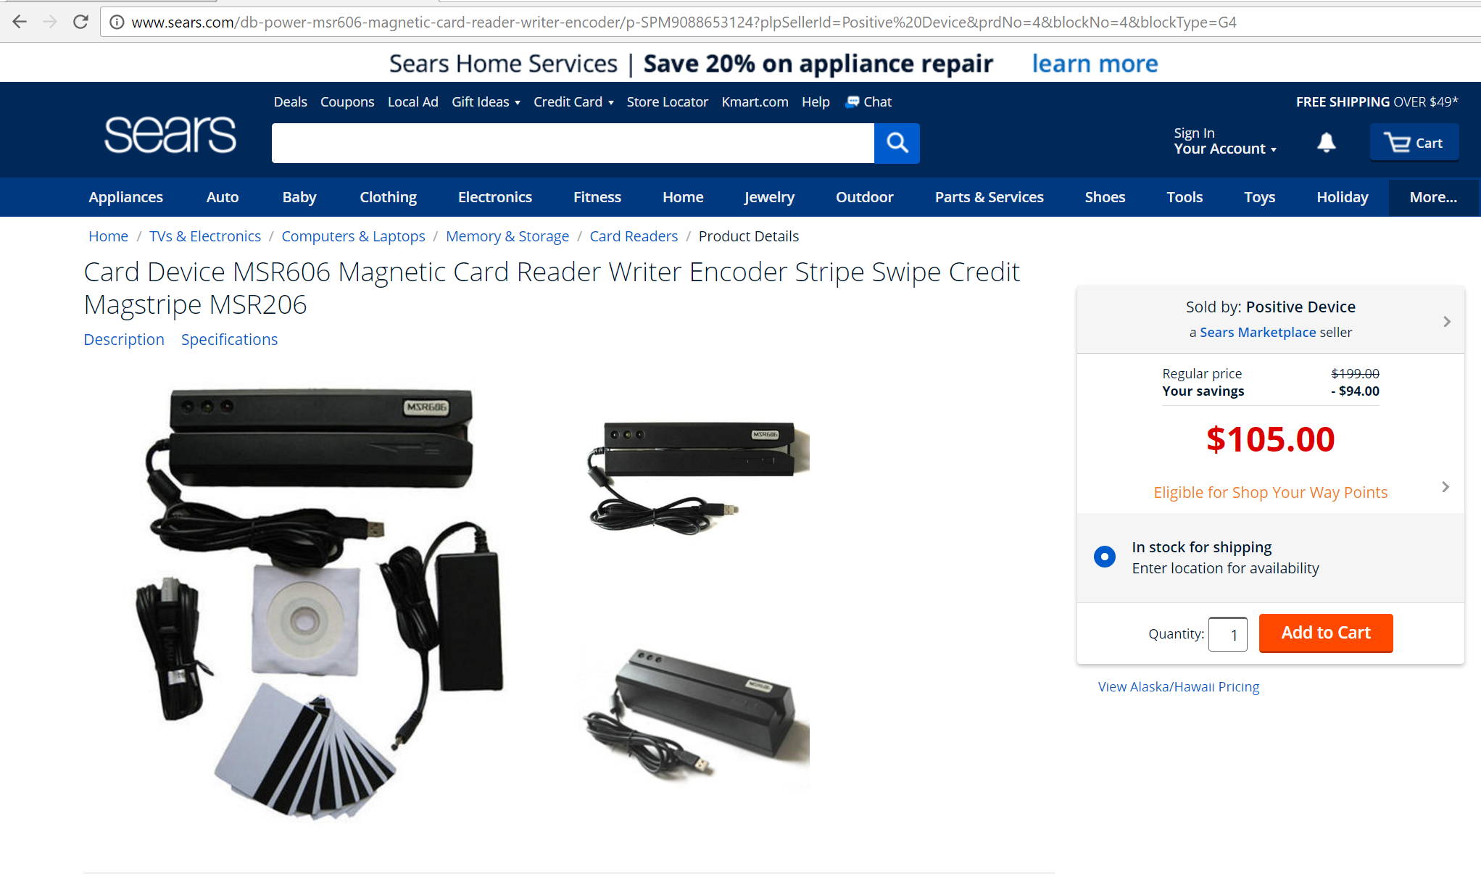
Card Skimming
Source: arstechnica.com

Slide 7
EMV - Brief History
1950
1970
1974
1977
1979
1984
1996
1999
2007
2014
Plastic Cards
Magnetic Cards
Chip card patent
uP chip card invention
Commercial smart cards
French chip card rollout
EMV
EMVCo established
Contactless protocol
Tokenization
2008
CCPS: Contactless Comm. Protocol Spec. (L1)

Slide 8
EMV Usage (2013-2014)

Slide 9
EMV – How It Works?
Magnetic Stripe
Card is a data store read by the terminal
Terminal performs all processing with the issuer/payment system
EMV
Chip stores and processes payment transaction with the terminal
Online data authentication
User PIN for cardholder identity verification
Online authorization
EMV Transactions: contact and contactless
Liability Shift
From issuers to acquirers and merchants

Slide 10
EMV - Cryptograms
Application Cryptograms: generated using 2-Key 3DES cryptography (*)
ARQC: Authorization Request Cryptogram (online authorization request)
TC: Transaction Certificate (chip signature over data for clearing and settlement)
AAC: Application Authentication Cryptogram (declined transaction)
Online card and issue authentication
Chip generates ARQC, sent to the issuer
Issuer verifies the ARQC
Issuer may generate ARPC (Authorization Response Cryptogram)
ARPC may be sent to the chip and verified for approval
Data signing for transaction authentication
ARQC: Online authorization request
ARPC: online authorization response
TC: approval message for clearing and settlement
AAC: declines transactions
Notes:
TC: Application Cryptogram generated by the card when accepting a transaction. Hash of TDOL (Transaction Data Object List)
CDOL: Card Risk Management Data Object List

Slide 11
EMV: Up and Coming
Next Gen Chip Specifications
Mobile tech
Consolidation across contact and contactless payment solutions
ECC for public key cryptography
Additional value-add data

Slide 12
EMV: Actors
Cardholder
Merchant
Acquirer
PAN, Token
Token
Token
Token Service Provider
Payment Network
Issuer
PAN,
Token
PAN, Token

Slide 13
EMV: Key Management (Book 2)
Static Data Authentication (SDA)
Digital signature generated on the terminal
Relies on an offline CA that signs issuer public keys
CA public keys are stored on terminals
Detects unauthorized data alteration
Terminals
CA public keys per registered application provider identifier
Key and algorithm identifiers for future expansion
Dynamic Data Authentication
ICC generated dynamic signature (unpredictable number)
Combined DDA
Signature includes AC
Notes:
http://www.emvco.com/specifications.aspx?id=223

Slide 14
Card Authentication
Done before any transaction
SDA: Static Data Authentication
Static Data
Issuer Public Key Certificate
DDA: Dynamic Data Authentication
Dynamic Data
Issuer Public Key Certificate
ICC Public Key Certificate
CDA: Combined Data Authentication
Combined Data
Issuer Public Key Certificate
ICC Public Key Certificate
Application Cryptogram
Cleartext PIN
Cleartext & Encrypted PIN
Cleartext & Encrypted PIN
Static App Data
Included in the signature
Unpredictable number is signed

Slide 15
Cardholder Verification
Offline
Separate PIN encryption certificate on the card
ICC generates a random nonce; 64-bits long
Terminal generates a nonce, pads message, encrypts with card’s public key
ICC decrypts and validates the nonce
ICC verifies the PIN
Online
Terminal sends encrypted PIN (2-Key 3DES) to the issuer
Issuer verifies the PIN
Where does the 3DES key come from? (HSMs to the rescue)
Notes:
https://crypto.stanford.edu/~dabo/courses/cs255_winter14/lectures/EMV.pdf

Slide 16
EMV: SDA Key Chain
Issuer
CA
Static Application Data
Issuer Private Key
CA Private Key
CA Public Key
Signature
Issuer Public Key Certificate
Sign
Sign
Acquirer
ICC
Terminal

Slide 17
Cryptogram Data (minimum)
Value | Comments | Source
Amount, authorized |  | Terminal
Amount, other |  | Terminal
Terminal country code |  | Terminal
Terminal verification results |  | Terminal
Transaction currency code |  | Terminal
Transaction date | 2 bytes | Terminal
Transaction type |  | Terminal
Unpredictable number | 4 bytes | Terminal
Application Interchange Profile |  | ICC
Application Transaction Counter | 2 byte | ICC
Issue Application Data |  | ICC

Slide 18
A Few Attacks
Unpredictable Number – too short?
How about using a counter? 1,2,3,4,5, …
Replay attack is easy to pull off
Paper Clip Attack
Snoop the communication channel between the card and the reader to sniff the PIN
Insert a paper clip through a pinhole to tap into the POS board, circa 2008
Compromised card readers
PINs were stolen, circa 2006

Slide 19
I’d like to displace CVV
CVV/CVC/CVV2/whatever – it is a static number
It is a 3 decimal digit number, at most 4 digits for AmEx
Calculation has been the same for 30 years from
PAN, Expiry Date, Service Code
CVV is a stand-in for card present state in online transactions
What about good enough or better user authentication protocols?
Instead of CVV
In addition to CVV

Slide 20
EMV Symmetric Encryption Algorithms
Encryption Mode of Operation: ECB or CBC
Padding $X$: add ‘80’ and then as many ‘00’
Cryptogram computation with ECB
$Y_{i}=ALG\left(K_{S},X_{i}\right)$
Cryptogram computation with CBC
$Y_{i}=ALG\left(K_{S}, X_{i}⊕Y_{i−1}\right), Y_{0}=00…00$
Approved algorithms
3DES with 112-bit key in EDE construction
AES, 128/192/256 bit key length
SHA-1

Slide 21
EMV Symmetric MAC Algorithms (DES)
Use DES or Triple DES in CBC mode, perform CMAC
Padding $X$: add ‘80’ and then as many ‘00’
Cryptogram computation, use CBC, ALG=3DES with a 112 bit key $K_{S}$
Session key: $K_{S}=K_{SL}││K_{SR}$, 3DES key $K=K_{SL}││K_{SR}││K_{SL}$
$X=X_{1},X_{2},…, X_{B}$
$H_{i}=ALG\left(K_{SL}, X_{i}⊕H_{i−1}\right), H_{0}=00…00$
Algorithm 1: $H_{B+1}=H_{B}$
Algorithm 3: $H_{B+1}=ALG(K_{SL}, ALG^{−1}\left(K_{SR}, H_{B}\right))$
MAC $S$ is the most significant bytes of $H_{B+1}$
X
K_{SR}
DES-CBC
K_{SL}
DES-ECB
MAC

Slide 22
EMV Symmetric MAC Algorithms (AES)
Use AES in CBC mode, perform CMAC
Padding $X$: add ‘80’ and then as many ‘00’
Session Key $K_{S}$, Algorithm 5 (CMAC), ALG=AES
$C=00…87$
$L=ALG\left(K_{S}, C\right)$
$K_{1}=L≪1, K_{1}=K_{1}⊕C$ if MSB(L)=1
$K_{2}=K_{1}≪1, K_{2}=K_{2}⊕C$, if MSB(K₁)=1
Cryptogram computation, use CBC
$X=X_{1},X_{2},…, X_{B}$
$X_{B}=X_{B}⊕K_{1}$, if no padding
$X_{B}=X_{B}⊕K_{2}$, if padding was added
$H_{i}=ALG\left(K_{S}, X_{i}⊕H_{i−1}\right), H_{0}=00…00$
MAC $S$ is the most significant bytes of $H_{B}$

Slide 23
EMV Session Key
Session keys $K_{S}$ are derived from a unique master key $K_{M}$
$R$ is diversification data
$K_{S}=F\left(K_{M}, R\right)$
Session key derivation function $F$ (issuers may define their own)
$R=R_{0}││R_{1}││…││R_{n−1}$
$R_{0}$ can be ATC
$K_{S}=ALG\left(K_{M},R\right)$, if $│K_{S}│$is the block length of ALG
$K_{S}=ALG\left(K_{M}, F_{1}\right)││ALG(K_{M}, F_{2})$, if $│K_{S}│$> block length of ALG
$F_{1}=R_{0}││R_{1}││F0││…││R_{n−1}$
$F_{2}=R_{0}││R_{1}││0F││…││R_{n−1}$
ALG = 3DES or AES

Slide 24
EMV Asymmetric Signature Algorithms
Signature generation
$N$ is the input/output length of the signature/verification functions
$h=H(M)$
$m=m_{1}││m_{2}$, where $m_{1}$ is the $N−22$ leftmost bytes of $m$, $m_{2}$ is the rest
$s=S(S_{K}, 6A ││m_{1}││h││BC)$
$H$ must be a hash function with 160 bit output; SHA-1
RSA with $e=3$ or $e=2^{16}+1$
Mandatory upper bounds for modulus is 248 bytes (1,984 bits)
$\max{(\left|N\right|)}=1984$

Slide 25
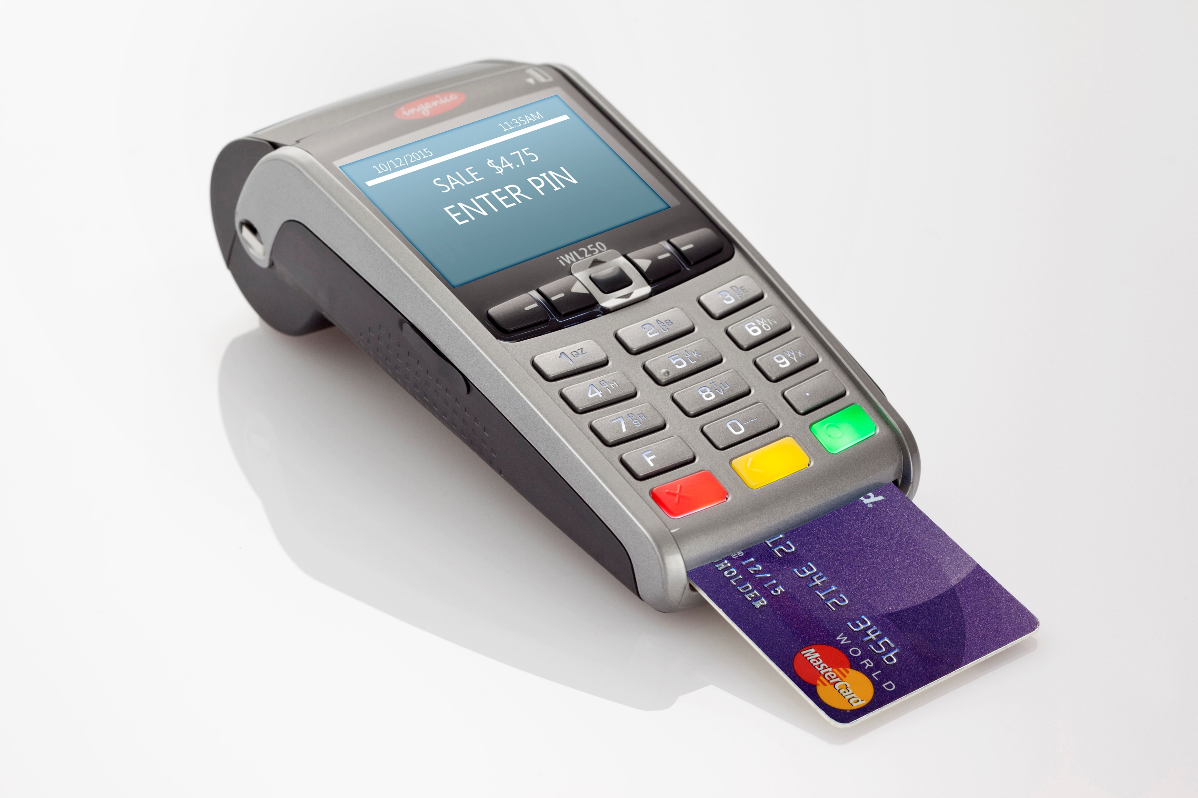
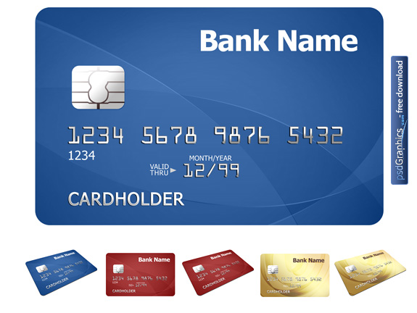
Online Transaction Authentication
Card Network
ARQC
ARQC
Acquirer
ARPC
ARPC
ARQC
ARPC
ARQC
3DES
Cryptogram
ARPC
Issuer
Shared Key

Slide 26
Mobile Payments (Apple, Microsoft, Android)
Secure Element (SE): certified chip running Java Card
NFC
Application processor and SE
SE and POS Terminal
Wallet, the Application
Secure Enclave
Manages authentication
Payment processing
Fingerprint storage
Apple Pay Servers
Payment card state management
Device account numbers in SE
Device/network communication
Notes:
http://www.emvco.com/specifications.aspx?id=223

Slide 27
Mobile Payments: ApplePay
Initialization
Secure Element is connected to NFC controller
NFC controller is also connected to the application processor
Secure Enclave and Secure Element has an AES key (manufacturing time)
Add Card
User enters card information on the device
CardInfo, UserInfo, DeviceInfo are sent to the corresponding issuer
Issuer performs ID&V (Identification and Verification)
PAN is not stored on the device
DPAN, Device PAN, is stored on the device (SE or other secure storage)
Notes:
https://www.apple.com/business/docs/iOS_Security_Guide.pdf

Slide 28
Mobile Payments: ApplePay
Payment Transactions use
DPAN: device account number
ATC: incrementing counter per transaction (shared with network and issuer)
Payment Authorization
NFC detection invokes the payment application
User is presented for authorization
Secure Element receives authorization from Secure Enclave
PAN is not used
Notes:
https://support.apple.com/en-us/HT203027

Slide 29
BitCoin
Transactions are recorded on a block chain
Transactions are published on the BitCoin network
Miners compete to solve a cryptographic puzzle (Proof of Work)
Fees are paid to the winning miner per transaction
BitCoin network data is public
Anonymity? Not really
Notes:
https://the-blockchain.net/

Slide 30
BitCoin, Silk Road
Silk Road: Online marketplace (since 2/2011)
Illegal substance and service trade
Run by Dread Pirate Roberts
All communications through TOR
13,000 listings as of 9/2013
FBI arrest on 10/1/2013, 29 year old male
How to find the person, trace money movement, debunk anonymity claims
Data mining techniques for large payment systems
Publicly available transaction graphs
Revenue of ~9.5 million BitCoins, commission ~600,000 BitCoins
Notes:
http://eprint.iacr.org/2013/782.pdf

Slide 31
Block Chain Layers
Application
Transactions
Smart contracts written in a language (Turing complete or not)
Language is run in an execution environment
View
Summary of the transaction log
Consensus
Distributed block agreement
Storage
Distributed storage of transactions and blocks
Network
New transaction broadcast

Slide 32
Block Chain Layers
Application
Transactions
Smart contracts written in a language (Turing complete or not)
Contracts are programs, and error-prone
Language is run in an execution environment
If CSEP590 is on Election Night on 2016
Then don’t talk about elections and voting,
And transfer $10 to NPR
What is our track record in correctly codifying the intent?
What is our track record in correctly executing the code?
What is our track record in securely executing the code?

Slide 33
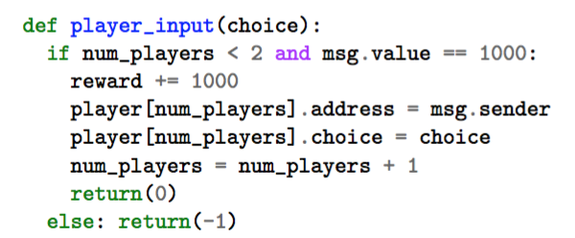
Smart Contract in Block Chains
What happens in an unmodifiable block chain when mistakes are found?
What happens when malicious mistakes are not found?
How do you prove it is a mistake?
From Cornell IC3 in May’16, Andrew Miller’s presentation, mistakes by UMD security class students.
What happens when a third player joins the contract?

Slide 34
Block Chain Layers
Perceived Layers
Application. Transactions, smart contracts
View. Summary of the transaction log
Consensus. Distributed block agreement
Storage. Distributed storage of transactions and blocks
Network. New transaction broadcast
Permissioned vs. Permissionless

Slide 35
Hash Functions
Arbitrary-length input
Hash Function
Hash Function
Fixed-length output

Slide 36
One-Way Hash Functions
Arbitrary-length input
One-Way
Hash Function
Given just an output, it is infeasible to find any input which produces that output.
Fixed-length output

Slide 37
SHA-256
Arbitrary-length input
SHA-256
Given just an output, it is infeasible to find any input which produces that output.
256-bit output

Slide 38
3 Definitions of One-Way Hashes
Non-invertible: Given a target output, it’s hard to find an input that produces the target output.
2nd pre-image resistant: Given an input, it’s hard to find another input that produces the same output.
Collision-intractable: It’s hard to find any two inputs that produce the same output.

Slide 39
Birthday Paradox
If you pick more than $\sim \sqrt{N}$ times from a space of $N$ items, you will start seeing repetitions.
Intuition: After $K$ items have been seen, $\frac{K(K−1)}{2}$ pairs will have been seen.

Slide 40
SHA-256 Mechanics

Slide 41
SHA-256 Mechanics
768-bit input
SHA-256 Compression Function
256-bit output

Slide 42
SHA-256 Mechanics
768-bit input
256 bits
512 bits
SHA-256 Compression Function
256-bit output

Slide 43
SHA-256 Mechanics
Full Input

Slide 44
SHA-256 Mechanics
512 bits
512 bits
512 bits
512 bits

Slide 45
SHA-256 Mechanics
512 bits
512 bits
512 bits
512 bits
256-bit Initial Value
512 bits
512 bits
512 bits
512 bits
SHA-256 Compression Function
SHA-256 Compression Function
SHA-256 Compression Function
SHA-256 Compression Function
SHA-256 Compression Function
256 bits
256 bits
256 bits
256 bits
256-bit output

Slide 46
Hash Chains
Input #1
Input #2
Input #3
Input #4
Initial Value
One-Way Hash Function
One-Way Hash Function
One-Way Hash Function
One-Way Hash Function
SHA-256 Compression Function
Output

Slide 47
Hash Chains
Initial Value
One-Way Hash Function
One-Way Hash Function
One-Way Hash Function
One-Way Hash Function
SHA-256 Compression Function
Output

Slide 48
Merkle Tree
$$H$$
$$H$$
$$H$$
$$H$$
$$H$$
$$H$$
$$H$$

Slide 49
Merkle Tree
$$H$$
$$H$$
$$H$$
$$H$$
$$H$$
$$H$$
$$H$$

Slide 50
Merkle Tree
$$H$$
$$H$$
$$H$$
$$H$$
$$H$$
$$H$$
$$H$$

Slide 51
Merkle Tree
$$H$$
$$H$$
$$H$$
$$H$$
$$H$$
$$H$$
$$H$$

Slide 52
Merkle Tree
$$H$$
$$H$$
$$H$$
$$H$$
$$H$$
$$H$$
$$H$$

Slide 53
One-Way Accumulators
Flatten Merkle trees with constant-sized proof of membership.
Use a “quasi-commutative” function.

Slide 54
One-Way Accumulators
When viewed as a two-argument function, the (candidate) one-way function
$$F_{N}(Y,X)=Y^{X} mod N$$
also satisfies a useful additional property which has been termed quasi-commutivity:
$$F(F(Y,X_{1}),X_{2})=F(F(Y,X_{2}),X_{1})$$
since $Y^{X_{1}X_{2}}=Y^{X_{2}X_{1}}$.

Slide 55
One-Way Accumulators
The “hash” of values $X_{1},X_{2},…, X_{m}$ is
$${Z=F}_{N}(Y,X_{1},X_{2},…, X_{m})=Y^{\sum_{i=1}^{m}{X_{i}}} mod N\text{.}$$
The value $X_{k}$ can be shown to be one of the hashed values by showing ${Z_{k}=Y}^{\sum_{i≠k}{X_{i}}} mod N$ since $Z=Z_{k}^{X_{k}} mod n$.

Slide 56
Historical Use of Hash Chains
1979: Merkle-Damgård – Chained Hash Function Construction
1979: Merkle Tree – Tree of Hashes used for Membership
1981: Lamport – Hash Chains for Password Protection
1991: Haber-Stornetta – Time-Stamping with Hash Trees
1994: Benaloh-deMare – One-Way Accumulators
2001: Rivest-Shamir – PayWord & MicroMint micropayments

Slide 57
Historical Use of Hash Chains
1979: Merkle-Damgård – Chained Hash Function Construction
1979: Merkle Tree – Tree of Hashes used for Membership
1981: Lamport – Hash Chains for Password Protection
1991: Haber-Stornetta – Time-Stamping with Hash Trees
1994: Benaloh-deMare – One-Way Accumulators
1997: Hashcash – Generating “cash” by Repeated Hashing
2001: Rivest-Shamir – PayWord & MicroMint micropayments

Slide 58
Finding Distinguished Outputs
With SHA-256 (or any good one-way hash function) …
The best way to achieve a specific target output is to repeatedly try different inputs until one succeeds.
The best way to achieve a specific output property is to repeatedly try different inputs until one succeeds.

Slide 59
Hashcash (1997)
To demonstrate work on $x$, find $y$ such that
$H\left(x,y\right)<z$,
for some pre-determined bound $z$.

Slide 60
Hashcash – Proof of Work
To demonstrate work on $x$, find $y$ such that
$H\left(x,y\right)<z$,
for some pre-determined bound $z$.

Slide 61
bitcoin Currency (2008)
The next bitcoin(s) are awarded to the first person who can find a value which when hashed with the previous bitcoin produces an output smaller than a pre-defined target.

Slide 62
bitcoin Transactions
Together with the most recently found coin, a bitcoin miner can optionally include some signed “transactions” in its hashes (for which it may receive transaction fees).

Slide 63
bitcoin Transactions
The values that are hashed together with the previous coins can contain other stuff:
My name
My public key
Transactions
Contracts
Etc.

Slide 64
bitcoin mining
$$H\left(c,t_{1},t_{2},…,t_{n},m,r\right)<z$$

Slide 65
bitcoin mining
$$H\left(c,t_{1},t_{2},…,t_{n},m,r\right)<z$$
Most recent prior coin

Slide 66
bitcoin mining
$$H\left(c,t_{1},t_{2},…,t_{n},m,r\right)<z$$
Most recent prior coin
Optional transactions

Slide 67
bitcoin mining
$$H\left(c,t_{1},t_{2},…,t_{n},m,r\right)<z$$
Most recent prior coin
Miner ID info
Optional transactions

Slide 68
bitcoin mining
$$H\left(c,t_{1},t_{2},…,t_{n},m,r\right)<z$$
Most recent prior coin
Miner ID info
Optional transactions
Random variable

Slide 69
bitcoin mining
$$H\left(c,t_{1},t_{2},…,t_{n},m,r\right)<z$$
Most recent prior coin
Miner ID info
Target value
Optional transactions
Random variable

Slide 70
bitcoin target value
The target value is set so that the blockchain will be extended once every 10 minutes – on average.
The target value is adjusted every 2016 blocks (which should happen about every two weeks).

Slide 71
Mining new bitcoins
When a miner successfully extends the blockchain, it broadcasts its new value to all the other miners and receives a reward.
Miners then (are supposed) continue mining on the new, longer chain.

Slide 72
Dispute Resolution
What if two miners extend the chain (each with their own info) at the same time?
There are numerous distributed consensus protocols that have been developed and published by Computer Scientists.

Slide 73
Dispute Resolution
The longest chain wins.

Slide 74
Mining Pools
Collaboration offers two principal benefits.
Centralized transaction processing
Reduced volatility

Slide 75
Pooling Details
Pools can pay members in proportion to their failed contributions.
Large pools threaten integrity of the system.

Slide 76
What Do Block Chains Provide?
Block chains can achieve distributed consensus without a trusted authority or random source.
Block chains can randomly select a leader/winner from a group in a “fair” manner.

Slide 77
Block Chain Overreach
Block chains are not ideal when a central authority is already part of the system.
N.B. Hash chains (now sometimes called private block chains) have numerous good applications.

