Slide 1
Practical Aspects of Modern Cryptography
Fall 2016
Josh Benaloh
Tolga Acar

Slide 2
Agenda
Protocols: Session-based protocols
  Introduction
  Kerberos
  SSL/TLS
Certificates and Public Key Infrastructure (PKI)
  Certificates
  Public Key Infrastructure
  Certificate Lifecycle Management
  Revocation

Slide 3
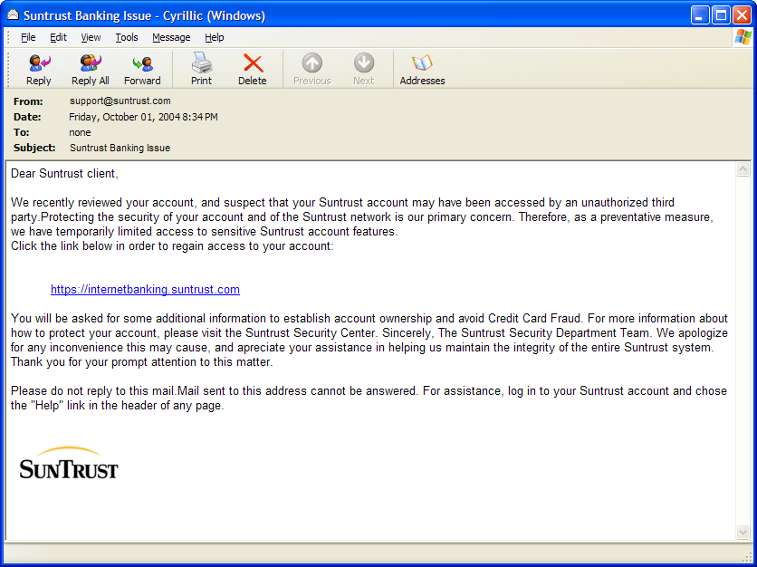
Motivation

Slide 4
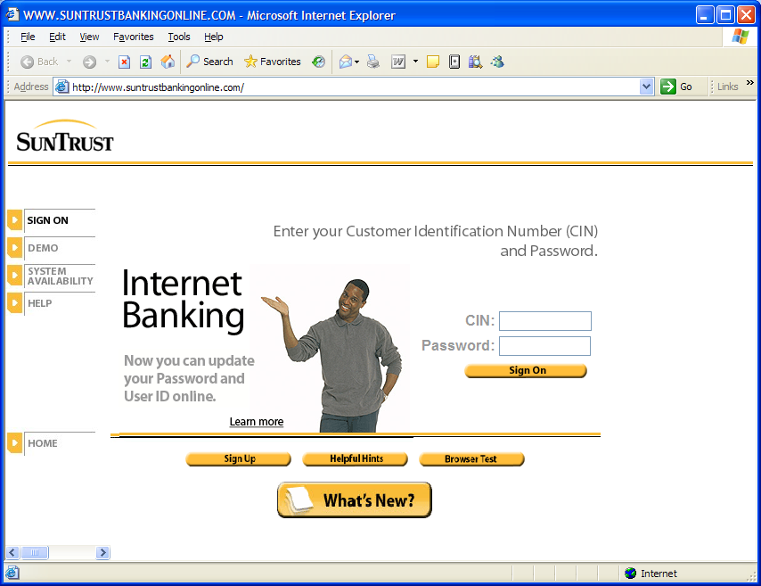
Motivation

Slide 5
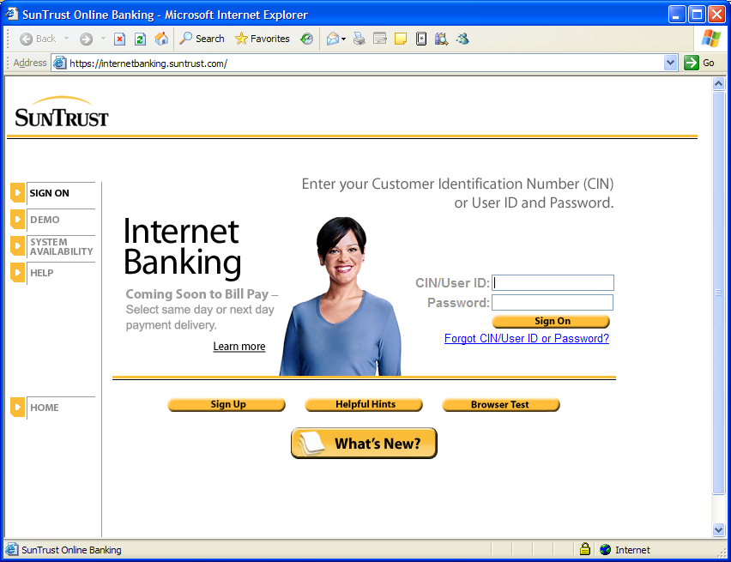
Motivation

Slide 6
Motivation
How do I know the web site I’m talking to is really who I think it is?
Is it safe to view to give sensitive information over the Web?
  What keeps my CC#, SSN, financial information or medical records out of the hands of the bad guys?
How do I know that the information I’m looking at hasn’t been maliciously modified?
  Has someone tampered with it?

Slide 7
Security Protocol Properties
Confidentiality
  Keeping message content secret, even if the information passes over a public channel
Integrity
  Keeping messages tamper-free from origin to destination
Authentication
  Determining the origin of messages (author and/or sender)

Slide 8
Agenda
Protocols: Session-based protocols
  Introduction
  Kerberos
  SSL/TLS
Certificates and Public Key Infrastructure (PKI)
  Certificates
  Public Key Infrastructure
  Certificate Lifecycle Management
  Revocation

Slide 9
Kerberos History
Based on symmetric Needham-Schroeder (1978)
Designed as part of MIT’s Project Athena in the 1980’s
  Kerberos v4 published in 1987
Migration to the IETF
  RFC 1510 (Kerberos v5, 1993)
Used in a number of products
  Example: Windows domains (since Windows 2000)
  Many web-based authentication protocols (e.g. Windows Live ID) are Kerberos inspired using HTTP and client-side cookies
  OAuthv2 is also Kerberos inspired

Slide 10
Kerberos
Designed for a single Administration Domain of machines & users
No public key crypto
  PKINIT is added as a pre-auth mechanism later on
Provides authentication & encryption services
Kerberized servers provide authorization on top of the authenticated identities

Slide 11
The Kerberos Model
Clients
Servers
The Key Distribution Center (KDC)
Centralized trust model
  KDC is trusted by all clients & servers
  KDC shares a secret, symmetric key with each client and server
A “realm” is single trust domain consisting of one or more clients, servers, KDCs

Slide 12


Picture of a Kerberos Realm
Key Distribution
Center (KDC)
Ticket Granting Server (TGS)
Server
Client
Notes:
Smart Card Logon - Kerberos v5 security provider implements the current IETF draft for PKINIT to support certificate-based authentication
GINA/Winlogon - recognizes the card insertion and prompts the user for a PIN rather than a password
The certificate is retrieved from the card and used to identify the user after a challenge-response requiring a private key operation on the smart card
KDC - the Key Distribution Center looks up the user in the Active Directory based on the identity in the certificate
The end result is a Kerberos Ticket Granting Ticket (TGT) that can be used to request access to network resources including accessing UNIX-based databases using delegation and referral.

Slide 13
Limitations
Password guessing attacks
Trusted path requirement for password entry
Loose time synchronization (clock skew)
Denial of service attacks
Trust in the key distribution center

Slide 14
Joining a Kerberos Realm
One-time setup
  Each client, server that wishes to participate in the realm exchanges a secret key with the KDC
  If the KDC is compromised, the entire system is cracked
Because the KDC knows everyone’s individual secret key, the KDC can issue credentials to each realm identity

Slide 15
Kerberos Credentials
Two types of credentials in Kerberos
  Tickets
  Authenticators
Tickets are credentials issued to a client for communication with a specific server
Authenticators are additional credentials that prove a client knows a key at a point in time
  Basic idea: encrypt a nonce

Slide 16
The Basic Kerberos Protocol
Assume client C wishes to authenticate to and communicate with server S
Phase 1: C gets a Ticket-Granting Ticket (TGT) from the KDC
Phase 2: C uses the TGT to get a Ticket for S
Phase 3: C communicates with S

Slide 17
Protocol Definitions
C = client, S = server
TGS = ticket-granting service
K_{x} = x’s secret key
K_{x,y} = session key for x and y
{m}K_{x} = m encrypted in x’s secret key
T_{x,y} = x’s ticket to use y
A_{x,y} = authenticator from x to y
N_{x} = a nonce generated by x

Slide 18
The Basic Kerberos Protocol (1)
Phase 1: C gets a Ticket Granting Ticket
C sends a request to the KDC for a ticket-granting ticket (TGT)
  A TGT is a ticket used to talk to the special ticket-granting service
  A TGT is relatively long-lived (~8-24 hours typically)
C ➔ KDC: C, TGS, N_{C}
Sent in the clear!

Slide 19
The Basic Kerberos Protocol (2)
Phase 1: C gets a Ticket-Granting Ticket
KDC responds with two items
  The ticket-granting ticket
    A ticket for C to talk to TGS
  A copy of the session key to use to talk to TGS, encrypted in C’s shared key
  KDC ➔ C: T_{C,TGS}, {K_{C,TGS}}K_{C}
  where T_{C,TGS} = TGS, {C, C-addr, lifetime, K_{C,TGS}}K_{TGS}
  Only the TGS can decrypt the ticket
  C can unlock the second part to retrieve K_{C,TGS}

Slide 20
Picture of a Kerberos Realm
Key Distribution
Center (KDC)
C ➔ KDC: C, TGS, N_{C}
KDC ➔ C: T_{C,TGS}, {K_{C,TGS}}K_{C}
T_{C,TGS} = TGS, {C, C-addr, lifetime, K_{C,TGS}}K_{TGS}
Client
Notes:
Smart Card Logon - Kerberos v5 security provider implements the current IETF draft for PKINIT to support certificate-based authentication
GINA/Winlogon - recognizes the card insertion and prompts the user for a PIN rather than a password
The certificate is retrieved from the card and used to identify the user after a challenge-response requiring a private key operation on the smart card
KDC - the Key Distribution Center looks up the user in the Active Directory based on the identity in the certificate
The end result is a Kerberos Ticket Granting Ticket (TGT) that can be used to request access to network resources including accessing UNIX-based databases using delegation and referral.

Slide 21
The Basic Kerberos Protocol (3)
Phase 2: C gets a Ticket for S
C requests a ticket to communicate with S from the ticket-granting service (TGS)
  C sends TGT to S along with an authenticator requesting a ticket from C to S
C ➔ TGS: {A_{C,S}}K_{C,TGS} , T_{C,TGS}
where A_{c,s} = {c, timestamp, opt. subkey}
  First part proves to TGS that C knows the session key
  Second part is the TGT C received from the KDC

Slide 22
The Basic Kerberos Protocol (4)
Phase 2: C gets a Ticket for S
TGS returns a ticket for C to talk to S
(Just like step 2 above...)
  TGS ➔ C: T_{C,S} , {K_{C,S}}K_{C,TGS}
  Where T_{C,S} = S, {C, C-addr, lifetime, K_{C,S}}K_{S}
  Only S can decrypt the ticket T_{C,S}
  C can unlock the second part to retrieve K_{C,S}

Slide 23
Picture of a Kerberos Realm
Ticket Granting Server (TGS)
C ➔ TGS: {A_{C,S}}K_{C,TGS} , T_{C,TGS}
A_{c,s} = {c, timestamp, opt. subkey}
TGS ➔ C: T_{C,S} , {K_{C,S}}K_{C,TGS}
Client
Notes:
Smart Card Logon - Kerberos v5 security provider implements the current IETF draft for PKINIT to support certificate-based authentication
GINA/Winlogon - recognizes the card insertion and prompts the user for a PIN rather than a password
The certificate is retrieved from the card and used to identify the user after a challenge-response requiring a private key operation on the smart card
KDC - the Key Distribution Center looks up the user in the Active Directory based on the identity in the certificate
The end result is a Kerberos Ticket Granting Ticket (TGT) that can be used to request access to network resources including accessing UNIX-based databases using delegation and referral.

Slide 24
The Basic Kerberos Protocol (5)
Phase 3: C communicates with S
C sends the ticket to S along with an authenticator to establish a shared secret
C ➔ S: {A_{C,S}}K_{C,S} , T_{C,S}
where A_{c,s} = {c, timestamp, opt. subkey}
  T_{C,S} = S, {C, C-addr, lifetime, K_{C,S}}K_{S}
  S decrypts the ticket T_{C,S} to get the shared secret K_{C,S} needed to communicate securely with C

Slide 25
The Basic Kerberos Protocol (6)
Phase 3: C communicates with S
S decrypts the ticket to obtain the K_{C,S} and replies to C with proof of possession of the shared secret (optional step)
S ➔ C: {timestamp, opt. subkey}K_{c,s}
Notice that S had to decrypt the authenticator, extract the timestamp & opt. subkey, and re-encrypt those two components with K_{c,s}

Slide 26
Picture of a Kerberos Realm
C ➔ S: {A_{C,S}} K_{c,s}, T_{C,S}
where A_{c,s} = {c, timestamp, opt. subkey}
Client
Server
S ➔ C: {timestamp, opt. subkey}K_{c,s}
Notes:
Smart Card Logon - Kerberos v5 security provider implements the current IETF draft for PKINIT to support certificate-based authentication
GINA/Winlogon - recognizes the card insertion and prompts the user for a PIN rather than a password
The certificate is retrieved from the card and used to identify the user after a challenge-response requiring a private key operation on the smart card
KDC - the Key Distribution Center looks up the user in the Active Directory based on the identity in the certificate
The end result is a Kerberos Ticket Granting Ticket (TGT) that can be used to request access to network resources including accessing UNIX-based databases using delegation and referral.

Slide 27
Picture of a Kerberos Realm
Key Distribution
Center (KDC)
Ticket Granting Server (TGS)
Ticket
Request
TGT Request
TGT
Ticket
Ticket + service request
“Do some stuff”
Server
Client
Notes:
Smart Card Logon - Kerberos v5 security provider implements the current IETF draft for PKINIT to support certificate-based authentication
GINA/Winlogon - recognizes the card insertion and prompts the user for a PIN rather than a password
The certificate is retrieved from the card and used to identify the user after a challenge-response requiring a private key operation on the smart card
KDC - the Key Distribution Center looks up the user in the Active Directory based on the identity in the certificate
The end result is a Kerberos Ticket Granting Ticket (TGT) that can be used to request access to network resources including accessing UNIX-based databases using delegation and referral.

Slide 28
Thoughts on Kerberos...
Only the KDC needs to know the user’s password (used to generate the shared secret)
  You can have multiple KDCs for redundancy, but they all need to have a copy of the username/password database
  Q: Is it possible not to record the password?
Only the TGS needs to know the secret keys for the servers
  You can split KDC from TGS, but it is common for those two services to reside on the same physical machine

Slide 29
Thoughts on Kerberos...(2)
Time is very important in Kerberos
  All participants in the realm need accurate clocks
  Timestamps are used in authenticators to detect replay; if a host can be fooled about the current time, old authenticators could be replayed
  Tickets tend to have lifetimes on the order of hours, and replays are possible during the lifetime of the ticket
Bearer Credentials: Capture it, you are the owner of the ticket (sometimes called token in OAuthv2)

Slide 30
Thoughts on Kerberos...(3)
Password-guessing attacks are possible
  Capture enough encrypted tickets and you can brute-force decrypt them to discover shared keys
It’s possible to screw up the implementation
  In fact, Kerberos v4 had a colossal security breach due to bad implementations
Notes:
Kerberos v4 tickets don’t include a hash, random padding, or a random IV. Attack: Cause a chosen plaintext be encrypted in a service ticket to fabricate a ticket.
The initial part of a plaintext version 4 ticket is constant (flags and client name). Attack: ticket splicing attacks

Slide 31
RNGs in Kerberos v4
Session keys were generated from a PRNG seeded with the XOR of the following:
  Time-of-day in seconds since 1/1/1970
  Process ID of the Kerberos server process
  Cumulative count of session keys generated
  Fractional part of time-of-day seconds
  Hostid of the machine running the server

Slide 32
RNGs in Kerberos v4 (continued)
The seed is a 32-bit value, so while the session key is used for DES (64 bits long, normally 56 bits of entropy), it has only 32 bits of entropy
What’s worse, the five values have predictable portions
  Time is completely predictable
  ProcessID is mostly predictable
  Even hostID has 12 predictable bits (of 32 total)

Slide 33
RNGs in Kerberos v4 (continued)
Of the 32 seed bits, only 20 bits really change with any frequency, so Kerberos v4 keys (in the MIT implementation) only have 20 bits of randomness
  They could be brute-force discovered in seconds
The hole was in the MIT Kerberos sources for seven years!

Slide 34
Agenda
Protocols: Session-based protocols
  Introduction
  Kerberos
  SSL/TLS
Public Key Infrastructure (PKI)

Slide 35
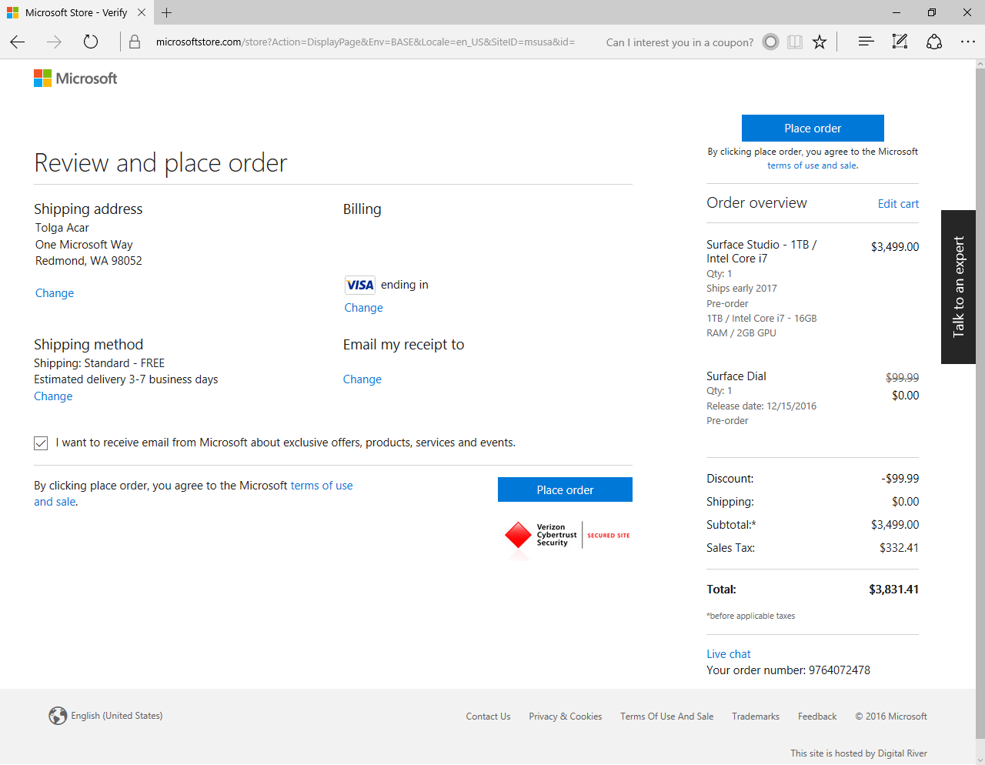
App-Level Security: TLS

Slide 36
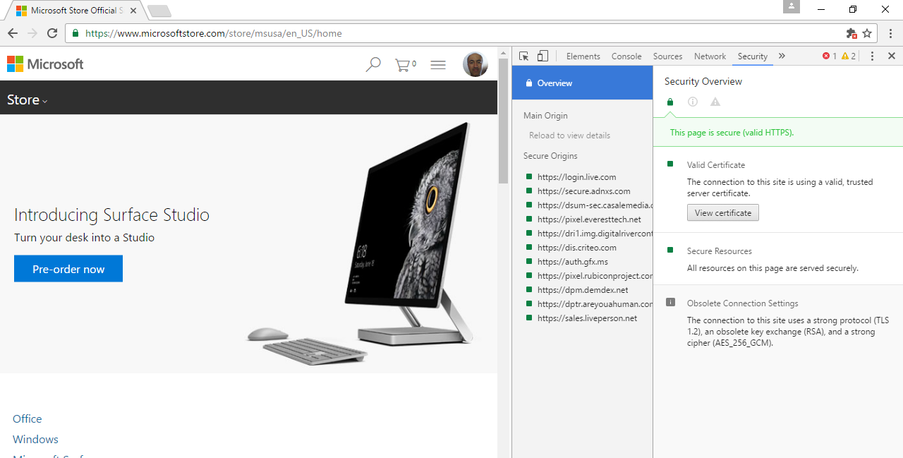
TLS for which content?

Slide 37
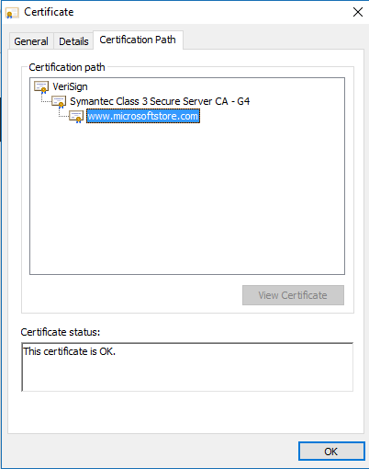
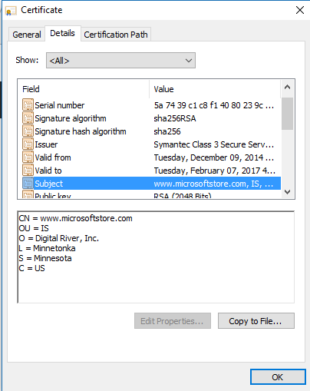
TLS: Certificates – more later

Slide 38
SSL/PCT/TLS History
1994: Secure Sockets Layer (SSL) V2.0
1995: Private Communication Technology (PCT) V1.0
1996: Secure Sockets Layer (SSL) V3.0
1997: Private Communication Technology (PCT) V4.0
1999: Transport Layer Security (TLS) V1.0
2006: TLS V1.1 (RFC 4346)
2008: TLS V1.2 (RFC 5246)
2016: TLS V1.3 (I-D Version 13), ETA: May 2017?

Slide 39
Typical Scenario
You (client)
Merchant (server)
Let’s talk securely
Here is my RSA public key
Here is a symmetric key, encrypted with your
public key, that we can use to talk

Slide 40
TLS (SSL)
You (client)
Merchant (server)
Let’s talk securely
Here are the protocols and ciphers I understand
Here is my RSA public key
Here is a symmetric key, encrypted with your
public key, that we can use to talk

Slide 41
TLS (SSL)
You (client)
Merchant (server)
Let’s talk securely
I choose this protocol and ciphers.
Here is my public key and
some other stuff.
Here is a symmetric key, encrypted with your
public key, that we can use to talk

Slide 42
TLS (SSL)
You (client)
Merchant (server)
Let’s talk securely.
Here are the protocols and ciphers I understand.
I choose this protocol and ciphers.
Here is my public key and
some other stuff.
Here is a symmetric key, encrypted with your
public key, that we can use to talk

Slide 43
SSL/TLS
All subsequent secure messages are protected using symmetric keys
  Key derivation from the agreed-upon secret
  HMAC and Encryption with two separate keys
  Authenticated encryption with a key

Slide 44
The five phases of SSL/TLS
Negotiate the ciphersuite to be used
Establish the shared session key
Client authenticates the server (“server auth”)
  Optional, but almost always done
  Typical for consumer-oriented Internet
Server authenticates the client (“client auth”)
  Optional, and almost never done
  Typical for data center applications
Authenticate previously exchanged data

Slide 45
Phase 1: Ciphersuite Negotiation
Client hello (client➔server)
  “Hi! I speak these ciphersuites, and here’s a 46-byte random number (nonce) I just picked”
      struct {
      ProtocolVersion client_version;
      opaque random[46];
      } PreMasterSecret;
Server hello (client⬅server)
  “Hello. We’re going to use this particular ciphersuite, and here’s a 46-byte nonce I just picked.”
Other info can be passed along (we’ll see why a little later...)

Slide 46
TLS V1.0 ciphersuites
TLS_NULL_WITH_NULL_NULL
TLS_RSA_WITH_NULL_MD5
TLS_RSA_WITH_NULL_SHA
TLS_RSA_EXPORT_WITH_RC4_40_MD5
TLS_RSA_WITH_RC4_128_MD5
TLS_RSA_WITH_RC4_128_SHA
TLS_RSA_EXPORT_WITH_RC2_CBC_40_MD5
TLS_RSA_WITH_IDEA_CBC_SHA
TLS_RSA_EXPORT_WITH_DES40_CBC_SHA
TLS_RSA_WITH_DES_CBC_SHA
TLS_RSA_WITH_3DES_EDE_CBC_SHA
TLS_DH_DSS_EXPORT_WITH_DES40_CBC_SHA
TLS_DH_DSS_WITH_DES_CBC_SHA
TLS_DH_DSS_WITH_3DES_EDE_CBC_SHA
TLS_DH_RSA_EXPORT_WITH_DES40_CBC_SHA
TLS_DH_RSA_WITH_DES_CBC_SHA
TLS_DH_RSA_WITH_3DES_EDE_CBC_SHA
TLS_DHE_DSS_EXPORT_WITH_DES40_CBC_SHA
TLS_DHE_DSS_WITH_DES_CBC_SHA
TLS_DHE_DSS_WITH_3DES_EDE_CBC_SHA
TLS_DHE_RSA_EXPORT_WITH_DES40_CBC_SHA
TLS_DHE_RSA_WITH_DES_CBC_SHA
TLS_DHE_RSA_WITH_3DES_EDE_CBC_SHA
TLS_DH_anon_EXPORT_WITH_RC4_40_MD5
TLS_DH_anon_WITH_RC4_128_MD5
TLS_DH_anon_EXPORT_WITH_DES40_CBC_SHA
TLS_DH_anon_WITH_DES_CBC_SHA
TLS_DH_anon_WITH_3DES_EDE_CBC_SHA

Slide 47
TLS V1.2 Ciphersuites (some, RFC5246)
TLS_RSA_WITH_NULL_MD5 = { 0x00,0x01 };
TLS_RSA_WITH_NULL_SHA = { 0x00,0x02 };
TLS_RSA_WITH_NULL_SHA256 = { 0x00,0x3B };
TLS_RSA_WITH_RC4_128_MD5 = { 0x00,0x04 };
TLS_RSA_WITH_RC4_128_SHA = { 0x00,0x05 };
TLS_RSA_WITH_3DES_EDE_CBC_SHA = { 0x00,0x0A };
TLS_RSA_WITH_AES_128_CBC_SHA = { 0x00,0x2F };
TLS_RSA_WITH_AES_256_CBC_SHA = { 0x00,0x35 };
TLS_RSA_WITH_AES_128_CBC_SHA256 = { 0x00,0x3C };
TLS_RSA_WITH_AES_256_CBC_SHA256 = { 0x00,0x3D };
TLS_DH_DSS_WITH_3DES_EDE_CBC_SHA = { 0x00,0x0D };
TLS_DH_RSA_WITH_3DES_EDE_CBC_SHA = { 0x00,0x10 };
TLS_DHE_DSS_WITH_3DES_EDE_CBC_SHA = { 0x00,0x13 };
TLS_DHE_RSA_WITH_3DES_EDE_CBC_SHA = { 0x00,0x16 };
TLS_DH_DSS_WITH_AES_128_CBC_SHA = { 0x00,0x30 };
TLS_DH_RSA_WITH_AES_128_CBC_SHA = { 0x00,0x31 };
TLS_DHE_DSS_WITH_AES_128_CBC_SHA = { 0x00,0x32 };
TLS_DHE_RSA_WITH_AES_128_CBC_SHA = { 0x00,0x33 };
TLS_DH_DSS_WITH_AES_256_CBC_SHA = { 0x00,0x36 };
TLS_DH_RSA_WITH_AES_256_CBC_SHA = { 0x00,0x37 };
TLS_DHE_DSS_WITH_AES_256_CBC_SHA = { 0x00,0x38 };
TLS_DHE_RSA_WITH_AES_256_CBC_SHA = { 0x00,0x39 };
TLS_DH_DSS_WITH_AES_128_CBC_SHA256 = { 0x00,0x3E };
TLS_DH_RSA_WITH_AES_128_CBC_SHA256 = { 0x00,0x3F };
TLS_DHE_DSS_WITH_AES_128_CBC_SHA256 = { 0x00,0x40 };
TLS_DHE_RSA_WITH_AES_128_CBC_SHA256 = { 0x00,0x67 };
TLS_DH_DSS_WITH_AES_256_CBC_SHA256 = { 0x00,0x68 };
TLS_DH_RSA_WITH_AES_256_CBC_SHA256 = { 0x00,0x69 };
TLS_DHE_DSS_WITH_AES_256_CBC_SHA256 = { 0x00,0x6A };
TLS_DHE_RSA_WITH_AES_256_CBC_SHA256 = { 0x00,0x6B };

Slide 48
ECC-based ciphersuites (RFC 4492)
TLS_ECDH_ECDSA_WITH_NULL_SHA
TLS_ECDH_ECDSA_WITH_RC4_128_SHA
TLS_ECDH_ECDSA_WITH_3DES_EDE_CBC_SHA
TLS_ECDH_ECDSA_WITH_AES_128_CBC_SHA
TLS_ECDH_ECDSA_WITH_AES_256_CBC_SHA
TLS_ECDHE_ECDSA_WITH_NULL_SHA
TLS_ECDHE_ECDSA_WITH_RC4_128_SHA
TLS_ECDHE_ECDSA_WITH_3DES_EDE_CBC_SHA
TLS_ECDHE_ECDSA_WITH_AES_128_CBC_SHA
TLS_ECDHE_ECDSA_WITH_AES_256_CBC_SHA
TLS_ECDH_RSA_WITH_NULL_SHA
TLS_ECDH_RSA_WITH_RC4_128_SHA
TLS_ECDH_RSA_WITH_3DES_EDE_CBC_SHA
TLS_ECDH_RSA_WITH_AES_128_CBC_SHA
TLS_ECDH_RSA_WITH_AES_256_CBC_SHA
TLS_ECDHE_RSA_WITH_NULL_SHA
TLS_ECDHE_RSA_WITH_RC4_128_SHA
TLS_ECDHE_RSA_WITH_3DES_EDE_CBC_SHA
TLS_ECDHE_RSA_WITH_AES_128_CBC_SHA
TLS_ECDHE_RSA_WITH_AES_256_CBC_SHA
TLS_ECDH_anon_WITH_NULL_SHA
TLS_ECDH_anon_WITH_RC4_128_SHA
TLS_ECDH_anon_WITH_3DES_EDE_CBC_SHA
TLS_ECDH_anon_WITH_AES_128_CBC_SHA
TLS_ECDH_anon_WITH_AES_256_CBC_SHA

Slide 49
Phase 2: Establish the shared session key
Client key exchange
  Client chooses a 48-byte “pre-master secret”
  Client encrypts the pre-master secret with the server’s RSA public key
  Client➔server encrypted pre-master secret
Client and server both compute
  PRF (pre-master secret, “master secret”, client nonce + server nonce)
  PRF: HMAC-based pseudo-random function
  First 48 bytes output from PRF form master secret

Slide 50
TLS’s PRF (V1.0 & V1.1)
PRF(secret, label, seed) =
P_MD5(S1, label + seed) XOR
P_SHA-1(S2, label + seed);
where S1, S2 are the two halves of the secret
P_hash(secret, seed) =
HMAC_hash(secret, A(1) + seed) + HMAC_hash(secret, A(2) + seed) + HMAC_hash(secret, A(3) + seed) + ...
A(0) = seed
A(i) = HMAC_hash(secret, A(i-1))

Slide 51
Major TLS V1.2 Differences from V1.1
PRF is specified in the negotiated ciphersuite
All ciphersuites in V1.2 use P_SHA256
MD5/SHA1 in digital signature is replaced with a single hash
Acceptable signature and hash algorithms are server and client specified
Authenticated encryption algorithms, e.g., AES-GCM
Better version checking
TLS_RSA_WITH_AES_128_CBC-SHA is MTI
HMAC-SHA256 ciphersuites are added
IDEA and DES ciphersuties are removed

Slide 52
Major TLS V1.3 differences from V1.2
Too many to list on a page
0-RTT Cleanup
New negotiation syntax
Server can send supported groups
Remove DSA, static RSA and DH
Move to HKDF
Deprecate SHA-1 with signatures
Remove weak and less used elliptic curves
Remove MD5 and SHA-224, non-AEAD ciphers
Prohibit RC4, prohibit SSL for backwards compatibility
Remove explicit IV, compression

Slide 53
Phases 3 & 4: Authentication
More on this in a moment...

Slide 54
Phase 5: Authenticate previously exchanged data
“Change ciphersuites” message
  Time to start sending data for real...
“Finished” handshake message
  First protected message, verifies algorithm parameters for the encrypted channel
  < TLS V1.2: 12 bytes from:
  PRF(master_secret, “client finished”, MD5(handshake_messages) +
  SHA-1(handshake_messages))

Slide 55
Phase 5: TLSV1.2 PRF
Finished handshake message
PRF is based on HMAC and SHA-256 for all ciphersuites when TLS V1.2 is negotiated
  TLS 1.2 inherits ciphersuites from pervious versions
  New ciphersuites MUST specify a PRF, SHOULD use SHA-256
  Verify_data can be >= 12 bytes
Verify_data: PRF(master_secret, finished_label, Hash(handshake_messages))
PRF(secret,label,seed) = P_<hash>(secret, label + seed)
P_hash(secret, seed) =
HMAC_hash(secret, A(1) + seed) +
HMAC_hash(secret, A(2) + seed) +
HMAC_hash(secret, A(3) + seed) + ...
A(0) = seed, A(i) = HMAC_hash(secret, A(i-1))

Slide 56
Why do I trust the server key?
How do I know I’m really talking to MicrosoftStore.com?
What defeats a man-in-the-middle attack?
HTTP with TLS
Client
Web
Server

Slide 57
Why do I trust the server key?
How do I know I’m really talking to MicrosoftStore.com?
What defeats a man-in-the-middle attack?
HTTP with
TLS
HTTP with
TLS
Client
Mallet
Web
Server

Slide 58
TLS High-Level
You (client)
Merchant (server)
Let’s talk securely.
Here are the protocols and ciphers I understand
I choose this protocol and ciphers.
Here is my public key and
some other stuff that will make you
trust this key is mine
Here is a fresh key encrypted with your key

Slide 59
What’s the “some other stuff”
How can we convince Alice that some key belongs to Bob?
Alice and Bob could have met previously & exchanged keys directly.
  Microsoft Store can’t expect everyone to come to one of the physical stores and get a copy of its public key …
  … and do this again when the key is renewed
Someone Alice trusts could vouch to her for Bob and Bob’s key
  A third party can certify Bob’s key in a way that convinces Alice

Slide 60


TLS: Public key trust with certificates
User (client) enters in IE
https://microsoftstore.com
Internet
Many routers and networks
Web Server
microsoftstore.com
Certificate is verified
Server certificate is sent over to client

Slide 61
Certificates and PKI: Witch’s Cauldron
PKI: Public Key Infrastructure
X.509 … a subset of X.500 from ITU-T (CCITT) from 1988 on
  Computer networking standards covering directory services
  X.500 was developed to support X.400 – electronic mail and name lookup
We ended up with X.500v3, which is now known as Certificates
Many cooks stirred the pot
  Directory services reps
  Developers
  Cryptographers
  Standard professionals disguised in technologist costumes
  Protocol designers
  E-mail and DNS professionals
  Bankers
  Lawyers
  Others straddling all of the above and more
    Example: Sample cert with Mr. Spock’s biography
    Example: Sample cert with an MPEG movie showing a friend of mine playing with his cat

Slide 62
Agenda
Protocols: Session-based protocols
  Introduction
  Kerberos
  SSL/TLS
Certificates and Public Key Infrastructure (PKI)
  Certificates
  Public Key Infrastructure
  Certificate Lifecycle Management
  Revocation

Slide 63
What is a certificate?
A certificate is a digitally-signed statement that binds a public key to some identifying information.
  The signer of the certificate is called its issuer.
  The entity talked about in the certificate is the subject of the certificate.
That’s all a certificate is, at the 30,000’ level.

Slide 64
Defeating Mallet
Bob can convince Alice that his key really does belong to him if he can also send along a digital certificate Alice will believe & trust
Let’s talk securely.
Here are the protocols and ciphers I understand.
Cert
Cert
Alice
I choose this protocol and ciphers.
Here is my public key and
a certificate to convince you that the
key really belongs to me.
Bob

Slide 65
Certificates are Like Marriage
By the power vested in me I now declare this text and this bit string “name” and “key.” What RSA has joined, let no man put asunder.
--Bob Blakley

Slide 66
Certs in the “real world”
A driver’s license is like a certificate
  It is a “signed” document (sealed, tamper-resistant)
  It is created and signed by an “issuing authority” (the WA Dept. of Licensing)
  It binds together various pieces of identifying information
    Name
    License number
    Driving restrictions (must wear glasses, etc.)

Slide 67
More certs in the real world
Many physical objects are like certificates:
  Any type of license – vehicle tabs, restaurant liquor license, amateur radio license, etc.
  Government-issued IDs (passports, green cards)
  Membership cards (e.g. Costco, discount cards)
All of these examples bind an identity and certain rights, privileges or other identifiers
  “BAL ==N1TJT” signed FCC

Slide 68
Why do we believe what certs say?
In the physical world, why do we trust the statements contained on a physical cert?
  We believe it’s hard to forge the cert
  We trust the entity that “signed” the cert
In the digital world we need those same two properties
  We need to believe it’s hard to forge the digital signature on a signed document
  We need to trust the issuer/signer not to lie to us

Slide 69
Defeating Mallet
Bob can convince Alice that his key really does belong to him if he can also send along a digital certificate Alice will believe & trust
Let’s talk securely.
Here are the protocols and ciphers I understand.
Cert
Cert
Alice
I choose this protocol and ciphers.
Here is my public key and
a certificate to convince you that the
key really belongs to me.
Bob

Slide 70
Getting a certificate
How does Bob get a certificate for his key?
He goes to a Certificate Authority (CA) that issues certificates and asks for one...
The CA issues Bob a certificate for his public key.
  CA is the issuer
  Bob is the subject

Slide 71
Using Certificates
Now that Bob has a certificate, is it useful?
Alice will believe Bob’s key belongs to Bob if Alice believes the certificate Bob gives her for his key.
Alice will believe Bob’s key belongs to Bob if Alice trusts the issuer of Bob’s certificate to make key-name binding statements
Have we made the situation any better?

Slide 72
Does Alice Trust Bob’s CA?
How can we convince Alice to trust Bob’s CA?
Alice and Bob’s CA could have met previously & exchanged keys directly.
  Bob’s CA isn’t going to shake hands with everyone he’s certified, let alone everyone whom Bob wants to talk to.

Slide 73
Does Alice Trust Bob’s CA?
How can we convince Alice to trust Bob’s CA?
Alice and Bob’s CA could have met previously & exchanged keys directly.
  Bob’s CA isn’t going to shake hands with everyone he’s certified, let alone everyone whom Bob wants to talk to.
Someone Alice trusts could vouch to her for Bob’s CA and Bob’s CA’s key
  Infinite Loop: See Loop, Infinite.
  Actually, it’s just a bounded recursion...

Slide 74
What’s Alice’s Trust Model
Alice has to implicitly trust some set of keys
  Once she does that, those keys can introduce others to her.
In the model used by SSL/TLS, CAs are arranged in a hierarchy
  Alice, and everyone else, trusts one or more “root CA” that live at the top of the tree
Other models work differently

Slide 75
Agenda
Integrity Checking
Protocols (Part 1 – Session-based protocols)
  Introduction
  Kerberos
  SSL/TLS
Certificates and Public Key Infrastructure (PKI)
  Certificates
  Public Key Infrastructure
  Certificate Lifecycle Management
  Revocation

Slide 76
Certificate Authorities
A certificate authority (CA) guarantees the connection between a key and another CA or an “end entity.”
An end entity is:
  A person
  A role (“VP of sales”)
  An organization
  A pseudonym
  A piece of hardware or software
  An account
Some CA’s only allow a subset of these types.

Slide 77
CA Hierarchies
CAs can certify other CAs or “end entities” (EEs)
Certificates are links in a tree of EEs & CAs
Root
CA
CA
CA
EE
CA
EE
EE

Slide 78
BAL’s No-Frills Certs
Certificates can contain all sorts of information inside them
  We’ll talk about the details in a little bit
In the abstract, though, they’re just statements by an issuer about a subject:
Issuer
Subject

Slide 79
Does Alice trust Bob’s Key?
Alice trusts Bob’s key if there is a chain of certificates from Bob’s key to a root CA that Alice implicitly trusts
Root
CA
CA
EE
Root CA
Root CA
Root CA
CA
CA
EE

Slide 80
Chain Building & Validation
“Given an end-entity certificate, does there exist a cryptographically valid chain of certificates linking it to a trusted root certificate?”
Root
CA
CA
EE
Root CA
Root CA
Root CA
CA
CA
EE

Slide 81
Chaining Certificates
In theory, building chains of certificates should be easy
  “Just link them together like dominos”
In practice, it’s a lot more complicated...

Slide 82
Chain Building Details (1)
Root
CA
Root CA
Root CA
CA1
CA2
CA1
CA2
CA1
CA1
CA2
EE1
EE2
EE3
EE1
EE2
EE3

Slide 83
Chain Building Details (2)
Root
CA1
Root
CA2
CA1
CA2
EE1
EE2
EE3

Slide 84
Chain Building Details (3)
Root
CA1
Root
CA2
CA1
CA2
EE1
EE2
EE3

Slide 85
Chain Building Details (3)
Root
CA1
Bridge
CA
Root
CA2
CA1
CA2
EE1
EE2
EE3

Slide 86
Chain Building Details (3)
Root
CA1
Bridge
CA
Root
CA2
CA1
CA2
EE1
EE2
EE3

Slide 87
Bridge
CA
Root
CA1
Root
CA2
CA1
CA2
EE1
EE2
EE3

Slide 88
Root
CA1
Bridge
CA
Root
CA2
CA1
CA2
EE1
EE2
EE3

Slide 89
Chaining Certificates
How do we determine whether two certificates chain together?
  You’d think this was an easy problem...
  But it’s actually a question with religious significance in the security community
  “Are you a believer in names, or in keys?”
The model SSL/TLS uses, the X.509 certificate model, is based on names
  “Names as principles”

Slide 90
PKI Alphabet Soup
X.509v3 - standard content of a certificate
PKIX – IETF Working Group on PKI interoperability
  PKIX == Public Key Infrastructure using X.509v3 certificates
ASN.1 - Abstract Syntax Notation, exact description of a certificate format
DER - Distinguished Encoding Rules, how to physically package a certificate

Slide 91
Key fields in a certificate
The core fields of an X.509 certificate are
  The subject public key
  The subject Distinguished Name
  The issuer Distinguished Name
What’s missing here?

Slide 92
Key fields in a certificate
The core fields of an X.509 certificate are
  The subject public key
  The subject Distinguished Name
  The issuer Distinguished Name
What’s missing here?
  The issuer’s public key is not present in the certificate.
  You can’t verify the signature on the cert without finding a parent cert!

Slide 93
Back to Chain Building
OK, assume we’re a “relying party application” -- something that received an end-entity certificate and wants to verify it.
  Our task is to build a cert chain from that end-entity cert to one of our trusted roots
How do we do that?
  We start with our EE cert, and using the information contained within we look for possible parent certificates.

Slide 94
Parent certs
What’s a valid parent certificate?
  In the raw X.509 model, parent-child relationships are determined solely by matching Issuer DN in the child to Subject DN in the parent
  Recall that there’s an assumption that you have a big directory handy to find certs.
If you don’t have a directory handy, you need to do the matching yourself
  This is not as easy as you might think…

Slide 95
Name matching
Issuer Name
Subject Name
Issuer Name
Subject Name

Slide 96
Even More Chain Building
Name matching is just the beginning of the chain-building process
  It is necessary that subject and issuer DNs exactly match for two certs to chain, but not always sufficient
The chain building process is also influenced dynamically by other information contained within the certs themselves
  Certificate Extensions

Slide 97
Trusted Root Certificates
Who do I trust to be roots at the top of the cert chain?
In theory, “anyone you want”
In practice, trusted roots come from two sources
  They’re baked into your web browser or operating system
  They’re pushed onto your “enterprise managed desktop”

Slide 98
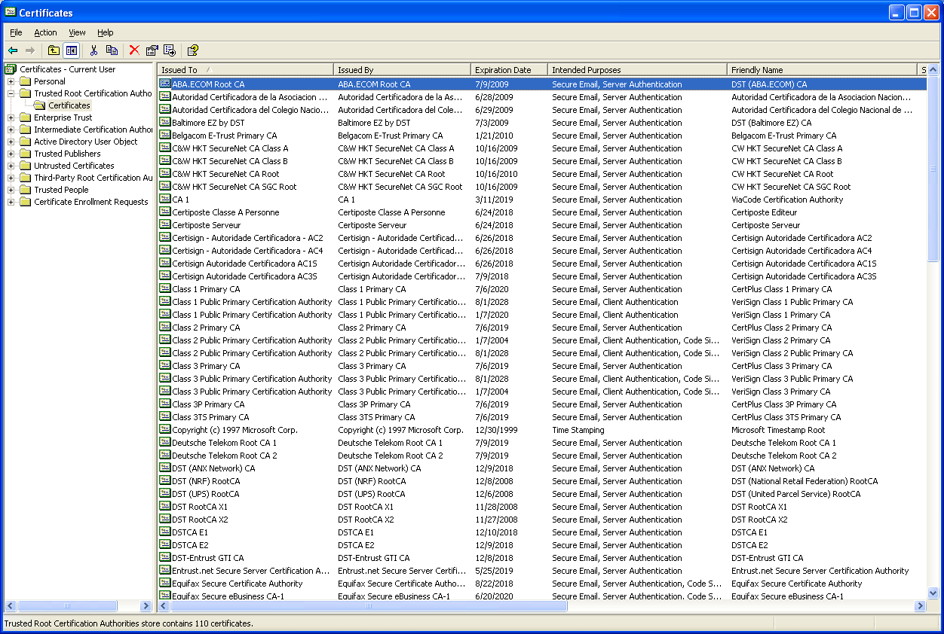
Trusted Root Certificates

Slide 99
Agenda
Integrity Checking
Protocols (Part 1 – Session-based protocols)
  Introduction
  Kerberos
  SSL/TLS
Certificates and Public Key Infrastructure (PKI)
  Certificates
  Public Key Infrastructure
  Certificate Lifecycle Management
  Revocation

Slide 100
Lifecycle Management
Certificate Enrollment
  Initial acquisition of a certificate based on other authentication information
Renewal
  Acquiring a new certificate for a key when the existing certificate expires
Revocation
  “Undoing” a certificate

Slide 101
Certificate Enrollment
Enrollment is the process of obtaining a certificate from a CA.
Alice generates a key pair, creates a message containing a copy of the public key and her identifying information, and signs the message with the private key (PKCS#10).
  Signing the message provided “proof-of-possession” (POP) of the private key as well as message integrity
CA verifies Alice’s signature on the message

Slide 102
Certificate Enrollment (2)
(Optional) CA verifies Alice’s ID through out-of-band means.
CA creates a certificate containing the ID and public key, and signs it with the CA’s own key
  CA has certified the binding between key and ID
Alice verifies the key, ID & CA signature
Alice and/or the CA publish the certificate

Slide 103

Certificate Enrollment Flow
Cert
Certificate Request
and Installation
Client
CA
Publish Certificate?
Directory
Notes:
A certificate enrollment involves a user or client initiating a request that is then sent to a CA for processing. As part of the request, the key pair is generated on the client and a Certificate Template is selected. The request message is known as a PKCS#10.
Certificate Templates - each CA will publish a CA object to the Active Directory at installation time that contains information about the CA including what certificates it can issue.
After the request is successfully processed by the CA it is issued and returned to the user or client in a message known as a PKCS#7.
Certificate Publishing - publishing certificates to the user object stored in the Active Directory is a feature of Windows 2000 to enable retrieval of a user’s S/MIME certificate in order to encrypt data to the user without the user having to have previously sent a signed message
All certificate requests are authenticated by the CA’s policy module if the CA is an Enterprise CA. Standalone CAs do not authenticate requests

Slide 104
More PKI Alphabet Soup
PKCS #10 – (old) standard message format for certificate requests
PKCS #7 – (old) standard message format for encrypted/signed data
  Also used for certificate request responses
  Replaced by IETF CMS syntax
CMC – “Certificate Management with CMS”
  Replacement for PKCS #10/PKCS#7 in a certificate management context
CMP – “Certificate Management Protocols”
  Alternative to CMC

Slide 105
Agenda
Integrity Checking
Protocols (Part 1 – Session-based protocols)
  Introduction
  Kerberos
  SSL/TLS
Certificates and Public Key Infrastructure (PKI)
  Certificates
  Public Key Infrastructure
  Certificate Lifecycle Management
  Revocation

Slide 106
Expiration & Revocation
Certificates (at least, all the ones we’re concerned with) contain explicit validity periods – “valid from” & “expires on”
  Expiration dates help bound the risk associated with issuing a certificate
Sometimes, though, it becomes necessary to “undo” a certificate while it is still valid
  Key compromise
  Cert was issued under false pretenses
This is called revoking a certificate

Slide 107
Status Info for Certificates
Two standards within PKIX:
  X.509v2/PKIX Part 1 Certificate Revocation Lists (CRLs)
  Online Certificate Status Protocol (OCSP)
Both methods state:
  Whether a cert has been revoked
  A “revocation code” indicating why the cert was revoked
  The time at which the cert was revoked

Slide 108
Certificate Revocation
A CA revokes a certificate by placing the cert on its Certificate Revocation List (CRL)
  Every CA issues CRLs to cancel out issued certs
  A CRL is like anti-matter – when it comes into contact with a certificate it lists it cancels out the certificate
  Think “1970s-style credit-card blacklist”
Relying parties are expected to check CRLs before they rely on a certificate
  “The cert is valid unless you hear something telling you otherwise”

Slide 109
The Problem with CRLs
Blacklists have numerous problems
  Not issued frequently enough to be effective against a serious attack
  Expensive to distribute (size & bandwidth)
  Vulnerable to simple DOS attacks
    If you block on lack of CRL access, why have off-line support in the first place?

Slide 110
The Problem with CRLs (2)
CRL design made it worse
  CRLs can contain retroactive invalidity dates
  A CRL issued today can say a cert was invalid as of last week.
    Checking that something was valid at time t wasn’t sufficient!
    Back-dated CRLs can appear at any time in the future
  If you rely on certs & CRLs you’re screwed because the CA can change the rules out from under you later.

Slide 111
The Problem with CRLs (3)
Revoking a CA cert is more problematic than revoking an end-entity cert
  When you revoke a CA cert, you potentially take out the entire subordinate structure, depending on what chaining logic you use
How do you revoke a self-signed cert?
  “The cert revokes itself.”
    Huh?
  Do I accept the CRL as valid & bounce the cert?
  Do I reject the CRL because the cert associated with the CRL signing key was revoked?

Slide 112
The Problem with CRLs (4)
You can’t revoke a CRL
  Once you commit to a CRL, it’s a valid state for the entirety of its validity period
What happens if you have to update the CRL while the CRL you just issued is still valid?
  You can update it, but clients aren’t required to fetch it since the one they have is still valid!
Bottom line: yikes!
  We need something else

Slide 113
CRLs vs. OCSP Responses
Aggregation vs. Freshness
  CRLs combine revocation information for many certs into one long-lived object
  OCSP Responses designed for real-time responses to queries about the status of a single certificate
Both CRLs & OCSP Responses are generated by the issuing CA or its designate. (Generally this is not the relying party.)

Slide 114
Online Status Checking
OCSP: Online Certificate Status Protocol
  A way to ask “is this certificate good right now?
  Get back a signed response from the OCSP server saying, “Yes, cert C is good at time t”
    Response is like a “freshness certificate”
OCSP response is like a selective CRL
  Client indicates the certs for which he wants status information
  OCSP responder dynamically creates a lightweight CRL-like response for those certs

Slide 115
OCSP in Action
CA
OCSP Response
OCSP Request
OCSP
For
Cert
Cert
Request
Cert
End-entity
Transaction
+
Cert
Relying
Party
Transaction Response

Slide 116
Final thoughts on Revocation
From a financial standpoint, it’s the revocation data that is valuable, not the issued certificate itself
  For high-valued financial transactions, seller wants to know your cert is good right now
  Same situation as with credit cards, where the merchant wants the card authorized right now at the point-of-sale
Card authorizations transfer risk from merchant to bank – thus they’re worth $$$
  Same with cert status checks

Slide 117
Using Certificates
Most certificate uses do not require any sort of directory
  Only needed to locate someone else’s certificate for encryption
Authentication protocols have the client present their certificate (or chain) to the server
  Ex: SSL, TLS, Smart card logon
  Rules for mapping a certificate to user account vary widely
    Cert fields, name forms, binary compare
Signing operations embed the certificates with the signature
  How else would you know who signed it?

Slide 118
Using Certificates (2)
X.509 and PKIX define the basic structure of certificates
  If you understand X.509, you can parse any certificate you’re presented
However, every protocol defines a certificate profile for certificate use in that particular protocol
  Ex: TLS, S/MIME, IPSEC, WPA/WPA2
CAs/organizations define profiles too
  Ex: US DoD Common Access Card certs

Slide 119
Additional Implementation Considerations
Publishing certificates
  How? Where? What format?
Key escrow / data recovery for encryption keys/certs
Auto-enrollment (users & machines)
Establishing trusts / hierarchies
Protecting private keys
Disseminating root certificates

Slide 120
Supplemental Material on
Certificate Extensions
(only if time permits)

Slide 121
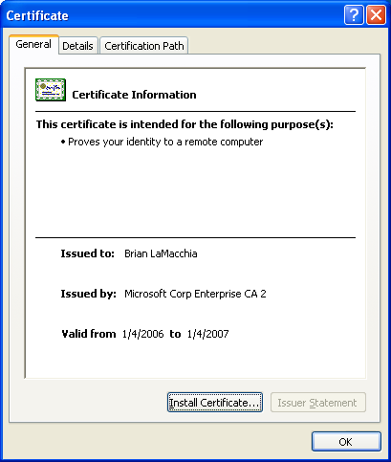
Exploring inside an X.509 Cert

Slide 122
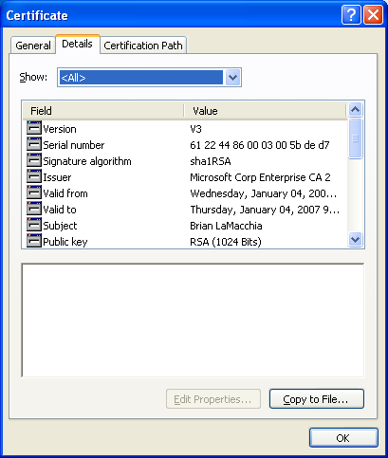
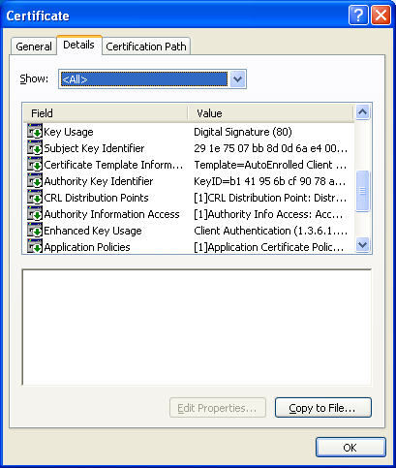
Exploring inside an X.509 Cert

Slide 123
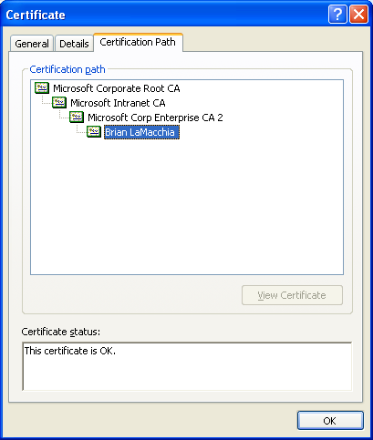
Exploring inside an X.509 Cert

Slide 124
Inside an X.509v3 Certificate
Version
Serial Number
Signing Algorithm
Issuer Distinguished Name
Validity Period
Subject Distinguished Name
Subject Public Key
Extensions
Extension 1
Extension 2
Extension n

Slide 125
Certificate Extensions
An extension consists of three things:
  A “critical” flag (boolean)
  A type identifier
  A value
    Format of the value depends on the type identifier

Slide 126
Certificate Extensions
Extensions
Critical?
Key Usage
Critical?
Subject Key ID
Critical?
Authority Key ID
Critical?
CRL Distribution Points
Critical?
Authority Info Access
Critical?
Extended Key Usage
Critical?
Subject Alt Name
Critical?
Certificate Policies
Critical?
Proprietary Extension 1
Critical?
Proprietary Extension n

Slide 127
Critical Flags
The “critical flag” on an extension is used to protect the issuing CA from assumptions made by software that doesn’t understand (implement support for) a particular extension
  If the flag is set, relying parties must process the extension if they recognize it, or reject the certificate
  If the flag is not set, the extension may be ignored

Slide 128
Critical Flags (2)
Some questions you might be asking yourself right now...
What does “must process the extension if they recognize it” mean?
  What does “recognize” mean?
  What does “process” mean?
  You’ve got me....
  The IETF standards folks didn’t know either...

Slide 129
Critical Flags (3)
Actual definitions of flag usage are vague:
  X.509: Non-critical extension “is an advisory field and does not imply that usage of the key is restricted to the purpose indicated”
  PKIX: “CA’s are required to support constrain extensions” but “support” is never defined.
  S/MIME: Implementations should “correctly handle” certain extensions
  Verisign: “All persons shall process the extension...or else ignore the extension”

Slide 130
Types of Extensions
There are two flavors of extensions
  Usage/informational extensions, which provide additional info about the subject of the certificate
  Constraint extensions, which place restrictions on one or more of:
    Use of the certificate
    The user of the certificate
    The keys associated with the certificate

Slide 131
Some common extensions
Key Usage
  digitalSignature
    “Sign things that don’t look like certs”
  keyEncipherment
    Exchange encrypted session keys
  keyAgreement
    Diffie-Hellman
  keyCertSign/keyCRLSign
    “Sign things that look like certs”
  nonRepidiation

Slide 132
NonRepudiation
The nonRepudiation bit is the black hole of PKIX
  It absorbs infinite amounts of argument time on the mailing list without making any progress toward understanding what it means
  What does it mean? How do you enforce that?
  No one knows...
“Nonrepudiation is anything which fails to go away when you stop believing in it”

Slide 133
More Extensions
Subject Key ID
  Short identifier for the subject public key
Authority Key ID
  Short identifier for the issuer’s public key – useful for locating possible parent certs
CRL Distribution Points
  List of URLs pointing to revocation information servers
Authority Info Access
  Pointer to issuer cert publication location

Slide 134
Even More Extensions
Basic constraints
  Is the cert a CA cert?’
  Limits on path length beneath this cert
Name constraints
  Limits on types of certs this key can issue
Policy mappings
  Convert one policy ID into another
Policy constraints
  Anti-matter for policy mappings

Slide 135
Still More Extensions
Extended Key Usage
  Because Key Usage wasn’t confusing enough!
Private Key Usage Period
  CA attempt to limit key validity period
Subject Alternative names
  Everything which doesn’t fit in a DN
  RFC822 names, DNS names, URIs
  IP addresses, X.400 names, EDI, etc.

Slide 136
Yet Still More Extensions
Certificate policies
  Information identifying the CA policy that was in effect when the cert was issued
  Policy identifier
  Policy qualifier
  Explicit text
  Hash reference (hash + URI) to a document
X.509 defers cert semantics to the CA’s issuing policy
Most CA policies disclaim liability

Slide 137
Extensions and Chain Building
When you build a cert chain, you start with the EE cert and discover possible parent certificates by matching DNs
  “Build the chain from the bottom up.”
However, to verify a cert chain, you have to start and the root and interpret all the extensions that may constrain subordinate CAs (and EEs)
  “Build the chain from the top down.”

