Slide 1
Practical Aspects of Modern Cryptography
Fall 2016
Josh Benaloh
Tolga Acar

Slide 2
The wiretap channel
Alice
Bob
Noisy insecure
channel
Plaintext
(P)
Encrypt
Decrypt
Plaintext
(P)
Key (K₁)
Key (K₂)
Message sent is:
  C= E_{K1}(P)
Decrypted as:
  P=D_{K2}(C)
Eavesdropper
Symmetric Key: K₁=K₂
Public Key: K₁¹K₂
  K₁ is publicly known
  K₂ is Bob’s secret

Slide 3
Adversaries
Cryptography is computing in the presence of an adversary
What do you want to protect?
Against who?
Under what circumstances?
An adversary is characterized by:
  Talent
  Access to information
    Probable plaintext attacks
    Known plaintext/ciphertext attacks
    Chosen plaintext attacks
    Adaptive interactive chosen plaintext attacks (oracle model)
  Computational resources

Slide 4
Cryptographic Algorithm Requirements
WW II
  Universally available (simple, light instrumentation) – interoperability.
  Compact, rugged: easy for people (soldiers) to use
  Kerckhoff’s Principle: Security in key only: We assume that the attacker knows the complete details of the cryptographic algorithm and implementation
  Adversary has access to some corresponding plain and cipher-text
Now
  Adversary has access to unlimited cipher-text and lots of chosen text
  Implementation in digital devices (power/speed) paramount
  Easy for computers to use
  Resistant to ridiculous amount of computing power

Slide 5
Computational strength of adversary
Infinite - Perfect Security
  Information Theoretic
  Doesn’t depend on computing resources or time available
Polynomial
  Asymptotic measure of computing power
  Indicative but not dispositive
Realistic
  The actual computing resources under known or suspected attacks
  This is us

Slide 6
Practical attacks
Exhaustive search of theoretical key space
Exhaustive search of actual key space as restricted by poor practice
Exploiting bad key management or storage
Stealing keys
Exploiting encryption errors
Spoofing (ATM PIN)
Leaking due to size, position, language choice, frequency, inter-symbol transitions, timing differences, side channels

Slide 7
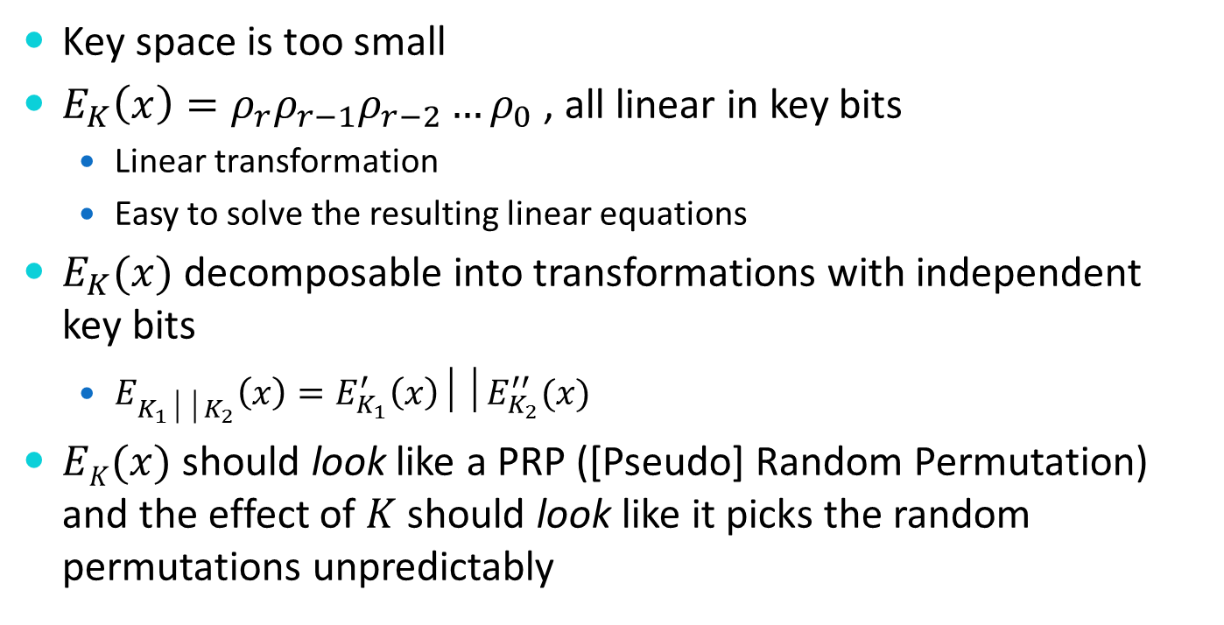
What can go wrong
Key space is too small
$E_{K}\left(x\right)=ρ_{r}ρ_{r−1}ρ_{r−2}…ρ_{0}$ , all linear in key bits
  Linear transformation
  Easy to solve the resulting linear equations
$E_{K}(x)$ decomposable into transformations with independent key bits
  $E_{K_{1}││K_{2}}\left(x\right)=E_{K_{1}}^{′}\left(x\right)││E_{K_{2}}^{′′}(x)$
$EK(x)$ should look like a PRP ([Pseudo] Random Permutation) and the effect of $K$ should look like it picks the random permutations unpredictably

Slide 8
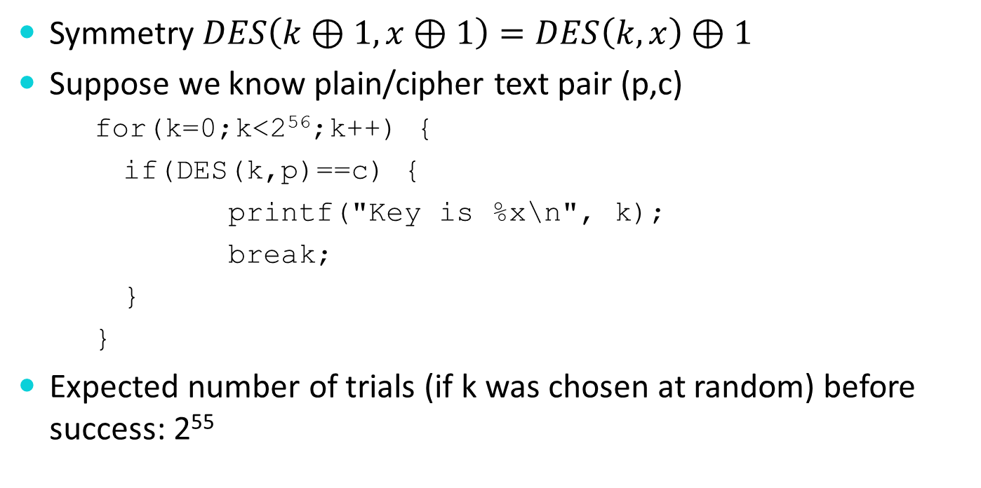
DES Attacks: Exhaustive Search
Symmetry $DES\left(k⊕1,x⊕1\right)=DES\left(k,x\right)⊕1$
Suppose we know plain/cipher text pair (p,c)
    for(k=0;k<2⁵⁶;k++) {
    if(DES(k,p)==c) {
    printf("Key is %x\n", k);
    break;
    }
    }
Expected number of trials (if k was chosen at random) before success: 2⁵⁵

Slide 9
DES: Weak Keys
DES has:
  Four weak keys k for which E_{k}(E_{k}(m))= m
  Twelve semi-weak keys which come in pairs k₁ and k₂ and are such that E_{k1}(E_{k2}(m))= m
  Weak keys are due to the key schedule algorithm
How they arise:
  A 28 bit quantity has potential symmetries of period 1, 2, 4, 7, and 14
  Suppose each of C₀ and D₀ has a symmetry of period 1
  For example C₀ =0x0000000, D₀= 0x1111111
  Easy to figure out a master key (K) that produces such a C₀ and D₀

Slide 10
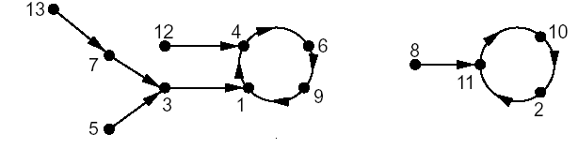

Random Mappings
Let $F_{n}: ℤ_{n}→ℤ_{n};$ all functions from a finite domain to a finite co-domain
Every mapping $F_{i}$ is equally likely to be chosen, $\left|Fn\right|= nn$
The probability of choosing a particular mapping is $\frac{1}{n^{n}}$
Example. f : {1, 2, …, 13} → {1, 2, …, 13}
Graphic by Maithili Narasimha

Slide 11
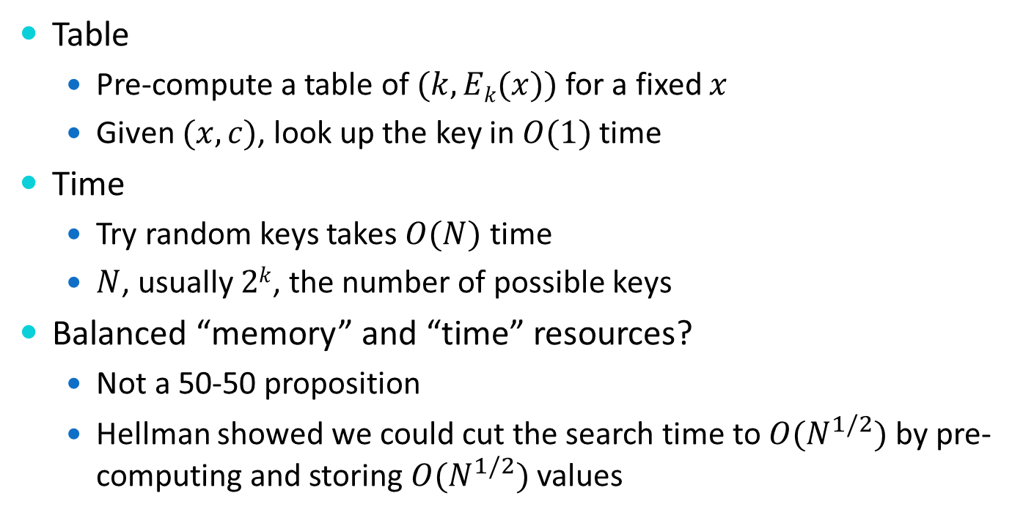
Time memory trade off
Table
  Pre-compute a table of $(k, Ek(x))$ for a fixed $x$
  Given $(x,c)$, look up the key in $O(1)$ time
Time
  Try random keys takes $O(N)$ time
  $N$, usually $2k$, the number of possible keys
Balanced “memory” and “time” resources?
  Not a 50-50 proposition
  Hellman showed we could cut the search time to $O(N^{1/2})$ by pre-computing and storing $O(N^{1/2})$ values

Slide 12
Sophisticated attacks
Exhaustive search
Differential cryptanalysis
  Differentials
Linear Cryptanalysis
  Linear approximations

Slide 13

Meet In The Middle: 2DES
Double DES: $c=E(K_{1},E\left(K_{2},m\right))$
Get in the middle: $c^{′}=E\left(K_{i},m\right), c^{′′}=D(K_{j},c)$
  Find the key when $E\left(K_{i},m\right)=D\left(K_{j}, c\right)$
c’=E(K₂,m)
c=E(K₁,c’)
m
c

Slide 14
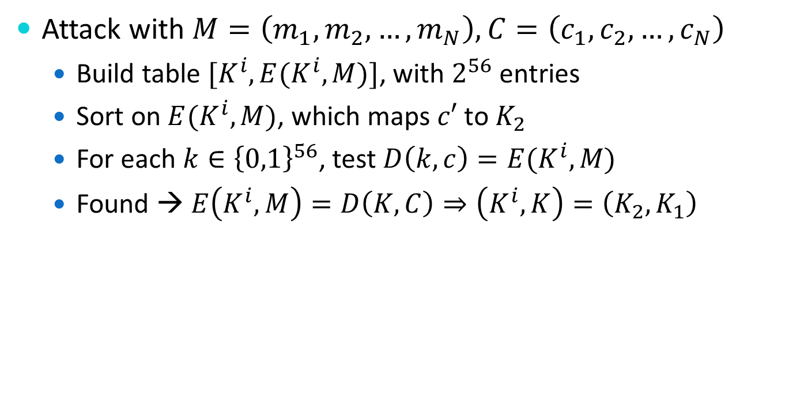
Meet In The Middle: 2DES
Attack with $M=\left(m_{1},m_{2},…, m_{N}\right), C=\left(c_{1},c_{2},…,c_{N}\right)$
  Build table ${[K}^{i}, E(K^{i},M)]$, with $2^{56}$ entries
  Sort on $E(K^{i},M)$, which maps $c′$ to $K_{2}$
  For each $k∈{\left\{0,1\right\}}^{56}$, test $D\left(k,c\right)=E(K^{i},M)$
  Found → $E\left(K^{i}, M\right)=D\left(K,C\right)⇒\left(K^{i},K\right)=\left(K_{2},K_{1}\right)$

Slide 15
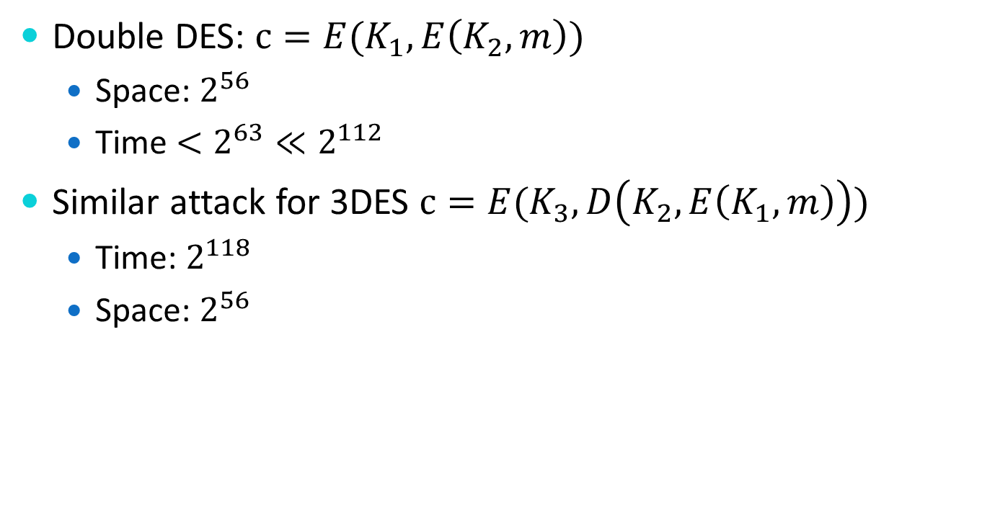
Meet In The Middle: 2DES
Double DES: $c=E(K_{1},E\left(K_{2},m\right))$
  Space: $2^{56}$
  Time $<2^{63}≪2^{112}$
Similar attack for 3DES $c=E(K_{3},D\left(K_{2},E\left(K_{1},m\right)\right))$
  Time: $2^{118}$
  Space: $2^{56}$

Slide 16
Faulty PRNG
DSA-1571-1 openssl -- predictable random number generator, May 2008
    MD_Update(&m,buf,j);
    [ .. ]
    MD_Update(&m,buf,j); /* purify complains */
Purify complained uninitialized data, lines removed
Random seed was no longer mixed in: only process ID
Max pid is 32,768
Bug was introduced in 2006

Slide 17
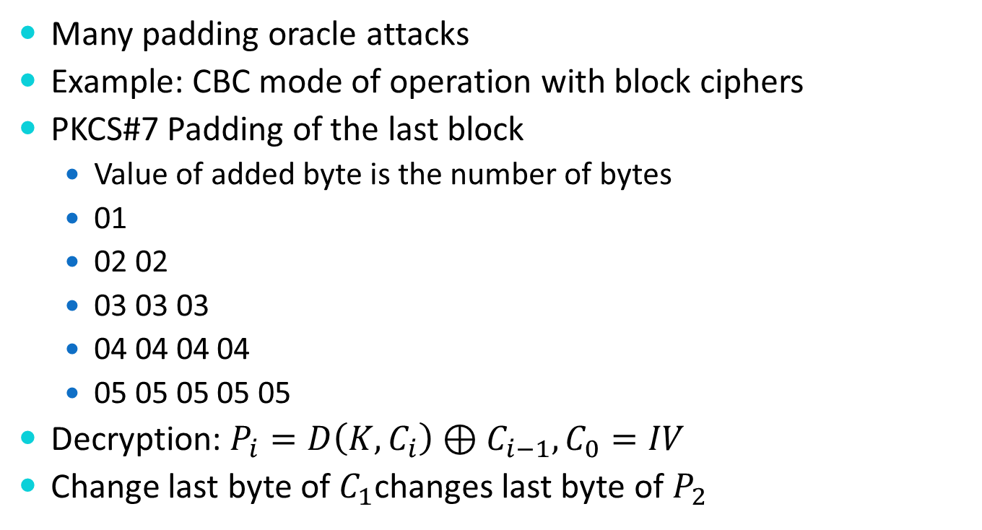
Padding Oracles
Many padding oracle attacks
Example: CBC mode of operation with block ciphers
PKCS#7 Padding of the last block
  Value of added byte is the number of bytes
  01
  02 02
  03 03 03
  04 04 04 04
  05 05 05 05 05
Decryption: $P_{i}=D\left(K,C_{i}\right)⊕C_{i−1}, C_{0}=IV$
Change last byte of $C_{1}$changes last byte of $P_{2}$

Slide 18
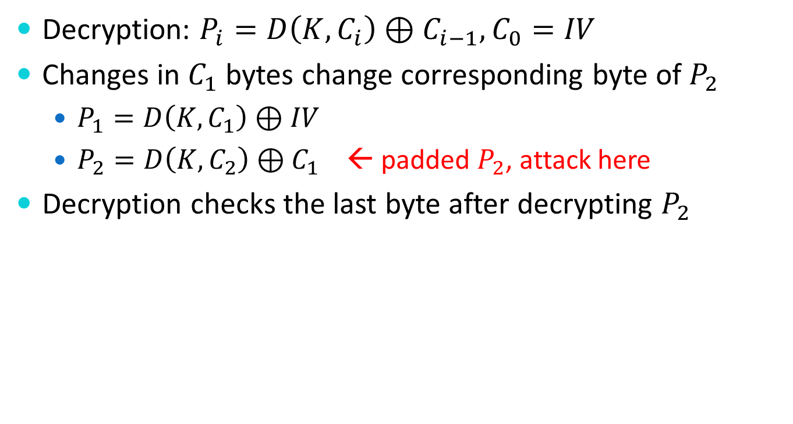
Padding Oracles: CBC w/ PKCS#7
Decryption: $P_{i}=D\left(K,C_{i}\right)⊕C_{i−1}, C_{0}=IV$
Changes in $C_{1}$ bytes change corresponding byte of $P_{2}$
  $P_{1}=D\left(K,C_{1}\right)⊕IV$
  $P_{2}=D\left(K,C_{2}\right)⊕C_{1}$ ← padded $P_{2}$, attack here
Decryption checks the last byte after decrypting $P_{2}$
Notes:
https://en.wikipedia.org/wiki/Padding_oracle_attack

Slide 19
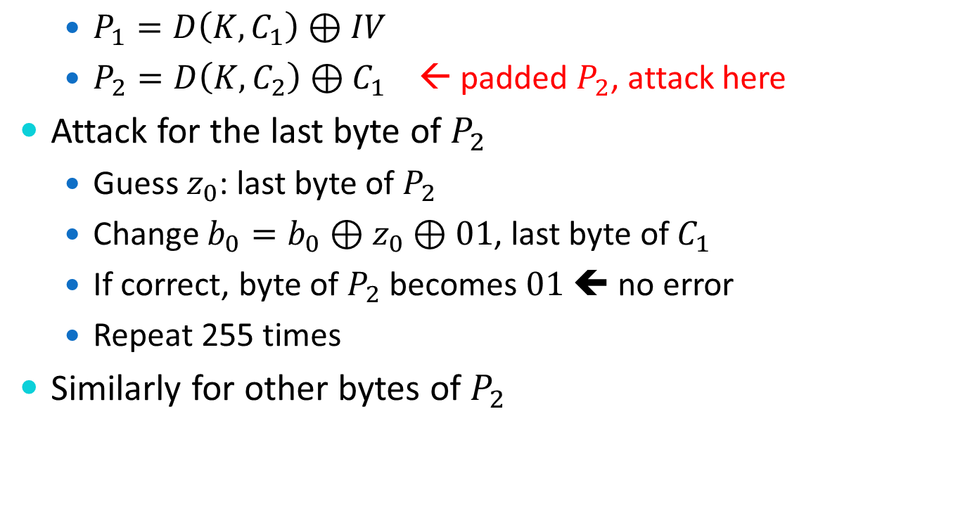
Padding Oracles: CBC w/ PKCS#7
  $P_{1}=D\left(K,C_{1}\right)⊕IV$
  $P_{2}=D\left(K,C_{2}\right)⊕C_{1}$ ← padded $P_{2}$, attack here
Attack for the last byte of $P_{2}$
  Guess $z_{0}$: last byte of $P_{2}$
  Change $b_{0}=b_{0}⊕z_{0}⊕01$, last byte of $C_{1}$
  If correct, byte of $P_{2}$ becomes $01$ ⬅ no error
  Repeat 255 times
Similarly for other bytes of $P_{2}$
Notes:
https://en.wikipedia.org/wiki/Padding_oracle_attack

Slide 20
Side-Channel Attacks
Breaking a cryptosystem is a frontal attack, but there may be easier access though a side or back door – especially on embedded cryptographic devices such as SmartCards and RFIDs

Slide 21
Side-Channel Attacks
Some attack vectors …
Fault Attacks
Timing Attacks
Cache Attacks
Power Analysis
Electromagnetic Emissions
Acoustic Emissions
Information Disclosure
… others?

Slide 22
Fault Attacks
Faults may be unintentional or induced by …
Heat
Cold
Supply voltage deviations (low, high, …)
Overclocking
Focused ion beams and other radiation
Microwaves
Malicious input
…

Slide 23
Review: AES Round
Plaintext
Key Addition
Round
Each round has 4 transformations:
ByteSub: nonlinearity
ShiftRow: inter-column diffusion
MixColumn: inter-byte diffusion
Round key addition (XOR)
First round key is the key
Byte Substitution
Shift Rows
Mix Columns
Key Addition
More Rounds
Ciphertext

Slide 24
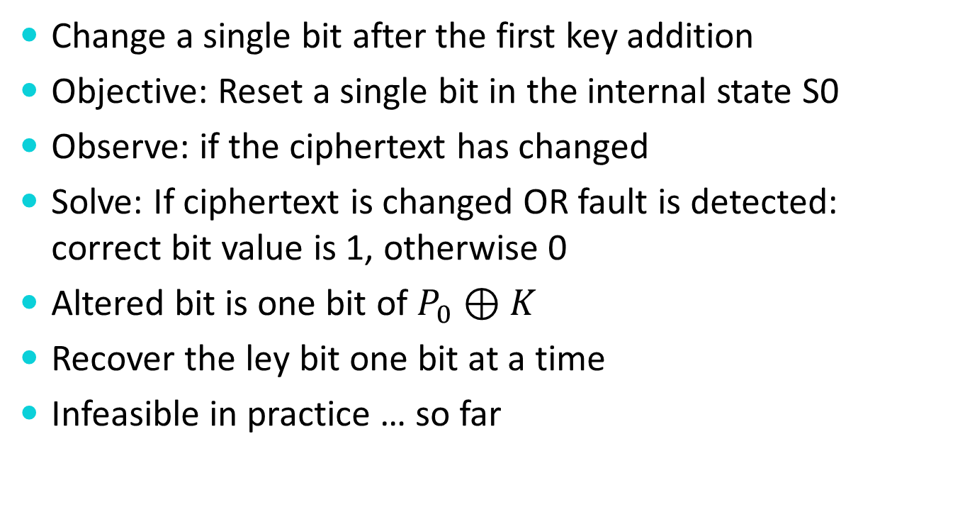
AES Fault Attack
Change a single bit after the first key addition
Objective: Reset a single bit in the internal state S0
Observe: if the ciphertext has changed
Solve: If ciphertext is changed OR fault is detected: correct bit value is 1, otherwise 0
Altered bit is one bit of $P_{0}⊕K$
Recover the ley bit one bit at a time
Infeasible in practice … so far

Slide 25
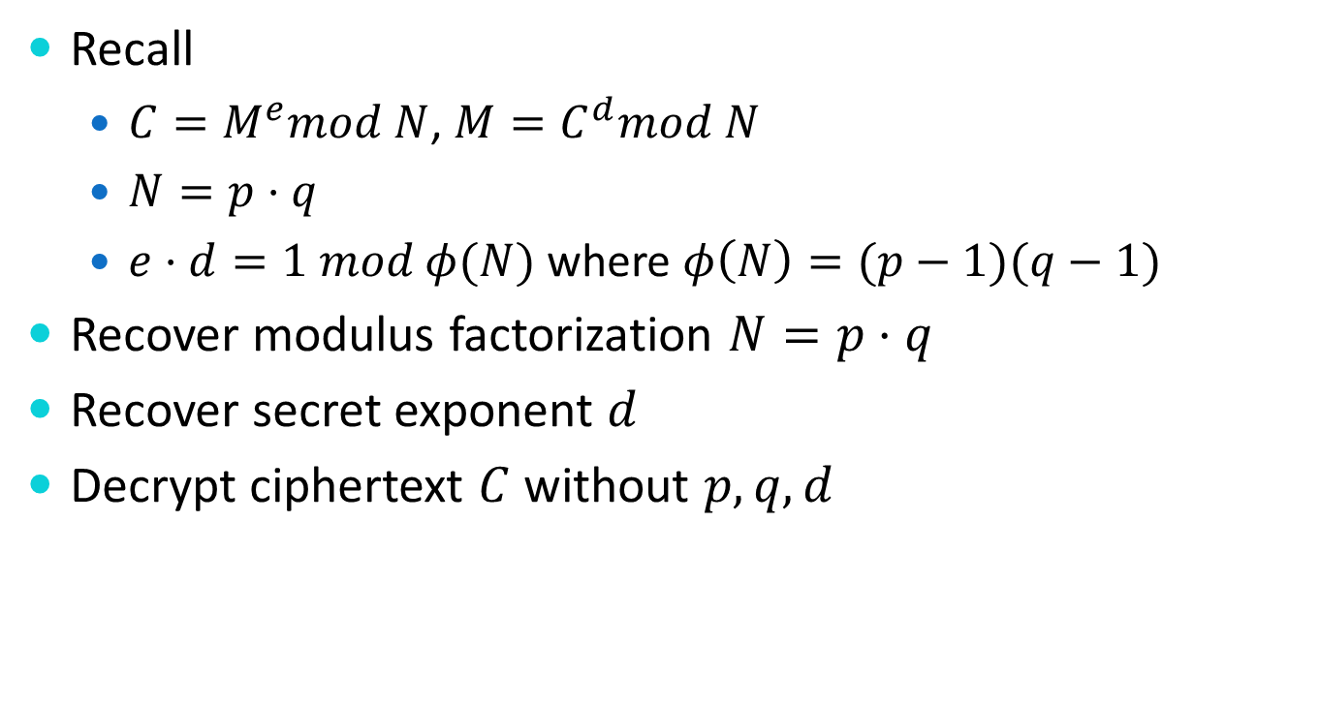
RSA Fault Attack
Recall
  $C=M^{e}mod N$, $M=C^{d}mod N$
  $N=p⋅q$
  $e⋅d=1 mod φ(N)$ where $φ\left(N\right)=(p−1)(q−1)$
Recover modulus factorization $N=p⋅q$
Recover secret exponent $d$
Decrypt ciphertext $C$ without $p,q,d$

Slide 26
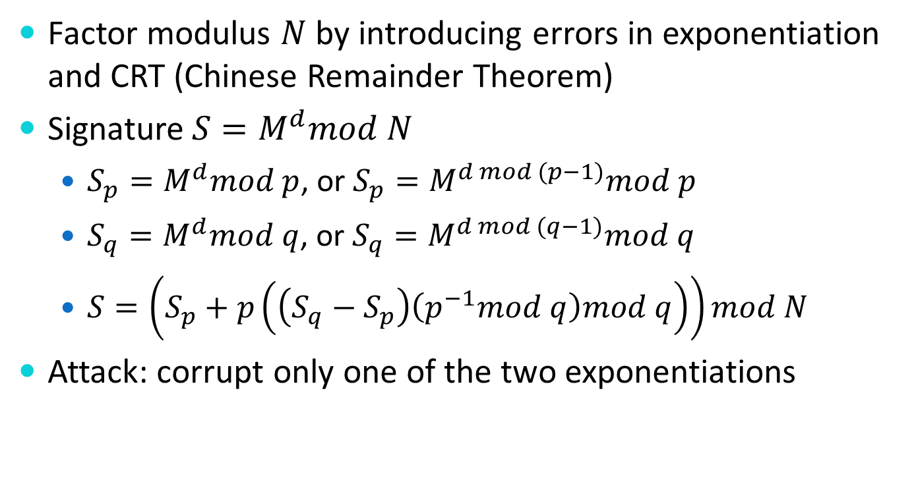
RSA Fault Attack: Bellcore
Factor modulus $N$ by introducing errors in exponentiation and CRT (Chinese Remainder Theorem)
Signature$S=M^{d}mod N$
  $S_{p}=M^{d}mod p$, or $S_{p}=M^{d mod (p−1)}mod p$
  $S_{q}=M^{d}mod q$, or $S_{q}=M^{d mod (q−1)}mod q$
  $S=\left(S_{p}+p\left(\left(S_{q}−S_{p}\right)\left(p^{−1}mod q\right)mod q\right)\right)mod N$
Attack: corrupt only one of the two exponentiations

Slide 27
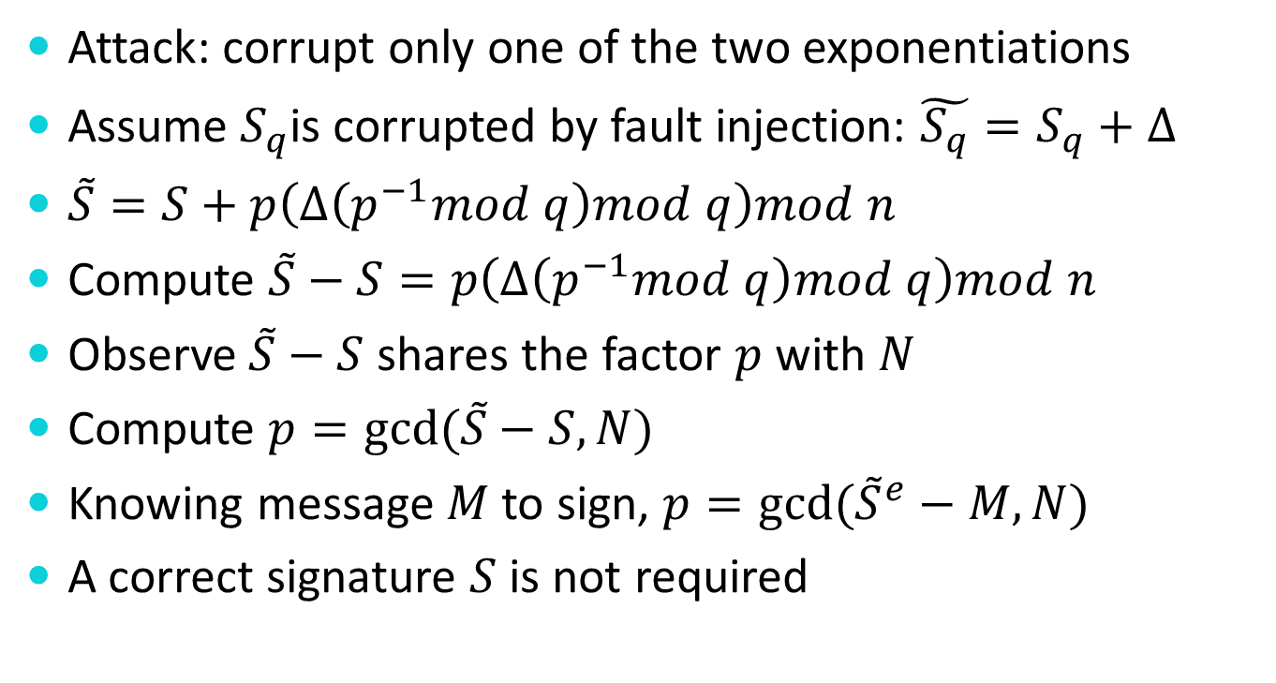
RSA Attack: Bellcore
Attack: corrupt only one of the two exponentiations
Assume $S_{q}$is corrupted by fault injection: $\tilde{S_{q}}=S_{q}+Δ$
$\tilde{S}=S+p\left(Δ\left(p^{−1}mod q\right)mod q\right)mod n$
Compute $\tilde{S}−S=p\left(Δ\left(p^{−1}mod q\right)mod q\right)mod n$
Observe$\tilde{S}−S$ shares the factor $p$ with $N$
Compute $p=gcd⁡(\tilde{S}−S,N)$
Knowing message $M$ to sign, $p=gcd⁡({\tilde{S}}^{e}−M,N)$
A correct signature $S$ is not required
Notes:
\cite{http://euler.ecs.umass.edu/research/bbkn-IEEEP-2012.pdf}

Slide 28
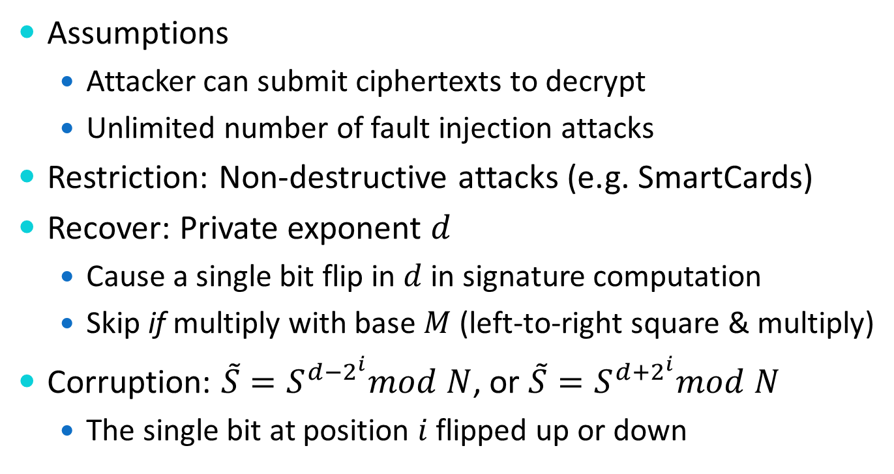
RSA Attack: Square & Multiply
Assumptions
  Attacker can submit ciphertexts to decrypt
  Unlimited number of fault injection attacks
Restriction: Non-destructive attacks (e.g. SmartCards)
Recover: Private exponent $d$
  Cause a single bit flip in $d$ in signature computation
  Skip if multiply with base $M$ (left-to-right square & multiply)
Corruption: $\tilde{S}=S^{d−2^{i}}mod N$, or $\tilde{S}=S^{d+2^{i}}mod N$
  The single bit at position $i$ flipped up or down

Slide 29
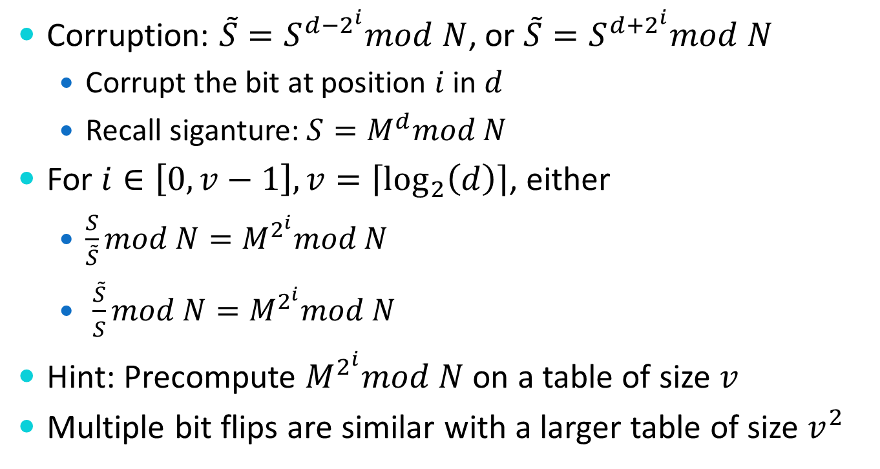
RSA Attack: Square & Multiply
Corruption: $\tilde{S}=S^{d−2^{i}}mod N$, or $\tilde{S}=S^{d+2^{i}}mod N$
  Corrupt the bit at position $i$ in $d$
  Recall siganture: $S=M^{d}mod N$
For $i∈\left[0,v−1\right], v=\left\lceil \log_{2}\left(d\right)\right\rceil$, either
  $\frac{S}{\tilde{S}}mod N=M^{2^{i}}mod N$
  $\frac{\tilde{S}}{S}mod N=M^{2^{i}}mod N$
Hint: Precompute $M^{2^{i}}mod N$ on a table of size $v$
Multiple bit flips are similar with a larger table of size $v^{2}$

Slide 30
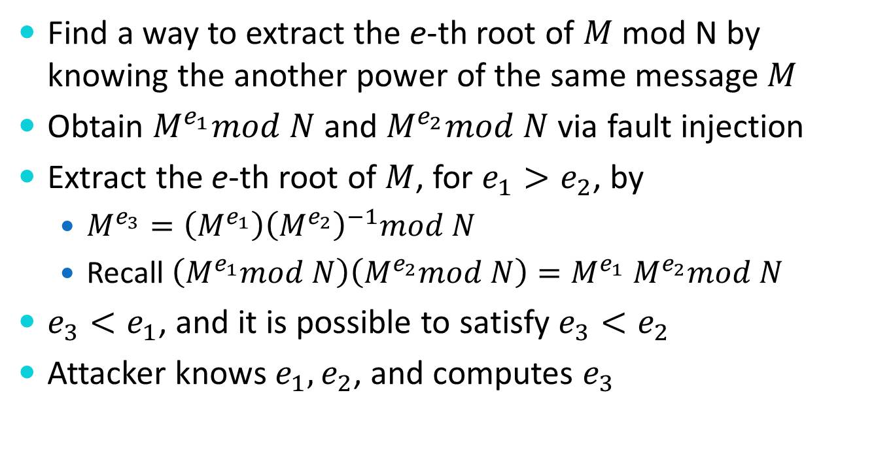

RSA Attack: $e−th$ root
Find a way to extract the e-th root of $M$ mod N by knowing the another power of the same message $M$
Obtain $M^{e_{1}}mod N$ and $M^{e_{2}}mod N$ via fault injection
Extract the e-th root of $M$, for $e_{1}>e_{2}$, by
  $M^{e_{3}}=\left(M^{e_{1}}\right){\left(M^{e_{2}}\right)}^{−1}mod N$
  Recall $\left(M^{e_{1}}mod N\right)\left(M^{e_{2}}mod N\right)=M^{e_{1}}$ $M^{e_{2}}mod N$
$e_{3}<e_{1}$, and it is possible to satisfy $e_{3}<e_{2}$
Attacker knows $e_{1},e_{2}$, and computes $e_{3}$

Slide 31
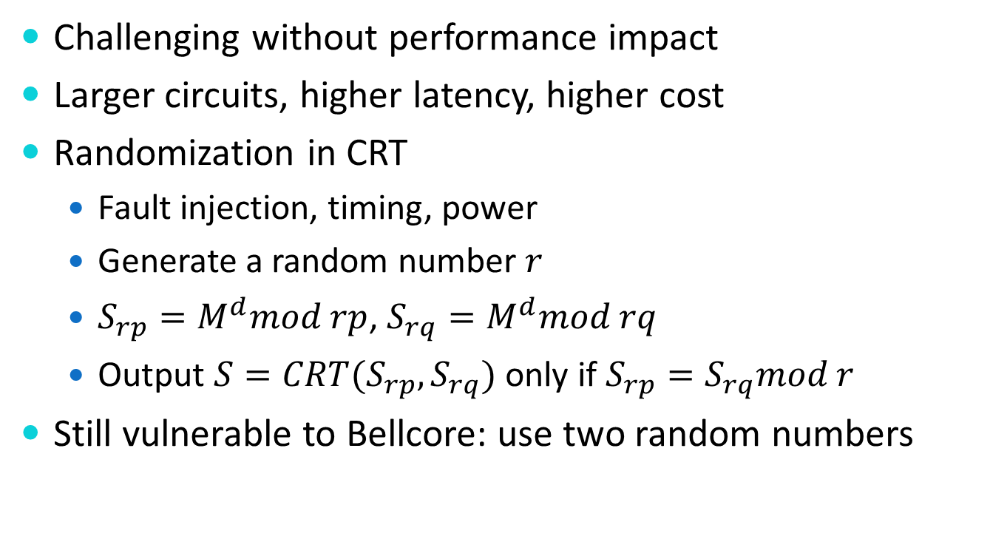
Countermeasures: RSA
Challenging without performance impact
Larger circuits, higher latency, higher cost
Randomization in CRT
  Fault injection, timing, power
  Generate a random number $r$
  $S_{rp}=M^{d}mod rp$, $S_{rq}=M^{d}mod rq$
  Output $S=CRT(S_{rp},S_{rq})$ only if $S_{rp}=S_{rq}mod r$
Still vulnerable to Bellcore: use two random numbers

Slide 32

Countermeasures: RSA
Generic approach: Validate the output
  Verify the signature
  Small $e$, cost is low

Slide 33
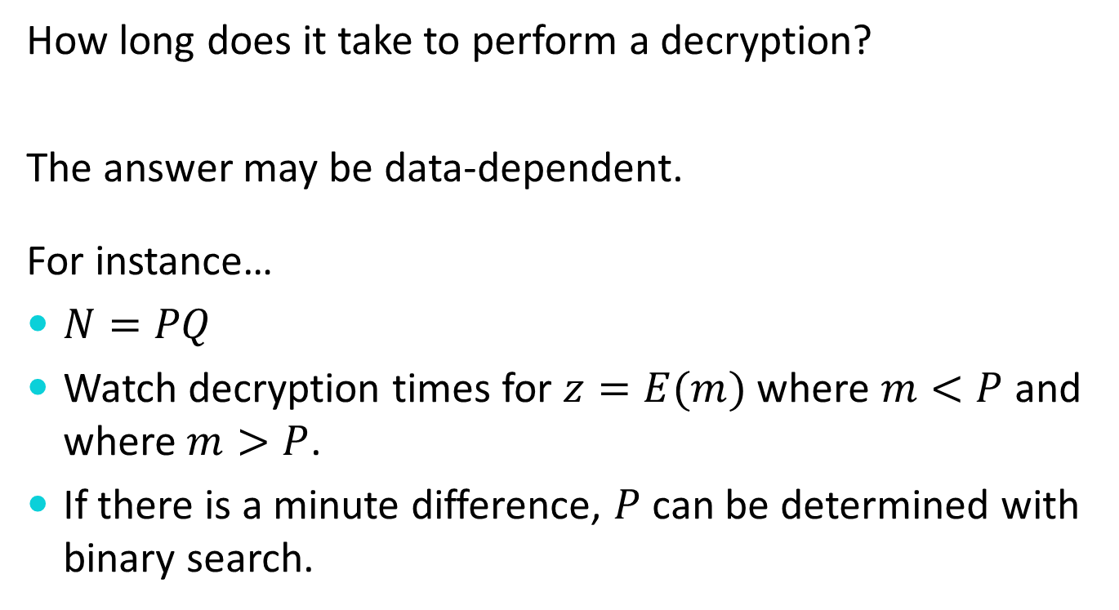
Timing Attacks
How long does it take to perform a decryption?
The answer may be data-dependent.
For instance…
$N=PQ$
Watch decryption times for $z=E(m)$ where $m<P$ and where $m>P$.
If there is a minute difference, $P$ can be determined with binary search.

Slide 34
Cache Attacks
If you can run code on the same device where a decryption is being performed, you may be able to selectively force certain cache lines to be flushed.
Decryption times may vary in a key-dependent manner based upon which lines have been flushed.

Slide 35
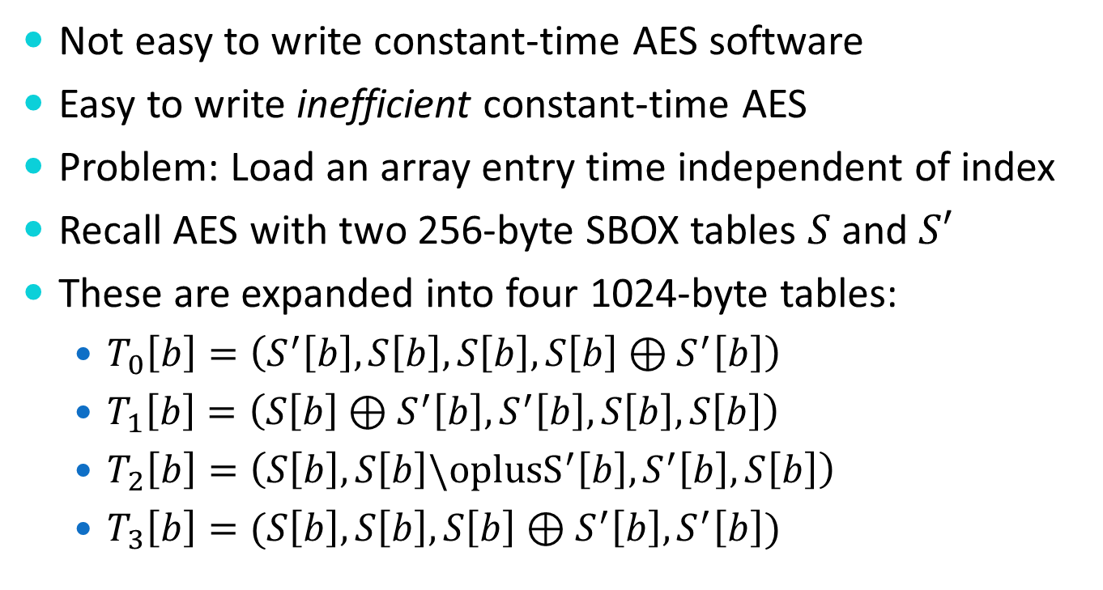
Cache Timing Attacks: AES
Not easy to write constant-time AES software
Easy to write inefficient constant-time AES
Problem: Load an array entry time independent of index
Recall AES with two 256-byte SBOX tables $S$ and $S′$
These are expanded into four 1024-byte tables:
  $T_{0}\left[b\right]=\left(S^{′}\left[b\right],S\left[b\right],S\left[b\right],S\left[b\right]⊕S^{′}\left[b\right]\right)$
  $T_{1}\left[b\right]=\left(S\left[b\right]⊕S^{′}\left[b\right], S^{′}\left[b\right], S\left[b\right],S\left[b\right]\right)$
  $T_{2}\left[b\right]=\left(S\left[b\right],S\left[b\right]\backslash {oplusS}^{′}\left[b\right],S^{′}\left[b\right],S\left[b\right]\right)$
  $T_{3}\left[b\right]=(S\left[b\right],S\left[b\right],S\left[b\right]⊕S^{′}\left[b\right],S^{′}\left[b\right])$

Slide 36
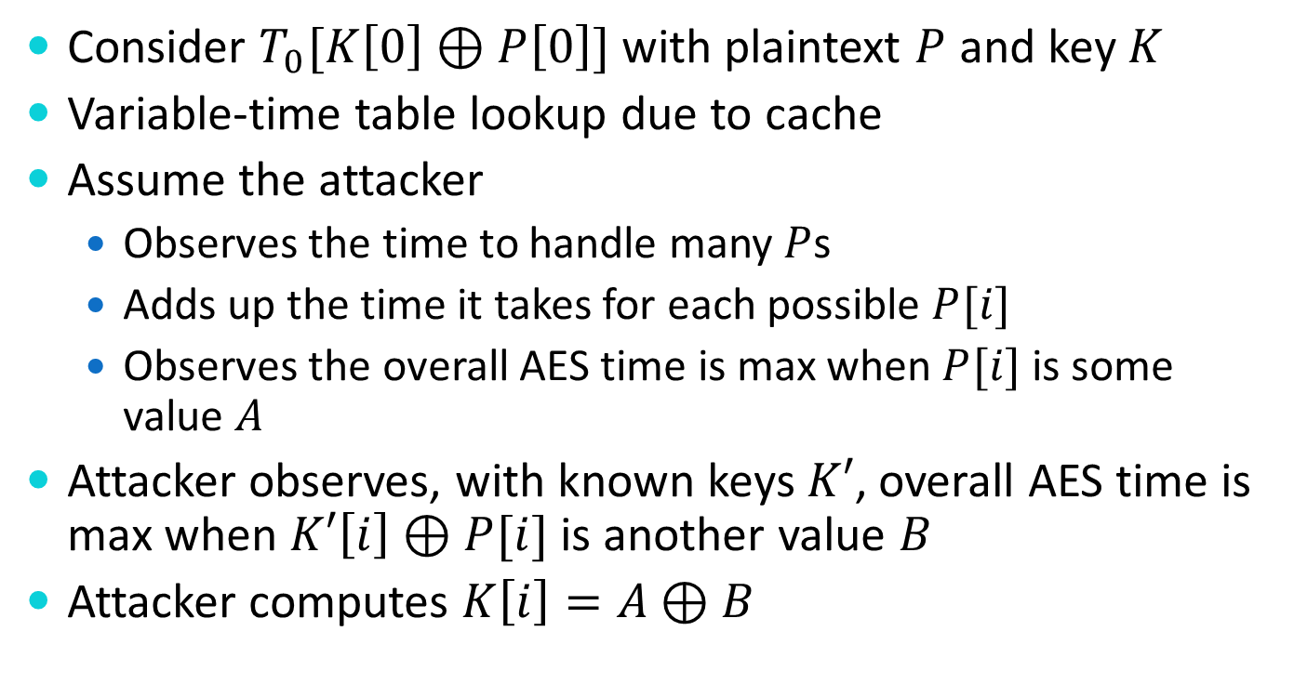
Cache-Timing Attacks: AES
Consider $T_{0}[K\left[0\right]⊕P\left[0\right]]$ with plaintext $P$ and key $K$
Variable-time table lookup due to cache
Assume the attacker
  Observes the time to handle many $P$s
  Adds up the time it takes for each possible $P[i]$
  Observes the overall AES time is max when $P[i]$ is some value $A$
Attacker observes, with known keys $K′$, overall AES time is max when $K′\left[i\right]⊕P[i]$ is another value $B$
Attacker computes $K\left[i\right]=A⊕B$
Notes:
\cite{http://cr.yp.to/antiforgery/cachetiming-20050414.pdf}

Slide 37
Power Analysis
Power usage of a device may vary in a key-dependent manner.
Careful measurement and analysis of power consumption can be used to determine the key.

Slide 38
Power Analysis
Goal: Extract secret key
SPA: Simple Power Analysis
  Power traces or graphs over time
  Variations in power consumption for different operations
  Example: Number of rounds, square, multiply
DPA: Differential Power Analysis
  Statistical analysis of multiple operations
  Measure power consumption per input/output data
  Partition measurements into subsets
  Statistical differences between subsets indicate leakage

Slide 39
Electromagnetic Emissions
One can record electromagnetic emissions of a device – often at a distance.
Careful analysis of the emissions may reveal a secret key.

Slide 40
Acoustic Emissions
Modular exponentiation is using done with repeated squaring and conditional “side” multiplications.
It can actually be possible to hear whether or not these conditional multiplications are performed.

Slide 41
Acoustic Cryptanalysis
There is a history of acoustic attacks
More recently
  ultrasonic noise emanating from capacitors and inductors in a computer motherboard
  Cooling fan
Small movements of current change capacitor diameter, and piezoelectric size changes
Countermeasures: Generate sound to jam
  Same spectrum sound
  White noise

Slide 42
Information Disclosures
(N.B. Bleichenbacher Attack)
A protocol may respond differently to properly and improperly formed data.
Careful manipulation of data may elicit responses which disclose information about a desired key or decryption value.

Slide 43
Cryptosystem Security Definitions
Cryptographers like inscrutable TLAs
Probabilistic Polynomial-Time (PPT) adversaries
  Probabilistic randomized algorithm that gives the correct answer with > ½ probability.
Random Oracle Model (RO or ROM)
  Black box with a stateful uniform random response
Random Oracle
x
y ← {0, 1}*
If (x in A) y ← Fetch(A,x)
Else Store(x,y) in A
Return y
y
Notes:
PPT: Probabilistic Turing machine in polynomial time with error probability < ½.
Probabilistic randomized algorithm that gives the correct answer > ½ probability.

Slide 44
Attack Game
Encryption scheme security definitions
  IND-R: Indistinguishability from Random
  IND-CPA: Indistinguishability under Chosen Plaintext Attack (a.k.a. semantic security)
  IND-CCA: Indistinguishability under Chosen Ciphertext Attack
IND-CPA ⊂ IND-CCA
Left-Right Oracle
m₀, m₁
b ← {0, 1}
C = Enc(K, m_{b})
Return C
C
Guess b?
IND-CPA Game

Slide 45
Ciphertext Attacks
IND-CCA2: Indistinguishability under adaptive chosen ciphertext attack
  Decryption Oracle access (non-trivial)
Non-adaptive
  Query the decryption oracle till the challenge ciphertext is received
Adaptive
  Continuous queries to the oracle (max q queries)
IND-CPA ⊂ IND-CCA ⊂ IND-CCA2

Slide 46
IND-CCA/CCA2 Game
Free Oracle Access
Encrypt
Queries {m,C}
C = Enc(K, m)
Responses {C,m}
Decrypt
m = Dec(K, C)
Challenge
m₀, m₁
Left-Right Oracle
C
b ← {0, 1}
C = Enc(K, m_{b})
Adaptive (CCA2) Adversary
C
Decrypt
m
m = Dec(K, C)
Guess b?

Slide 47
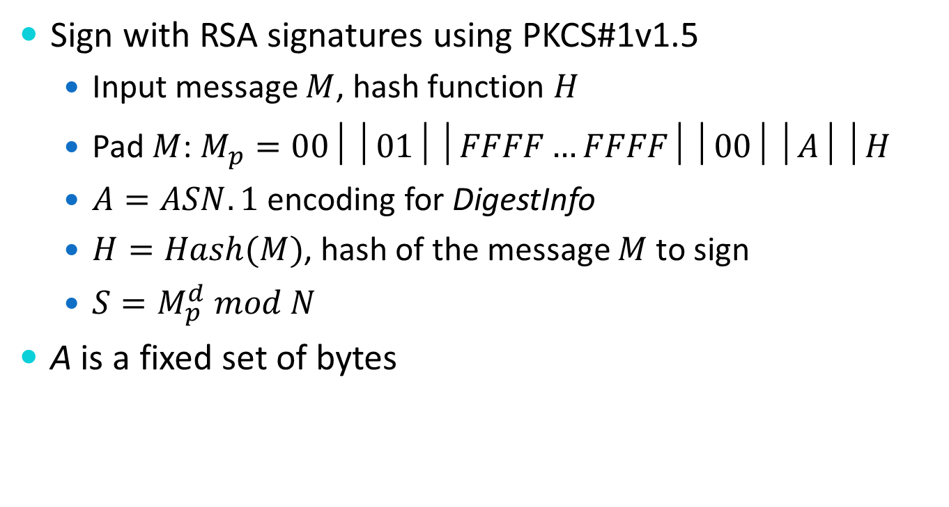
Bleichenbacher Attack
Sign with RSA signatures using PKCS#1v1.5
  Input message $M$, hash function $H$
  Pad $M$: $M_{p}=00││01││FFFF…FFFF││00││A││H$
  $A=ASN.1$ encoding for DigestInfo
  $H=Hash(M)$, hash of the message $M$ to sign
  $S=M_{p}^{d} mod N$
A is a fixed set of bytes

Slide 48
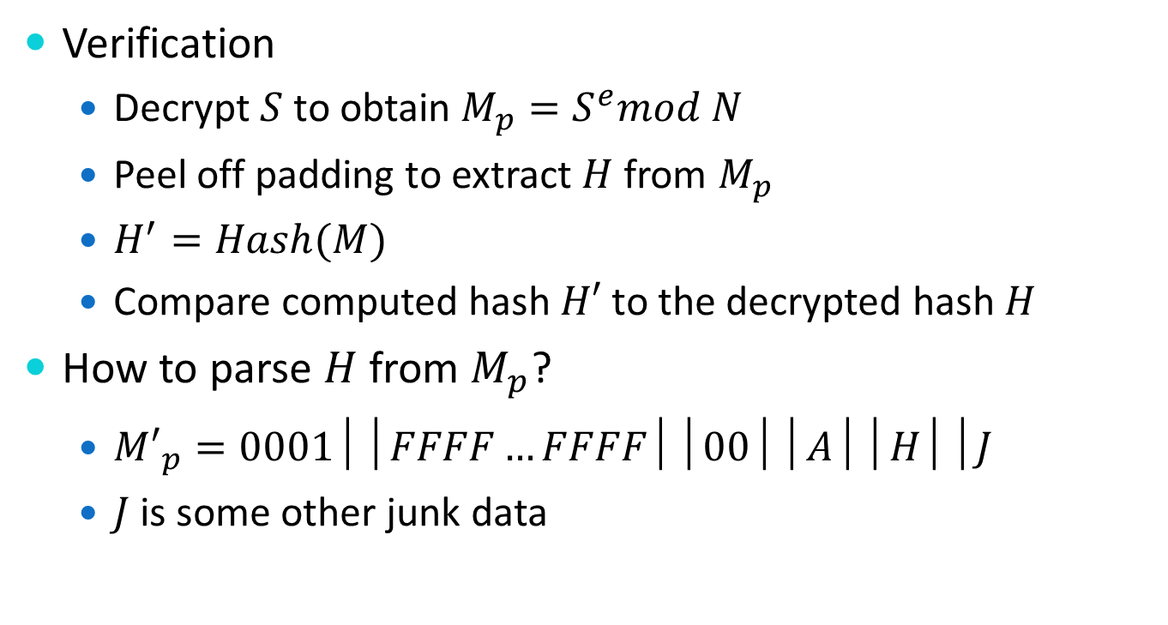
Bleichenbacher Attack
Verification
  Decrypt $S$ to obtain $M_{p}=S^{e}mod N$
  Peel off padding to extract $H$ from $M_{p}$
  $H^{′}=Hash(M)$
  Compare computed hash $H′$ to the decrypted hash $H$
How to parse $H$ from $M_{p}$?
  ${M′}_{p}=0001││FFFF…FFFF││00││A││H││J$
  $J$ is some other junk data

Slide 49
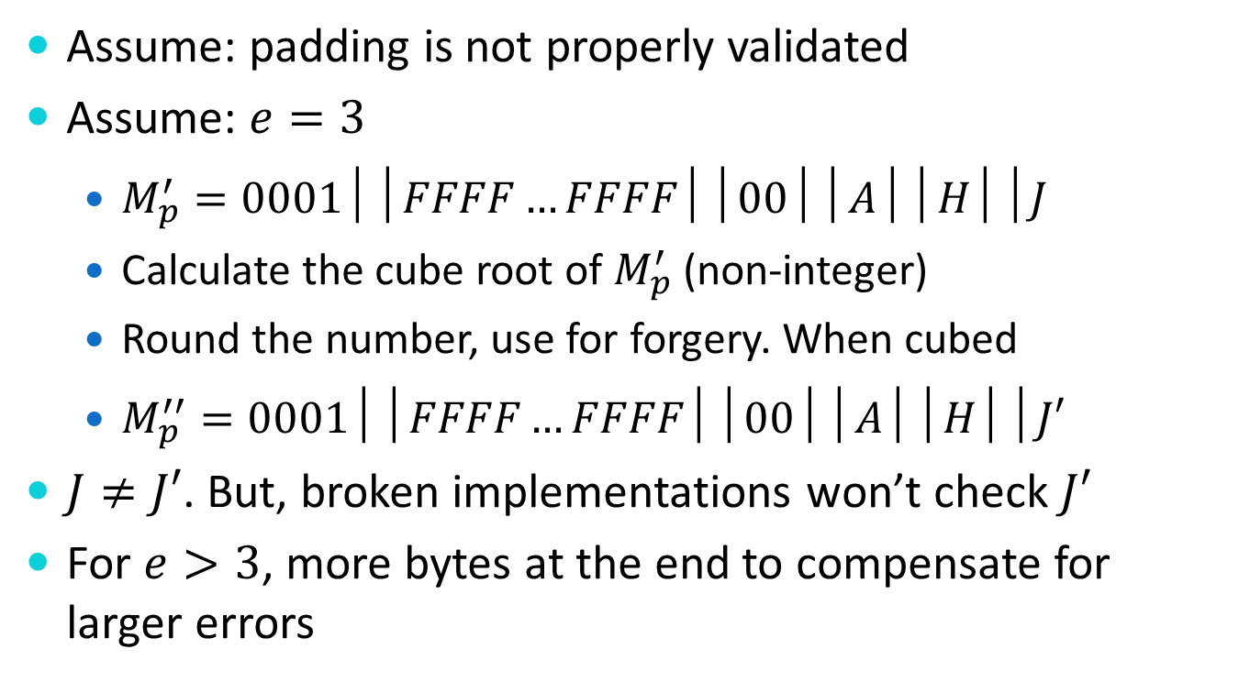
Bleichenbacher Attack
Assume: padding is not properly validated
Assume: $e=3$
  $M_{p}^{′}=0001││FFFF…FFFF││00││A││H││J$
  Calculate the cube root of $M_{p}^{′}$ (non-integer)
  Round the number, use for forgery. When cubed
  $M_{p}^{′′}=0001││FFFF…FFFF││00││A││H││J′$
$J≠J′$. But, broken implementations won’t check $J′$
For $e>3$, more bytes at the end to compensate for larger errors
Notes:
https://www.ietf.org/mail-archive/web/openpgp/current/msg00999.html

Slide 50
Design Charrette
How would you design a transit fare card system?

Slide 51
Fare Card System Elements
An RFID card for each rider
Readers on each vehicle and/or transit station (Internet connected?)
Card purchase/payment machines
A web portal for riders to manage and/or enrich their cards

