Slide 1
Practical Aspects of Modern Cryptography
Fall 2016
Tolga Acar Josh Benaloh

Slide 2
Agenda
Secret-key cryptographic algorithms
  Stream ciphers
  Block ciphers
  Modes of Operation
Hash functions
  [SHA-1,] SHA-2, SHA-3
  Message Authentication Codes

Slide 3
Public Key vs. Symmetric Key
Recall from last time that in a public key cryptosystem, each participant has a key pair consisting of related keys
  Alice (or anyone) encrypts to Bob using Bob’s public key
  Bob decrypts with Bob’s private key
Public keys are public
  They can be published in a directory, on a website, etc.

Slide 4
Public Key vs. Symmetric Key
In contrast, in a symmetric key system, the same key is used for encryption and decryption
  Such keys must be kept secret
  Alice and Bob must both know the same secret key to use a symmetric cryptosystem with that key
Common pattern we will come back to later:
  Use a public key cryptosystem to send/negotiate a randomly-generated secret key with the party to whom you wish to communicate
  Then use that secret key with a symmetric key cryptosystem

Slide 5
Encryption
You’ve got some data you want to protect.
Of course you’d encrypt
You take your key and …

Slide 6
Kerckhoffs’s Principle (1883)
The security of a cryptosystem must depend only on the key.
You should assume that attackers know everything about your system except the key.

Slide 7
Random Oracle (RO)
Random Oracle (RO)
  Responds to every unique query with a random response
Response is chosen uniformly in the output domain
Given the same input, responds with the same output
Typical Implementations
  Table look-up
  Hash functions
  HMAC

Slide 8
PRF, PRP, Ideal Cipher
Pseudo Random Function (PRF)
  Efficiently computable function to emulate a RO
  No efficient algorithm can distinguish between a PRF and a RO
  Hash functions and HMAC are typical examples
Random Permutation
  Selected at random with uniform probability
Pseudo Random Permutation (PRP)
  A permutation
  No efficient algorithm can distinguish from a random permutation
Ideal Cipher
  Random permutation oracle
  Forward and Reverse permutations

Slide 9
PINs, Passwords, Keys
Informally …
A PIN is a 4-6 digit speed bump
A password is a short, user-chosen, usually guessable selection from a small dictionary
A key is an unguessable, randomly chosen string

Slide 10
Secrets: Off-Line Attacks
PINs and passwords are subject to off-line attacks
Off the cuff guidelines
  An attacker can search a space of roughly 2⁶⁴ values
    All PINs of fewer than 20 digits
    All passwords of fewer than 14 lower case letters
    All alphanumeric passwords of fewer than 12 characters
    All printable passwords of fewer than 10 characters

Slide 11
Dictionary Attacks
Off-line attacks can be especially effective against a list of objects (e.g. encrypted passwords, SSNs, etc.) that are all encrypted with the same key
A dictionary attack can be deterred by
  adding SALT – a public, non-repeating, random value per encryption
  adding a large iteration count (>=10,000)

Slide 12
Example: Credit Card Numbers
PAN: Primary Account Number (CC#)
  IIN (BIN) (First 6): Issuer Identification Number (card network and bank)
  Variable length: Usually 6 decimal digits
  Last-4: Allowed to be in the clear
  One of the digits is a check digit per Luhn’s algorithm
First-6 and Last-4 in the clear or guessable, 6 digits are left
  6 decimal digits is about 2²⁰ bits
  Conservative estimates
    SHA-256 (16 cycles/byte)
    AES-128-CBC (16 cycles/byte)

Slide 13
Common Security Services
Confidentiality
  Encryption
Integrity
  Digital Signatures
Authentication
  Signatures
Availability
Identification

Slide 14
Cryptographic Primitives
Encryption
  Stream ciphers
  Block ciphers
Hash Functions
Digital Signatures
Key Agreement and Transport
Key Derivation Functions
Random Number Generation

Slide 15
Encryption
Input: Plaintext
Encryption
Algorithm
Key
Output: Ciphertext
Message (plaintext) is secret

Slide 16
Asymmetric Encryption
Encryption
Decryption
Reverse encryption
Plaintext
Ciphertext
Public
Key
Cipher
Private
Key
Cipher
Ciphertext
Plaintext

Slide 17
Symmetric Encryption
Encryption
Decryption
Reverse encryption
Plaintext
Ciphertext
Secret
Key
Cipher
Secret
Key
Inverse
Cipher
Ciphertext
Plaintext

Slide 18
Symmetric Key Cryptosystems
In a symmetric key system, the same key is used for encryption and decryption
  Such keys must be kept secret
  Alice and Bob must both know the same secret key to use a symmetric cryptosystem with that key
C = E_{K}(M)
M = D_{K}(C)
K
K

Slide 19
Common Cryptographic Algorithms
Public-key
  RSA, DSA, DH, ECDSA, ECDH
Symmetric
  3DES, AES, RC2, RC4
Message Digest (Hash Functions)
  MD5*, SHA-1*, SHA-256
Message Authentication Codes
  HMAC

Slide 20
Symmetric Ciphers
Secret-key (symmetric) ciphers are usually divided into two classes:
Stream ciphers
Block ciphers

Slide 21

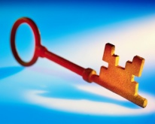
Stream Ciphers
Examples: RC4, A5/1, SEAL, etc.
Use the key as a seed to a pseudo-random number-generator (PRNG)
Take the stream of output bits from the PRNG and XOR it with the plaintext to form the ciphertext
Plaintext
Key Stream
Ciphertext

Slide 22
Stream Cipher Encryption
Plaintext:
PRNG(seed):
Ciphertext:

Slide 23
Stream Cipher Decryption
Ciphertext:
PRNG(seed):
Plaintext:

Slide 24
Some Good Properties
Stream ciphers are typically very fast
Stream ciphers can be very simple
The same function is used for encryption and decryption

Slide 25
Stream Cipher Security
If two plaintexts are ever encrypted with the same stream cipher and key
C₁ = K ⊕ P₁
C₂ = K ⊕ P₂
  an attacker can easily compute
  C₁ ⊕ C₂ = P₁ ⊕ P₂
  from which P₁ and P₂ can usually be teased apart easily

Slide 26
Stream Cipher Integrity
It is easy for an adversary (even one who can’t decrypt the ciphertext) to alter the plaintext P in a known way
  Let P_{i} be the i^{th} bit of P.
  Attacker changes the ciphertext C_{i} to C_{i}'
  P_{i}' = K_{i} XOR C_{i}'

Slide 27
Stream Cipher Integrity
It is easy for an adversary (even one who can’t decrypt the ciphertext) to alter the plaintext in a known way
Bob to Bob’s Bank:
Transfer $0,000,002.00 to the account of my good friend Alice.

Slide 28
Stream Cipher Integrity
It is easy for an adversary (even one who can’t decrypt the ciphertext) to alter the plaintext in a known way
Bob to Bob’s Bank:
Transfer $1,000,002.00 to the account of my good friend Alice.

Slide 29
A Sample PRNG: “Alleged RC4”
Initialization
S[0..255] = 0,1,…,255
K[0..255] = Key, Key, Key,…
for i = 0 to 255
j = (j + S[i] + K[i]) mod 256
swap S[i] and S[j]

Slide 30
A Sample PRNG: “Alleged RC4”
Iteration
i = (i + 1) mod 256
j = (j + S[i]) mod 256
swap S[i] and S[j]
t = (S[i] + S[j]) mod 256
Output S[t]

Slide 31
Stream Ciphers are Fragile
They are broken by key re-use
They require integrity checking
If you’re going to use a stream cipher
  Consider other options
  Make sure you understand the risks if you make a mistake in use

Slide 32
Symmetric Ciphers
Secret-key (symmetric) ciphers are usually divided into two classes:
Stream ciphers
Block ciphers

Slide 33
Block Ciphers
Why are they called “block” ciphers?
  Because the cipher is defined as a function on a fixed-size block of data
  This is called the “block size” and is a fundamental parameter of the cipher
  8- or 16-byte blocks are common
What’s the “block size” of a stream cipher?

Slide 34
Example Block Ciphers
DES
3DES
AES
RC2, RC5, TwoFish, Serpent, etc.

Slide 35
How to Build a Block Cipher
Plaintext
Block
Cipher
Key
Ciphertext

Slide 36
Feistel Ciphers
Ugly

Slide 37
Feistel Ciphers
Ugly

Slide 38
Feistel Ciphers
Ugly

Slide 39
Feistel Ciphers
Ugly
Ugly

Slide 40
Feistel Ciphers
Typically, most Feistel ciphers are iterated for about 16 rounds.
Different “sub-keys” are used for each round.
Even a weak round function can yield a strong Feistel cipher if iterated sufficiently.

Slide 41
Data Encryption Standard (DES)
64-bit Plaintext
Block
Cipher
56-bit Key
64-bit Ciphertext

Slide 42
Data Encryption Standard (DES)
DES was the most popular algorithm during the 1980-1990s
DES was published in 1975, standardized in 1977
  64-bit block size
  56-bit key
US Standard (FIPS) expired in 1998, no longer an approved algorithm
3DES (Triple DES) EDE is still in use (3x56 = 168 bit key)
DES influenced many other cipher designs

Slide 43
Data Encryption Standard (DES)
64-bit Plaintext
56-bit Key
16 Feistel
Rounds
64-bit Ciphertext

Slide 44
Data Encryption Standard (DES)
64-bit Plaintext
56-bit Key
16 Feistel
Rounds
64-bit Ciphertext

Slide 45
DES Round
F

Slide 46
Simplified DES Round Function
32 bits
Sub-key
4-bit substitutions
32-bit permutation

Slide 47
Actual DES Round Function
32 bits
Sub-key
Expansion
48 bits
2. XOR with the round key
6/4-bit substitutions
3. S-Box substitution
32-bit permutation
4. Permutation
Notes:
Expansion from 32 to 48 bits
XOR with the round key
S-Box substitution
Permutation

Slide 48
DES S-Boxes
8 different Lookup Tables (6x4) S₁ .. S₈
Non-linearity in DES needed for security
6-bit to 4-bit substitution
  2 bits select a substitution row
  4 bits is the substitution look-up
S₁ | 0 | 1 | 2 | 3 | 4 | 5 | 6 | 7 | 8 | 9 | 10 | 11 | 12 | 13 | 14 | 15
0 | 14 | 04 | 13 | 01 | 02 | 15 | 11 | 08 | 03 | 10 | 06 | 12 | 05 | 09 | 00 | 07
1 | 00 | 15 | 07 | 04 | 14 | 02 | 13 | 01 | 10 | 06 | 12 | 11 | 09 | 05 | 03 | 08
2 | 04 | 01 | 14 | 08 | 13 | 06 | 02 | 11 | 15 | 12 | 09 | 07 | 03 | 10 | 05 | 00
3 | 15 | 12 | 08 | 02 | 04 | 08 | 01 | 07 | 05 | 11 | 03 | 14 | 10 | 00 | 06 | 13
Notes:
COPACOBANA, U of Bochum, 120 FPGAs to break DES in 6.4 days at $10,000 (2008)

Slide 49
AES: Advanced Encryption Standard
Open competition run by NIST to replace DES (began 1/2/1997)
128-bit block size
Key sizes of 128, 192, and 256 bits
15 ciphers were submitted (August 1998)
5 finalists were chosen (August 1999)

Slide 50
AES Finalists
MARS (IBM submission)
RC6 (RSA Labs submission)
Rijndael (Joan Daemen and Vincent Rijmen)
Serpent (Anderson, Biham, and Knudsen)
Twofish (Schneier, et. al.)

Slide 51
AES Finalists
MARS (IBM submission)
RC6 (RSA Labs submission)
Rijndael (Joan Daemen and Vincent Rijmen) – October 2, 2000
  128-bit block size
  128, 192, 256 bit keys (10, 12, 14 rounds, respectively)
Serpent (Anderson, Biham, and Knudsen)
Twofish (Schneier, et. al.)

Slide 52
Rijndael: Key Sizes and Block Lengths
k_{0,0} | k_{0,1} | k_{0,2} | k_{0,3} | k_{0,4} | k_{0,5} | k_{0,6} | k_{0,7}
k_{1,0} | k_{1,1} | k_{1,2} | k_{1,3} | k_{1,4} | k_{1,5} | k_{1,6} | k_{1,7}
k_{2,0} | k_{2,1} | k_{2,2} | k_{2,3} | k_{2,4} | k_{2,5} | k_{2,6} | k_{2,7}
k_{3,0} | k_{3,1} | k_{3,2} | k_{3,3} | k_{3,4} | k_{3,5} | k_{3,6} | k_{3,7}
16, 24, or 32
bytes of key
a_{0,0} | a_{0,1} | a_{0,2} | a_{0,3} | a_{0,4} | a_{0,5} | a_{0,6} | a_{0,7}
a_{1,0} | a_{1,1} | a_{1,2} | a_{1,3} | a_{1,4} | a_{1,5} | a_{1,6} | a_{1,7}
a_{2,0} | a_{2,1} | a_{2,2} | a_{2,3} | a_{2,4} | a_{2,5} | a_{2,6} | a_{2,7}
a_{3,0} | a_{3,1} | a_{3,2} | a_{3,3} | a_{3,4} | a_{3,5} | a_{3,6} | a_{3,7}
16, 24, or 32
bytes of data
Practical Aspects of Modern Cryptography

Slide 53
Rijndael Round
Plaintext
Key Addition
Round
Each round has 4 transformations:
ByteSub: nonlinearity
ShiftRow: inter-column diffusion
MixColumn: inter-byte diffusion
Round key addition (XOR)
Byte Substitution
Shift Rows
Mix Columns
Key Addition
More Rounds
Ciphertext

Slide 54
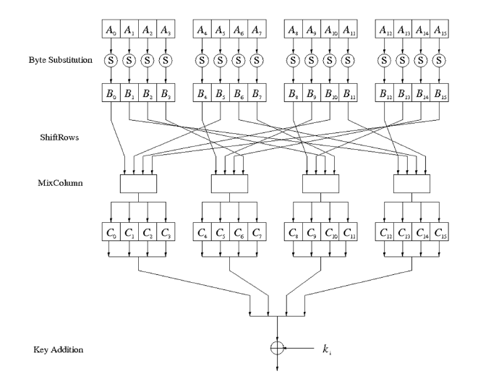
AES Round Structure
Rounds 1..9 are the same
MixColumn is omitted in the last round

Slide 55
Rijndael ByteSub
a_{0,0} | a_{0,1} | a_{0,2} | a_{0,3}
a_{1,0} | a_{1,1} | a_{1,2} | a_{1,3}
a_{2,0} | a_{2,1} | a_{2,2} | a_{2,3}
a_{3,0} | a_{3,1} | a_{3,2} | a_{3,3}
b_{0,0} | b_{0,1} | b_{0,2} | b_{0,3}
b_{1,0} | b_{1,1} | b_{1,2} | b_{1,3}
b_{2,0} | b_{2,1} | b_{2,2} | b_{2,3}
b_{3,0} | b_{3,1} | b_{3,2} | b_{3,3}
⇒
16 identical XBoxes
  Only nonlinear element in Rijndael
  8-bit to 8-bit substitution
  Bijective (1:1): reversible operation
Software implementation: Lookup table
October 18, 2016
Practical Aspects of Modern Cryptography
55

Slide 56
Rijndael ShiftRow
a_{0,0} | a_{0,1} | a_{0,2} | a_{0,3}
a_{1,0} | a_{1,1} | a_{1,2} | a_{1,3}
a_{2,0} | a_{2,1} | a_{2,2} | a_{2,3}
a_{3,0} | a_{3,1} | a_{3,2} | a_{3,3}
a_{0,0} | a_{0,1} | a_{0,2} | a_{0,3}
a_{1,3} | a_{1,0} | a_{1,1} | a_{1,2}
a_{2,2} | a_{2,3} | a_{2,0} | a_{2,1}
a_{3,1} | a_{3,2} | a_{3,3} | a_{3,0}
⇒
A different cyclic shift is applied to each row
October 18, 2016
Practical Aspects of Modern Cryptography
56

Slide 57
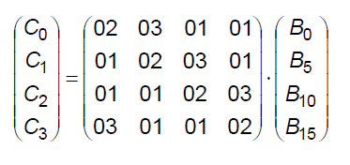
Rijndael MixColumn
a_{0,0} | a_{0,1} | a_{0,2} | a_{0,3}
a_{1,0} | a_{1,1} | a_{1,2} | a_{1,3}
a_{2,0} | a_{2,1} | a_{2,2} | a_{2,3}
a_{3,0} | a_{3,1} | a_{3,2} | a_{3,3}
b_{0,0} | b_{0,1} | b_{0,2} | b_{0,3}
b_{1,0} | b_{1,1} | b_{1,2} | b_{1,3}
b_{2,0} | b_{2,1} | b_{2,2} | b_{2,3}
b_{3,0} | b_{3,1} | b_{3,2} | b_{3,3}
⇒
An (invertible) linear transform is applied to each column.
October 18, 2016
Practical Aspects of Modern Cryptography
57

Slide 58
AES Diffusion (ShiftRow and MixColumn)
Linear operation on state matrices
  Diffusion(A) + Diffusion(B) = Diffusion(A+B)
ShiftRow: Byte permutation
Mixcolumn: Combination of 4-byte blocks via matrix operation

Slide 59
Rijndael Round key addition
a_{0,0} | a_{0,1} | a_{0,2} | a_{0,3}
a_{1,0} | a_{1,1} | a_{1,2} | a_{1,3}
a_{2,0} | a_{2,1} | a_{2,2} | a_{2,3}
a_{3,0} | a_{3,1} | a_{3,2} | a_{3,3}
k_{0,0} | k_{0,1} | k_{0,2} | k_{0,3}
k_{1,0} | k_{1,1} | k_{1,2} | k_{1,3}
k_{2,0} | k_{2,1} | k_{2,2} | k_{2,3}
k_{3,0} | k_{3,1} | k_{3,2} | k_{3,3}
b_{0,0} | b_{0,1} | b_{0,2} | b_{0,3}
b_{1,0} | b_{1,1} | b_{1,2} | b_{1,3}
b_{2,0} | b_{2,1} | b_{2,2} | b_{2,3}
b_{3,0} | b_{3,1} | b_{3,2} | b_{3,3}
⊗
=
The round key is XORed to complete the round.
October 18, 2016
Practical Aspects of Modern Cryptography
59

Slide 60
Rijndael Key Schedule
k₀ | k₁ | k₂ | k₃ | k₄ | k₅ | k₆ | k₇ | k₈ | k₉ | k₁₀ | k₁₁ | …
_{Round key 0} | _{Round key 1} | _{Round key 2} | …
The key schedule is defined on 4-byte words by
k_{i} = k_{i-4} ⊗ k_{i-1} when i is not a multiple of 4
k_{i} = k_{i-4} ⊗ f(k_{i-1}) when i is a multiple of 4
October 18, 2016
Practical Aspects of Modern Cryptography
60

Slide 61
Modes of Operation
What do I do if I want to encrypt more that one block of data with a block cipher?
Simple A: Divide the to-be-encrypted plaintext into block-size chunks, and then apply the cipher to each block.
Real A: Divide the to-be-encrypted plaintext into block-size chunks, and then apply the cipher to the sequence of blocks using a mode of operation.

Slide 62
Block Cipher Modes
Electronic Code Book (ECB) Encryption:
Plaintext
Block
Cipher
Block
Cipher
Block
Cipher
Block
Cipher
Ciphertext

Slide 63
Block Cipher Modes
Electronic Code Book (ECB) Decryption:
Plaintext
Inverse
Cipher
Inverse
Cipher
Inverse
Cipher
Inverse
Cipher
Ciphertext

Slide 64

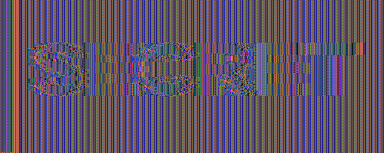
Why is ECB of Concern?
ECB

Slide 65
Block Cipher Modes
Cipher Block Chaining (CBC) Encryption:
Incorporate an Initial Value (IV) which changes with each encryption.
The IV can be
  A counter
  A random value
  Openly known

Slide 66
Block Cipher Modes
Cipher Block Chaining (CBC) Encryption:
Plaintext
IV
Block
Cipher
Block
Cipher
Block
Cipher
Block
Cipher
Ciphertext

Slide 67
Block Cipher Modes
Cipher Block Chaining (CBC) Decryption:
Plaintext
IV
Inverse
Cipher
Inverse
Cipher
Inverse
Cipher
Inverse
Cipher
Ciphertext

Slide 68
Some CBC-Mode Myths
I can’t use CBC mode because I need random-access decryption.

Slide 69
Block Cipher Modes
Cipher Block Chaining (CBC) Decryption:
Plaintext
IV
Inverse
Cipher
Inverse
Cipher
Inverse
Cipher
Inverse
Cipher
Ciphertext

Slide 70
Block Cipher Modes
Cipher Block Chaining (CBC) Decryption:
Plaintext
IV
IV
Inverse
Cipher
Inverse
Cipher
Inverse
Cipher
Inverse
Cipher
Ciphertext

Slide 71
Some CBC-Mode Myths
I can’t use CBC mode because I need random-access decryption.

Slide 72
Some CBC-Mode Myths
I can’t use CBC mode because I need random-access decryption.

Slide 73
Some CBC-Mode Myths
I can’t use CBC mode because I need random-access decryption.
I can’t use a block cipher because of data expansion.

Slide 74
Ciphertext Stealing
Cipher Block Chaining (CBC) Encryption:
Plaintext
00…0
IV
Block
Cipher
Block
Cipher
Block
Cipher
Block
Cipher
Ciphertext

Slide 75
Ciphertext Stealing
Cipher Block Chaining (CBC) Decryption:
Plaintext
110101
00…0
IV
Inverse
Cipher
Inverse
Cipher
Inverse
Cipher
Inverse
Cipher
110101
Ciphertext

Slide 76
Some CBC-Mode Myths
I can’t use CBC mode because I need random-access decryption.
I can’t use a block cipher because of data expansion.

Slide 77
Some CBC-Mode Myths
I can’t use CBC mode because I need random-access decryption.
I can’t use a block cipher because of data expansion.

Slide 78
Integrity Checking
Encrypted text: decryption succeeds, but is it the correct plaintext?
Straightforward encryption does not provide integrity
Stream ciphers offer no integrity at all
Block cipher “integrity” has been compromised many times
➔ Authenticated Encryption
  Modes of operation that encrypts and provides an integrity Tag
    CCM (CBC Counter Mode)
    GCM (Galois Counter Mode)
  Beware of repeating nonce!

Slide 79
Agenda
Symmetric key ciphers
  Stream ciphers
  Block ciphers
Cryptographic hash functions

Slide 80
One-Way Hash Functions
The idea of a check sum is great, but it is designed to prevent accidental changes in a message. Example: CRC
For cryptographic integrity, we need an integrity check that is resilient against a smart and a determined adversary.

Slide 81
One-Way Hash Functions
Common Hash Functions:
MD2, MD4, MD5 (RFC)
SHA-1, SHA-256, SHA-384, SHA-512 (FIPS 180-4)
Generally, a one-way hash function is a function
H : {0,1}* → {0,1}^{k}
(typically k is 128, 160, or 256)

Slide 82
One-Way Hash Functions
There are many properties of one-way hashes
Non-invertability
  Given y, it’s difficult to find any x such that H(x) = y
Second-preimage
  Given x, it’s difficult to find x′ ≠ x such that H(x) = H(x′ )
Collision-intractability
  One cannot find a pair of values x′ ≠ x such that H(x) = H(x′ )

Slide 83
State of the Art for Hashes
Collisions have been demonstrated for MD4 and MD5
MD5 Collisions and pre-image attack
  [Improved] Wang attack complexity 2²⁴ compressions
  Preimage (full) is theoretical with 2¹²³ complexity
SHA-1 Collision attacks
  Free-start collision attack on SHA-1 compression function with 2⁵⁷ collisions
  Near collisions with 2^{57.5} compressions, 2⁶¹ for full collision (claimed)

Slide 84



Call from Copenhagen …

Slide 85
One-Way Hash Functions
When encrypting, a hash of the message can be appended to ensure integrity
  Especially when using a stream cipher
  MAC: Message Authentication Code
When forming a digital signature, the signature need only be applied to a hash of the message
  Message Digest (more later in public key crypto)

Slide 86
Message Authentication Codes
A Message Authentication Code (MAC) is often constructed with a keyed hash
If one hashes a secret key together with the correct message, an attacker who doesn’t know the key will be unable to change the message without detection
But how?

Slide 87
Cipher Integrity
  Original plaintext P.
  Encryption key K₁.
  MAC key K₂.
  Ciphertext C=E_{K1}(P).
  MAC M=H_{K2}(P) or M=H_{K2}(C).
  Transmit (C,M).

Slide 88
Message Authentication Codes
MAC key K, plaintext P, ciphertext C=E(P)
MAC=H(K,P)? MAC=H(P,K)?
MAC=H(K,C)? MAC=H(C,K)?
There are weaknesses with all of the above.
HMAC = H(K,H(K,P))

Slide 89
HMAC (RFC 2401, FIPS 198)
Keyed digest with a security proof
HMAC(K,m) = H( (K XOR opad) || H(K XOR ipad) || m )
opad = 0x5c5c5c5c5c……5c, one block long
ipad = 0x3636363636……36, one block long

Slide 90
Crypto Hygiene
Do I really need to use different keys for encryption and integrity?
Use different keys for separate functions
You can derive keys from the same master
K₁=H(“Key1”,K) K₂=H(“Key2”,K)

Slide 91
What else are Hash Functions Good for?
Hash functions are very versatile; additional examples
Uniquely and securely identify bit streams like programs: Hash is strong name for program
Entropy mixing: Cryptographic hashes are random functions with fixed size blocks, they can “mix” biased input to produce a “seed” for a pseudo-random number generator
Password Protection: Store salted hash of password instead of password
Bit Commitment

Slide 92
Merkle-Damgård Construction
(IV)
Large Input (e.g. 512 bits)
Compression
Function
Smaller Output (e.g. 256 bits)

Slide 93
A Cryptographic Hash: SHA-1
160-bit
512-bit
One of 80 rounds

Slide 94
A Cryptographic Hash: SHA-1
160-bit
512-bit
No Change
One of 80 rounds

Slide 95
A Cryptographic Hash: SHA-1
160-bit
512-bit
Rotate 30 bits
One of 80 rounds

Slide 96
A Cryptographic Hash: SHA-1
160-bit
512-bit
No Change
One of 80 rounds

Slide 97
A Cryptographic Hash: SHA-1
160-bit
512-bit
No Change
One of 80 rounds

Slide 98
A Cryptographic Hash: SHA-1
160-bit
512-bit
?
One of 80 rounds

Slide 99
A Cryptographic Hash: SHA-1
What’s in the final 32-bit transform?
Take the rightmost word.
Add in the leftmost word rotated 5 bits.
Add in a round-dependent function f of the middle three words.

Slide 100
A Cryptographic Hash: SHA-1
160-bit
512-bit
f
One of 80 rounds

Slide 101
A Cryptographic Hash: SHA-1
What’s in the final 32-bit transform?
Take the rightmost word.
Add in the leftmost word rotated 5 bits.
Add in a round-dependent function f of the middle three words.
Add in a round-dependent constant.
Add in a portion of the 512-bit message.

Slide 102
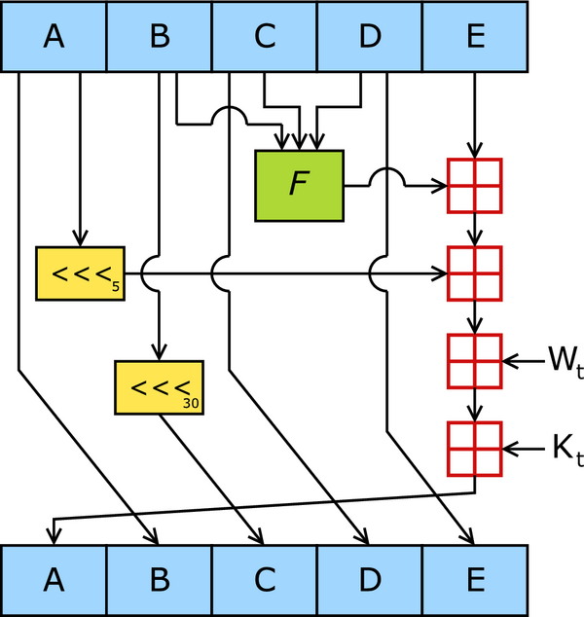
A Cryptographic Hash: SHA-1
_{Picture from Wikipedia}

Slide 103
A Cryptographic Hash: SHA-1
Depending on the round, the “non-linear” function f is one of the following.
f(X,Y,Z) = (X∧Y) ∨ ((¬X)∧Z)
f(X,Y,Z) = (X∧Y) ∨ (X∧Z) ∨ (Y∧Z)
f(X,Y,Z) = X ⊕ Y ⊕ Z

Slide 104
A Cryptographic Hash: SHA-1
160-bit
512-bit
One of 80 rounds

Slide 105
From SHA-1 to SHA-2
Quick history: in 1993, NIST published SHA (Secure Hash Algorithm) as part of FIPS 180, Secure Hash Standard.
  Designed by NSA
  Withdrawn in 1995 and replaced with SHA-1
    One modification: single bitwise rotation added
In 2001, NIST revises FIPS 180 and adds SHA-2
  Also designed by NSA
  Originally 3 variants: SHA-256, SHA-384, SHA-512
    SHA-224 added later

Slide 106
Merkle-Damgård Construction
(IV)
Large Input (e.g. 512 bits)
Compression
Function
Smaller Output (e.g. 256 bits)

Slide 107
A Cryptographic Hash: SHA-2
Prior State
256 or 512 bits
New Message Bits
256 or 512 bits
A
B
C
D
E
F
G
H
A’
B’
C’
D’
E’
F’
G’
H’
One of 64 rounds

Slide 108
A Cryptographic Hash: SHA-2
Prior State
256 or 512 bits
New Message Bits
256 or 512 bits
A
B
C
D
E
F
G
H
No Change
B’ = A
C’ = B
D’ = C
F’ = E
G’ = F
H’ = G
A’
B’
C’
D’
E’
F’
G’
H’
One of 64 rounds

Slide 109
A Cryptographic Hash: SHA-2
Prior State
256 or 512 bits
New Message Bits
256 or 512 bits
A
B
C
D
E
F
G
H
What about the last 2?
A’
B’
C’
D’
E’
F’
G’
H’
One of 64 rounds

Slide 110
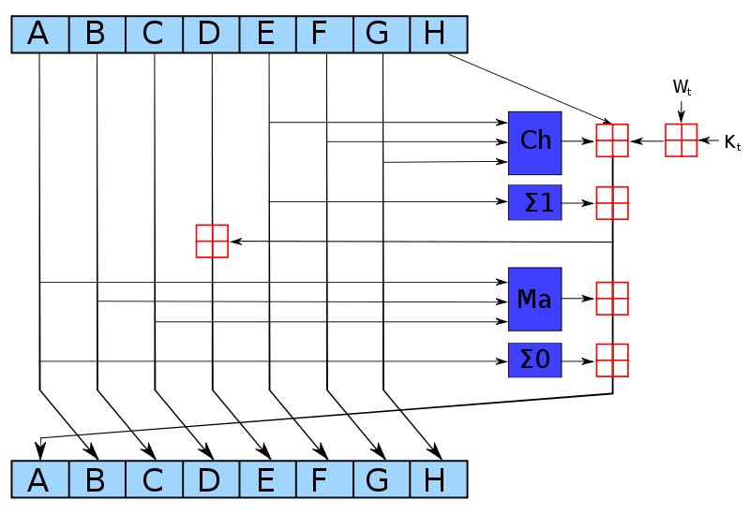
A Cryptographic Hash: SHA-2
_{Picture from Wikipedia}

Slide 111
From SHA-2 to SHA-3
In 2007, NIST announced that it would hold an open competition to pick a new “SHA-3” hash function
  Similar to the competition held to pick AES.
Submissions were due 31 October 2008
  51 submissions accepted by NIST for Round One
  14 submissions advanced to Round 2
  5 finalists (announced December 10, 2010)
SHA-3 is announced in October 2012: Keccak

Slide 112
The SHA-3 Finalists
BLAKE
Grøstl (Knudsen et al.)
JH
Keccak (Keccak team, Daemen et al.)
Skein (Schneier et al.)

Slide 113
Key Derivation Functions (KDF)
Derive secret bits from one secret key
  Input: Secret key, public information
  Output: Secret keys
Password-Based Key Derivation: PBKDF2, new PBKDFs
Secret Key KDF: Typically follows a public key exchange algorithm
A few primitives
  Extractors: non-uniform high-entropy source to uniform random output
  Expanders: Expand a secret to longer bits, typically a PRF
    PRF: Pseudo-Random Function
  Extract-and-Expand KDFs
  Stretching: typically with password input
  HMAC, Hash, and block ciphers are typical primitives

