Slide 1
Practical Aspects of Modern Cryptography
Fall 2016
Tolga Acar Josh Benaloh

Slide 2
Cryptography is ...
Protecting Privacy of Data
Authentication of Identities
Preservation of Integrity
… basically any protocols designed to operate in an environment absent of universal trust.

Slide 3
Characters

Slide 4
Characters
Alice

Slide 5
Characters
Bob

Slide 6
Basic Communication
Alice talking to Bob

Slide 7
Another Character
Eve

Slide 8
Basic Communication Problem
Eve listening to Alice talking to Bob

Slide 9
Two-Party Environments
Alice Bob

Slide 10
Remote Coin Flipping
Alice and Bob decide to make a decision by flipping a coin.
Alice and Bob are not in the same place.

Slide 11
Ground Rule
Protocol must be asynchronous.
We cannot assume simultaneous actions.
Players must take turns.

Slide 12
Is Remote Coin Flipping Possible?

Slide 13
Is Remote Coin Flipping Possible?
Two-part answer:

Slide 14
Is Remote Coin Flipping Possible?
Two-part answer:
NO – I will sketch a formal proof.

Slide 15
Is Remote Coin Flipping Possible?
Two-part answer:
NO – I will sketch a formal proof.
YES – I will provide an effective protocol.

Slide 16
A Protocol Flow Tree
A:
B:
A:
B:

Slide 17
A Protocol Flow Tree
A:
B:
B
B
A
B
B
A
A:
B
A
A
B
B
A
B
B
B:
B
A
B
B
A
A
B

Slide 18
Pruning the Tree
A
A
A
A
B
B
B
B

Slide 19
Pruning the Tree
A:
A
A
⬧
⬧
B:
B
B
⬧
⬧

Slide 20
A Protocol Flow Tree
A:
B:
B
B
A
B
B
A
A:
B
A
A
B
B
A
B
B
B:
B
A
B
B
A
A
B

Slide 21
A Protocol Flow Tree
A:
B:
B
B
A
B
B
A
A:
B
A
A
B
B
B
A
B
B
B:
A
A
B

Slide 22
A Protocol Flow Tree
A:
B:
B
B
A
B
B
A
A:
B
A
A
B
B
B
A
B
B
B
B:

Slide 23
A Protocol Flow Tree
A:
B:
B
A
B
A
B
B
A
A:
A
B
B
B
A
B
B
B
B:

Slide 24
A Protocol Flow Tree
A:
B:
B
A
B
A
A
B
B
A
A:
B
A
B
B
B
B:

Slide 25
A Protocol Flow Tree
A:
B:
B
A
B
A
A
B
A
B
A
A:
B
B
B
B:

Slide 26
A Protocol Flow Tree
A:
B:
B
A
B
A
A
B
A
B
B
A
A:
B:

Slide 27
A Protocol Flow Tree
A:
B:
B
A
A
B
A
B
B
A
A:
B:

Slide 28
A Protocol Flow Tree
A:
B:
B
A
B
A
B
B
A
A:
B:

Slide 29
A Protocol Flow Tree
A:
B:
B
A
B
A:
B
B
A
B:

Slide 30
A Protocol Flow Tree
A:
B:
B
A
B
B
A:
B:

Slide 31
A Protocol Flow Tree
A:
A
B:
A:
B:

Slide 32
A Protocol Flow Tree
A

Slide 33
Completing the Pruning
When the pruning is complete one will end up with either

Slide 34
Completing the Pruning
When the pruning is complete one will end up with either
a winner before the protocol has begun, or

Slide 35
Completing the Pruning
When the pruning is complete one will end up with either
a winner before the protocol has begun, or
a useless infinite game.

Slide 36
Conclusion of Part I
Remote coin flipping is utterly impossible!!!

Slide 37
How to Remotely Flip a Coin

Slide 38
How to Remotely Flip a Coin
The Positive INTEGERS

Slide 39
How to Remotely Flip a Coin
The Positive INTEGERS
1 5 9 13 17 21 25 29 …
2 6 10 14 18 22 26 30 …
3 7 11 15 19 23 27 31 …
4 8 12 16 20 24 28 32 …

Slide 40
How to Remotely Flip a Coin
Group 1:
Group 2:
Group 3:
Group 4:
The Positive INTEGERS
1 5 9 13 17 21 25 29 …
2 6 10 14 18 22 26 30 …
3 7 11 15 19 23 27 31 …
4 8 12 16 20 24 28 32 …

Slide 41
How to Remotely Flip a Coin
Group 1:
Group 2:
Group 3:
Group 4:
The Positive INTEGERS
1 5 9 13 17 21 25 29 …
2 6 10 14 18 22 26 30 …
3 7 11 15 19 23 27 31 …
4 8 12 16 20 24 28 32 …
Where do products between groups wind up?

Slide 42
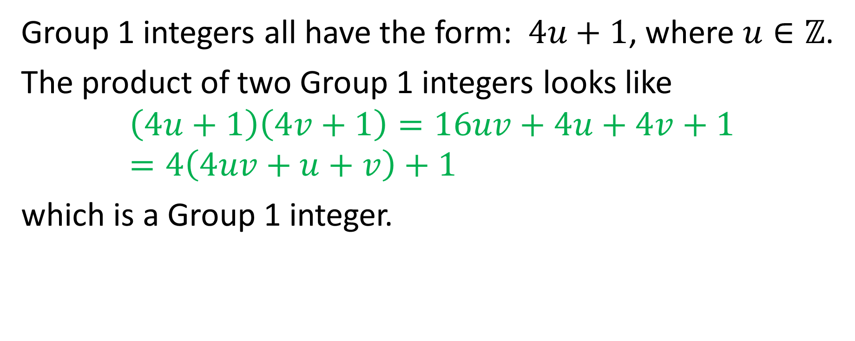
How to Remotely Flip a Coin
Group 1 integers all have the form: $4u+1$, where $u∈ℤ$.
The product of two Group 1 integers looks like
$$\left(4u+1\right)\left(4v+1\right)=16uv+4u+4v+1=4\left(4uv+u+v\right)+1$$
which is a Group 1 integer.

Slide 43
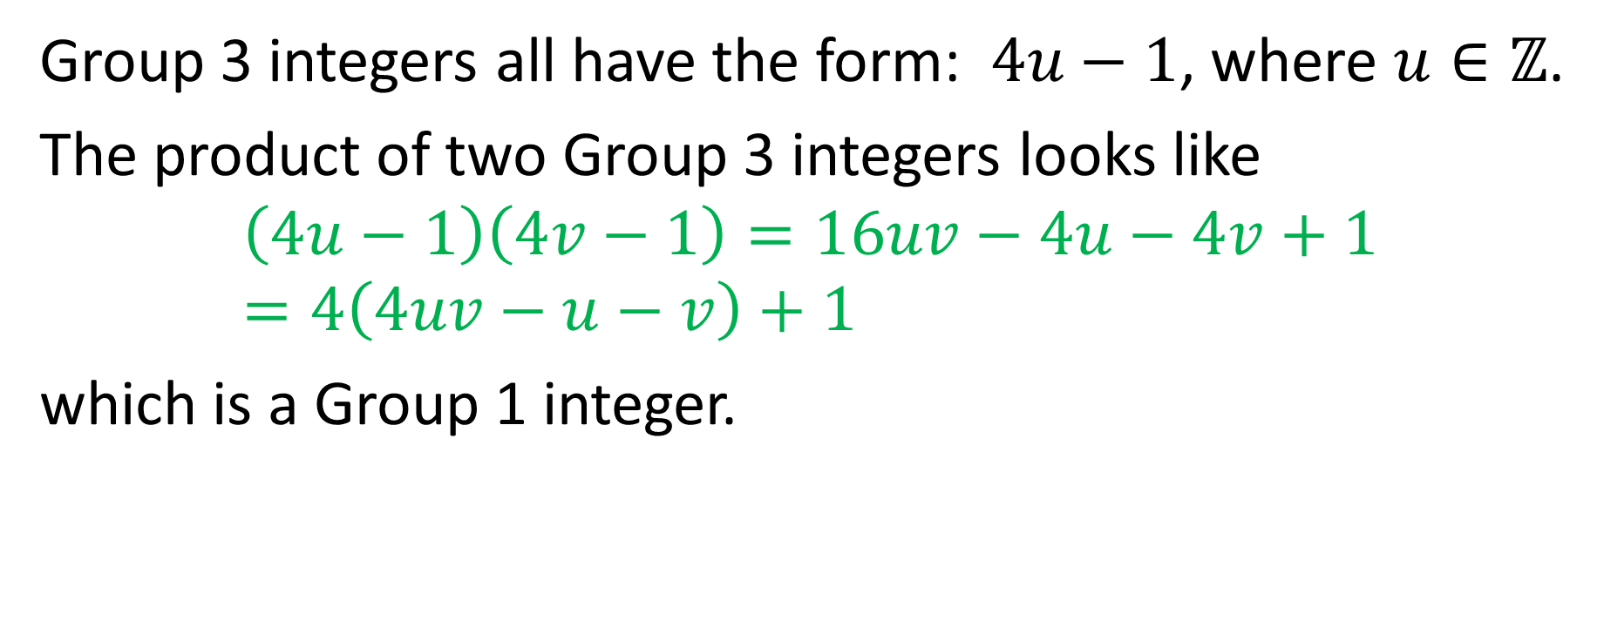
How to Remotely Flip a Coin
Group 3 integers all have the form: $4u−1$, where $u∈ℤ$.
The product of two Group 3 integers looks like
$$\left(4u−1\right)\left(4v−1\right)=16uv−4u−4v+1=4\left(4uv−u−v\right)+1$$
which is a Group 1 integer.

Slide 44
How to Remotely Flip a Coin
Fact 1
Multiplying two odd integers of from the same group always yields a product of Group 1.

Slide 45
How to Remotely Flip a Coin
Fact 2
There is no known method (other than factoring) to distinguish a product of two “Group 1” integers from a product of two “Group 3” integers.

Slide 46
How to Remotely Flip a Coin
Fact 3
Factoring large integers is believed to be much harder than multiplying large integers.

Slide 47
How to Remotely Flip a Coin

Slide 48
How to Remotely Flip a Coin
Alice
Bob

Slide 49

How to Remotely Flip a Coin
Alice
Randomly select a bit $b\{1,3\}$ and two large integers $P$ and $Q$ – both from Group $b$.
Bob

Slide 50

How to Remotely Flip a Coin
Alice
Randomly select a bit $b\{1,3\}$ and two large integers $P$ and $Q$ – both from Group $b$.
Compute $N = PQ$.
Bob

Slide 51
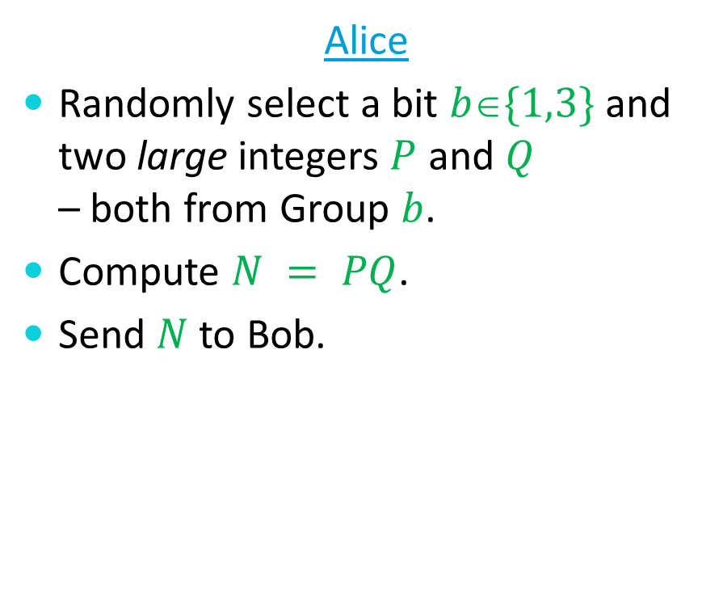
How to Remotely Flip a Coin
Alice
Randomly select a bit $b\{1,3\}$ and two large integers $P$ and $Q$ – both from Group $b$.
Compute $N = PQ$.
Send $N$ to Bob.
Bob

Slide 52
How to Remotely Flip a Coin
Alice Bob
N

Slide 53
How to Remotely Flip a Coin
Alice
Randomly select a bit $b\{1,3\}$ and two large integers $P$ and $Q$ – both from Group $b$.
Compute $N = PQ$.
Send $N$ to Bob.
Bob

Slide 54

How to Remotely Flip a Coin
Alice
Randomly select a bit $b\{1,3\}$ and two large integers $P$ and $Q$ – both from Group $b$.
Compute $N = PQ$.
Send $N$ to Bob.
Bob
After receiving $N$ from Alice, guess the value of $b$ and send this guess to Alice.

Slide 55
How to Remotely Flip a Coin
Alice Bob
b

Slide 56
How to Remotely Flip a Coin
Alice
Randomly select a bit $b\{1,3\}$ and two large integers $P$ and $Q$ – both from Group $b$.
Compute $N = PQ$.
Send $N$ to Bob.
Bob
After receiving $N$ from Alice, guess the value of $b$ and send this guess to Alice.

Slide 57
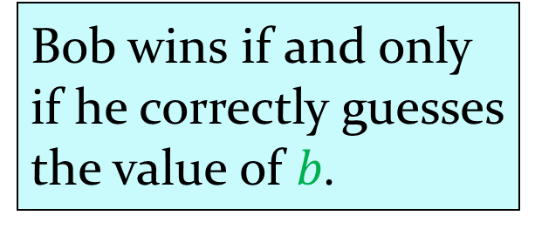
How to Remotely Flip a Coin
Alice
Randomly select a bit $b\{1,3\}$ and two large integers $P$ and $Q$ – both from Group $b$.
Compute $N = PQ$.
Send $N$ to Bob.
Bob
After receiving $N$ from Alice, guess the value of $b$ and send this guess to Alice.
Bob wins if and only
if he correctly guesses
the value of $b$.

Slide 58
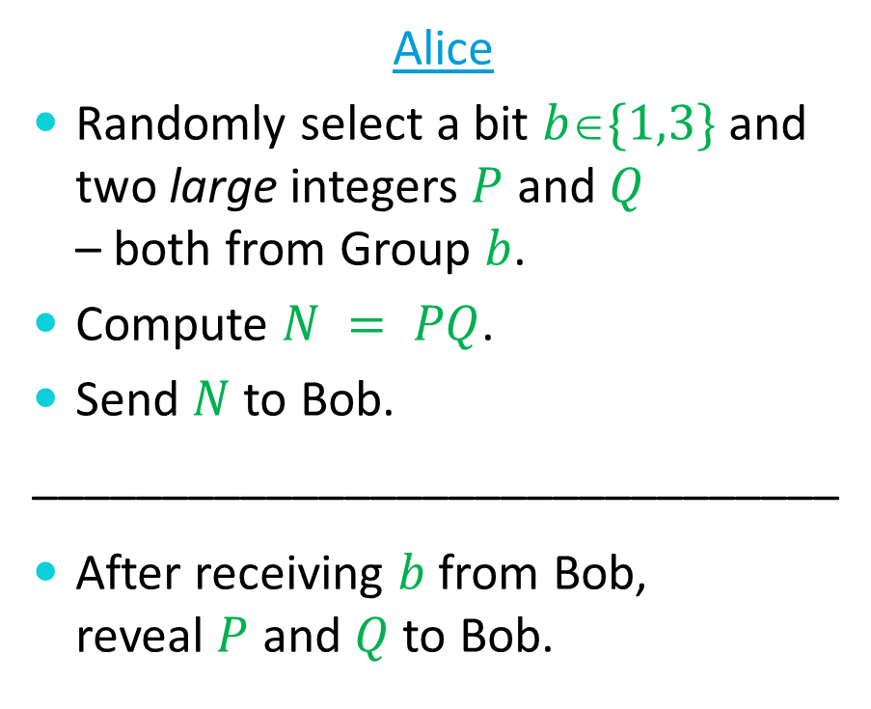
How to Remotely Flip a Coin
Alice
Randomly select a bit $b\{1,3\}$ and two large integers $P$ and $Q$ – both from Group $b$.
Compute $N = PQ$.
Send $N$ to Bob.
_______________________________
After receiving $b$ from Bob, reveal $P$ and $Q$ to Bob.
Bob
After receiving $N$ from Alice, guess the value of $b$ and send this guess to Alice.
Bob wins if and only
if he correctly guesses
the value of $b$.

Slide 59
How to Remotely Flip a Coin
Alice Bob
P,Q

Slide 60
How to Remotely Flip a Coin
Alice
Randomly select a bit $b\{1,3\}$ and two large integers $P$ and $Q$ – both from Group $b$.
Compute $N = PQ$.
Send $N$ to Bob.
_______________________________
After receiving $b$ from Bob, reveal $P$ and $Q$ to Bob.
Bob
After receiving $N$ from Alice, guess the value of $b$ and send this guess to Alice.
Bob wins if and only
if he correctly guesses
the value of $b$.

Slide 61
Let’s Play
Group 1:
Group 2:
Group 3:
Group 4:
The Positive INTEGERS
1 5 9 13 17 21 25 29 …
2 6 10 14 18 22 26 30 …
3 7 11 15 19 23 27 31 …
4 8 12 16 20 24 28 32 …

Slide 62
How to Remotely Flip a Coin
Alice
Randomly select a bit $b\{1,3\}$ and two large integers $P$ and $Q$ – both from Group $b$.
Compute $N = PQ$.
Send $N$ to Bob.
_______________________________
After receiving $b$ from Bob, reveal $P$ and $Q$ to Bob.
Bob
After receiving $N$ from Alice, guess the value of $b$ and send this guess to Alice.
Bob wins if and only
if he correctly guesses
the value of $b$.

Slide 63
How to Remotely Flip a Coin
Alice
Randomly select a bit $b\{1,3\}$ and two large integers $P$ and $Q$ – both from Group $b$.
Compute $N = PQ$.
Send $N$ to Bob.
_______________________________
After receiving $b$ from Bob, reveal $P$ and $Q$ to Bob.
Bob
After receiving $N$ from Alice, guess the value of $b$ and send this guess to Alice.
primes
Bob wins if and only
if he correctly guesses
the value of $b$.

Slide 64
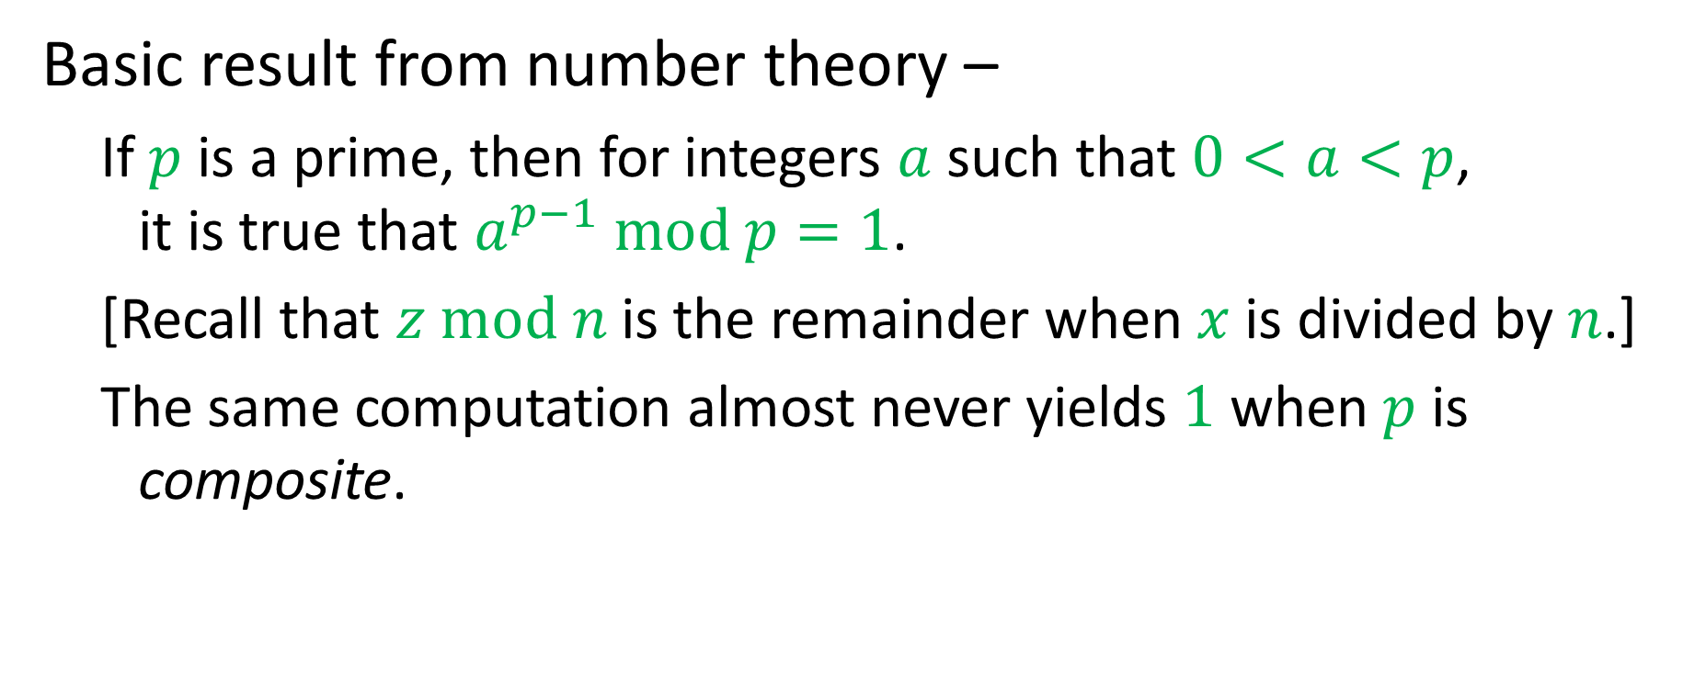
Checking Primality
Basic result from number theory –
  If $p$ is a prime, then for integers $a$ such that $0<a<p$, it is true that $a^{p−1} mod p=1$.
  [Recall that $z mod n$ is the remainder when $x$ is divided by $n$.]
  The same computation almost never yields $1$ when $p$ is composite.

Slide 65
How is this contradiction resolved?

Slide 66
How is this contradiction resolved?
The impossibility proof assumed unlimited computational ability.

Slide 67
How is this contradiction resolved?
The impossibility proof assumed unlimited computational ability.
The protocol is not 50/50 – Bob has a small advantage.

Slide 68
Applications of Remote Flipping
Remote Card Playing
Internet Gambling
Various “Fair” Agreement Protocols

Slide 69
Bit Commitment
We have implemented remote coin flipping via bit commitment.
Commitment protocols can also be used for
Sealed bidding
Undisclosed contracts
Interactive proofs

Slide 70
One-Way Functions
We have implemented bit commitment via one-way functions.
One-way functions can be used for
Authentication
Data integrity
Strong “randomness”

Slide 71
One-Way Functions

Slide 72
One-Way Functions
Two basic classes of one-way functions

Slide 73
One-Way Functions
Two basic classes of one-way functions
Mathematical

Slide 74

One-Way Functions
Two basic classes of one-way functions
Mathematical
  Multiplication: $Z=X×Y$

Slide 75
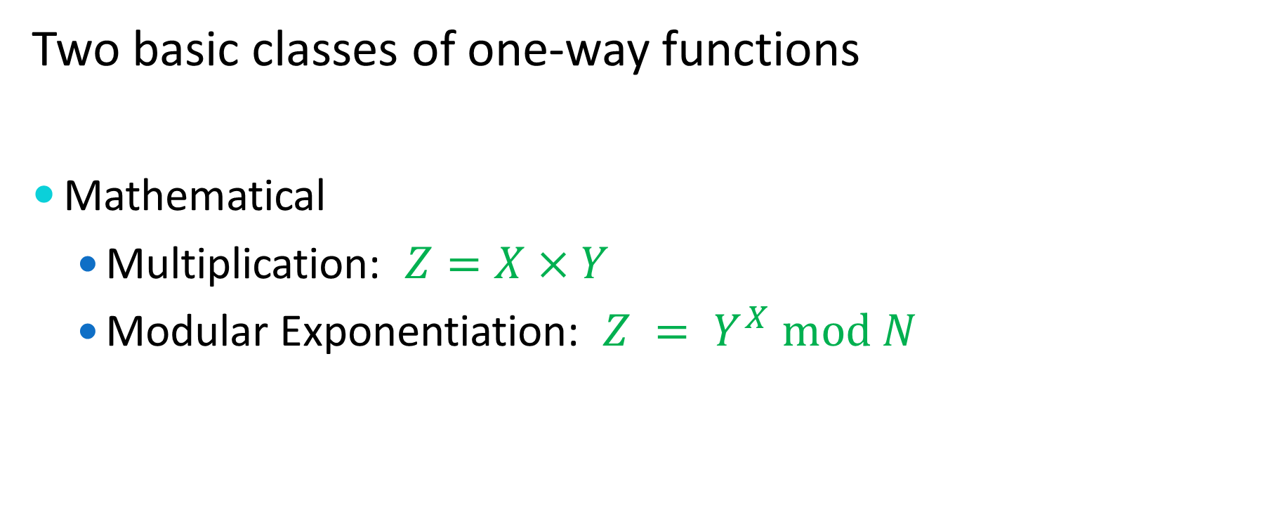
One-Way Functions
Two basic classes of one-way functions
Mathematical
  Multiplication: $Z=X×Y$
  Modular Exponentiation: $Z = Y^{X} mod N$

Slide 76
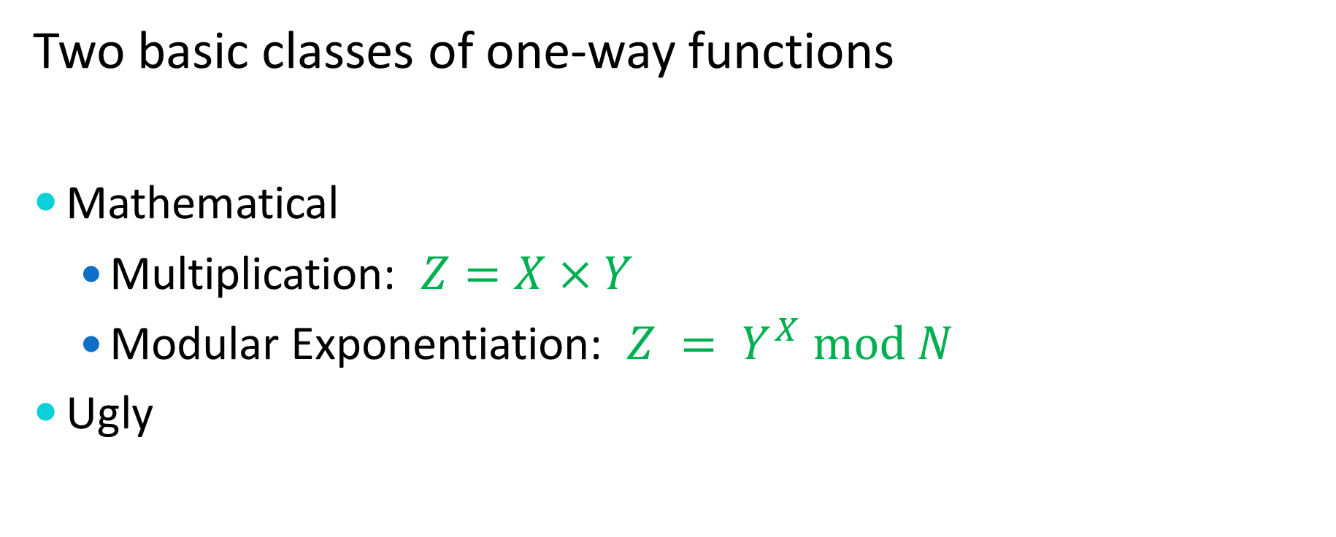
One-Way Functions
Two basic classes of one-way functions
Mathematical
  Multiplication: $Z=X×Y$
  Modular Exponentiation: $Z = Y^{X} mod N$
Ugly

Slide 77

The Fundamental Equation
$$Z=Y^{X} mod N$$

Slide 78
Modular Arithmetic

Slide 79

Modular Arithmetic
$Z mod N$is the integer remainder when $Z$ is divided by $N$.

Slide 80
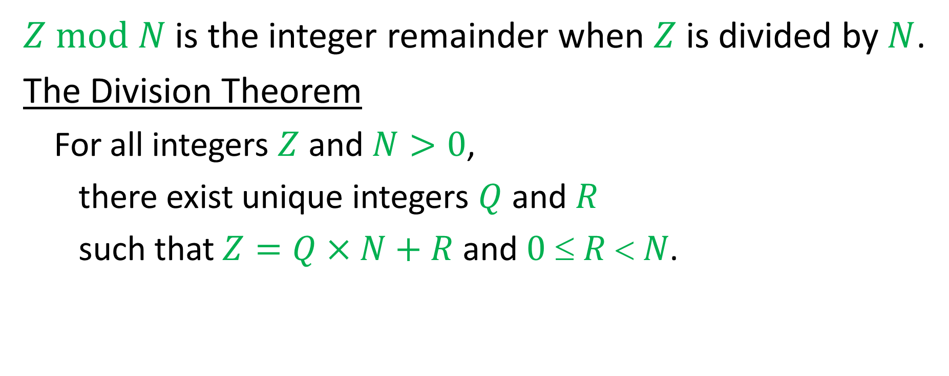
Modular Arithmetic
$Z mod N$is the integer remainder when $Z$ is divided by $N$.
The Division Theorem
  For all integers $Z$ and $N>0$,
  there exist unique integers $Q$ and $R$
  such that $Z=Q×N+R$ and $0  R  N$.

Slide 81
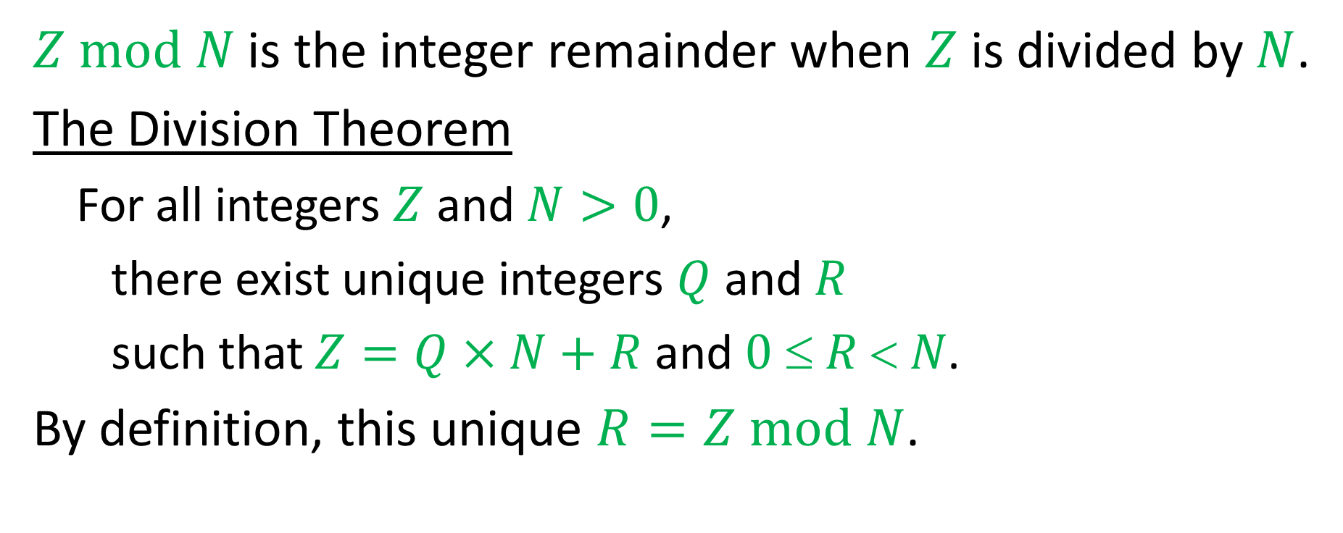
Modular Arithmetic
$Z mod N$is the integer remainder when $Z$ is divided by $N$.
The Division Theorem
  For all integers $Z$ and $N>0$,
  there exist unique integers $Q$ and $R$
  such that $Z=Q×N+R$ and $0  R  N$.
By definition, this unique $R=Z mod N$.

Slide 82
Modular Arithmetic

Slide 83

Modular Arithmetic
To compute $(A+B) mod N$,
  compute $(A+B)$ and take the result $mod N$.

Slide 84
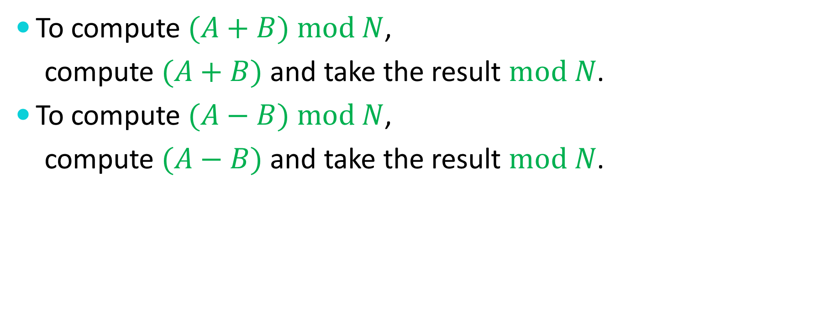
Modular Arithmetic
To compute $(A+B) mod N$,
  compute $(A+B)$ and take the result $mod N$.
To compute $(A−B) mod N$,
  compute $(A−B)$ and take the result $mod N$.

Slide 85
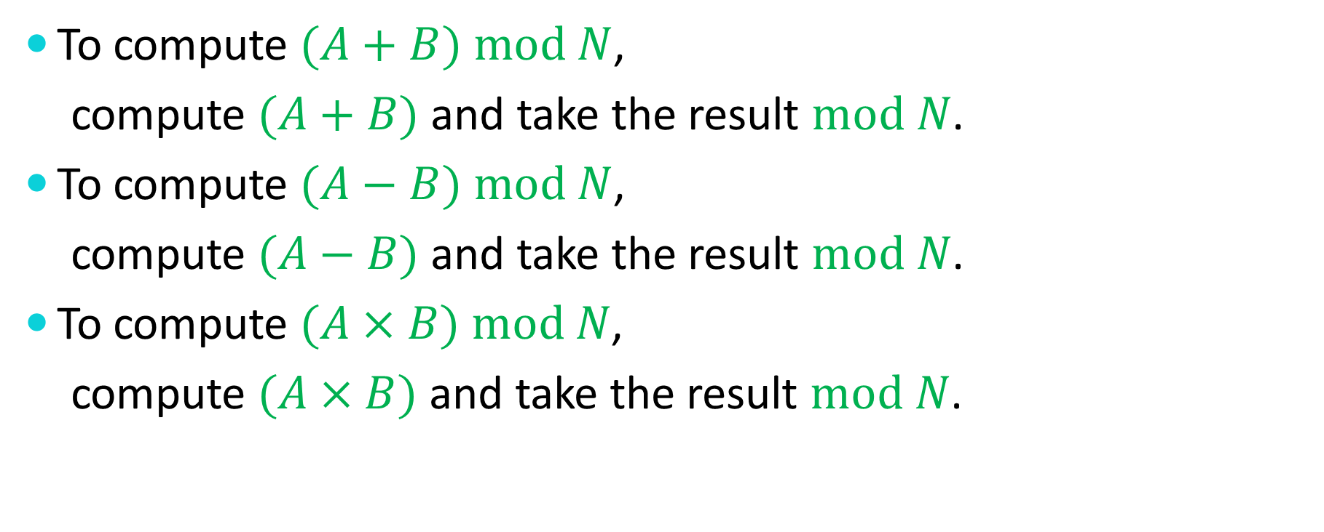
Modular Arithmetic
To compute $(A+B) mod N$,
  compute $(A+B)$ and take the result $mod N$.
To compute $(A−B) mod N$,
  compute $(A−B)$ and take the result $mod N$.
To compute $(A×B) mod N$,
  compute $(A×B)$ and take the result $mod N$.

Slide 86
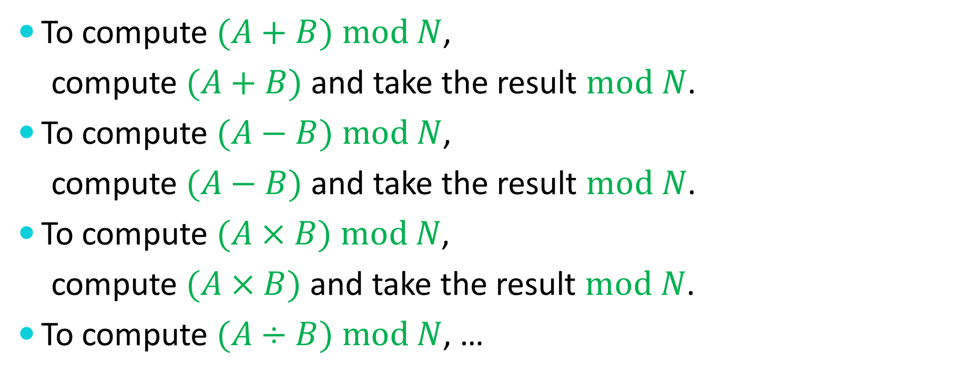
Modular Arithmetic
To compute $(A+B) mod N$,
  compute $(A+B)$ and take the result $mod N$.
To compute $(A−B) mod N$,
  compute $(A−B)$ and take the result $mod N$.
To compute $(A×B) mod N$,
  compute $(A×B)$ and take the result $mod N$.
To compute $(A÷B) mod N$, …

Slide 87
Modular Division

Slide 88

Modular Division
What is the value of $(1÷2) mod 7$?
We need a solution to $2x mod 7 = 1$.

Slide 89

Modular Division
What is the value of $(1÷2) mod 7$?
We need a solution to $2x mod 7 = 1$.
Try $x=4$.

Slide 90
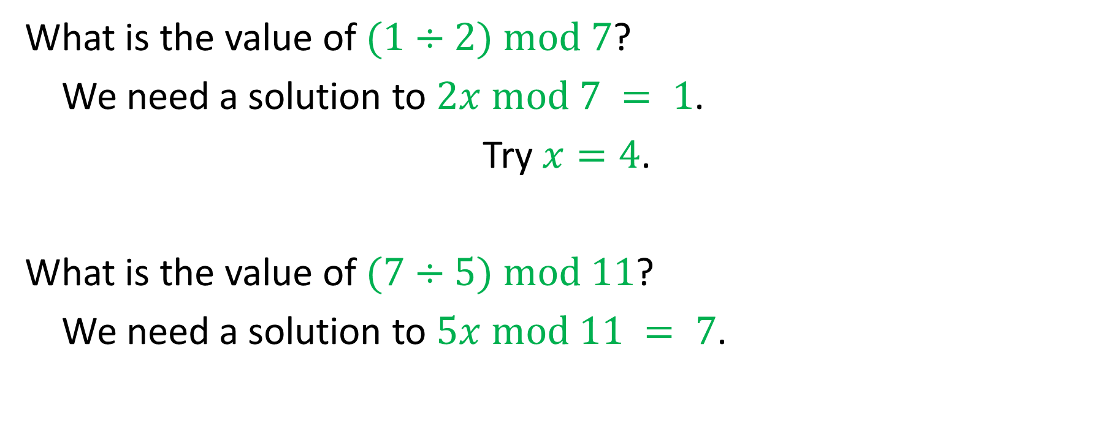
Modular Division
What is the value of $(1÷2) mod 7$?
We need a solution to $2x mod 7 = 1$.
Try $x=4$.
What is the value of $(7÷5) mod 11$?
We need a solution to $5x mod 11 = 7$.

Slide 91
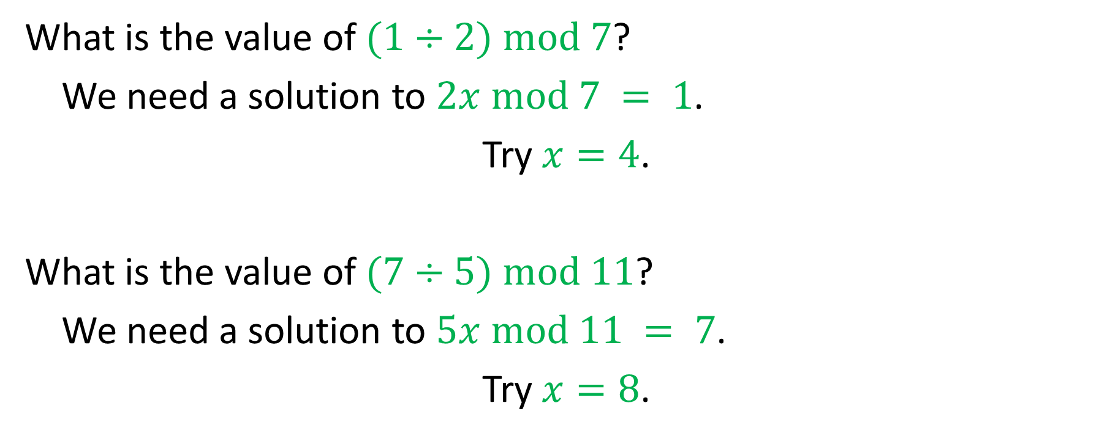
Modular Division
What is the value of $(1÷2) mod 7$?
We need a solution to $2x mod 7 = 1$.
Try $x=4$.
What is the value of $(7÷5) mod 11$?
We need a solution to $5x mod 11 = 7$.
Try $x=8$.

Slide 92
Modular Division

Slide 93
Modular Division
Is modular division always well-defined?

Slide 94

Modular Division
Is modular division always well-defined?
$(1÷3) mod 6$ = ?

Slide 95

Modular Division
Is modular division always well-defined?
$(1÷3) mod 6$ = ?
$3x mod 6 = 1$ has no solution!

Slide 96
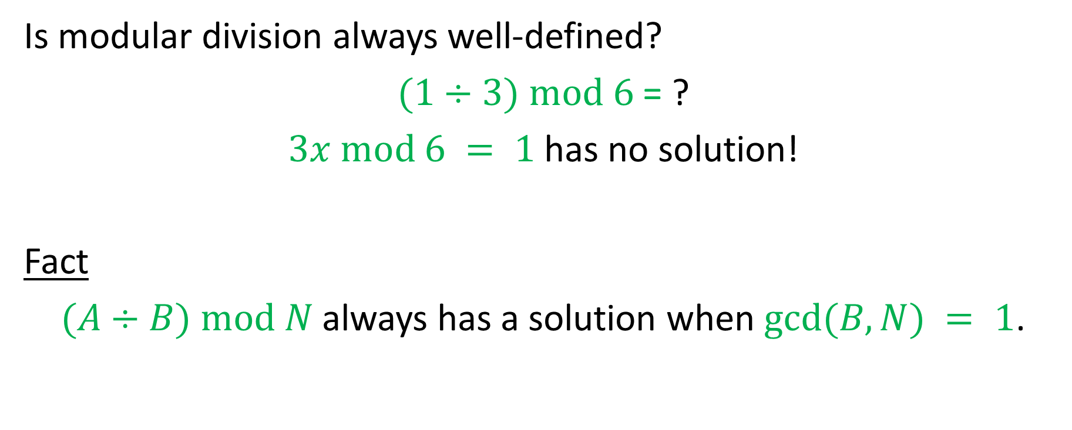
Modular Division
Is modular division always well-defined?
$(1÷3) mod 6$ = ?
$3x mod 6 = 1$ has no solution!
Fact
$(A÷B) mod N$always has a solution when $gcd⁡(B,N) = 1$.

Slide 97
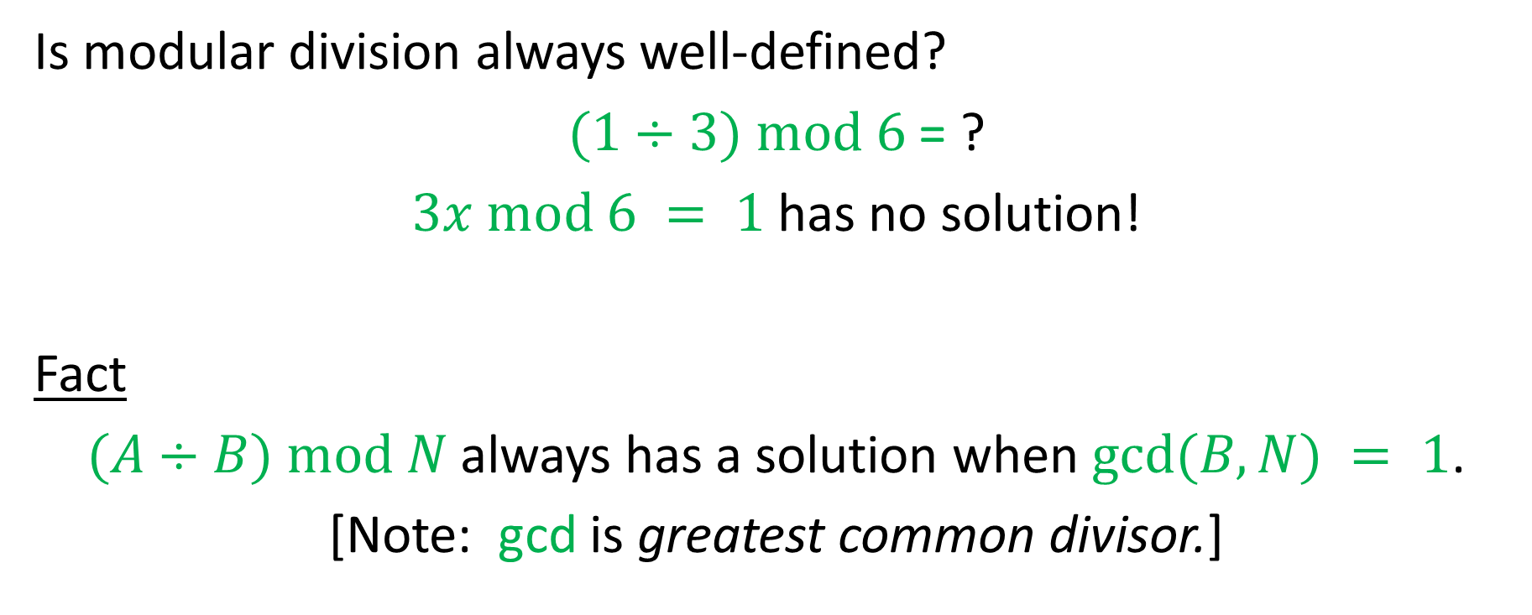
Modular Division
Is modular division always well-defined?
$(1÷3) mod 6$ = ?
$3x mod 6 = 1$ has no solution!
Fact
$(A÷B) mod N$always has a solution when $gcd⁡(B,N) = 1$.
[Note: gcd is greatest common divisor.]

Slide 98

Modular Division
Fact 1
$(A÷B) mod N$ always has a solution when $gcd⁡(B,N)=1$.

Slide 99
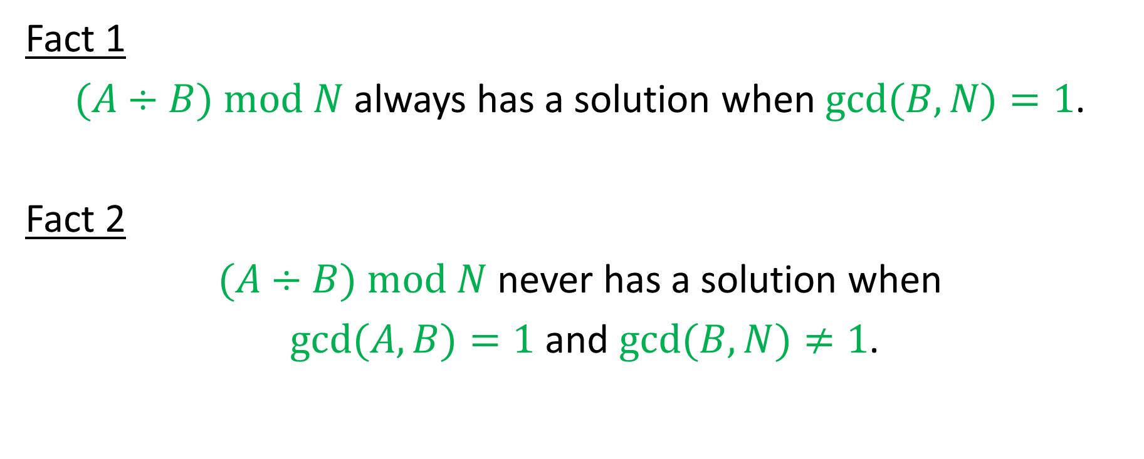
Modular Division
Fact 1
$(A÷B) mod N$ always has a solution when $gcd⁡(B,N)=1$.
Fact 2
$(A÷B) mod N$ never has a solution when
$gcd⁡(A,B)=1$ and $gcd⁡(B,N)≠1$.

Slide 100
Greatest Common Divisors

Slide 101

Greatest Common Divisors
$gcd⁡(A , B) = gcd⁡(B , A – B)$

Slide 102
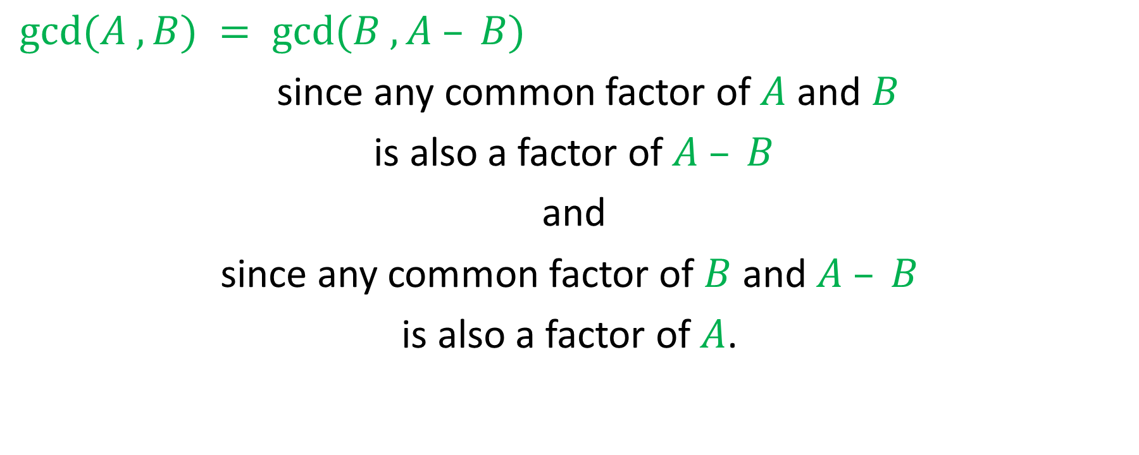
Greatest Common Divisors
$gcd⁡(A , B) = gcd⁡(B , A – B)$
since any common factor of $A$ and $B$
is also a factor of $A – B$
and
since any common factor of $B$ and $A – B$
is also a factor of $A$.

Slide 103
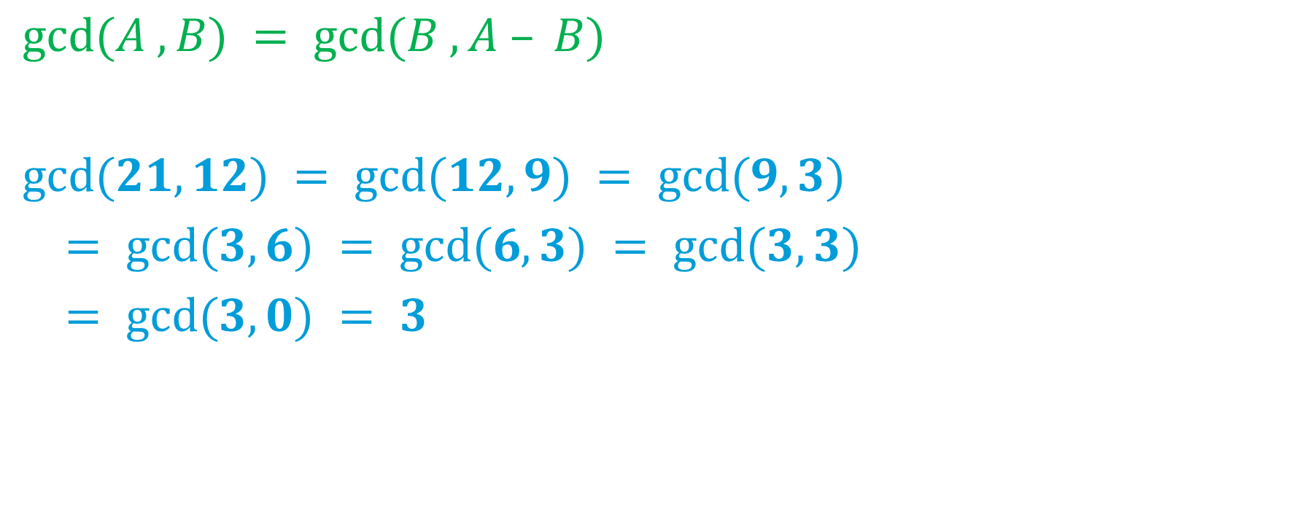
Greatest Common Divisors
$gcd⁡(A , B) = gcd⁡(B , A – B)$
$gcd⁡(21,12) = gcd⁡(12,9) = gcd⁡(9,3)$
$= gcd⁡(3,6) = gcd⁡(6,3) = gcd⁡(3,3)$
$= gcd⁡(3,0) = 3$

Slide 104

Greatest Common Divisors
$gcd⁡(A , B) = gcd⁡(B , A – B)$

Slide 105

Greatest Common Divisors
$gcd⁡(A , B) = gcd⁡(B , A – B)$
$gcd⁡(A , B) = gcd⁡(B , A – kB)$ for any integer $k$.

Slide 106

Greatest Common Divisors
$gcd⁡(A , B) = gcd⁡(B , A – B)$
$gcd⁡(A , B) = gcd⁡(B , A – kB)$ for any integer $k$.
$gcd⁡(A , B) = gcd⁡(B , A mod B)$

Slide 107
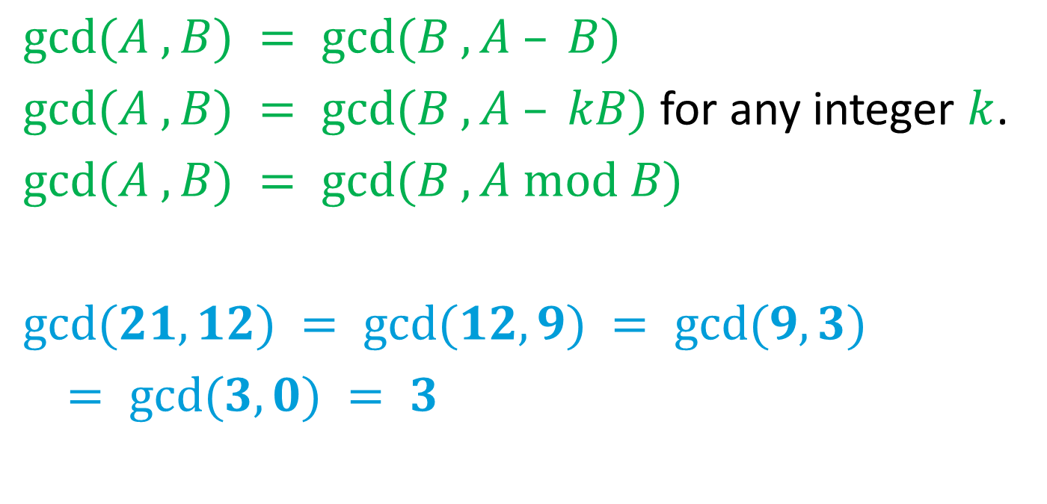
Greatest Common Divisors
$gcd⁡(A , B) = gcd⁡(B , A – B)$
$gcd⁡(A , B) = gcd⁡(B , A – kB)$ for any integer $k$.
$gcd⁡(A , B) = gcd⁡(B , A mod B)$
$gcd⁡(21,12) = gcd⁡(12,9) = gcd⁡(9,3)$
$= gcd⁡(3,0) = 3$

Slide 108

Extended Euclidean Algorithm
Given integers $A$ and $B$, find integers $X$ and $Y$ such that $AX+BY=gcd⁡(A,B)$.

Slide 109
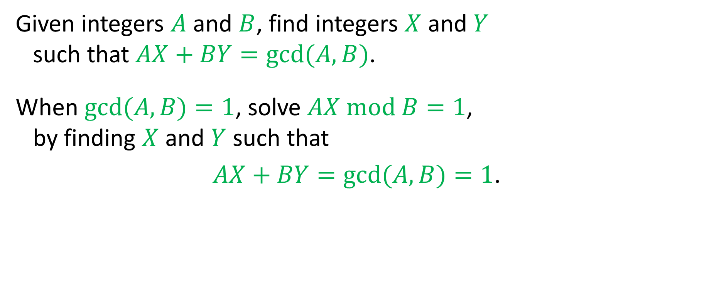
Extended Euclidean Algorithm
Given integers $A$ and $B$, find integers $X$ and $Y$ such that $AX+BY=gcd⁡(A,B)$.
When $gcd⁡(A,B)=1$, solve $AX mod B=1$, by finding $X$ and $Y$ such that
$AX+BY=gcd⁡(A,B)=1$.

Slide 110
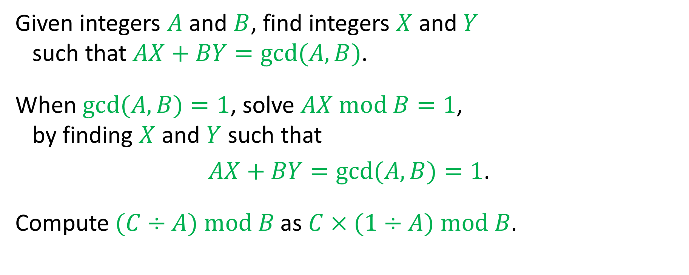
Extended Euclidean Algorithm
Given integers $A$ and $B$, find integers $X$ and $Y$ such that $AX+BY=gcd⁡(A,B)$.
When $gcd⁡(A,B)=1$, solve $AX mod B=1$, by finding $X$ and $Y$ such that
$AX+BY=gcd⁡(A,B)=1$.
Compute $(C÷A) mod B$ as $C×(1÷A) mod B$.

Slide 111
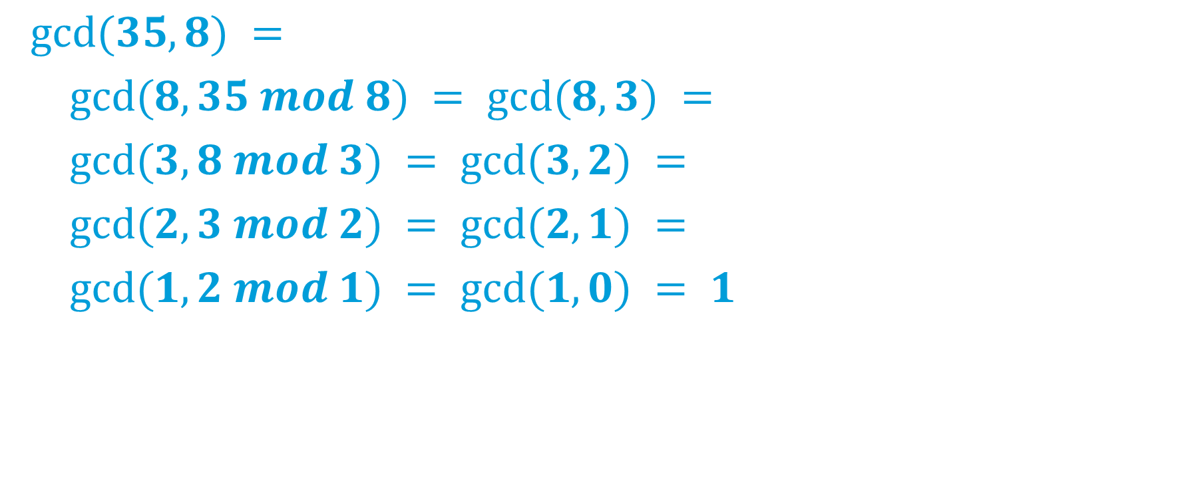
Extended Euclidean Algorithm
$gcd⁡(35, 8) =$
$gcd⁡(8, 35 mod 8) = gcd⁡(8, 3) =$
$gcd⁡(3, 8 mod 3) = gcd⁡(3, 2) =$
$gcd⁡(2, 3 mod 2) = gcd⁡(2, 1) =$
$gcd⁡(1, 2 mod 1) = gcd⁡(1, 0) = 1$

Slide 112
Extended Euclidean Algorithm
35 = 8 × 4 + 3

Slide 113
Extended Euclidean Algorithm
35 = 8 × 4 + 3
8 = 3 × 2 + 2

Slide 114
Extended Euclidean Algorithm
35 = 8 × 4 + 3
8 = 3 × 2 + 2
3 = 2 × 1 + 1

Slide 115
Extended Euclidean Algorithm
35 = 8 × 4 + 3
8 = 3 × 2 + 2
3 = 2 × 1 + 1
2 = 1 × 2 + 0

Slide 116
Extended Euclidean Algorithm
35 = 8 × 4 + 3 3 = 35 – 8 × 4
8 = 3 × 2 + 2 2 = 8 – 3 × 2
3 = 2 × 1 + 1 1 = 3 – 2 × 1
2 = 1 × 2 + 0

Slide 117
Extended Euclidean Algorithm
3 = 35 – 8 × 4
2 = 8 – 3 × 2
1 = 3 – 2 × 1

Slide 118
Extended Euclidean Algorithm
3 = 35 – 8 × 4
2 = 8 – 3 × 2
1 = 3 – 2 × 1 = (35 – 8 × 4) – (8 – 3 × 2) × 1

Slide 119
Extended Euclidean Algorithm
3 = 35 – 8 × 4
2 = 8 – 3 × 2
1 = 3 – 2 × 1 = (35 – 8 × 4) – (8 – 3 × 2) × 1 = (35 – 8 × 4) – (8 – (35 – 8 × 4) × 2) × 1

Slide 120
Extended Euclidean Algorithm
3 = 35 – 8 × 4
2 = 8 – 3 × 2
1 = 3 – 2 × 1 = (35 – 8 × 4) – (8 – 3 × 2) × 1 = (35 – 8 × 4) – (8 – (35 – 8 × 4) × 2) × 1 = 35 × 3 – 8 × 13

Slide 121
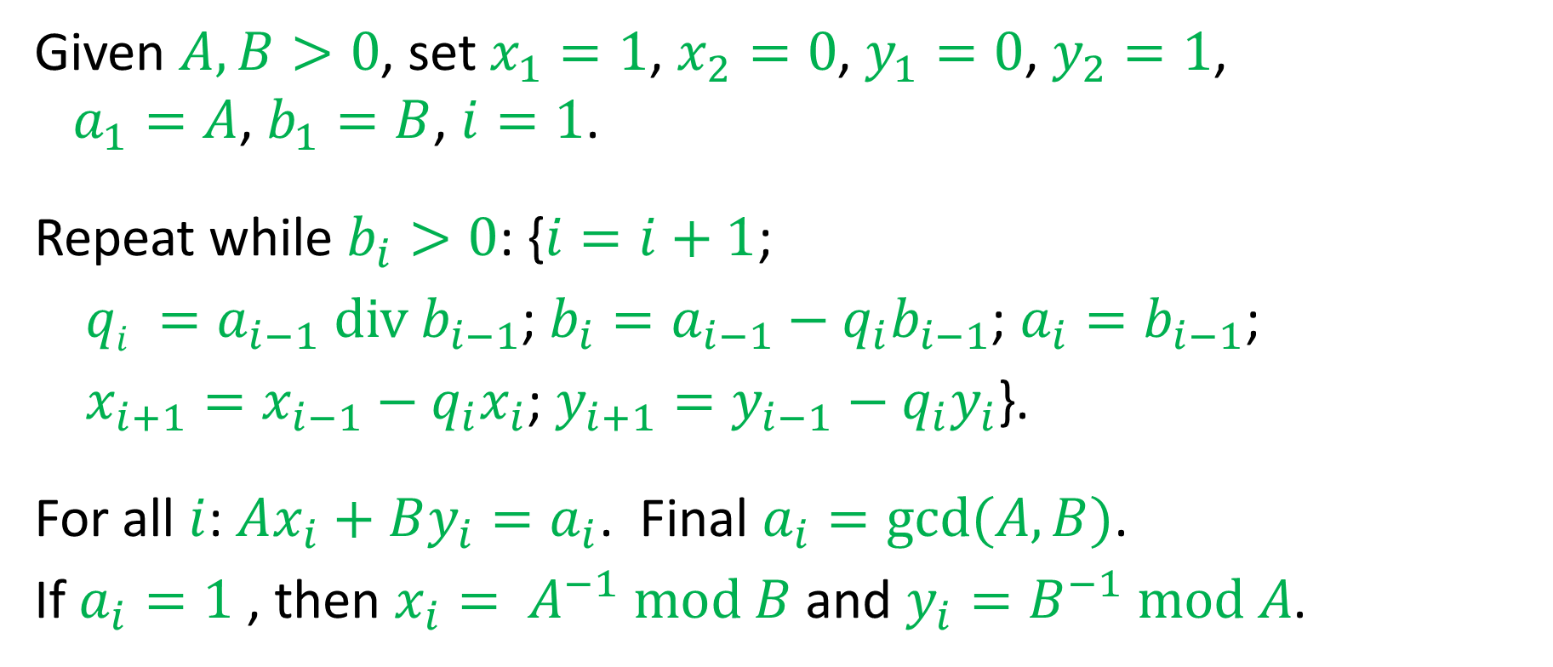
Extended Euclidean Algorithm
Given $A,B>0$, set $x_{1}=1$, $x_{2}=0$, $y_{1}=0$, $y_{2}=1$, $a_{1}=A$, $b_{1}=B$, $i=1$.
Repeat while $b_{i}>0$: {$i=i+1$;
$qi =a_{i−1} div b_{i−1}$; $b_{i}=a_{i−1}−q_{i}b_{i−1}$; $a_{i}=b_{i−1}$;
$x_{i+1}=x_{i−1}−q_{i}x_{i}$; $y_{i+1}=y_{i−1}−q_{i}y_{i}$}.
For all $i$: $Ax_{i}+By_{i}=a_{i}$. Final $a_{i}=gcd⁡(A,B)$.
If $a_{i}=1$ , then $x_{i}= A^{−1} mod B$ and $y_{i}=B^{−1} mod A$.

Slide 122
The Fundamental Equation
$$Z=Y^{X} mod N$$

Slide 123
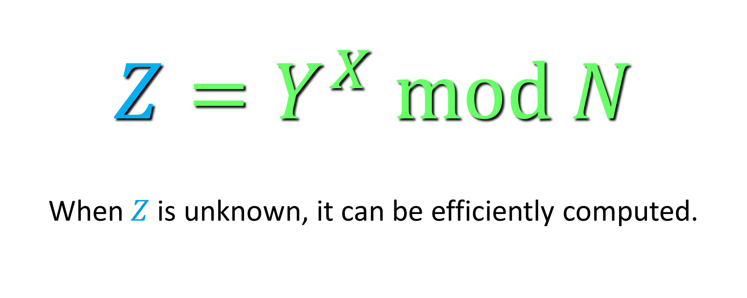
The Fundamental Equation
$$Z=Y^{X} mod N$$
When $Z$ is unknown, it can be efficiently computed.

Slide 124
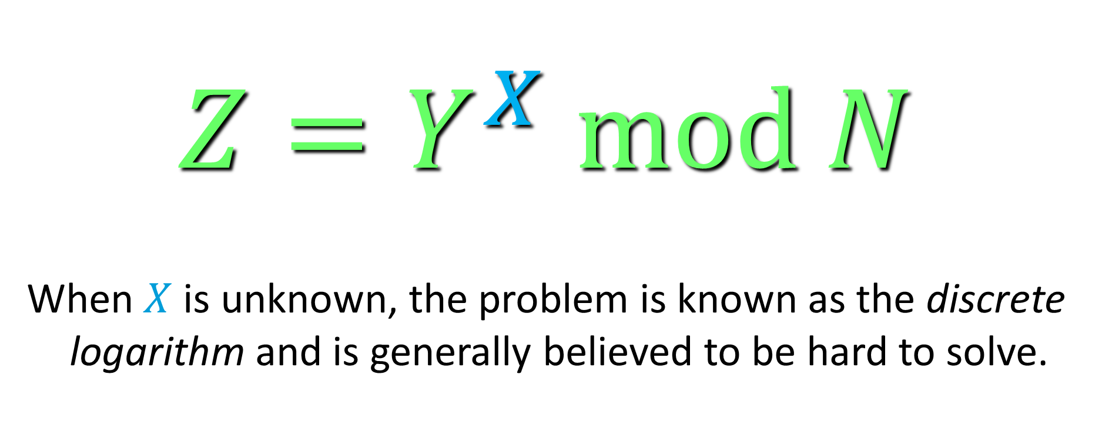
The Fundamental Equation
$$Z=Y^{X} mod N$$
When $X$ is unknown, the problem is known as the discrete logarithm and is generally believed to be hard to solve.

Slide 125
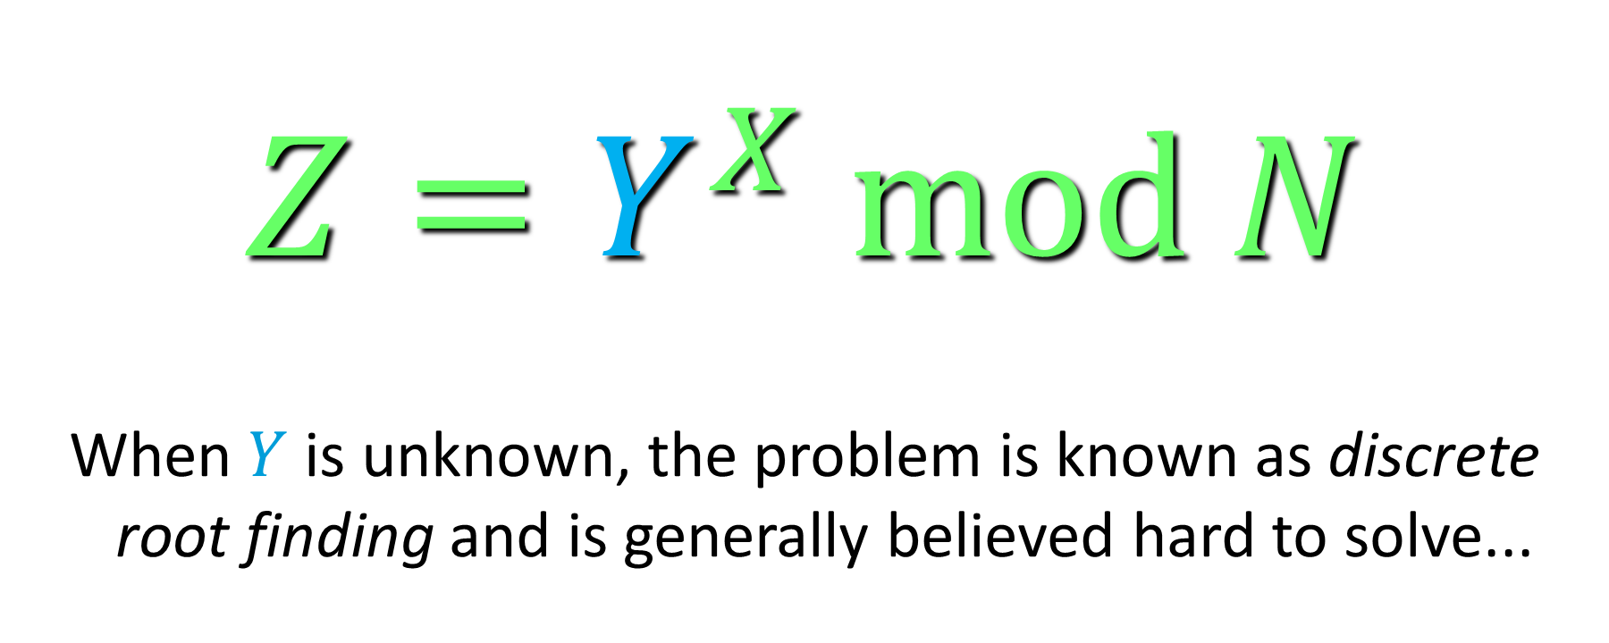
The Fundamental Equation
$$Z=Y^{X} mod N$$
When $Y$ is unknown, the problem is known as discrete root finding and is generally believed hard to solve...

Slide 126
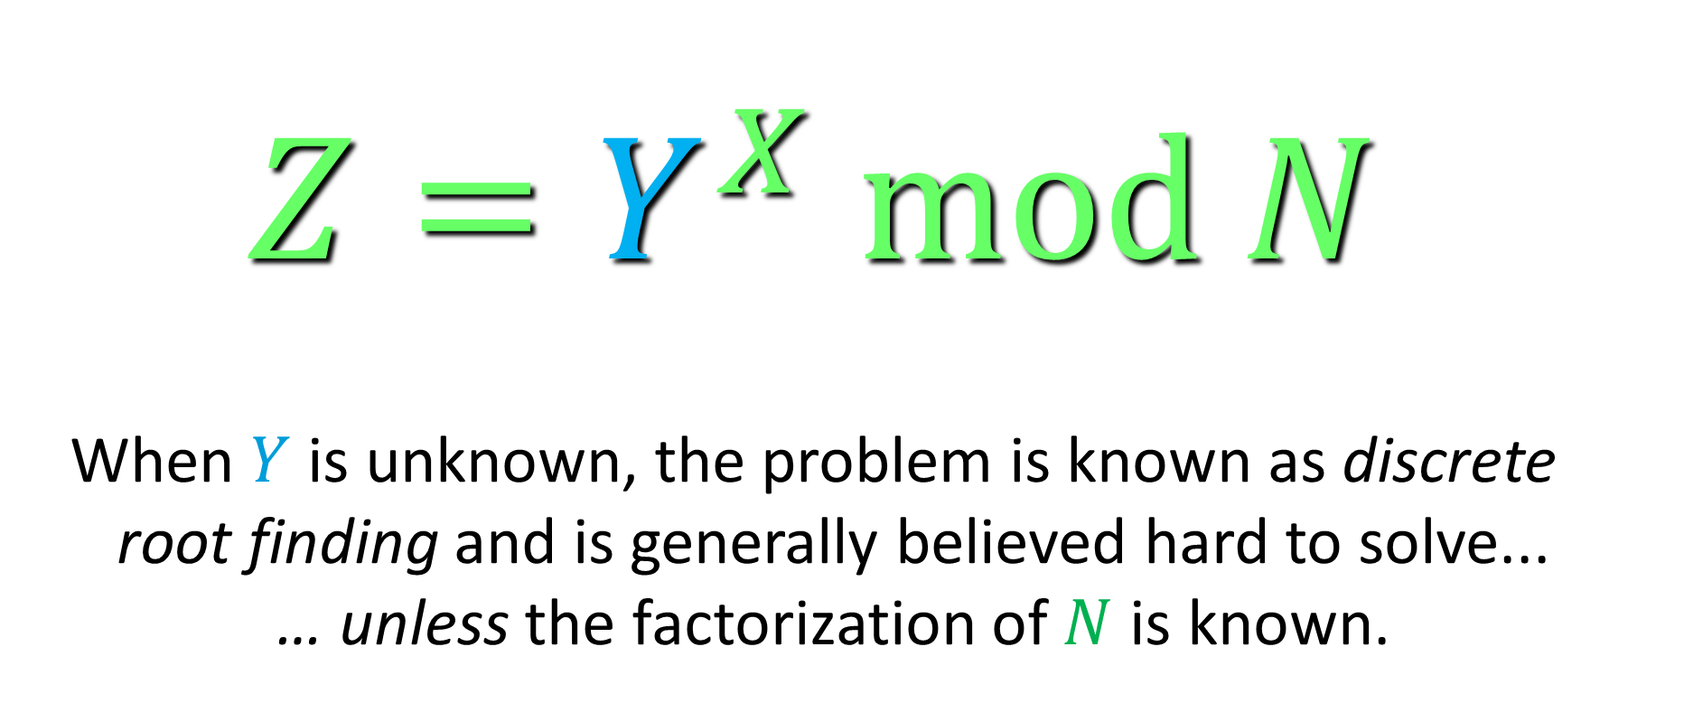
The Fundamental Equation
$$Z=Y^{X} mod N$$
When $Y$ is unknown, the problem is known as discrete root finding and is generally believed hard to solve... … unless the factorization of $N$ is known.

Slide 127
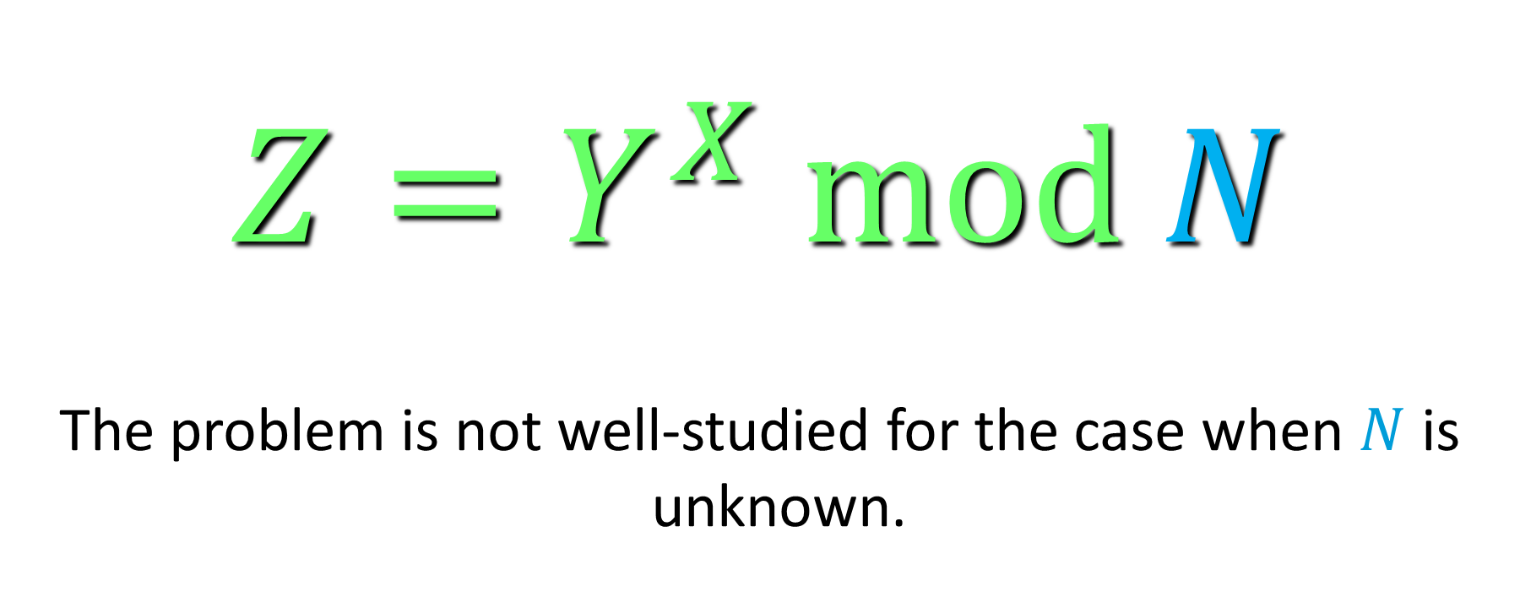
The Fundamental Equation
$$Z=Y^{X} mod N$$
The problem is not well-studied for the case when $N$ is unknown.

Slide 128

Implementation
$$Z=Y^{X} mod N$$

Slide 129

How to compute $Y^{X} mod N$

Slide 130

How to compute $Y^{X} mod N$
Compute $Y^{X}$ and then reduce $mod N$.

Slide 131
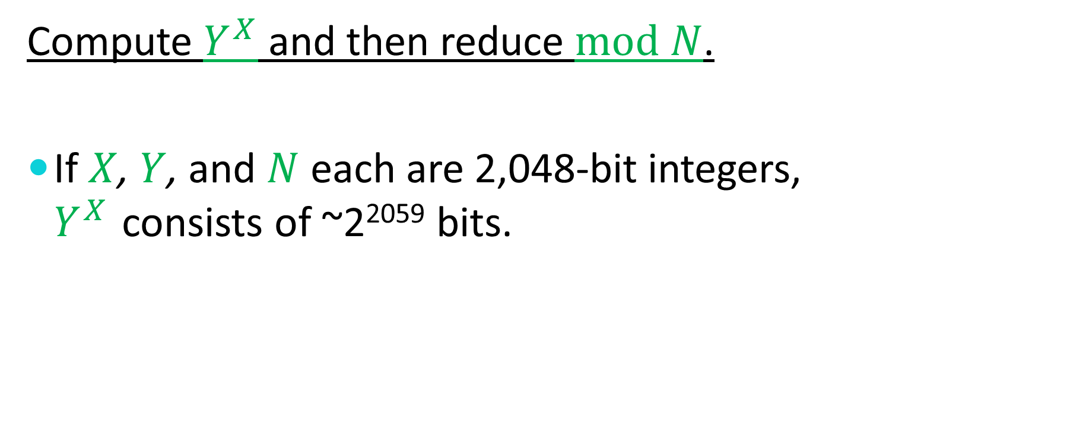
How to compute $Y^{X} mod N$
Compute $Y^{X}$ and then reduce $mod N$.
If $X$, $Y$, and $N$ each are 2,048-bit integers, $Y^{X}$ consists of ~2²⁰⁵⁹ bits.

Slide 132

How to compute $Y^{X} mod N$
Compute $Y^{X}$ and then reduce $mod N$.
If $X$, $Y$, and $N$ each are 2,048-bit integers, $Y^{X}$ consists of ~2²⁰⁵⁹ bits.
Since there are roughly 2²⁵⁰ particles in the universe, storage is a problem.

Slide 133
How to compute $Y^{X} mod N$

Slide 134

How to compute $Y^{X} mod N$
Repeatedly multiplying by $Y$ (followed each time by a reduction modulo $N$) $X$ times solves the storage problem.

Slide 135

How to compute $Y^{X} mod N$
Repeatedly multiplying by $Y$ (followed each time by a reduction modulo $N$) $X$ times solves the storage problem.
However, we would need to perform ~2⁹⁰⁰ 64-bit multiplications per second to complete the computation before the sun burns out.

Slide 136
How to compute $Y^{X} mod N$

Slide 137
How to compute $Y^{X} mod N$
Multiplication by Repeated Doubling

Slide 138

How to compute $Y^{X} mod N$
Multiplication by Repeated Doubling
To compute $X×Y$,

Slide 139

How to compute $Y^{X} mod N$
Multiplication by Repeated Doubling
To compute $X×Y$,
compute $Y$, $2Y$, $4Y$, $8Y$, $16Y$,…

Slide 140

How to compute $Y^{X} mod N$
Multiplication by Repeated Doubling
To compute $X×Y$,
compute $Y$, $2Y$, $4Y$, $8Y$, $16Y$,…
and sum up those values dictated by the binary representation of $X$.

Slide 141

How to compute $Y^{X} mod N$
Multiplication by Repeated Doubling
To compute $X×Y$,
compute $Y$, $2Y$, $4Y$, $8Y$, $16Y$,…
and sum up those values dictated by the binary representation of $X$.
Example: $26Y=2Y+8Y+16Y$.

Slide 142
How to compute $Y^{X} mod N$

Slide 143
How to compute $Y^{X} mod N$
Exponentiation by Repeated Squaring

Slide 144

How to compute $Y^{X} mod N$
Exponentiation by Repeated Squaring
To compute $Y^{X}$,

Slide 145

How to compute $Y^{X} mod N$
Exponentiation by Repeated Squaring
To compute $Y^{X}$,
compute $Y$, $Y^{2}$, $Y^{4}$, $Y^{8}$, $Y^{16}$, …

Slide 146

How to compute $Y^{X} mod N$
Exponentiation by Repeated Squaring
To compute $Y^{X}$,
compute $Y$, $Y^{2}$, $Y^{4}$, $Y^{8}$, $Y^{16}$, …
and multiply those values dictated by the binary representation of $X$.

Slide 147

How to compute $Y^{X} mod N$
Exponentiation by Repeated Squaring
To compute $Y^{X}$,
compute $Y$, $Y^{2}$, $Y^{4}$, $Y^{8}$, $Y^{16}$, …
and multiply those values dictated by the binary representation of $X$.
Example: $Y^{26}=Y^{2}×Y^{8}×Y^{16}$.

Slide 148

How to compute $Y^{X} mod N$
We can now perform a 2,048-bit modular exponentiation using ~3,072 2,048-bit modular multiplications.
2,048 squarings: $y$, $y^{2}$, $y^{4}$, …, $y^{2^{2048}}$
~1024 “ordinary” multiplications

Slide 149

Large-Integer Operations
Addition and Subtraction
Multiplication
Division and Remainder (mod $N$)
Exponentiation

Slide 150
Large-Integer Addition
+

Slide 151
Large-Integer Addition
+

Slide 152
Large-Integer Addition
+

Slide 153
Large-Integer Addition
+

Slide 154
Large-Integer Addition
+

Slide 155
Large-Integer Addition
+

Slide 156

Large-Integer Addition
In general, adding two large integers – each consisting of $n$ small blocks – requires $𝒪(n)$ small-integer additions.
Large-integer subtraction is similar.

Slide 157
Large-Integer Multiplication
×

Slide 158
Large-Integer Multiplication
×

Slide 159
Large-Integer Multiplication
×

Slide 160
Large-Integer Multiplication
×

Slide 161
Large-Integer Multiplication
×

Slide 162
Large-Integer Multiplication
×

Slide 163

Large-Integer Multiplication
In general, multiplying two large integers – each consisting of $n$ small blocks – requires $𝒪(n^{2})$ small-integer multiplications and $𝒪(n)$ large-integer additions.

Slide 164
Large-Integer Squaring
×

Slide 165
Large-Integer Squaring
×

Slide 166
Large-Integer Squaring
×

Slide 167
Large-Integer Squaring
Careful bookkeeping can save nearly half of the small-integer multiplications (and nearly half of the time).

Slide 168


Recall computing $Y^{X} mod N$
About 2/3 of the multiplications required to compute $Y^{X}$ are actually squarings.
Overall, efficient squaring can save about 1/3 of the small multiplications required for modular exponentiation.

Slide 169

Karatsuba Multiplication
$$(Ax+B)(Cx+D)=ACx^{2}+(AD+BC)x+BD$$

Slide 170

Karatsuba Multiplication
$$(Ax+B)(Cx+D)=ACx^{2}+(AD+BC)x+BD$$
Given 4 coefficients $A$, $B$, $C$, and $D$,

Slide 171

Karatsuba Multiplication
$$(Ax+B)(Cx+D)=ACx^{2}+(AD+BC)x+BD$$
Given 4 coefficients $A$, $B$, $C$, and $D$,
we need to compute 3 values:

Slide 172

Karatsuba Multiplication
$$(Ax+B)(Cx+D)=ACx^{2}+(AD+BC)x+BD$$
Given 4 coefficients $A$, $B$, $C$, and $D$,
we need to compute 3 values:
$AC$, $AD+BC$, and $BD$.

Slide 173

Karatsuba Multiplication
$$(Ax+B)(Cx+D)=ACx^{2}+(AD+BC)x+BD$$
Given 4 coefficients $A$, $B$, $C$, and $D$,
we need to compute 3 values:
$AC$, $AD+BC$, and $BD$.

Slide 174

Karatsuba Multiplication
$$(Ax+B)(Cx+D)=ACx^{2}+(AD+BC)x+BD$$
Given 4 coefficients $A$, $B$, $C$, and $D$,
we need to compute 3 values:
$AC$, $AD+BC$, and $BD$.

Slide 175

Karatsuba Multiplication
$$(Ax+B)(Cx+D)=ACx^{2}+(AD+BC)x+BD$$
Given 4 coefficients $A$, $B$, $C$, and $D$,
we need to compute 3 values:
$AC$, $AD+BC$, and $BD$.

Slide 176

Karatsuba Multiplication
$$(Ax+B)(Cx+D)=ACx^{2}+(AD+BC)x+BD$$
4 multiplications, 1 addition

Slide 177

Karatsuba Multiplication
$$(Ax+B)(Cx+D)=ACx^{2}+(AD+BC)x+BD$$
4 multiplications, 1 addition

Slide 178

Karatsuba Multiplication
$$(Ax+B)(Cx+D)=ACx^{2}+(AD+BC)x+BD$$
4 multiplications, 1 addition

Slide 179

Karatsuba Multiplication
$$(Ax+B)(Cx+D)=ACx^{2}+(AD+BC)x+BD$$
4 multiplications, 1 addition

Slide 180

Karatsuba Multiplication
$$(Ax+B)(Cx+D)=ACx^{2}+(AD+BC)x+BD$$
4 multiplications, 1 addition

Slide 181

Karatsuba Multiplication
$$(Ax+B)(Cx+D)=ACx^{2}+(AD+BC)x+BD$$
4 multiplications, 1 addition

Slide 182
Karatsuba Multiplication
$$(Ax+B)(Cx+D)=ACx^{2}+(AD+BC)x+BD$$
4 multiplications, 1 addition

Slide 183

Karatsuba Multiplication
$$(Ax+B)(Cx+D)=ACx^{2}+(AD+BC)x+BD$$
4 multiplications, 1 addition
$$(A+B)(C+D)=AC+AD+BC+BD$$

Slide 184

Karatsuba Multiplication
$$(Ax+B)(Cx+D)=ACx^{2}+(AD+BC)x+BD$$
4 multiplications, 1 addition
$$(A+B)(C+D)=AC+AD+BC+BD$$
$$(A+B)(C+D) –AC –BD=AD+BC$$

Slide 185

Karatsuba Multiplication
$$(Ax+B)(Cx+D)=ACx^{2}+(AD+BC)x+BD$$
4 multiplications, 1 addition
$$(A+B)(C+D)=AC+AD+BC+BD$$
$$(A+B)(C+D) –AC –BD=AD+BC$$
3 multiplications, 2 additions, 2 subtractions

Slide 186

Karatsuba Multiplication
$$(Ax+B)(Cx+D)=ACx^{2}+(AD+BC)x+BD$$
4 multiplications, 1 addition
$$(A+B)(C+D)=AC+AD+BC+BD$$
$$(A+B)(C+D) –AC –BD=AD+BC$$
3 multiplications, 2 additions, 2 subtractions

Slide 187

Karatsuba Multiplication
$$(Ax+B)(Cx+D)=ACx^{2}+(AD+BC)x+BD$$
4 multiplications, 1 addition
$$(A+B)(C+D)=AC+AD+BC+BD$$
$$(A+B)(C+D) –AC –BD=AD+BC$$
3 multiplications, 2 additions, 2 subtractions

Slide 188

Karatsuba Multiplication
$$(Ax+B)(Cx+D)=ACx^{2}+(AD+BC)x+BD$$
4 multiplications, 1 addition
$$(A+B)(C+D)=AC+AD+BC+BD$$
$$(A+B)(C+D) –AC –BD=AD+BC$$
3 multiplications, 2 additions, 2 subtractions

Slide 189

Karatsuba Multiplication
$$(Ax+B)(Cx+D)=ACx^{2}+(AD+BC)x+BD$$
4 multiplications, 1 addition
$$(A+B)(C+D)=AC+AD+BC+BD$$
$$(A+B)(C+D) –AC –BD=AD+BC$$
3 multiplications, 2 additions, 2 subtractions

Slide 190

Karatsuba Multiplication
$$(Ax+B)(Cx+D)=ACx^{2}+(AD+BC)x+BD$$
4 multiplications, 1 addition
$$(A+B)(C+D)=AC+AD+BC+BD$$
$$(A+B)(C+D) –AC –BD=AD+BC$$
3 multiplications, 2 additions, 2 subtractions

Slide 191

Karatsuba Multiplication
$$(Ax+B)(Cx+D)=ACx^{2}+(AD+BC)x+BD$$
4 multiplications, 1 addition
$$(A+B)(C+D)=AC+AD+BC+BD$$
$$(A+B)(C+D) –AC –BD=AD+BC$$
3 multiplications, 2 additions, 2 subtractions

Slide 192

Karatsuba Multiplication
$$(Ax+B)(Cx+D)=ACx^{2}+(AD+BC)x+BD$$
4 multiplications, 1 addition
$$(A+B)(C+D)=AC+AD+BC+BD$$
$$(A+B)(C+D) –AC –BD=AD+BC$$
3 multiplications, 2 additions, 2 subtractions

Slide 193
Karatsuba Multiplication
$$(Ax+B)(Cx+D)=ACx^{2}+(AD+BC)x+BD$$
4 multiplications, 1 addition
$$(A+B)(C+D)=AC+AD+BC+BD$$
$$(A+B)(C+D) –AC –BD=AD+BC$$
3 multiplications, 2 additions, 2 subtractions

Slide 194
Karatsuba Multiplication
This can be done on integers as well as on polynomials, but it’s not as nice on integers because of carries.
The larger the integers, the larger the benefit.

Slide 195

Karatsuba Multiplication
$(A×2^{k}+B)(C×2^{k}+D)=$
$AC×2^{2k}+\left(AD+BC\right)×2^{k} + BD$
4 multiplications, 1 addition
$$(A+B)(C+D)=AC+AD+BC+BD$$
$$(A+B)(C+D)–AC–BD=AD+BC$$
3 multiplications, 2 additions, 2 subtractions

Slide 196

Chinese Remaindering
If $X=A mod P$, $X= B mod Q$, and $gcd⁡(P,Q)=1$, then $X mod (PQ)$ can be computed as
$$X=AQ(Q^{−1} mod P)+BP(P^{−1} mod Q).$$

Slide 197

Chinese Remaindering
If $N=PQ$, then a computation $mod N$ can be accomplished by performing the same computation $mod P$ and again $mod Q$ and then using Chinese Remaindering to derive the answer to the $mod N$ computation.

Slide 198

Chinese Remaindering
Since modular exponentiation of $n$-bit integers requires $𝒪(n^{3})$ time, performing two modular exponentiations on half size values requires only about one quarter of the time of a single $n$-bit modular exponentiation.

Slide 199

Modular Reduction
Generally, computing $(A×B) mod N$ requires much more than twice the time to compute $A×B$.

Slide 200

Modular Reduction
Generally, computing $(A×B) mod N$ requires much more than twice the time to compute $A×B$.
Large-integer division is …

Slide 201

Modular Reduction
Generally, computing $(A×B) mod N$ requires much more than twice the time to compute $A×B$.
Large-integer division is …
slow

Slide 202

Modular Reduction
Generally, computing $(A×B) mod N$ requires much more than twice the time to compute $A×B$.
Large-integer division is …
slow … cumbersome

Slide 203

Modular Reduction
Generally, computing $(A×B) mod N$ requires much more than twice the time to compute $A×B$.
Large-integer division is …
slow … cumbersome … disgusting

Slide 204

Modular Reduction
Generally, computing $(A×B) mod N$ requires much more than twice the time to compute $A×B$.
Large-integer division is …
slow … cumbersome … disgusting … wretched

Slide 205
The Montgomery Method
The Montgomery Method performs a domain transform to a domain in which the modular reduction operation can be achieved by multiplication and simple truncation.
Since a single modular exponentiation requires many modular multiplications and reductions, transforming the arguments is well justified.

Slide 206

Montgomery Multiplication
Let $A$, $B$, and $M$ be $n$-block integers represented in base $x$ with $0  M  x^{n}$.
Let $R=x^{n}$. $gcd(R,M)=1$.
The Montgomery Product of $A$ and $B$ modulo $M$ is the integer $ABR^{−1} mod M$.
Let $M^{′}= –M^{−1} mod R$ and $S=ABM^{′} mod R$.
Fact: $(AB+SM)/R  ABR^{−1} (mod M)$.

Slide 207

Using the Montgomery Product
The Montgomery Product $ABR^{−1} mod M$ can be computed in the time required for two ordinary large-integer multiplications.
Montgomery transform: $AAR mod M$.
The Montgomery product of $(AR mod M)$ and $(BR mod M)$ is $(ABR mod M)$.

Slide 208
One-Way Functions
$$Z=Y^{X} mod N$$
When $X$ is unknown, the problem is known as the discrete logarithm and is generally believed to be hard to solve.

Slide 209

One-Way Functions
Informally, $F : X→ Y$is a one-way if
Given $x$, $y=F(x)$ is easily computable.
Given $y$, it is difficult to find any $x$ for which $y=F(x)$.

Slide 210

One-Way Functions
The family of functions
$$F_{Y,N}\left(X\right)=Y^{X} mod N$$
is believed to be one-way for most $N$ and $Y$.

Slide 211

One-Way Functions
The family of functions
$$F_{Y,N}\left(X\right)=Y^{X} mod N$$
is believed to be one-way for most $N$ and $Y$.
No one has ever proven a function to be one-way, and doing so would, at a minimum, yield as a consequence that $PNP$.

Slide 212

One-Way Functions
When viewed as a two-argument function, the (candidate) one-way function
$$F_{N}(Y,X)=Y^{X} mod N$$
also satisfies a useful additional property which has been termed quasi-commutivity:
$$F(F(Y,X_{1}),X_{2})=F(F(Y,X_{2}),X_{1})$$
since $Y^{X_{1}X_{2}}=Y^{X_{2}X_{1}}$.

Slide 213
More on Quasi-Commutivity
Quasi-commutivity has additional applications.
decentralized digital signatures
membership testing
digital time-stamping

Slide 214
Diffie-Hellman Key Exchange
Alice
Bob

Slide 215


Diffie-Hellman Key Exchange
Alice
Randomly select a large integer $a$ and send $A= Ya mod N$.
Bob
Randomly select a large integer $b$ and send $B=Y^{b} mod N$.

Slide 216
Diffie-Hellman Key Exchange
Alice Bob
A
B

Slide 217
Diffie-Hellman Key Exchange
Alice
Randomly select a large integer $a$ and send $A= Ya mod N$.
Bob
Randomly select a large integer $b$ and send $B=Y^{b} mod N$.

Slide 218


Diffie-Hellman Key Exchange
Alice
Randomly select a large integer $a$ and send $A= Ya mod N$.
Compute the key $K=B^{a} mod N$.
Bob
Randomly select a large integer $b$ and send $B=Y^{b} mod N$.
Compute the key $K=A^{b} mod N$.

Slide 219

Diffie-Hellman Key Exchange
Alice
Randomly select a large integer $a$ and send $A= Ya mod N$.
Compute the key $K=B^{a} mod N$.
Bob
Randomly select a large integer $b$ and send $B=Y^{b} mod N$.
Compute the key $K=A^{b} mod N$.
$$B^{a}=Y^{ba}=Y^{ab}=A^{b}$$

Slide 220
Diffie-Hellman Key Exchange

Slide 221
Diffie-Hellman Key Exchange
What does Eve see?

Slide 222

Diffie-Hellman Key Exchange
What does Eve see?
$Y$, $Y^{a}$, $Y^{b}$

Slide 223

Diffie-Hellman Key Exchange
What does Eve see?
$Y$, $Y^{a}$, $Y^{b}$
… but the exchanged key is $Y^{ab}$.

Slide 224

Diffie-Hellman Key Exchange
What does Eve see?
$Y$, $Y^{a}$, $Y^{b}$
… but the exchanged key is $Y^{ab}$.
Belief: Given $Y$, $Y^{a}$, $Y^{b}$ it is difficult to compute $Y^{ab}$.

Slide 225

Diffie-Hellman Key Exchange
What does Eve see?
$Y$, $Y^{a}$, $Y^{b}$
… but the exchanged key is $Y^{ab}$.
Belief: Given $Y$, $Y^{a}$, $Y^{b}$ it is difficult to compute $Y^{ab}$.
Contrast with discrete logarithm assumption: Given $Y$, $Y^{a}$ it is difficult to compute $a$.

