Slide 1
Practical Aspects of Modern Cryptography
Assignment 2 Solutions

Slide 2
Problem 1

Slide 3
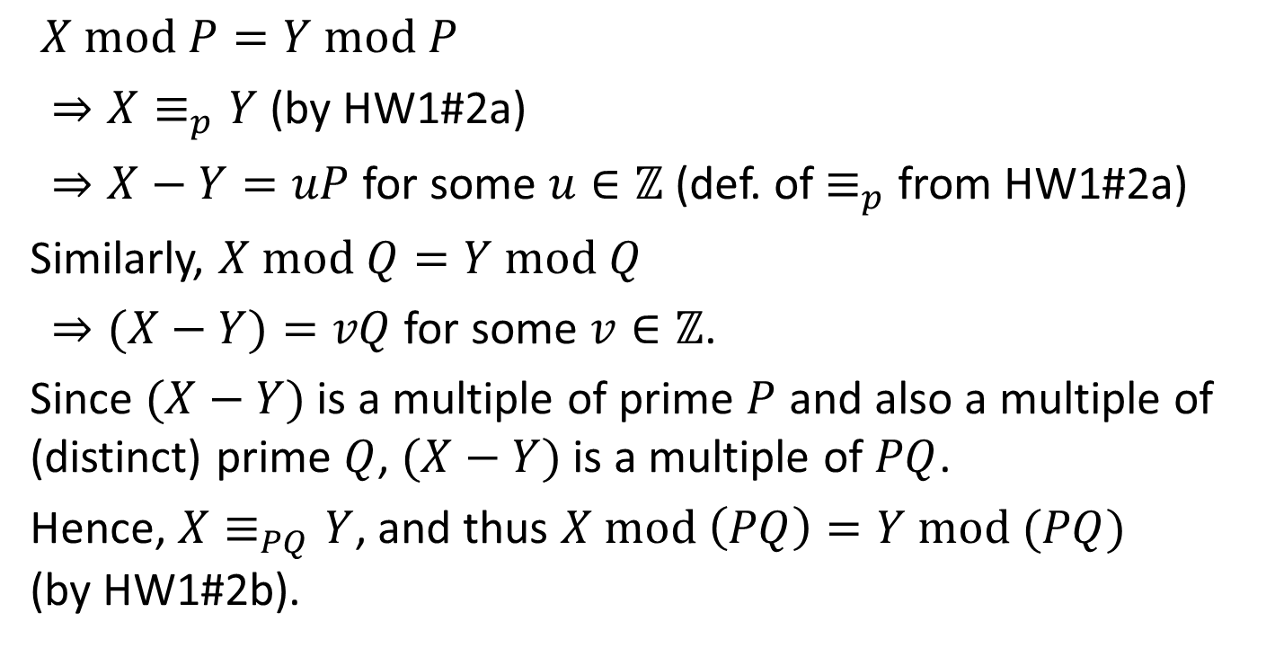
Problem 1a
$X mod P=Y mod P$
$⇒X≡_{p}Y$ (by HW1#2a)
$⇒X−Y=uP$ for some $u∈ℤ$ (def. of $≡_{p}$ from HW1#2a)
Similarly, $X mod Q=Y mod Q$
$⇒(X−Y)=vQ$ for some $v∈ℤ$.
Since $(X−Y)$ is a multiple of prime $P$ and also a multiple of (distinct) prime $Q$, $(X−Y)$ is a multiple of $PQ$.
Hence, $X≡_{PQ}Y$, and thus $X mod \left(PQ\right)=Y mod (PQ)$ (by HW1#2b).

Slide 4
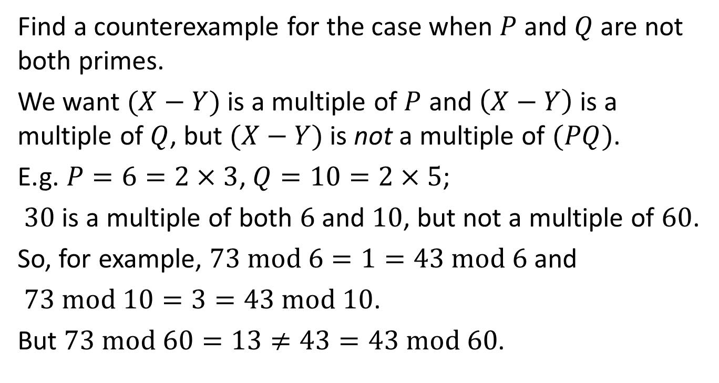
Problem 1b
Find a counterexample for the case when $P$ and $Q$ are not both primes.
We want $(X−Y)$ is a multiple of $P$ and $\left(X−Y\right)$ is a multiple of $Q$, but $(X−Y)$ is not a multiple of $(PQ)$.
E.g. $P=6=2×3$, $Q=10=2×5$;
$30$ is a multiple of both $6$ and $10$, but not a multiple of $60$.
So, for example, $73 mod 6=1=43 mod 6$ and
$73 mod 10=3=43 mod 10$.
But $73 mod 60=13≠43=43 mod 60$.

Slide 5
Problem 2

Slide 6
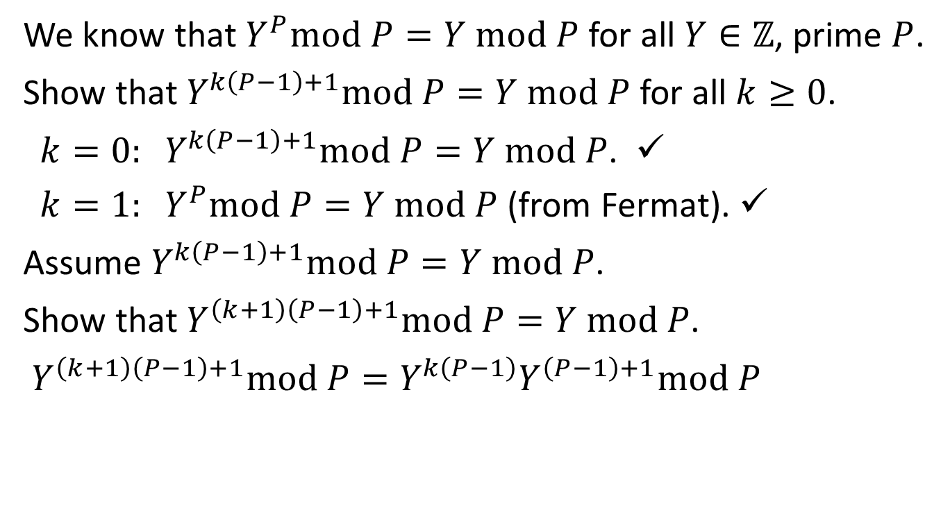
Problem 2
We know that $Y^{P}mod P=Y mod P$ for all $Y∈ℤ$, prime $P$.
Show that $Y^{k\left(P−1\right)+1}mod P=Y mod P$ for all $k≥0$.
$k=0: Y^{k\left(P−1\right)+1}mod P=Y mod P$. ✓
$k=1: Y^{P}mod P=Y mod P$ (from Fermat). ✓
Assume $Y^{k\left(P−1\right)+1}mod P=Y mod P$.
Show that $Y^{\left(k+1\right)\left(P−1\right)+1}mod P=Y mod P$.
$Y^{\left(k+1\right)\left(P−1\right)+1}mod P=Y^{k\left(P−1\right)}Y^{\left(P−1\right)+1}mod P$

Slide 7
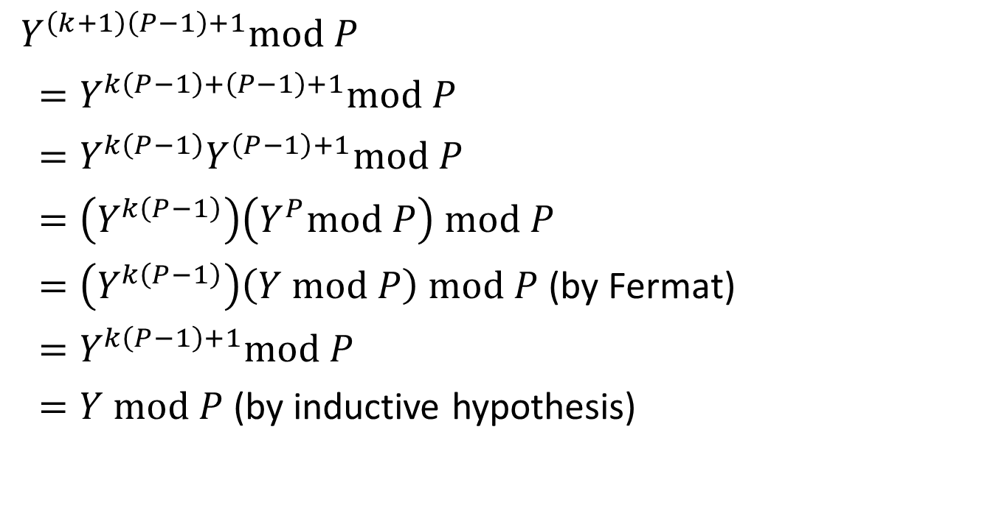
Problem 2
$Y^{\left(k+1\right)\left(P−1\right)+1}mod P$
$=Y^{k\left(P−1\right)+\left(P−1\right)+1}mod P$
$=Y^{k\left(P−1\right)}Y^{\left(P−1\right)+1}mod P$
$=\left(Y^{k\left(P−1\right)}\right)\left(Y^{P}mod P\right) mod P$
$=\left(Y^{k\left(P−1\right)}\right)\left(Y mod P\right) mod P$ (by Fermat)
$=Y^{k\left(P−1\right)+1}mod P$
$=Y mod P$ (by inductive hypothesis)

Slide 8
Problem 3

Slide 9
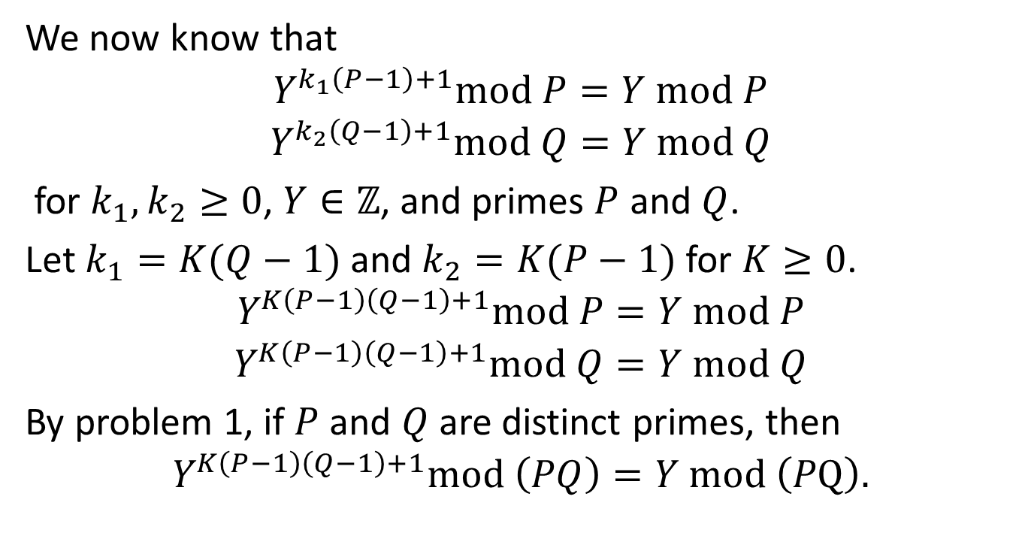
Problem 3
We now know that
$$Y^{k_{1}\left(P−1\right)+1}mod P=Y mod P$$
$$Y^{k_{2}\left(Q−1\right)+1}mod Q=Y mod Q$$
for $k_{1},k_{2}≥0$, $Y∈ℤ$, and primes $P$ and $Q$.
Let $k_{1}=K(Q−1)$ and $k_{2}=K(P−1)$ for $K≥0$.
$$Y^{K\left(P−1\right)\left(Q−1\right)+1}mod P=Y mod P$$
$$Y^{K\left(P−1\right)\left(Q−1\right)+1}mod Q=Y mod Q$$
By problem 1, if $P$ and $Q$ are distinct primes, then
$$Y^{K\left(P−1\right)\left(Q−1\right)+1}mod \left(PQ\right)=Y mod \left(PQ\right).$$

Slide 10
Problem 4

Slide 11
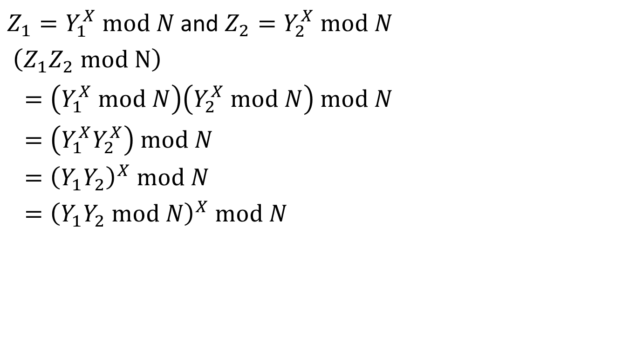
Problem 4a
$Z_{1}=Y_{1}^{X} mod N$ and $Z_{2}=Y_{2}^{X} mod N$
$\left(Z_{1}Z_{2} mod N\right)$
$=\left(Y_{1}^{X} mod N\right)\left(Y_{2}^{X} mod N\right) mod N$
$=\left(Y_{1}^{X}Y_{2}^{X}\right) mod N$
$={\left(Y_{1}Y_{2}\right)}^{X} mod N$
$={\left(Y_{1}Y_{2} mod N\right)}^{X} mod N$

Slide 12
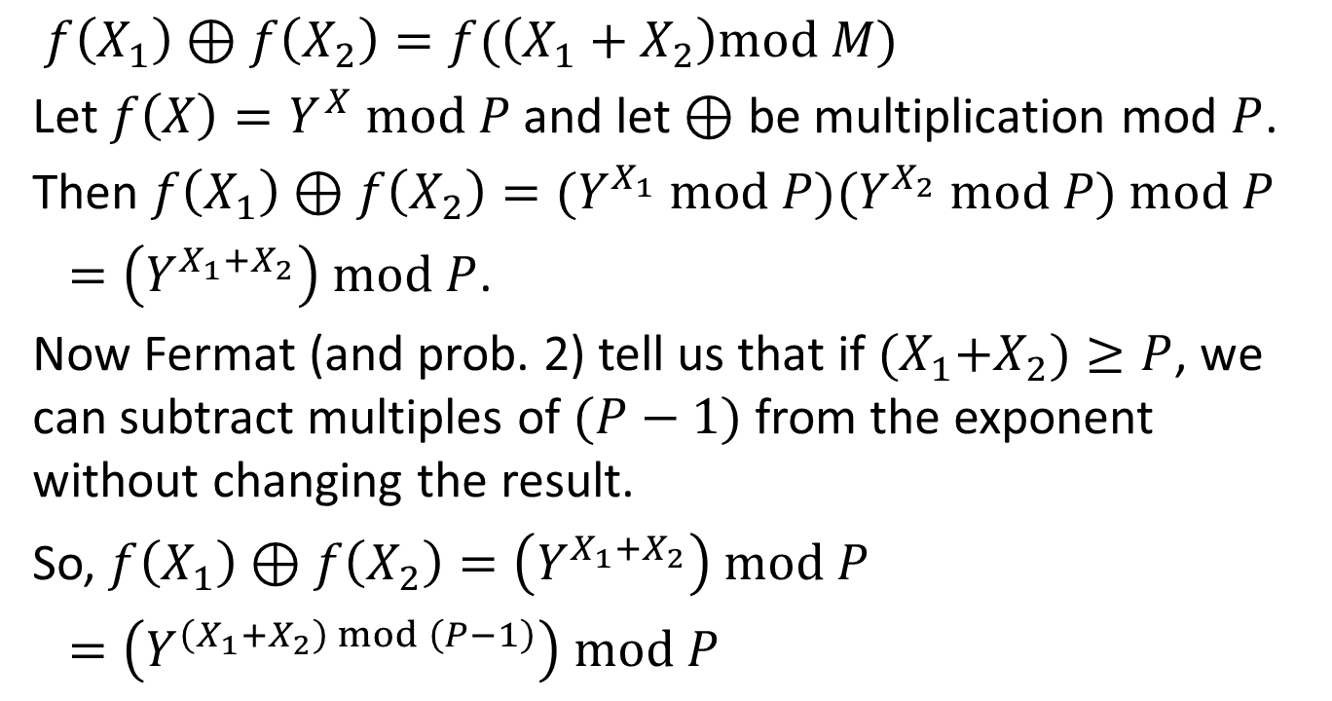
Problem 4b
$f\left(X_{1}\right)⊕f\left(X_{2}\right)=f(\left(X_{1}+X_{2}\right)mod M)$
Let $f\left(X\right)=Y^{X} mod P$ and let $⊕$ be multiplication mod $P$.
Then $f\left(X_{1}\right)⊕f\left(X_{2}\right)={(Y}^{X_{1}} mod P){(Y}^{X_{2}} mod P) mod P$
$=\left(Y^{X_{1}+X_{2}}\right) mod P$.
Now Fermat (and prob. 2) tell us that if ${(X}_{1}+X_{2})≥P$, we can subtract multiples of $(P−1)$ from the exponent without changing the result.
So, $f\left(X_{1}\right)⊕f\left(X_{2}\right)=\left(Y^{X_{1}+X_{2}}\right) mod P$
$=\left(Y^{\left(X_{1}+X_{2}\right) mod \left(P−1\right)}\right) mod P$

Slide 13
Problem 5

Slide 14
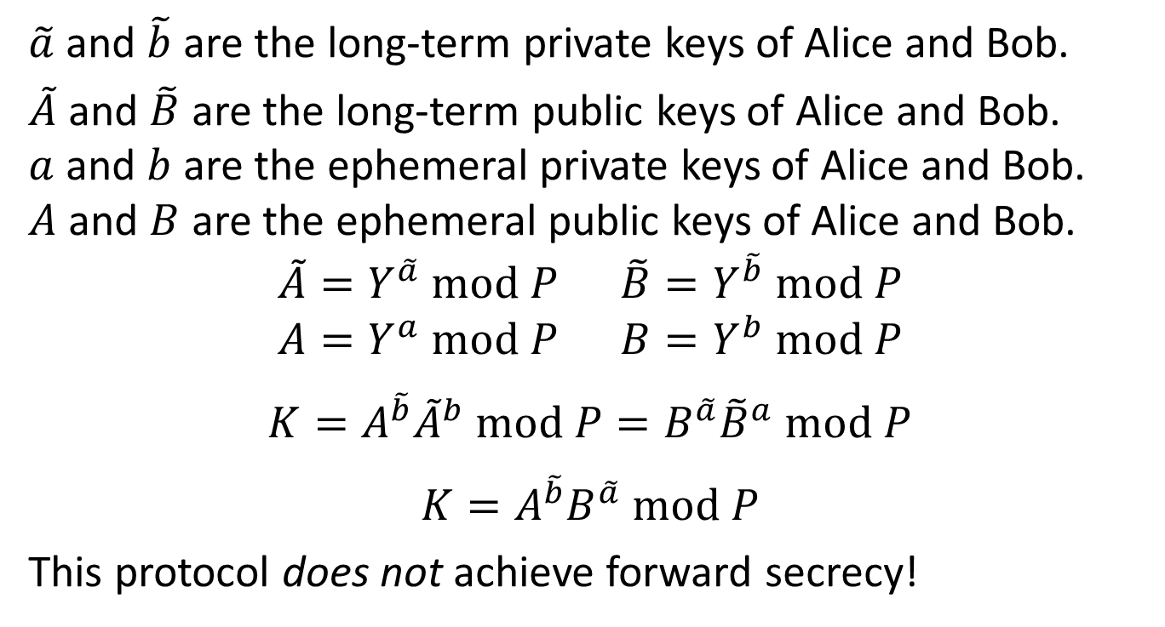
Problem 5
$\tilde{a}$ and $\tilde{b}$ are the long-term private keys of Alice and Bob.
$\tilde{A}$ and $\tilde{B}$ are the long-term public keys of Alice and Bob. $a$ and $b$ are the ephemeral private keys of Alice and Bob. $A$ and $B$ are the ephemeral public keys of Alice and Bob.
$$\tilde{A}=Y^{\tilde{a}} mod P \tilde{B}=Y^{\tilde{b}} mod P$$
$$A=Y^{a} mod P B=Y^{b} mod P$$
$$K=A^{\tilde{b}}{\tilde{A}}^{b} mod P=B^{\tilde{a}}{\tilde{B}}^{a} mod P$$
$$K=A^{\tilde{b}}B^{\tilde{a}} mod P$$
This protocol does not achieve forward secrecy!

Slide 15
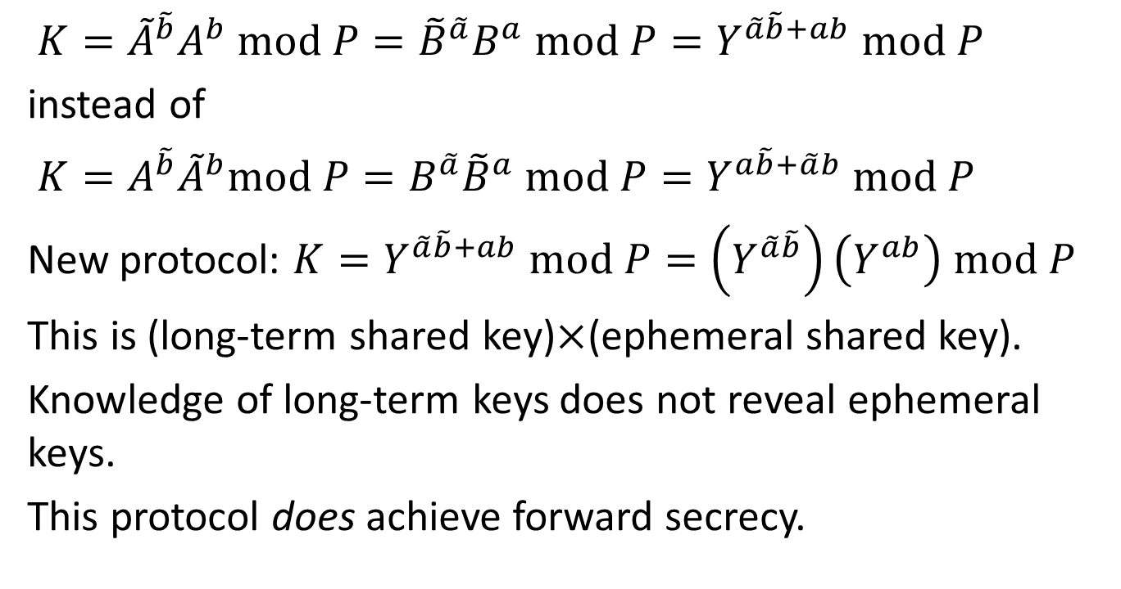
Problem 5a
$K={\tilde{A}}^{\tilde{b}}A^{b} mod P={\tilde{B}}^{\tilde{a}}B^{a} mod P=Y^{\tilde{a}\tilde{b}+ab} mod P$
instead of
$K={A^{\tilde{b}}\tilde{A}}^{b}mod P=B^{\tilde{a}}{\tilde{B}}^{a} mod P=Y^{a\tilde{b}+\tilde{a}b} mod P$
New protocol: $K=Y^{\tilde{a}\tilde{b}+ab} mod P=\left(Y^{\tilde{a}\tilde{b}}\right)\left(Y^{ab}\right) mod P$
This is (long-term shared key)$×$(ephemeral shared key).
Knowledge of long-term keys does not reveal ephemeral keys.
This protocol does achieve forward secrecy.

Slide 16
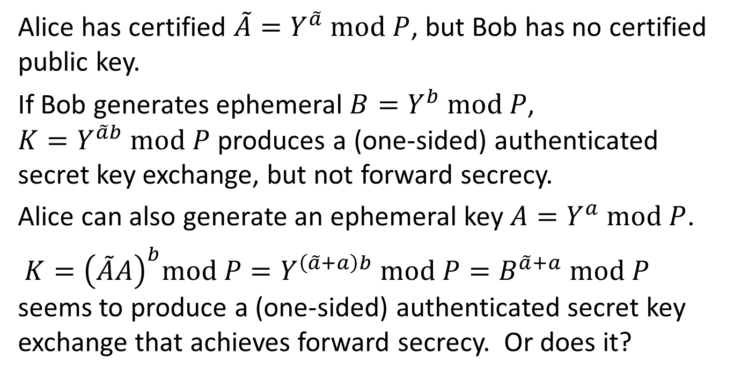
Problem 5b
Alice has certified $\tilde{A}=Y^{\tilde{a}} mod P$, but Bob has no certified public key.
If Bob generates ephemeral $B=Y^{b} mod P$, $K=Y^{\tilde{a}b} mod P$ produces a (one-sided) authenticated secret key exchange, but not forward secrecy.
Alice can also generate an ephemeral key $A=Y^{a} mod P$.
$K={\left(\tilde{A}A\right)}^{b}mod P=Y^{\left(\tilde{a}+a\right)b} mod P=B^{\tilde{a}+a} mod P$ seems to produce a (one-sided) authenticated secret key exchange that achieves forward secrecy. Or does it?

Slide 17
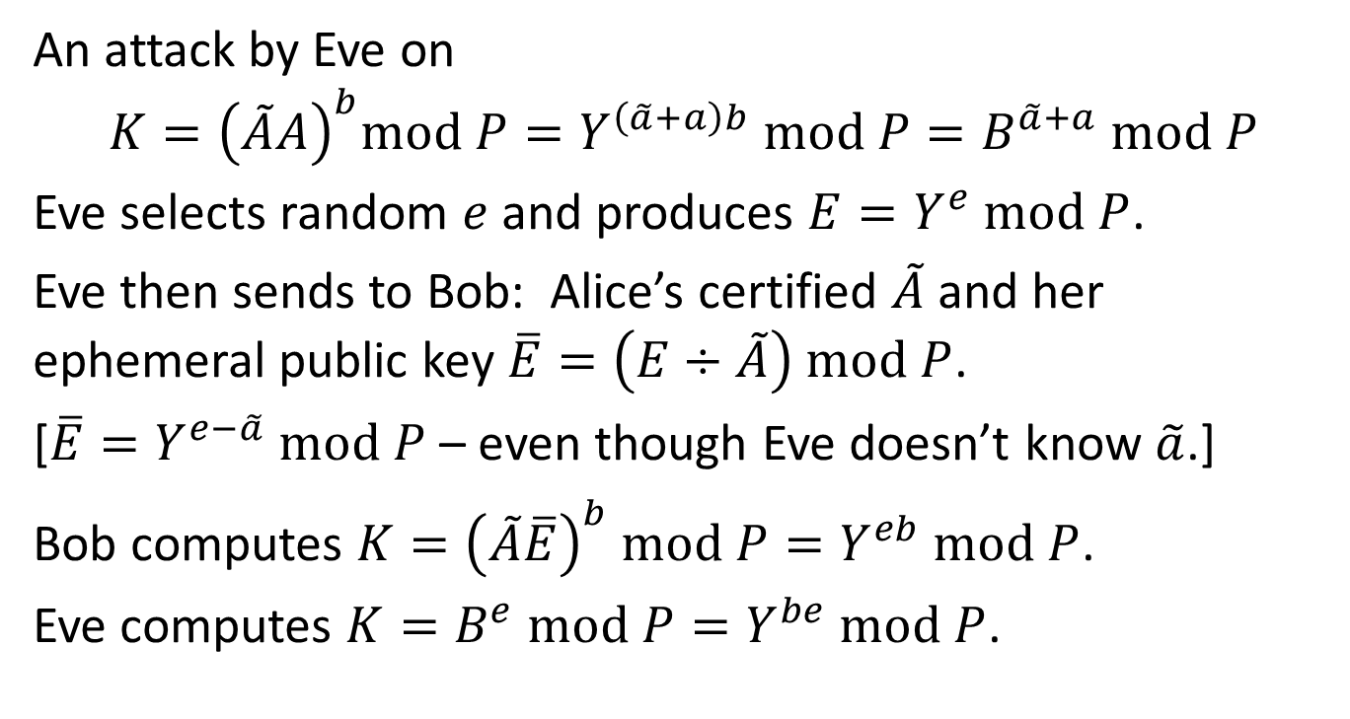
Problem 5b
An attack by Eve on
$$K={\left(\tilde{A}A\right)}^{b}mod P=Y^{\left(\tilde{a}+a\right)b} mod P=B^{\tilde{a}+a} mod P$$
Eve selects random $e$ and produces $E=Y^{e} mod P$.
Eve then sends to Bob: Alice’s certified $\tilde{A}$ and her ephemeral public key $\overline{E}=\left(E÷\tilde{A}\right) mod P$.
[$\overline{E}=Y^{e−\tilde{a}} mod P$ – even though Eve doesn’t know $\tilde{a}$.]
Bob computes $K={\left(\tilde{A}\overline{E}\right)}^{b} mod P=Y^{eb} mod P$.
Eve computes $K=B^{e} mod P=Y^{be} mod P$.

Slide 18
Problem 5b
Instead of $K={(Y}^{\tilde{a}b} ×Y^{ab}) mod P$, one option is
$K=\left(Y^{\tilde{a}b}+Y^{ab}\right) mod P$.
Bob computes $K=\left({\tilde{A}}^{b}+A^{b}\right) mod P$.
Alice computes $K=\left(B^{\tilde{a}}+B^{a}\right) mod P$.
This does (we believe) provide a secret key exchange with (one-sided) authentication and forward secrecy.

