Slide 1
Practical Aspects of Modern Cryptography
Assignment 1 Solutions

Slide 2
Problem 1

Slide 3
Problem 1
Group 1:
Group 2:
Group 3:
Group 4:
The Positive INTEGERS
1 5 9 13 17 21 25 29 …
2 6 10 14 18 22 26 30 …
3 7 11 15 19 23 27 31 …
4 8 12 16 20 24 28 32 …

Slide 4
Problem 1
Group 1 integers all have the form: $4u+1$, where $u∈ℤ$.
The product of two Group 1 integers looks like
$$\left(4u+1\right)\left(4v+1\right)=16uv+4u+4v+1=4\left(4uv+u+v\right)+1$$
which is a Group 1 integer.

Slide 5
Problem 1
Group 3 integers all have the form: $4u−1$, where $u∈ℤ$.
The product of two Group 3 integers looks like
$$\left(4u−1\right)\left(4v−1\right)=16uv−4u−4v+1=4\left(4uv−u−v\right)+1$$
which is a Group 1 integer.

Slide 6
Problem 1
Group 1:
Group 2:
Group 3:
The Positive INTEGERS
1 4 7 10 13 16 19 22 …
2 5 8 11 14 17 20 23 …
3 6 9 12 15 18 21 24 …

Slide 7
Problem 1
Group 1 integers all have the form: $3u+1$, where $u∈ℤ$.
The product of two Group 1 integers looks like
$$\left(3u+1\right)\left(3v+1\right)=9uv+3u+3v+1=3\left(3uv+u+v\right)+1$$
which is a Group 1 integer.

Slide 8
Problem 1
Group 2 integers all have the form: $3u−1$, where $u∈ℤ$.
The product of two Group 2 integers looks like
$$\left(3u−1\right)\left(3v−1\right)=9uv−3u−3v+1=3\left(3uv−u−v\right)+1$$
which is a Group 1 integer.

Slide 9
Problem 1
Group 1:
Group 2:
The Positive INTEGERS
1 3 5 7 9 11 13 15 …
2 4 6 8 10 12 14 16 …

Slide 10
Problem 1
Group 1:
Group 2:
Group 3:
Group 4:
Group 5:
Group 6:
The Positive INTEGERS
1 7 13 19 25 31 37 43 …
2 8 14 20 26 32 38 44 …
3 9 15 21 27 33 39 45 …
4 10 16 22 28 34 40 46 …
5 11 17 23 29 35 41 47 …
6 12 18 24 30 36 42 48 …

Slide 11
Problem 2

Slide 12
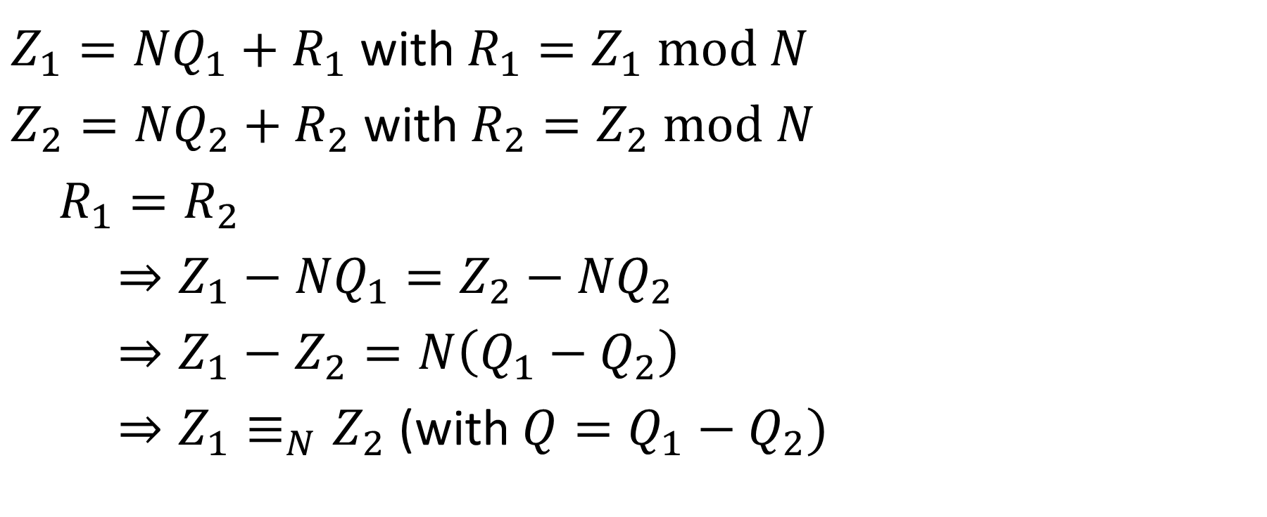
Problem 2
$Z_{1}={NQ}_{1}+R_{1}$ with $R_{1}=Z_{1} mod N$
$Z_{2}={NQ}_{2}+R_{2}$ with $R_{2}=Z_{2} mod N$
$R_{1}=R_{2}$
$⇒Z_{1}−{NQ}_{1}=Z_{2}−{NQ}_{2}$
$⇒Z_{1}−Z_{2}=N\left(Q_{1}−Q_{2}\right)$
$⇒Z_{1}≡_{N}Z_{2}$ (with $Q=Q_{1}−Q_{2})$

Slide 13
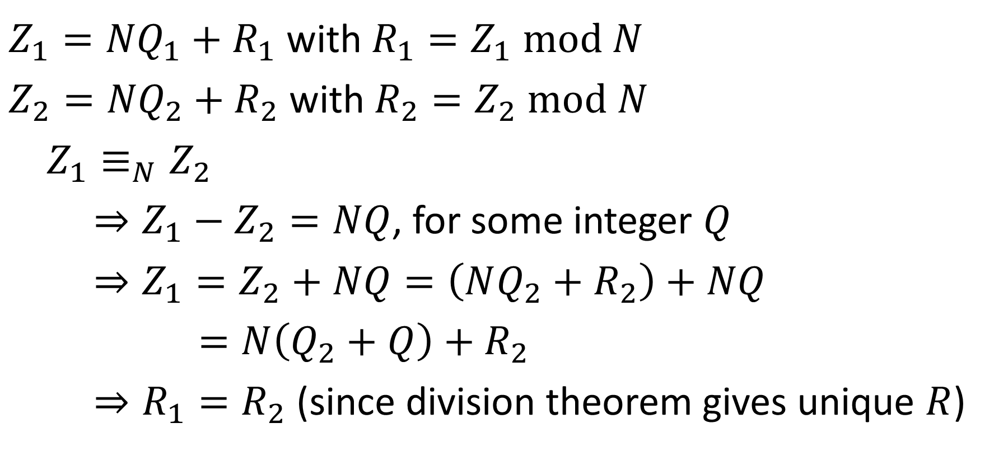
Problem 2
$Z_{1}={NQ}_{1}+R_{1}$ with $R_{1}=Z_{1} mod N$
$Z_{2}={NQ}_{2}+R_{2}$ with $R_{2}=Z_{2} mod N$
$Z_{1}≡_{N}Z_{2}$
$⇒Z_{1}−Z_{2}=NQ$, for some integer $Q$
$⇒Z_{1}=Z_{2}+NQ=\left(NQ_{2}+R_{2}\right)+NQ$
$=N\left(Q_{2}+Q\right)+R_{2}$
$⇒R_{1}=R_{2}$ (since division theorem gives unique $R$)

Slide 14
Problem 3

Slide 15
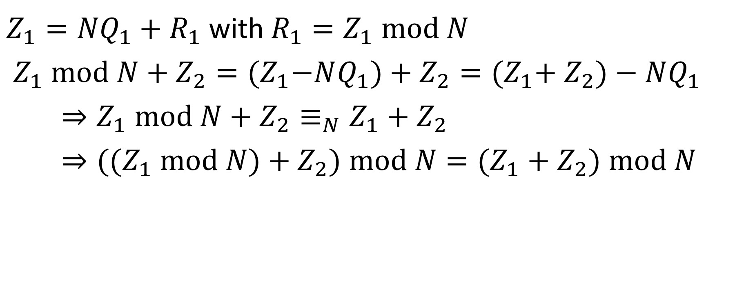
Problem 3
$Z_{1}={NQ}_{1}+R_{1}$ with $R_{1}=Z_{1} mod N$
$Z_{1} mod N+Z_{2}={(Z}_{1}−NQ_{1})+Z_{2}={(Z}_{1}+ Z_{2})−NQ_{1}$
$⇒Z_{1} mod N+Z_{2}≡_{N}{Z_{1}+Z}_{2}$
$⇒{((Z}_{1} mod N)+Z_{2}) mod N={(Z_{1}+Z}_{2}) mod N$

Slide 16
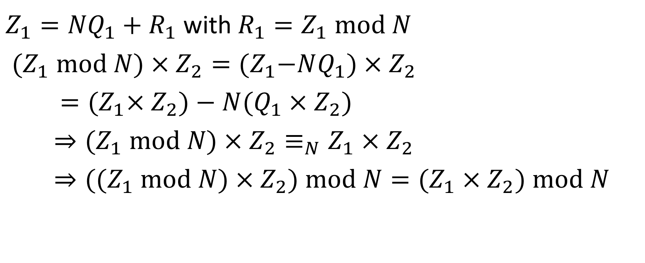
Problem 3
$Z_{1}={NQ}_{1}+R_{1}$ with $R_{1}=Z_{1} mod N$
${(Z}_{1} mod N)×Z_{2}={(Z}_{1}−NQ_{1})×Z_{2}$
$={(Z}_{1}×Z_{2})−N(Q_{1}×Z_{2})$
$⇒{(Z}_{1} mod N)×Z_{2}≡_{N}Z_{1}×Z_{2}$
$⇒{((Z}_{1} mod N)×Z_{2}) mod N={(Z_{1}×Z}_{2}) mod N$

Slide 17
Problem 4

Slide 18
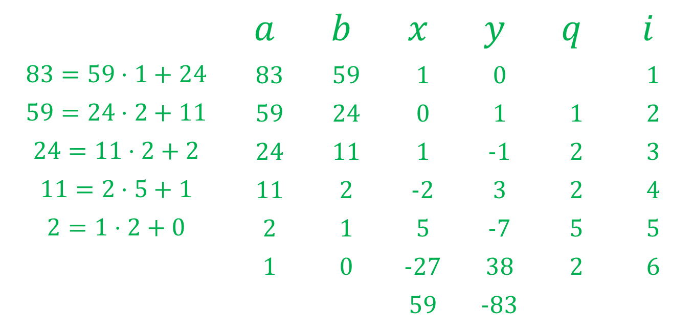
Problem 4
 | $$a$$ | $$b$$ | $$x$$ | $$y$$ | $$q$$ | $$i$$
$$83=59⋅1+24$$ | 83 | 59 | 1 | 0 |  | 1
$$59=24⋅2+11$$ | 59 | 24 | 0 | 1 | 1 | 2
$$24=11⋅2+2$$ | 24 | 11 | 1 | -1 | 2 | 3
$$11=2⋅5+1$$ | 11 | 2 | -2 | 3 | 2 | 4
$$2=1⋅2+0$$ | 2 | 1 | 5 | -7 | 5 | 5
 | 1 | 0 | -27 | 38 | 2 | 6
 |  |  | 59 | -83

Slide 19
Problem 4
 | $$a$$ | $$b$$ | $$x$$ | $$y$$ | $$q$$ | $$i$$
$$83=59⋅1+24$$ | 83 | 59 | 1 | 0 |  | 1
$$59=24⋅2+11$$ | 59 | 24 | 0 | 1 | 1 | 2
$$24=11⋅2+2$$ | 24 | 11 | 1 | -1 | 2 | 3
$$11=2⋅5+1$$ | 11 | 2 | -2 | 3 | 2 | 4
$$2=1⋅2+0$$ | 2 | 1 | 5 | -7 | 5 | 5
 | 1 | 0 | -27 | 38 | 2 | 6
 |  |  | 59 | -83

Slide 20
Problem 4
 | $$a$$ | $$b$$ | $$x$$ | $$y$$ | $$q$$ | $$i$$
$$83=59⋅1+24$$ | 83 | 59 | 1 | 0 |  | 1
$$59=24⋅2+11$$ | 59 | 24 | 0 | 1 | 1 | 2
$$24=11⋅2+2$$ | 24 | 11 | 1 | -1 | 2 | 3
$$11=2⋅5+1$$ | 11 | 2 | -2 | 3 | 2 | 4
$$2=1⋅2+0$$ | 2 | 1 | 5 | -7 | 5 | 5
 | 1 | 0 | -27 | 38 | 2 | 6
 |  |  | 59 | -83
$$\left(83\right)⋅\left(−27\right)+\left(59\right)⋅\left(38\right)=1$$

Slide 21
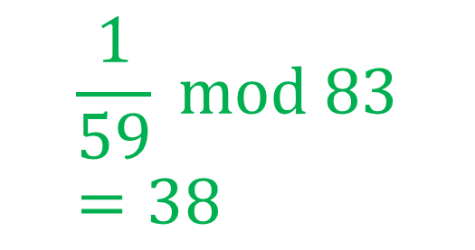
Problem 4
 | $$a$$ | $$b$$ | $$x$$ | $$y$$ | $$q$$ | $$i$$
$$83=59⋅1+24$$ | 83 | 59 | 1 | 0 |  | 1
$$59=24⋅2+11$$ | 59 | 24 | 0 | 1 | 1 | 2
$$24=11⋅2+2$$ | 24 | 11 | 1 | -1 | 2 | 3
$$11=2⋅5+1$$ | 11 | 2 | -2 | 3 | 2 | 4
$$2=1⋅2+0$$ | 2 | 1 | 5 | -7 | 5 | 5
 | 1 | 0 | -27 | 38 | 2 | 6
 |  |  | 59 | -83
$$\frac{1}{59} mod 83=38$$
$$\left(83\right)⋅\left(−27\right)+\left(59\right)⋅\left(38\right)=1$$

Slide 22
Problem 5

Slide 23
Problem 5
Alice
Randomly select a large integer $a$ and send $A= Ya mod N$.
Compute the key $K=B^{a} mod N$.
Bob
Randomly select a large integer $b$ and send $B=Y^{b} mod N$.
Compute the key $K=A^{b} mod N$.
$$B^{a}=Y^{ba}=Y^{ab}=A^{b}$$

Slide 24
Problem 5
Alice
Randomly select a large integer $a$ and send $A=Ya mod N$.
Compute the key $K=Ba mod N$.
Bob
Randomly select a large integer $b$ and send $B=Yb mod N$.
Compute the key $K=Ab mod N$.
$$Ba=Yba=Yab=Ab$$

Slide 25
Problem 5
What does Eve see?
$Y$, $Y^{a}$, $Y^{b}$
… but the exchanged key is $Y^{ab}$.
Belief: Given $Y$, $Y^{a}$, $Y^{b}$ it is difficult to compute Y^{ab}.

Slide 26
Problem 5
What does Eve see?
$Y$, $Ya$, $Yb$ (all $mod p$)
… but the exchanged key is $Yab$.
But given $Ya$ and $Y$, one can use the Extended Euclidean Algorithm to compute $Ya÷Y mod p$ to determine $a mod p$.
From $Yb mod p$ and $a mod p$, $Yab mod p$ can be computed.
So the key exchange is insecure.

