Slide 1
Development Engineering
CSEP 590 B
Engineering the Immunization Cold Chain
Richard Anderson

Slide 2
Today
Announcements
Some general themes
Mapping the immunization cold chain
Discussion of Uganda deployment

Slide 3
Announcements
Discussion Sections – Zoom – Attend one
Wednesday: 3:00-4:00 pm
Wednesday: 5:00-6:00 pm
Homework 1, Due April 13.
Submit by email
Course grade based on 7 of 9 assignments
Defer questions on HW1 until end of class
Reading: Global Goods Software for the Immunization Cold Chain, W. Brunette, R. Anderson, et al., Under submission.

Slide 4
Course Schedule
Date | Topic | Lead
April 6 | Engineering the Vaccine Cold Chain
April 13 | Community Cellular Networks | Kurtis Heimerl
April 20 | Remote Temperature Monitoring | Martin Lukac, Nexleaf
April 27 | Election Monitoring | James Long
May 4 | Voice Based Social Networks | Aditya Vashistha
May 11 | TBD
May 18 | Fintech for Rural Networks | Jenny Aker
May 26 | TBD
June 1 | Open Data Kit | Waylon Brunette

Slide 5
Development Engineering
Technological interventions to improve human and economic conditions in low-resource settings
An engineering discipline aimed at addressing global inequity
Develop principles for design, introduction, scaling, and sustainability of Global Good technology

Slide 6
Engineering
Domain Understanding
General Principles

Slide 7
Case study approach
Engage with individual examples
Extract transferable knowledge

Slide 8
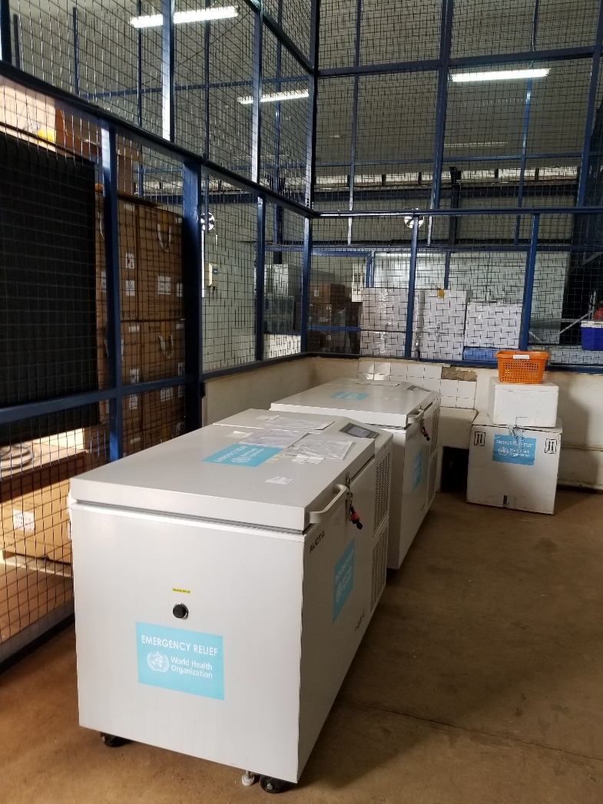
Today – The immunization cold chain

Slide 9
General Issues
Top down management of global development
Global Goods software
Designing for users

Slide 10
Global Development
Global organizations set policy
Donors
Country ministries

Slide 11
Global Goods Software
Software systems for global development
Health data reporting, medical records, human resource management, health insurance, logistics
Goal of Global Goods software is to have a positive impact
Generally, Open Source, but different models
Many projects depend on donor support
Projects often have a fairly long history
Barriers to entry

Slide 12
Designing for the user
Common conflict between “purchaser of system” and user of the system
Information systems may make overall system more efficient, but the actual users do more work
In development setting, Global Organizations and Country Ministries set policy and are the “customers”

Slide 13
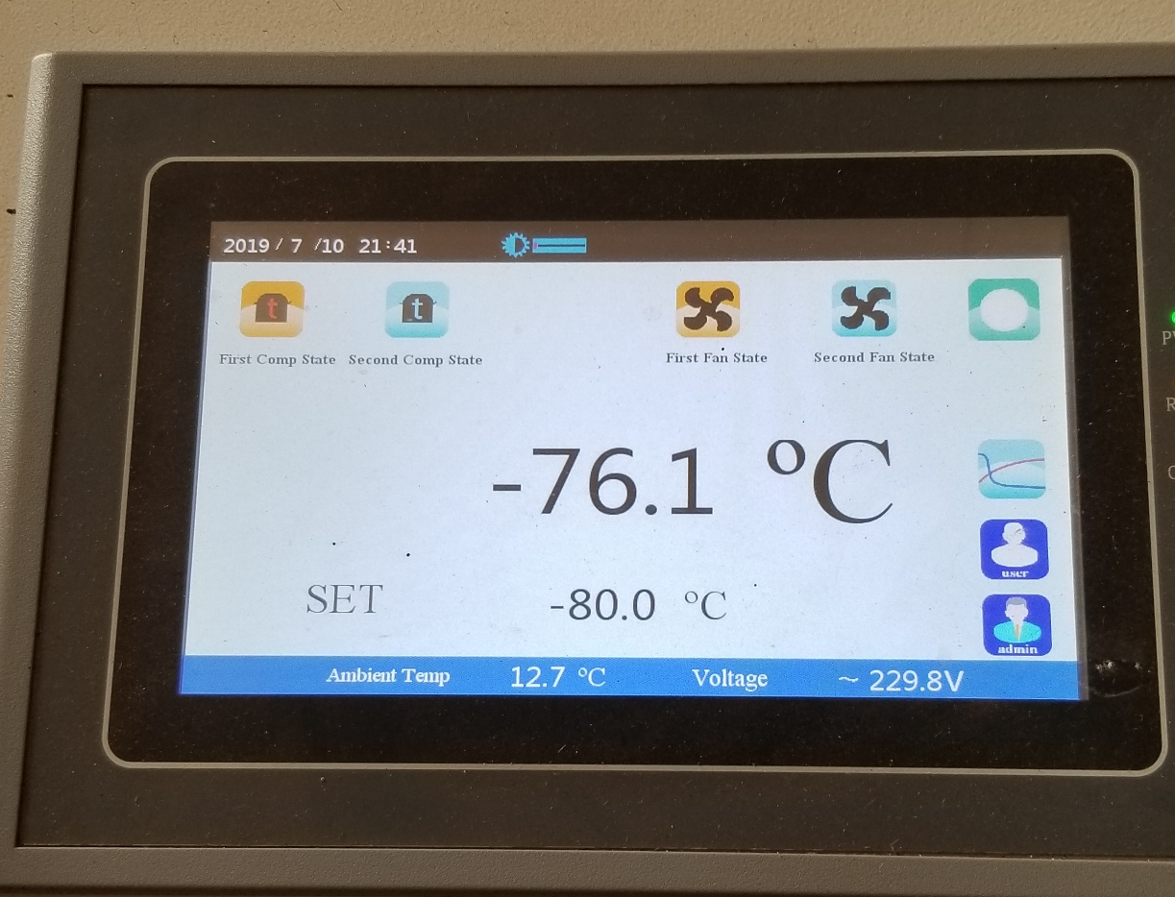
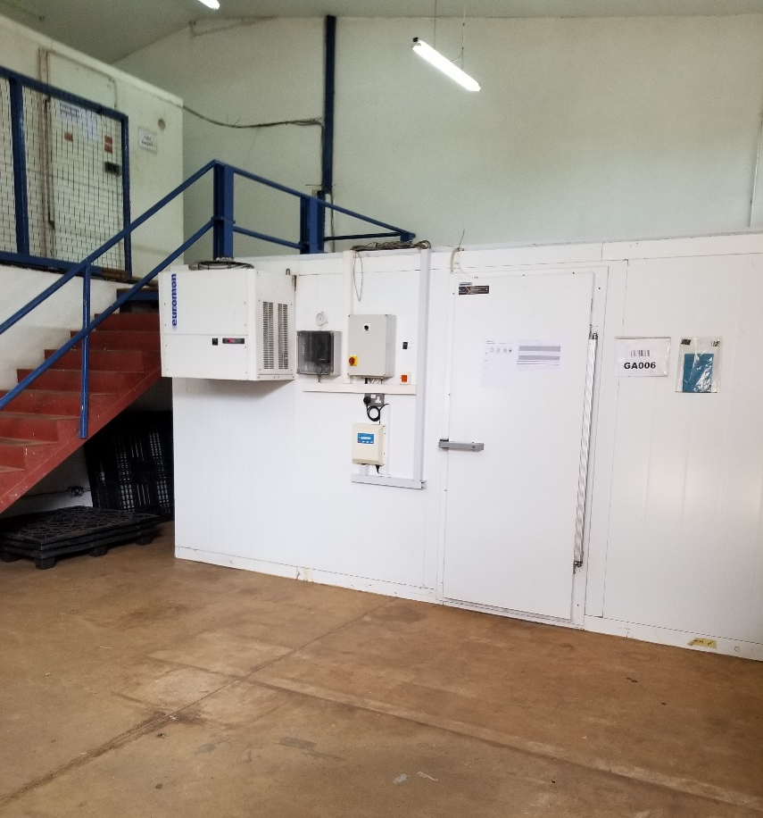
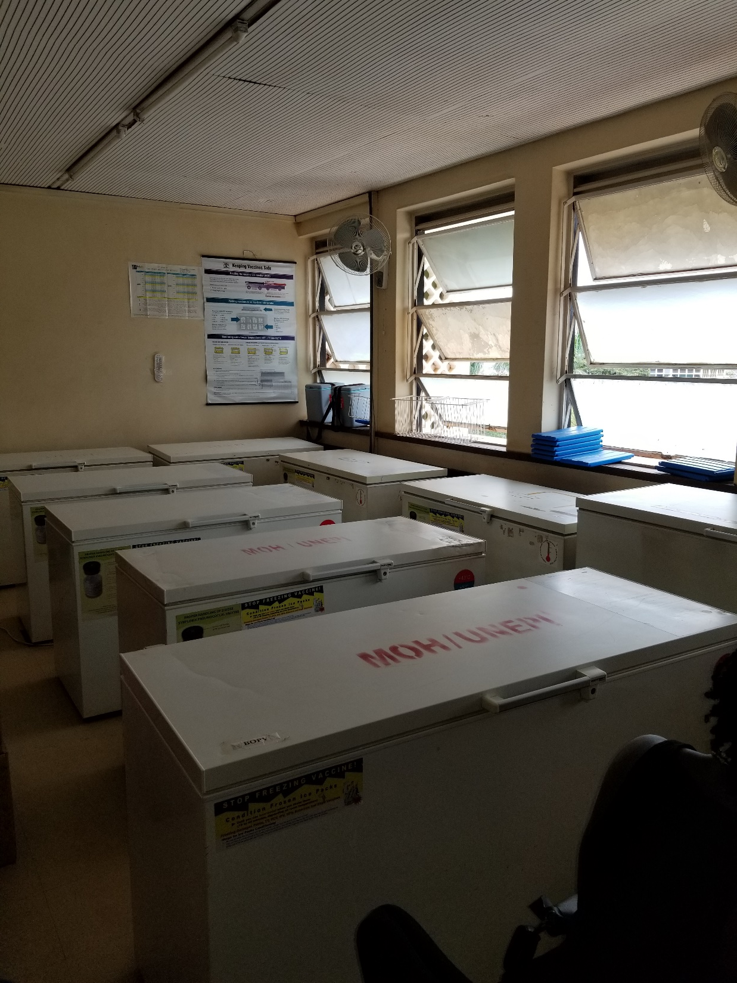
Mapping the Global Immunization Cold Chain
Richard Anderson
University of Washington

Slide 14
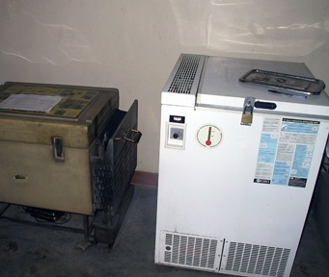
Problem: How do we count every vaccine refrigerator in the world?
Mapping the global immunization cold chain
Construct an accurate cold chain equipment inventory for all low- and medium-income countries

Slide 15
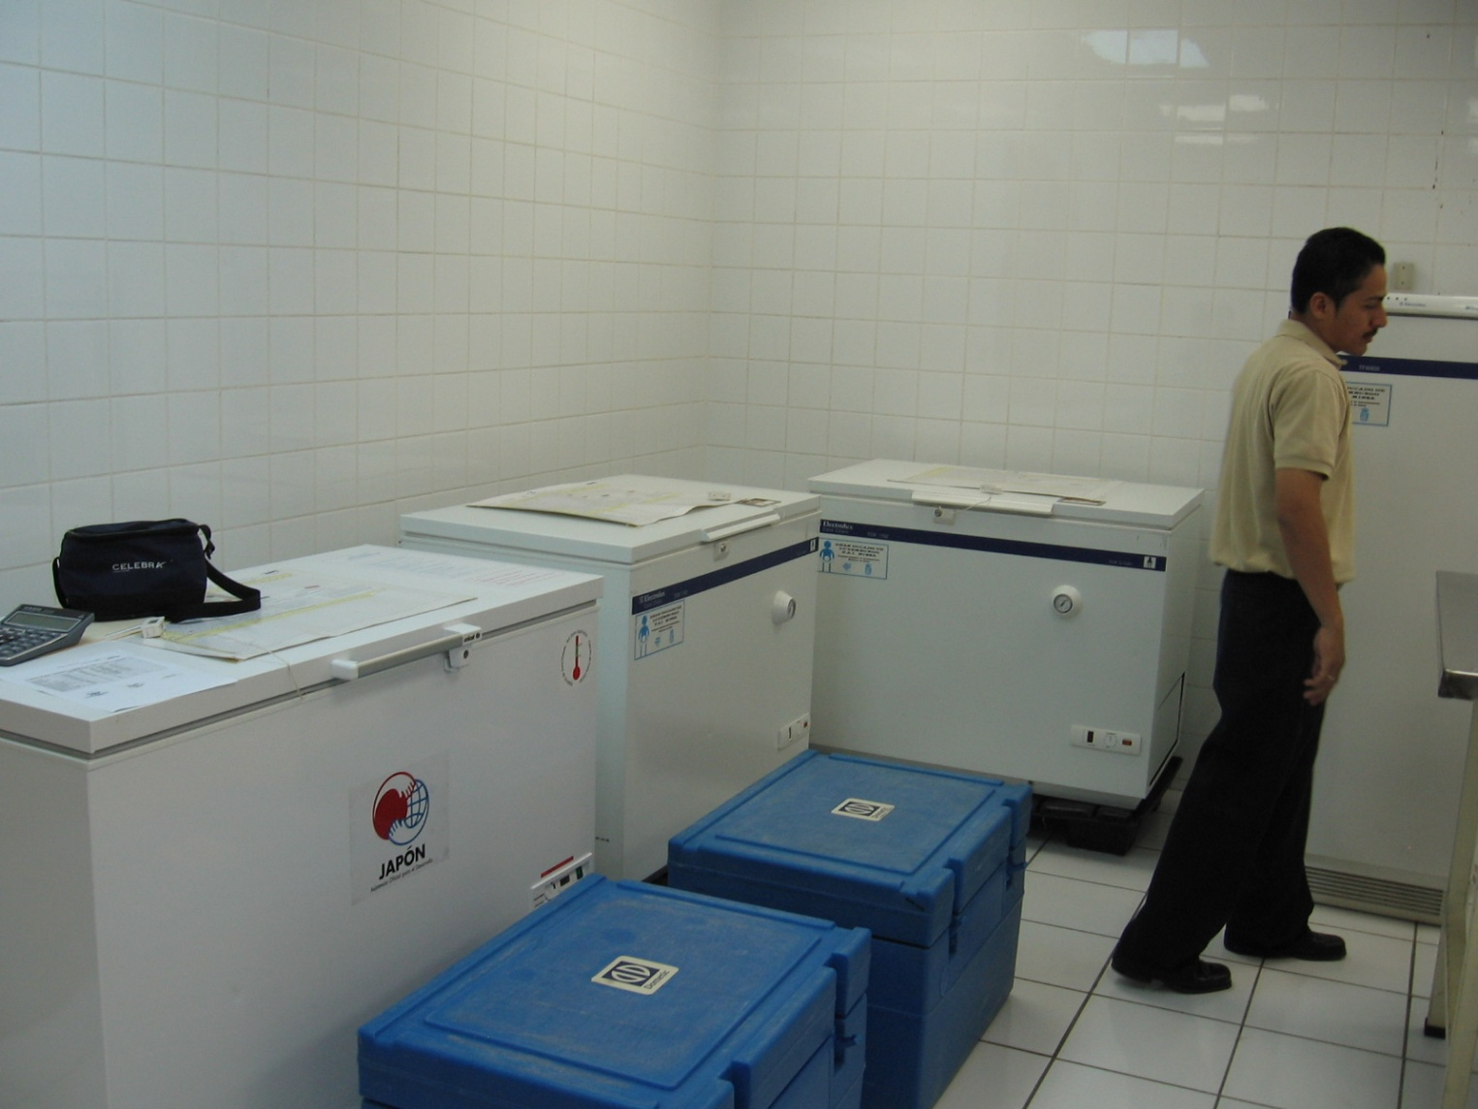
Why is this an interesting Development Engineering problem?
Address the problem of taking DevEngr interventions to scale
How does the field have impact
Difference between pilots and sustainability
Examples: 99 Dots, Digital Green, DHIS2
Understanding “Global Good” Software
Creating, deploying, and sustaining low-cost software platforms
Open source software in global health eco-system

Slide 16
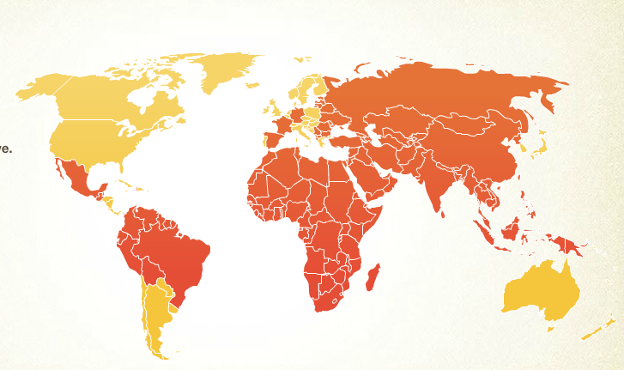
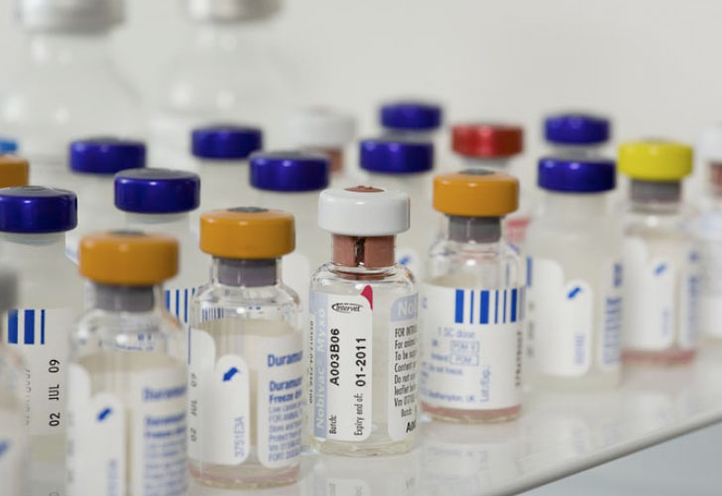
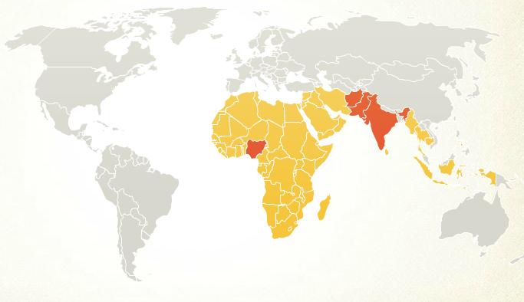
Why this is important: Immunization
One of the world’s most effective health interventions
Wide coverage of basic vaccines
Diphtheria, Pertussis, Tetanus: 77% in poorest countries
Tremendous reduction in deaths
Some diseases close to elimination
Polio 1990
Polio 2008

Slide 17
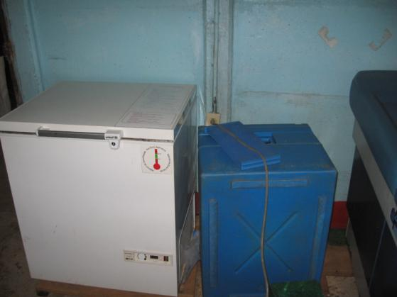
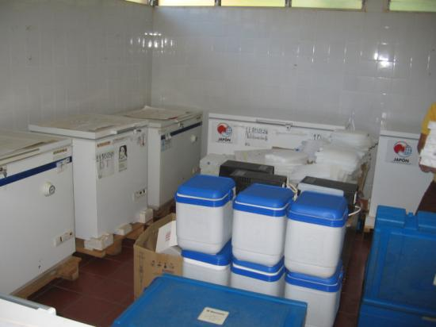
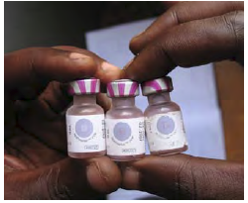
Why this is important: Immunization Logistics
Vaccines need to be kept in a given temperature range
Spoil if vaccines freeze
Spoil if above 8 degrees for extended period of time
Facilities must store between 1 to 3 months of stock

Slide 18
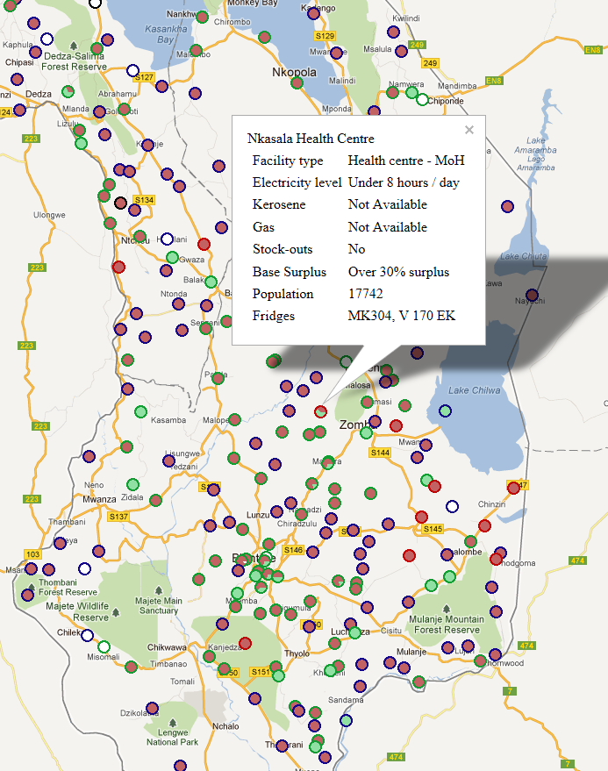
Why this is important
This information is critical for decision making for managing the global immunization cold chain

Slide 19
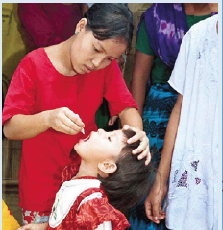
Immunization Domain Background
Vaccines are the same around the world
For many countries – immunization is managed and funded globally
Ministry of Health
National Immunization Program
Logistics

Slide 20
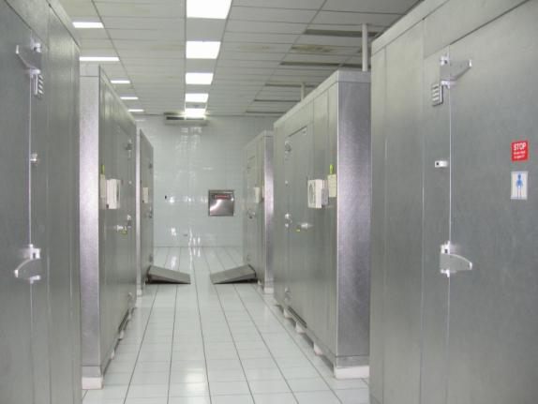
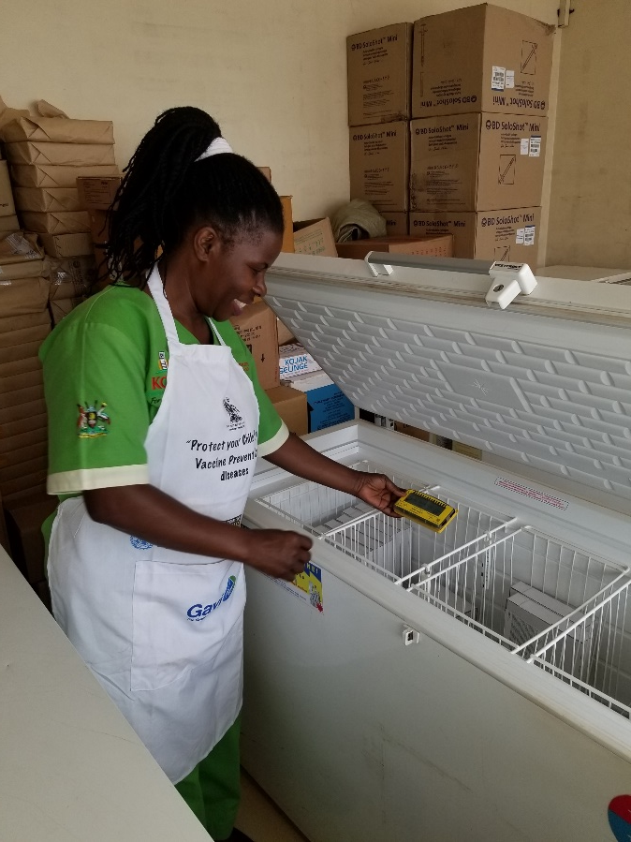
Immunization Cold Chain
Vaccine Manufacturers
National Vaccine Store
Regional Store
Regional Store
District Store
District Store
District Store
District Store
Health Center
Health Post
Health Post
Health Post

Slide 21
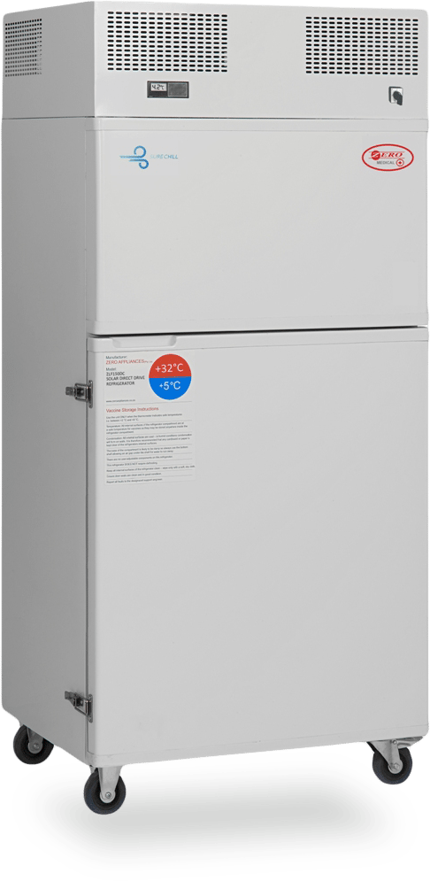
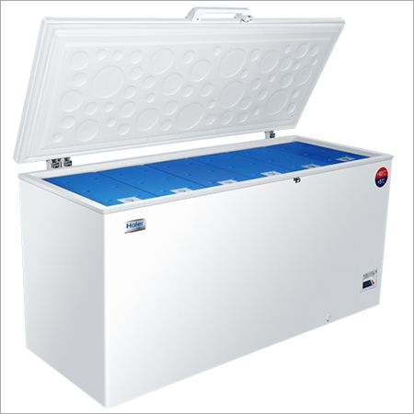
Immunization Cold Chain Challenges
Ensure that all countries have high quality vaccine cold chains
Working equipment at all points in vaccine supply chain
Sufficient capacity for vaccines
Refrigerators need power
Grid power, Solar power, Gas, Kerosene
Many areas suffer from regular power outages
Desire to replace Kerosene / Gas equipment with Solar
Equipment upgrades
Identify needs and determine order size
Remove obsolete equipment
Ensure proper installation
Establish repair infrastructure
Monitoring of equipment condition

Slide 22
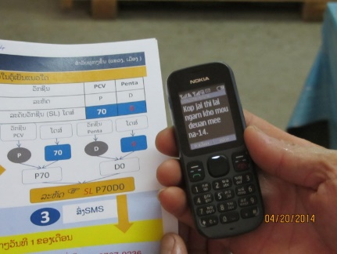
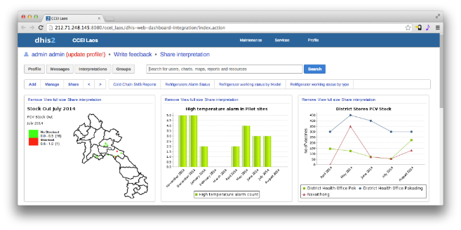
My background in immunization logistics
Sabbatical with PATH (2008-2009)
CCEM Project
Country projects: Nicaragua, Kenya, Zimbabwe, Malawi, Nigeria, Ghana, Uganda, India, Pakistan, Laos
Multiple projects on cold chain information systems
DHIS2 for Cold Chain Inventories
SMS Temperature Reporting
Promoted Cold Chain Equipment Inventory Data Standards
Refrigerator

Slide 23
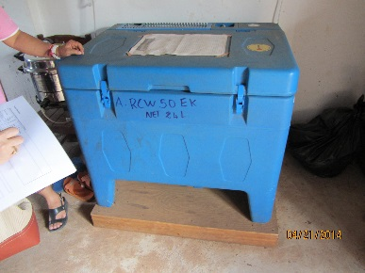
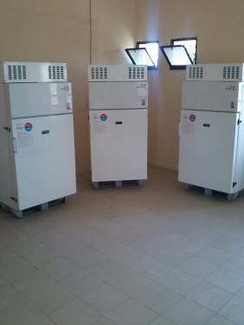
Problem Statement
Count every refrigerator
Global data base of refrigerator and health facility info
Analytics to make this information useful
Caveats
Focus on low and middle income countries
Multiple levels of dashboards and distinction between global and country data bases
Kenya: 5306 facilities, 4946 refrigerators, Population 41 M
Malawi: 827 facilities, 1426 refrigerators, Population 15 M
Uganda: 2846 facilities, 3153 refrigerators, Population 35 M
Zimbabwe: 1605 facilities, 3080 refrigerators, Population 14 M
2010 data

Slide 24
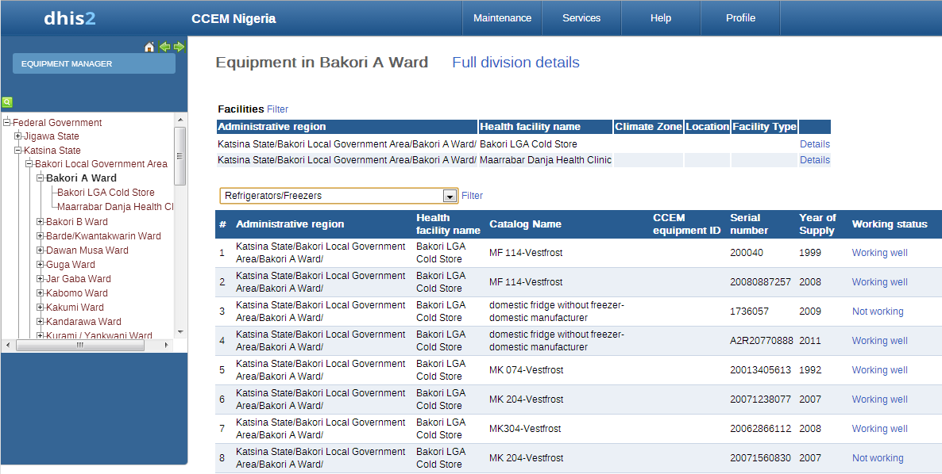
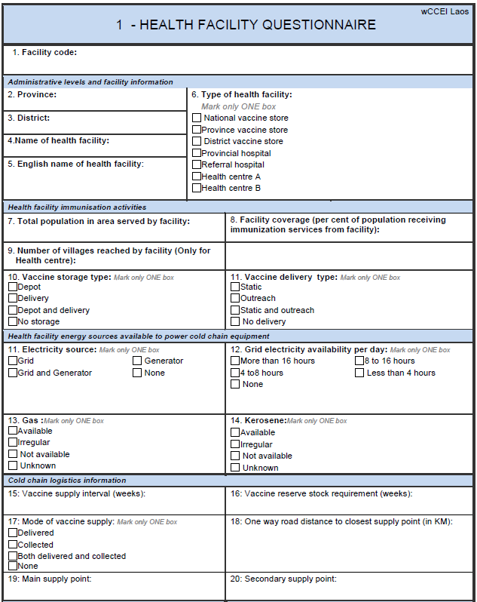
Cold Chain Equipment Inventories
No accurate global equipment inventories
Inconsistent at the country level
Inventories often become out of date
Not updated for equipment changes
Health facility information is also a challenge
Periodic efforts to collect inventory information for reporting
Often restricted to sampling
Fragmented data sources
Different health systems inside a country
Public, Private, NGO, Faith-based

Slide 25
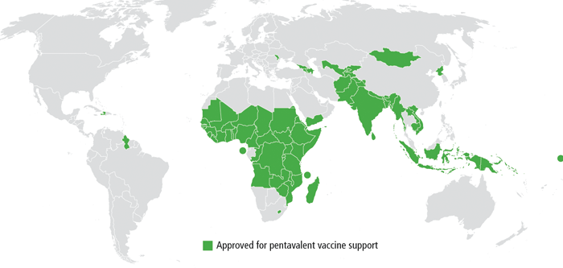
Vision
Country Cold Chain Information System
Global Cold Chain Information System
Country Cold Chain Information System
Country Cold Chain Information System

Slide 26
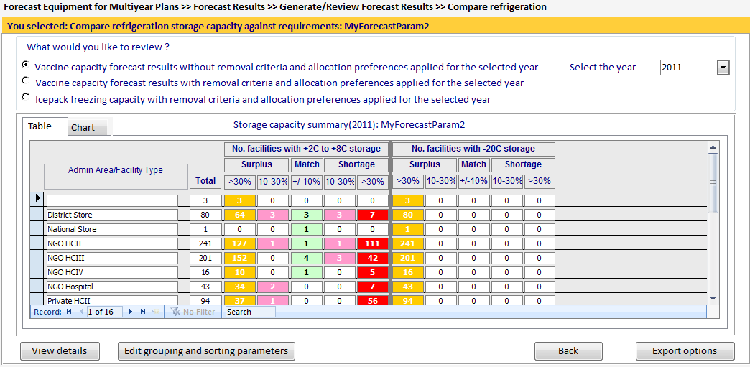
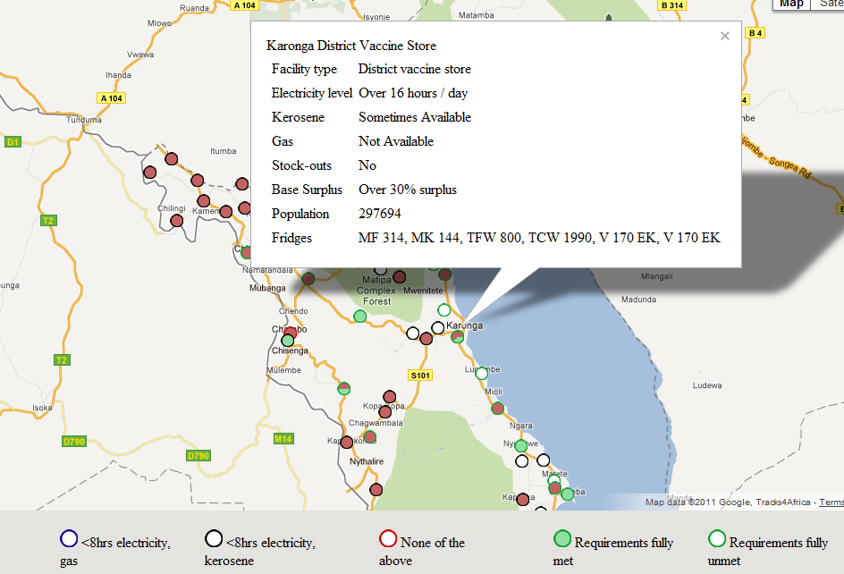
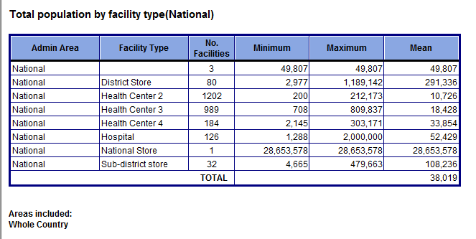
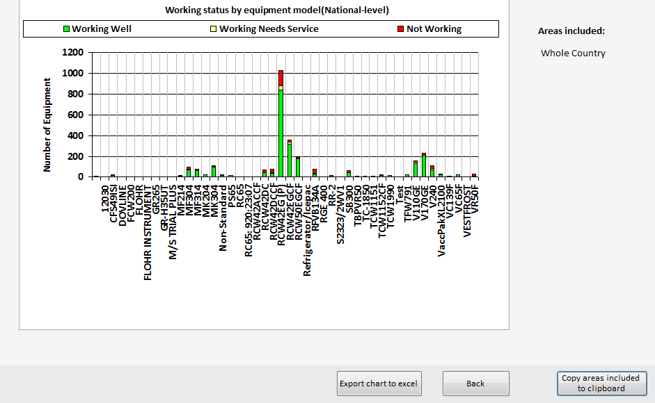
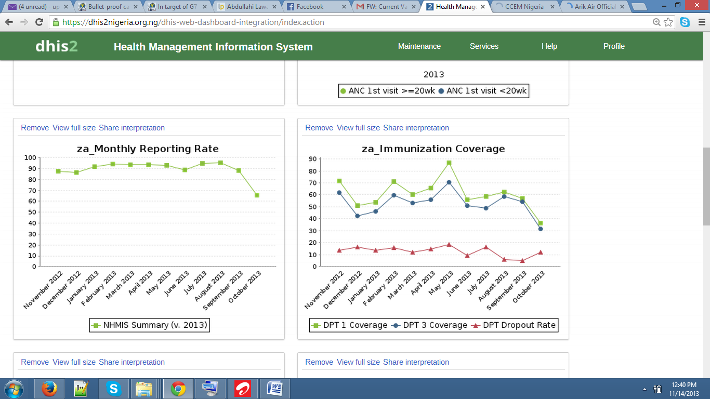
Part I: Visualizing the Cold Chain
Map based visualization
GIS Coords
Regions
Global Management Questions
Country summaries
Equipment trends
Integrated analysis tools and models
Country Cold Chain Management
Equipment management
Allocation
Reporting

Slide 27
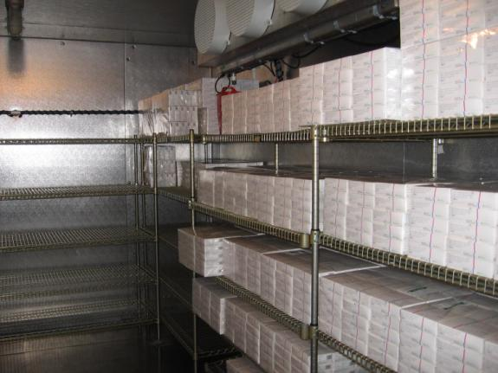
Part II: Data Management
Cold Chain Equipment Inventory
Basic equipment and facility information
Tracking of performance and maintenance
Remote data updates
Keeping data up to date is the critical challenge
District cold chain supervisor responsible for managing equipment
Mobile App is feasible for district supervisors
Integrate with other Health Information Systems
Ownership by the country

Slide 28
ODK-X
Mobile data collection on Android Phones. Project started at University of Washington by Professor Gaetano Borriello
Open Data Kit 1.0 aka ODK
Submission of forms
Open Data Kit 2.0 aka ODK-X
Synchronization with a database
Open source tools. Strong commitment to contributing to global good software

Slide 29
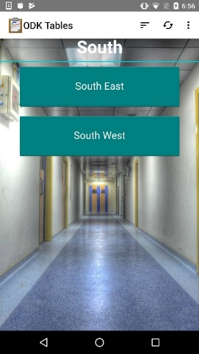
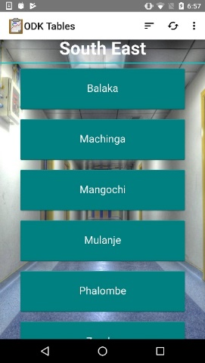
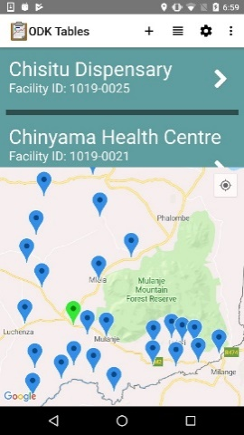
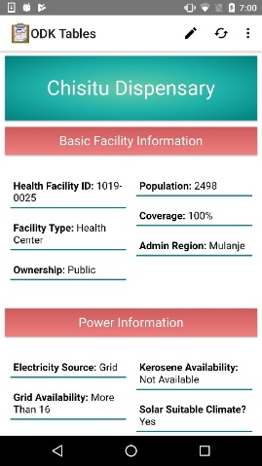
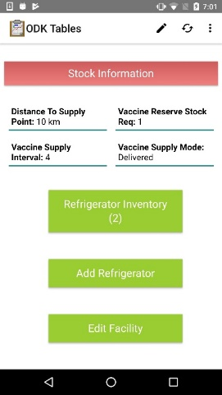
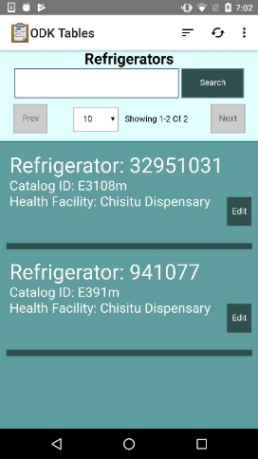
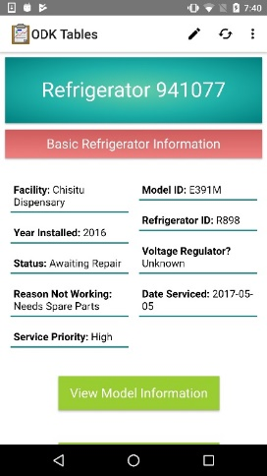
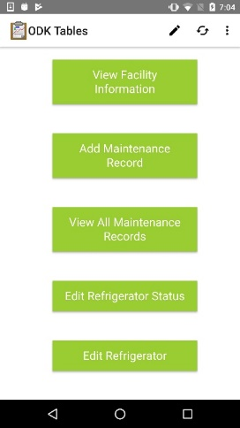
Cold Chain App
App built on top of the ODK-X platform
Combination of ODK Survey and ODK Tables
Written in Java Script
Manage a database of health facilities and refrigerators associated with facilities

Slide 30
Architecture
Global Cold Chain Information System
Dash Board
Database
Report Generation
ODK-X Client
ODK-X Server
Country Database
Local Database
ODK-X Client
Data Bridge
Local Database
CCEM

Slide 31
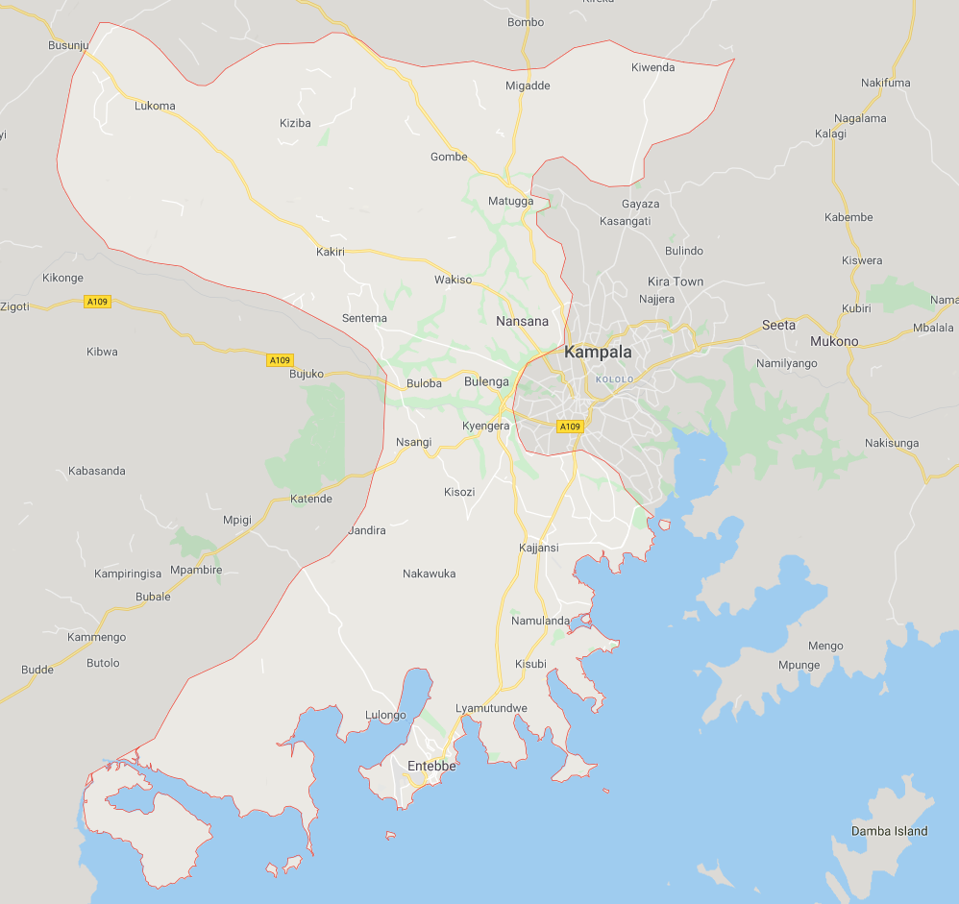
Project Status
Cold Chain Visualization project
Cold Chain App prototype
WHO Deployment
Haiti, Pakistan, DRC, Bangladesh
Sentinel Surveillance officers
GAVI Deployment – Uganda
Two regions - Kampala and Wakiso (13 Districts)
Possible expansion to national scale

Slide 32
Challenges
Data Challenges
Initial collection and cleaning
Name resolution
Country administrative regions
Mobile App
Data connection, on-line/off-line
Usability
Android Phones
Country Deployment
IT support and training
Project Scoping
Software can do anything . . .
Boundaries with other health information systems
Hosting and Data Ownership
Country specific versus general
Sustainability
Planning for partnership with Makerere

Slide 33
Can this be made global scale?
Technologically, yes
Architectural choices are straight forward
This is not big data
Estimate 200,000 Health Facilities and 300,000 Refrigerators
Data management
Administrative and geographic data across 70 countries will be a significant challenge
App deployment
Diverse deployment settings
Challenge of producing multiple versions of App on per country basis
Split global and country management
Determination of global verses country data

Slide 34
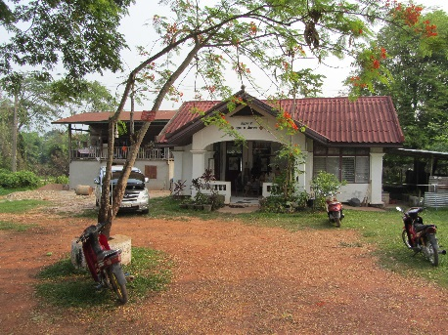
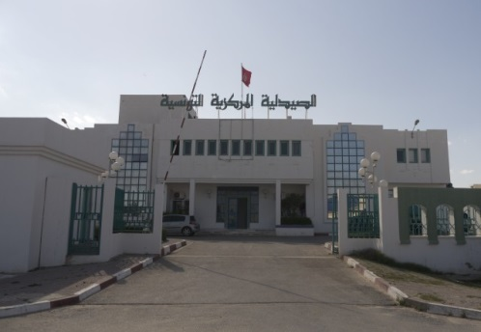
Does it provide sufficient value to cover the cost
Global immunization has substantial resources
Cost of developing and maintaining this is modest
But – this only makes sense if has quantifiable benefits

Slide 35
Value at the Global Level
Ensure adequate immunization cold chain
Equipment purchase and distribution
Implementation and management of equipment
Market shaping

Slide 36
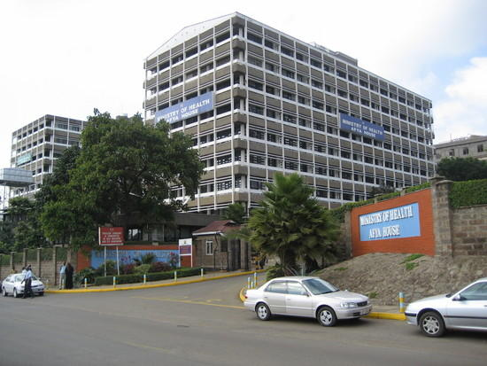
Value at the Country Level
Immunization System Management
Equipment Allocation
Equipment Management
Strategic decisions
Reporting
Interactions with Global Level

Slide 37
Research Questions
Multiple country deployments underway
Thirteen Districts in Uganda
Potential long term deployment in Uganda
What can we learn at this stage of the project?

Slide 38
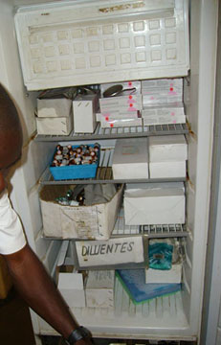
Technical questions
Performance and usability of ODK-X application
Global administrative data pipeline
Data cleaning pipeline for country data
Multi country App and system deployment

Slide 39
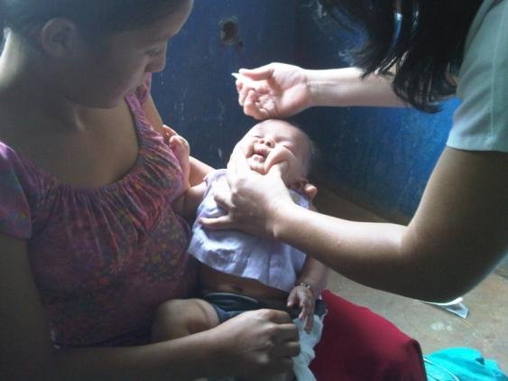
Country Questions
Does the project yield a usable and up to date cold chain equipment inventory
Updating inventory – last good inventory in Uganda was 2011 with a partial update in 2014
Can Uganda’s cold chain equipment be inventoried by district cold chain technicians using the mobile application
Does the system help or hinder district cold chain workers
In which processes is the data used
What is the country costs of maintaining and managing the system

Slide 40
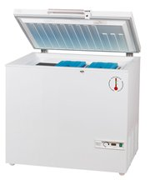
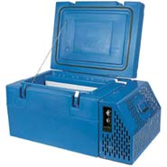
Global Questions
How do country and global level systems interact
How does the global cold chain mapper fit with other systems and information sources
How can more accurate and complete country data be used for improved global support for immunization

Slide 41
Taking the project live
Training – January 28-30
4 UW people + 2 PATH
15 cold chain technicians
15 other people from ministry
Methodology
Powerpoint presentation
Instruction
Walk through
Exercises
Hands on training with the application

Slide 42
Training
14 of 15 technicians were already familiar with Android phones
MoH Android phones were distributed to all
Quick understanding of the cold chain application
Hard parts of training were
Configuring the application
Managing synchronization and the possibility of data conflicts

Slide 43
ODK-X
Behind the scenes concerns
App installation a slow process as the entire database is installed
30 users simultaneously hitting the server on a unknown networking environment
Stress test on conflict resolution
Necessary to collect and reconfigure all devices each night
Move from a test server to the live server the last day
Technology worked very well throughout
Good performance and few issues

Slide 44
User reactions
Surprise at list of health facilities for each district
Differences between national view and district view
Discussions on user permissions for operations
Handling of dangerous operation
Some workflow issues
Who has permission to delete, move refrigerators
Who handles administrative updates (e.g., adding health facilities)

Slide 45
Training summary
Capacity development for Development Engineering interventions is critically important
A practice run with training materials in Seattle was very helpful
Carefully constructed time schedules had to be discarded
Last minute changes in the application added to the stress of implementing training
Lots of work for trainers outside of training sessions
Considered to have been successful

Slide 46
Deployment: Feb 1 to April 30
Scale: Approx 400 health facilities and 600 refrigerators
Data update (through March 15): Approx 80%
Information collected on need for refrigerator maintenance and temperature alarms
Leading to various actions on refrigerator repair / replacement
Existing system where additional information allows new actions
Demonstrates feasibility of collecting performance data
A small number of erroneous entries
Usability / training issue
One escalated issue on synchronization

Slide 47
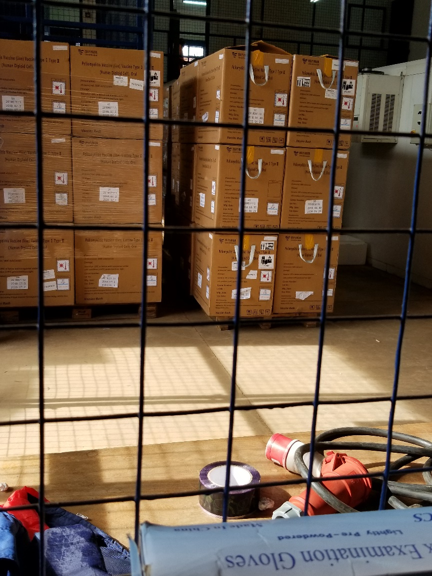
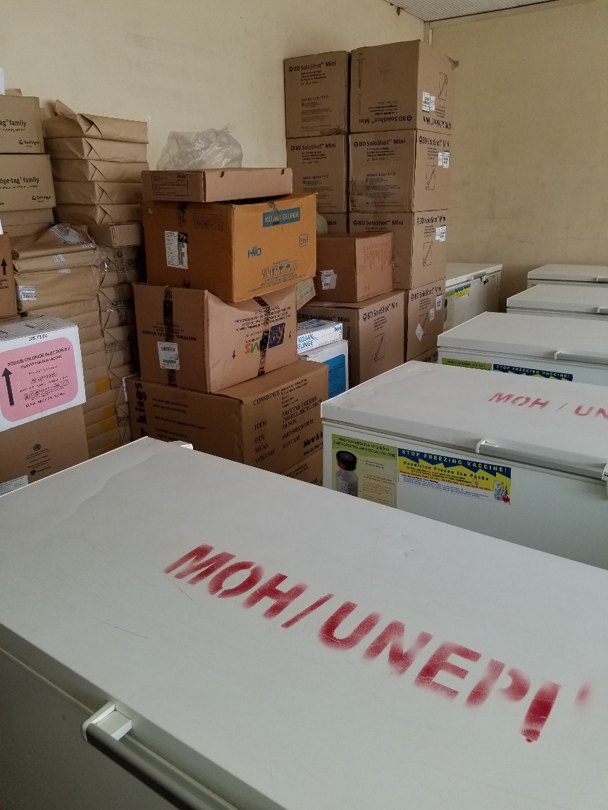
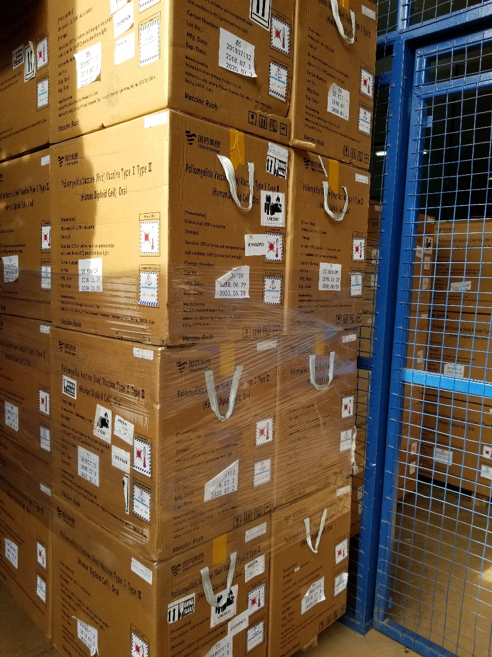
Questions and Discussion

