Slide 1
Towards SHA-3
Christian Rechberger, KU Leuven

Slide 3
Fundamental questions in CS theory
Do oneway functions exist?
Do collision-intractable functions exist?
We don't know.

Slide 4
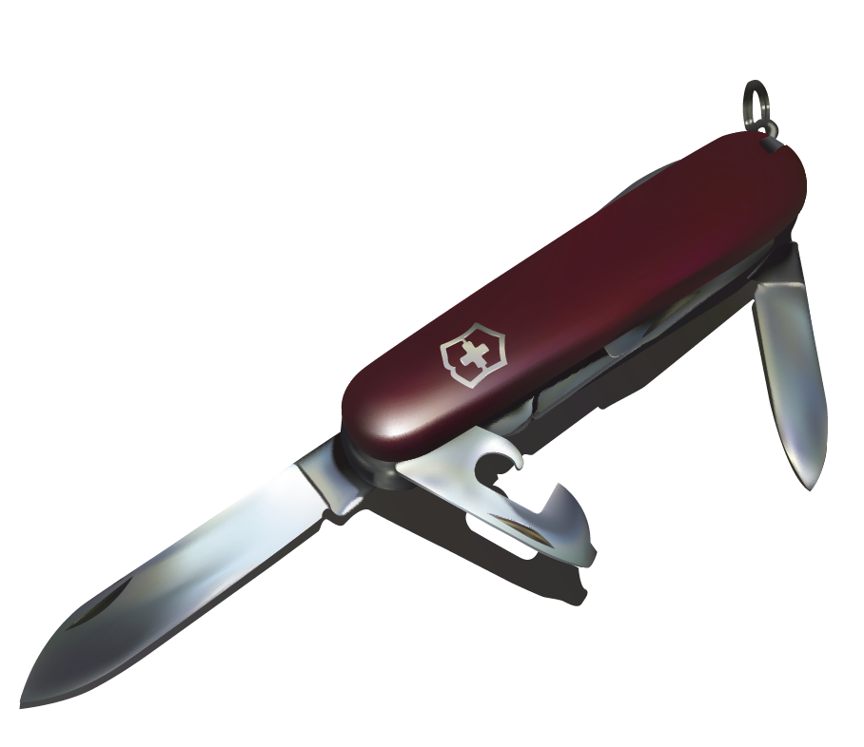
Do we care?
What we care about: computational properties
For cryptographic hash functions, it should be sufficiently hard to
find preimages
find collisions
...
© CC BY-SA 2.0

Slide 5
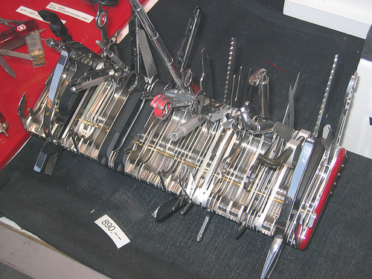
Secure? What properties?
Collision resistance
Preimage resistance
2nd preimage resistance
Near-collision resistance
Pseudorandom generator
Pseudorandom function
Key derivation function
Random oracle
…
© CC BY-SA 2.0

Slide 6
Hash functions as a fundamental primitive
Users
Systems
Protocols
Primitives

Slide 7
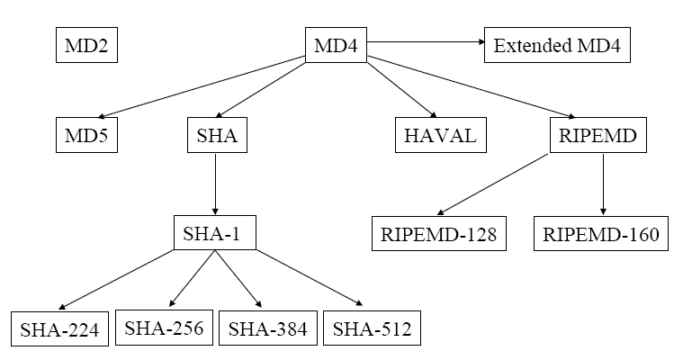
MD4 family
Notes:
7

Slide 8
MD4 family
x
x
x
x
x
x
?
?
?
?
Notes:
8

Slide 9
Collisions for reduced SHA-1
40 rounds: Biham, Chen, 2005
58 rounds: Wang, Yu, Yin, 2005
64 rounds: De Cannière, R., 2006
70 rounds: De Cannière, Mendel, R., 2007
Full 80 rounds?

Slide 10
What are the problems
Too fast?
Designers too optimistic
New powerful variants of
differential cryptanalysis

Slide 11
Road towards SHA-3
x
x
x
x
x
x
?
?
?
?
SHA-3 (selected in an open competition)
Notes:
11

Slide 12
Design challenges for SHA-3
Faster than SHA-2 on many platforms
More secure than SHA-2, confidence
All the properties that you could think of now
and in the years to come
Notes:
12

Slide 13
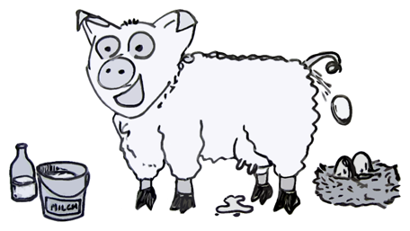
Design challenges for SHA-3
Faster than SHA-2 on many platforms
More secure than SHA-2, confidence
All the properties that you could think of now
and in the years to come
© CC BY-SA 2.0
Notes:
13

Slide 14
Outline
Motivation
SHA-3 competition
Grøstl and the rebound attack
SHA-3 candidates through the rebound lens
Concluding discussions

Slide 15
SHA-3 competition
2006/2007: NIST drafts requirements and calls for submissions
10/2008: 64 submissions, >200 designers
12/2008: 51 round-1 candidates announced
07/2009: 14 round-2 candidates announced
12/2010: Five finalists announced
Q2 2012: Final selection

Slide 16
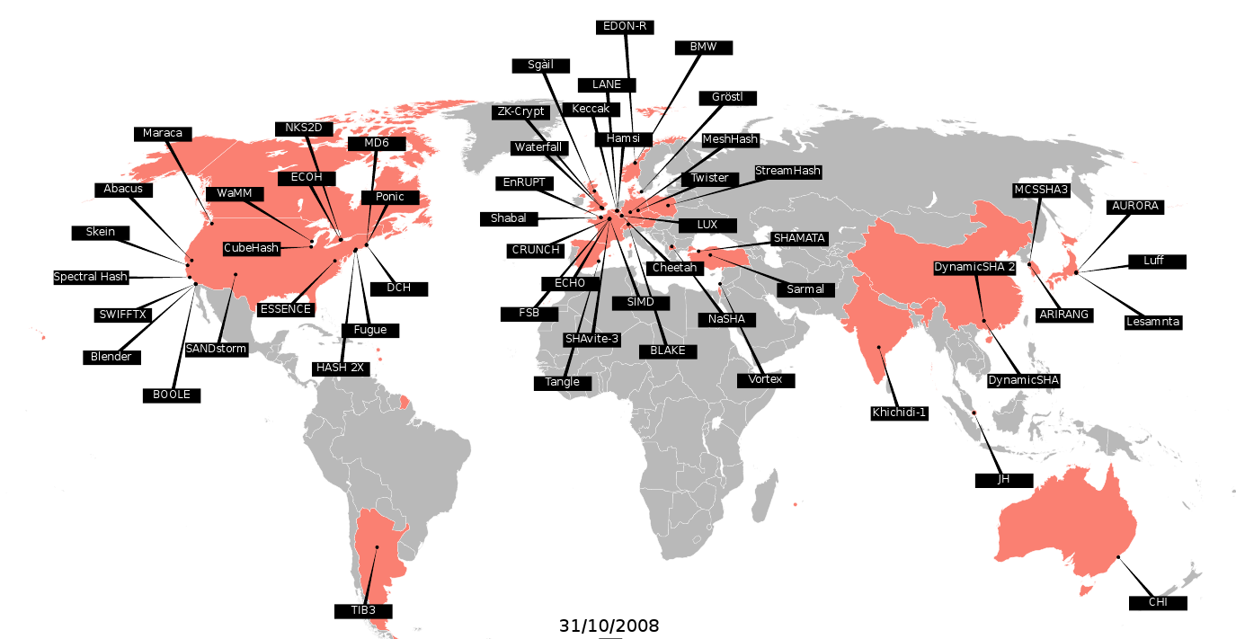
The candidates
Slides credits: Christophe De Cannière

Slide 17
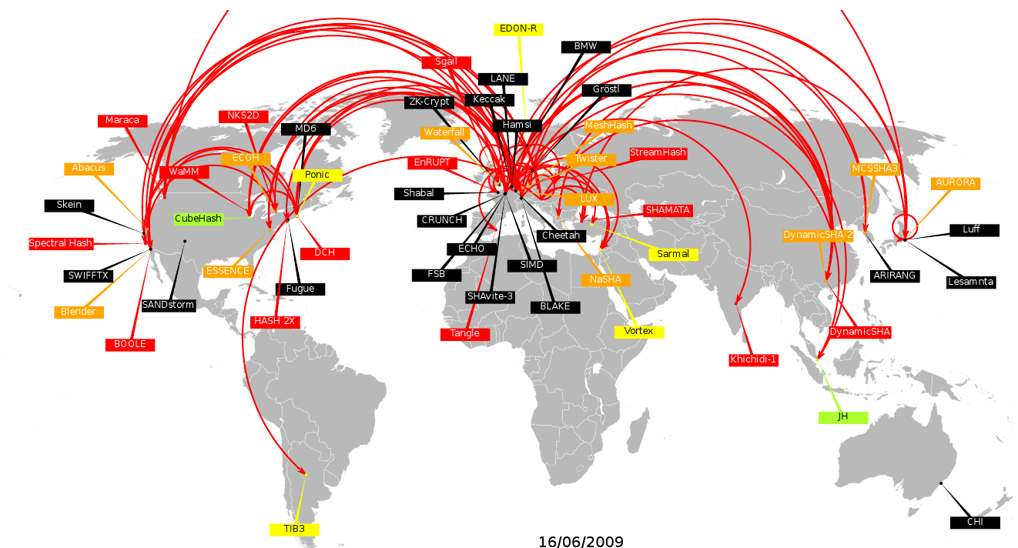
Preliminary cryptanalysis

Slide 18
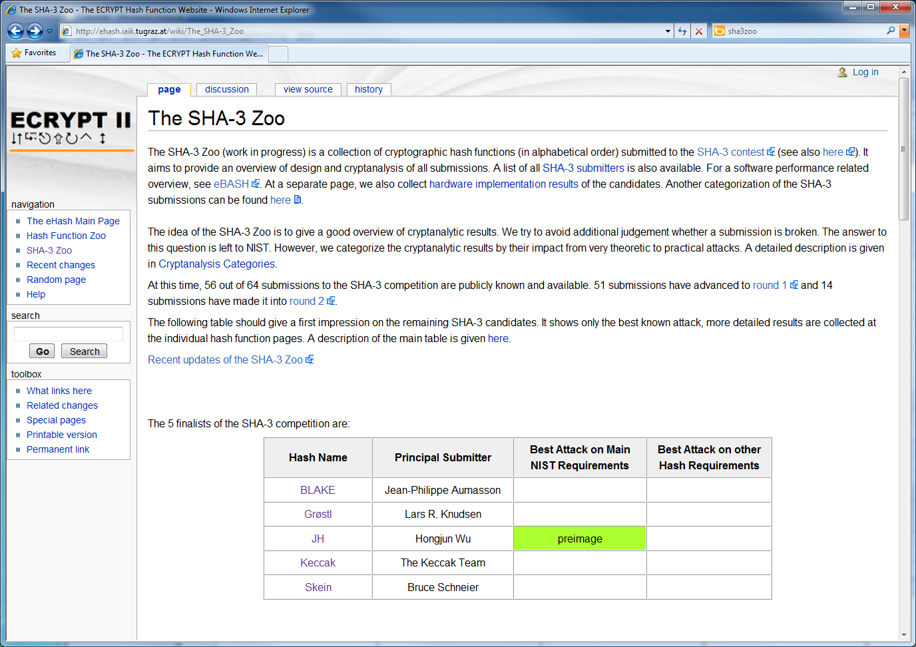
SHA-3 Zoo
ECRYPT2 SHA-3 Zoo: http://ehash.iaik.tugraz.at

Slide 19
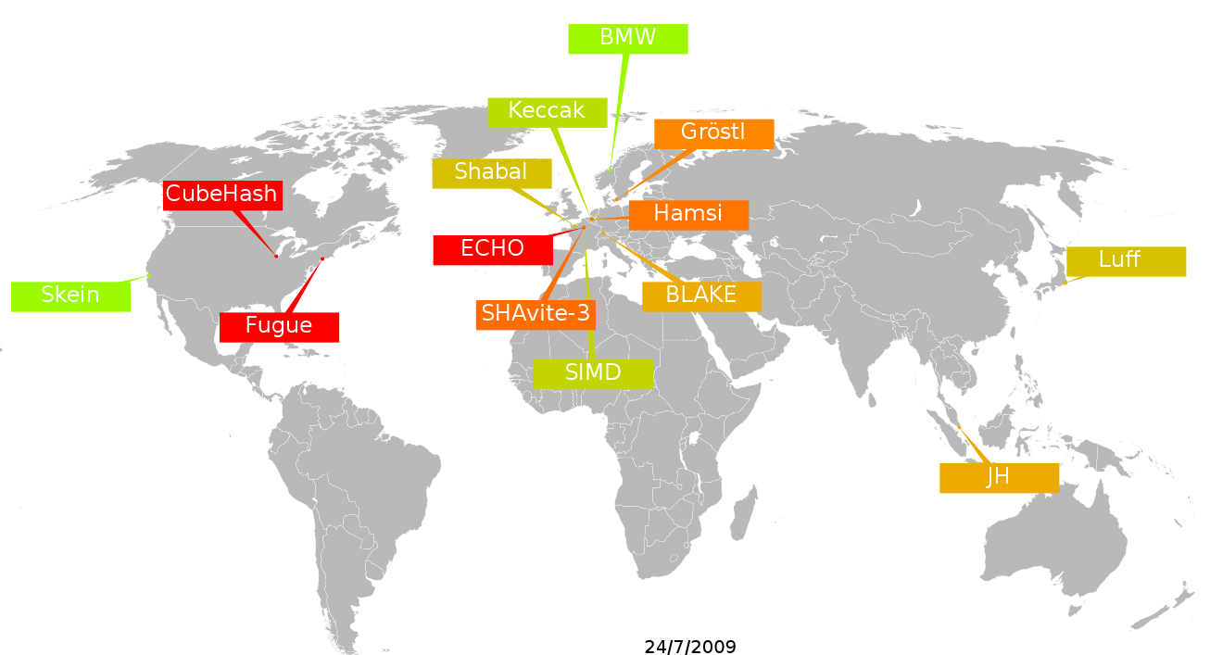
Round-2 candidates

Slide 20
How to categorize them?

Slide 21
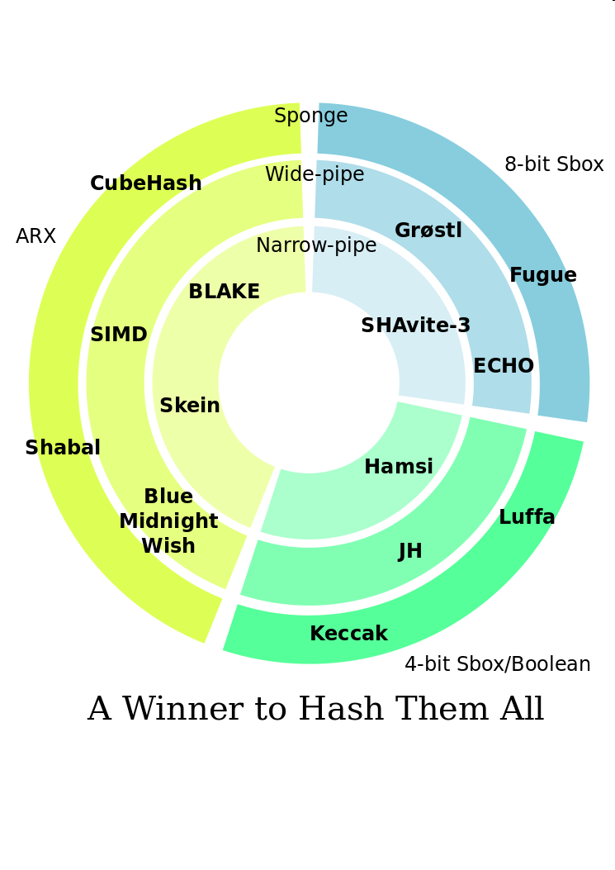
How to categorize them?
Credits to
Dai Watanabe

Slide 22
How to compare them?
Security
Performance/Implementation costs
  Software (code size, speed, ...)
  Hardware (lowest gate count, highest throughput, power consumption characteristics, …)
  Side-Channel countermeasures
Confidence?
Notes:
22

Slide 23
Grøstl
Grøstl is inspired by
Rijndael/AES (Daemen, Rijmen, 1997)
SMASH (Knudsen, 2005)
Grindahl (Knudsen, R., Thomsen, 2007)
Proofs against differential attacks
Proofs against generic shortcut attacks

Slide 24
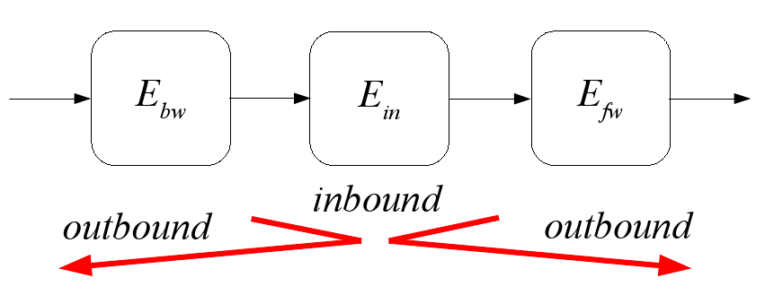
Rebound attack
New variant of differential cryptanalysis, FSE 2009
Developed during the design of Grøstl

Slide 25
Origins of the rebound attack
Differential attack, Biham and Shamir, 1989
Inside-out approach, Dobbertin 1995, Wagner 1998
Truncated differential, Knudsen, 1994
Original Goal:
Get a good estimate of the security margin of Grøstl

Slide 26
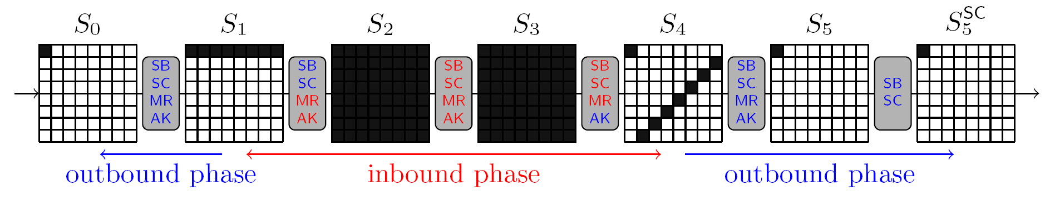
Example of a rebound attack
Within a few months, others became a “victim”:
  Twister (round-1 SHA-3 candidate)
  LANE (round-1 SHA-3 candidate)
  Whirlpool (ISO standard, unbroken since 2001)
  …

Slide 27
Further technical developments
The
  Linear solving variant (SAC 2009)
  Start-in-the-middle variant (SAC 2009)
  Super(S)box variant (Asiacrypt 2009 and FSE 2010)
  Multiple-inbound phase variant (Asiacrypt 2009)
  Rotational variant (Asiacrypt 2010)
...of the rebound attack

Slide 28
SHA-3 finalists

Slide 29
Rebound

Slide 30
SHA-3
Rebound

Slide 31
SHA-3 round-2 candidates through the rebound lens
4 or 8-bit S-box based
Grøstl
ECHO
JH
Luffa
Shavite-3
Fugue
Hamsi
Others
Skein
BMW
Blake
Cubehash
Keccak
SIMD
Shabal

Slide 32

SHA-3 round-2 candidates
through the rebound lens
4 or 8-bit S-box based
Grøstl
ECHO
JH
Luffa
Shavite-3
Fugue
Hamsi
Others
Skein
BMW
Blake
Cubehash
Keccak
SIMD
Shabal

Slide 33
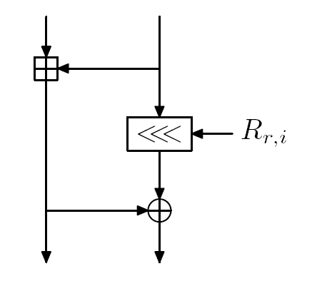
Most recent case: Skein
Recent analysis by
Khovratovich, Nikolic, R. in 2010
Rebound idea for the first time applied to ARX construction
Results in perspective:
  2009: Related-key differential attack: 34 rounds
  2010: Rotational attack: 42 rounds
  New: Rebound rotational attack: 57 rounds

Slide 34
SHA-3 finalists
through the rebound lens
4 or 8-bit S-box based
Grøstl
ECHO
JH
Luffa
Shavite-3
Fugue
Hamsi
Others
Skein
BMW
Blake
Cubehash
Keccak
SIMD
Shabal

Slide 35
SHA-3 finalists in numbers
Geography:
3 from Europe, 1 from Asia, 1 from America
Tweaks:
|all 5 got tweaked, 2 got tweaked twice
Team members also AES finalist: 3
Teams that designed a hash function before: 2

Slide 36
How to categorize them?
Credits to
Dai Watanabe

Slide 37
SHA-3 finalists
Compression strategy:
  Single Permutation: Blake (with finalization), JH, Keccak
  Two Permutations: Grøstl
  Large family of permutations (block cipher): Skein
Source of non-linearity:
  64-bit: Skein
  32/64-bit: Blake
  8-bit: Grøstl
  4/5-bit: JH
  3-bit: Keccak

Slide 38
Conclusion (1/2) Assurance?
Very complicated attacks against MD5 and SHA-1
  (1) Differential trail with complicated carry interactions
  (2) Degrees of freedom utilization for speedup
Level of assurance provided by finalists against this class of attacks:
  Blake, Skein: ARX, issues similar to SHA-1/SHA-2
  Grøstl: both (1) and (2) done by rebound attacks
  JH: (1) and (2) may be possible, open problem
  Keccak: seems infeasible

Slide 39
Conclusion (2/2)
Building confidence in a new cryptographic primitive takes time
A lot remains to be done for a final SHA-3 selection by 2012
Upcoming: ECRYPT Hash Workshop 2011,
May 19-20, Tallinn

Slide 40
The road ahead
Application of new cryptanalytic techniques to other areas, examples
  Internal fixed points:
    Collision and preimage attack on GOST hash: 2008
    Key recovery attack on GOST block cipher: 2011
  Local collisions:
    Collisions in SHA-0: 1998
    Related-key attacks on AES: 2009
New lightweight algorithms, where designers cut corners

Slide 41
Towards SHA-3
Q&A
Christian Rechberger, KU Leuven
SHA-3
Rebound

Slide 42
Backup slides

Slide 43
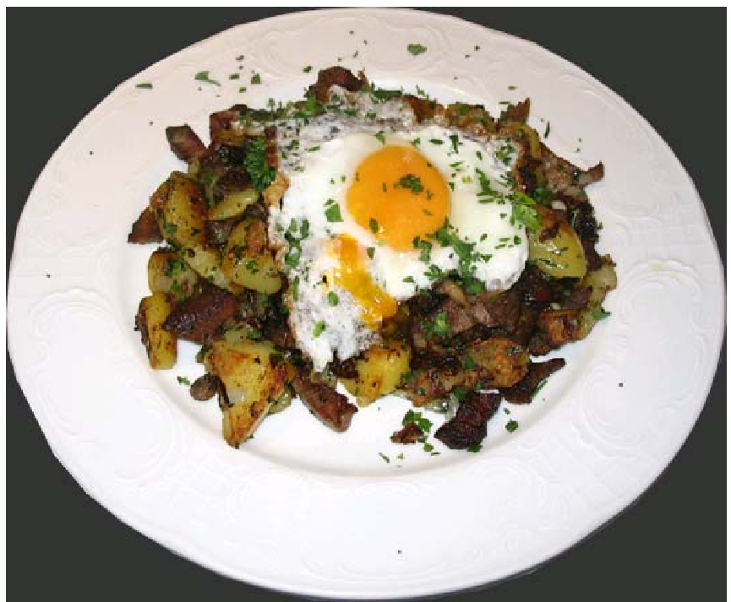
Addendum: Grøstl?

Slide 44
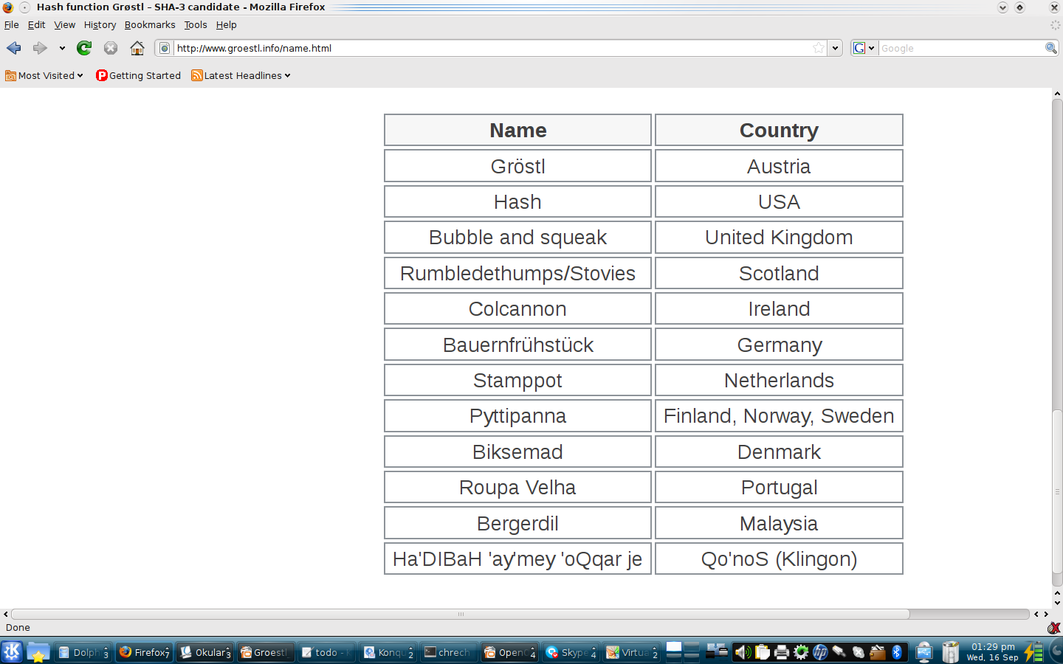
Call for input

