Slide 1
Assignment #8 – Solutions

Slide 2
Problem 1
Each participant $T_{i}$ selects a random polynomial
$$P_{i}\left(x\right)=\sum_{j=0}^{k−1}{a_{i,j}x^{j} mod q}$$
The joint secret is the sum of the original secrets
$$\sum_{i=1}^{n}{P_{i}\left(0\right) mod q}=\sum_{i=1}^{n}{a_{i,0} mod q}$$
How are shares of the joint secret formed?

Slide 3
Problem 1
$$P_{i}$$
$$a_{i,0}$$
$$P_{3}$$
$$a_{3,0}$$
$$a_{2,0}$$
$$P_{2}$$
$$P_{1}$$
$$a_{1,0}$$
1
2
3
$$i$$

Slide 4
Problem 1
$$P_{i}(i)$$
$$P_{i}$$
$$a_{i,0}$$
$$P_{3}$$
$$a_{3,0}$$
$$P_{3}(i)$$
$$a_{2,0}$$
$$P_{2}(i)$$
$$P_{2}$$
$$P_{1}(i)$$
$$P_{1}$$
$$a_{1,0}$$
1
2
3
$$i$$

Slide 5



Problem 1
$$\sum{P_{l}(i)}$$
$$\sum{P_{l}}$$
$$\sum{a_{l,0}}$$
$$P_{i}(i)$$
$$P_{i}$$
$$a_{i,0}$$
$$P_{3}$$
$$a_{3,0}$$
$$P_{3}(i)$$
$$a_{2,0}$$
$$P_{2}(i)$$
$$P_{2}$$
$$P_{1}(i)$$
$$P_{1}$$
$$a_{1,0}$$
1
2
3
$$i$$

Slide 6
Problem 1
Participant $T_{i}$ computes its share of the secret $S=\sum_{l=1}^{n}{a_{l,0} mod q}$ by taking the values $P_{1}(i),P_{2}(i),…,P_{n}(i)$ (including the value $P_{i}(i)$ which it can compute for itself) and forming the sum
$$S_{i}=\sum_{l=1}^{n}{P_{l}\left(i\right) mod q}$$

Slide 7
Problem 2
How does a set of $k$ participants use their respective $S_{i}$ values to decode an ElGamal encryption $\left(X,Y\right)$?

Slide 8
Problem 2
Lagrange Interpolation:
Given $k$ distinct pairs $\left(i,S_{i}\right)$ with $i∈I$, form the interpolated polynomial by computing
$$P\left(x\right)=\sum_{i∈I}{\left(S_{i}\frac{\prod_{l≠i∈I}{(x−l)}}{\prod_{l≠i∈I}{(i−l)}}\right)} mod q$$
The joint secret can be computed as
$$S=P\left(0\right)=\sum_{i∈I}{\left(S_{i}\frac{\prod_{l≠i∈I}{(0−l)}}{\prod_{l≠i∈I}{(i−l)}}\right)} mod q$$

Slide 9
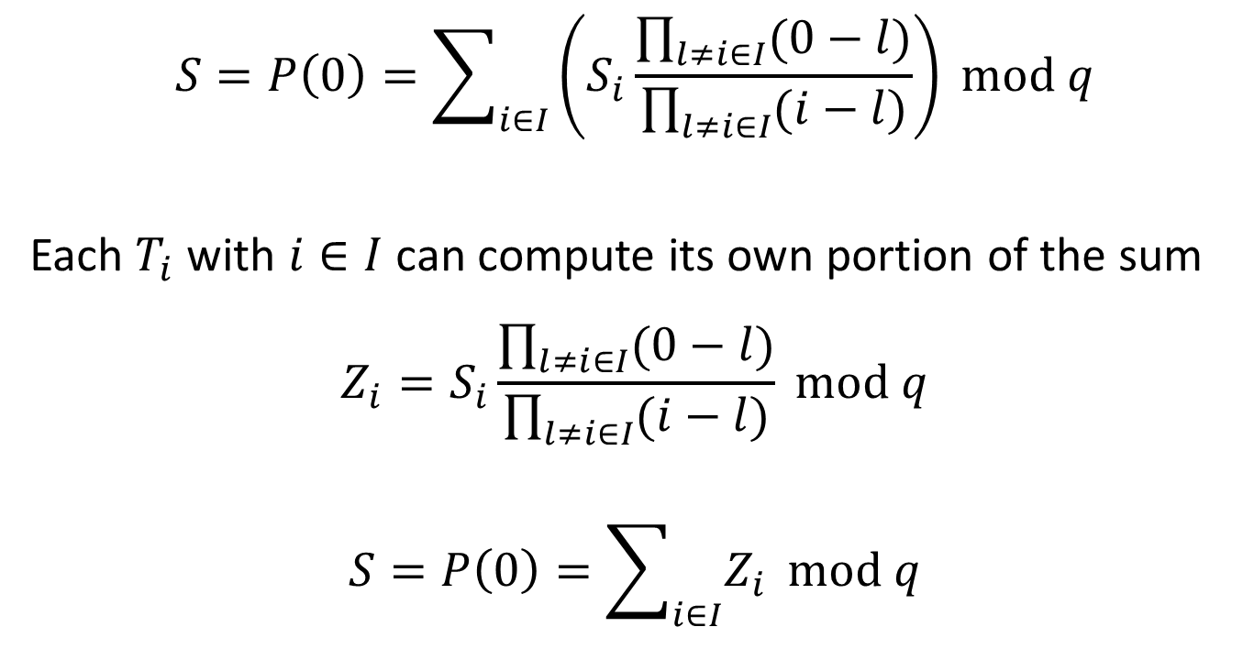
Problem 2
$$S=P\left(0\right)=\sum_{i∈I}{\left(S_{i}\frac{\prod_{l≠i∈I}{(0−l)}}{\prod_{l≠i∈I}{(i−l)}}\right)} mod q$$
Each $T_{i}$ with $i∈I$ can compute its own portion of the sum
$$Z_{i}=S_{i}\frac{\prod_{l≠i∈I}{(0−l)}}{\prod_{l≠i∈I}{(i−l)}} mod q$$
$$S=P\left(0\right)=\sum_{i∈I}{Z_{i}} mod q$$

Slide 10
Group ElGamal Encryption
Each recipient selects a large random private key $ai$ and computes an associated public key $Ai = g^{a_{i}} mod p$.
The group key is $A = \prod{A_{i}}mod p = g^{\sum{a_{i}}} mod p$.
To send a message $M$ to the group, Bob selects a random value $r$ and computes the pair $(X,Y) = (A^{r}M mod p, g^{r} mod p)$.
To decrypt, each group member computes $Y_{i}=Y^{a_{i}} mod p$. The message $M = X/\prod{Y_{i}}mod p$.

Slide 11
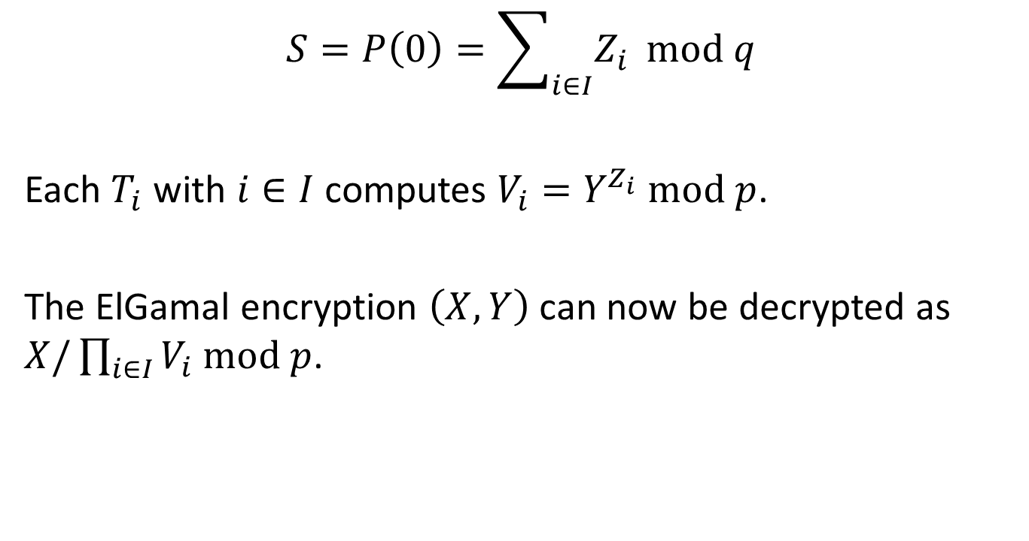
Problem 2
$$S=P\left(0\right)=\sum_{i∈I}{Z_{i}} mod q$$
Each $T_{i}$ with $i∈I$ computes $V_{i}=Y^{Z_{i}} mod p$.
The ElGamal encryption $\left(X,Y\right)$ can now be decrypted as $X/\prod_{i∈I}{V_{i} mod p}$.

Slide 12
Problem 3
Given a set of ElGamal encryptions $\left(X_{1},Y_{1}\right),\left(X_{2},Y_{2}\right),…,\left(X_{n},Y_{n}\right)$, create an equivalent set of ElGamal encryptions and prove the equivalence without revealing the correspondence.

Slide 13
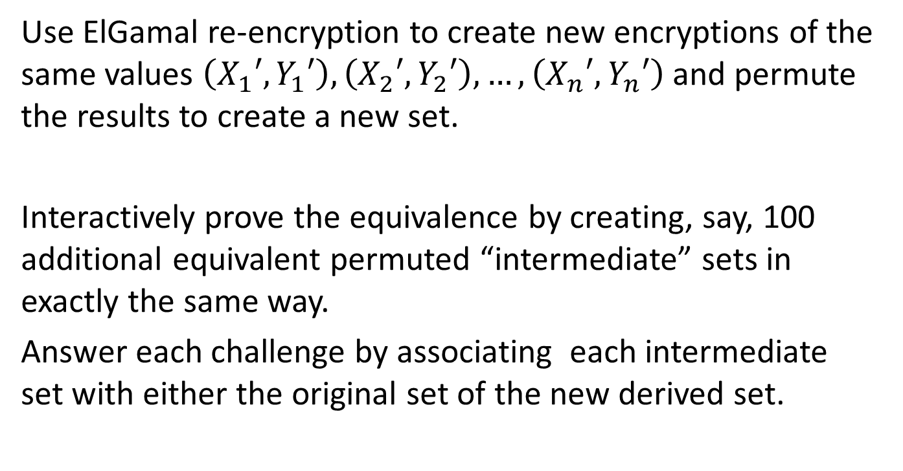
Problem 3
Use ElGamal re-encryption to create new encryptions of the same values $\left(X_{1}′,Y_{1}′\right),\left(X_{2}′,Y_{2}′\right),…,\left(X_{n}′,Y_{n}′\right)$ and permute the results to create a new set.
Interactively prove the equivalence by creating, say, 100 additional equivalent permuted “intermediate” sets in exactly the same way.
Answer each challenge by associating each intermediate set with either the original set of the new derived set.

Slide 14
A Verifiable Re-encryption Mix

Slide 15
A Verifiable Re-encryption Mix

Slide 16
A Verifiable Re-encryption Mix

Slide 17
A Verifiable Re-encryption Mix

Slide 18
A Verifiable Re-encryption Mix

Slide 19
A Verifiable Re-encryption Mix

Slide 20
A Verifiable Re-encryption Mix

Slide 21
A Verifiable Re-encryption Mix

Slide 22
A Verifiable Re-encryption Mix

Slide 23
A Verifiable Re-encryption Mix

Slide 24
A Verifiable Re-encryption Mix

Slide 25
A Verifiable Re-encryption Mix

Slide 26
A Verifiable Re-encryption Mix

Slide 27
A Verifiable Re-encryption Mix

Slide 28
A Verifiable Re-encryption Mix

Slide 29
A Verifiable Re-encryption Mix

Slide 30
A Verifiable Re-encryption Mix

Slide 31
A Verifiable Re-encryption Mix

Slide 32
A Verifiable Re-encryption Mix

Slide 33
A Verifiable Re-encryption Mix

Slide 34
A Verifiable Re-encryption Mix

Slide 35
A Verifiable Re-encryption Mix

Slide 36
A Verifiable Re-encryption Mix

Slide 37
A Verifiable Re-encryption Mix

Slide 38
A Verifiable Re-encryption Mix

Slide 39
A Verifiable Re-encryption Mix

Slide 40
A Verifiable Re-encryption Mix

Slide 41
A Verifiable Re-encryption Mix

Slide 42
Problem 3
The challenges for this re-encryption mix can be obtained by feeding all of the intermediate and final ballot sets into a cryptographic hash function such as SHA-1.
The output bits of the hash can be used as the challenge bits in an interactive proof.

