Slide 1
Assignment #7 – Solutions

Slide 2
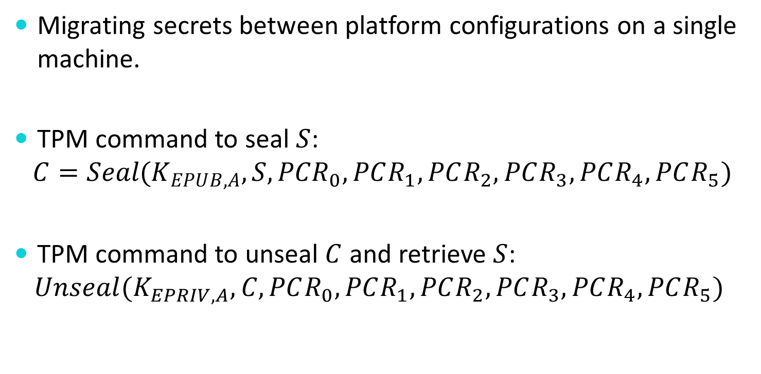
Problem 1a
Migrating secrets between platform configurations on a single machine.
TPM command to seal $S$:
$$C=Seal(K_{EPUB,A},S,PCR_{0},PCR_{1},PCR_{2},PCR_{3},PCR_{4},PCR_{5})$$
TPM command to unseal $C$ and retrieve $S$:
$$Unseal(K_{EPRIV,A},C,PCR_{0},PCR_{1},PCR_{2},PCR_{3},PCR_{4},PCR_{5})$$

Slide 3
Problem 1b
Patching part of the measured OS
Before applying the patch, the OS needs to seal $S$ to the set of new PCR values that match the patched OS and save this sealed value away
Then, after patching, the PCR values of the patched OS will update and allow this sealed value to be unsealed.
$$Seal(K_{EPUB,A},S,PCR_{0},PCR_{1},PCR_{2},PCR_{3},PC{R′}_{4},PC{R′}_{5})$$

Slide 4
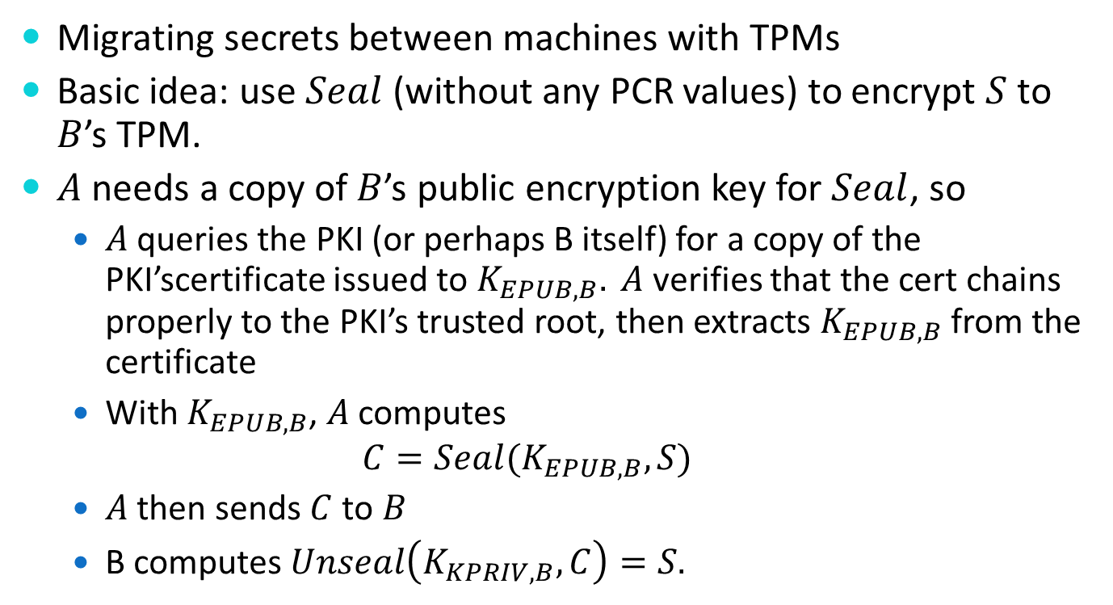
Problem 2
Migrating secrets between machines with TPMs
Basic idea: use $Seal$ (without any PCR values) to encrypt $S$ to $B$’s TPM.
$A$ needs a copy of $B$’s public encryption key for $Seal$, so
$A$ queries the PKI (or perhaps B itself) for a copy of the PKI’scertificate issued to $K_{EPUB,B}. A$ verifies that the cert chains properly to the PKI’s trusted root, then extracts $K_{EPUB,B}$ from the certificate
With $K_{EPUB,B}$, $A$ computes
$$C=Seal(K_{EPUB,B},S)$$
$A$ then sends $C$to $B$
B computes $Unseal\left(K_{KPRIV,B},C\right)=S.$

Slide 5
Problem 3
Migrating secrets between machines with TPMs with assurance of equivalent software stacks
Before sending $S$ to $B$ (in any form), $A$ should receive from $B$ some proof that $B^{′}s$ OS boot sequence (measured by PCRs 0-5) is the same as $A^{′}s.$
When $S$ is transmitted to $B$, $A$ should ensure that $S$ will only be accessible on $B$ if the same software stack is running on $B$ as on $A$ at the time the migration begins.

Slide 6
Problem 3a
“Before sending $S$ to $B$ (in any form), $A$ should receive from $B$ some proof that $B^{′}s$ OS boot sequence (measured by PCRs 0-5) is the same as $A^{′}s.$”
$A$ can request an attestation from $B$ to something that includes PCRs 0-5.
To make sure the attestation is “fresh”, $A$ should send a random challenge value to $B$ and ask $B$ to $Quote$ that.
$A$ → $B$: random value $R$ (say 128 bits of random)
$B$→ $A$: $Q=Quote(K_{SSIG,B},R, PCR_{0},PCR_{1},…, PCR_{5})$
$A$verifies the signature on $Q$, checks $R$ hasn’t changed, checks $PCR_{0},…, PCR_{5}.$

Slide 7
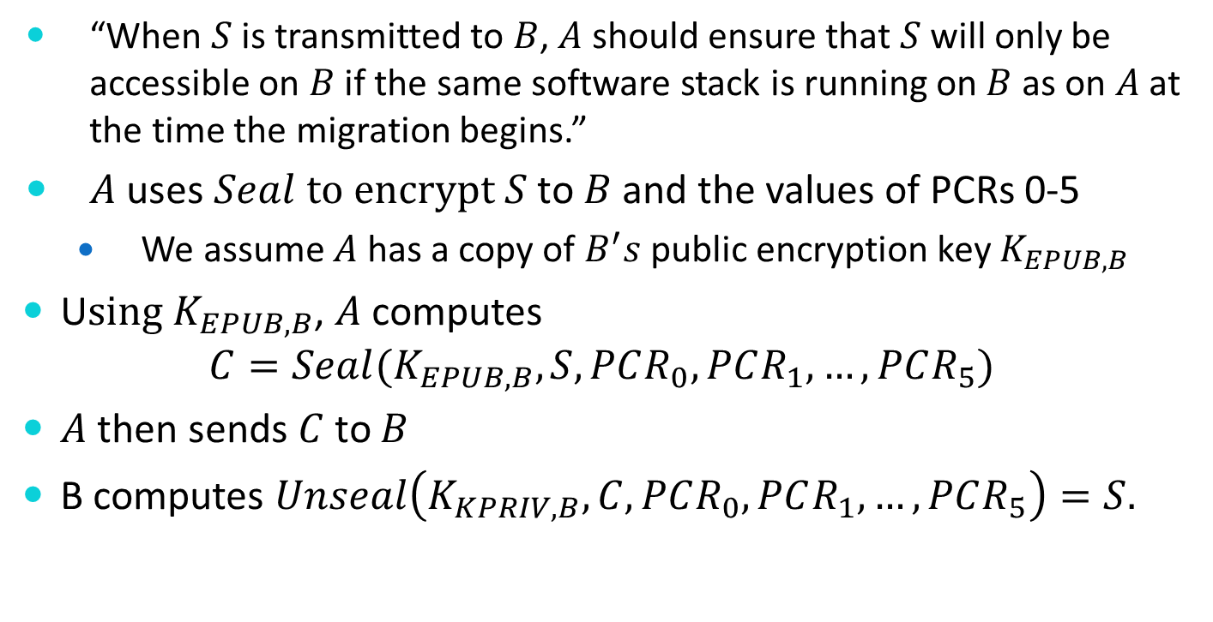
Problem 3b
“When $S$ is transmitted to $B$, $A$ should ensure that $S$ will only be accessible on $B$ if the same software stack is running on $B$ as on $A$ at the time the migration begins.”
$A$ uses $Seal$ $to encrypt S$ to $B$ and the values of PCRs 0-5
We assume $A$ has a copy of $B^{′}s$ public encryption key $K_{EPUB,B}$
U$sing K_{EPUB,B}$, $A$ computes
$$C=Seal(K_{EPUB,B},S, PCR_{0},PCR_{1},…, PCR_{5})$$
$A$ then sends $C$to $B$
B computes $Unseal\left(K_{KPRIV,B},C, PCR_{0}, PCR_{1}, …, PCR_{5}\right)=S.$

