Slide 1
Assignment #6 – Solutions

Slide 2
Problem 1
Show that $y$ is not a square modulo $N=pq$ without revealing the factorization of $N$.
Verifier generates 100 known squares $y_{i}={x_{i}}^{2}\operatorname{mod}{N}$.
Verifier randomly flips 100 coins $b_{i}∈\left\{0,1\right\}$.
Verifier forms 100 challenge values $z_{i}=y_{i}∙y^{b_{i}}\operatorname{mod}{N}$.
Verifier gives all of the $z_{i}$ to the prover.
Prover responds with the correct $b_{i}$ values.
Note that this interactive proof is not zero-knowledge since the prover can be used as an oracle to distinguish squares.

Slide 3
Problem 2
CA wants to certify only strong RSA keys.
Subject generates 100 strong RSA keys $N_{i}=p_{i}q_{i}$.
Subject gives all of the $N_{i}$ to the CA.
CA randomly selects an $j∈\left\{1, 2, …,100\right\}$.
Subject reveals $p_{i}$ and $q_{i}$ for all $i≠j$.
CA certifies $N_{j}$.
Note that this is a weak form of interactive proof typically known as “cut and choose”.
The probability of failure is 1 in 100 (not 1 in $2^{100}$).

Slide 4
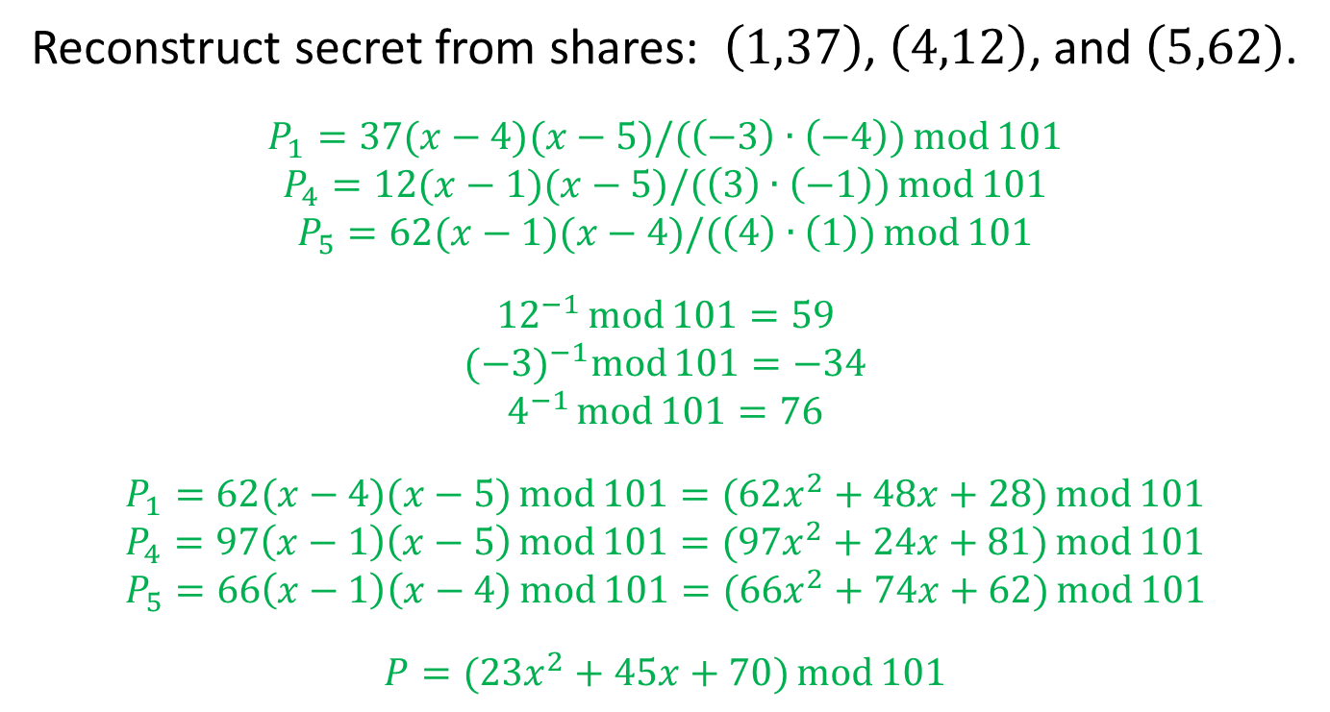
Problem 3
Reconstruct secret from shares: $\left(1,37\right)$, $\left(4,12\right)$, and $\left(5,62\right)$.
$$P_{1}=37(x−4)(x−5)/(\left(−3\right)∙\left(−4\right))\operatorname{mod}{101}$$
$$P_{4}=12(x−1)(x−5)/(\left(3\right)∙\left(−1\right))\operatorname{mod}{101}$$
$$P_{5}=62(x−1)(x−4)/(\left(4\right)∙\left(1\right))\operatorname{mod}{101}$$
$${12}^{−1}\operatorname{mod}{101}=59$$
$${(−3)}^{−1}\operatorname{mod}{101}=−34$$
$$4^{−1}\operatorname{mod}{101}=76$$
$$P_{1}=62(x−4)(x−5)\operatorname{mod}{101=(62x^{2}+48x+28)\operatorname{mod}{101}}$$
$$P_{4}=97\left(x−1\right)\left(x−5\right)\operatorname{mod}{101}=(97x^{2}+24x+81)\operatorname{mod}{101}$$
$$P_{5}=66\left(x−1\right)\left(x−4\right)\operatorname{mod}{101}=({66x}^{2}+74x+62)\operatorname{mod}{101}$$
$$P=(23x^{2}+45x+70)\operatorname{mod}{101}$$

Slide 5
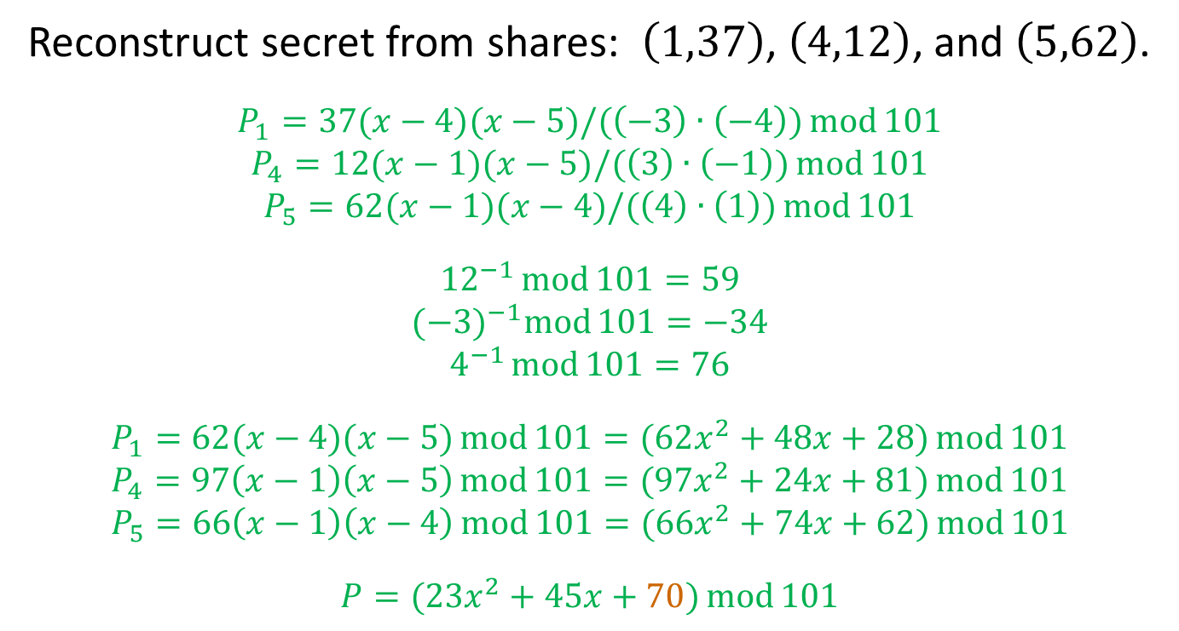
Problem 3
Reconstruct secret from shares: $\left(1,37\right)$, $\left(4,12\right)$, and $\left(5,62\right)$.
$$P_{1}=37(x−4)(x−5)/(\left(−3\right)∙\left(−4\right))\operatorname{mod}{101}$$
$$P_{4}=12(x−1)(x−5)/(\left(3\right)∙\left(−1\right))\operatorname{mod}{101}$$
$$P_{5}=62(x−1)(x−4)/(\left(4\right)∙\left(1\right))\operatorname{mod}{101}$$
$${12}^{−1}\operatorname{mod}{101}=59$$
$${(−3)}^{−1}\operatorname{mod}{101}=−34$$
$$4^{−1}\operatorname{mod}{101}=76$$
$$P_{1}=62(x−4)(x−5)\operatorname{mod}{101=(62x^{2}+48x+28)\operatorname{mod}{101}}$$
$$P_{4}=97\left(x−1\right)\left(x−5\right)\operatorname{mod}{101}=(97x^{2}+24x+81)\operatorname{mod}{101}$$
$$P_{5}=66\left(x−1\right)\left(x−4\right)\operatorname{mod}{101}=({66x}^{2}+74x+62)\operatorname{mod}{101}$$
$$P=(23x^{2}+45x+70)\operatorname{mod}{101}$$
$$S=70$$

Slide 6
Problem 3 (alternate approach)
Reconstruct secret from shares: $\left(1,37\right)$, $\left(4,12\right)$, and $\left(5,62\right)$.
$$P(x)=(a_{2}x^{2}+a_{1}x+a_{0})\operatorname{mod}{101}$$
$$P\left(1\right)=\left(a_{2}+a_{1}+a_{0}\right)\operatorname{mod}{101}=37$$
$$P\left(4\right)=\left(16a_{2}+{4a}_{1}+a_{0}\right)\operatorname{mod}{101}=12$$
$$P\left(5\right)=\left(25a_{2}+5a_{1}+a_{0}\right)\operatorname{mod}{101}=62$$
$$a_{2}=23$$
$$a_{1}=45$$
$$a_{0}=s=70$$

Slide 7
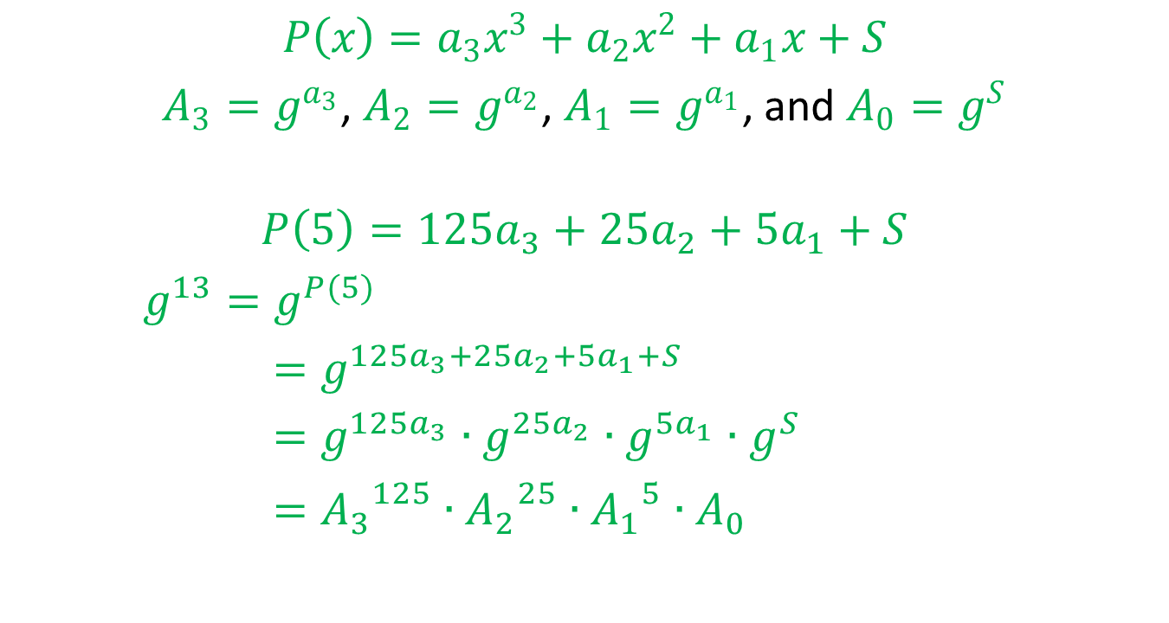
Problem 4
$$P\left(x\right)=a_{3}x^{3}+a_{2}x^{2}+a_{1}x+S$$
$A_{3}=g^{a_{3}}$, $A_{2}=g^{a_{2}}$, $A_{1}=g^{a_{1}}$, and $A_{0}=g^{S}$
$$P\left(5\right)=125a_{3}+25a_{2}+5a_{1}+S$$
$g^{13}=g^{P(5)}$
$=g^{125a_{3}+25a_{2}+5a_{1}+S}$
$=g^{125a_{3}}∙g^{25a_{2}}∙g^{5a_{1}}∙g^{S}$
$={A_{3}}^{125}∙{A_{2}}^{25}∙{A_{1}}^{5}∙A_{0}$

