Slide 1
Recognition
CSEP 576

Slide 2
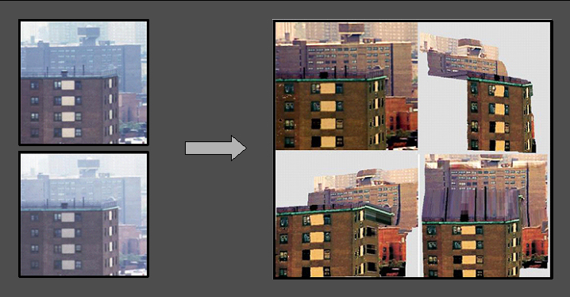
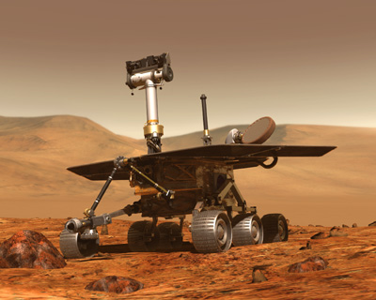
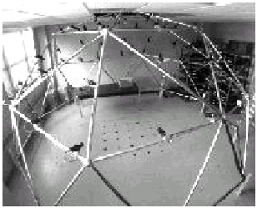
What we have seen so far:
Vision as Measurement Device
Real-time stereo on Mars
Physics-based Vision
Structure from Motion
Virtualized Reality
Slide Credit: Alyosha Efros

Slide 3
Visual Recognition
What does it mean to “see”?
  “What” is “where”, Marr 1982
Get computers to “see”

Slide 4

Visual Recognition
Verification
Is this a car?

Slide 5
Visual Recognition
Classification:
Is there a car in this picture?

Slide 6
Visual Recognition
Detection:
Where is the car in this picture?

Slide 7
Visual Recognition
Pose Estimation:

Slide 8
Visual Recognition
Activity Recognition:
What is he doing?
What is he doing?

Slide 9
Visual Recognition
Object Categorization:
Sky
Person
Tree
Horse
Car
Person
Bicycle
Road

Slide 10
Visual Recognition
Segmentation
Sky
Tree
Car
Person

Slide 11
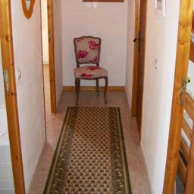

Object recognition
Is it really so hard?
Find the chair in this image
Output of normalized correlation
This is a chair

Slide 12
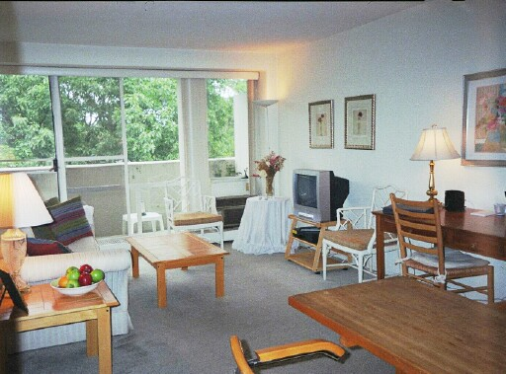
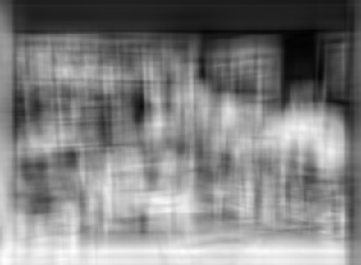
Object recognition
Is it really so hard?
Find the chair in this image
Pretty much garbage
Simple template matching is not going to make it

Slide 13
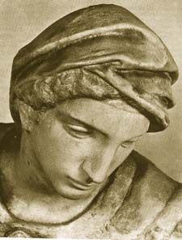
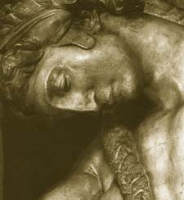
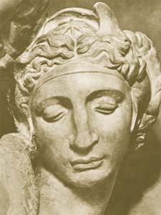
Challenges 1: view point variation
Michelangelo 1475-1564
slide by Fei Fei, Fergus & Torralba

Slide 14
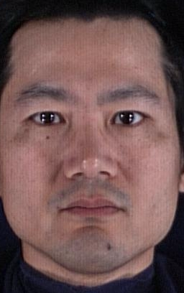
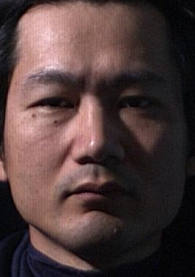
Challenges 2: illumination
slide credit: S. Ullman

Slide 15
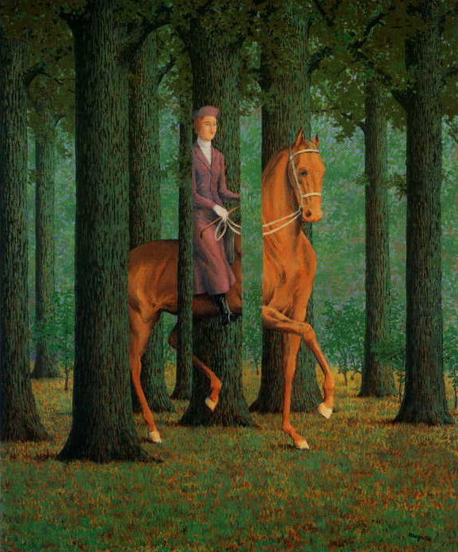
Challenges 3: occlusion
Magritte, 1957
slide by Fei Fei, Fergus & Torralba

Slide 16
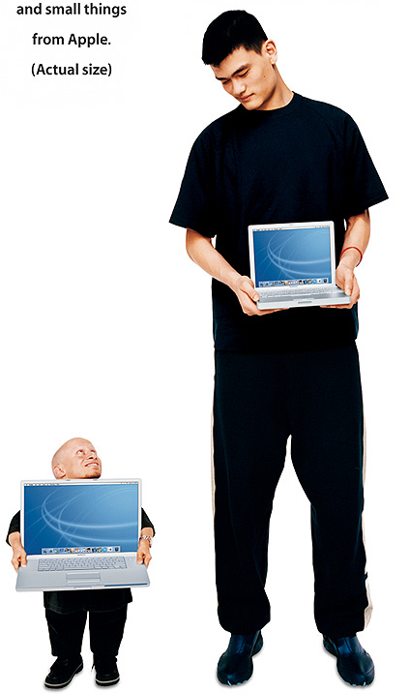
Challenges 4: scale
slide by Fei Fei, Fergus & Torralba

Slide 17
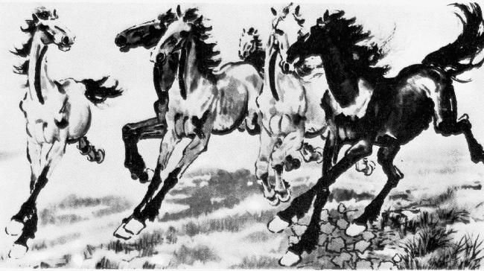
Challenges 5: deformation
slide by Fei Fei, Fergus & Torralba
Xu, Beihong 1943

Slide 18
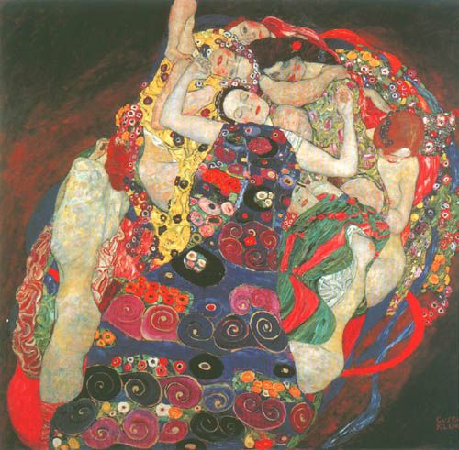
Challenges 6: background clutter
Klimt, 1913
slide by Fei Fei, Fergus & Torralba

Slide 19


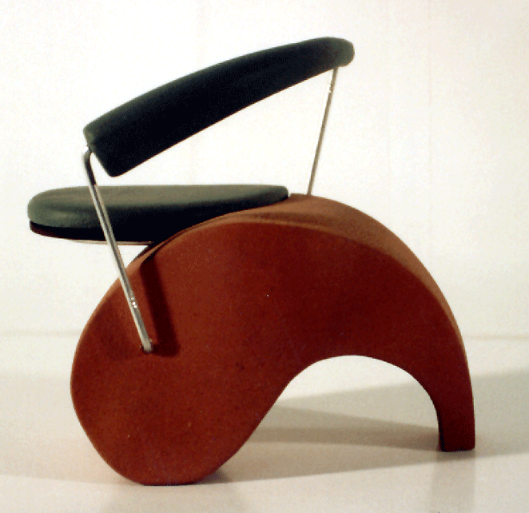
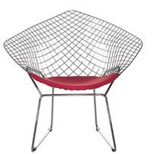


Challenges 7: object intra-class variation
slide by Fei-Fei, Fergus & Torralba

Slide 20
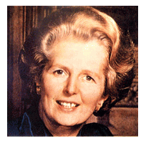
Let’s start with
Face detection
How to tell if a face is present?
Notes:
You can ask people to see what they come up with

Slide 21


One simple method: skin detection
skin
Skin pixels have a distinctive range of colors
  Corresponds to region(s) in RGB color space
    for visualization, only R and G components are shown above
Skin classifier
  A pixel X = (R,G,B) is skin if it is in the skin region
  But how to find this region?

Slide 22

Skin detection
Learn the skin region from examples
  Manually label pixels in one or more “training images” as skin or not skin
  Plot the training data in RGB space
    skin pixels shown in orange, non-skin pixels shown in blue
    some skin pixels may be outside the region, non-skin pixels inside. Why?
Skin classifier
  Given X = (R,G,B): how to determine if it is skin or not?

Slide 23
Skin classification techniques
Skin
Skin
Skin classifier
  Given X = (R,G,B): how to determine if it is skin or not?
  Nearest neighbor
    find labeled pixel closest to X
    choose the label for that pixel
  Data modeling
    Model the distribution that generates the data (Generative)
    Model the boundary (Discriminative)

Slide 24
Classification
Probabilistic
Supervised Learning
Discriminative vs. Generative
Ensemble methods
Linear models
Non-linear models

Slide 25
Let’s play with probability for a bit
Remembering simple stuff

Slide 26



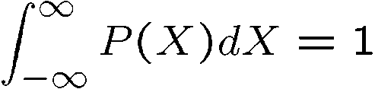

Probability
Basic probability
  X is a random variable
  P(X) is the probability that X achieves a certain value
  or
  Conditional probability: P(X | Y)
    probability of X given that we already know Y
continuous X
discrete X

Slide 27



Thumbtack & Probabilities
P(Heads) = θ, P(Tails) = 1-θ
Flips are i.i.d.:
  Independent events
  Identically distributed according to Binomial distribution
Sequence D of α_{H} Heads and α_{T} Tails
…
D={x_{i} | i=1…n}, P(D | θ ) = Π_{i}P(x_{i} | θ )

Slide 28
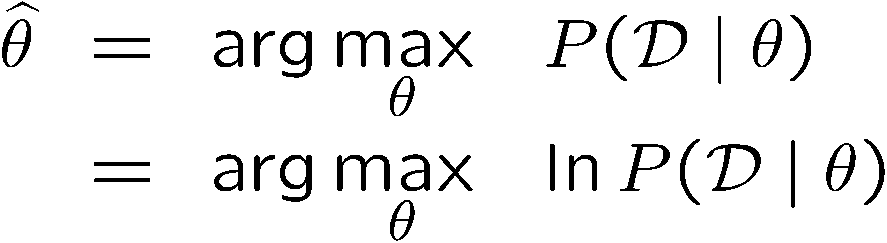
Maximum Likelihood Estimation
Data: Observed set D of α_{H} Heads and α_{T} Tails
Hypothesis: Binomial distribution
Learning: finding θ is an optimization problem
  What’s the objective function?
MLE: Choose θ to maximize probability of D

Slide 29
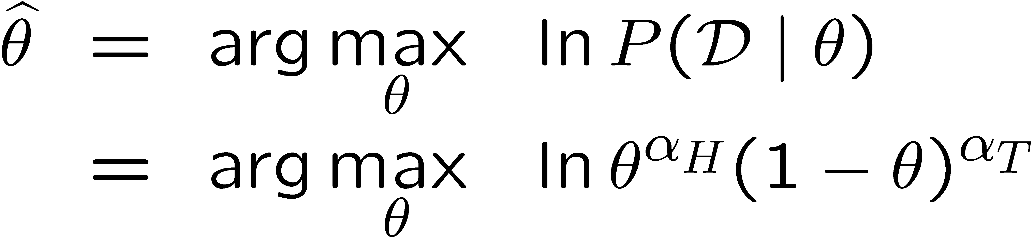
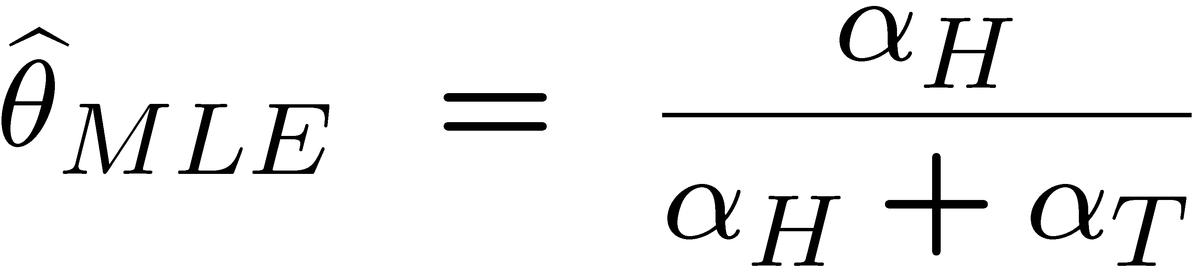
Parameter learning
Set derivative to zero, and solve!

Slide 30
But, how many flips do I need?
3 heads and 2 tails.
θ = 3/5, I can prove it!
What if I flipped 30 heads and 20 tails?
Same answer, I can prove it!
What’s better?
Umm… The more the merrier???

Slide 31
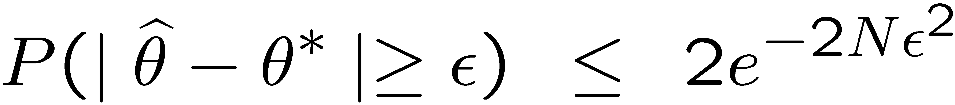
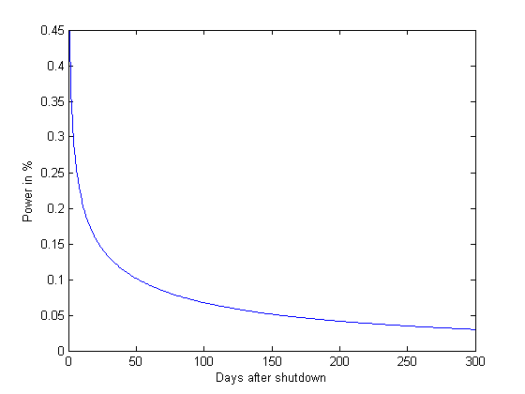
A bound
(from Hoeffding’s inequality)
For N =α_{H}+α_{T}, and
Let θ * be the true parameter, for any ε>0:
Exponential
Decay!
Prob. of Mistake
N
Notes:
Hoeffding’s inequality: provides a bound on the probability that a sum of random variables deviates from its expectation.

Slide 32
What if I have prior beliefs?
Wait, I know that the thumbtack is “close” to 50-50. What can you do for me now?
Rather than estimating a single θ, we obtain a distribution over possible values of θ
In the beginning
After observations
Observe flips
e.g.: {tails, tails}

Slide 33
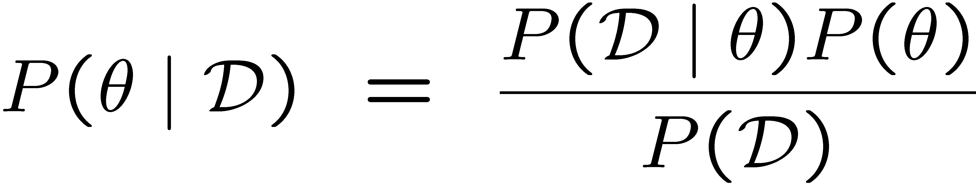
How to use Prior
Prior
Data Likelihood
Use Bayes rule:
Posterior
Normalization
Or equivalently:
Also, for uniform priors:
→ reduces to MLE objective
Notes:
Only made it to Gaussians. Probability review was pretty painful, look 15+ minutes.

Slide 34
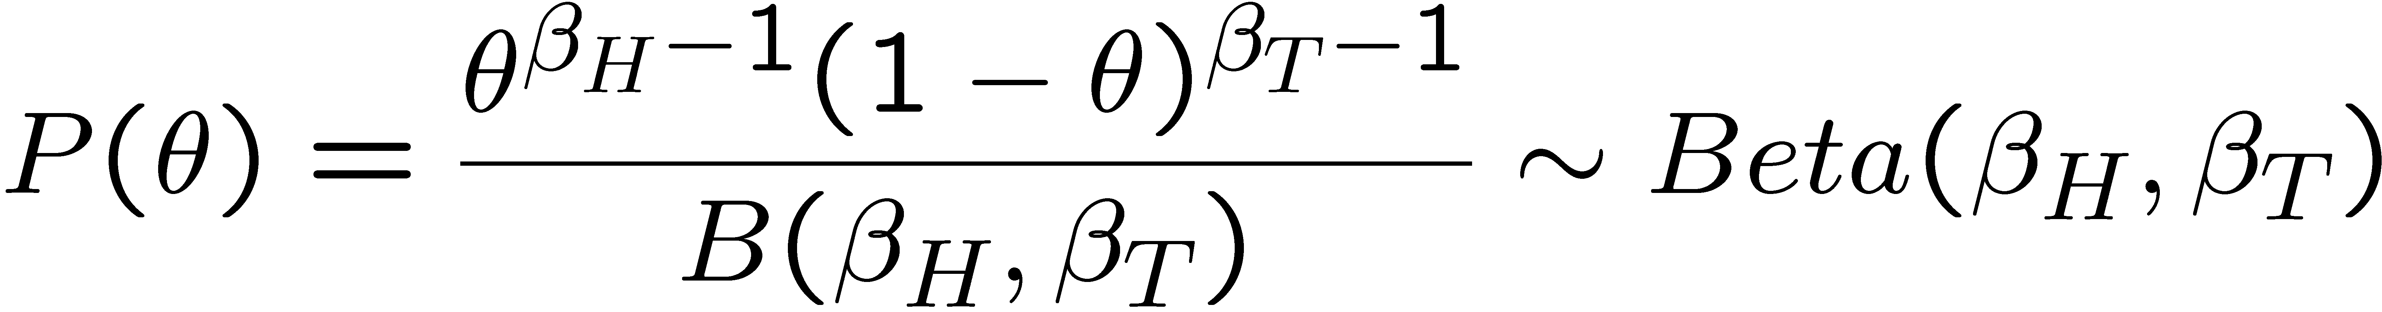
Beta prior distribution – P(θ)
Likelihood function:
Posterior:

Slide 35
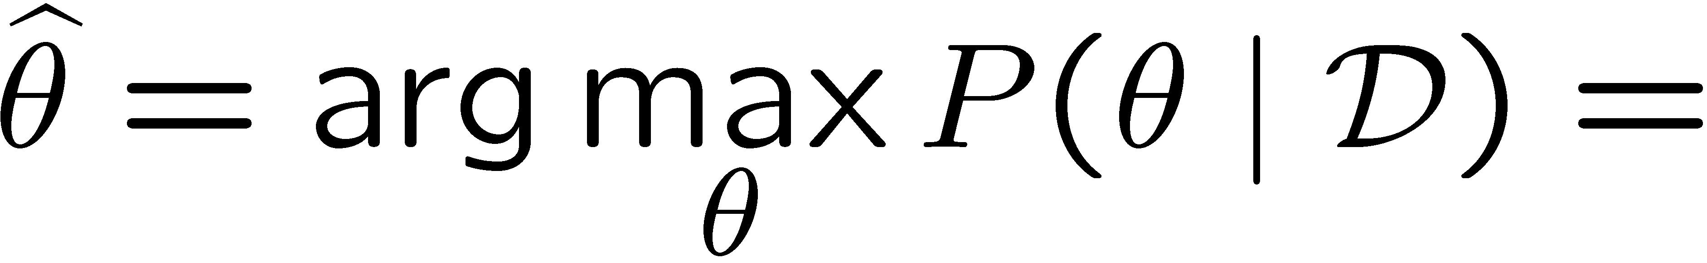
MAP for Beta distribution
MAP: use most likely parameter:

Slide 36
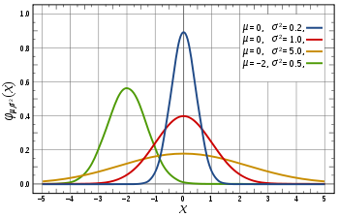
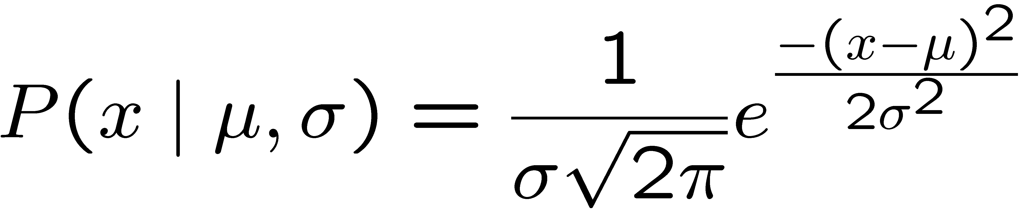
What about continuous variables?

Slide 37
We like Gaussians because
Affine transformation (multiplying by scalar and adding a constant) are Gaussian
  X ~ N(μ,σ²)
  Y = aX + b → Y ~ N(aμ+b,a²σ²)
Sum of Gaussians is Gaussian
  X ~ N(μ_{X},σ²_{X})
  Y ~ N(μ_{Y},σ²_{Y})
  Z = X+Y → Z ~ N(μ_{X}+μ_{Y}, σ²_{X}+σ²_{Y})
Easy to differentiate

Slide 38
Learning a Gaussian
x_{i} i = | Exam Score
0 | 85
1 | 95
2 | 100
3 | 12
… | …
99 | 89
Collect a bunch of data
  Hopefully, i.i.d. samples
  e.g., exam scores
Learn parameters
  Mean: μ
  Variance: σ

Slide 39
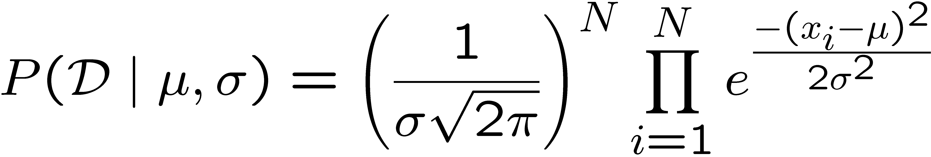
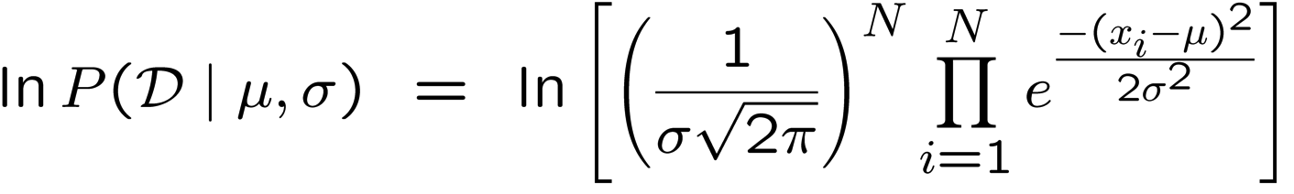
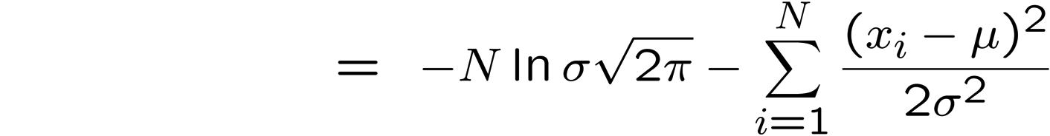
MLE for Gaussian:
Prob. of i.i.d. samples D={x₁,…,x_{N}}:
Log-likelihood of data:

Slide 40
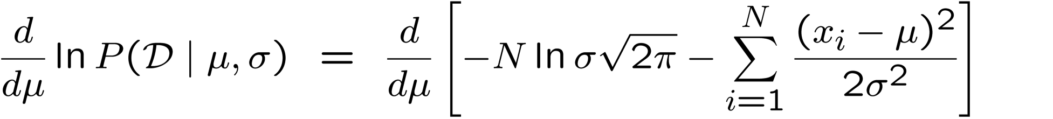
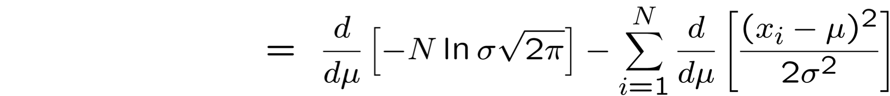
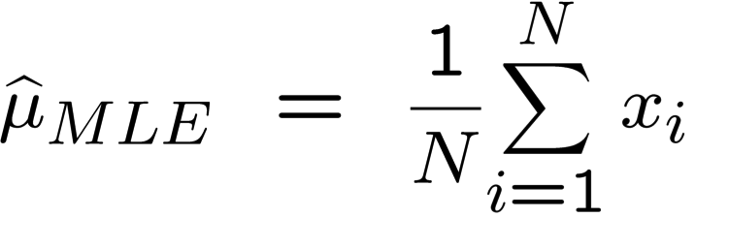
MLE for mean of a Gaussian
What’s MLE for mean?

Slide 41
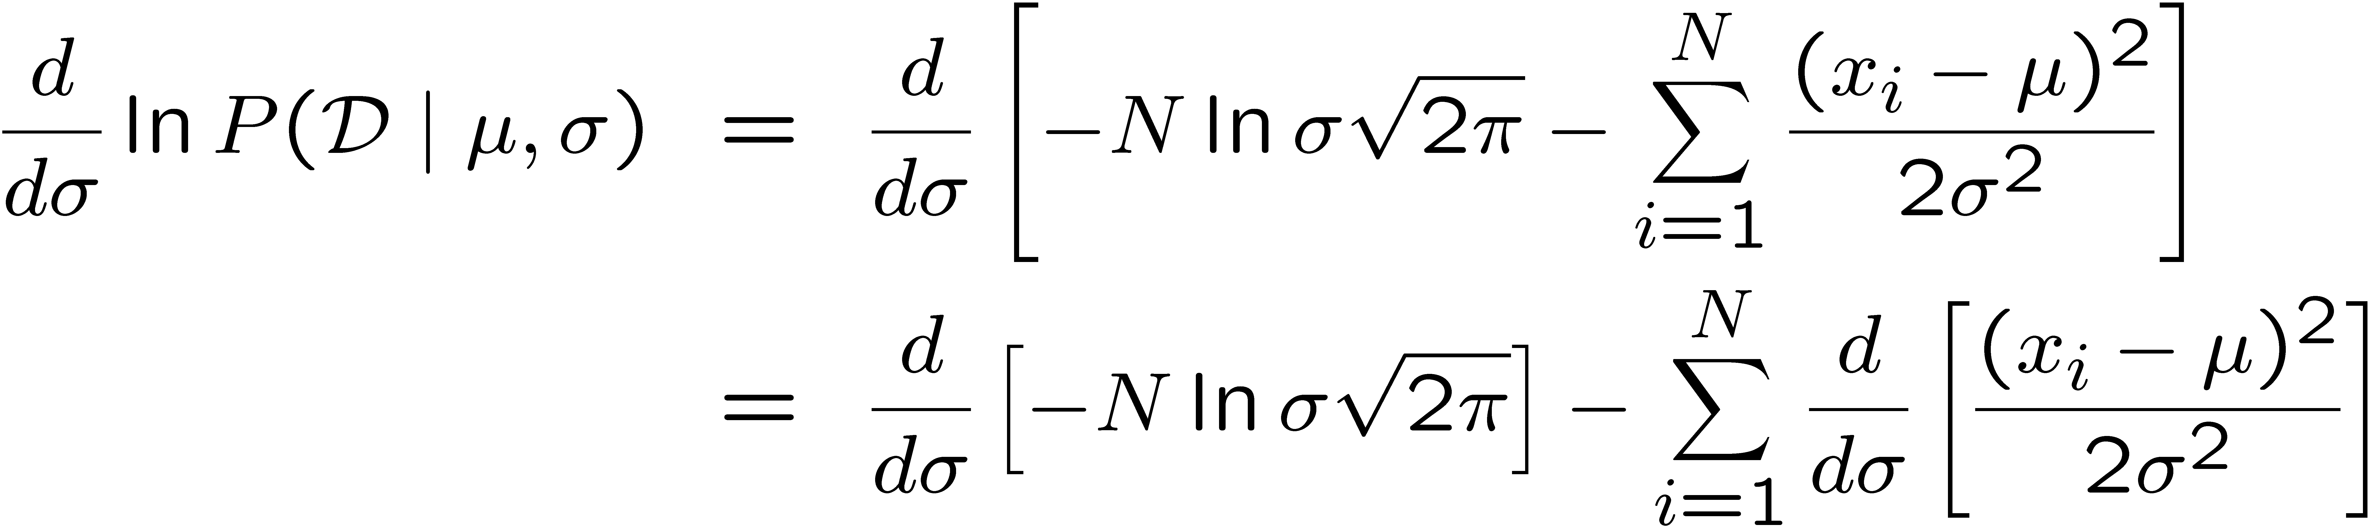
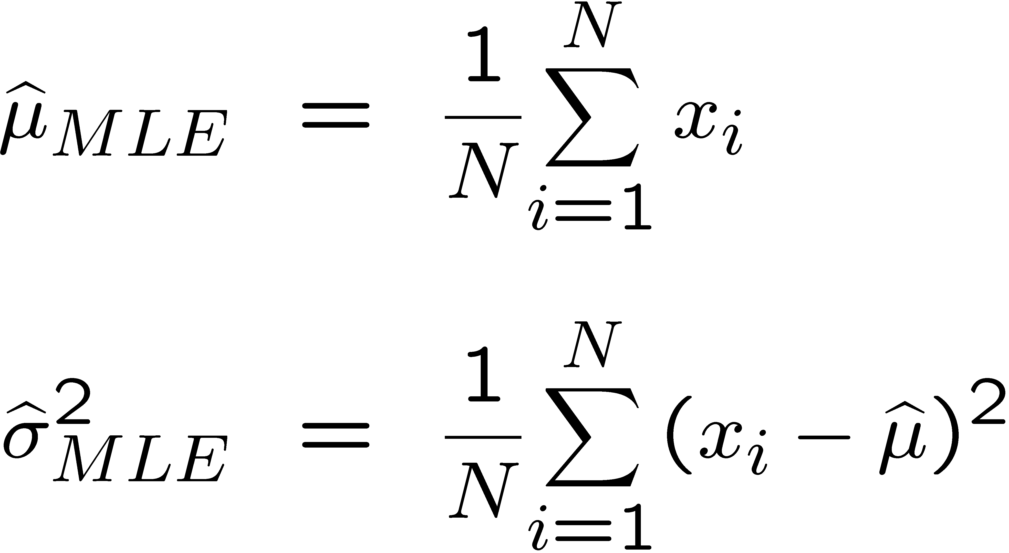
MLE for variance
Again, set derivative to zero:

Slide 42
Learning Gaussian parameters
MLE:

Slide 43


Fitting a Gaussian to Skin samples

Slide 44
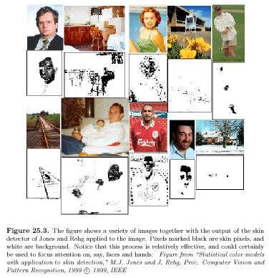
Skin detection results

Slide 45
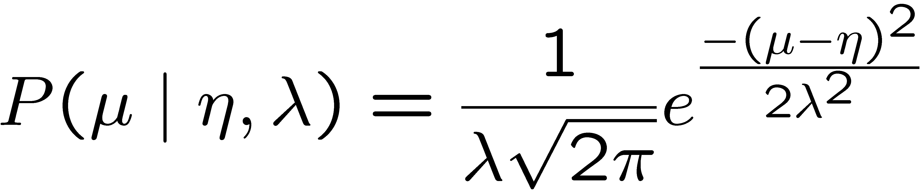
MAP
Conjugate priors
  Mean: Gaussian prior
  Variance: Wishart Distribution
Prior for mean:

Slide 46
Supervised Learning: find f
Given: Training set {(x_{i}, y_{i}) | i = 1 … n}
Find: A good approximation to f : X → Y
What is x?
What is y?

Slide 47




Simple Example: Digit Recognition
Input: images / pixel grids
Output: a digit 0-9
Setup:
  Get a large collection of example images, each labeled with a digit
  Note: someone has to hand label all this data!
  Want to learn to predict labels of new, future digit images
Features: ?
0
1
2
1
Screw You, I want to use Pixels :D
??

Slide 48
Lets take a probabilistic approach!!!
Can we directly estimate the data distribution P(X,Y)?
How do we represent these? How many parameters?
  Prior, P(Y):
    Suppose Y is composed of k classes
  Likelihood, P(X|Y):
    Suppose X is composed of n binary features

Slide 49
Conditional Independence
X is conditionally independent of Y given Z, if the probability distribution for X is independent of the value of Y, given the value of Z
e.g.,
Equivalent to:

Slide 50

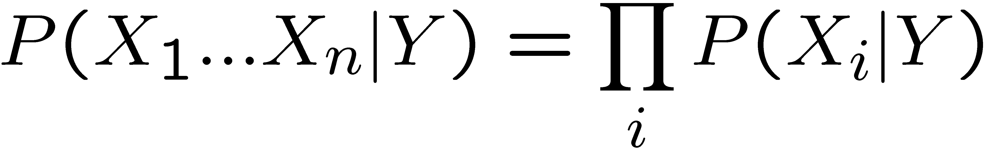
Naïve Bayes
Naïve Bayes assumption:
  Features are independent given class:
  More generally:

Slide 51

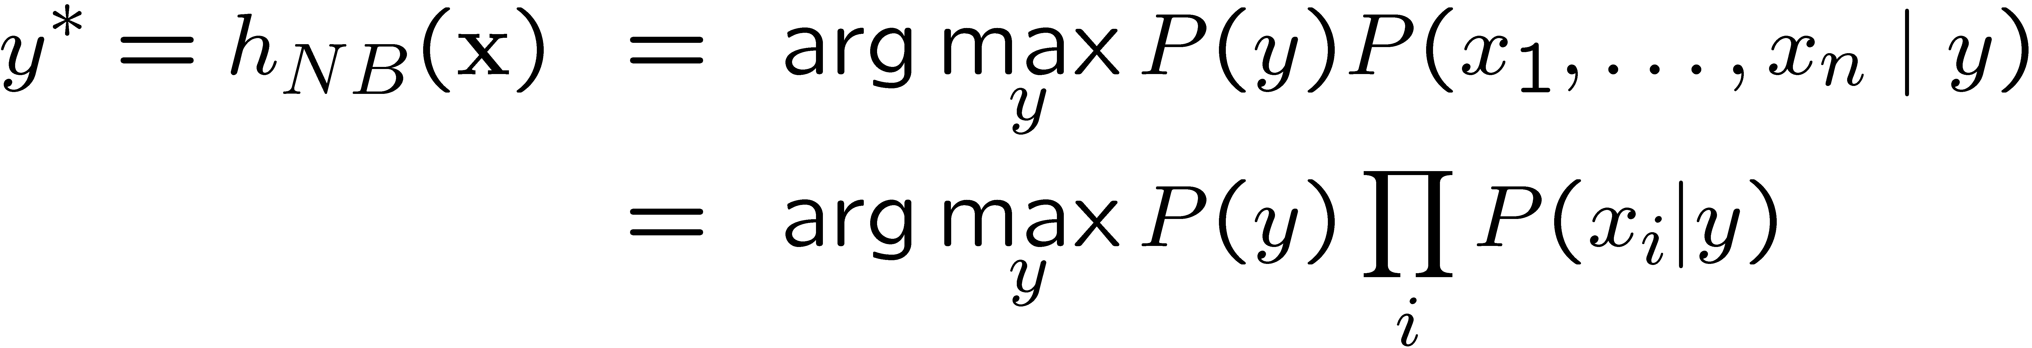
The Naïve Bayes Classifier
Given:
  Prior P(Y)
  n conditionally independent features X given the class Y
  For each X_{i}, we have likelihood P(X_{i}|Y)
Decision rule:
Y
X₁
X₂
X_{n}

Slide 52

A Digit Recognizer
Input: pixel grids
Output: a digit 0-9

Slide 53


Naïve Bayes for Digits (Binary Inputs)
Simple version:
  One feature F_{ij} for each grid position <i,j>
  Possible feature values are on / off, based on whether intensity is more or less than 0.5 in underlying image
  Each input maps to a feature vector, e.g.
  Here: lots of features, each is binary valued
Naïve Bayes model:
Are the features independent given class?
What do we need to learn?

Slide 54
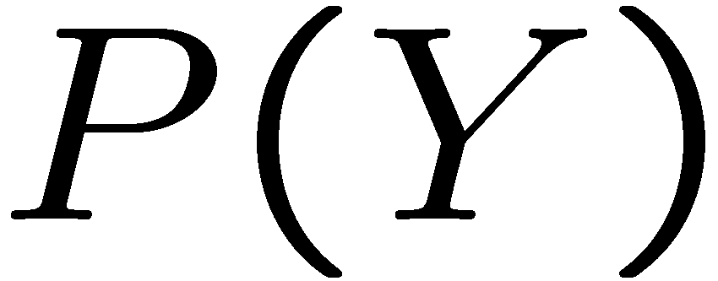


Example Distributions
1 | 0.1
2 | 0.1
3 | 0.1
4 | 0.1
5 | 0.1
6 | 0.1
7 | 0.1
8 | 0.1
9 | 0.1
0 | 0.1
1 | 0.01
2 | 0.05
3 | 0.05
4 | 0.30
5 | 0.80
6 | 0.90
7 | 0.05
8 | 0.60
9 | 0.50
0 | 0.80
1 | 0.05
2 | 0.01
3 | 0.90
4 | 0.80
5 | 0.90
6 | 0.90
7 | 0.25
8 | 0.85
9 | 0.60
0 | 0.80

Slide 55
MLE for the parameters of NB
Given dataset
  Count(A=a,B=b) number of examples where A=a and B=b
MLE for discrete NB, simply:
  Prior:
  Likelihood:

Slide 56
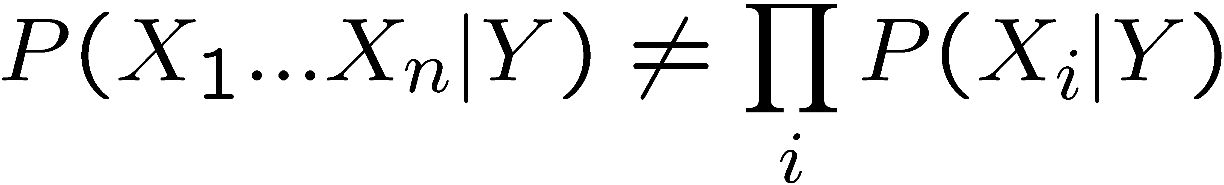
Violating the NB assumption
Usually, features are not conditionally independent:
  NB often performs well, even when assumption is violated
  [Domingos & Pazzani ’96] discuss some conditions for good performance

Slide 57












Smoothing
2 wins!!
Does this happen in vision?

Slide 58
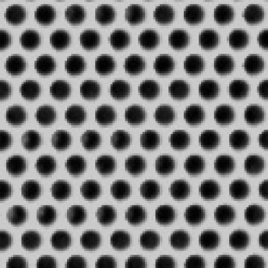



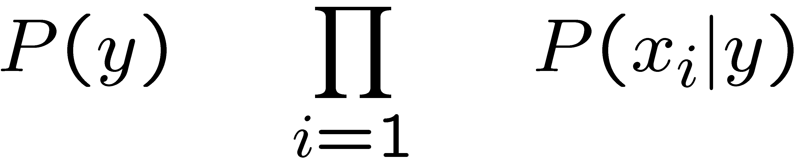
NB & Bag of words model

Slide 59
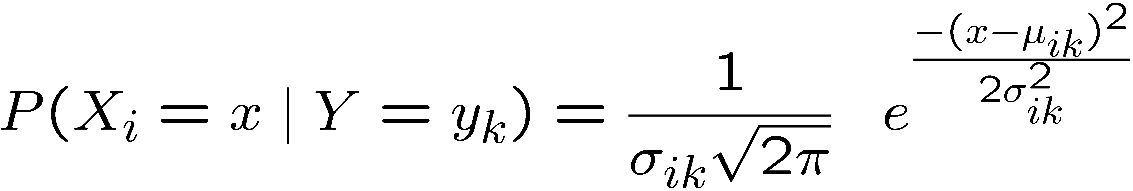
What about real Features?
What if we have continuous X_{i} ?
Eg., character recognition: X_{i} is i^{th} pixel
Gaussian Naïve Bayes (GNB):
Sometimes assume variance
is independent of Y (i.e., σ_{i}),
or independent of X_{i} (i.e., σ_{k})
or both (i.e., σ)

Slide 60
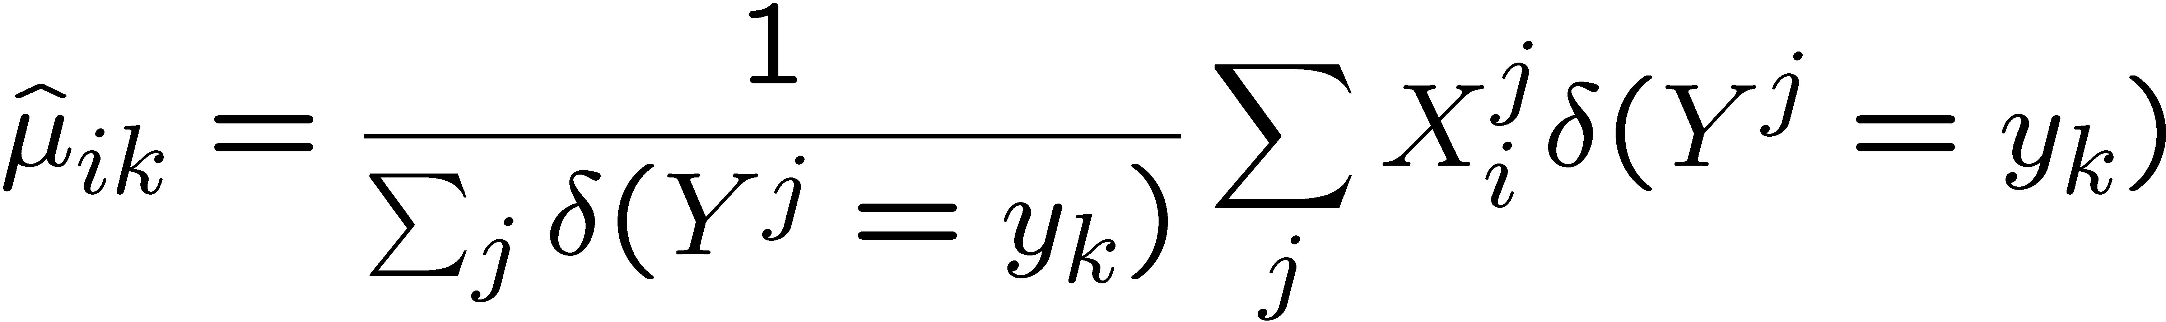
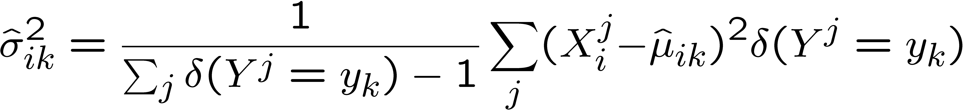
Estimating Parameters
Maximum likelihood estimates:
Mean:
Variance:
jth training example
δ(x)=1 if x true, else 0

Slide 61
another probabilistic approach!!!
Naïve Bayes: directly estimate the data distribution P(X,Y)!
  challenging due to size of distribution!
  make Naïve Bayes assumption: only need P(X_{i}|Y)!
But wait, we classify according to:
  max_{Y} P(Y|X)
Why not learn P(Y|X) directly?

Slide 62
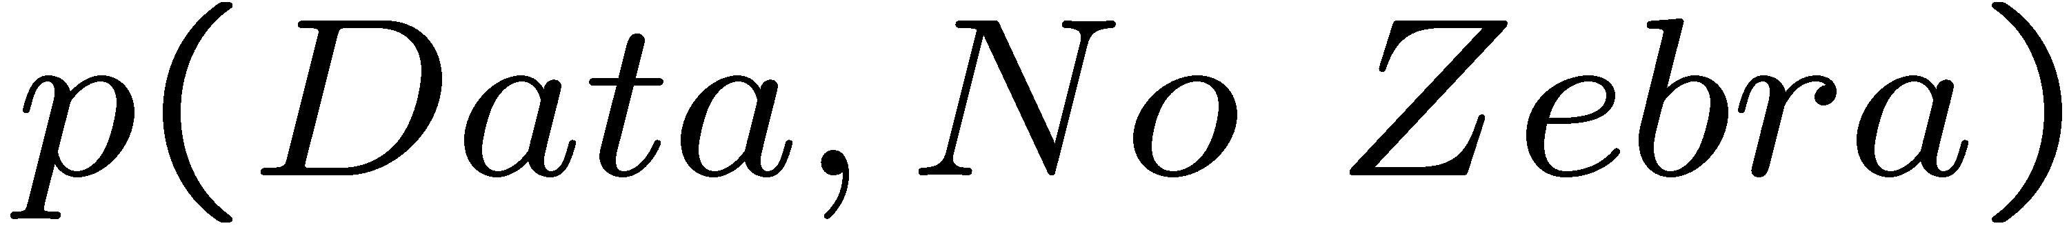
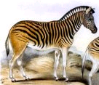







Discriminative vs. generative
Generative model
(The artist)
0.1
0.05
0
0
10
20
30
40
50
60
70
x = data
Discriminative model
(The lousy
painter)
1
0.5
0
0
10
20
30
40
50
60
70
x = data
Classification function
1
-1
0
10
20
30
40
50
60
70
80
x = data

Slide 63


Logistic Regression
Logistic function (Sigmoid):
Learn P(Y|X) directly!
  Assume a particular functional form
  Sigmoid applied to a linear function of the data:
Z

Slide 64
Logistic Regression: decision boundary
Prediction: Output the Y with highest P(Y|X)
  For binary Y, output Y=0 if
w.X+w₀ = 0
A Linear Classifier!

Slide 65


Loss functions / Learning Objectives: Likelihood v. Conditional Likelihood
Generative (Naïve Bayes) Loss function:
Data likelihood
But, discriminative (logistic regression) loss function:
Conditional Data Likelihood
  Doesn’t waste effort learning P(X) – focuses on P(Y|X) all that matters for classification
  Discriminative models cannot compute P(x^{j}|w)!

Slide 66



Conditional Log Likelihood
equal because y^{j} is in {0,1}
remaining steps: substitute definitions, expand logs, and simplify

Slide 67

Logistic Regression Parameter Estimation:
Maximize Conditional Log Likelihood
Good news: l(w) is concave function of w
        no locally optimal solutions!
Bad news: no closed-form solution to maximize l(w)
Good news: concave functions “easy” to optimize

Slide 68




Optimizing concave function – Gradient ascent
Conditional likelihood for Logistic Regression is concave !
Gradient ascent is simplest of optimization approaches
  e.g., Conjugate gradient ascent much better
Gradient:
Update rule:

Slide 69


Maximize Conditional Log Likelihood: Gradient ascent

Slide 70


Gradient Descent for LR
Gradient ascent algorithm: (learning rate η > 0)
do:
For i=1…n: (iterate over weights)
until “change” < ε
Loop over training examples!

Slide 71
Large parameters…
a=1
a=5
a=10
Maximum likelihood solution: prefers higher weights
  higher likelihood of (properly classified) examples close to decision boundary
  larger influence of corresponding features on decision
  can cause overfitting!!!
Regularization: penalize high weights
  again, more on this later in the quarter

Slide 72


How about MAP?
One common approach is to define priors on w
  Normal distribution, zero mean, identity covariance
Often called Regularization
  Helps avoid very large weights and overfitting
MAP estimate:

Slide 73
M(C)AP as Regularization
Add log p(w) to objective:
  Quadratic penalty: drives weights towards zero
  Adds a negative linear term to the gradients

Slide 74


MLE vs. MAP
Maximum conditional likelihood estimate
Maximum conditional a posteriori estimate

Slide 75
Logistic regression v. Naïve Bayes
Consider learning f: X → Y, where
  X is a vector of real-valued features, < X₁ … X_{n} >
  Y is boolean
Could use a Gaussian Naïve Bayes classifier
  assume all X_{i} are conditionally independent given Y
  model P(X_{i} | Y = y_{k}) as Gaussian N(μ_{ik},σ_{i})
  model P(Y) as Bernoulli(θ,1-θ)
What does that imply about the form of P(Y|X)?

Slide 76



Derive form for P(Y|X) for continuous X_{i}
up to now, all arithmetic
only for Naïve Bayes models
Can we solve for w_{i} ?
Yes, but only in Gaussian case
Looks like a setting for w₀?

Slide 77


Ratio of class-conditional probabilities
Linear function! Coefficents expressed with original Gaussian parameters!
…

Slide 78


Derive form for P(Y|X) for continuous X_{i}

Slide 79
Gaussian Naïve Bayes vs. Logistic Regression
Set of Gaussian
Naïve Bayes parameters
(feature variance
independent of class label)
Set of Logistic
Regression parameters
Can go both ways, we only did one way
Representation equivalence
  But only in a special case!!! (GNB with class-independent variances)
But what’s the difference???
LR makes no assumptions about P(X|Y) in learning!!!
Loss function!!!
  Optimize different functions ! Obtain different solutions

Slide 80
Naïve Bayes vs. Logistic Regression
Consider Y boolean, X_{i} continuous, X=<X₁ ... X_{n}>
Number of parameters:
Naïve Bayes: 4n +1
Logistic Regression: n+1
Estimation method:
Naïve Bayes parameter estimates are uncoupled
Logistic Regression parameter estimates are coupled

Slide 81
Naïve Bayes vs. Logistic Regression
[Ng & Jordan, 2002]
Generative vs. Discriminative classifiers
Asymptotic comparison
  (# training examples → infinity)
  when model correct
    GNB (with class independent variances) and
    LR produce identical classifiers
  when model incorrect
    LR is less biased – does not assume conditional independence
      therefore LR expected to outperform GNB

Slide 82
Naïve Bayes vs. Logistic Regression
[Ng & Jordan, 2002]
Generative vs. Discriminative classifiers
Non-asymptotic analysis
  convergence rate of parameter estimates,
    (n = # of attributes in X)
    Size of training data to get close to infinite data solution
    Naïve Bayes needs O(log n) samples
    Logistic Regression needs O(n) samples
  GNB converges more quickly to its (perhaps less helpful) asymptotic estimates

Slide 83
What you should know about Logistic Regression (LR)
Gaussian Naïve Bayes with class-independent variances representationally equivalent to LR
  Solution differs because of objective (loss) function
In general, NB and LR make different assumptions
  NB: Features independent given class ! assumption on P(X|Y)
  LR: Functional form of P(Y|X), no assumption on P(X|Y)
LR is a linear classifier
  decision rule is a hyperplane
LR optimized by conditional likelihood
  no closed-form solution
  concave ! global optimum with gradient ascent
  Maximum conditional a posteriori corresponds to regularization
Convergence rates
  GNB (usually) needs less data
  LR (usually) gets to better solutions in the limit

Slide 84


Slide 85

Decision Boundary

Slide 86
Voting (Ensemble Methods)
Instead of learning a single classifier, learn many weak classifiers that are good at different parts of the data
Output class: (Weighted) vote of each classifier
  Classifiers that are most “sure” will vote with more conviction
  Classifiers will be most “sure” about a particular part of the space
  On average, do better than single classifier!
But how???
  force classifiers to learn about different parts of the input space? different subsets of the data?
  weigh the votes of different classifiers?

Slide 87
BAGGing = Bootstrap AGGregation
(Breiman, 1996)
for i = 1, 2, …, K:
  T_{i} ← randomly select M training instances
  with replacement
  h_{i} ← learn(T_{i}) [ID3, NB, kNN, neural net, …]
Now combine the T_{i} together with uniform voting (w_{i}=1/K for all i)

Slide 89
Decision Boundary

Slide 90

shades of blue/red indicate strength of vote for particular classification

Slide 91
Fighting the bias-variance tradeoff
Simple (a.k.a. weak) learners are good
  e.g., naïve Bayes, logistic regression, decision stumps (or shallow decision trees)
  Low variance, don’t usually overfit
Simple (a.k.a. weak) learners are bad
  High bias, can’t solve hard learning problems
Can we make weak learners always good???
  No!!!
  But often yes…

Slide 92
Boosting
[Schapire, 1989]
Idea: given a weak learner, run it multiple times on (reweighted) training data, then let learned classifiers vote
On each iteration t:
  weight each training example by how incorrectly it was classified
  Learn a hypothesis – h_{t}
  A strength for this hypothesis – α_{t}
Final classifier:
Practically useful
Theoretically interesting

Slide 93

time = 0
blue/red = class
size of dot = weight
weak learner =
Decision stub:
horizontal or vertical line

Slide 94

time = 1
this hypothesis has 15%
error
and so does
this ensemble, since
the ensemble contains
just this one hypothesis

Slide 95

time = 2

Slide 96

time = 3

Slide 97

time = 13

Slide 98

time = 100

Slide 99

time = 300
overfitting!!

Slide 100
Learning from weighted data
Consider a weighted dataset
  D(i) – weight of i th training example (x^{i},y^{i})
  Interpretations:
    i th training example counts as if it occurred D(i) times
    If I were to “resample” data, I would get more samples of “heavier” data points
Now, always do weighted calculations:
  e.g., MLE for Naïve Bayes, redefine Count(Y=y) to be weighted count:
  setting D(j)=1 (or any constant value!), for all j, will recreates unweighted case

Slide 101


How? Many possibilities. Will see one shortly!
Final Result: linear sum of “base” or “weak” classifier outputs.

Slide 102




Slide 103



What α_{t} to choose for hypothesis h_{t}?
[Schapire, 1989]
Idea: choose α_{t} to minimize a bound on training error!
Where

Slide 104


What α_{t} to choose for hypothesis h_{t}?
[Schapire, 1989]
Idea: choose α_{t} to minimize a bound on training error!
Where
And
If we minimize ∏_{t} Z_{t}, we minimize our training error!!!
We can tighten this bound greedily, by choosing α_{t} and h_{t} on each iteration to minimize Z_{t.}
h_{t} is estimated as a black box, but can we solve for α_{t}?
This equality isn’t obvious! Can be shown with algebra (telescoping sums)!

Slide 105
Summary: choose α_{t} to minimize error bound
[Schapire, 1989]
We can squeeze this bound by choosing α_{t} on each iteration to minimize Z_{t.}
For boolean Y: differentiate, set equal to 0, there is a closed form solution! [Freund & Schapire ’97]:

Slide 106

Strong, weak classifiers
If each classifier is (at least slightly) better than random: ε_{t} < 0.5
Another bound on error:
What does this imply about the training error?
  Will get there exponentially fast!
Is it hard to achieve better than random training error?
Notes:
Why will it reach zero?
our bound is exp(-x), for ever increasing x!!! (al long as we get better than 50%)

Slide 107

Boosting results – Digit recognition
[Schapire, 1989]
Test error
Training error
Boosting:
  Seems to be robust to overfitting
  Test error can decrease even after training error is zero!!!

Slide 108

Boosting generalization error bound
[Freund & Schapire, 1996]
Constants:
T: number of boosting rounds
  Higher T → Looser bound, what does this imply?
d: VC dimension of weak learner, measures complexity of classifier
  Higher d → bigger hypothesis space → looser bound
m: number of training examples
  more data → tighter bound

Slide 109
Boosting generalization error bound
[Freund & Schapire, 1996]
Constants:
T: number of boosting rounds:
  Higher T → Looser bound, what does this imply?
d: VC dimension of weak learner, measures complexity of classifier
  Higher d → bigger hypothesis space → looser bound
m: number of training examples
  more data → tighter bound
Theory does not match practice:
  Robust to overfitting
  Test set error decreases even after training error is zero
Need better analysis tools
  we’ll come back to this later in the quarter

Slide 110


Logistic Regression as Minimizing Loss
Logistic regression assumes:
And tries to maximize data likelihood, for Y={-1,+1}:
Equivalent to minimizing log loss:

Slide 111


Boosting and Logistic Regression
Logistic regression equivalent to minimizing log loss:
Boosting minimizes similar loss function:
Both smooth approximations of 0/1 loss!

Slide 112

Face detection
State-of-the-art face detection demo
(Courtesy Boris Babenko)

Slide 113


Face detection and recognition
Detection
Recognition
“Sally”

Slide 114

Face detection
Where are the faces?

Slide 115
Face Detection
What kind of features?
What kind of classifiers?

Slide 116

Image Features
“Rectangle filters”
+1
-1
Value =
∑ (pixels in white area) –
∑ (pixels in black area)
Notes:
For real problems results are only as good as the features used...
This is the main piece of ad-hoc (or domain) knowledge
Rather than the pixels, we have selected a very large set of simple functions
Sensitive to edges and other critcal features of the image
** At multiple scales
Since the final classifier is a perceptron it is important that the features be non-linear… otherwise the final classifier will be a simple perceptron.
We introduce a threshold to yield binary features

Slide 117


Feature extraction
“Rectangular” filters
  Feature output is difference between adjacent regions
  Efficiently computable with integral image: any sum can be computed in constant time
  Avoid scaling images scale features directly for same cost
Viola & Jones, CVPR 2001
K. Grauman, B. Leibe
Notes:
117

Slide 118
Sums of rectangular regions
How do we compute the sum of the pixels in the red box?
243 | 239 | 240 | 225 | 206 | 185 | 188 | 218 | 211 | 206 | 216 | 225
242 | 239 | 218 | 110 | 67 | 31 | 34 | 152 | 213 | 206 | 208 | 221
243 | 242 | 123 | 58 | 94 | 82 | 132 | 77 | 108 | 208 | 208 | 215
235 | 217 | 115 | 212 | 243 | 236 | 247 | 139 | 91 | 209 | 208 | 211
233 | 208 | 131 | 222 | 219 | 226 | 196 | 114 | 74 | 208 | 213 | 214
232 | 217 | 131 | 116 | 77 | 150 | 69 | 56 | 52 | 201 | 228 | 223
232 | 232 | 182 | 186 | 184 | 179 | 159 | 123 | 93 | 232 | 235 | 235
232 | 236 | 201 | 154 | 216 | 133 | 129 | 81 | 175 | 252 | 241 | 240
235 | 238 | 230 | 128 | 172 | 138 | 65 | 63 | 234 | 249 | 241 | 245
237 | 236 | 247 | 143 | 59 | 78 | 10 | 94 | 255 | 248 | 247 | 251
234 | 237 | 245 | 193 | 55 | 33 | 115 | 144 | 213 | 255 | 253 | 251
248 | 245 | 161 | 128 | 149 | 109 | 138 | 65 | 47 | 156 | 239 | 255
190 | 107 | 39 | 102 | 94 | 73 | 114 | 58 | 17 | 7 | 51 | 137
23 | 32 | 33 | 148 | 168 | 203 | 179 | 43 | 27 | 17 | 12 | 8
17 | 26 | 12 | 160 | 255 | 255 | 109 | 22 | 26 | 19 | 35 | 24
After some pre-computation, this can be done in constant time for any box.
This “trick” is commonly used for computing Haar wavelets (a fundemental building block of many object recognition approaches.)

Slide 119
Sums of rectangular regions
The trick is to compute an “integral image.” Every pixel is the sum of its neighbors to the upper left.
Sequentially compute using:

Slide 120
Sums of rectangular regions
 |  | A |  |  |  |  |  |  | B
 |  | C |  |  |  |  |  |  | D
Solution is found using:
A + D – B - C
What if the position of the box lies between pixels?

Slide 121

Large library of filters
  Considering all possible filter parameters: position, scale, and type:
180,000+ possible features associated with each 24 x 24 window
Use AdaBoost both to select the informative features and to form the classifier
Viola & Jones, CVPR 2001
Notes:
121

Slide 122
Feature selection
For a 24x24 detection region, the number of possible rectangle features is ~160,000!
At test time, it is impractical to evaluate the entire feature set
Can we create a good classifier using just a small subset of all possible features?
How to select such a subset?

Slide 123


AdaBoost for feature+classifier selection
Want to select the single rectangle feature and threshold that best separates positive (faces) and negative (non-faces) training examples, in terms of weighted error.
Resulting weak classifier:
For next round, reweight the examples according to errors, choose another filter/threshold combo.
…
Outputs of a possible rectangle feature on faces and non-faces.
Viola & Jones, CVPR 2001
Notes:
123

Slide 124

AdaBoost: Intuition
Consider a 2-d feature space with positive and negative examples.
Each weak classifier splits the training examples with at least 50% accuracy.
Examples misclassified by a previous weak learner are given more emphasis at future rounds.
Figure adapted from Freund and Schapire
124
K. Grauman, B. Leibe
Notes:
124

Slide 125
AdaBoost: Intuition
125
K. Grauman, B. Leibe
Notes:
125

Slide 126
AdaBoost: Intuition
Final classifier is combination of the weak classifiers
126
K. Grauman, B. Leibe
Notes:
126

Slide 127

Final classifier is combination of the weak ones, weighted according to error they had.

Slide 128


AdaBoost Algorithm
Start with uniform weights on training examples
{x₁,…x_{n}}
For T rounds
Find the best threshold and polarity for each feature, and return error.
Re-weight the examples:
Incorrectly classified -> more weight
Correctly classified -> less weight
Notes:
128

Slide 129

Picking the best classifier
Efficient single pass approach:
At each sample compute:
= min ( S + (T – S), S + (T – S) )
Find the minimum value of , and use the value of the corresponding sample as the threshold.
S = sum of samples below the current sample
T = total sum of all samples

Slide 130
Measuring classification performance
Confusion matrix
Accuracy
  (TP+TN)/
  (TP+TN+FP+FN)
True Positive Rate=Recall
  TP/(TP+FN)
False Positive Rate
  FP/(FP+TN)
Precision
  TP/(TP+FP)
F1 Score
  2*Recall*Precision/
  (Recall+Precision)
 |  | Predicted class
 |  | Class1 | Class2 | Class3
Actual class | Class1 | 40 | 1 | 6
 | Class2 | 3 | 25 | 7
 | Class3 | 4 | 9 | 10
 |  | Predicted
 |  | Positive | Negative
Actual | Positive | True Positive | False Negative
 | Negative | False Positive | True Negative
Notes:
Compare to the output of classifier to the actual label
In the case of binary classification, postive and negative
Confusion matrix, each entry show the frequency of will show actual value, predicted value.
True positive, the number of positive examples that has been correctly classified as positive. False positive, negative, positive

Slide 131

Boosting for face detection
First two features selected by boosting:
This feature combination can yield 100% detection rate and 50% false positive rate

Slide 132

Boosting for face detection
A 200-feature classifier can yield 95% detection rate and a false positive rate of 1 in 14084
Is this good enough?
Receiver operating characteristic (ROC) curve

Slide 133
Attentional cascade
We start with simple classifiers which reject many of the negative sub-windows while detecting almost all positive sub-windows
Positive response from the first classifier triggers the evaluation of a second (more complex) classifier, and so on
A negative outcome at any point leads to the immediate rejection of the sub-window
T
T
T
IMAGE
SUB-WINDOW
T
FACE
Classifier 1
Classifier 2
Classifier 3
F
F
F
NON-FACE
NON-FACE
NON-FACE

Slide 134
Attentional cascade
Chain classifiers that are progressively more complex and have lower false positive rates:
Receiver operating characteristic
% False Pos
0
50
vs
false
neg
determined by
0 100
% Detection
T
T
T
IMAGE
SUB-WINDOW
T
FACE
Classifier 1
Classifier 2
Classifier 3
F
F
F
NON-FACE
NON-FACE
NON-FACE
Notes:
In general simple classifiers, while they are more efficient, they are also weaker.
We could define a computational risk hierarchy (in analogy with structural risk minimization)…
A nested set of classifier classes
The training process is reminiscent of boosting…
- previous classifiers reweight the examples used to train subsequent classifiers
The goal of the training process is different
- instead of minimizing errors minimize false positives

Slide 135
Attentional cascade
The detection rate and the false positive rate of the cascade are found by multiplying the respective rates of the individual stages
A detection rate of 0.9 and a false positive rate on the order of 10⁻⁶ can be achieved by a
10-stage cascade if each stage has a detection rate of 0.99 (0.99¹⁰ ≈ 0.9) and a false positive rate of about 0.30 (0.3¹⁰ ≈ 6×10⁻⁶)
T
T
T
IMAGE
SUB-WINDOW
T
FACE
Classifier 1
Classifier 2
Classifier 3
F
F
F
NON-FACE
NON-FACE
NON-FACE

Slide 136
Training the cascade
Set target detection and false positive rates for each stage
Keep adding features to the current stage until its target rates have been met
  Need to lower AdaBoost threshold to maximize detection
  (as opposed to minimizing total classification error)
  Test on a validation set
If the overall false positive rate is not low enough, then add another stage
Use false positives from current stage as the negative training examples for the next stage

Slide 137







Viola-Jones Face Detector: Summary
Train cascade of classifiers with AdaBoost
Apply to each subwindow
Faces
New image
Selected features, thresholds, and weights
Non-faces
Train with 5K positives, 350M negatives
Real-time detector using 38 layer cascade
6061 features in final layer
[Implementation available in OpenCV: http://www.intel.com/technology/computing/opencv/]
Notes:
137

Slide 138

The implemented system
Training Data
  5000 faces
    All frontal, rescaled to
    24x24 pixels
  300 million non-faces
    9500 non-face images
  Faces are normalized
    Scale, translation
Many variations
  Across individuals
  Illumination
  Pose
Notes:
This situation with negative examples is actually quite common… where negative examples are free.

Slide 139
System performance
Training time: “weeks” on 466 MHz Sun workstation
38 layers, total of 6061 features
Average of 10 features evaluated per window on test set
“On a 700 Mhz Pentium III processor, the face detector can process a 384 by 288 pixel image in about .067 seconds”
  15 Hz
  15 times faster than previous detector of comparable accuracy (Rowley et al., 1998)

Slide 140

Non-maximal suppression (NMS)
Many detections above threshold.

Slide 141

Non-maximal suppression (NMS)

Slide 142

Is this good?
Similar accuracy, but 10x faster

Slide 143
Viola-Jones Face Detector: Results
Notes:
143

Slide 144

Viola-Jones Face Detector: Results
Notes:
144

Slide 145


Viola-Jones Face Detector: Results

Slide 146


Detecting profile faces?
Detecting profile faces requires training separate detector with profile examples.

Slide 147



Viola-Jones Face Detector: Results
Paul Viola, ICCV tutorial

Slide 148
Summary: Viola/Jones detector
Rectangle features
Integral images for fast computation
Boosting for feature selection
Attentional cascade for fast rejection of negative windows

Slide 149
Face recognition: once you’ve detected and cropped a face, try to recognize it
Detection
Recognition
“Sally”

Slide 150
Face recognition: overview
Typical scenario: few examples per face, identify or verify test example
What’s hard: changes in expression, lighting, age, occlusion, viewpoint
Basic approaches (all nearest neighbor)
  Project into a new subspace (or kernel space) (e.g., “Eigenfaces”=PCA)
  Measure face features

Slide 151
Typical face recognition scenarios
Verification: a person is claiming a particular identity; verify whether that is true
  E.g., security
Closed-world identification: assign a face to one person from among a known set
General identification: assign a face to a known person or to “unknown”

Slide 152

What makes face recognition hard?
Expression

Slide 153




What makes face recognition hard?
Lighting

Slide 154

What makes face recognition hard?
Occlusion

Slide 155

What makes face recognition hard?
Viewpoint

Slide 156
Simple idea for face recognition
Treat face image as a vector of intensities
Recognize face by nearest neighbor in database

Slide 157
The space of all face images
When viewed as vectors of pixel values, face images are extremely high-dimensional
  100x100 image = 10,000 dimensions
  Slow and lots of storage
But very few 10,000-dimensional vectors are valid face images
We want to effectively model the subspace of face images

Slide 158

The space of all face images
Eigenface idea: construct a low-dimensional linear subspace that best explains the variation in the set of face images

Slide 159









Linear subspaces
Consider the variation along direction v among all of the orange points:
What unit vector v minimizes var?
What unit vector v maximizes var?
Solution: v₁ is eigenvector of A with largest eigenvalue
v₂ is eigenvector of A with smallest eigenvalue

Slide 160

Principal component analysis (PCA)
Suppose each data point is N-dimensional
  Same procedure applies:
  The eigenvectors of A define a new coordinate system
    eigenvector with largest eigenvalue captures the most variation among training vectors x
    eigenvector with smallest eigenvalue has least variation
  We can compress the data by only using the top few eigenvectors
    corresponds to choosing a “linear subspace”
      represent points on a line, plane, or “hyper-plane”
    these eigenvectors are known as the principal components

Slide 161



The space of faces
=
+
An image is a point in a high dimensional space
  An N x M image is a point in R^{NM}
  We can define vectors in this space as we did in the 2D case

Slide 162
Dimensionality reduction
The set of faces is a “subspace” of the set of images
  Suppose it is K dimensional
  We can find the best subspace using PCA
  This is like fitting a “hyper-plane” to the set of faces
    spanned by vectors v₁, v₂, ..., v_{K}
    any face

Slide 163



Eigenfaces
PCA extracts the eigenvectors of A
  Gives a set of vectors v₁, v₂, v₃, ...
  Each one of these vectors is a direction in face space
    what do these look like?

Slide 164















Projecting onto the eigenfaces
The eigenfaces v₁, ..., v_{K} span the space of faces
  A face is converted to eigenface coordinates by

Slide 165

Recognition with eigenfaces
Algorithm
  Process the image database (set of images with labels)
    Run PCA—compute eigenfaces
    Calculate the K coefficients for each image
  Given a new image (to be recognized) x, calculate K coefficients
  Detect if x is a face
  If it is a face, who is it?
Find closest labeled face in database
nearest-neighbor in K-dimensional space

Slide 166


Choosing the dimension K
eigenvalues
i =
K
NM
How many eigenfaces to use?
Look at the decay of the eigenvalues
  the eigenvalue tells you the amount of variance “in the direction” of that eigenface
  ignore eigenfaces with low variance

Slide 167

Visualization of eigenfaces
Principal component (eigenvector) u_{k}
μ + 3σ_{k}u_{k}
μ – 3σ_{k}u_{k}

Slide 168

Representation and reconstruction
Face x in “face space” coordinates:
=

Slide 169


Representation and reconstruction
Face x in “face space” coordinates:
Reconstruction:
=
=
+
^
x
=
µ + w₁u₁+w₂u₂+w₃u₃+w₄u₄+ …

Slide 170



Reconstruction
P = 4
P = 200
P = 400
After computing eigenfaces using 400 face images from ORL face database

Slide 171

Eigenvalues (variance along eigenvectors)

Slide 172
Note
Preserving variance (minimizing MSE) does not necessarily lead to qualitatively good reconstruction.
P = 200

Slide 173
Recognition with eigenfaces
Process labeled training images
Find mean µ and covariance matrix Σ
Find k principal components (eigenvectors of Σ) u₁,…u_{k}
Project each training image x_{i} onto subspace spanned by principal components:
(w_{i1},…,w_{ik}) = (u₁^{T}(x_{i} – µ), … , u_{k}^{T}(x_{i} – µ))
Given novel image x
Project onto subspace:
(w₁,…,w_{k}) = (u₁^{T}(x – µ), … , u_{k}^{T}(x – µ))
Optional: check reconstruction error x – x to determine whether image is really a face
Classify as closest training face in k-dimensional subspace
^
M. Turk and A. Pentland, Face Recognition using Eigenfaces, CVPR 1991

Slide 174
PCA
General dimensionality reduction technique
Preserves most of variance with a much more compact representation
  Lower storage requirements (eigenvectors + a few numbers per face)
  Faster matching
What are the problems for face recognition?

Slide 175


Limitations
Global appearance method: not robust to misalignment, background variation

Slide 176
Question
Would PCA on image pixels work well as a general compression technique?
P = 200

Slide 177
Limitations
The direction of maximum variance is not always good for classification

Slide 178
A more discriminative subspace: FLD
Fisher Linear Discriminants → “Fisher Faces”
PCA preserves maximum variance
FLD preserves discrimination
  Find projection that maximizes scatter between classes and minimizes scatter within classes
Reference: Eigenfaces vs. Fisherfaces, Belheumer et al., PAMI 1997

Slide 179
Illustration of the Projection
Using two classes as example:
x2
x2
x1
x1
Poor Projection
Good

Slide 180
Comparing with PCA

Slide 181
Variables
N Sample images:
c classes:
Average of each class:
Average of all data:

Slide 182
Scatter Matrices
Scatter of class i:
Within class scatter:
Between class scatter:

Slide 183
Illustration
x2
Within class scatter
x1
Between class scatter

Slide 184
Mathematical Formulation
After projection
  Between class scatter
  Within class scatter
Objective
Solution: Generalized Eigenvectors
Rank of W_{opt} is limited
  Rank(S_{B}) <= |C|-1
  Rank(S_{W}) <= N-C

Slide 185
Illustration
x2
x1

Slide 186
Recognition with FLD
Use PCA to reduce dimensions to N-C
Compute within-class and between-class scatter matrices for PCA coefficients
Solve generalized eigenvector problem
Project to FLD subspace (c-1 dimensions)
Classify by nearest neighbor
Note: x in step 2 refers to PCA coef; x in step 4 refers to original data

Slide 187

Results: Eigenface vs. Fisherface
Input: 160 images of 16 people
Train: 159 images
Test: 1 image
Variation in Facial Expression, Eyewear, and Lighting
With glasses
Without glasses
3 Lighting conditions
5 expressions
Reference: Eigenfaces vs. Fisherfaces, Belheumer et al., PAMI 1997

Slide 188

Eigenfaces vs. Fisherfaces
Reference: Eigenfaces vs. Fisherfaces, Belheumer et al., PAMI 1997

Slide 189
1. Identify a Specific Instance
Frontal faces
  Typical scenario: few examples per face, identify or verify test example
  What’s hard: changes in expression, lighting, age, occlusion, viewpoint
  Basic approaches (all nearest neighbor)
    Project into a new subspace (or kernel space) (e.g., “Eigenfaces”=PCA)
    Measure face features
    Make 3d face model, compare shape+appearance (e.g., AAM)

Slide 190

Large scale comparison of methods
FRVT 2006 Report

Slide 191

FVRT Challenge
Frontal faces
  FVRT2006 evaluation
False Rejection Rate at False Acceptance Rate = 0.001

Slide 192

FVRT Challenge
Frontal faces
  FVRT2006 evaluation: controlled illumination

Slide 193

FVRT Challenge
Frontal faces
  FVRT2006 evaluation: uncontrolled illumination

Slide 194

FVRT Challenge
Frontal faces
  FVRT2006 evaluation: computers win!

Slide 195
Face recognition by humans
Face recognition by humans: 20 results (2005)
Slides by Jianchao Yang

Slide 196


Slide 197


Slide 198


Slide 199


Slide 200


Slide 201




Slide 202



Slide 203


Slide 204

Result 17: Vision progresses from piecemeal to holistic

Slide 205


Slide 206
Things to remember
PCA is a generally useful dimensionality reduction technique
  But not ideal for discrimination
FLD better for discrimination, though only ideal under Gaussian data assumptions
Computer face recognition works very well under controlled environments – still room for improvement in general conditions

