Slide 1
Image Stitching
Computer Vision
CSE P 576, Spring 2011
Richard Szeliski
Microsoft Research

Slide 2
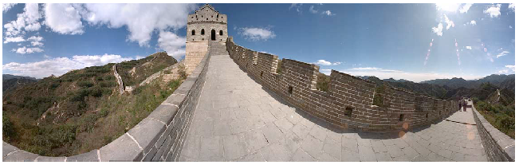
Panoramic Image Mosaics
Full screen panoramas (cubic): http://www.panoramas.dk/
Mars: http://www.panoramas.dk/fullscreen3/f2_mars97.html
2003 New Years Eve: http://www.panoramas.dk/fullscreen3/f1.html

Slide 3
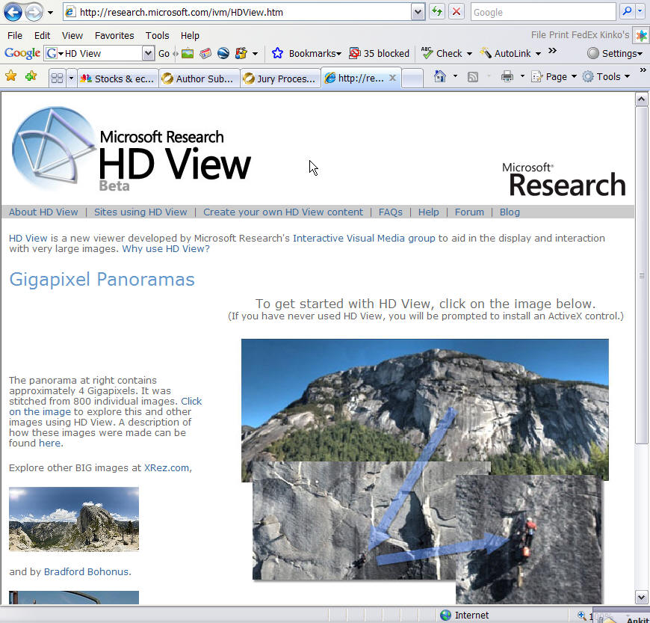
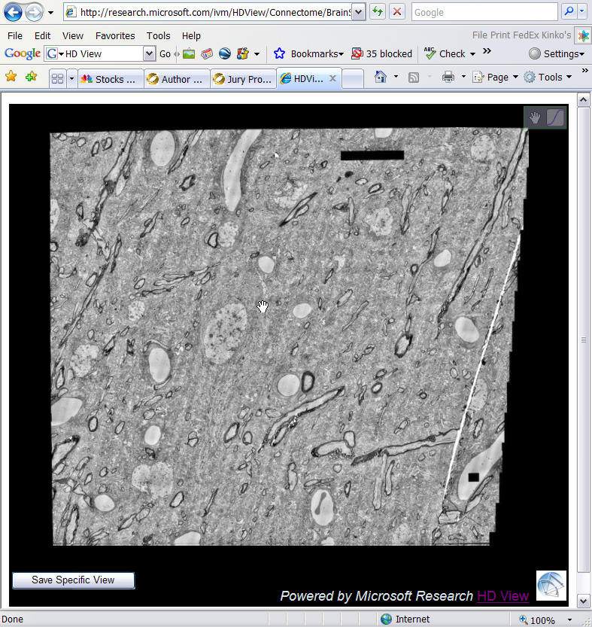
Gigapixel panoramas & images
Mapping / Tourism / WWT
Medical Imaging

Slide 4
Image Mosaics
+ + … + =
Goal: Stitch together several images into a seamless composite

Slide 5
Today’s lecture
Image alignment and stitching
motion models
image warping
point-based alignment
complete mosaics (global alignment)
compositing and blending
ghost and parallax removal

Slide 6
Readings
Szeliski, CVAA:
  Chapter 3.6: Image warping
  Chapter 6.1: Feature-based alignment
  Chapter 9.1: Motion models
  Chapter 9.2: Global alignment
  Chapter 9.3: Compositing
Recognizing Panoramas, Brown & Lowe, ICCV’2003
Szeliski & Shum, SIGGRAPH'97

Slide 7
Motion models

Slide 8
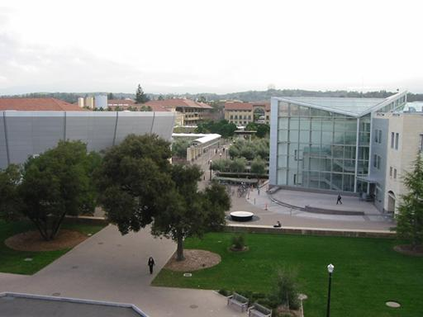
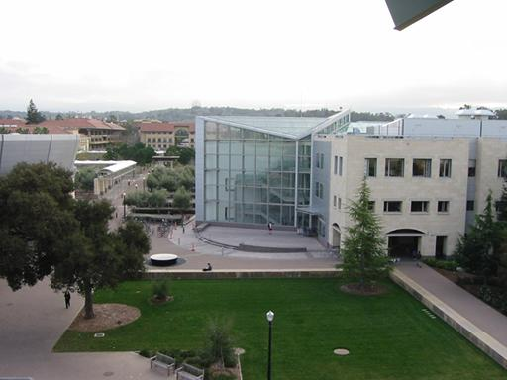
Motion models
What happens when we take two images with a camera and try to align them?
translation?
rotation?
scale?
affine?
perspective?
… see interactive demo (VideoMosaic)

Slide 9



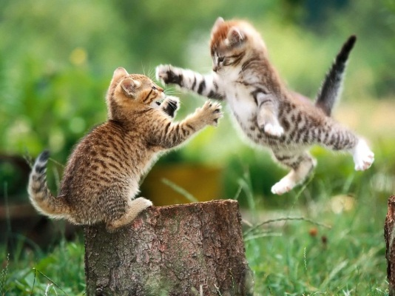


Projective transformations
(aka homographies)
“keystone” distortions

Slide 10
Image Warping

Slide 11
Image Warping
image filtering: change range of image
g(x) = h(f(x))
image warping: change domain of image
g(x) = f(h(x))
f
g
h
x
x
f
g
h
x
x

Slide 12

Image Warping
image filtering: change range of image
g(x) = h(f(x))
image warping: change domain of image
g(x) = f(h(x))
f
g
h
f
g
h

Slide 13


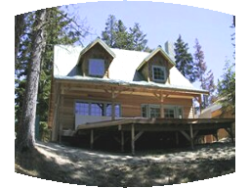

Parametric (global) warping
Examples of parametric warps:
translation
rotation
aspect
perspective
affine
cylindrical

Slide 14
2D coordinate transformations
translation: x’ = x + t x = (x,y)
rotation: x’ = R x + t
similarity: x’ = s R x + t
affine: x’ = A x + t
perspective: x’ ≅ H x x = (x,y,1)
(x is a homogeneous coordinate)
These all form a nested group (closed w/ inv.)

Slide 15
Image Warping
Given a coordinate transform x’ = h(x) and a source image f(x), how do we compute a transformed image g(x’) = f(h(x))?
h(x)
x
x’
f(x)
g(x’)

Slide 16
Forward Warping
Send each pixel f(x) to its corresponding location x’ = h(x) in g(x’)
What if pixel lands “between” two pixels?
h(x)
x
x’
f(x)
g(x’)

Slide 17
Forward Warping
Send each pixel f(x) to its corresponding location x’ = h(x) in g(x’)
What if pixel lands “between” two pixels?
Answer: add “contribution” to several pixels, normalize later (splatting)
h(x)
x
x’
f(x)
g(x’)

Slide 18
Inverse Warping
Get each pixel g(x’) from its corresponding location x’ = h(x) in f(x)
What if pixel comes from “between” two pixels?
h(x)
x
x’
f(x)
g(x’)

Slide 19
Inverse Warping
Get each pixel g(x’) from its corresponding location x’ = h(x) in f(x)
What if pixel comes from “between” two pixels?
Answer: resample color value from interpolated (prefiltered) source image
x
x’
f(x)
g(x’)

Slide 20

Interpolation
Possible interpolation filters:
  nearest neighbor
  bilinear
  bicubic (interpolating)
  sinc / FIR
Needed to prevent “jaggies”
and “texture crawl” (see demo)

Slide 21
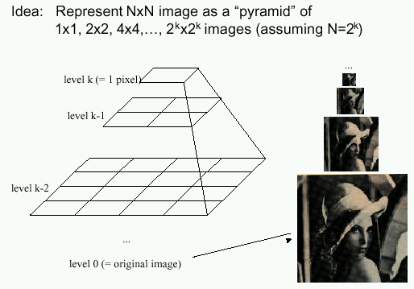
Prefiltering
Essential for downsampling (decimation) to prevent aliasing
MIP-mapping [Williams’83]:
  build pyramid (but what decimation filter?):
    block averaging
    Burt & Adelson (5-tap binomial)
    7-tap wavelet-based filter (better)
  trilinear interpolation
    bilinear within each 2 adjacent levels
    linear blend between levels (determined by pixel size)

Slide 22
Prefiltering
Essential for downsampling (decimation) to prevent aliasing
Other possibilities:
  summed area tables
  elliptically weighted Gaussians (EWA) [Heckbert’86]

Slide 23
Motion models (reprise)

Slide 24



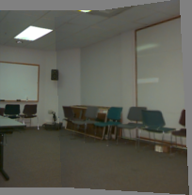
Motion models
Translation
Affine
Perspective
3D rotation
2 unknowns
6 unknowns
8 unknowns
3 unknowns

Slide 25
Finding the transformation
Translation = 2 degrees of freedom
Similarity = 4 degrees of freedom
Affine = 6 degrees of freedom
Homography = 8 degrees of freedom
How many corresponding points do we need to solve?

Slide 26
Plane perspective mosaics
  8-parameter generalization of affine motion
    works for pure rotation or planar surfaces
  Limitations:
    local minima
    slow convergence
    difficult to control interactively

Slide 27


Image warping with homographies
image plane in front
image plane below

Slide 28
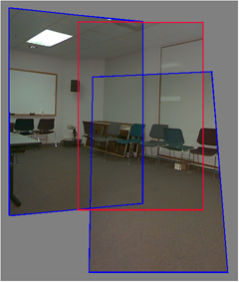
Rotational mosaics
  Directly optimize rotation and focal length
  Advantages:
    ability to build full-view
    panoramas
    easier to control interactively
    more stable and accurate
    estimates

Slide 29
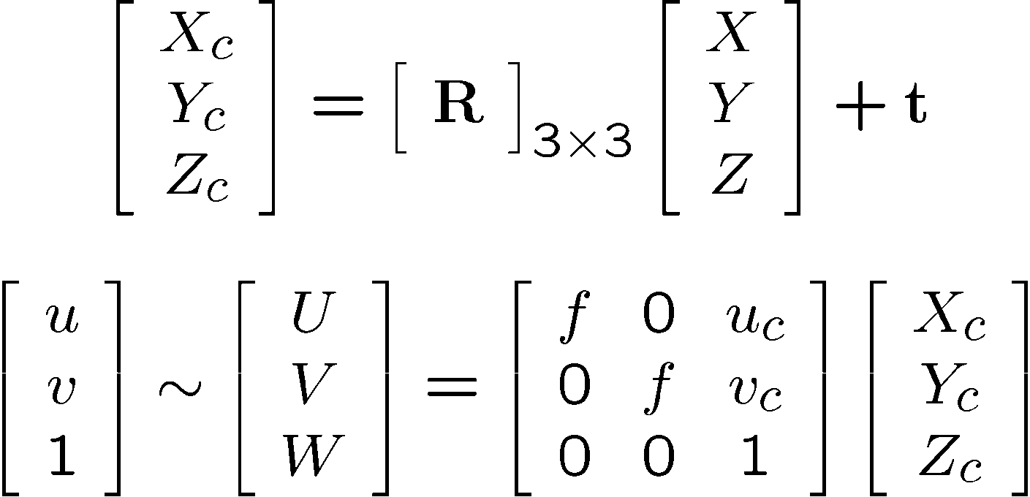
3D → 2D Perspective Projection
(X_{c},Y_{c},Z_{c})
f
u_{c}
u

Slide 30
Rotational mosaic
Projection equations
Project from image to 3D ray
(x₀,y₀,z₀) = (u₀-u_{c},v₀-v_{c},f)
Rotate the ray by camera motion
(x₁,y₁,z₁) = R₀₁ (x₀,y₀,z₀)
Project back into new (source) image
(u₁,v₁) = (fx₁/z₁+u_{c},fy₁/z₁+v_{c})

Slide 31
Image reprojection
mosaic PP
The mosaic has a natural interpretation in 3D
  The images are reprojected onto a common plane
  The mosaic is formed on this plane

Slide 32
Rotations and quaternions
How do we represent rotation matrices?
Axis / angle (n,θ)
R = I + sinθ [n]× + (1- cosθ) [n]×²
(Rodriguez Formula), with
[n]× = cross product matrix (see paper)
Unit quaternions [Shoemake SIGG’85]
q = (n sinθ/2, cosθ/2) = (w,s)
quaternion multiplication (division is easy)
q₀ q₁ = (s₁w₀+ s₀w₁, s₀ s₁-w₀·w₁)

Slide 33
Incremental rotation update
Small angle approximation
ΔR = I + sinθ [n]× + (1- cosθ) [n]×²
≈ θ [n]× = [ω]×
linear in ω
Update original R matrix
R ← R ΔR

Slide 34
Perspective & rotational motion
Solve 8x8 or 3x3 system (see papers for details), and iterate (non-linear)
Patch-based approximation:
break up image into patches (say 16x16)
accumulate 2x2 linear system in each
(local translational assumption)
compose larger system from smaller 2x2 results [Shum & Szeliski, ICCV’98]

Slide 35
Image Mosaics (Stitching)
[Szeliski & Shum, SIGGRAPH’97]
[Szeliski, FnT CVCG, 2006]

Slide 36
Image Mosaics (stitching)
Blend together several overlapping images into one seamless mosaic (composite)
+ + … + =

Slide 37
Mosaics for Video Coding
Convert masked images into a background sprite for content-based coding
+ + +
=

Slide 38
Establishing correspondences
Direct method:
  Use generalization of affine motion model
  [Szeliski & Shum ’97]
Feature-based method
  Extract features, match, find consisten inliers [Lowe ICCV’99; Schmid ICCV’98,
  Brown&Lowe ICCV’2003]
  Compute R from correspondences
  (absolute orientation)

Slide 39
Absolute orientation
[Arun et al., PAMI 1987] [Horn et al., JOSA A 1988]
Procrustes Algorithm [Golub & VanLoan]
Given two sets of matching points, compute R
p_{i}’ = R p_{i} 3D rays
A = Σ_{i} p_{i} p_{i}’^{T} = Σ_{i} p_{i} p_{i}^{T} R^{T} = U S V^{T} = (U S U^{T}) R^{T}
V^{T} = U^{T} R^{T}
R = V U^{T}

Slide 40

Stitching demo

Slide 41
Panoramas
What if you want a 360° field of view?
mosaic Projection Cylinder

Slide 42
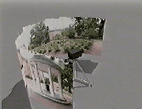
Cylindrical panoramas
Steps
  Reproject each image onto a cylinder
  Blend
  Output the resulting mosaic

Slide 43
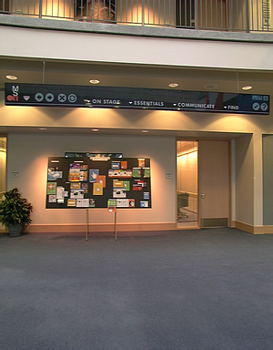
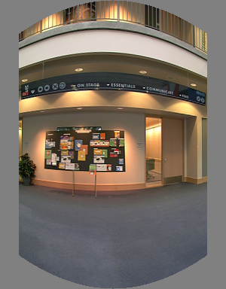
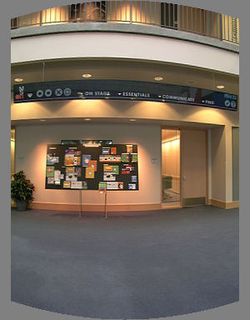
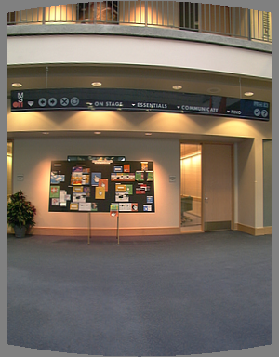
Cylindrical Panoramas
Map image to cylindrical or spherical coordinates
  need known focal length
Image 384x300
f = 180 (pixels)
f = 280
f = 380
Notes:
Therefore, it is desirable if the global motion model we need to recover is translation, which has only two parameters. It turns out that for a pure panning motion, if we convert two images to their cylindrical maps with known focal length, the relationship between them can be represented by a translation.
Here is an example of how cylindrical maps are constructed with differently with f’s. Note how straight lines are curved.
Similarly, we can map an image to its longitude/latitude spherical coordinates as well if f is given.

Slide 44
Determining the focal length
Initialize from homography H
(see text or [SzSh’97])
Use camera’s EXIF tags (approx.)
Use a tape measure
Ask your instructor
1m
4m

Slide 45
3D → 2D Perspective Projection
(X_{c},Y_{c},Z_{c})
f
u_{c}
u

Slide 46

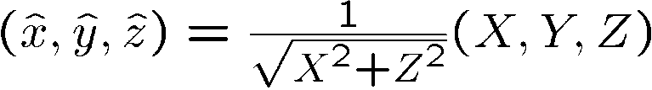


Cylindrical projection
  Map 3D point (X,Y,Z) onto cylinder
  Convert to cylindrical coordinates
Y
Z
X
  Convert to cylindrical image coordinates
unit cylinder
    s defines size of the final image
unwrapped cylinder
cylindrical image

Slide 47
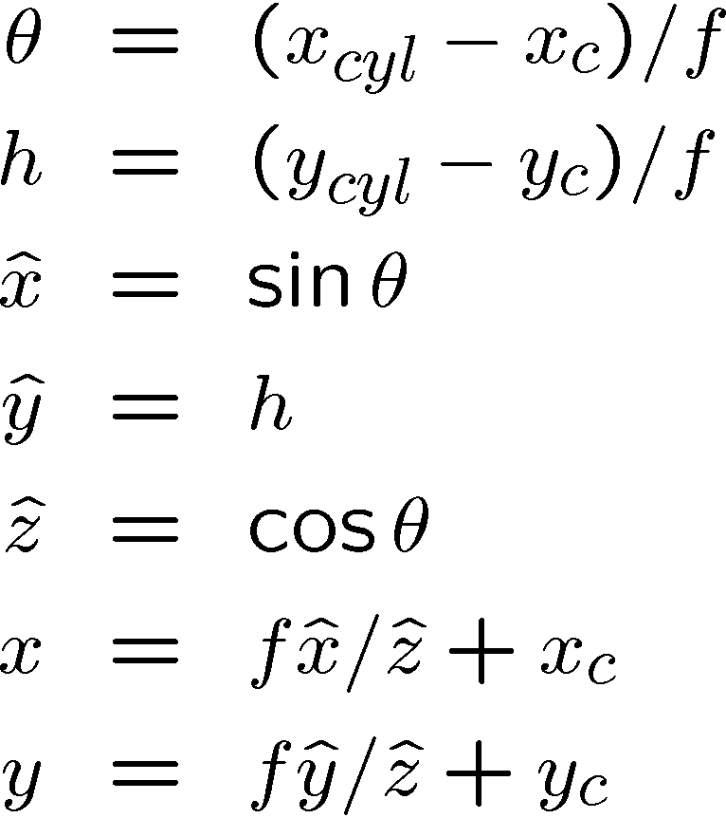
Cylindrical warping
Given focal length f and image center (x_{c},y_{c})
(X,Y,Z)
(sinθ,h,cosθ)
Y
Z
X

Slide 48
Spherical warping
Given focal length f and image center (x_{c},y_{c})
φ
(x,y,z)
cos φ
(sinθcosφ, sinφ, cosθcosφ)
sin φ
Y
Z
cos θ cos φ
X

Slide 49
3D rotation
Rotate image before placing on unrolled sphere
φ
(x,y,z)
cos φ
(sinθcosφ, sinφ, cosθcosφ)
sin φ
Y
Z
cos θ cos φ
X
p = R p
_ _
_ _

Slide 50
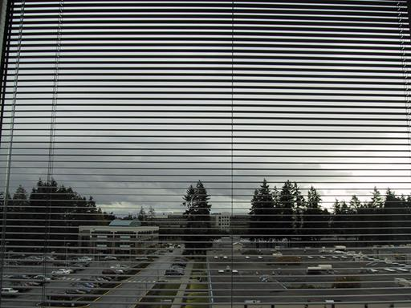
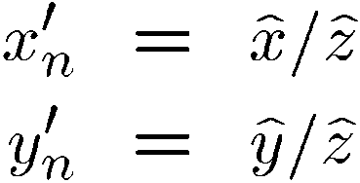
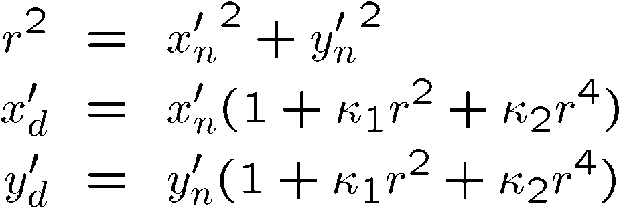
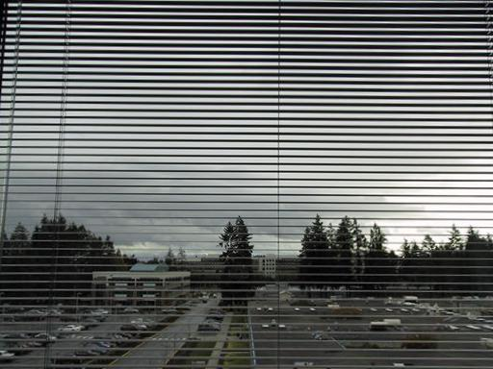
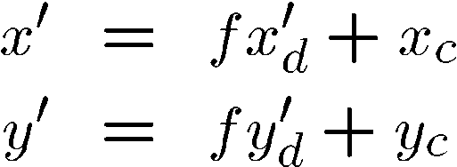
Radial distortion
Correct for “bending” in wide field of view lenses
Project
to “normalized”
image coordinates
Apply radial distortion
Apply focal length
translate image center
To model lens distortion
  Use above projection operation instead of standard projection matrix multiplication

Slide 51
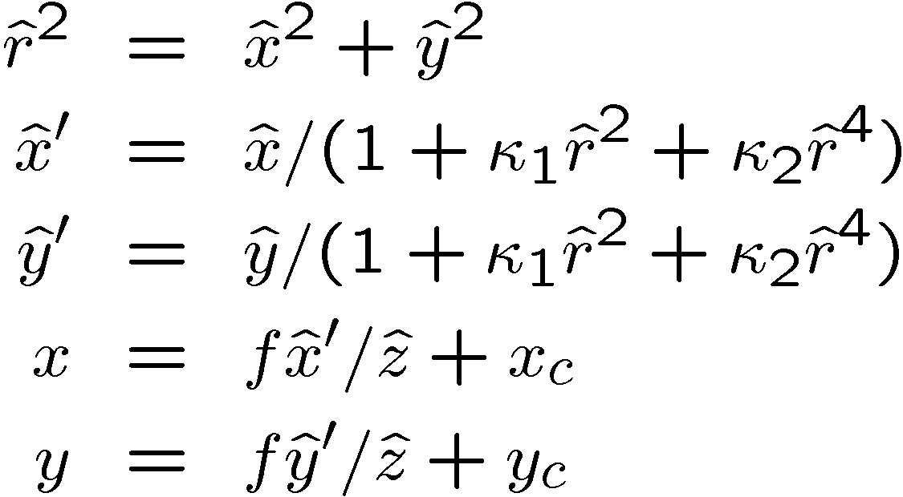
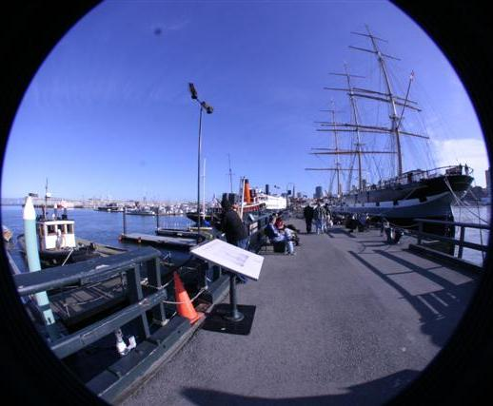
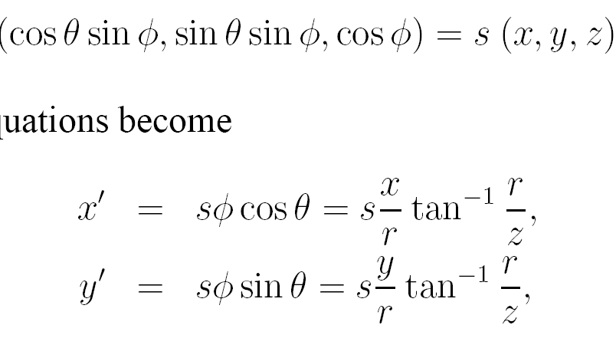
Fisheye lens
Extreme “bending” in ultra-wide fields of view

Slide 52

Matching features
What do we do about the “bad” matches?

Slide 53
RAndom SAmple Consensus
Select one match, count inliers

Slide 54
RAndom SAmple Consensus
Select one match, count inliers

Slide 55
Least squares fit
Find “average” translation vector

Slide 56
RANSAC for estimating homography
RANSAC loop:
Select four feature pairs (at random)
Compute homography H (exact)
Compute inliers where ||p_{i}’, H p_{i}|| < ε
Keep largest set of inliers
Re-compute least-squares H estimate using all of the inliers

Slide 57
Simple example: fit a line
Rather than homography H (8 numbers)
fit y=ax+b (2 numbers a, b) to 2D pairs
57

Slide 58
Simple example: fit a line
Pick 2 points
Fit line
Count inliers
3 inliers
58

Slide 59
Simple example: fit a line
Pick 2 points
Fit line
Count inliers
4 inliers
59

Slide 60
Simple example: fit a line
Pick 2 points
Fit line
Count inliers
9 inliers
60

Slide 61
Simple example: fit a line
Pick 2 points
Fit line
Count inliers
8 inliers
61

Slide 62
Simple example: fit a line
Use biggest set of inliers
Do least-square fit
62

Slide 63
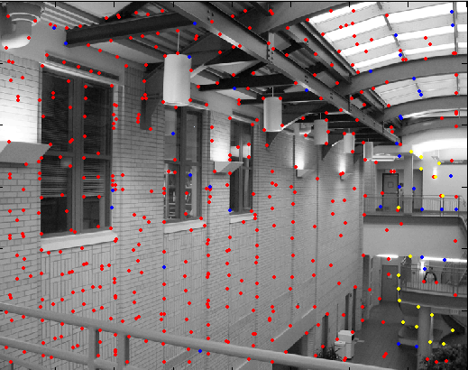
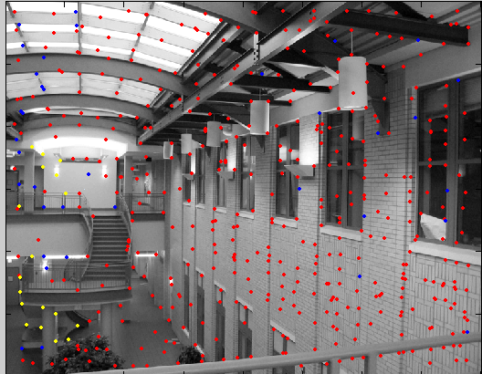
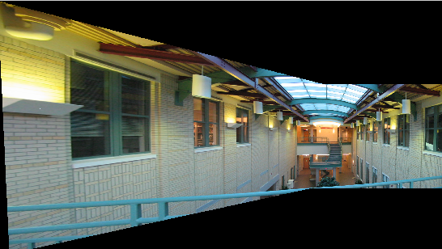
RANSAC
red:
rejected by 2nd nearest neighbor criterion
blue:
Ransac outliers
yellow:
inliers

Slide 64
Robustness
Proportion of inliers in our pairs is G (for “good”)
Our model needs P pairs
  P=4 for homography
Probability that we pick P inliers?
  G^{P}
Probability that after N RANSAC iterations we have not picked a set of inliers?
  (1-G^{P})^{N}
64

Slide 65
Robustness: example
Matlab: p=4; x=0.5; n=1000; (1-x^p)^n
Proportion of inliers G=0.5
Probability that we pick P=4 inliers?
  0.5⁴=0.0625 (6% chance)
Probability that we have not picked a set of inliers?
  N=100 iterations:
  (1-0.5⁴)¹⁰⁰=0.00157 (1 chance in 600)
  N=1000 iterations:
  1 chance in 1e28
65

Slide 66
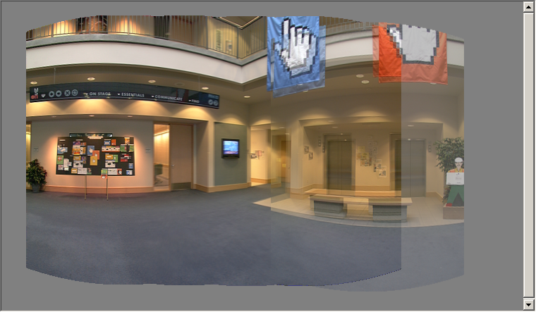
Image Stitching—review
Align the images over each other
  camera pan ↔ translation on cylinder
Blend the images together (demo)

Slide 67
Assignment 2 – Creating Panoramas
Implement Harris corner detector
Implement MatchInterestPoints
Compute homography using RANSAC
Compute size of stitched images from projected corners
Inverse sample image and average

Slide 68
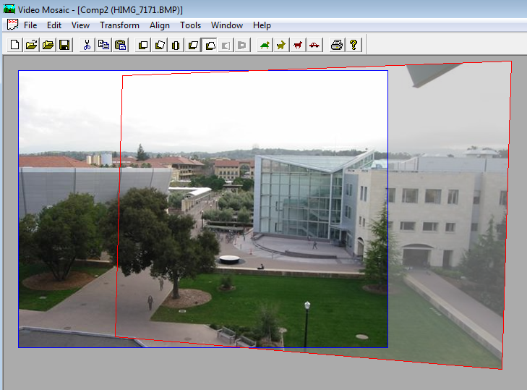
Resampling the final image

Slide 69
Assembling the panorama
Stitch pairs together, blend, then crop

Slide 70
Problem: Drift
Error accumulation
  small (vertical) errors accumulate over time
  apply correction so that sum = 0 (for 360° pan.)

Slide 71
Problem: Drift
(x₁,y₁)
(x_{n},y_{n})
copy of first image
Solution
  add another copy of first image at the end
  this gives a constraint: y_{n} = y₁
  there are a bunch of ways to solve this problem
    add displacement of (y₁ – y_{n})/(n -1) to each image after the first
    compute a global warp: y’ = y + ax
    run a big optimization problem, incorporating this constraint

Slide 72
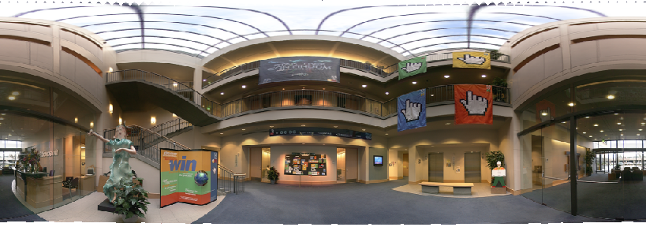
Full-view (360° spherical) panoramas

Slide 73
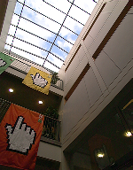
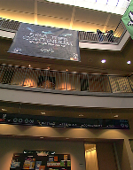
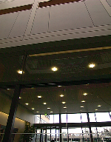
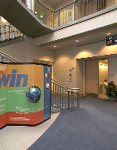
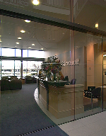
Full-view Panorama
+
+
+
+

Slide 74
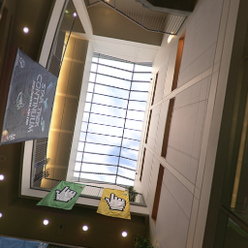
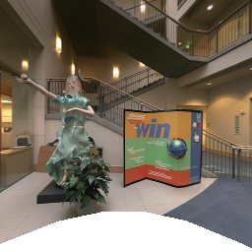
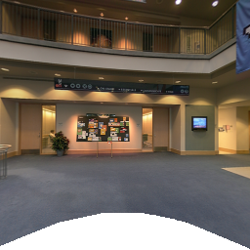
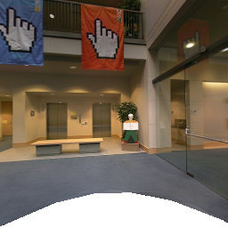
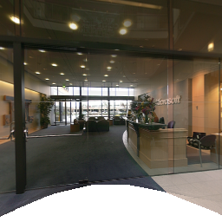
Texture Mapped Model

Slide 75
Global alignment
Register all pairwise overlapping images
Use a 3D rotation model (one R per image)
Use direct alignment (patch centers) or feature based
Infer overlaps based on previous matches (incremental)
Optionally discover which images overlap other images using feature selection (RANSAC)

Slide 76
Recognizing Panoramas
Matthew Brown & David Lowe
ICCV’2003

Slide 77
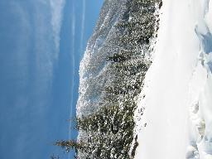
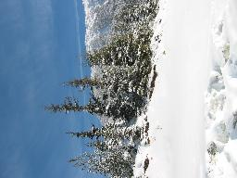
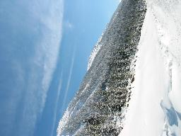
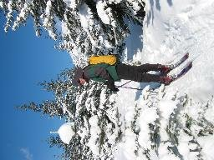
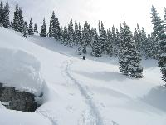
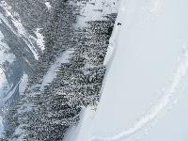
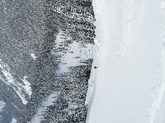
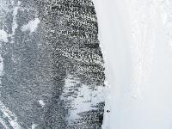




















Recognizing Panoramas
[Brown & Lowe, ICCV’03]

Slide 78
Finding the panoramas

Slide 79
Finding the panoramas

Slide 80
Finding the panoramas

Slide 81
Finding the panoramas

Slide 82

Fully automated 2D stitching
Demo

Slide 83

Get you own copy
http://get.live.com/photogallery/overview

Slide 84
Rec.pano.: system components
Feature detection and description
  more uniform point density
Fast matching (hash table)
RANSAC filtering of matches
Intensity-based verification
Incremental bundle adjustment
[M. Brown, R. Szeliski, and S. Winder. Multi-image matching using multi-scale oriented patches, CVPR'2005]

Slide 85
Multi-Scale Oriented Patches
Interest points
  Multi-scale Harris corners
  Orientation from blurred gradient
  Geometrically invariant to similarity transforms
Descriptor vector
  Bias/gain normalized sampling of local patch (8x8)
  Photometrically invariant to affine changes in intensity

Slide 86





Feature irregularities
Distribute points evenly over the image

Slide 87

Descriptor Vector
Orientation = blurred gradient
Similarity Invariant Frame
  Scale-space position (x, y, s) + orientation (θ)

Slide 88






Probabilistic Feature Matching

Slide 89




RANSAC motion model

Slide 90


RANSAC motion model

Slide 91

RANSAC motion model

Slide 92


Probabilistic model for verification

Slide 93
How well does this work?
Test on 100s of examples…

Slide 94
How well does this work?
Test on 100s of examples…
…still too many failures (5-10%)
for consumer application

Slide 95


Matching Mistakes: False Positive

Slide 96


Matching Mistakes: False Positive

Slide 97

Matching Mistake: False Negative
Moving objects: large areas of disagreement

Slide 98


Matching Mistakes
Accidental alignment
  repeated / similar regions
Failed alignments
  moving objects / parallax
  low overlap
  “feature-less” regions
  (more variety?)
No 100% reliable algorithm?

Slide 99
How can we fix these?
Tune the feature detector
Tune the feature matcher (cost metric)
Tune the RANSAC stage (motion model)
Tune the verification stage
Use “higher-level” knowledge
  e.g., typical camera motions
→ Sounds like a big “learning” problem
  Need a large training/test data set (panoramas)

Slide 100
Image Blending

Slide 101
Image feathering
Weight each image proportional to its distance from the edge
(distance map [Danielsson, CVGIP 1980]
1. Generate weight map for each image
2. Sum up all of the weights and divide by sum:
weights sum up to 1: w_{i}’ = w_{i} / ( ∑_{i} w_{i})

Slide 102



Image Feathering

Slide 103



Feathering
+
1
=
1
0
0

Slide 104


Effect of window size
1
left
1
right
0
0

Slide 105


Effect of window size
1
1
0
0

Slide 106

Good window size
1
0
“Optimal” window: smooth but not ghosted
  Doesn’t always work...

Slide 107



Pyramid Blending
Burt, P. J. and Adelson, E. H., A multiresolution spline with applications to image mosaics, ACM Transactions on Graphics, 42(4), October 1983, 217-236.

Slide 108



Laplacian
level
4
Laplacian
level
2
Laplacian
level
0
left pyramid
right pyramid
blended pyramid

Slide 109
Laplacian image blend
Compute Laplacian pyramid
Compute Gaussian pyramid on weight image (can put this in A channel)
Blend Laplacians using Gaussian blurred weights
Reconstruct the final image
Q: How do we compute the original weights?
A: For horizontal panorama, use mid-lines
Q: How about for a general “3D” panorama?

Slide 110
Weight selection (3D panorama)
Idea: use original feather weights to select
strongest contributing image
Can be implemented using L-∞ norm: (p = 10)
w_{i}’ = [w_{i}^{p} / ( ∑_{i} w_{i}^{p})]^{1/p}

Slide 111

Poisson Image Editing
Blend the gradients of the two images, then integrate
For more info: Perez et al, SIGGRAPH 2003
  see Computational Photography lecture

Slide 112
De-Ghosting

Slide 113
Local alignment (deghosting)
Use local optic flow to compensate for small motions [Shum & Szeliski, ICCV’98]

Slide 114

Local alignment (deghosting)
Use local optic flow to compensate for radial distortion [Shum & Szeliski, ICCV’98]

Slide 115
Region-based de-ghosting
Select only one image in regions-of-difference using weighted vertex cover
[Uyttendaele et al., CVPR’01]

Slide 116
Region-based de-ghosting
Select only one image in regions-of-difference using weighted vertex cover
[Uyttendaele et al., CVPR’01]

Slide 117
Cutout-based de-ghosting
Select only one image per output pixel, using spatial continuity
Blend across seams using gradient continuity (“Poisson blending”)
[Agarwala et al., SG’2004]

Slide 118

Cutout-based compositing
Photomontage [Agarwala et al., SG’2004]
Interactively blend different images:
group portraits

Slide 119

PhotoMontage
Technical details:
use Graph Cuts to optimize seam placement
Demo:
Windows Live
Photo Gallery
Photo Fuse

Slide 120
Cutout-based compositing
Photomontage [Agarwala et al., SG’2004]
Interactively blend different images:
focus settings

Slide 121

Cutout-based compositing
Photomontage [Agarwala et al., SG’2004]
Interactively blend different images:
people’s faces

Slide 122
More stitching possibilities
Video stitching
High dynamic range image stitching
  see demo…
Flash + Non-Flash
Video-based rendering
Next-next week’s lecture:
Computational Photography

Slide 123

Other types of mosaics
Can mosaic onto any surface if you know the geometry
  See NASA’s Visible Earth project for some stunning earth mosaics
    http://earthobservatory.nasa.gov/Newsroom/BlueMarble/

Slide 124

Slit images
y-t slices of the video volume are known as slit images
  take a single column of pixels from each input image

Slide 125

Slit images: cyclographs

Slide 126

Slit images: photofinish

Slide 127





Final thought:
What is a “panorama”?
Tracking a subject
Repeated (best) shots
Multiple exposures
“Infer” what photographer wants?

