Slide 1
Introduction to Threat Modeling
Mike Grimm
November 8, 2012

Slide 2
Goals for a Security Development Process (“SDL”)
Secure by Design
Reduce the number of vulnerabilities
Which reduces the number of security updates
But you can never remove all vulnerabilities
Secure by Default
Reduce the severity of the vulnerabilities missed
Focus on defenses and reduced exposure

Slide 3
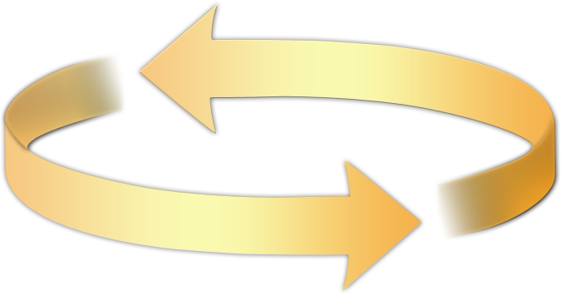
The Microsoft SDL
Helping to protect customers by:
Reducing the number and severity of SW vulnerabilities before release
Executive commitment → SDL a mandatory policy at Microsoft since 2004
Training
Requirements
Design
Implementation
Verification
Release
Response
Core training
Analyze security and privacy risk
Define quality gates
Threat modeling
Attack surface analysis
Specify tools
Enforce banned functions
Static analysis
Dynamic/Fuzz testing
Verify threat models/attack surface
Response plan
Final security review
Release archive
Response execution
Education
Technology and Process
Accountability
Ongoing Process Improvements → 12 month cycle

Slide 4
Threat Modeling Process
Initially rolled out at the inception of Trustworthy Computing in Windows Server 2003 Security Push
Goal: Identify designed interactions between components, enumerate threats and suggest mitigations
This process evolved into:
Create a data-flow diagram (leverage existing design concepts)
Enumerate threats based on STRIDE threat categorization
Suggest mitigations for each threat

Slide 5
Understand the threats
Threat | Property | Definition | Example
Spoofing | Authentication | Spoofing is when a process or entity is something other than its claimed identity. Examples include substituting a process, a file, website or a network address. | Pretending to be a different user, process, or website.
Tampering | Integrity | Tampering is the act of altering the bits. Tampering with a process involves changing bits in the running process. Similarly, Tampering with a data flow involves changing bits on the wire or between two running processes. | Modifying a program image, or a network packet.
Repudiation | Non-repudiation | Claiming to have not performed an action. | “I didn’t send that email,” “I didn’t modify that file,” “I certainly didn’t visit that web site, dear!”
Information Disclosure | Confidentiality | Information disclosure happens when the information can be read by an unauthorized party. | Allowing someone to read the Windows source code; publishing a list of customers to a web site.
Denial of Service | Availability | Deny or degrade service to users | Crashing Windows or a web site, sending a packet and absorbing seconds of CPU time, or routing packets into a black hole.
Elevation of Privilege | Authorization | Gain capabilities without proper authorization | Allowing a remote internet user to run commands is the classic example, but going from a limited user to admin is also EoP.

Slide 6
Tool-Based Threat Modeling (Manual)
Problem: Threat modeling is a complex activity that only experts can do
Main innovation: Transform threat modeling into an activity that any software architect can perform effectively
Main Approach:
Simple
Prescriptive
Self-checks
Tool
Guidance in drawing threat diagrams
Guided analysis of threats and mitigations
Integration with bug tracking systems
Robust reporting capabilities
Notes:
Design analysis: show me your threat model. Requirements: what’s your threat model? “

Slide 7
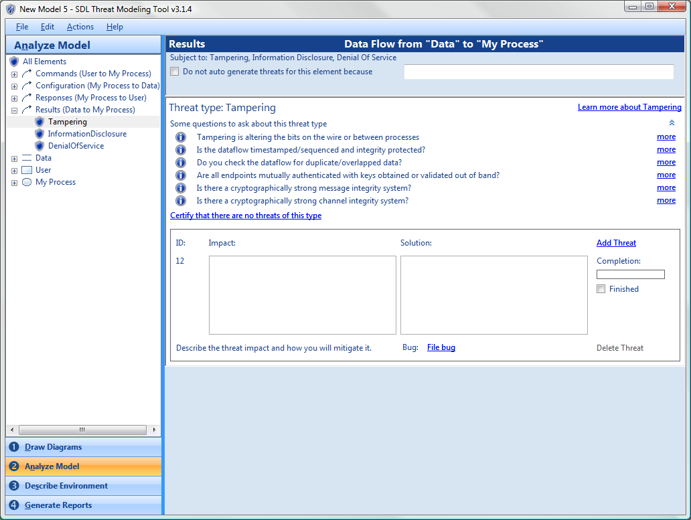
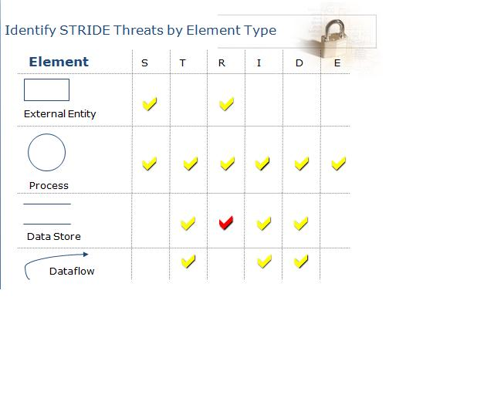
Find threats: Use STRIDE per item

Slide 8
Tool-Based Threat Modeling (Automated)
Towards automated threat modeling
Automate collection of system data, follow program control flow across processes and machines.
Use instrumented or un-instrumented binaries?
Instrumentation can be a starting point for sophisticated code analysis.
Pioneered by University of Wisconsin and Universitat Autònoma de Barcelona
See http://research.cs.wisc.edu/mist/projects/SecSTAR/

Slide 9
Methodology: Canonicalization

Slide 10
Methodology: Threat Identification
Identification Trees: Part of the Attack Pattern representing a threat
Attack Pattern 1
Type
Label
Frameworks
…
Threat Agent 1
Threat Agent N
Identification Tree
…
…
Asset 2
Asset N

Slide 11
Resources
Fundamental Practices for Secure Software Development | http://www.safecode.org/publications/SAFECode_Dev_Practices0211.pdf
Microsoft Security Development Lifecycle | http://www.microsoft.com/security/sdl/default.aspx
SDL Threat Modeling Tool | http://www.microsoft.com/security/sdl/adopt/threatmodeling.aspx
Automated Threat Modeling | http://research.cs.wisc.edu/mist/papers/Guifre-sep2012.pdf
Common Attack Pattern Enumeration and Classification | http://capec.mitre.org
University of Wisconsin Security Research | http://research.cs.wisc.edu/mist/

Slide 12
Thank You!
© 2012 Microsoft Corporation. All rights reserved. Microsoft, Windows, Internet Explorer, and other product names are or may be registered trademarks and/or trademarks in the U.S. and/or other countries.
The information herein is for informational purposes only and represents the current view of Microsoft Corporation as of the date of this presentation. Because Microsoft must respond to changing market conditions, it should not be interpreted to be a commitment on the part of Microsoft, and Microsoft cannot guarantee the accuracy of any information provided after the date of this presentation. MICROSOFT MAKES NO WARRANTIES, EXPRESS, IMPLIED OR STATUTORY, AS TO THE INFORMATION IN THIS PRESENTATION.

Slide 13
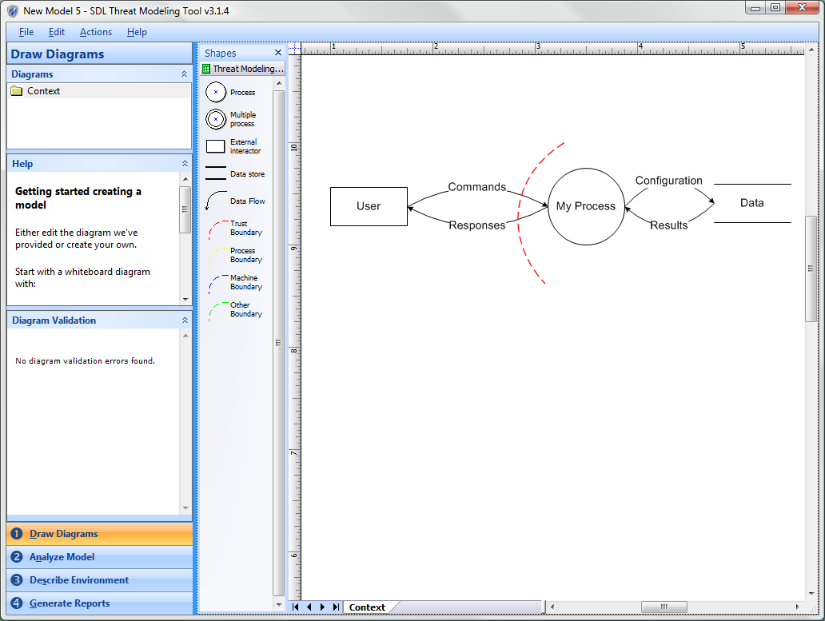
Evolved SDL Approach

Slide 14
SDL Threat Modeling Tool Demo

