Slide 1
P561: Network Systems
Week 7: Finding content
Multicast
Tom Anderson
Ratul Mahajan
TA: Colin Dixon

Slide 2
Today
Finding content and services
  Infrastructure hosted (DNS)
  Peer-to-peer hosted (Napster, Gnutella, DHTs)
Multicast: one to many content dissemination
  Infrastructure (IP Multicast)
  Peer-to-peer (End-system Multicast, Scribe)

Slide 3
Names and addresses
33¢
name
Ratul Mahajan
Microsoft Research
Redmond
address
Names: identifiers for objects/services (high level)
Addresses: locators for objects/services (low level)
Resolution: name → address
But addresses are really lower-level names
  e.g., NAT translation from a virtual IP address to physical IP, and IP address to MAC address

Slide 4
Naming in systems
Ubiquitous
  Files in filesystem, processes in OS, pages on the Web
Decouple identifier for object/service from location
  Hostnames provide a level of indirection for IP addresses
Naming greatly impacts system capabilities and performance
  Ethernet addresses are a flat 48 bits
    flat → any address anywhere but large forwarding tables
  IP addresses are hierarchical 32/128 bits
    hierarchy → smaller routing tables but constrained locations

Slide 5
Key considerations
For the namespace
  Structure
For the resolution mechanism
  Scalability
  Efficiency
  Expressiveness
  Robustness

Slide 6
Internet hostnames
Human-readable identifiers for end-systems
Based on an administrative hierarchy
  E.g., june.cs.washington.edu, www.yahoo.com
  You cannot name your computer foo.yahoo.com
In contrast, (public) IP addresses are a fixed-length binary encoding based on network position
  128.95.1.4 is june’s IP address, 209.131.36.158 is one of www.yahoo.com’s IP addresses
  Yahoo cannot pick any address it wishes

Slide 7
Original hostname system
When the Internet was really young …
Flat namespace
  Simple (host, address) pairs
Centralized management
  Updates via a single master file called HOSTS.TXT
  Manually coordinated by the Network Information Center (NIC)
Resolution process
  Look up hostname in the HOSTS.TXT file
  Works even today: (c:/WINDOWS/system32/drivers)/etc/hosts

Slide 8
Problems with the original system
Coordination
  Between all users to avoid conflicts
  E.g., everyone likes a computer named Mars
Inconsistencies
  Between updated and old versions of file
Reliability
  Single point of failure
Performance
  Competition for centralized resources

Slide 9
Domain Name System (DNS)
Developed by Mockapetris and Dunlap, mid-80’s
Namespace is hierarchical
  Allows much better scaling of data structures
  e.g., root → edu → washington → cs → june
Namespace is distributed
  Decentralized administration and access
  e.g., june managed by cs.washington.edu
Resolution is by query/response
  With replicated servers for redundancy
  With heavy use of caching for performance

Slide 10
DNS Hierarchy
edu
com
mil
org
au
uw
yahoo
ee
cs
www
“dot” is the root of the hierarchy
Top levels now controlled by ICANN
Lower level control is delegated
Usage governed by conventions
FQDN = Fully Qualified Domain Name
june

Slide 11
Name space delegation
Each organization controls its own name space (“zone” = subtree of global tree)
  each organization has its own nameservers
    replicated for availability
  nameservers translate names within their organization
    client lookup proceeds step-by-step
  example: washington.edu
    contains IP addresses for all its hosts (www.washington.edu)
    contains pointer to its subdomains (cs.washington.edu)

Slide 12
DNS resolution
Reactive
Queries can be recursive or iterative
Uses UDP (port 53)
Root
2
name
server
cicada.cs.princeton.edu
3
princeton.edu, 128.196.128.233
1
4
cicada.cs.princeton.edu
Local
cicada.cs.princeton.edu
Princeton
Client
name
name
192.12.69.60
server
cs.princeton.edu, 192.12.69.5
server
8
5
cicada.cs.princeton.edu
192.12.69.60
cicada.cs.princeton.edu,
6
CS
name
7
server

Slide 13
Hierarchy of nameservers
Root
name server
Princeton
…
Cisco
name server
name server
CS
…
EE
name server
name server

Slide 14
DNS performance: caching
DNS query results are cached at local proxy
  quick response for repeated translations
  lookups are the rare case
  vastly reduces load at the servers
  what if something new lands on slashdot?
1
cicada.cs.princeton.edu
Local
Client
name
192.12.69.60
server
2 (if cicada is cached)
2 (if cs is cached)
4 (if cs is cached)
cicada.cs.princeton.edu
192.12.69.60
cicada.cs.princeton.edu,
CS
name
3
server

Slide 15
DNS cache consistency
How do we keep cached copies up to date?
  DNS entries are modified from time to time
    to change name → IP address mappings
    to add/delete names
Cache entries invalidated periodically
  each DNS entry has time-to-live (TTL) field: how long can the local proxy can keep a copy
  if entry accessed after the timeout, get a fresh copy from the server
  how do you pick the TTL?
  how long after a change are all the copies updated?

Slide 16
DNS cache effectiveness
Traffic seen on UW’s access link in 1999

Slide 17
Negative caching in DNS
Pro: traffic reduction
  Misspellings, old or non-existent names
  “Helpful” client features
Con: what if the host appears?
Status:
  Optional in original design
  Mandatory since 1998

Slide 18
DNS traffic in the wide-area
Study | % of DNS packets
Danzig, 1990 | 14%
Danzig, 1992 | 8%
Frazer, 1995 | 5%
Thomson, 1997 | 3%

Slide 19
DNS bootstrapping
Need to know IP addresses of root servers before we can make any queries
Addresses for 13 root servers ([a-m].root-servers.net) handled via initial configuration
  Cannot have more than 13 root server IP addresses

Slide 20
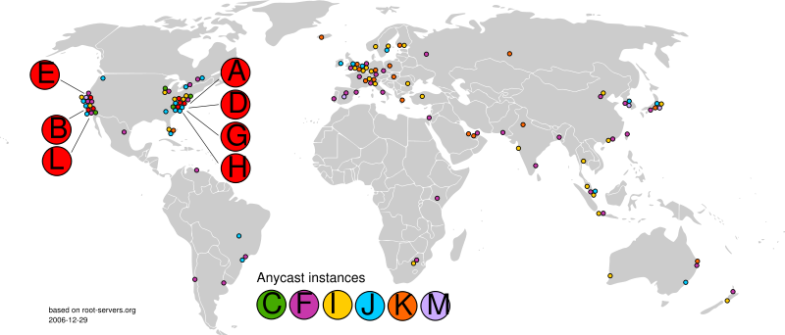
DNS root servers
123 servers as of Dec 2006

Slide 21
DNS availability
What happens if DNS service is not working?
DNS servers are replicated
  name service available if at least one replica is working
  queries load balanced between replicas
2
name
name
name
server
server
server
cicada.cs.princeton.edu
3
princeton.edu, 128.196.128.233

Slide 22
Building on the DNS
Email: ratul@microsoft.com
  DNS record for ratul in the domain microsoft.com, specifying where to deliver the email
Uniform Resource Locator (URL) names for Web pages
  e.g., www.cs.washington.edu/homes/ratul
  Use domain name to identify a Web server
  Use “/” separated string for file name (or script) on the server

Slide 23
DNS evolution
Static host to IP mapping
  What about mobility (Mobile IP) and dynamic address assignment (DHCP)?
  Dynamic DNS
Location-insensitive queries
    Many servers are geographically replicated
    E.g., Yahoo.com doesn’t refer to a single machine or even a single location; want closest server
    Next week
Security (DNSSec)
Internationalization

Slide 24
DNS properties (summary)
Nature of the namespace | Hierarchical; flat at each level
Scalability of resolution | High
Efficiency of resolution | Moderate
Expressiveness of queries | Exact matches
Robustness to failures | Moderate

Slide 25
Peer-to-peer content sharing
Want to share content among large number of users; each serves a subset of files
  need to locate which user has which files
Question: Would DNS be a good solution for this?

Slide 26
Napster (directory-based)
Centralized directory of all users offering each file
Users register their files
Users make requests to Napster central
Napster returns list of users hosting requested file
Direct user-to-user communication to download files

Slide 27


Naptser illustration
2. Does anyone have “Foo Fighters”?
1. I have “Foo Fighters”
3. Bob has it
4. Share “Foo Fighters”?
5. There you go

Slide 28
Naptser vs. DNS
 | Napster | DNS
Nature of the namespace | Multi-dimensional | Hierarchical; flat at each level
Scalability | Moderate | High
Efficiency of resolution | High | Moderate
Expressiveness of queries | High | Exact matches
Robustness to failures | Low | Moderate

Slide 29
Gnutella (crawl-based)
Can we locate files without a centralized directory?
  for legal and privacy reasons
Gnutella
  organize users into ad hoc graph
  flood query to all users, in breadth first search
    use hop count to control depth
  if found, server replies back through path of servers
  client makes direct connection to server to get file

Slide 30
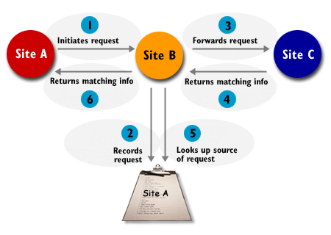
Gnutella illustration

Slide 31
Gnutella vs. DNS
 | Gnutella | DNS
Nature of the namespace | Multi-dimensional | Hierarchical; flat at each level
Scalability | Low | High
Efficiency of resolution | Low | Moderate
Expressiveness of queries | High | Exact matches
Robustness to failures | Moderate | Moderate
Content is not indexed in Gnutella
Trade-off between exhaustiveness and efficiency

Slide 32
Distributed hash tables (DHTs)
Can we locate files without an exhaustive search?
  want to scale to thousands of servers
DHTs (Pastry, Chord, etc.)
  Map servers and objects into an coordinate space
  Objects/info stored based on its key
  Organize servers into a predefined topology (e.g., a ring or a k-dimensional hypercube)
  Route over this topology to find objects
We’ll talk about Pastry (with some slides stolen from Peter Druschel)

Slide 33
Pastry: Id space
2¹²⁸-1
O
128 bit circular id space
nodeIds (uniform random)
objIds (uniform random)
Invariant: node with numerically closest nodeId maintains object
objId
nodeIds
Notes:
Each node has a randomly assigned 128-bit nodeId, circular namespace
Basic operation: A message with key X, sent by any Pastry node, is delivered
to the live node with nodeId closest to X in at most log₁₆ N steps (barring node failures).
Pastry uses a form of generalized hypercube routing, where the routing tables are initialized and updated dynamically.

Slide 34
Pastry: Object insertion/lookup
2¹²⁸-1
O
Msg with key X is routed to live node with nodeId closest to X
Problem: complete routing table not feasible
X
Route(X)
Notes:
Each node has a randomly assigned 128-bit nodeId, circular namespace
Basic operation: A message with key X, sent by any Pastry node, is delivered
to the live node with nodeId closest to X in at most log₁₆ N steps (barring node failures).
Pastry uses a form of generalized hypercube routing, where the routing tables are initialized and updated dynamically.

Slide 35
Pastry: Routing
Tradeoff
O(log N) routing table size
O(log N) message forwarding steps

Slide 36
Pastry: Routing table (# 65a1fcx)
Row 0
Row 1
Row 2
Row 3

Slide 37
Pastry: Routing
d471f1
d467c4
d462ba
d46a1c
d4213f
Properties
log₁₆ N steps
O(log N) state
Route(d46a1c)
d13da3
65a1fc
Notes:
Each node has a randomly assigned 128-bit nodeId, circular namespace
Basic operation: A message with key X, sent by any Pastry node, is delivered
to the live node with nodeId closest to X in at most log₁₆ N steps (barring node failures).
Pastry uses a form of generalized hypercube routing, where the routing tables are initialized and updated dynamically.

Slide 38
Pastry: Leaf sets
Each node maintains IP addresses of the nodes with the L/2 numerically closest larger and smaller nodeIds, respectively.
routing efficiency/robustness
fault detection (keep-alive)
application-specific local coordination

Slide 39
Pastry: Routing procedure
if (destination is within range of our leaf set)
forward to numerically closest member
else
let l = length of shared prefix
let d = value of l-th digit in D’s address
if (R_{l}^{d} exists)
forward to R_{l}^{d}
else
forward to a known node that
(a) shares at least as long a prefix
(b) is numerically closer than this node

Slide 40
Pastry: Performance
Integrity of overlay/ message delivery:
guaranteed unless L/2 simultaneous failures of nodes with adjacent nodeIds
Number of routing hops:
No failures: < log₁₆ N expected, 128/4 + 1 max
During failure recovery:
  O(N) worst case, average case much better

Slide 41
Pastry: Node addition
d471f1
d467c4
d462ba
d46a1c
New node: d46a1c
d4213f
Route(d46a1c)
d13da3
65a1fc

Slide 42
Node departure (failure)
Leaf set members exchange keep-alive messages
Leaf set repair (eager): request set from farthest live node in set
Routing table repair (lazy): get table from peers in the same row, then higher rows

Slide 43
Pastry: Average # of hops
L=16, 100k random queries

Slide 44
Pastry: # of hops (100k nodes)
L=16, 100k random queries

Slide 45

A potential route to d467c4 from 65a1fc
d462ba
65a1fc
d13da3
d467c4
d4213f

Slide 46
Pastry: Proximity routing
Assumption: scalar proximity metric, e.g. ping delay, # IP hops; a node can probe distance to any other node
Proximity invariant: Each routing table entry refers to a node close to the local node (in the proximity space), among all nodes with the appropriate nodeId prefix.
Locality-related route qualities: Distance traveled, likelihood of locating the nearest replica

Slide 47
Pastry: Routes in proximity space
d467c4
d471f1
d467c4
d462ba
d46a1c
Proximity space
d4213f
Route(d46a1c)
d13da3
d4213f
65a1fc
65a1fc
d462ba
d13da3
NodeId space

Slide 48
Pastry: Distance traveled
L=16, 100k random queries, Euclidean proximity space

Slide 49
Pastry: Locality properties
1) Expected distance traveled by a message in the proximity space is within a small constant of the minimum
2) Routes of messages sent by nearby nodes with same keys converge at a node near the source nodes
3) Among k nodes with nodeIds closest to the key, message likely to reach the node closest to the source node first

Slide 50
DHTs vs. DNS
 | Gnutella | DNS
Nature of the namespace | Flat | Hierarchical; flat at each level
Scalability | High | High
Efficiency of resolution | Moderate | Moderate
Expressiveness of queries | Exact matches | Exact matches
Robustness to failures | High | Moderate
DHTs are increasingly pervasive in Instant messengers, p2p content sharing, storage systems, within data centers

Slide 51
DNS using DHT?
Potential benefits:
  Robustness to failures
  Load distribution
  Performance
Challenges:
  Administrative control
    Performance, robustness, load
    DNS tricks
Average-case improvement vs. self-case deterioration

Slide 52
Churn
Node departure and arrivals
  A key challenge to correctness and performance of peer-to-peer systems
Study System studied Session Time
Saroiu, 2002 Gnutella, Napster 50% <= 60 min.
Chu, 2002 Gnutella, Napster 31% <= 10 min.
Sen, 2002 FastTrack 50% <= 1 min.
Bhagwan, 2003 Overnet 50% <= 60 min.
Gummadi, 2003 Kazaa 50% <= 2.4 min.
Observed session times in various peer-to-peer systems. (Compiled by Rhea et al., 2004)

Slide 53
Dealing with churn
Needs careful design; no silver bullet
Rate of recovery >> rate of failures
Robustness to imperfect information
Adapt to heterogeneity

Slide 54
Multicast
Many applications require sending messages to a group of receivers
  Broadcasting events, telecollaboration, software updates, popular shows
How do we do this efficiently?
  Could send to receivers individually but that is not very efficient

Slide 55
Multicast efficiency
Send data only once along a link shared by paths to multiple receivers
R
R
Sender
R
R

Slide 56
Two options for implementing multicast
IP multicast
  special IP addresses to represent groups of receivers
  receivers subscribe to specific channels
  modify routers to support multicast sends
Overlay network
  PC routers, forward multicast traffic by tunneling over Internet
  Works on existing Internet, with no router modifications

Slide 57
IP multicast
How to distribute packets across thousands of LANs?
  Each router responsible for its attached LAN
  Hosts declare interest to their routers
Reduces to:
  How do we forward packets to all interested routers? (DVMRP, M-OSPF, MBone)

Slide 58
Why not simple flooding?
If haven’t seen a packet before, forward it on every link but incoming
  routers need to remember each pkt!
  every router gets every packet!
R
Sender
R
R

Slide 59
Distance vector multicast
Intuition: unicast routing tables form inverse tree from senders to destination
  why not use backwards for multicast?
  Various refinements to eliminate useless transfers
Implemented in DVMRP (Distance Vector Multicast Routing Protocol)

Slide 60
Reverse Path Flooding (RPF)
Router forwards packet from S iff packet came via shortest path back to S
s
R
S
R
s
R

Slide 61
Redundant sends
RPF will forward packet to router, even if it will discard
  each router gets pkt on all of its input links!
Each router connected to LAN will broadcast packet
Ethernet

Slide 62
Reverse Path Broadcast (RPB)
With distance vector, neighbors exchange routing tables
Only send to neighbor if on its shortest path back to source
Only send on LAN if have shortest path back to source
  break ties arbitrarily

Slide 63
Truncated RPB
End hosts tell routers if interested
Routers forward on LAN iff there are receivers
Routers tell their parents if no active children

Slide 64
The state of IP multicast
Available in isolated pockets of the network
But absent at a global scale:
  Technical issues:
    Scalable? reliability? congestion control?
  For ISPs:
    Profitable? managable?

Slide 65
Overlay multicast
Can we efficiently implement multicast functionality on top of IP unicast?
One answer: Narada (with some slides stolen from ESM folks)

Slide 66
Naïve unicast
Stanford
Gatech
CMU
Berkeley
End Systems
Routers

Slide 67
An alternative: end-system multicast
Gatech
Stanford
Stan1
Stan2
CMU
Berk1
Berkeley
Stan1
Berk2
Gatech
Stan2
CMU
Overlay Tree
Berk1
Berk2

Slide 68
End-system vs. IP multicast
Benefits:
  Scalable
    No state at routers
    Hosts maintain state only for groups they are part of
  Easier to deploy (no need for ISPs’ consent)
  Reuse unicast reliability and congestion control
Challenges:
  Performance
  Efficient use of the network

Slide 69
Narada design
Mesh: Rich overlay graph that includes all group members
Members have low degrees
Small delay between any pair of members along the mesh
Step 1
Spanning tree: source rooted tree built over the mesh
Constructed using well known routing algorithms
Small delay from source to receivers
Step 2
CMU
Stan2
Stan1
CMU
Stan2
Stan1
Berk2
Gatech
Berk2
Berk1
Gatech
Berk1

Slide 70
Narada components
Mesh optimization
  Distributed heuristics for ensuring shortest path delay between members along the mesh is small
Mesh management
  Ensures mesh remains connected in face of membership changes
Spanning tree construction:
  DVMRP

Slide 71
Mesh optimization heuristics
CMU
Stan2
Stan1
A poor mesh
Berk1
Gatech1
Gatech2
Continuously evaluate adding new links and dropping existing links such that
  Links that reduce mesh delay are added
  Unhelpful links are deleted, without partition
  Stability

Slide 72
Link addition heuristic
Members periodically probe non-neighbors
New Link added if Utility Gain > Add threshold
CMU
CMU
Stan2
Stan1
Stan2
Stan1
Probe
Gatech1
Gatech1
Berk1
Berk1
Probe
Gatech2
Gatech2
Delay improves to CMU, Gatech1
and significantly.
Add link!
Delay improves to Stan1, CMU
but marginally.
Do not add link!

Slide 73
Link deletion heuristic
Members periodically monitor existing links
Link dropped if Cost of dropping < Drop threshold
Cost computation and drop threshold is chosen with stability and partitions in mind
CMU
Stan2
Stan1
Berk1
Gatech1
Gatech2
Used by Berk1 to reach only Gatech2 and vice versa.
Drop!!

Slide 74
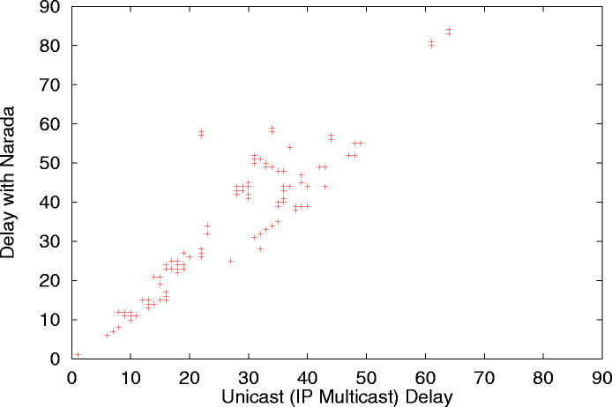
Narada delay (performance)
2x unicast delay
1x unicast delay
  Internet experiments
(ms)
Internet Routing
can be sub-optimal
(ms)

Slide 75
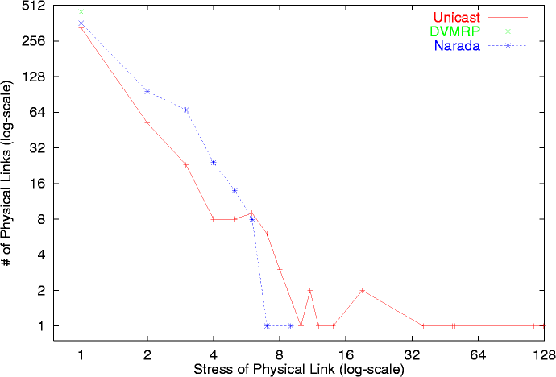
Narada stress (efficiency)
IP Multicast
  Waxman topology: 1024 routers, 3145 links
  Group Size : 128
  Fanout Range : <3-6> for all members
Narada : 14-fold reduction in worst-case stress !
Naive Unicast

Slide 76
Scalable overlay multicast
Can we design an overlay multicast system that scales to very large groups?
One answer: Scribe (with some slides stolen from Kasper Egdø and Morten Bjerre)

Slide 77
Scribe
Built on top of a DHT (Pastry)
Key ideas:
  Treat the multicast group name as a key into the DHT
  Publish info to the key owner, called the Rendezvous point
  Paths from subscribers to the RP form the multicast tree

Slide 78
Creating a group (1100)
1111
0100
GroupID | 1100
ACL | xxx
Parent | Null
1100
1101
Rendezvous Point
1001
(Pastry root)
Group Creator
creates Group 1100
0111

Slide 79
Joining a group
GroupID | 1100
Parent | 1001
Child | 0100
1111
0100
GroupID | 1100
ACL | xxx
Parent | Null
1100
1101
Join request
GroupID | 1100
Parent | 1001
Child | 0111
Rendezvous Point
1001
GroupID | 1100
Parent | 1100
Child | 1001
(Pastry root)
GroupID | 1100
Parent | 1101
Child | 0100
Child | 0111
0111
Joining member

Slide 80
Multicasting
1111
Message
0100
1100
1101
Multicast down tree
Rendezvous Point
1001
(Pastry root)
0111

Slide 81
Repairing failures
GroupID | 1100
Parent | 1001
Child | 0100
GroupID | 1100
Parent | 1100
Child | 1001
1111
Join request
0100
Join request
1100
1101
Rendezvous Point
GroupID | 1100
Parent | 1001
Child | 0111
Failed Node
1001
(Pastry root)
GroupID | 1100
ACL | Xxx
Parent | Null
Child | 1111
GroupID | 1100
Parent | 1111
Child | 0100
Child | 0111
0111

Slide 82
Next week
Building scalable services
  CDNs, BitTorrent, caching, replication, load balancing, prefetching, …

