Slide 1
Chapel: Motivating Themes
Brad Chamberlain
Cray Inc.
CSEP 524
May 20, 2010

Slide 2
What is Chapel?
A new parallel language being developed by Cray Inc.
Part of Cray’s entry in DARPA’s HPCS program
Main Goal: Improve programmer productivity
Improve the programmability of parallel computers
Match or beat the performance of current programming models
Provide better portability than current programming models
Improve robustness of parallel codes
Target architectures:
multicore desktop machines
clusters of commodity processors
Cray architectures
systems from other vendors
A work in progress

Slide 3
Chapel’s Setting: HPCS
HPCS: High Productivity Computing Systems (DARPA et al.)
Goal: Raise productivity of high-end computing users by 10×
Productivity = Performance
+ Programmability
+ Portability
+ Robustness
Phase II: Cray, IBM, Sun (July 2003 – June 2006)
Evaluated the entire system architecture’s impact on productivity…
processors, memory, network, I/O, OS, runtime, compilers, tools, …
…and new languages:
Cray: Chapel IBM: X10 Sun: Fortress
Phase III: Cray, IBM (July 2006 – )
Implement the systems and technologies resulting from phase II
(Sun also continues work on Fortress, without HPCS funding)

Slide 4
Chapel: Motivating Themes
general parallel programming
global-view abstractions
multiresolution design
control of locality/affinity
reduce gap between mainstream & parallel languages

Slide 5
1) General Parallel Programming
General software parallelism
Algorithms: should be able to express any that come to mind
should never hit a limitation requiring the user to return to MPI
Styles: data-parallel, task-parallel, concurrent algorithms
as well as the ability to compose these naturally
Levels: module-level, function-level, loop-level, statement-level, …
General hardware parallelism
Types: multicore desktops, clusters, HPC systems, …
Levels: inter-machine, inter-node, inter-core, vectors, multithreading

Slide 6
2) Global-view vs. Fragmented
Problem: “Apply 3-pt stencil to vector”
global-view
fragmented
(
+
)/2
=

Slide 7
2) Global-view vs. Fragmented
Problem: “Apply 3-pt stencil to vector”
global-view
fragmented
(
+
)/2
=
(
(
(
+
)/2
+
)/2
+
)/2
=
=
=

Slide 8
2) Global-view vs. SPMD Code
Problem: “Apply 3-pt stencil to vector”
SPMD
global-view
def main() {
var n: int = 1000;
var locN: int = n/numProcs;
var a, b: [0..locN+1] real;
if (iHaveRightNeighbor) {
send(right, a(locN));
recv(right, a(locN+1));
}
if (iHaveLeftNeighbor) {
send(left, a(1));
recv(left, a(0));
}
forall i in 1..locN {
b(i) = (a(i-1) + a(i+1))/2;
}
}
def main() {
var n: int = 1000;
var a, b: [1..n] real;
forall i in 2..n-1 {
b(i) = (a(i-1) + a(i+1))/2;
}
}

Slide 9
2) Global-view vs. SPMD Code
Assumes numProcs divides n;
a more general version would require additional effort
Problem: “Apply 3-pt stencil to vector”
SPMD
global-view
def main() {
var n: int = 1000;
var locN: int = n/numProcs;
var a, b: [0..locN+1] real;
var innerLo: int = 1;
var innerHi: int = locN;
if (iHaveRightNeighbor) {
send(right, a(locN));
recv(right, a(locN+1));
} else {
innerHi = locN-1;
}
if (iHaveLeftNeighbor) {
send(left, a(1));
recv(left, a(0));
} else {
innerLo = 2;
}
forall i in innerLo..innerHi {
b(i) = (a(i-1) + a(i+1))/2;
}
}
def main() {
var n: int = 1000;
var a, b: [1..n] real;
forall i in 2..n-1 {
b(i) = (a(i-1) + a(i+1))/2;
}
}

Slide 10
2) SPMD pseudo-code + MPI
Problem: “Apply 3-pt stencil to vector”
SPMD (pseudocode + MPI)
var n: int = 1000, locN: int = n/numProcs;
var a, b: [0..locN+1] real;
var innerLo: int = 1, innerHi: int = locN;
var numProcs, myPE: int;
var retval: int;
var status: MPI_Status;
MPI_Comm_size(MPI_COMM_WORLD, &numProcs);
MPI_Comm_rank(MPI_COMM_WORLD, &myPE);
if (myPE < numProcs-1) {
retval = MPI_Send(&(a(locN)), 1, MPI_FLOAT, myPE+1, 0, MPI_COMM_WORLD);
if (retval != MPI_SUCCESS) { handleError(retval); }
retval = MPI_Recv(&(a(locN+1)), 1, MPI_FLOAT, myPE+1, 1, MPI_COMM_WORLD, &status);
if (retval != MPI_SUCCESS) { handleErrorWithStatus(retval, status); }
} else
innerHi = locN-1;
if (myPE > 0) {
retval = MPI_Send(&(a(1)), 1, MPI_FLOAT, myPE-1, 1, MPI_COMM_WORLD);
if (retval != MPI_SUCCESS) { handleError(retval); }
retval = MPI_Recv(&(a(0)), 1, MPI_FLOAT, myPE-1, 0, MPI_COMM_WORLD, &status);
if (retval != MPI_SUCCESS) { handleErrorWithStatus(retval, status); }
} else
innerLo = 2;
forall i in (innerLo..innerHi) {
b(i) = (a(i-1) + a(i+1))/2;
}
Communication becomes geometrically more complex for higher-dimensional arrays

Slide 11
2) rprj3 stencil from NAS MG
= w₀
= w₁
=
= w₂
= w₃
+
+
=

Slide 12
2) NAS MG rprj3 stencil in Fortran + MPI
subroutine comm3(u,n1,n2,n3,kk)
use caf_intrinsics
implicit none
include 'cafnpb.h'
include 'globals.h'
integer n1, n2, n3, kk
double precision u(n1,n2,n3)
integer axis
if( .not. dead(kk) )then
do axis = 1, 3
if( nprocs .ne. 1) then
call sync_all()
call give3( axis, +1, u, n1, n2, n3, kk )
call give3( axis, -1, u, n1, n2, n3, kk )
call sync_all()
call take3( axis, -1, u, n1, n2, n3 )
call take3( axis, +1, u, n1, n2, n3 )
else
call comm1p( axis, u, n1, n2, n3, kk )
endif
enddo
else
do axis = 1, 3
call sync_all()
call sync_all()
enddo
call zero3(u,n1,n2,n3)
endif
return
end
subroutine give3( axis, dir, u, n1, n2, n3, k )
use caf_intrinsics
implicit none
include 'cafnpb.h'
include 'globals.h'
integer axis, dir, n1, n2, n3, k, ierr
double precision u( n1, n2, n3 )
integer i3, i2, i1, buff_len,buff_id
buff_id = 2 + dir
buff_len = 0
if( axis .eq. 1 )then
if( dir .eq. -1 )then
do i3=2,n3-1
do i2=2,n2-1
buff_len = buff_len + 1
buff(buff_len,buff_id ) = u( 2, i2,i3)
enddo
enddo
buff(1:buff_len,buff_id+1)[nbr(axis,dir,k)] =
> buff(1:buff_len,buff_id)
else if( dir .eq. +1 ) then
do i3=2,n3-1
do i2=2,n2-1
buff_len = buff_len + 1
buff(buff_len, buff_id ) = u( n1-1, i2,i3)
enddo
enddo
buff(1:buff_len,buff_id+1)[nbr(axis,dir,k)] =
> buff(1:buff_len,buff_id)
endif
endif
if( axis .eq. 2 )then
if( dir .eq. -1 )then
do i3=2,n3-1
do i1=1,n1
buff_len = buff_len + 1
buff(buff_len, buff_id ) = u( i1, 2,i3)
enddo
enddo
buff(1:buff_len,buff_id+1)[nbr(axis,dir,k)] =
> buff(1:buff_len,buff_id)
else if( dir .eq. +1 ) then
do i3=2,n3-1
do i1=1,n1
buff_len = buff_len + 1
buff(buff_len, buff_id )= u( i1,n2-1,i3)
enddo
enddo
buff(1:buff_len,buff_id+1)[nbr(axis,dir,k)] =
> buff(1:buff_len,buff_id)
endif
endif
if( axis .eq. 3 )then
if( dir .eq. -1 )then
do i2=1,n2
do i1=1,n1
buff_len = buff_len + 1
buff(buff_len, buff_id ) = u( i1,i2,2)
enddo
enddo
buff(1:buff_len,buff_id+1)[nbr(axis,dir,k)] =
> buff(1:buff_len,buff_id)
else if( dir .eq. +1 ) then
do i2=1,n2
do i1=1,n1
buff_len = buff_len + 1
buff(buff_len, buff_id ) = u( i1,i2,n3-1)
enddo
enddo
buff(1:buff_len,buff_id+1)[nbr(axis,dir,k)] =
> buff(1:buff_len,buff_id)
endif
endif
return
end
subroutine take3( axis, dir, u, n1, n2, n3 )
use caf_intrinsics
implicit none
include 'cafnpb.h'
include 'globals.h'
integer axis, dir, n1, n2, n3
double precision u( n1, n2, n3 )
integer buff_id, indx
integer i3, i2, i1
buff_id = 3 + dir
indx = 0
if( axis .eq. 1 )then
if( dir .eq. -1 )then
do i3=2,n3-1
do i2=2,n2-1
indx = indx + 1
u(n1,i2,i3) = buff(indx, buff_id )
enddo
enddo
else if( dir .eq. +1 ) then
do i3=2,n3-1
do i2=2,n2-1
indx = indx + 1
u(1,i2,i3) = buff(indx, buff_id )
enddo
enddo
endif
endif
if( axis .eq. 2 )then
if( dir .eq. -1 )then
do i3=2,n3-1
do i1=1,n1
indx = indx + 1
u(i1,n2,i3) = buff(indx, buff_id )
enddo
enddo
else if( dir .eq. +1 ) then
do i3=2,n3-1
do i1=1,n1
indx = indx + 1
u(i1,1,i3) = buff(indx, buff_id )
enddo
enddo
endif
endif
if( axis .eq. 3 )then
if( dir .eq. -1 )then
do i2=1,n2
do i1=1,n1
indx = indx + 1
u(i1,i2,n3) = buff(indx, buff_id )
enddo
enddo
else if( dir .eq. +1 ) then
do i2=1,n2
do i1=1,n1
indx = indx + 1
u(i1,i2,1) = buff(indx, buff_id )
enddo
enddo
endif
endif
return
end
subroutine comm1p( axis, u, n1, n2, n3, kk )
use caf_intrinsics
implicit none
include 'cafnpb.h'
include 'globals.h'
integer axis, dir, n1, n2, n3
double precision u( n1, n2, n3 )
integer i3, i2, i1, buff_len,buff_id
integer i, kk, indx
dir = -1
buff_id = 3 + dir
buff_len = nm2
do i=1,nm2
buff(i,buff_id) = 0.0D0
enddo
dir = +1
buff_id = 3 + dir
buff_len = nm2
do i=1,nm2
buff(i,buff_id) = 0.0D0
enddo
dir = +1
buff_id = 2 + dir
buff_len = 0
if( axis .eq. 1 )then
do i3=2,n3-1
do i2=2,n2-1
buff_len = buff_len + 1
buff(buff_len, buff_id ) = u( n1-1, i2,i3)
enddo
enddo
endif
if( axis .eq. 2 )then
do i3=2,n3-1
do i1=1,n1
buff_len = buff_len + 1
buff(buff_len, buff_id )= u( i1,n2-1,i3)
enddo
enddo
endif
if( axis .eq. 3 )then
do i2=1,n2
do i1=1,n1
buff_len = buff_len + 1
buff(buff_len, buff_id ) = u( i1,i2,n3-1)
enddo
enddo
endif
dir = -1
buff_id = 2 + dir
buff_len = 0
if( axis .eq. 1 )then
do i3=2,n3-1
do i2=2,n2-1
buff_len = buff_len + 1
buff(buff_len,buff_id ) = u( 2, i2,i3)
enddo
enddo
endif
if( axis .eq. 2 )then
do i3=2,n3-1
do i1=1,n1
buff_len = buff_len + 1
buff(buff_len, buff_id ) = u( i1, 2,i3)
enddo
enddo
endif
if( axis .eq. 3 )then
do i2=1,n2
do i1=1,n1
buff_len = buff_len + 1
buff(buff_len, buff_id ) = u( i1,i2,2)
enddo
enddo
endif
do i=1,nm2
buff(i,4) = buff(i,3)
buff(i,2) = buff(i,1)
enddo
dir = -1
buff_id = 3 + dir
indx = 0
if( axis .eq. 1 )then
do i3=2,n3-1
do i2=2,n2-1
indx = indx + 1
u(n1,i2,i3) = buff(indx, buff_id )
enddo
enddo
endif
if( axis .eq. 2 )then
do i3=2,n3-1
do i1=1,n1
indx = indx + 1
u(i1,n2,i3) = buff(indx, buff_id )
enddo
enddo
endif
if( axis .eq. 3 )then
do i2=1,n2
do i1=1,n1
indx = indx + 1
u(i1,i2,n3) = buff(indx, buff_id )
enddo
enddo
endif
dir = +1
buff_id = 3 + dir
indx = 0
if( axis .eq. 1 )then
do i3=2,n3-1
do i2=2,n2-1
indx = indx + 1
u(1,i2,i3) = buff(indx, buff_id )
enddo
enddo
endif
if( axis .eq. 2 )then
do i3=2,n3-1
do i1=1,n1
indx = indx + 1
u(i1,1,i3) = buff(indx, buff_id )
enddo
enddo
endif
if( axis .eq. 3 )then
do i2=1,n2
do i1=1,n1
indx = indx + 1
u(i1,i2,1) = buff(indx, buff_id )
enddo
enddo
endif
return
end
subroutine rprj3(r,m1k,m2k,m3k,s,m1j,m2j,m3j,k)
implicit none
include 'cafnpb.h'
include 'globals.h'
integer m1k, m2k, m3k, m1j, m2j, m3j,k
double precision r(m1k,m2k,m3k), s(m1j,m2j,m3j)
integer j3, j2, j1, i3, i2, i1, d1, d2, d3, j
double precision x1(m), y1(m), x2,y2
if(m1k.eq.3)then
d1 = 2
else
d1 = 1
endif
if(m2k.eq.3)then
d2 = 2
else
d2 = 1
endif
if(m3k.eq.3)then
d3 = 2
else
d3 = 1
endif
do j3=2,m3j-1
i3 = 2*j3-d3
do j2=2,m2j-1
i2 = 2*j2-d2
do j1=2,m1j
i1 = 2*j1-d1
x1(i1-1) = r(i1-1,i2-1,i3 ) + r(i1-1,i2+1,i3 )
> + r(i1-1,i2, i3-1) + r(i1-1,i2, i3+1)
y1(i1-1) = r(i1-1,i2-1,i3-1) + r(i1-1,i2-1,i3+1)
> + r(i1-1,i2+1,i3-1) + r(i1-1,i2+1,i3+1)
enddo
do j1=2,m1j-1
i1 = 2*j1-d1
y2 = r(i1, i2-1,i3-1) + r(i1, i2-1,i3+1)
> + r(i1, i2+1,i3-1) + r(i1, i2+1,i3+1)
x2 = r(i1, i2-1,i3 ) + r(i1, i2+1,i3 )
> + r(i1, i2, i3-1) + r(i1, i2, i3+1)
s(j1,j2,j3) =
> 0.5D0 * r(i1,i2,i3)
> + 0.25D0 * (r(i1-1,i2,i3) + r(i1+1,i2,i3) + x2)
> + 0.125D0 * ( x1(i1-1) + x1(i1+1) + y2)
> + 0.0625D0 * ( y1(i1-1) + y1(i1+1) )
enddo
enddo
enddo
j = k-1
call comm3(s,m1j,m2j,m3j,j)
return
end

Slide 13
2) NAS MG rprj3 stencil in Chapel
def rprj3(S, R) {
const Stencil = [-1..1, -1..1, -1..1],
w: [0..3] real = (0.5, 0.25, 0.125, 0.0625),
w3d = [(i,j,k) in Stencil] w((i!=0) + (j!=0) + (k!=0));
forall ijk in S.domain do
S(ijk) = + reduce [offset in Stencil]
(w3d(offset) * R(ijk + offset*R.stride));
}
Our previous work in ZPL showed that compact, global-view codes like these can result in performance that matches or beats hand-coded Fortran+MPI while also supporting more runtime flexibility

Slide 14
NAS MG rprj3 stencil in ZPL
procedure rprj3(var S,R: [,,] double;
d: array [] of direction);
begin
S := 0.5 * R
+ 0.25 * (R@^d[ 1, 0, 0] + R@^d[ 0, 1, 0] + R@^d[ 0, 0, 1] +
R@^d[-1, 0, 0] + R@^d[ 0,-1, 0] + R@^d[ 0, 0,-1])
+ 0.125 * (R@^d[ 1, 1, 0] + R@^d[ 1, 0, 1] + R@^d[ 0, 1, 1] +
R@^d[ 1,-1, 0] + R@^d[ 1, 0,-1] + R@^d[ 0, 1,-1] +
R@^d[-1, 1, 0] + R@^d[-1, 0, 1] + R@^d[ 0,-1, 1] +
R@^d[-1,-1, 0] + R@^d[-1, 0,-1] + R@^d[ 0,-1,-1])
+ 0.0625 * (R@^d[ 1, 1, 1] + R@^d[ 1, 1,-1] +
R@^d[ 1,-1, 1] + R@^d[ 1,-1,-1] +
R@^d[-1, 1, 1] + R@^d[-1, 1,-1] +
R@^d[-1,-1, 1] + R@^d[-1,-1,-1]);
end;

Slide 15
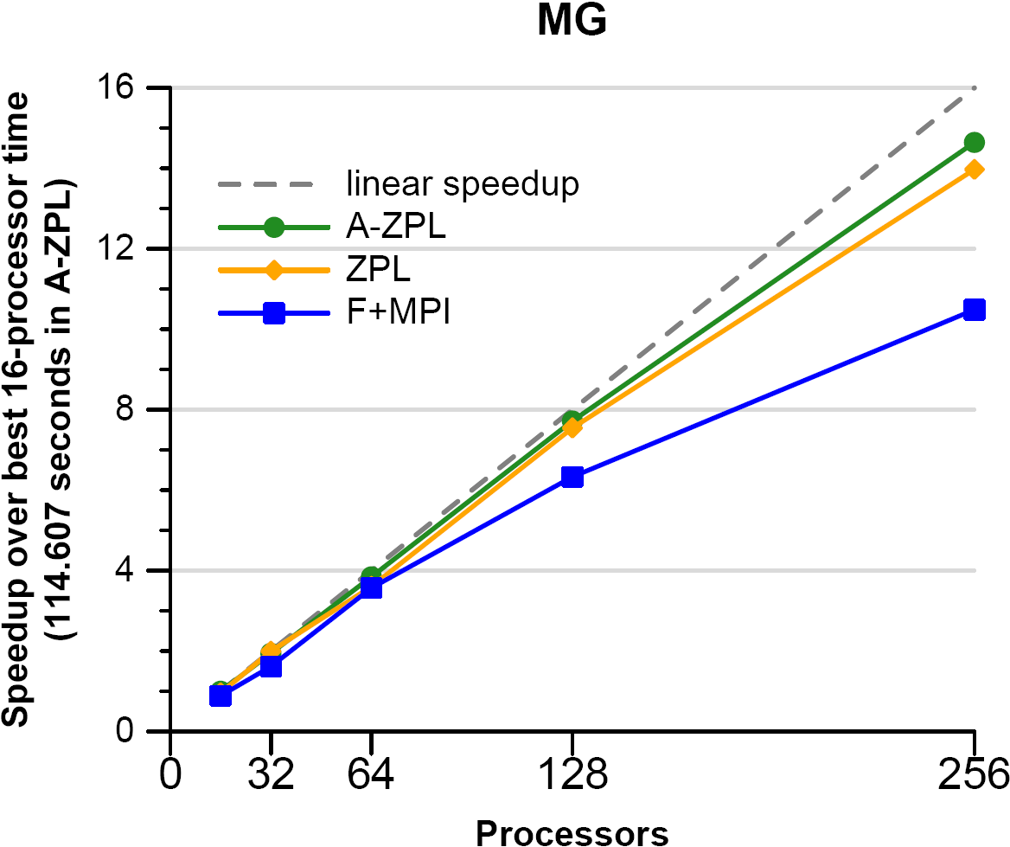
NAS MG Speedup: ZPL vs. Fortran + MPI
ZPL scales better than MPI since its communication is expressed in an implementation-neutral way; this permits the compiler to use SHMEM on this Cray T3E but MPI on a commodity cluster
ZPL also performs better at smaller scales where communication is not the bottleneck ⇒ new languages need not imply performance sacrifices
Similar observations—and more dramatic ones—have been made using more recent architectures, languages, and benchmarks
Cray T3E

Slide 16
Generality Notes
Each ZPL binary supports:
an arbitrary load-time problem size
an arbitrary load-time # of processors
1D/2D/3D data decompositions
This MPI binary only supports:
a static 2**k problem size
a static 2**j # of processors
a 3D data decomposition
The code could be rewritten to relax these assumptions, but at what cost?
- in performance?
- in development effort?
Cray T3E

Slide 17
Code Size

Slide 18
Code Size Notes
the ZPL codes are 5.5–6.5x shorter because
it supports a global view of parallelism
rather than an SPMD programming model
⇒ little/no code for communication
⇒ little/no code for array bookkeeping
More important than the size difference is that it is easier to write, read, modify, and maintain

Slide 19
Global-view models can benefit Productivity
Cray T3E
more programmable, flexible
able to achieve competitive performance
more portable; leave low-level details to the compiler

Slide 20
NPB: MPI vs. ZPL Code Size (timed kernel)
EP
CG
FT
MG
IS

Slide 21
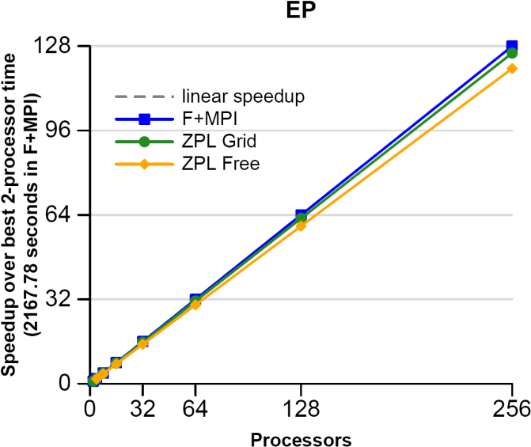
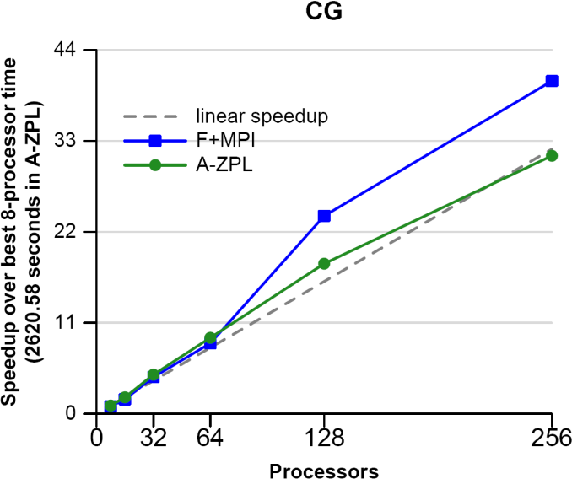
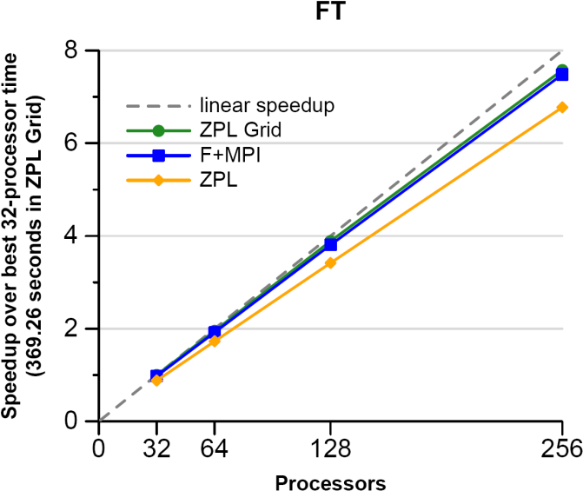
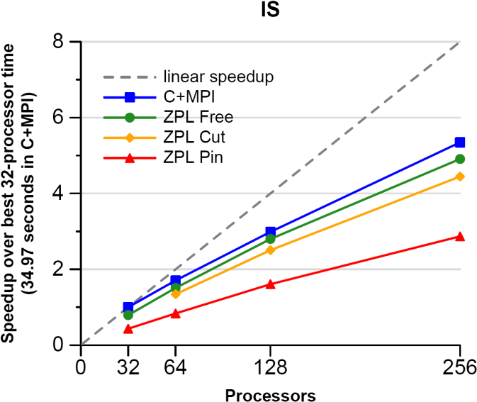
NPB: MPI vs. ZPL Performance
EP
CG
FT
MG
IS
C/Fortran + MPI
ZPL versions

Slide 22
2) Classifying HPC Programming Notations
communication libraries:
MPI, MPI-2
SHMEM, ARMCI, GASNet
shared memory models:
OpenMP, pthreads
PGAS languages:
Co-Array Fortran
UPC
Titanium
HPCS languages:
Chapel
X10 (IBM)
Fortress (Sun)
communication libraries: data / control
MPI, MPI-2 fragmented / fragmented/SPMD
SHMEM, ARMCI, GASNet fragmented / SPMD
shared memory models:
OpenMP global-view / global-view (trivially)
PGAS languages:
Co-Array Fortran fragmented / SPMD
UPC global-view / SPMD
Titanium fragmented / SPMD
global-view / global-view
global-view / global-view
global-view / global-view

Slide 23
3) Multiresolution Languages: Motivation
Two typical camps of parallel language design:
low-level vs. high-level
ZPL
Higher-Level Abstractions
HPF
Expose
Implementing
Mechanisms
MPI
OpenMP
pthreads
Target Machine
Target Machine
Target Machine
“Why is everything so tedious?”
“Why don’t I have more control?”

Slide 24
3) Multiresolution Language Design
Our Approach: Structure the language in a layered manner, permitting it to be used at multiple levels as required/desired
support high-level features and automation for convenience
provide the ability to drop down to lower, more manual levels
use appropriate separation of concerns to keep these layers clean
language concepts
Distributions
Data parallelism
Task Parallelism
Locality Control
Base Language
Target Machine

Slide 25
4) Ability to Tune for Locality/Affinity
Large-scale systems tend to store memory w/ processors
a good approach for building scalable parallel systems
Remote accesses tend to be significantly more expensive than local
Therefore, placement of data relative to computation matters for scalable performance
⇒ programmer should have control over placement of data, tasks
As multicore chips grow in #cores, locality likely to become more important in desktop parallel programming as well
GPUs/accelerators also expose node-level locality concerns

Slide 26
4) A Note on Machine Model
As with ZPL, the CTA is still present in our design to reason about locality
That said, it is probably more subconscious for us
And we vary in some minor ways:
no controller node
though we do utilize a front-end launcher node in practice
nodes can execute multiple tasks/threads
through software multiplexing if not hardware

Slide 27
5) Support for Modern Language Concepts
students graduate with training in Java, Matlab, Perl, C#
HPC community mired in Fortran, C (maybe C++) and MPI
we’d like to narrow this gulf
leverage advances in modern language design
better utilize the skills of the entry-level workforce…
…while not ostracizing traditional HPC programmers
examples:
build on an imperative, block-structured language design
support object-oriented programming, but make its use optional
support for static type inference, generic programming to support…
…exploratory programming as in scripting languages
…code reuse

