Slide 1
CSEP 521 Applied Algorithms
Richard Anderson
Lecture 9
Network Flow Applications

Slide 2
Announcements
Reading for this week
7.5-7.12. Network flow applications
Next week: Chapter 8. NP-Completeness
Final exam, March 18, 6:30 pm. At UW.
2 hours
In class (CSE 303 / CSE 305)
Comprehensive
67% post midterm, 33% pre midterm

Slide 3
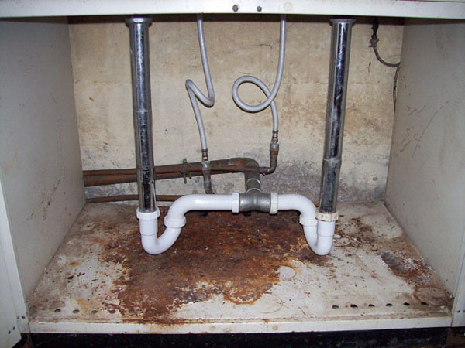
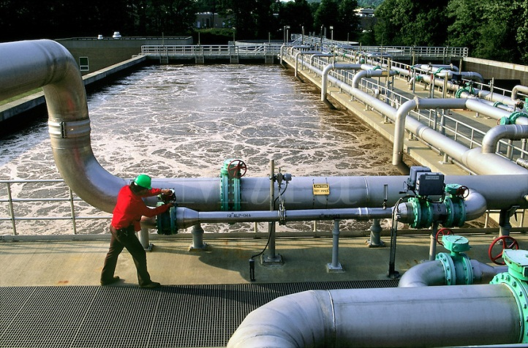
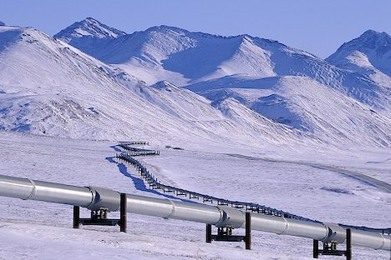
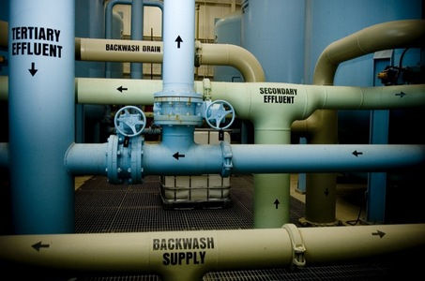
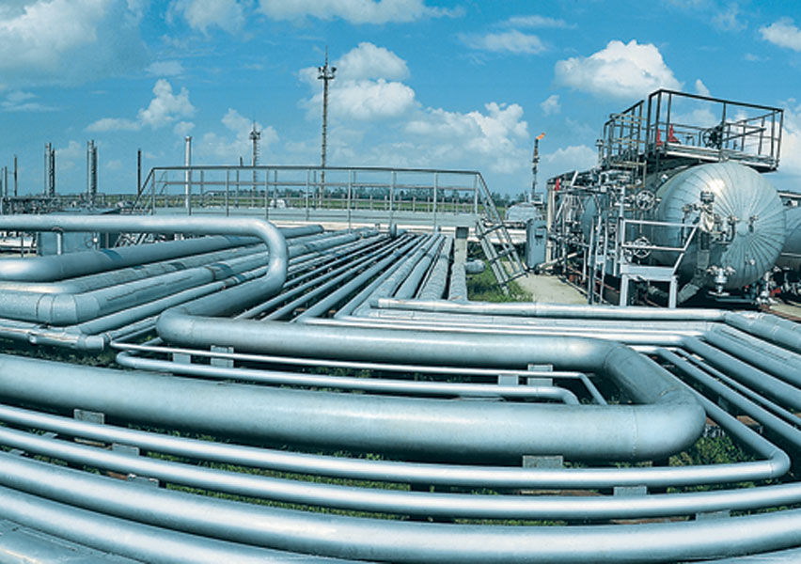
Network Flow

Slide 4
Review
Network flow definitions
Flow examples
Augmenting Paths
Residual Graph
Ford Fulkerson Algorithm
Cuts
Maxflow-MinCut Theorem

Slide 5
Network Flow Definitions
Flowgraph: Directed graph with distinguished vertices s (source) and t (sink)
Capacities on the edges, c(e) >= 0
Problem, assign flows f(e) to the edges such that:
0 <= f(e) <= c(e)
Flow is conserved at vertices other than s and t
Flow conservation: flow going into a vertex equals the flow going out
The flow leaving the source is a large as possible

Slide 6
Find a maximum flow
20/20
20/20
a
d
g
0/5
0/5
20/20
20/20
5/5
0/5
0/5
5/5
0/20
s
25/30
b
20/20
e
h
30/30
t
20/20
0/5
5/5
20/20
0/5
0/5
15/20
15/25
c
f
i
20/20
10/10

Slide 7
Residual Graph
Flow graph showing the remaining capacity
Flow graph G, Residual Graph G_{R}
G: edge e from u to v with capacity c and flow f
G_{R}: edge e’ from u to v with capacity c – f
G_{R}: edge e’’ from v to u with capacity f

Slide 8
Residual Graph
u
u
15/20
0/10
5
10
15
s
15/30
t
15
15
s
t
5
5/10
20/20
5
20
v
v

Slide 9
Augmenting Path Lemma
Let P = v₁, v₂, …, v_{k} be a path from s to t with minimum capacity b in the residual graph.
b units of flow can be added along the path P in the flow graph.
u
u
5
10
15/20
0/10
15
s
15
15
t
s
15/30
t
5
5
20
5/10
20/20
v
v

Slide 10
Ford-Fulkerson Algorithm (1956)
while not done
Construct residual graph G_{R}
Find an s-t path P in G_{R} with capacity b > 0
Add b units along in G
If the sum of the capacities of edges leaving S is at most C, then the algorithm takes at most C iterations

Slide 11
Cuts in a graph
Cut: Partition of V into disjoint sets S, T with s in S and t in T.
Cap(S,T): sum of the capacities of edges from S to T
Flow(S,T): net flow out of S
Sum of flows out of S minus sum of flows into S
Flow(S,T) <= Cap(S,T)

Slide 12
Ford Fulkerson MaxFlow – MinCut Theorem
There exists a flow which has the same value of the minimum cut
Shows that a cut is the dual of the flow
Proves that the augmenting paths algorithm finds a maximum flow
Gives an algorithms for finding the minimum cut

Slide 13
Better methods of for constructing a network flow
Improved methods for finding augmenting paths or blocking flows
Goldberg’s Preflow-Push algorithm
Text, section 7.4

Slide 14
Applications of Network Flow

Slide 15
Problem Reduction
Reduce Problem A to Problem B
Convert an instance of Problem A to an instance of Problem B
Use a solution of Problem B to get a solution to Problem A
Practical
Use a program for Problem B to solve Problem A
Theoretical
Show that Problem B is at least as hard as Problem A

Slide 16
Problem Reduction Examples
Reduce the problem of finding the longest path in a directed graph to the problem of finding a shortest path in a directed graph
Construct an equivalent minimization problem

Slide 17
Undirected Network Flow
Undirected graph with edge capacities
Flow may go either direction along the edges (subject to the capacity constraints)
u
10
20
s
5
t
20
10
v
Construct an equivalent flow problem

Slide 18
Multi-source network flow
Multi-source network flow
Sources s₁, s₂, . . ., s_{k}
Sinks t₁, t₂, . . . , t_{j}
Solve with Single source network flow

Slide 19
Bipartite Matching
A graph G=(V,E) is bipartite if the vertices can be partitioned into disjoints sets X,Y
A matching M is a subset of the edges that does not share any vertices
Find a matching as large as possible

Slide 20
Application
A collection of teachers
A collection of courses
And a graph showing which teachers can teach which courses
RA
303
PB
321
CC
326
DG
401
AK
421

Slide 21
Converting Matching to Network Flow
s
t

Slide 22
Finding edge disjoint paths
t
s
Construct a maximum cardinality set of
edge disjoint paths

Slide 23
Theorem
The maximum number of edge disjoint paths equals the minimum number of edges whose removal separates s from t

Slide 24
Finding vertex disjoint paths
t
s
Construct a maximum cardinality set of
vertiex disjoint paths

Slide 25
Network flow with vertex capacities

Slide 26
Balanced allocation Problem 9, Page 419
To make a long story short:
N injured people
K hospitals
Assign each person to a hospital with 30 minutes drive
Assign N/K patients to each hospital

Slide 27
Baseball elimination
Can the Dinosaurs win the league?
Remaining games:
AB, AC, AD, AD, AD, BC, BC, BC, BD, CD
 | W | L
Ants | 4 | 2
Bees | 4 | 2
Cockroaches | 3 | 3
Dinosaurs | 1 | 5
A team wins the league if it has strictly more wins than any other team at the end of the season
A team ties for first place if no team has more wins, and there is some other team with the same
number of wins

Slide 28
Baseball elimination
Can the Fruit Flies win or tie the league?
Remaining games:
AC, AD, AD, AD, AF, BC, BC, BC, BC, BC, BD, BE, BE, BE, BE, BF, CE, CE, CE, CF, CF, DE, DF, EF, EF
 | W | L
Ants | 17 | 12
Bees | 16 | 7
Cockroaches | 16 | 7
Dinosaurs | 14 | 13
Earthworms | 14 | 10
Fruit Flies | 12 | 15

Slide 29
Assume Fruit Flies win remaining games
Fruit Flies are tied for first place if no team wins more than 19 games
Allowable wins
Ants (2)
Bees (3)
Cockroaches (3)
Dinosaurs (5)
Earthworms (5)
18 games to play
AC, AD, AD, AD, BC, BC, BC, BC, BC, BD, BE, BE, BE, BE, CE, CE, CE, DE
 | W | L
Ants | 17 | 13
Bees | 16 | 8
Cockroaches | 16 | 9
Dinosaurs | 14 | 14
Earthworms | 14 | 12
Fruit Flies | 19 | 15

Slide 30
Remaining games
AC, AD, AD, AD, BC, BC, BC, BC, BC, BD, BE, BE, BE, BE, CE, CE, CE, DE
s
AC
AD
BC
BD
BE
CE
DE
A
B
C
D
E
T

Slide 31
Solving problems with a minimum cut
Image Segmentation
Open Pit Mining / Task Selection Problem
S, T is a cut if S, T is a partition of the vertices with
s in S and t in T
The capacity of an S, T cut is the sum of the capacities of
all edges going from S to T

Slide 32
Image Segmentation
Separate foreground from background
Reduction to min-cut problem
S, T is a cut if S, T is a partition of the vertices with
s in S and t in T
The capacity of an S, T cut is the sum of the capacities of
all edges going from S to T

Slide 34
Image analysis
a_{i}: value of assigning pixel i to the foreground
b_{i}: value of assigning pixel i to the background
p_{ij}: penalty for assigning i to the foreground, j to the background or vice versa
A: foreground, B: background
Q(A,B) = Σ_{{i in A}}a_{i} + Σ_{{j in B}}b_{j} - Σ_{{(i,j) in E, i in A, j in} _{B}}p_{ij}

Slide 35
Pixel graph to flow graph
s
t

Slide 36
Mincut Construction
s
a_{v}
p_{vu}
u
v
p_{uv}
b_{v}
t

Slide 37
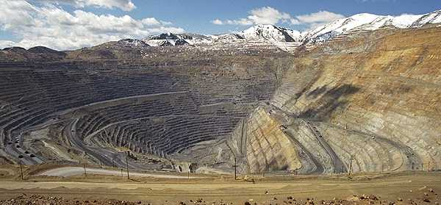
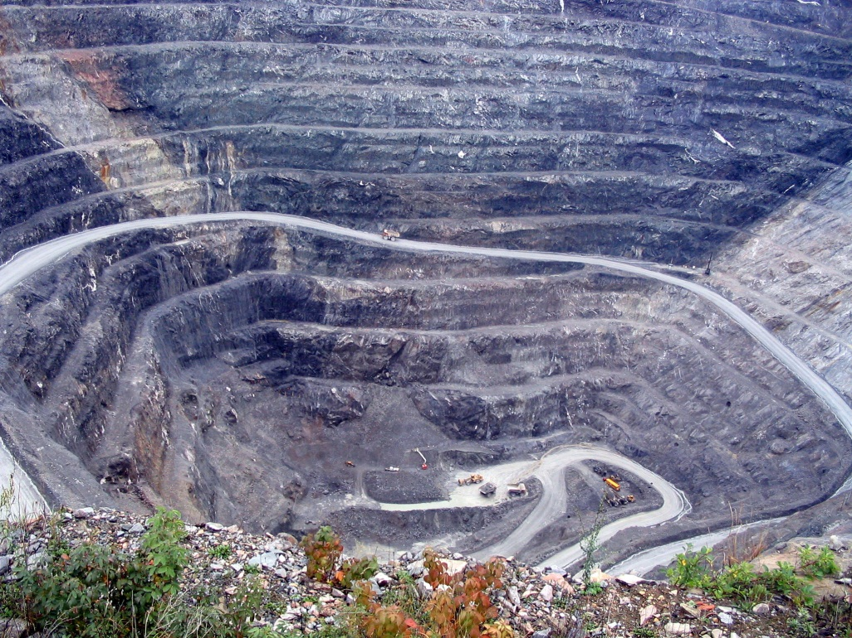
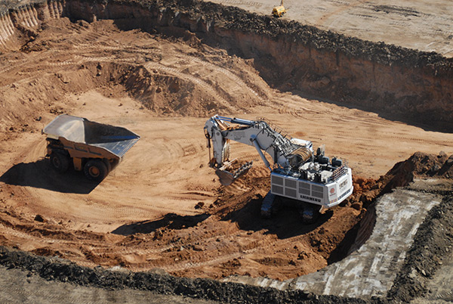
Open Pit Mining

Slide 38
Application of Min-cut
Open Pit Mining Problem
Task Selection Problem
Reduction to Min Cut problem
S, T is a cut if S, T is a partition of the vertices with
s in S and t in T
The capacity of an S, T cut is the sum of the capacities of
all edges going from S to T

Slide 39
Open Pit Mining
Each unit of earth has a profit (possibly negative)
Getting to the ore below the surface requires removing the dirt above
Test drilling gives reasonable estimates of costs
Plan an optimal mining operation

Slide 40
Mine Graph
-4
-3
-2
-1
-1
-3
3
-1
4
-7
-10
-2
8
3
-10

Slide 41
Determine an optimal mine
-5
-3
-4
-4
2
-4
3
-1
-7
-10
-1
-3
-3
3
4
4
-3
-10
-10
-10
4
7
-2
-10
3
-10
-10
-10
-10
6
8
6
-3
-10
-10
-10
-10
-10
-10
1
4
4
-10
-10
-10
-10
-10
-10
-10
-10
-10
-10
-10
-10

Slide 42
Generalization
Precedence graph G=(V,E)
Each v in V has a profit p(v)
A set F if feasible if when w in F, and (v,w) in E, then v in F.
Find a feasible set to maximize the profit
6
-4
-2
-3
5
-1
-10
4

Slide 43
Min cut algorithm for profit maximization
Construct a flow graph where the minimum cut identifies a feasible set that maximizes profit

Slide 44
Precedence graph construction
Precedence graph G=(V,E)
Each edge in E has infinite capacity
Add vertices s, t
Each vertex in V is attached to s and t with finite capacity edges

Slide 45
Show a finite value cut with at least two vertices on each side of the cut
s
Infinite
Finite
t

Slide 46
The sink side of a finite cut is a feasible set
No edges permitted from S to T
If a vertex is in T, all of its ancestors are in T

Slide 47
Setting the costs
s
If p(v) > 0,
cap(v,t) = p(v)
cap(s,v) = 0
If p(v) < 0
cap(s,v) = -p(v)
cap(v,t) = 0
If p(v) = 0
cap(s,v) = 0
cap(v,t) = 0
3
3
1
1
-3
-3
-1
0
2
3
2
1
3
t

Slide 48
Enumerate all finite s,t cuts and show their capacities
s
2
2
-2
1
2
-2
1
1
2
1
t

Slide 49
Minimum cut gives optimal solution Why?
s
2
2
-2
1
2
-2
1
1
2
1
t

Slide 50
Computing the Profit
Cost(W) = Σ_{{w in W; p(w) < 0}}-p(w)
Benefit(W) = Σ_{{w in W; p(w) > 0}} p(w)
Profit(W) = Benefit(W) – Cost(W)
Maximum cost and benefit
C = Cost(V)
B = Benefit(V)

Slide 51
Express Cap(S,T) in terms of B, C, Cost(T), Benefit(T), and Profit(T)
Cap(S,T) = Cost(T) + Ben(S) = Cost(T) + Ben(S) + Ben(T) – Ben(T)
= B + Cost(T) – Ben(T) = B – Profit(T)

Slide 52
Summary
Construct flow graph
Infinite capacity for precedence edges
Capacities to source/sink based on cost/benefit
Finite cut gives a feasible set of tasks
Minimizing the cut corresponds to maximizing the profit
Find minimum cut with a network flow algorithm

