Slide 1
CSEP 521 Applied Algorithms
Richard Anderson
Winter 2013
Lecture 3

Slide 2
Announcements
Reading
For today, sections 4.1, 4.2, 4.4
For January 28, sections 4.5, 4.7, 4.8 (Plus additional material from chapter 5)
No class January 21
Homework 2 is due January 21

Slide 3
Highlights from last lecture
Algorithm runtime
Runtime as a function of problem size
Asymptotic analysis, (Big Oh notation)
Graph theory
Basic terminology
Graph search and breadth first search
Two coloring
Connectivity
Topological search

Slide 4
Greedy Algorithms

Slide 5
Greedy Algorithms
Solve problems with the simplest possible algorithm
The hard part: showing that something simple actually works
Pseudo-definition
An algorithm is Greedy if it builds its solution by adding elements one at a time using a simple rule

Slide 6
Scheduling Theory
Tasks
Processing requirements, release times, deadlines
Processors
Precedence constraints
Objective function
Jobs scheduled, lateness, total execution time

Slide 7
Interval Scheduling
Tasks occur at fixed times
Single processor
Maximize number of tasks completed
Tasks {1, 2, . . . N}
Start and finish times, s(i), f(i)

Slide 8
What is the largest solution?

Slide 9
Greedy Algorithm for Scheduling
Let T be the set of tasks, construct a set of independent tasks I, A is the rule determining the greedy algorithm
I = { }
While (T is not empty)
Select a task t from T by a rule A
Add t to I
Remove t and all tasks incompatible with t from T

Slide 10
Simulate the greedy algorithm for each of these heuristics
Schedule earliest starting task
Schedule shortest available task
Schedule task with fewest conflicting tasks

Slide 11
Greedy solution based on earliest finishing time
Example 1
Example 2
Example 3

Slide 12
Theorem: Earliest Finish Algorithm is Optimal
Key idea: Earliest Finish Algorithm stays ahead
Let A = {i₁, . . ., i_{k}} be the set of tasks found by EFA in increasing order of finish times
Let B = {j₁, . . ., j_{m}} be the set of tasks found by a different algorithm in increasing order of finish times
Show that for r<= min(k, m), f(i_{r}) <= f(j_{r})

Slide 13
Stay ahead lemma
A always stays ahead of B, f(i_{r}) <= f(j_{r})
Induction argument
f(i₁) <= f(j₁)
If f(i_{r-1}) <= f(j_{r-1}) then f(i_{r}) <= f(j_{r})
Since f(i_{r-1}) <= f(j_{r-1}), both i_{r} and j_{r} are available for the Earliest Finish Algorithm

Slide 14
Completing the proof
Let A = {i₁, . . ., i_{k}} be the set of tasks found by EFA in increasing order of finish times
Let O = {j₁, . . ., j_{m}} be the set of tasks found by an optimal algorithm in increasing order of finish times
If k < m, then the Earliest Finish Algorithm stopped before it ran out of tasks

Slide 15
Scheduling all intervals
Minimize number of processors to schedule all intervals

Slide 16
How many processors are needed for this example?

Slide 17
Prove that you cannot schedule this set of intervals with two processors

Slide 18
Depth: maximum number of intervals active

Slide 19
Algorithm
Sort by start times
Suppose maximum depth is d, create d slots
Schedule items in increasing order, assign each item to an open slot
Correctness proof: When we reach an item, we always have an open slot

Slide 20
Scheduling tasks
Each task has a length t_{i} and a deadline d_{i}
All tasks are available at the start
One task may be worked on at a time
All tasks must be completed
Goal minimize maximum lateness
Lateness = f_{i} – d_{i} if f_{i} >= d_{i}

Slide 21
Example
Time
Deadline
2
2
3
4
2
3
Lateness 1
3
2
Lateness 3

Slide 22
Determine the minimum lateness
Show the schedule 2, 3, 4, 5 first and compute lateness
Time
Deadline
2
6
3
4
4
5
5
12

Slide 23
Greedy Algorithm
Earliest deadline first
Order jobs by deadline
This algorithm is optimal
This result may be surprising, since it ignores the job lengths

Slide 24
Analysis
Suppose the jobs are ordered by deadlines, d₁ <= d₂ <= . . . <= d_{n}
A schedule has an inversion if job j is scheduled before i where j > i
The schedule A computed by the greedy algorithm has no inversions.
Let O be the optimal schedule, we want to show that A has the same maximum lateness as O

Slide 25
List the inversions
Time
Deadline
a₁
3
4
a₂
4
5
a₃
2
6
a₄
5
12
a₄
a₂
a₁
a₃

Slide 26
Lemma: There is an optimal schedule with no idle time
a₄
a₂
a₃
a₁
It doesn’t hurt to start your homework early!
Note on proof techniques
This type of can be important for keeping proofs clean
It allows us to make a simplifying assumption for the remainder of the proof

Slide 27
Lemma
If there is an inversion i, j, there is a pair of adjacent jobs i’, j’ which form an inversion

Slide 28
Interchange argument
Suppose there is a pair of jobs i and j, with d_{i} <= d_{j}, and j scheduled immediately before i. Interchanging i and j does not increase the maximum lateness.
j
i
i
j
d_{i} d_{j}
d_{i} d_{j}

Slide 29
Proof by Bubble Sort
d₁
d₂
d₃
d₄
a₂
a₄
a₃
a₁
a₂
a₄
a₁
a₃
a₂
a₁
a₄
a₃
a₂
a₁
a₃
a₄
a₁
a₂
a₃
a₄
Determine maximum lateness

Slide 30
Real Proof
There is an optimal schedule with no inversions and no idle time.
Let O be an optimal schedule k inversions, we construct a new optimal schedule with k-1 inversions
Repeat until we have an optimal schedule with 0 inversions
This is the solution found by the earliest deadline first algorithm

Slide 31
Result
Earliest Deadline First algorithm constructs a schedule that minimizes the maximum lateness

Slide 32
Homework Scheduling
How is the model unrealistic?

Slide 33
Extensions
What if the objective is to minimize the sum of the lateness?
EDF does not seem to work
If the tasks have release times and deadlines, and are non-preemptable, the problem is NP-complete
What about the case with release times and deadlines where tasks are preemptable?

Slide 34
Subsequence Testing
Is a₁a₂…a_{m} a subsequence of b₁b₂…b_{n} ?
e.g. A,B,C,D,A is a subsequence of B,A,B,A,B,D,B,C,A,D,A,C,D,A

Slide 35
Greedy Algorithm for Subsequence Testing

Slide 36
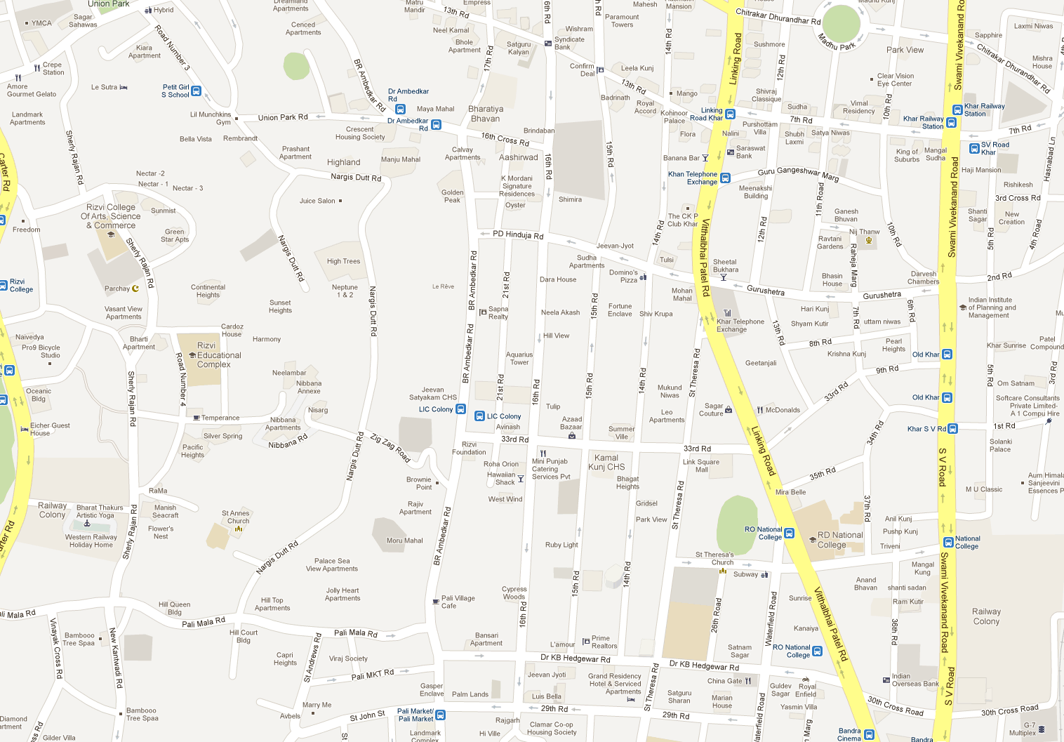
Shortest Paths

Slide 37
Single Source Shortest Path Problem
Given a graph and a start vertex s
Determine distance of every vertex from s
Identify shortest paths to each vertex
Express concisely as a “shortest paths tree”
Each vertex has a pointer to a predecessor on shortest path
1
u
u
1
2
3
5
s
x
s
x
3
4
3
v
v

Slide 38
Construct Shortest Path Tree from s
2
d
d
a
1
5
a
4
4
4
e
e
-3
c
s
-2
c
3
s
3
2
6
g
g
b
b
7
3
f
f

Slide 39
Warmup
If P is a shortest path from s to v, and if t is on the path P, the segment from s to t is a shortest path between s and t
WHY?
v
t
s

Slide 40
Dijkstra’s Algorithm
Assume all edges have non-negative cost
S = {}; d[s] = 0; d[v] = infinity for v != s
While S != V
Choose v in V-S with minimum d[v]
Add v to S
For each w in the neighborhood of v
d[w] = min(d[w], d[v] + c(v, w))
4
3
y
1
1
u
1
0
1
s
4
2
2
x
2
2
v
2
3
z
5

Slide 41
Simulate Dijkstra’s algorithm (strarting from s) on the graph
Round
Vertex Added
s
a
b
c
d
1
c
1
2
3
4
5
a
1
3
2
s
4
1
4
6
1
b
d
3

Slide 42
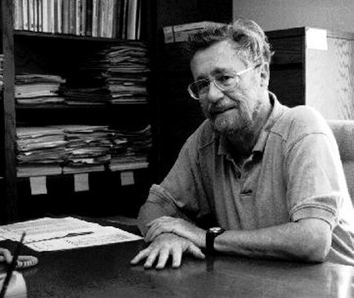
Who was Dijkstra?
What were his major contributions?

Slide 43
http://www.cs.utexas.edu/users/EWD/
Edsger Wybe Dijkstra was one of the most influential members of computing science's founding generation. Among the domains in which his scientific contributions are fundamental are
algorithm design
programming languages
program design
operating systems
distributed processing
formal specification and verification
design of mathematical arguments

Slide 44
Dijkstra’s Algorithm as a greedy algorithm
Elements committed to the solution by order of minimum distance

Slide 45
Correctness Proof
Elements in S have the correct label
Key to proof: when v is added to S, it has the correct distance label.
y
x
s
u
v

Slide 46
Proof
Let v be a vertex in V-S with minimum d[v]
Let P_{v} be a path of length d[v], with an edge (u,v)
Let P be some other path to v. Suppose P first leaves S on the edge (x, y)
P = P_{sx} + c(x,y) + P_{yv}
Len(P_{sx}) + c(x,y) >= d[y]
Len(P_{yv}) >= 0
Len(P) >= d[y] + 0 >= d[v]
y
x
s
u
v

Slide 47
Negative Cost Edges
Draw a small example a negative cost edge and show that Dijkstra’s algorithm fails on this example

Slide 48
Bottleneck Shortest Path
Define the bottleneck distance for a path to be the maximum cost edge along the path
u
6
5
s
2
5
x
3
4
v

Slide 49
Compute the bottleneck shortest paths
6
d
d
a
6
5
a
4
4
4
e
e
-3
c
s
-2
c
3
s
3
2
6
g
g
b
b
7
4
f
f

Slide 50
How do you adapt Dijkstra’s algorithm to handle bottleneck distances
Does the correctness proof still apply?

